Slide 1
What is Biomass?
Biomass is fuel that is developed from organic materials,
a renewable and sustainable source of energy used to create
electricity and other forms of power.

Slide 2
Where does biomass come from
Biomass is everywhere around us.
1. It can be the living plants, the dead plants, bodily waste of animals or humans.
2. Wood from trees, agricultural crops, wood factory waste, and the construction industry

Slide 3
why Biomass is a renewable source of fuel to produce energy??
waste residues will always exist – in terms of scrap wood, mill residuals and forest resources.

Slide 4
Using Biomass Energy
Usually we burn wood and use its energy for heating. Burning, though,
is not the only way to convert biomass energy into a usable energy source.
There:
Burning
Bacterial Decay
Conversion

Slide 5
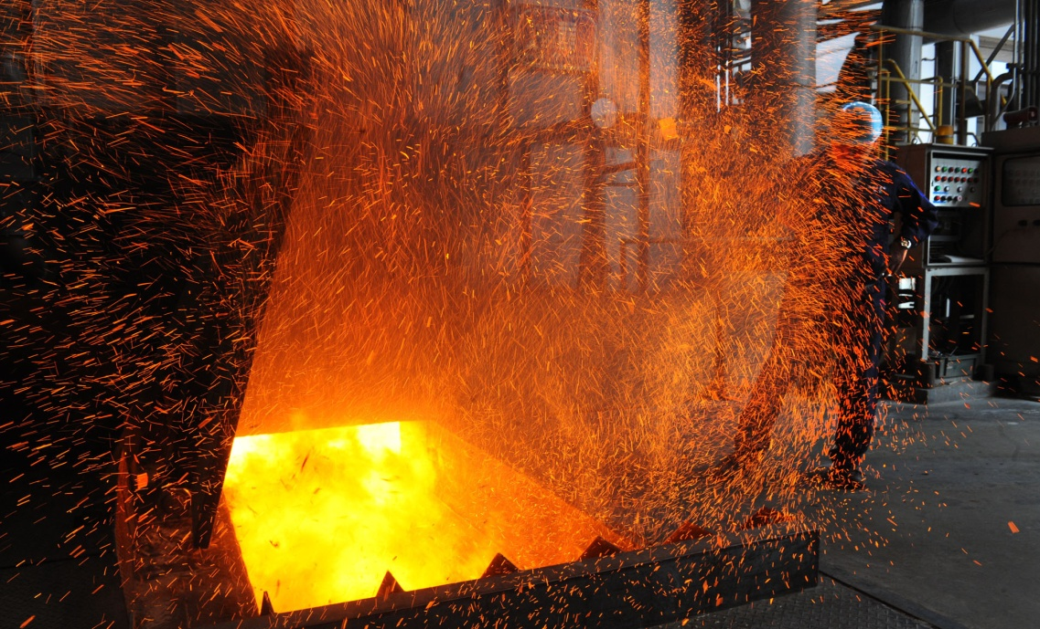
1. Burning:
We can bum biomass in special plants to produce steam for making
electricity, or we can burn it to provide heat for industries and homes.

Slide 6
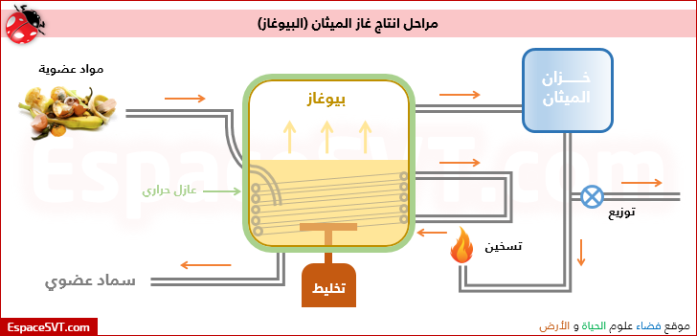
2. Bacterial Decay:
Bacteria feed on dead plants and animals, producing a gas called methane.
This is a natural process that happens whenever waste decays.
Methane is the same thing as natural gas, the gas sold by natural gas utilities.

Slide 7
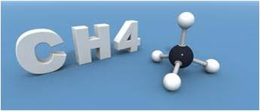
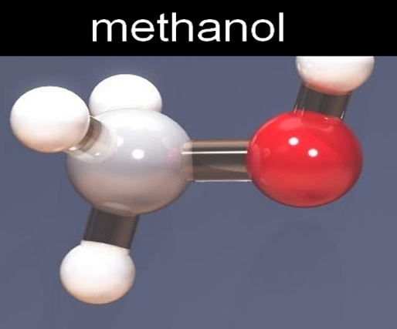
3. Conversion
Biomass can be converted into gas or liquid fuels by using
chemicals or heat. In India, cow manure is converted to
methane gas to produce electricity.
Methane gas can also be converted to methanol, a liquid form of methane.

Slide 8
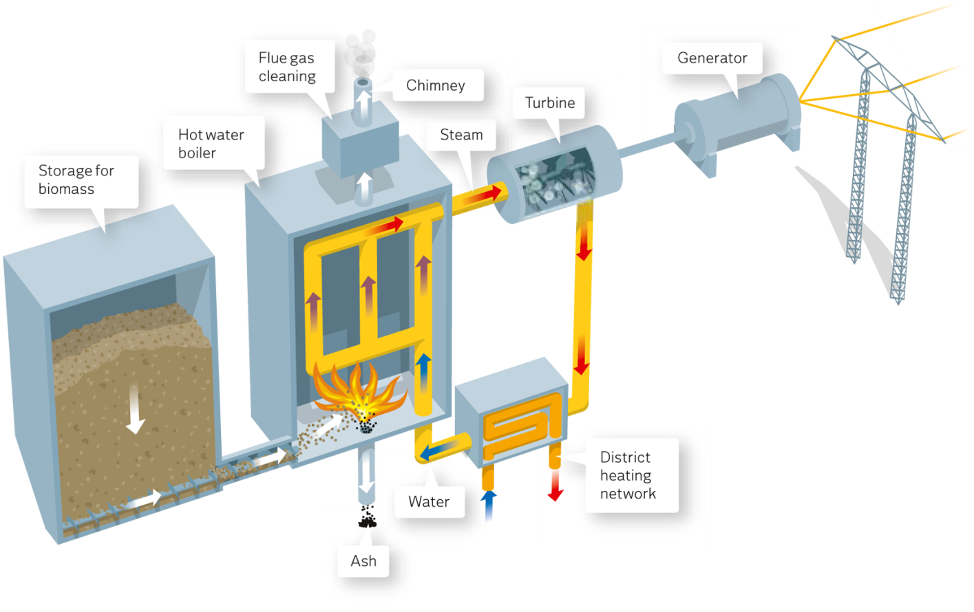
how can generate electricity from biomass
In biomass power plants, wood waste or other waste is burned to produce steam that runs a turbine to make electricity, or that provides heat to industries and homes. Fortunately, new technologies ,have advanced to the point that any emissions from burning biomass in industrial facilities are generally less than emissions produced when using fossil fuels (coal, natural gas, oil).

Slide 9
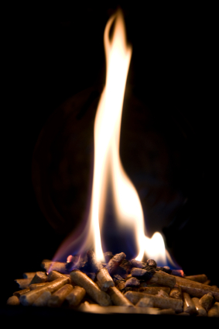
Conversion of Biomass
There are four types of conversion :
1. Thermal conversion is the use of heat, with or without the presence of oxygen, to convert biomass materials or feedstocks into other forms of energy. Thermal conversion technolgies include direct combustion, pyrolysis

Slide 10
2. Thermochemical conversion
is the application of heat and chemical processes in the
production of energy products from biomass.
Example for these process is gasification.

Slide 11
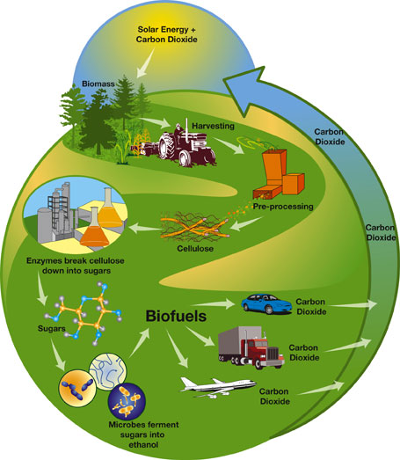
3. Biochemical conversion
involves use of enzymes, bacteria or other microorganisms to break down biomass into liquid fuels, and includes anaerobic digestion, and fermentation.
.

Slide 12
4. Chemical conversion
involves use of chemical agents to convert biomass into liquid fuels

Slide 13
Advantages of Biomass Energy
No Harmful Emissions: Biomass energy, creates no harmful carbon dioxide emissions.
Clean Energy: Because of its relatively clean use
Abundant and Renewable: Biomass products are abundant and renewable. Since they come from living sources, and life is cyclical, these products potentially never run out, so long as there is something living on earth and there is someone there to turn that living things components and waste products into energy

Slide 14
Advantages of Biomass Energy
4. Reduce Dependency on Fossil Fuels
5. Reduce Landfills: Another benefit of this energy is that it can take waste that is harmful to the environment and turn it into something useful. For instance, garbage as landfill can, at least partially, be burned to create useable biomass energy.
6. Can be Used to Create Different Products

Slide 15
Disadvantages of Biomass Energy
Expensive: Firstly, its expensive. Living things are expensive to care for, feed, and house, and all of that has to be considered when trying to use waste products from animals for fuel.
Inefficient as Compared to Fossil Fuels: the relative inefficiency of biomass energy. Ethanol, as a biodiesel is terribly inefficient when compared to gasoline, On top of that, ethanol is harmful to combustion engines over long term use.
Require More Land: Combustion of biomass products require some land where they can easily be burnt. Since, it produces gases like methane in atmosphere; therefore it can be produced in those areas which are quite far from residential homes.

