Slide 1
Compilers: Principles, Components, & Techniques

Slide 2
Compilers and Interpreters
“Compilation”
Translation of a program written in a source language into a semantically equivalent program written in a target language
Input
Source
Program
Compiler
Target
Program
Error messages
Output

Slide 3
Compilers and Interpreters (cont’d)
“Interpretation”
Performing the operations implied by the source program
Source
Program
Interpreter
Output
Input
Error messages

Slide 4
The Analysis-Synthesis Model of Compilation
There are two parts to compilation:
Analysis determines the operations implied by the source program which are recorded in a tree structure
Synthesis takes the tree structure and translates the operations therein into the target program

Slide 5
Preprocessors, Compilers, Assemblers, and Linkers
Skeletal Source Program
Preprocessor
Source Program
Try for example:
gcc -v myprog.c
Compiler
Target Assembly Program
Assembler
Relocatable Object Code
Linker
Libraries and
Relocatable Object Files
Absolute Machine Code

Slide 6
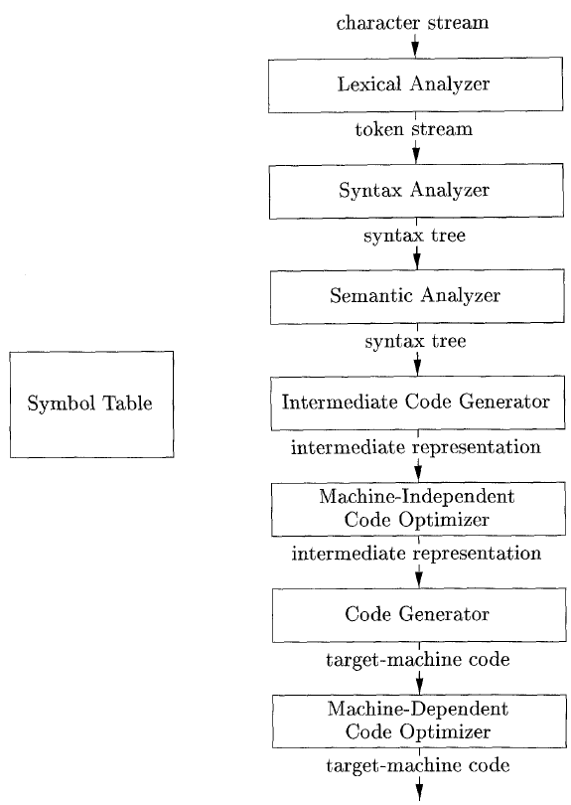
Phases of a compiler
Analysis Part
Synthesis

Slide 7
Lexical Analysis
reads the stream of characters making up the source program and groups the characters into meaningful sequences called lexemes (tokens).
Lexeme (token):
token-name: symbol that is used during syntax analysis
attribute-value: points to an entry in the symbol table of (token-name)

Slide 8
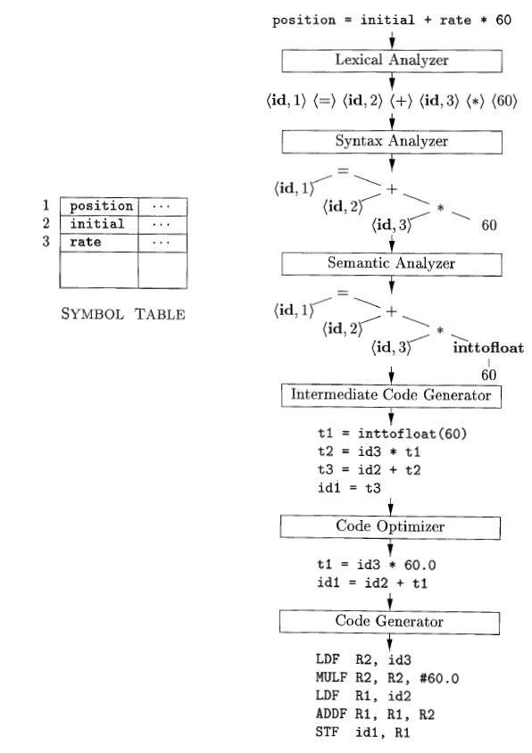
Translation of assignment St.: position = initial + rate*60

Slide 9
Syntax Analysis (parsing)
tokens produced by the lexical analyzer to create a tree-like intermediate representation.
depicts the grammatical structure of the token stream.
Syntax Tree

Slide 10
Semantic Analysis
uses syntax tree and the symbol table to check the source program for semantic consistency with the language definition.
gathers type information
saves it in either the syntax tree or the symbol table
used during intermediate-code generation.
type checking (each operator has matching operands)

Slide 11
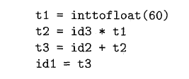
Intermediate Code Generation
one or more intermediate representations might be constructed

Slide 12
Code Optimization
Improve intermediate code so that better target code will result
Mainly, faster.
Example)

Slide 13
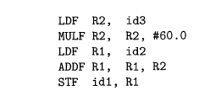
Code Generation
takes as input an intermediate representation of the source program and maps it into the target language

Slide 14
The Grouping of Phases into Passes
activities from several phases may be grouped together into a pass that reads an input file and writes an output file.
lexical analysis, syntax analysis, semantic analysis, and intermediate code generation might be grouped together into one pass
a back-end pass: consisting of code generation for a particular target machine

