Slide 1
Nutrition focused physical examination
Alma Irshaid, MSc. MPH

Slide 2
NFLP
ASPEN and the Academy of Nutrition & Dietetics defined malnutrition based on the characteristics of insufficient energy intake, weight loss, loss of muscle mass, loss of subcutaneous fat, localized or generalized fluid accumulation and decreased functional status.
The last four are best assessed by a physical exam.
When doing an NFPE, the dietitian begins by visually examining the patient to search for physical signs of nutrition status. This includes overall state of physical health, level of frailty or fitness, posture, and body symmetry.
The shape, texture, and color of the fingernails and the color and texture of the skin can reveal a number of nutrient deficiencies or nutrition-related diseases that might not be detected by lab work.

Slide 3
Components of a system-based examination of each region of the body are as follows:
General Inspection
Vitals
Skin
Nails
Head/Hair
Eyes/Nose
Mouth
Neck/Chest
Abdomen
Musco-skeletal

Slide 5
How to start?
1. Prepare for patient interaction 2.Check for privacy and comfort
Physical exam techniques:
A. Inspection—close observation
B. Palpitation- tactile examination
C. Percussion—elicit a sound wave
D. Auscultation—listening to body sounds

Slide 6
A.Overall/general impresion
The NFPE begins with a general observation of the patient.
characteristics to note during interview:
What is the apparent state of health?
What is the level of consciousness?
Does the patient show signs of physical distress?
How is the patient dressed?
Do you see any obvious signs of nutrient deficiencies?
Is there any involuntary movements or signs of paralysis?

Slide 7
Overall appearance
✓ Body positioning (muscle contractures, paralysis)
✓ Body Language ✓ Body habitus ✓ Amputations
✓ Ability to communicate
✓ Affect

Slide 8
B.Palpitation- tactile examination
Tactile exam using fingertips to assess for edema, skin temperature, texture, tenderness, areas of skin elevation, depression, size etc. Use light touch to avoid damaging the skin and underlying tissues.

Slide 9
C.Percussion—elicit a sound wave
Assessment of sounds using 3rd finger on dominant hand to tap areas 3rd finger of non dominant hand to evoke a sound from underlying tissue. The sound generates a tactile vibration.
Percussion utilizes the sense of touch to identify body organ borders, masses, fluid etc using vibrations from sounds.

Slide 10
D. Auscultation—listening to body sounds
Auscultation is using the sense of hearing to listen to body sounds such as heart, lung, bowel sounds and blood vessels. Mastering the techniques of percussion and auscultation and interpreting findings requires hands-on supervised clinical experience.

Slide 11
Nutrition diagnoses often used in conjunction with NFPA include:
sub-optimal or excessive intake of fluid and specific macro or micronutrients; body habitus and unintentional weight changes.
Domains of intervention might include:
food and nutrient delivery, nutrition education, nutrition counseling and coordination of care.

Slide 12
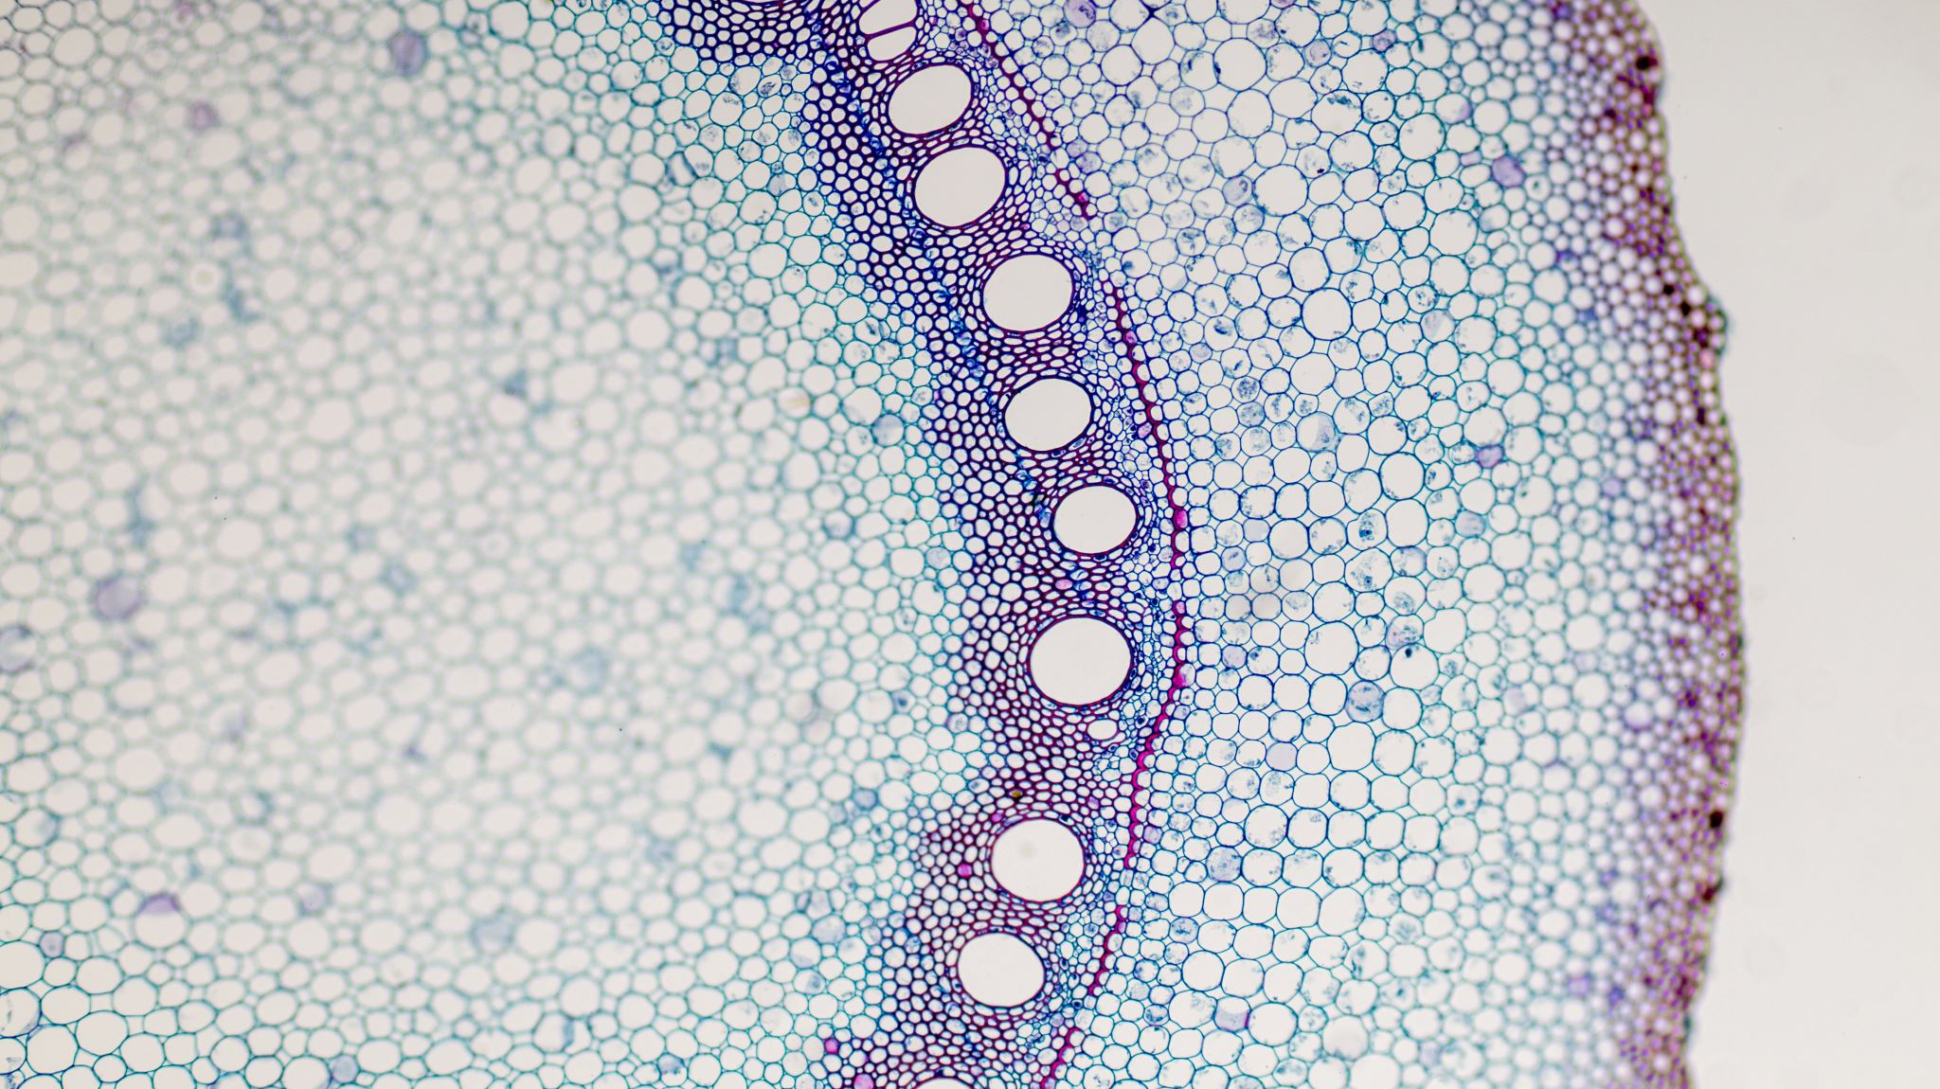
Organs assessment

Slide 13
Skin
Its major function is to keep the body in homeostasis, as well as provide boundaries for body fluid, protect the underlying tissues, regulate body temperature, and synthesize vitamin D.
Nails and hair are considered accessory structures of the skin that aid in keeping the skin from dryness through oil and fluid production, as well as sharing vascular and nutrient supplies.
When observing the skin, the clinician should inspect the entire skin surface for changes in color, texture, temperature, moisture, lesions, and mobility and turgor.
Coloring of the skin is affected by the amount of blood flow, thickness, and melanin in skin.

Slide 14
Skin color changes may be noticed on the lips/tongue, mucous membranes, fingernails, and palms of hands and feet.
The physical finding of pallor (unusual lightness of skin color compared with a normal hue) can be noted in the overall appearance, lower eyelid (conjunctiva), nail beds, and tongue.
These physical findings correlate with iron and/or B-complex vitamin deficiencies, as they are involved in hematologic processes.
Conditions that cause a reduced amount of hemoglobin in the blood due to anemia can lead to paleness in skin or mucous membranes and can occur in the following conditions: alcoholism, long-term parenteral nutrition (PN) support, and patients with partial gastrectomies.
Biotin deficiency, a water-soluble vitamin, can present with similar physical finding; however, this deficiency is commonly seen in patients receiving PN without biotin and individuals consuming a raw egg diet over an extended period.

Slide 15
Pigmentation of the skin (hypo/hyperpigmentation) can also be noted as a physical finding on the face, hands/fingers, chest cavity, and legs and feet.
Depigmentation of skin and hair (whitish, gray coloring) is a physical finding that can result from copper deficiency; however anemia, neutropenia( low neutrophils), and ataxia (presence of abnormal, uncoordinated movements) are more common manifestations of copper deficiency.

Slide 18
Nails
Inspection and palpation of the nail should be performed to assess for color, capillary refill, and texture.
The nail plate gets its pink color from the vascular nail bed, to which the nail plate is firmly attached. If the color of the nail bed changes to either a whitish or bluish hue, anemia or cyanosis may be present.
Capillary refill time is a short test done by pressing on the nail bed to see if the pinkish color returns within 2 seconds. Slow capillary refill of greater than 2 seconds may indicate impaired peripheral vascular flow or dehydration.
Texture changes of thinness, brittleness, and rigidity can relate to iron deficiency anemia and to suboptimal dietary protein.

Slide 22
Hair/Head
Inspection and palpation of the head, scalp, and hair should be performed to assess for quantity, distribution, and texture.
Looking for hair loss and diffuse and/or patchy areas on the scalp and head may assist in assessing hair quality.
These physical findings can relate to protein deficiencies or malnutrition, as well as biotin and zinc deficiency. The water-soluble vitamin biotin is needed for hair growth and can relate to the clinical finding of sparse hair (alopecia).
The physical finding of corkscrew hair at the base of the follicle is indicative of vitamin C deficiency.

Slide 25
Eyes
During the patient interview, note if changes in night vision, dryness, and/or inability to produce tears are physical findings mentioned.
The most common consequence of vitamin A deficiency is night blindness and the presence of foamy, superficial patches on the bulbar conjunctiva known as Bitot’s spots.
Cornea softening (kerotomalacia) around the eye lens can appear in the late more severe stage of vitamin A deficiency prior to blindness.
If any of these physical findings are present, blood tests (assessed by serum retinol or retinol binding protein) can determine if a possible VAD is present.
a penlight can be used to inspect the eyes for color changes in the conjunctiva and sclera to assess for the appearance of pallor compared with a pink hue ,which can be indicative of iron deficiency.

Slide 28
Mouth
Vitamin and mineral deficiency can manifest within the oral cavity in a relatively short period of time because of the 3- to 7-day turnover rate of most oral mucosal cells.
Cellular changes can also occur from gum disease, infections, viruses, and injury or trauma and should also be considered when noting physical changes in the oral cavity.
Inspection and palpation are used when assessing and examining the mouth, lips, mucosal lining, gums, and tongue. Observe and assess for color, cracking, texture, moisture, and lesions.
Physical signs of bilateral cracks and redness at the corners of the lips/ mouth (angular fissures/stomatitis) can signify B-complex vitamin deficiencies (riboflavin, niacin, vitamin B6, and iron).
The appearance of dry, swollen, ulcerated lips (cheilosis) can occur as a result of inadequate riboflavin and niacin.
Color changes of magenta can signify riboflavin, niacin, and folate deficiencies while pallor can relate to iron and vitamin B12 deficiencies associated with the lips and tongue.

Slide 31
Atrophic glossitis
Present in:
Anemia (macro and micro)
PEM
Hospitalized patients with low dietary intake
Vitamin E deficiency

Slide 32
Muscoskeletal
Assessment of functional status and changes in musculoskeletal can be included in the nutrition assessment using the following measurement approaches: muscle mass (bioelectric impendence analysis), muscle strength (handgrip strength), and physical performance (gait speed).
These tests are usually performed in determining sarcopenia and malnutrition, mostly relating to macronutrient deficiencies.
A common reported finding due to micronutrient deficiency is an uncoordinated gait (ataxia) seen in thiamine and copper deficiencies. Thiamine deficiency is possible in malabsorption disorders, weight loss surgeries, inadequate intake, and in those with recurrent vomiting. Alcoholics are at great risk for thiamine deficiency since the alcohol impairs thiamine absorption and increases excretion in the urine, leading to the risk of severe thiamine deficiency called Wernicke-Korsakoff syndrome— disorientation, loss of memory, and staggering gait.

Slide 33
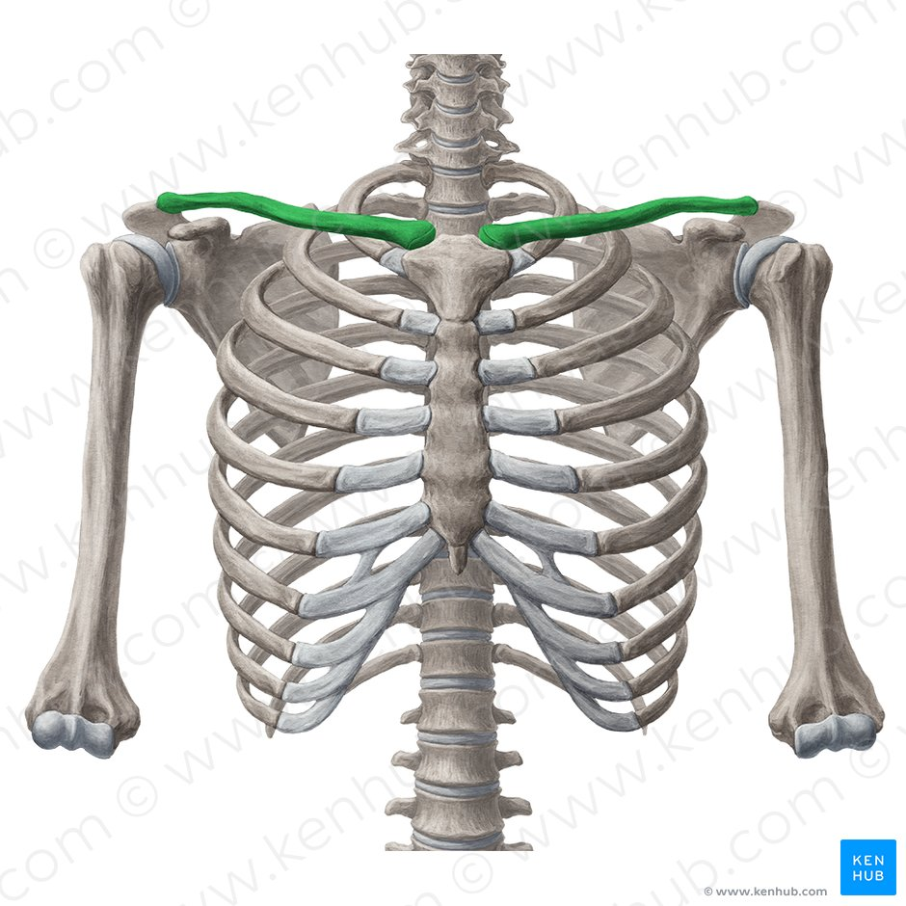
Assessing for muscle loss: Upper body
Clavicular region:
Pectoralis major, deltoid, trapezius muscles

Slide 34
Assessing for muscle loss: Upper body
Temporalis

Slide 35
Shoulder region: Deltoid muscle

Slide 36
Scapular region

Slide 37
PEM?

Slide 38
Hand: Interosseous muscle

Slide 39
Assessing lower body for muscle loss: Anterior thigh/ patellar region: Quadriceps femoris group

Slide 41
Posterior calf: Gastrocnemius and soleus

Slide 42
Assessing for fat loss

Slide 43
Orbital region (orbital fat pads)

Slide 44
Ribs
Upper arm: triceps brachii
Mid-axillary

Slide 45
Fluid Assessment

Slide 46
Assessing fluid status
ETIOLOGY: When plasma proteins are depleted, there is decreased oncotic pressure (colloid osmotic pressure), and thus increased capillary filtration. This results in increased fluid accumulation in the interstitial spaces (edema).
• Several common conditions are associated with fluid accumulation. Rule these out before using fluid retention as a malnutrition criteria.
• CHF • Kidney disease • Liver disease • Lymphatic obstruction
• Critical illness

Slide 47
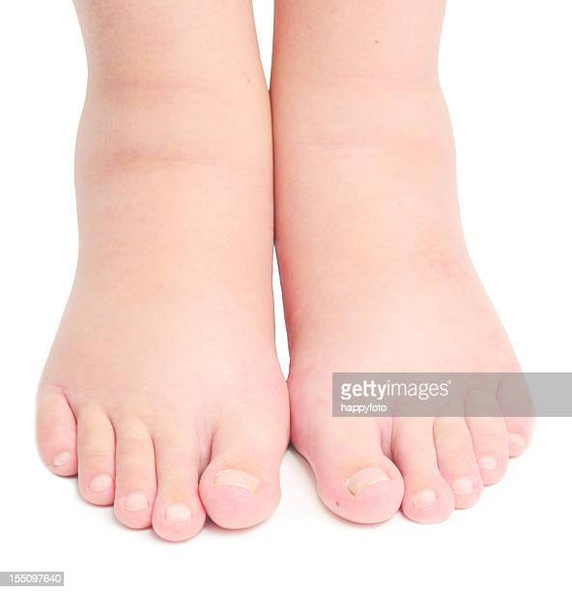
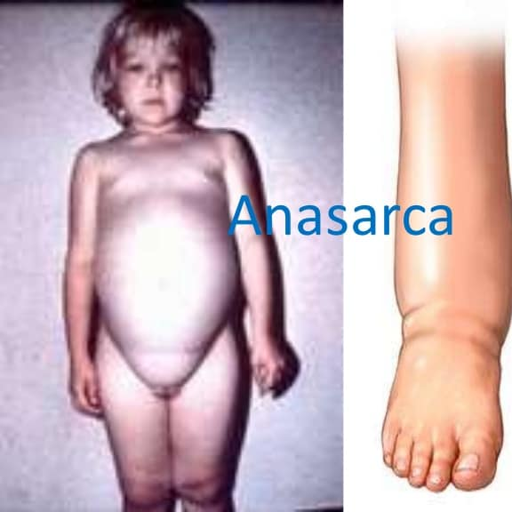
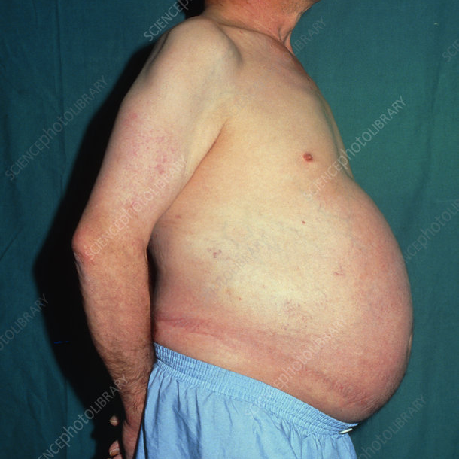
• Edema
Definition: abnormal retention of fluid in interstitial spaces and
cavities Commonly found: ankles, sacrum, scrotum, vulva
• Ascites • Anasarca

Slide 48
HYDRATION:
• Skin turgor/elasticity • Skin tenting

Slide 49
OBJECTIVE MEASURES
• Vital signs • Intake/output • Weight
Fluid may mask weight and/or muscle loss
• History • Urine concentration • Imaging
• APPEARANCE: •Skin/Mucous membranes

Slide 53
Congratulations
You have survived this course!

