Slide 1
Non vitamin B
Human Nutrition

Slide 2
Non-B Vitamins
Choline Deficiency and Toxicity
Deficiencies are rare.
Deficiency symptom is liver damage
Toxicity Symptoms
Body odor and sweating
Salivation
Reduced growth rate
Low blood pressure
Liver damage

Slide 3
Non-B Vitamins
Choline Food Sources
Milk
Liver
Eggs
Peanuts

Slide 4
Vitamin C
Also called ascorbic acid
Vitamin C serves as a cofactor to facilitate the action of an enzyme and also serves as an antioxidant.

Slide 5
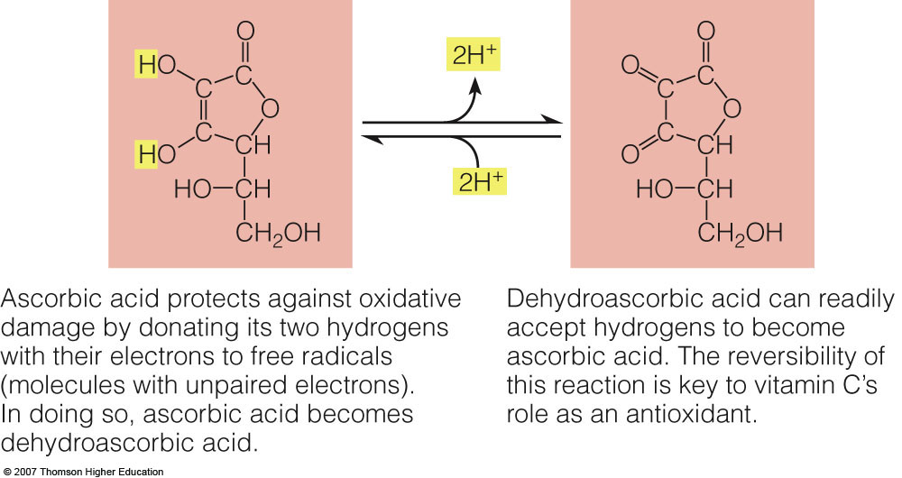
Vitamin C

Slide 6
Vitamin C
Vitamin C Roles
As an Antioxidant
Defends against free radicals
Protects tissues from oxidative stress
As a Cofactor in Collagen Formation
Collagen is used for bones and teeth, scar tissue, and artery walls.
Works with iron to form hydroxiproline which is needed in collagen formation

Slide 7
Vitamin C Roles
As a Cofactor in Other Reactions
Vitamin C needs increase during body stress, i.e. infections, burns, extremely high or low temperatures, heavy metal intakes, certain medications, and smoking.
Reduce the symptoms of the Common Cold
Some relief of symptoms
Vitamin C deactivates histamine like an antihistamine.
Disease prevention is still being researched.

Slide 8
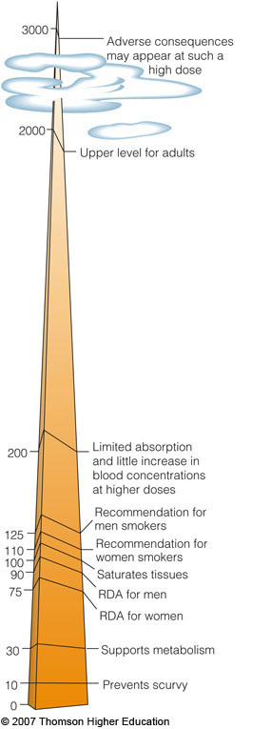
Vitamin C
Vitamin C Recommendations
RDA Men: 90 mg/day
RDA Women: 75 mg/day
Smokers: +35 mg/day

Slide 9
Vitamin C Deficiency
Deficiency disease is called scurvy
Deficiency Symptoms
Anemia – small cell type
Bone fragility and joint pain
Poor wound healing and frequent infections
Bleeding gums and loosened teeth
Muscle degeneration and pain, hysteria, and depression
Rough skin and blotchy bruises

Slide 10
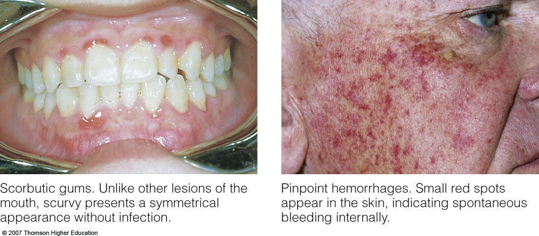
Vitamin C Deficiency

Slide 11
Vitamin C Toxicity
Toxicity Symptoms
Nausea, abdominal cramps, diarrhea, headache, fatigue and insomnia
Hot flashes and rashes
Interference with medical tests, creating a false positive or a false negative
kidney stones
Upper level for adults: 2000 mg/day

Slide 12
Vitamin C Food Sources
Citrus fruits, cantaloupe, strawberries, papayas and mangoes
Cabbage-type vegetables, dark green vegetables like green peppers and broccoli, lettuce, tomatoes and potatoes
Easily destroyed by heat and oxygen

Slide 13
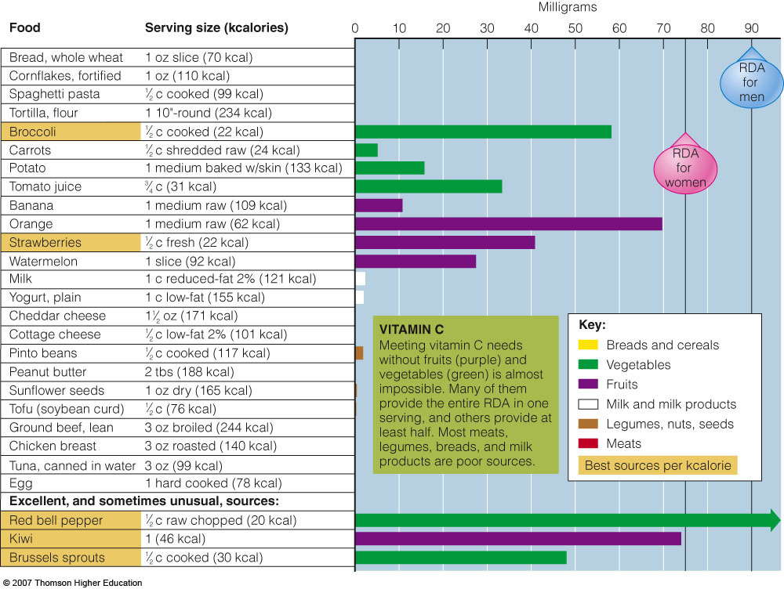
Vitamin C Food Sources

Slide 14
Vitamin and Mineral Supplements

Slide 15
Vitamin and Mineral Supplements
Many people take dietary supplements for dietary and health insurance.
Some take multinutrient pills daily.
Others take large doses of single nutrients.
A valid nutrition assessment by professionals determines the need for supplements.
Self-prescribed supplementation is not advised.
There are many arguments for and against supplements.

Slide 16
Arguments for Supplements
Correct Overt Deficiencies
Support Increased Nutrient Needs
Improve the Body’s Defenses

Slide 17
Who Needs Supplements?
People with nutritional deficiencies
People with low energy intake – less than 1200 kcalories per day
Vegans and those with atrophic gastritis need vitamin B₁₂
People with lactose intolerance, milk allergies, or inadequate intake of dairy foods

Slide 18
Who Needs Supplements?
People in certain stages of the life cycle
Infants need iron and fluoride
Women of childbearing age need folate
Pregnant women need folate and iron
Elderly need vitamins B₁₂ and D
People with diseases, infections, or injuries, and those who have had surgery that affects nutrient digestion, absorption or metabolism
People taking medications that interfere with the body’s use of specific nutrients

Slide 19
Arguments against Supplements
Toxicity
Life-Threatening Misinformation
Unknown Needs
False Sense of Security

Slide 20
Arguments against Supplements
Other Invalid Reasons:
Belief that food supply and soil contain inadequate nutrients
Belief that supplements provide energy
Belief that supplements enhance athletic performance or lean body mass without physical work or faster than work alone
Belief that supplements will help a person cope with stress
Belief that supplements can prevent, treat or cure conditions

Slide 21
Selection of Supplements
What form do you want? (chewable, liquid or pills?)
What vitamins and minerals do you need?
Do not exceed Tolerable Upper Intake Levels.
Be careful about greater that 10 mg of iron.

Slide 22
Selection of Supplements
Are there misleading claims?
Ignore organic or natural claims.
Avoid products that make high potency claims.
Watch fake preparations.
Be aware of marketing ploys.
Be aware of preparations that contain alcohol.
Be aware of the latest nutrition buzzwords.
Internet information is not closely regulated.
What about the cost?
Local or store brands may be just as good as nationally advertised brands.

Slide 23
Regulation of Supplements
Nutritional labeling for supplements is required.
Labels may make nutrient claims according to specified criteria.
Labels may claim that lack of a nutrient can cause a deficiency disease and include the prevalence of that disease.
Labels may make health claims that are supported by significant scientific agreement.

Slide 24
