Slide 1
Liver Toxicity Chapter 5
Dr. Basma Damiri
2nd semester 2012-2013

Slide 2
Lecture Outline
Introduction
Role of the liver
Anatomy of the liver
Organization of the liver
Cells of the liver
Liver toxicity

Slide 3
Liver is Complex Organ
Largest organ in body - 1500 g in humans (2% of BW)
25% of cardiac output - 2 L/Minute in 70 kg Human
Source of most plasma proteins
Interface between food and energy needs
Largest source of fixed macrophages
Marked circadian rhythm

Slide 4
Role of the Liver
Processes, dietary proteins, carbohydrates, lipids
Stores and releases energy
Exports Glucose from glycogen
Exports Acetoacetate from fatty acids
Detoxification
Endogenous & Exogenous compounds
Oxidation and reduction
Conjugation and hydrolysis
Important role in vitamins
Active synthesis of some forms of B vitamins
Proteins for transport of vitamins
Retinoid storage and metabolism

Slide 5
Role of the Liver
Acute Phase Response
Transient increase or decrease in plasma proteins
Systemic response to local injury
Phagocytosis of particulates
Critical location with blood flow from GI tract
Central role in cholesterol homeostasis
Critical for iron, zinc and copper metabolism

Slide 6
Why is the Liver so Important in Toxicology?
Hepatotoxicity is the major reason for rejecting new drugs in clinical trials
and withdrawal of drugs already in use
Major metabolic organ
Hepatotoxicity is quite common
Cirrhosis - One of top ten causes of death
Model for cancer mechanisms

Slide 7
Effect of Toxic Chemicals on the Liver
The liver is the most common site of damage in laboratory animals administered drugs and other chemicals.
There are many reasons including the fact that the liver is the first major organ to be exposed to ingested chemicals due to its portal blood supply.
Although chemicals are delivered to the liver to be metabolized and excreted, this can frequently lead to activation and liver injury.
Study of the liver has been and continues to be important in understanding fundamental molecular mechanisms of toxicity as well as in assessment of risks to humans.

Slide 8
Organization of Liver
Hepatic plates with bile canicular system
Dual blood supply
75% portal vein (low in oxygen)
25% hepatic artery (high in oxygen)
Blood collects in hepatic vein
What is the portal triad?

Slide 9
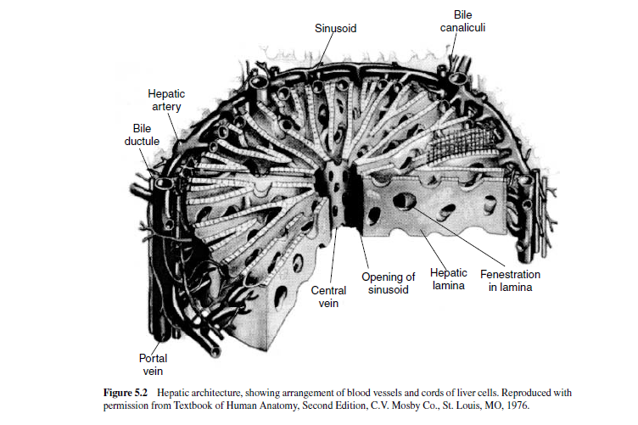
What is the portal triad?

Slide 10
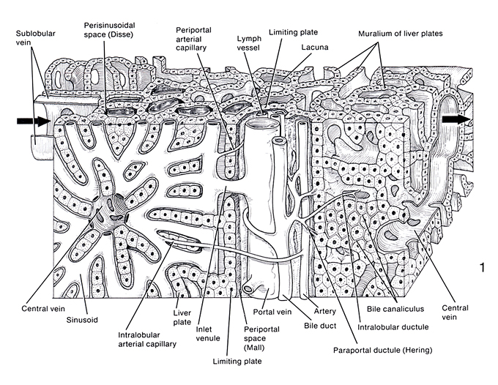
Tissues and Organs:a text of scanning electron microscopy, Kessel, RG and Kardon,RH, 1979
Notes:
Question: Is there evidence of a carcinogenic effect due to this compound?
Points for discussion:
Is it okay to combine HCAd and HCCas? Is it necessary?
Is there a shift (progression) to malignancy? If so, does that constitute a carcinogenic effect?
Does it matter if it’s only liver tumors in mice?
Ancillary information:
**p<0.01 with Fisher’s exact t-test
50 animals per group, number of animals with the lesion are listed in the box
2-year exposure
This compound is/is not genotoxic
There was/was not an increase in eosinophilic foci, other foci
Gavage exposure, Similar survival rates, Similar body weight gains
No effect seen in other species (rat), or other gender (female)
No real difference of opinion between pathologists with regards to diagnoses

Slide 11
Periportal: Cells near the portal vein.
Perivenular: Cells near the hepatic venule.
Centrilobular: cells around the hepatic lobule.
Peripheral lobular: cells far away from the hepatic lobule but next to the portal vein.

Slide 12
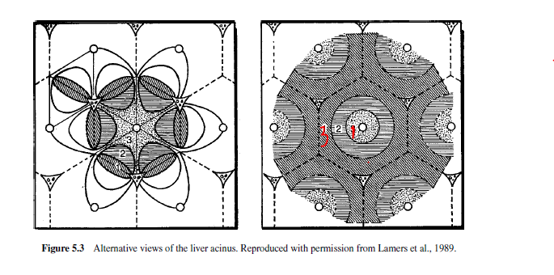
Rappaport Unit
Anatomical unit called acinus.
Cells within the acinus are divided into zones.

Slide 13
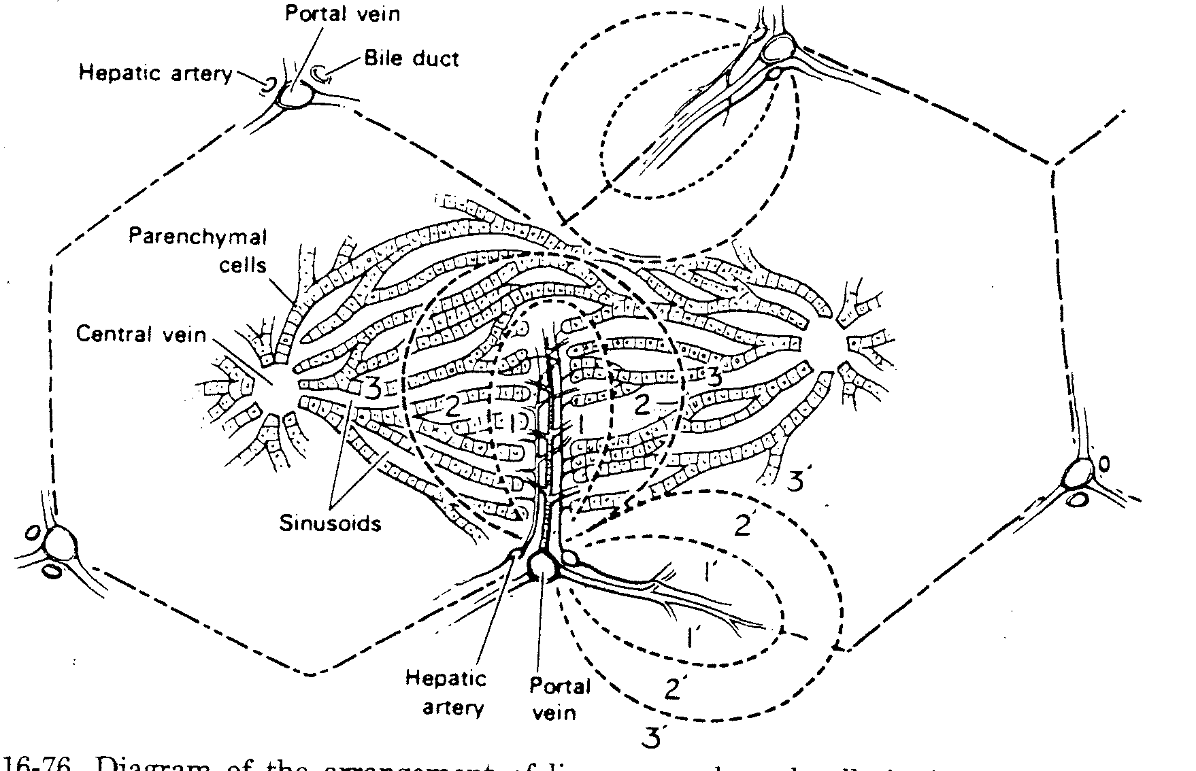
Zonation of Liver Microstructure
Acinus
Lobule

Slide 14
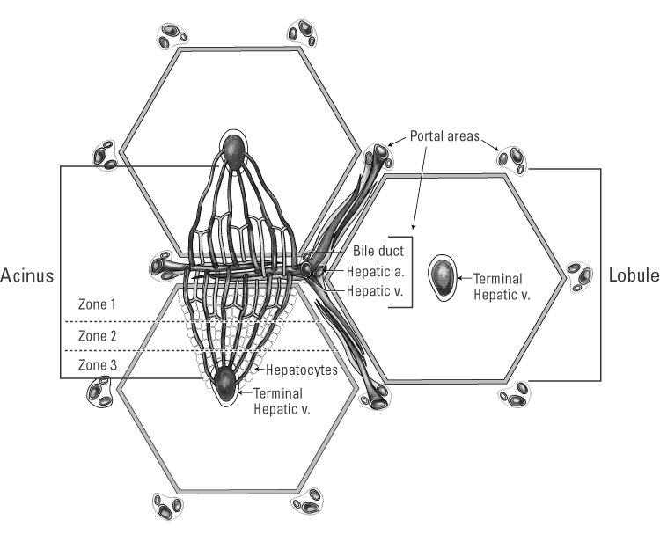
Approximately 1 million classic lobules per liver
Zone 1: aerobic metabolism. Why? What are the metabolic activities that occur in Zone 1?
See page 114 in the book.
Notes:
Question: Is there evidence of a carcinogenic effect due to this compound?
Points for discussion:
Is it okay to combine HCAd and HCCas? Is it necessary?
Is there a shift (progression) to malignancy? If so, does that constitute a carcinogenic effect?
Does it matter if it’s only liver tumors in mice?
Ancillary information:
**p<0.01 with Fisher’s exact t-test
50 animals per group, number of animals with the lesion are listed in the box
2-year exposure
This compound is/is not genotoxic
There was/was not an increase in eosinophilic foci, other foci
Gavage exposure, Similar survival rates, Similar body weight gains
No effect seen in other species (rat), or other gender (female)
No real difference of opinion between pathologists with regards to diagnoses

Slide 15
Rappaport Unit
Zone 1 (central or periportal)
Largest hepatocytes
More mitochondria
More granular ER
Glycogen metabolism
Glucuronidation of xenobiotics
Formation of plasma proteins
Best oxygenated
Highest concentration of bile salts
More Kupffer cells

Slide 16
Portal “triad” (zone 1)
hepatic artery
portal vein
bile duct
lymphatics
nerves
connective tissue-collagen type I
Pathology of the Liver, MacSween RNM et al, 2002
Notes:
Question: Is there evidence of a carcinogenic effect due to this compound?
Points for discussion:
Is it okay to combine HCAd and HCCas? Is it necessary?
Is there a shift (progression) to malignancy? If so, does that constitute a carcinogenic effect?
Does it matter if it’s only liver tumors in mice?
Ancillary information:
**p<0.01 with Fisher’s exact t-test
50 animals per group, number of animals with the lesion are listed in the box
2-year exposure
This compound is/is not genotoxic
There was/was not an increase in eosinophilic foci, other foci
Gavage exposure, Similar survival rates, Similar body weight gains
No effect seen in other species (rat), or other gender (female)
No real difference of opinion between pathologists with regards to diagnoses

Slide 17
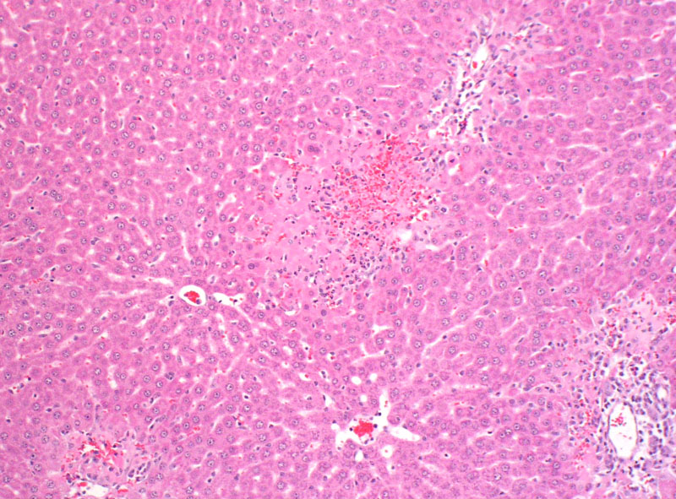
Allyl Alcohol-Induced Necrosis in Zone 1
PP
THV
THV
PP

Slide 18
Rappaport Unit
Zone 3 (More peripheral - Terminal Hepatic Venule) (most commonly Centrilobular)
Smaller hepatocytes
Fewer mitochondria
More agranular ER
Fat and pigment storage
Reductase reactions
Enzyme induction may occur
More susceptible to anoxia

Slide 19
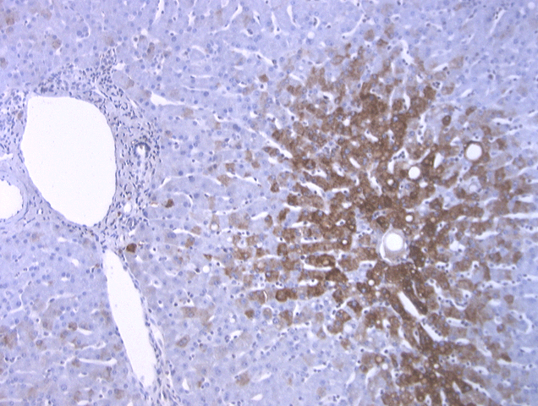
Zonal Expression of P450’s
Labeling with P450 Antibodies
PV
CV
In which zone can we find cytochrome P450? What does that mean? P. 114
Remember that C P450 are located in the ER.

Slide 20
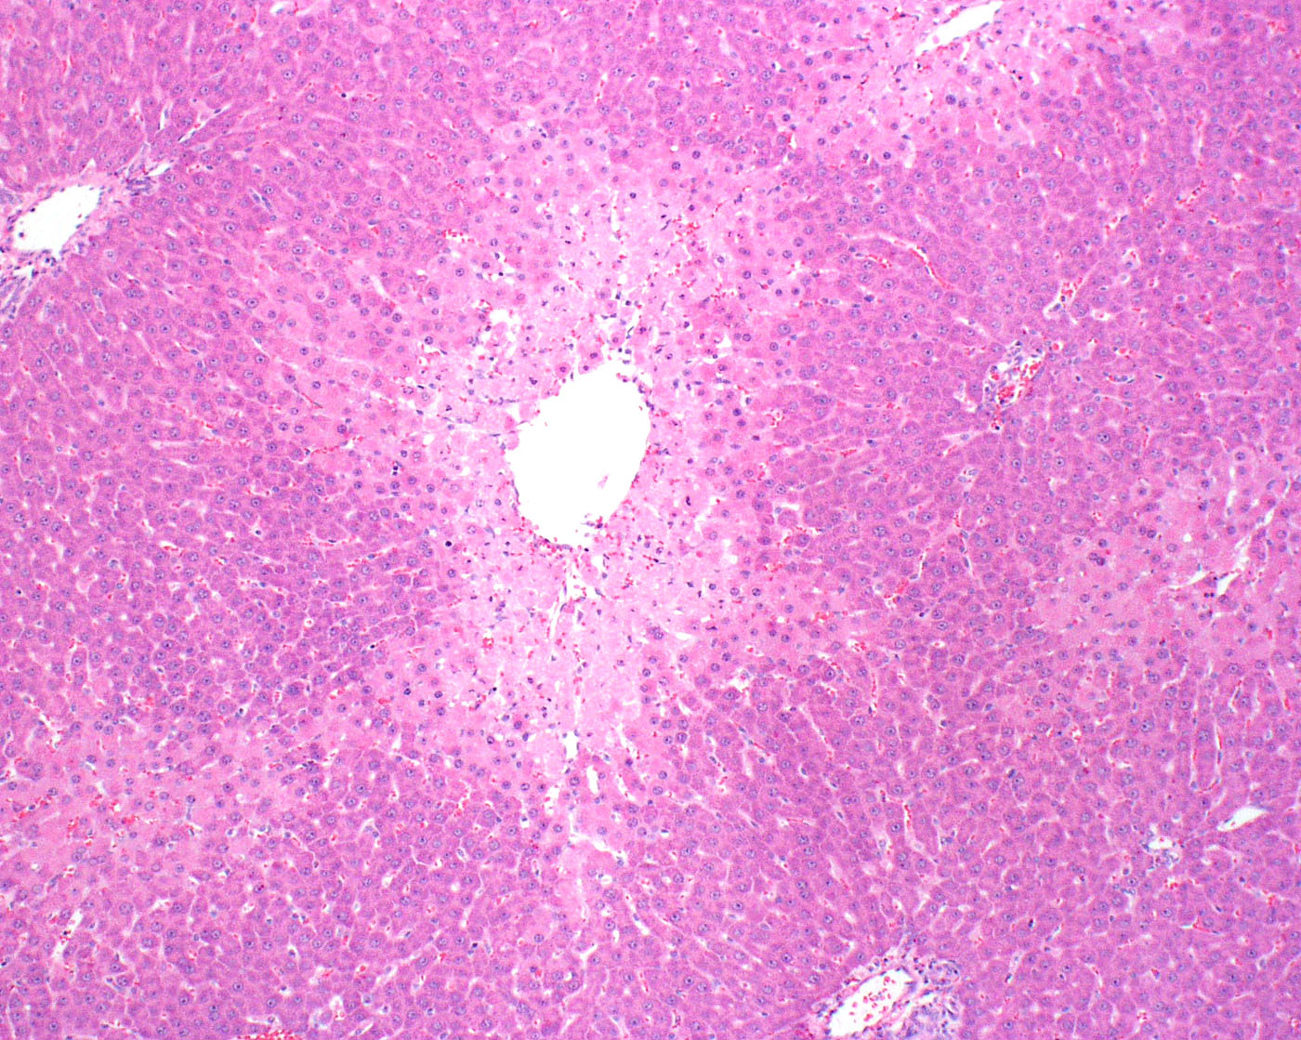
Acetaminophen Necrosis in Zone 3
2
1
3
THV

Slide 21
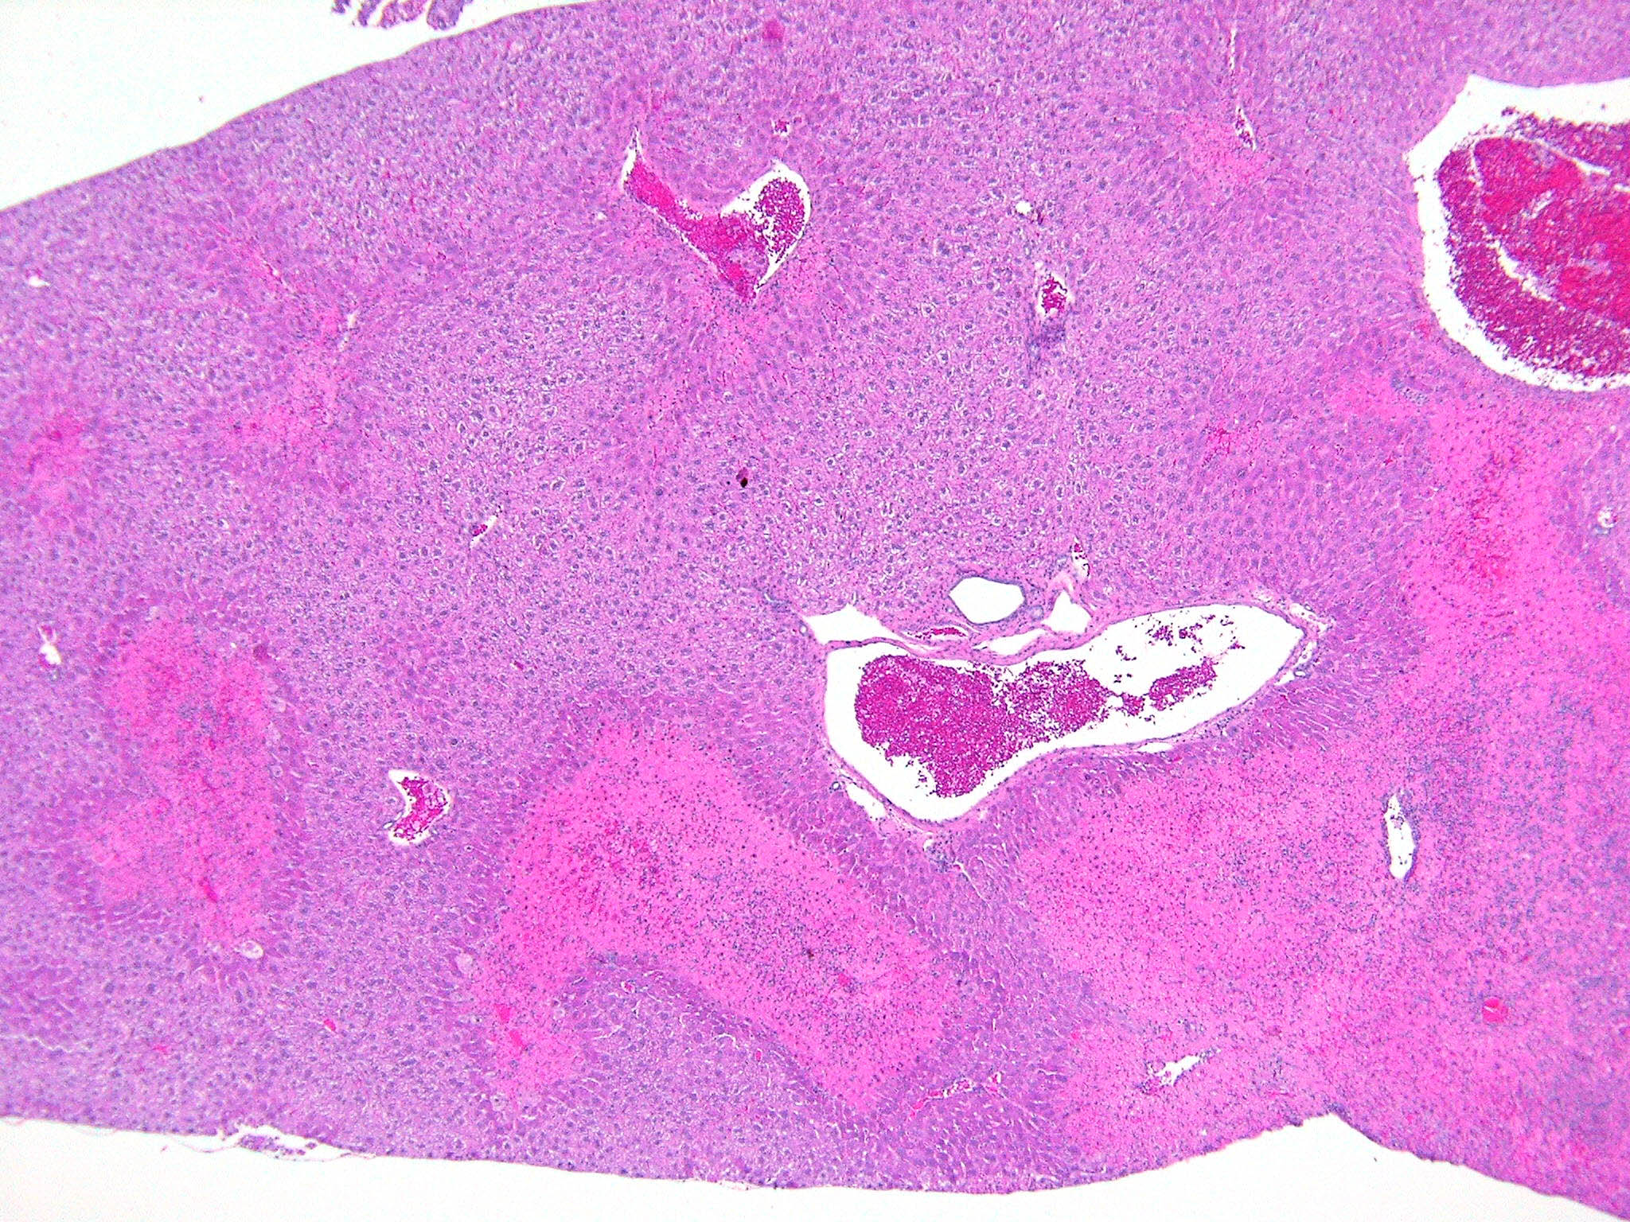
Sometimes lesions are patchy involving more than a lobule
Notes:
3327

Slide 22
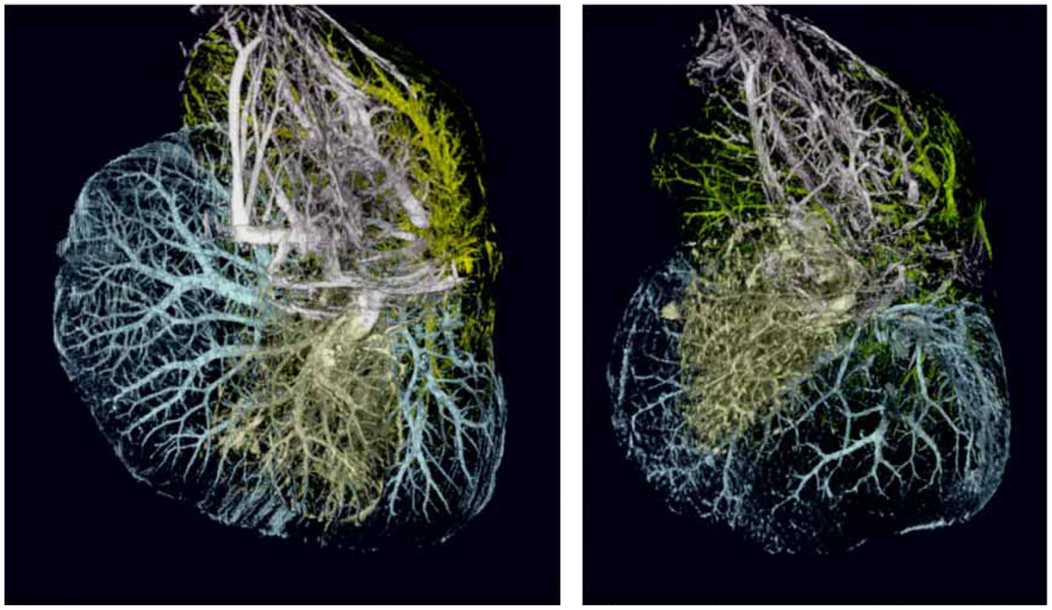
Vascular damage following acetaminophen (MRI image)
Malarkey, Ryan, Johnson, Maronpot, 2004

Slide 23
Heterogeneity of liver
Epithelial Cells
Hepatocytes
Cholangiocyes
Mesenchymal cells
Kupffer cells
Endothelial cells
Stellate cells
Other Hepatic components
Smooth muscle cells (blood vessels)
Mesothelia (capsule)
Nerves (unmyelinated)
Neuroendocrine cells
Hematopoeitic cells
Extracellular matrix
5-10% of liver is collagen

Slide 24
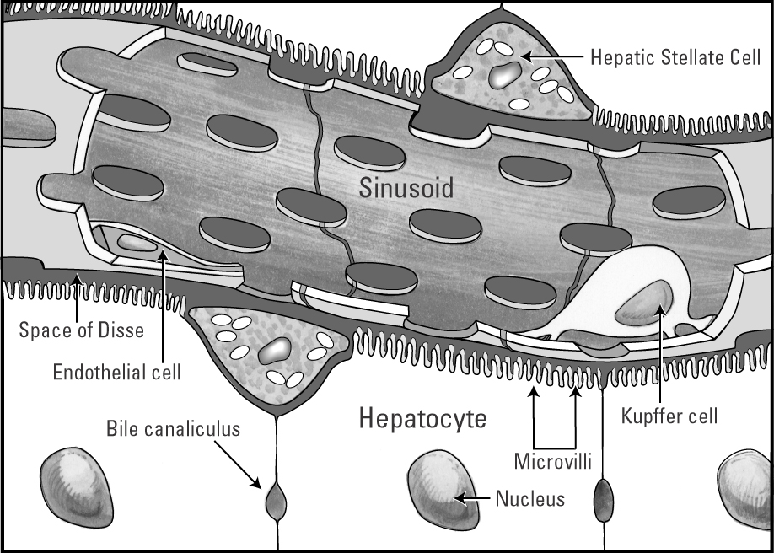
Liver
Notes:
Question: Is there evidence of a carcinogenic effect due to this compound?
Points for discussion:
Is it okay to combine HCAd and HCCas? Is it necessary?
Is there a shift (progression) to malignancy? If so, does that constitute a carcinogenic effect?
Does it matter if it’s only liver tumors in mice?
Ancillary information:
**p<0.01 with Fisher’s exact t-test
50 animals per group, number of animals with the lesion are listed in the box
2-year exposure
This compound is/is not genotoxic
There was/was not an increase in eosinophilic foci, other foci
Gavage exposure, Similar survival rates, Similar body weight gains
No effect seen in other species (rat), or other gender (female)
No real difference of opinion between pathologists with regards to diagnoses

Slide 25
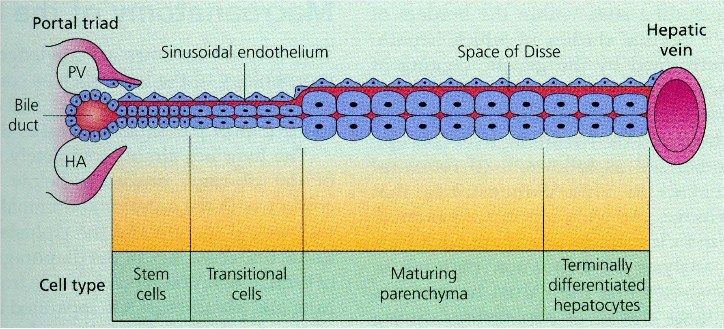
Lobular Heterogeneity: The Streaming Liver
Pathology of the Liver, MacSween RNM et al, 2002
Notes:
Question: Is there evidence of a carcinogenic effect due to this compound?
Points for discussion:
Is it okay to combine HCAd and HCCas? Is it necessary?
Is there a shift (progression) to malignancy? If so, does that constitute a carcinogenic effect?
Does it matter if it’s only liver tumors in mice?
Ancillary information:
**p<0.01 with Fisher’s exact t-test
50 animals per group, number of animals with the lesion are listed in the box
2-year exposure
This compound is/is not genotoxic
There was/was not an increase in eosinophilic foci, other foci
Gavage exposure, Similar survival rates, Similar body weight gains
No effect seen in other species (rat), or other gender (female)
No real difference of opinion between pathologists with regards to diagnoses

Slide 26
Heterogeneity of liver
Hepatocytes (60%)
Biliary epithelium (3-5%)
Endothelia (20%)
sinusoids
blood vessels (arteries and veins)
lymphatics
Kupffer cells (15%)
Hepatic stellate cells (5 -%)
Lymphocytes (Pit cells)

Slide 27
Hepatocytes
80% of mass; 60% of cell numbers
Free ribosomes
Golgi complex
Lysosomes (~ 30 per cell)
Peroxisomes / microbodies (~ 500 per cell)
Mitochondria (1000 per cell)
Cytoskeleton (microfilaments, intermediate filaments, microtubules)
Glycogen
Produces bile (~ 15 ml per kg per day)
Notes:
Question: Is there evidence of a carcinogenic effect due to this compound?
Points for discussion:
Is it okay to combine HCAd and HCCas? Is it necessary?
Is there a shift (progression) to malignancy? If so, does that constitute a carcinogenic effect?
Does it matter if it’s only liver tumors in mice?
Ancillary information:
**p<0.01 with Fisher’s exact t-test
50 animals per group, number of animals with the lesion are listed in the box
2-year exposure
This compound is/is not genotoxic
There was/was not an increase in eosinophilic foci, other foci
Gavage exposure, Similar survival rates, Similar body weight gains
No effect seen in other species (rat), or other gender (female)
No real difference of opinion between pathologists with regards to diagnoses

Slide 28
Endothelial Cells
20% of liver cells, 3.3% of protein content
Discontinuous individual cells/fenestrated
Sieve plates - clustered fenestrate
Direct access of blood to hepatocytes
Gives rise to vascular tumors
Vinyl chloride hemangiosarcomas - human carcinogen

Slide 29
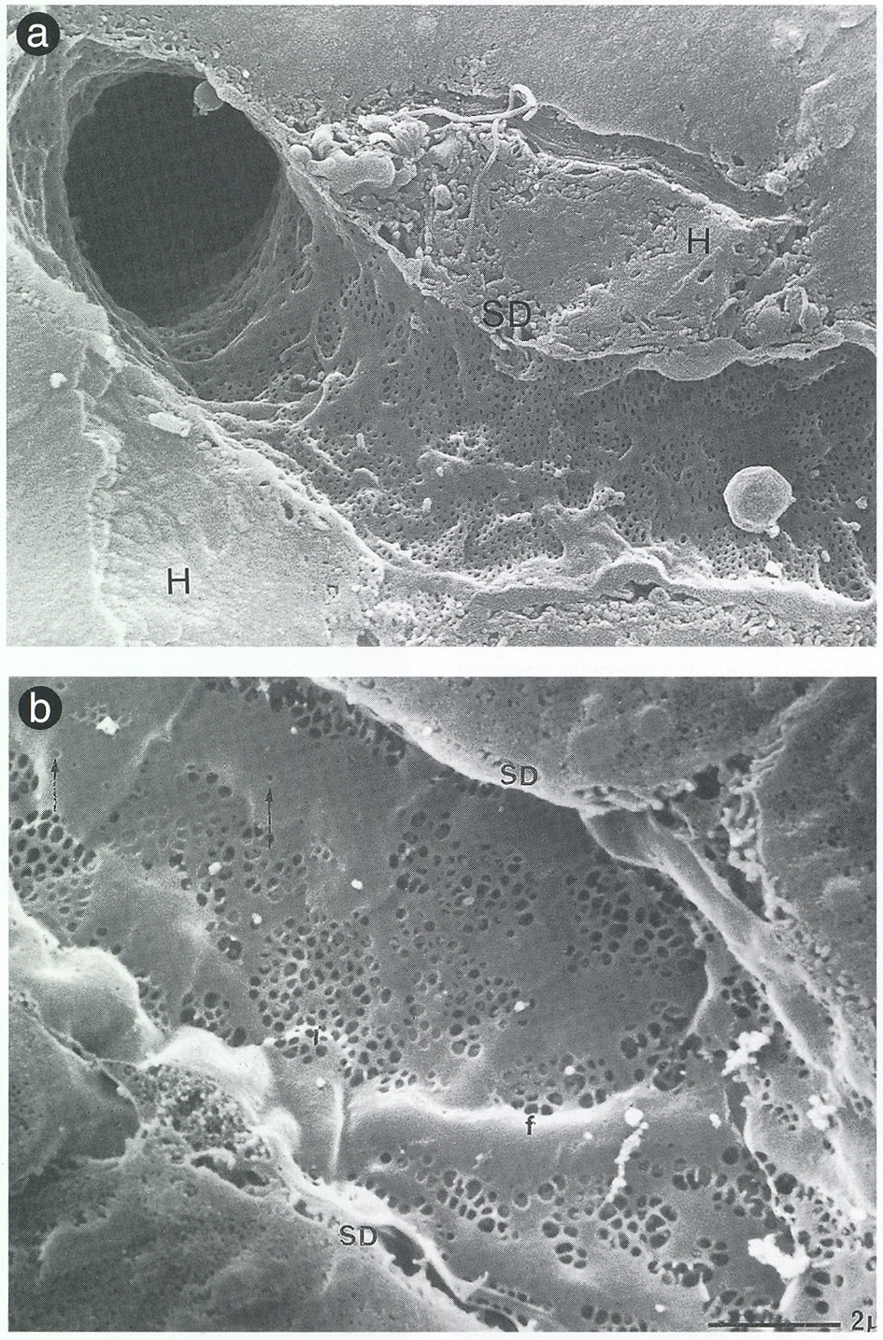
Sinusoidal endothelial cells
Fenestrations
Tissues and Organs: a text of scanning electron microscopy, Kessel, RG and Kardon,RH, 1979
Notes:
Question: Is there evidence of a carcinogenic effect due to this compound?
Points for discussion:
Is it okay to combine HCAd and HCCas? Is it necessary?
Is there a shift (progression) to malignancy? If so, does that constitute a carcinogenic effect?
Does it matter if it’s only liver tumors in mice?
Ancillary information:
**p<0.01 with Fisher’s exact t-test
50 animals per group, number of animals with the lesion are listed in the box
2-year exposure
This compound is/is not genotoxic
There was/was not an increase in eosinophilic foci, other foci
Gavage exposure, Similar survival rates, Similar body weight gains
No effect seen in other species (rat), or other gender (female)
No real difference of opinion between pathologists with regards to diagnoses

Slide 30
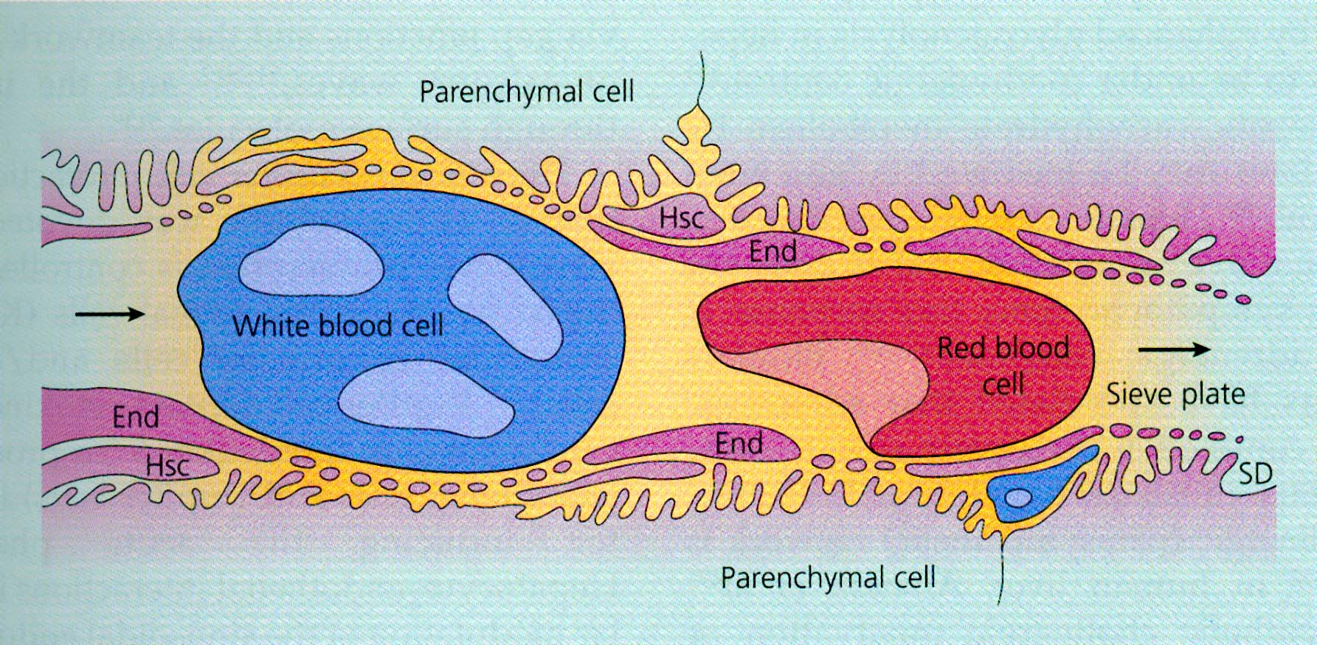
Pathology of the Liver, MacSween RNM et al, 2002
Notes:
Question: Is there evidence of a carcinogenic effect due to this compound?
Points for discussion:
Is it okay to combine HCAd and HCCas? Is it necessary?
Is there a shift (progression) to malignancy? If so, does that constitute a carcinogenic effect?
Does it matter if it’s only liver tumors in mice?
Ancillary information:
**p<0.01 with Fisher’s exact t-test
50 animals per group, number of animals with the lesion are listed in the box
2-year exposure
This compound is/is not genotoxic
There was/was not an increase in eosinophilic foci, other foci
Gavage exposure, Similar survival rates, Similar body weight gains
No effect seen in other species (rat), or other gender (female)
No real difference of opinion between pathologists with regards to diagnoses

Slide 31
Kupffer Cells
15% of liver cell population, 2.5% of liver protein
Precursors arise from circulating monocytes
Major component of fixed macrophage system
Ingest particles
May contribute to liver disease
Mediators of inflammation (TNF-alpha)

Slide 32
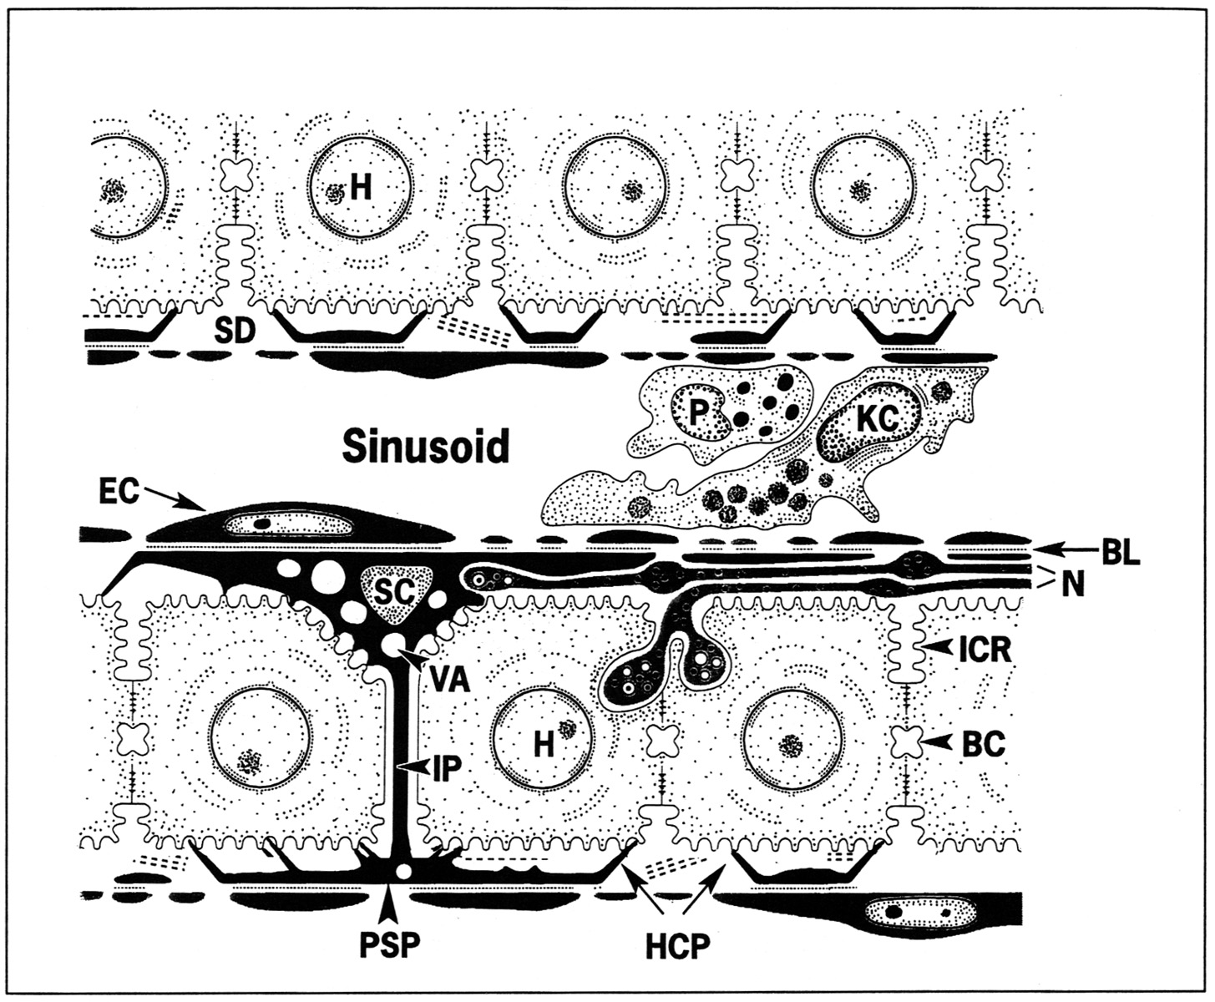
Liver showing hepatocytes (H), Kupffer cells (KC), endothelial cells (EC) and stellate cells (SC)

Slide 33
Stellate Cells
5% - 8% of all parenchymal cells
Vitamin A storage and metabolism: Ito cell
Significant source of collagen, hepatic fibrosis
Major player in hepatic regeneration
Control microvascular tone

Slide 34
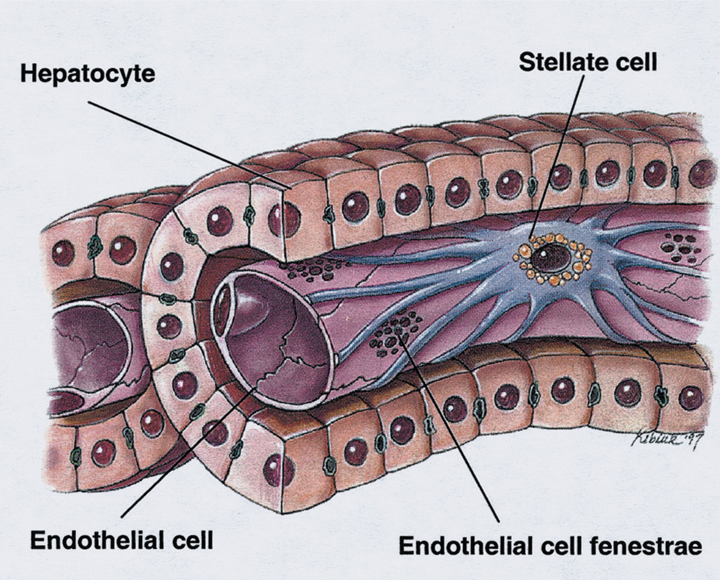
Tissues and Organs: a text of scanning electron microscopy, Kessel, RG and Kardon,RH, 1979
Notes:
Question: Is there evidence of a carcinogenic effect due to this compound?
Points for discussion:
Is it okay to combine HCAd and HCCas? Is it necessary?
Is there a shift (progression) to malignancy? If so, does that constitute a carcinogenic effect?
Does it matter if it’s only liver tumors in mice?
Ancillary information:
**p<0.01 with Fisher’s exact t-test
50 animals per group, number of animals with the lesion are listed in the box
2-year exposure
This compound is/is not genotoxic
There was/was not an increase in eosinophilic foci, other foci
Gavage exposure, Similar survival rates, Similar body weight gains
No effect seen in other species (rat), or other gender (female)
No real difference of opinion between pathologists with regards to diagnoses

Slide 35
Biliary cells
3% to 5% of liver cell population
Form approximately 2 km of tubules
Tight junctions isolate lumen
Modifies bile
Active in secretion and absorption
Effective communicator with other cells
Contains numerous transporters

Slide 36
What do we mean by zonal necrosis and site specificity? Explain in details? P117 see Table 5.1 Endoplasmatic reticulum is a target for the toxicity of chemicals. Explain? (p116)

Slide 37
Chemical-induced Hepatotoxicity
Hepatotoxic response depends on concentration of toxicant delivered to hepatocytes in the liver acinus
Hepatotoxicity a function of:
Blood concentration of (pro)toxicant
Blood flow in
Biotransformation (to more or less toxic species)
Blood flow out
Most hepatotoxicants produce characteristic patterns of cytolethality across the acinus

Slide 38
Mechanisms of Chemical-induced Toxicity
Direct effects
Toxicants can have direct surfactant effects upon plasma membranes
Chlorpromazine and phenothiozines, erythromycin salts, chenodeoxycholate
Effects on the cytoskeleton, resulting in plasma membrane permeability changes
Phalloidin, taxol
Effects upon mitochondrial membranes and enzymes
Cadmium, butylated hydroxyanisole, butylated hydroxytoluene, inhibitors and uncouplers of electron transport

Slide 39
Types of liver injury
1- Heptatocelluar degradation and death.
Lipid peroxidation
Irreversable binding to macromolecule
Loss of Ca ⁺⁺ homeostasis
Immune reactions
Fatty liver
Cholestasis
Vascular injury
Cirrhosis
Tumors

Slide 40
1- Heptatocelluar degradation and death.
Plasma membrane: acetaminophen, ethanol, mercurials, phaloidin.
Mitochondrial dysfunction: Responsible for ATP and Ca⁺⁺ regulation
CCl4, cocaine, dichlorethylene, ethionine, hydrazine, and phosphorus.
Endoplasmatic reticulum: acetaminophen, bromobenzene, CCl4, cocaine.
Nucleus: aflatoxin B, beryllium, ethionine, g;actosamine, nitrosamine.
Lysosomes

Slide 41
Necrosis
Damage occurs in different parts of the liver lobule depending on oxygen tension or levels of particular drug metabolizing enzymes.
Allyl alcohol causes periportal necrosis because the enzymes metabolizing it are located there (Zone 1).
CH2=CHCH2OH CH2 =CHCHO
Carbon tetrachloride causes centrilobular necrosis - endothelial and Kupffer cells adjacent to hepatocytes may be normal - with diethylnitrosamine, endothelial cells are also killed. Due to activation by higher concentrations of cytochrome P450 in zone 3.

Slide 42
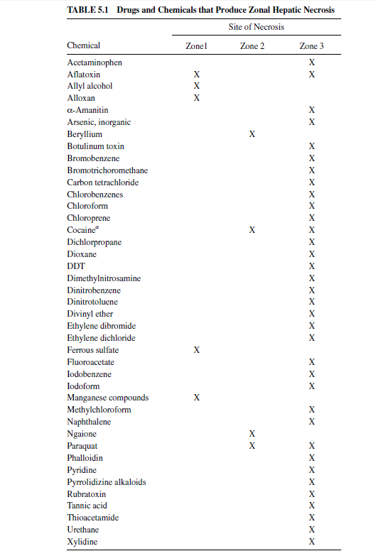

Slide 43
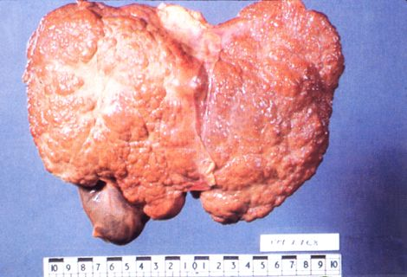
Most Hepatotoxic Chemicals Cause Necrosis
Result of loss of cellular volume homeostasis
Affects tracts of contiguous cells
Plasma membrane blebs
Increased plasma membrane permeability
Organelle swelling
Vesicular endoplasmic reticulum
Inflammation usually present

Slide 44
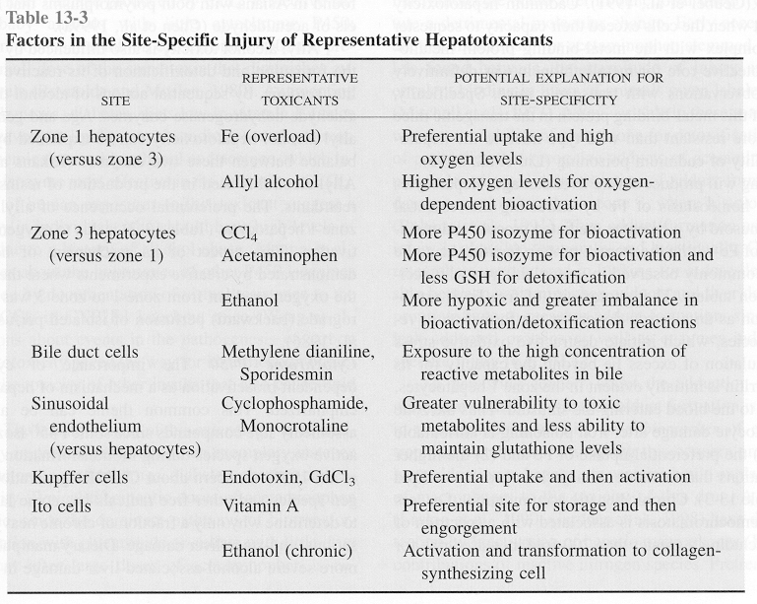

Slide 45
Chemical Exposure Can Also Lead to Apoptosis
Defined primarily by morphological criteria:
Condensation of chromatin
Gene expression, protein synthesis
Ca⁺⁺-dependent endonuclease activation
Cleavage to oligonucleosomes
Cytoplasmic organelle condensation
Phagocytosis
Inflammation absent
Death-receptor (TNF-R1, Fas) or mitochondrial pathways
Unlike necrotic cells, apoptotic cells show no evidence of increased plasma membrane permeability

Slide 46
Chemical-induced Hepatocyte Apoptosis
Thioacetamine
Ethanol
Chemicals- induced hypertrophy (growth of the liver beyond the normal size).
Lead nitrate
Phenobarbital
Why do chemicals that induced hypertrophy could increase apoptosis? See page 119

Slide 47
2- Lipid peroxidation
A cause of free radicals → free oxygen species or reactive oxygen species (ROS)
Halogenated carbons such as:
CCl4
Chloroform’
Bromobenzene
Tetrachlorethane
Alcohol: Ethanol, isopropanol
Hydroperoxide
Herbicide: paraquat
Others: Cd, Cocaine,

Slide 48
3- Reactive Metabolite Formation
Many compounds are metabolically activated to chemically reactive toxic species
Aflatoxin, carbon tetrachloride, acetaminophen, bromobenzene, nitrosamines, pyrrolizidine alkaloids
Chemically reactive metabolites (electrophiles) can covalently bind to crucial cellular macromolecules (nucleophiles)
Glutathione (GSH) is the prevalent cellular nucleophile, which acts as a protective agent

Slide 49
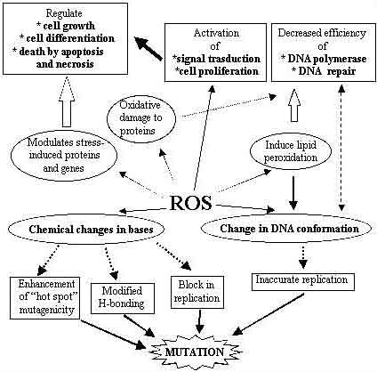

Slide 50
Covalent Binding Theory of Chemical Toxicity
Metabolism of chemical to reactive metabolite
Covalent binding of reactive metabolite to critical cellular nucleophiles (protein SH, NH, OH groups)
Inactivation of critical cell function (e.g., ion homeostasis)
Cell death

Slide 51
Mechanisms of Chemical-induced Toxicity
Alteration in the intracellular prooxidant-antioxidant ratio
Redox cycling of toxicant (e.g., quinone) produces oxygen radicals, depletes GSH
Hydroperoxides and metal ions (Fe, Cu) can produce oxidative stress and deplete GSH
Lipid peroxidation, protein sulfhydryl oxidation, disruption of Ca⁺⁺ homeostasis

Slide 52
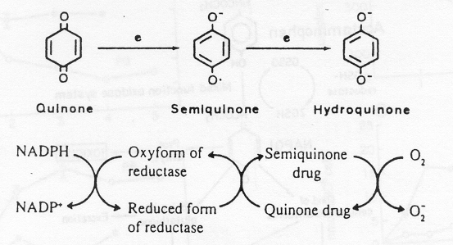
Redox Cycling and Formation of Oxygen Radicals

Slide 53
Critical Role of Glutathione
Glutathione is the major cellular nucleophile, detoxication pathway for most electrophilic chemicals
Glutathione depletion generally makes cells more susceptible to electrophilic cellular toxicants, ‘threshold’ effect
Glutathione depletion induced by alkylating agents , oxidative stress, substrates, biosynthetically with buthionine sulfoximine
Glutathione can be increased by precursors, such as N-acetylcysteine, which is used as an antidote for toxicity

Slide 54
Summary lipid peroxidation
Free radical attacks double bonds of unsaturated carbon of fatty acids particularly phospholipids
↓
The carbon becomes radical and reacts with Oxygen
↓
Forms lipid hydroperoxide a lipid radical which react with other lipids
↓
Fragmantation and destruction of the lipid
↓
Loss of membrane function

Slide 55
4-Mechanisms of Chemical-induced Toxicity: Disruption of Calcium Homeostasis
Calcium regulates a wide variety of physiological processes
Ca⁺⁺ accumulation in necrotic tissue, association with ischemic and chemical toxicity
Ca⁺⁺ homeostasis in the cell very precisely regulated
Impairment of homeostasis can lead to Ca⁺⁺ influx, release, or extrusion

Slide 56
Chemical Disruption of Ca⁺⁺ Homeostasis
Release from mitochondria
Uncouplers, quinones, hydroperoxides, MPTP, Fe⁺², Cd⁺²
Release from endoplasmic reticulum
CCl₄, bromobenzene, quinones hydroperoxides, aldehydes
Influx through plasma membrane
CCl₄, CHCl₃, dimethylnitrosamine, acetaminophen, TCDD
Inhibition of efflux from the cell
Cystamine, quinones, hydroperoxides, diquat, MPTP, vanadate

Slide 57
5-Immune reaction
Most familiar of drugs causes immune toxicity is the anesthetic halothane.
Halothane undergoes both oxidative and reductive metabolism by cytochrome P450 (CYP), respectively causing rare immune-mediated hepatic necrosis and common, mild subclinical hepatic toxicity. Halothane also causes lipid peroxidation.
Halothane is metabolized to reactive metabolite that binds with proteins.
These proteins become expressed on the cell surface where are recognized by the immune system as foreign.
Immune system response results in destruction to the hepatocytes (Halothane hepatitis).
Seldom occurs 1/10000 but has a 50% mortality rate.
Similar phenomenon has observed with other drugs like diclofenac

Slide 58
Summary halothane toxicity
Halothane metabolism
↓
Reactive metabolites
↓
Binds to proteins expressed on cell surface
↓
Recognized by immune system
↓
Destruction of hepatocytes
↓
Halothane hepatitis (seldom occurs)
↓
1/10,000 but 50% mortality
↓
Dicolfenac could have similar phenomena

Slide 59
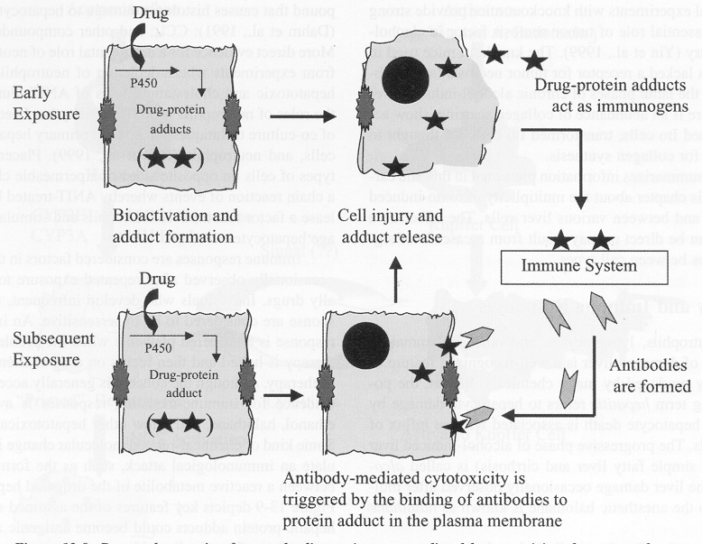
5- Immune-mediated Hepatotoxicity
From: Treinen-Moslen, Toxic responses of the liver, Casarett & Doull’s Toxicology, 6th Ed., 2001.

Slide 60
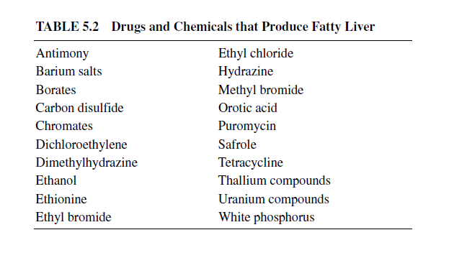
6- Fatty liver or steatosis

Slide 61
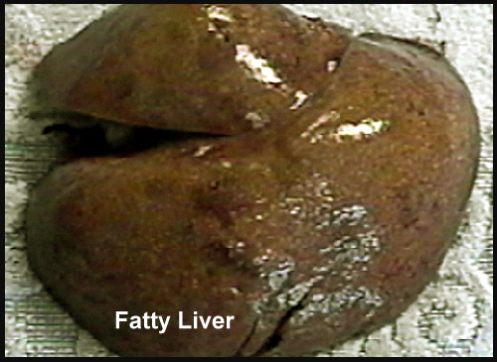

Slide 62
Fatty liver and zonation
Zone 1
Zone 3
White phosphorus
Tetracycline and ethanol

Slide 63
LIPIDOSIS
Many chemicals cause a fatty liver. Sometimes associated with necrosis but often not.
Not really understood but essentially is due to an imbalance between uptake of fatty acids and their secretion as VLDL.
Carbon tetrachloride can cause lipidosis by interfering in apolipoprotein synthesis as well as oxidation of fatty acids.
Other chemicals can cause lipidosis by interfering with export via the Golgi apparatus.
Ethanol can induce increased production of fatty acids.

Slide 64
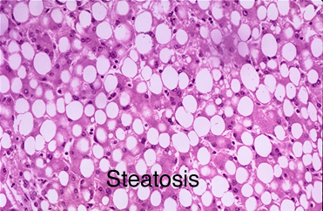
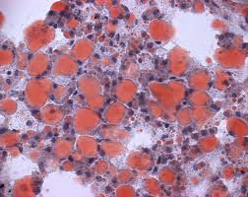
Fatty Liver
Normal Liver

Slide 65
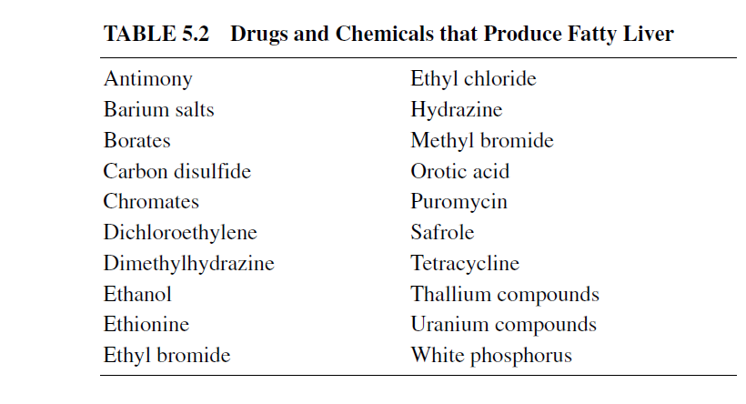
Table 5.2 Drugs and chemicals that produce fatty liver

Slide 66
Macro and micro vesicular steatosis
Macro
Micro
Barium salt
Carbon disulfide
Dichloroethylene
Ehanol
Hydrazine
Methyl and ethyl bromide
Thallium
Uranium compounds
Tetracycline
Valporic acid
Salicylate
Aflatoxin
Dimethylformamide
Antiviral nucleoside analogs to treat HIV
Rey’s syndrome
Fatty liver of pregnancy

Slide 67
Potential chemical effects on steatosis
Effect
Causes
Inhibition of lipoprotein synthesis.
Decreases conjugation of triglyceride with lipoproteins
Interference with VLDL transfer
Impaired peroxidation of the lipids in the mitochondria
Increased synthesis of fatty acids
CCl4, ethionine, puromycin
CCl4
Tetracycline
CCl4, ethionine, white phosphorus
ethanol

Slide 68
Fatty liver in conjunction with hepatocellular necrosis
Dimethylnitrozamine
Dinitrotoluene
DDT
Dichloropopane
Naphthalene
Pyrrolizidne alkaloids in herbal teas
Aflatoxin
Amanitin
Arsenic compounds
Bromobenzene
CCl4
Chloroform
Tetrachloroethane

Slide 69
Phospholipidosis
A special case of steatosis.
Accumulation of phospholipids in the hepatocytes
Enlarge hepatocytes with foamy cytoplasm
Often this condition progresses to cirrhosis
Could be inborn error
Due to certain drugs such as amiodarone.

Slide 70
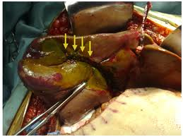
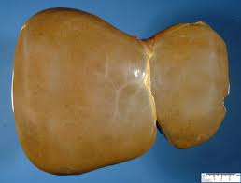
7- Cholestasis

Slide 71
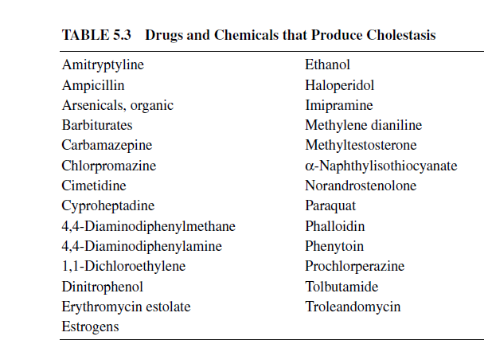
7- Cholestasis
Decreased or arrested bile flow.

Slide 72
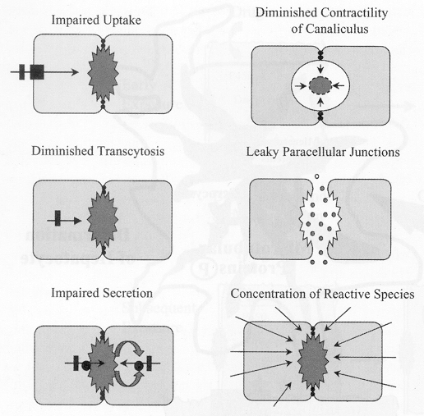
Potential Mechanisms or Causes of Impaired Bile Flow
1- Loss of the integrity of the canalicular system that collects bile and carries it to the gall bladder.
e.g. α-naphthylisothiocyannate
2- The formation and the secretion of the bile.
e.g. paraquat and methylene dianiline
From: Treinen-Moslen, Toxic responses of the liver, Casarett & Doull’s Toxicology, 6th Ed., 2001.

Slide 73
8- Vascular injury (Hepatic venoocculsive disease)
Impaired blood flow which in turn leads to hypoxia
Cells in Zone 3 are most vulnerable (Why???).
Hypoxia→ necrosis → fibrosis
Pyrrolizidne alkaloids in herbal teas
Oral contraceptive
Anticancer drugs
Peliosis hepatitis : defect in the sinusoidal supporting membrane caused by anabolic steroids and causes bleeding in the abdominal cavity

Slide 74
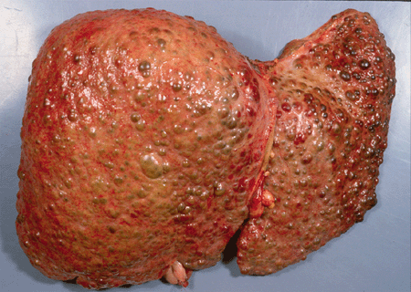
9- Cirrhosis
Chronic liver injury→ accumulation of collagen fibers →fibrosis
Fibrotic cells begin to form walls separating cells to become hypoxic and die→ fibrotic scar tissue
The organization of the liver is reduced to nodules of regenerating hepatocytes surrounded by walls of fibrous tissue → cirrhosis.
Chronic ethanol ingestion
CCl4
Trinitrotoluene
Dimethylnitrosamine
Arsenicals
Methotrexate
diclofenac

Slide 75
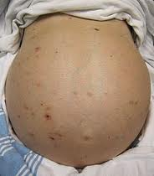

Slide 76
10- Tumor
Carcinomas→ malignant tumor arises from epithelial origin
Sarcomas → malignant tumor arises from mesenchymal origin
Cholangiocarcinomas → malignant tumor from bile duct cells also of epithelial origin

Slide 78
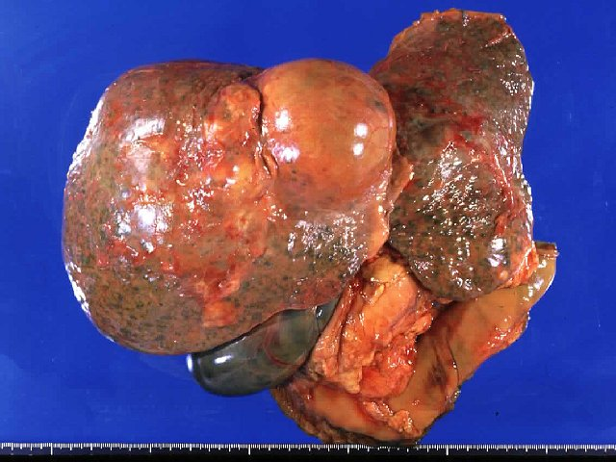

Slide 79
Chemicals that may cause liver cancer
Cause DNA adduct →Nitro sources or nitrosamine
Nongenotoxic but appear to work through epigenetic mechanism:
Dioxin
Sex steroids
Synthetic antioxidant
Phenobarbital
Peroxisome proliferators

Slide 80
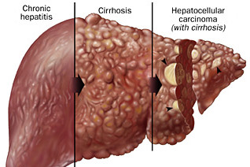

Slide 81
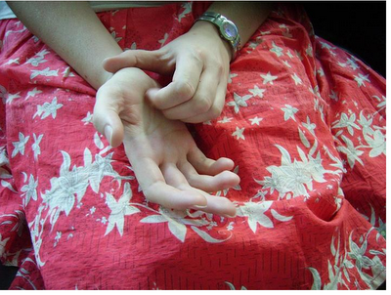
Evaluation of liver injury
Symptoms of liver toxicity
Anorexia (loss of appetite)
Nausea,
Vomiting
Fatigue
Abdominal tenderness
Physical examination
Hepatomegaly (swelling of the liver)
Ascites (the accumulation of fluid in the abdominal space)
Jaundice
Pruritis (itching sensation on the skin, often accompany with jaundice)

Slide 82
Fulminant hepatic failure:
When the liver fails, death can occur in as little as 10 days.
Complications:
No production of clotting factors, albumin, glucose→ hemorrhage and hypoglycemia.
Kidney failure and deterioration of CNS ( hepatic encephalopathy)
Inability to sustain blood pressure and accumulation of fluids in lungs.
Mortality rate is 90%

Slide 83
Morphological evaluations
Histopathologic evaluation→ nature of the lesion and the regions affected in the liver → mechanism of toxicity → the cause may be known to be stopped.
Altered morphology of the mitochondria →sequence events leading to cell death.
Centrilobular necrosis → bioactivation of the chemical by P450.
CT, MRI are used to detect liver cancer, obstructive biliary injury, cirrhosis, venoocclusive injury in the liver

Slide 84
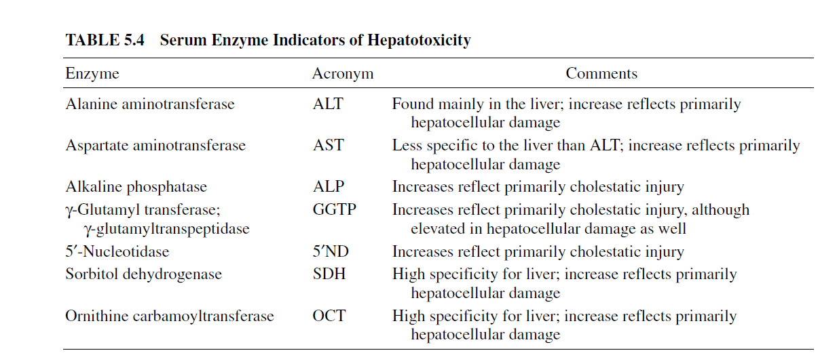
Blood tests

Slide 85
Summary: Consequences of Toxic Mechanisms
Disruption of intracellular calcium
Cell lysis
Disruption of actin filaments
Cholestasis
Generation of high-energy reactions
Covalent binding and adduct formation
Adduct-induced immune response
Cytolytic T cells and cytokines
Activation of apoptotic pathways
Programmed cell death with loss of nuclear chromatin
Disruption of mitochondrial function
Decreased ATP production
Increased lactate and reactive oxygen/nitrogen species (ROS, RNS)
Peroxidation of Membrane Lipids
Blebbing of plasma membrane

Slide 86
