Slide 1
Dairy Cattle Production (95314)
Instructor: Dr Jihad Abdallah
Raising heifers from weaning to calving

Slide 2
Sources of this lecture
Michel A. Wattiaux. HEIFER RAISING—WEANING TO CALVING: FEEDING AND HOUSING. Dairy Essentials, Babcock Institute for International Dairy Research and Development, University of Wisconsin-Madison
Michel A. Wattiaux. HEIFER RAISING—WEANING TO CALVING: GROWTH RATE. Dairy Essentials, Babcock Institute for International Dairy Research and Development, University of Wisconsin-Madison
Michel A. Wattiaux. HEIFER RAISING—WEANING TO CALVING: MEASURING GROWTH. Dairy Essentials, Babcock Institute for International Dairy Research and Development, University of Wisconsin-Madison
2

Slide 3
Feeding from weaning to breeding
From three to six months of age, heifer rations should contain between 40% and 80% forage.
For heifers from seven to 12 months of age, the percentage of forage in the diet may vary from 50 to 90%.
As heifers grow older, the concentration of protein in the diet can be decreased and the concentration of fiber (NDF) can be increased.
Forage of low quality should be avoided in the rations of three- to six month- old heifers.
Poor quality forage fed to older heifers must be adequately complemented with concentrates and minerals

Slide 4
Feeding from weaning to breeding
The percentage of crude protein needed in the concentrate depends on the crude protein content of the forage in the diet.
Usually, a concentrate mixture of 16% crude protein (which is sometimes formulated for the lactating cow) can be used for heifers.

Slide 5
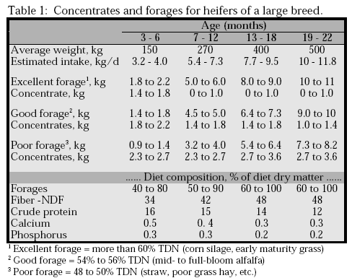

Slide 6
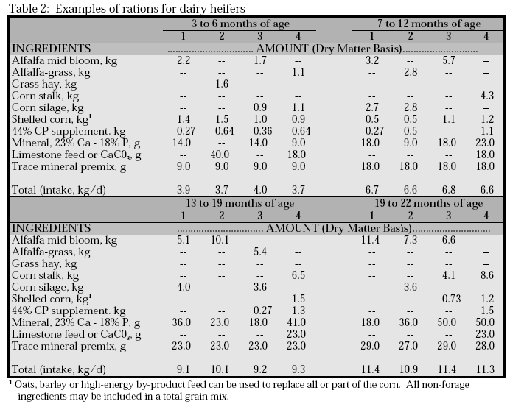

Slide 7
Feeding from breeding to calving
Heifers that are more than 13 months old have sufficient rumen capacity for adequate growth when fed good quality forage rations alone.
High energy forage such as corn silage should be offered in limited quantities because older heifers may overeat and become obese.
A combination of corn silage and a legume or well-fertilized grass provides adequate energy and protein intake.
Concentrate should be used primarily when the forage in the ration is low quality.

Slide 8
Feeding from breeding to calving
One to two months prior to calving, the feeding program must be adjusted to prepare the heifer for calving and first lactation.
These heifers should receive forage and progressively more concentrate to ensure a smooth transition and encourage high dry matter intake as soon as possible after calving.
Sould avoid inappropriate (low or high) body condition score at calving.

Slide 9
Housing heifers
As heifers grow, there are considerable changes in their needs for resting area and feeding space.
In addition, many management practices require animal restraint (vaccination, parasite treatment, artificial insemination, measuring height, taping for weight, etc.).
Facilities for older heifers should be designed to meet an animal’s requirements and ease the work of the operator.
Housing features for older heifers should allow for convenience of:
- Feeding;
- Bedding and cleaning;
- Moving and restraining animals.

Slide 10
Housing heifers
After weaning, heifers should first be grouped in small numbers, primarily according to their nutritional requirements.
The size and number of groups will also depend on herd size and available housing.
Similar body size as well as age are important when grouping animals.

Slide 11
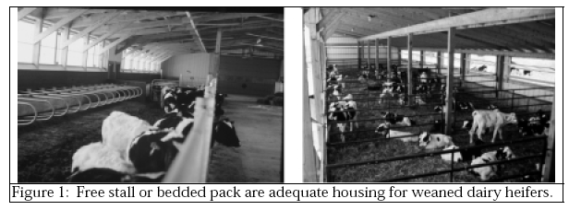

Slide 12
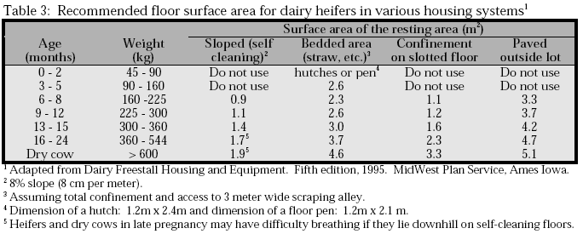

Slide 13
Housing heifers
Weaned calves: 2-5 months old:
Weaned calves of similar size should be placed in small groups (four to six calves) in transitional housing designed to maintain the same characteristics as individual housing (housing—clean, dry bedding, good ventilation, easy access to water and feed, etc)
There should be sufficient manger space for all calves to eat at the same time, especially when a concentrate is fed in restricted amounts.
Opportunities for competition between young calves should be avoided.

Slide 14
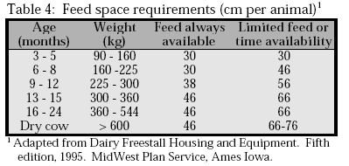

Slide 15
Housing heifers
Pre-pubertal heifers (6-11 months old):
Groups of pre-pubertal heifers may consist of 10 to 20 animals.
Maximum weight variations within a group should not exceed 70-90 kg.
Breeding age heifers: 12-15 months old
These heifers should be grouped primarily for ease of heat detection and breeding purposes.
Maximum range in body weight should not exceed 130 kg.

Slide 16
Housing heifers
Pregnant heifers: 16-22 months old
During this period, feeding and growth rates should be monitored to have heifers of desired height, weight and body condition at parturition.
Minimum housing requirements and flexible feeding programs make grazing suitable for bred heifers.

Slide 17
Housing heifers
Heifers in late pregnancy: 22-24 months old
A few days prior to calving, first-calf heifers may be taken through the milking parlor along with the milking cows to help them adjust to the milking routine.
If possible, first-calf heifers should be kept in their own group after calving as they may suffer from the stress of entering a group of older cows.

Slide 19
Growth rate
Importance of growth rate:
Heifer growth rate is an indicator of management level.
Heifer growth should be monitored for multiple reasons:
To avoid delays in sexual maturity and first calving due to slow growth;
To determine whether heifers are overfed or underfed;
To get “ideal” body weight at first calving, thereby minimizing calving problems.

Slide 20
Growth rate
Desirable growth rate and age at first calving:
Short rearing periods are desirable from economic and genetic standpoints. The advantages of an enhanced growth rate and an age at calving of 24 months include:
Quicker return on capital investment;
Reduction in variable costs (labor);
Reduction in number of heifers required to maintain herd size;
Increased lifetime production;
Quicker genetic gain in the herd;
Reduction in total amount of feed needed from birth to calving.

Slide 21
Growth rate
Difficulties or disadvantages associated with fast growth rates that reduce the number of months to first calving, from 24 months to 20 months for example, include:
Need for higher quality forage and concentrate feed;
Need for higher management skills;
Greater risk of difficult calving if growth rate is not properly monitored;
Greater risk of adversely affecting milk production.

Slide 22
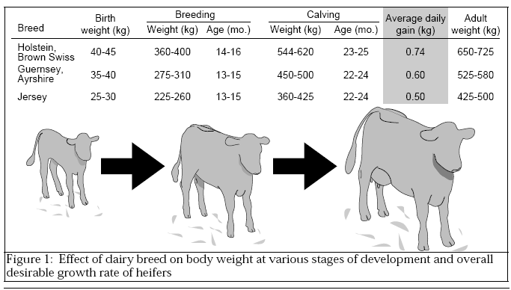
Source: (2)

Slide 23
Growth rate
Growth rate and sexual maturity
Sexual maturity of heifers depends more on body weight than on age. Thus growth rate considerably influences age at puberty and ultimately age at first calving.
Heifers may not reach puberty before 18 or 20 months of age when they grow slowly (<0.35 kg/d).
However, puberty may occur before nine months of age when heifer growth is accelerated (> 0.9 kg/d).

Slide 24
Growth rate
Puberty occurs when heifers weigh between 40 and 50% of mature body weight, regardless of age.
Breeding should occur when heifers reach 50-60% of mature body weight (14-16 months of age).
Growth rate should be sustained during pregnancy such that heifers weigh 80-85% of mature body weight at first calving.

Slide 25
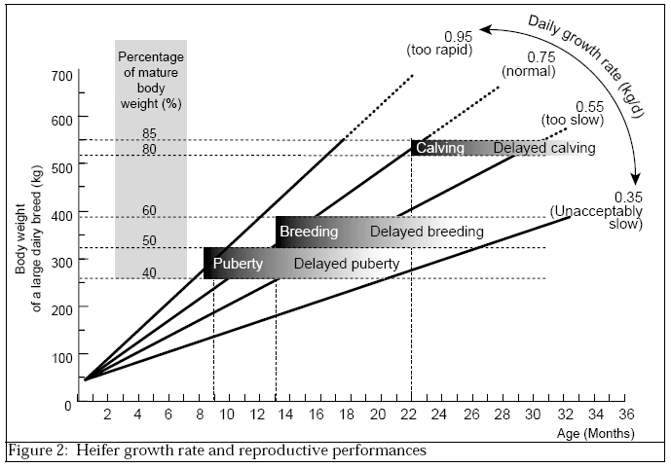
Source: (2)

Slide 26
Growth rate
Body weight and calving problems
Calving problems are more common at first calving than any other calving.
In general, difficult calving is due to one or a combination of the following:
- The newborn calf is large: because of its genetics or because it is overdue;
- The heifer is underdeveloped and the pelvic area is too narrow relative to the size of the calf;
- The heifer is overweight and excessive adipose tissue interferes with normal calving.

Slide 27
Growth rate
Body weight and first lactation yield
There is a strong positive relation between body weight at first calving and first lactation milk yield (it is desirable that heifers are sufficiently developed at calving).
Holstein heifers should weigh, on the average, 620 kg (weight of the cow within the first month after calving) to maximize first lactation milk yield.
These first-calf heifers will continue to grow and reach mature body weight (> 700 kg) during the fourth or fifth lactation.

Slide 28
Growth rate
Constant vs. variable growth rate:
Heifer growth rate need not be constant. Most often heifer growth is characterized by periods of slow growth and periods of more rapid growth.
Heifers actually show a great ability to compensate for periods of slow growth with periods of more rapid growth.
The variability in the growth rate of heifers may reflect:
- Seasonal availability of forages (quantity and quality);
- Management decisions to adjust heifer growth to a desired rate.

Slide 29
Growth rate
Growth rates before and after puberty
Moderate growth rate before puberty followed by more rapid growth to achieve target body weight at calving appears to be the best rearing strategy to maximize future milk production.
This concept appears to be true for all dairy breeds, although the actual rate of growth will vary substantially across breeds .

Slide 30
Growth rate
Effects of overfeeding and rapid growth before puberty
Some research has shown that feeding high energy rations to accelerate body growth before puberty may affect the development of the mammary gland and limit milk production later in life (this research remains controversial).
Surveys of high-producing dairy herds in the United States indicate that growth rates of heifers vary between 0.8 and 0.95 kg/day. These rapid growth rates are not incompatible with high milk yields of first calf heifers.

Slide 31
Growth rate
Effects of underfeeding and slow growth before puberty
Age at puberty may range from 9 to 20 months of age, depending on growth rate.
To ensure calving at 24 months of age, puberty should occur when heifers are 12 to 13 months of age.
When the growth rate before puberty is slow, the desired body weight at calving cannot be achieved without:
- Accelerated growth during pregnancy
- Delayed breeding and calving;
- A combination of the above.

Slide 32
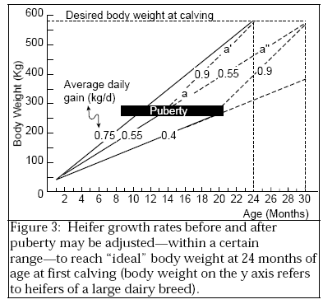
- When average body weight
gain is 0.55 kg/day, puberty is expected to occur at 12-13 months of age. Assuming that pregnancy begins at 15 months of age, growth rate must be then be adjusted to 0.9 kg/day to ensure adequate body weight at calving.
- When the growth rate of a large breed heifer is 0.55 kg/day throughout the entire rearing period, then breeding should be delayed until 19-20 months of age.
Source: (2)

Slide 33
Growth rate
Effects of overfeeding after puberty
Feeding a high energy, balanced diet that promotes rapid growth during pregnancy is usually desirable because it ensures:
- Good nutrition for the fetus;
- Adequate heifer development at calving.
However, fattening is undesirable. Obese heifers have a higher risk of calving difficulty and metabolic problems after calving.
Feeding a balanced ration is a good way to avoid obesity. Body condition score is also a good tool to help adjust the feeding levels of pregnant heifers.

Slide 34
Growth rate
Effects of underfeeding after puberty
Conception rate may be reduced when heifers are not gaining weight at breeding time.
A slow growth rate after puberty causes no harm as long as the heifer is not pregnant (except for the likelihood of delayed first calving).
However, once a heifer is pregnant, insufficient growth may have harmful effects:
- Poor fetal nutrition;
- Difficult calving due to sub-optimal skeletal growth;
- Lower first lactation milk yield.

Slide 35
Growth rate
If availability of feed (or other resources) does not permit higher growth rates after conception, it may be better to delay conception until heifers have a higher body weight.
The first lactation record will then be satisfactory, but the productive life of the cow will be shortened and the cost of rearing increased.

Slide 36
Measuring growth
Growth is measured by:
- Body weight
- withers height
- body condition score
The height of a heifer reflects frame growth (skeletal growth) while body weight reflects the growth of organs, muscles, and adipose tissue (fat).
Body condition score can also be used to evaluate heifer feeding (management) programs. when it is used in conjunction with body weight and withers height, it helps characterize growth as either skeletal and muscular or adipose.

Slide 37
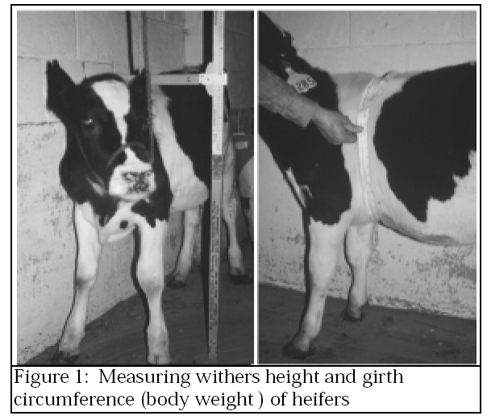
Source: (3)

Slide 38
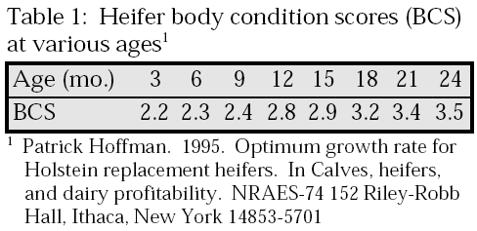
Source: (3)

Slide 39
Measuring growth
How often should height and weight be measured?
- Over the entire rearing period (birth to calving);
- Over specific phases or rearing periods (milk-feeding period, weaning period, indoor feeding period, grazing period, etc.).

Slide 40
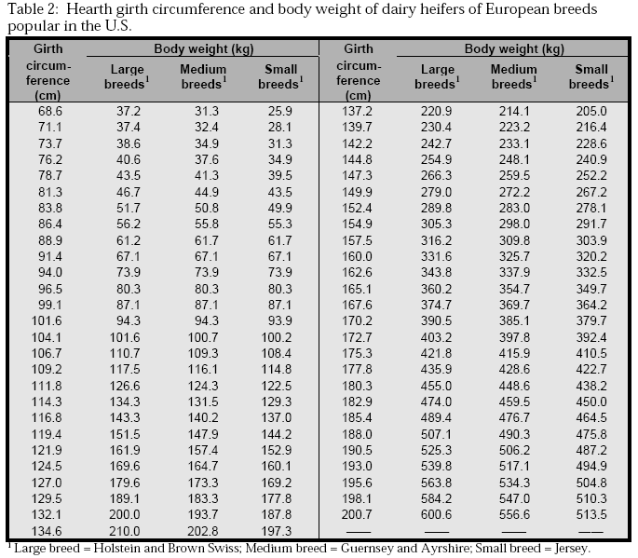
Source: (3)

Slide 41
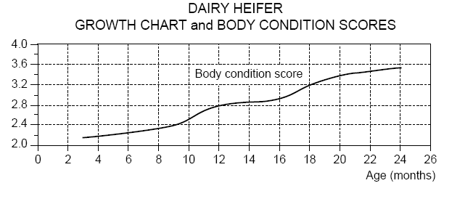
Source: (3)

Slide 42
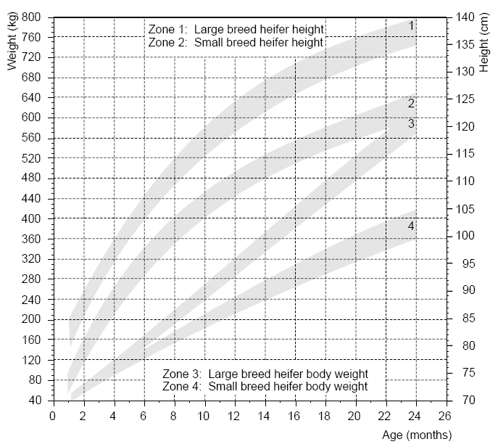
Source: (3)

