Slide 1
An-Najah National University
Faculty of Medicine
Department of Physiology
Anatomy and Physiology 1
7102101
Instructor: Heba Salah
Chapter 3:
The Skeletal System
Part 3: Axial Skeleton: The Skull

Slide 2
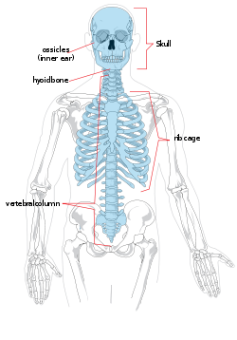
The Axial Skeleton
Forms the longitudinal part of the body
Divided into three parts
Skull
Vertebral column
Bony thorax

Slide 3
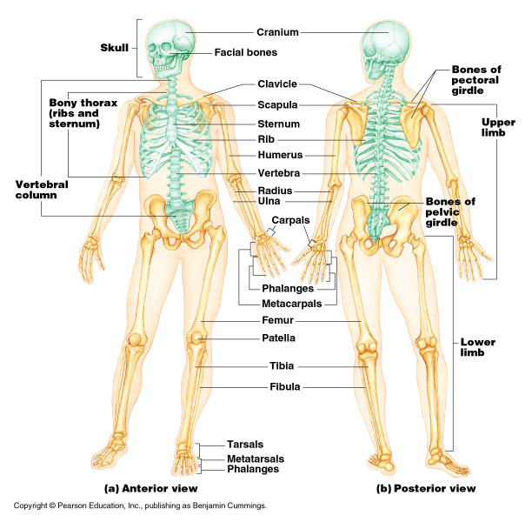
The Axial Skeleton

Slide 4
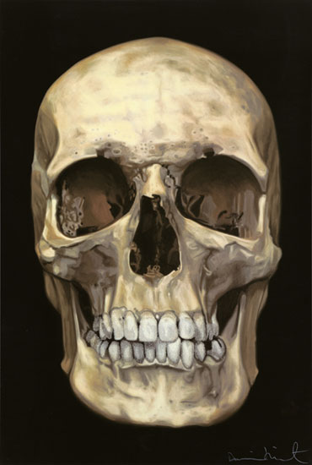
The Skull
Two sets of bones
Cranium
Facial bones
Bones are joined by sutures
Only the mandible is attached by a freely movable joint

Slide 5
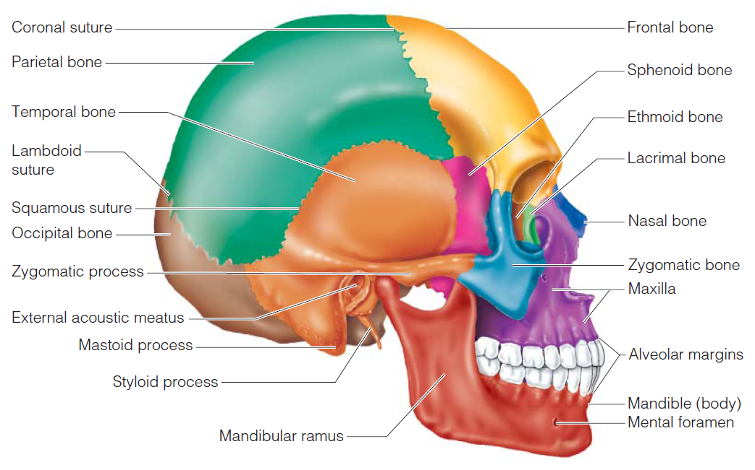
The Skull: Lateral View

Slide 6
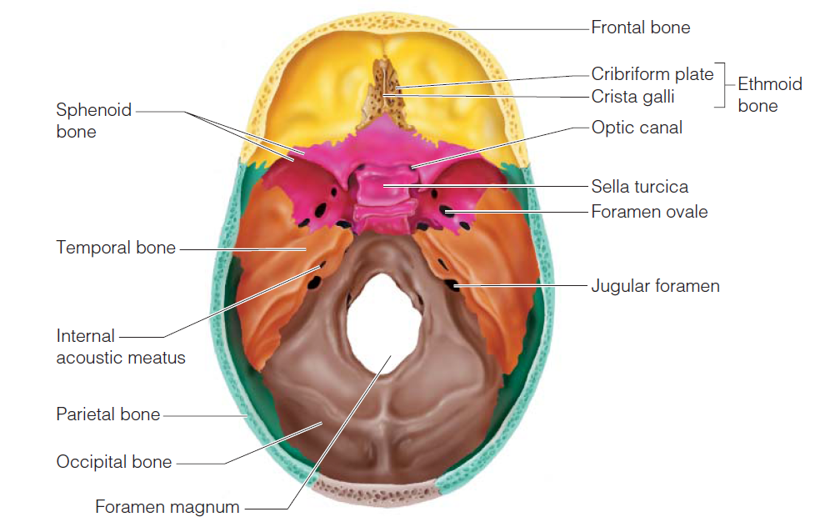
The Skull: Superior View

Slide 7
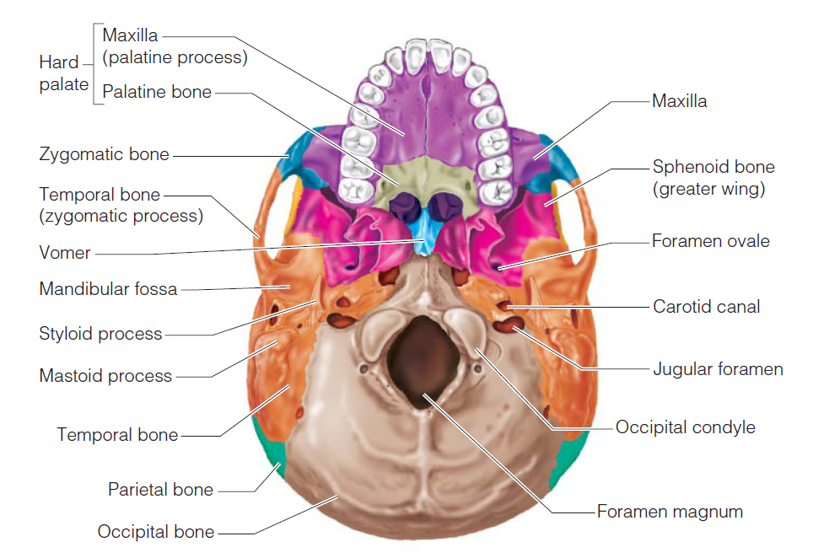
The Skull: Inferior View

Slide 8
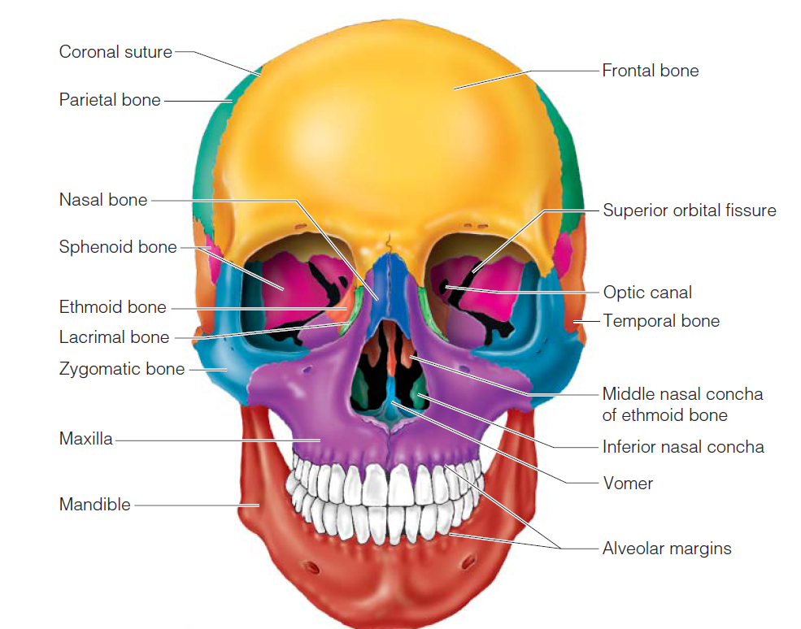
The Skull: Anterior View

Slide 9
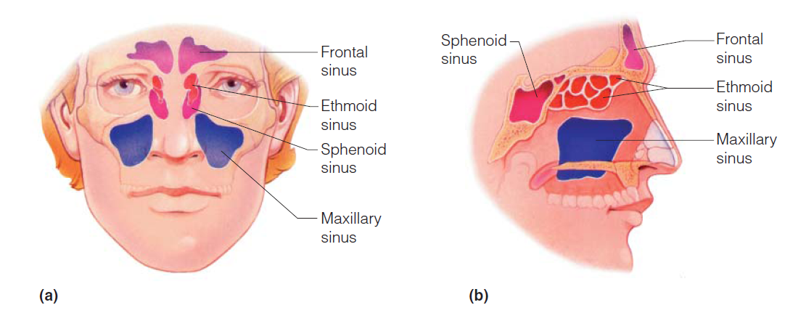
Paranasal Sinuses
Hollow portions of bones surrounding the nasal cavity

