Slide 1
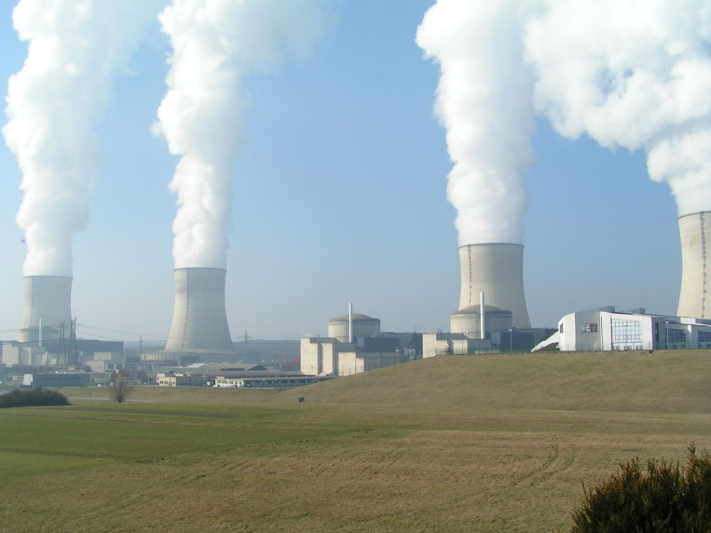
Nuclear energy

Slide 2
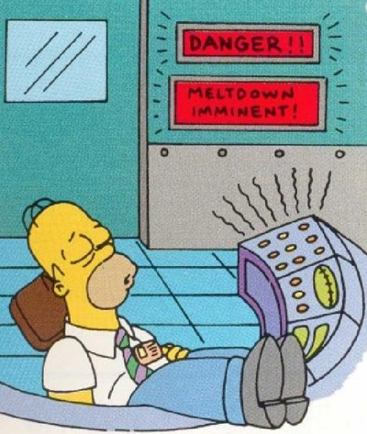
What Is It?
Nuclear energy is energy produced by the nuclear reaction through fusion and fission. The energy released through the reaction is transferred into electrical energy, which is used in local power grids.

Slide 3
Objective
This presentation focus on the entire nuclear fuel cycle.
Study the differences between fission and fusion .
Advantage and disadvantage of nuclear energy .

Slide 4
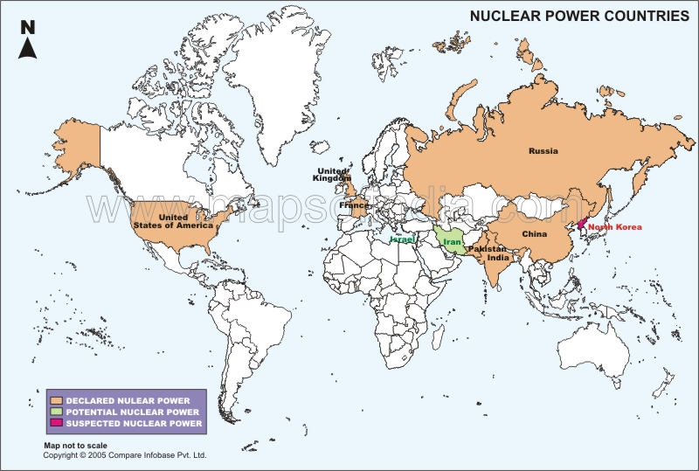
Nuclear energy Countries

Slide 5
The Process of Nuclear Fission
Fission is the release of energy by splitting heavy nuclei such as Uranium-235 and Plutonium-239

Slide 6
How does a nuclear plant work?
Each fission releases 2 or 3 neutrons
These neutrons are slowed down with a moderator to initiate more fission events
Control rods absorb neutrons to keep the chain reaction in check

Slide 9
The energy from the reaction drives a steam cycle to produce electricity

Slide 11
Nuclear Fission

Slide 12
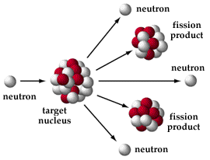

Slide 13
The Fission Process
A neutron travels at high speed towards a uranium-235 nucleus.
1
n
235
U
0
92

Slide 14
The Fission Process
A neutron travels at high speed towards a uranium-235 nucleus.
1
n
235
U
0
92

Slide 15
The Fission Process
A neutron travels at high speed towards a uranium-235 nucleus.
1
n
235
U
0
92

Slide 16
The Fission Process
The neutron strikes the nucleus which then captures the neutron.
1
n
235
U
0
92

Slide 17
The Fission Process
]The nucleus changes from being uranium-235 to uranium-236 as it has captured a neutron.
236
U
92

Slide 18
The Fission Process
The uranium-236 nucleus formed is very unstable.
It transforms into an elongated shape for a
short time.

Slide 19
The Fission Process
The uranium-236 nucleus formed is very unstable.
It transforms into an elongated shape for a short time.

Slide 20
The Fission Process
The uranium-236 nucleus formed is very unstable.
It transforms into an elongated shape for a short time.

Slide 21
The Fission Process
It then splits into 2 fission fragments and releases neutrons.
1
n
0
141
Ba
56
1
n
0
92
Kr
36
1
n
0

Slide 22
The Fission Process
It then splits into 2 fission fragments and releases neutrons.
1
n
0
141
Ba
56
1
n
0
92
Kr
36
1
n
0

Slide 23
The Fission Process
It then splits into 2 fission fragments and releases neutrons. Barium Ba krypton Kr
1
n
0
141
Ba
56
1
n
0
92
Kr
36
1
n
0

Slide 24
The Fission Process
It then splits into 2 fission fragments and releases neutrons.
1
n
0
141
Ba
56
1
n
0
92
Kr
36
1
n
0

Slide 25
Nuclear Fusion
Nuclear fusion is the energy source of the future. It is what provides the sun and the stars with the energy to shine continuously for billions of years. Fusion has been used here on earth to produce nuclear bombs, but has not yet been controlled so that we can obtain useful energy. We will try to show how fusion works, and describe current efforts to tame this limitless energy source.

Slide 26
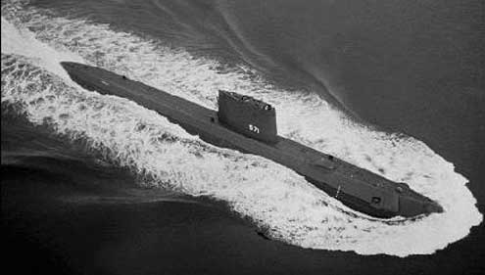
Nuclear Fusion
Fusion is what happens when two atomic nuclei are forced together by high pressure ... high enough to overcome the strong repulsive forces of the respective protons in the nuclei. When the nuclei fuse, they form a new element, and release excess energy in the form of a fast-moving neutron. The energy is 'extra' because the mass of the newly formed nucleus is less than the sum of the masses of the original two nuclei; the extra mass is converted to energy according to Einstein's equation E=mc² This energy can be used to do useful work!
Notes:
Nonrenewable energies come from combustion of coal, oil, and natural gas. Their creation took millions of years, and we are using it faster than it was produced and faster than it is being created.
Renewable energies come from the sun. Collection is from natural occurrences. While the energy is free, it costs money to collect it.
Nuclear and geothermal energies aren’t renewable but are treated that way since the quantity is so large.

Slide 27
Nuclear Fusion

Slide 29
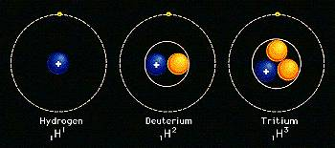
Nuclear Fusion
The nuclei used by the sun, and in experiments on earth, that undergo fusion, are two isotopes of hydrogen called deuterium and tritium.

Slide 30
Nuclear Fusion
The first generation fusion reactors will use deuterium and tritium for fuel because they will fuse at a lower temperature. Deuterium can be easily extracted from seawater, where 1 in 6500 hydrogen atoms is deuterium.
Tritium can be bred from lithium, which is abundant in the earth's crust.
090129

Slide 31
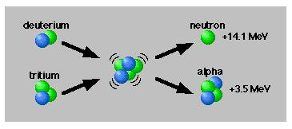
Nuclear Fusion
In the fusion reaction a deuterium and tritium atom combine together, or fuse, to form an atom of helium and an energetic neutron. It only takes a small amount of these isotopes to produce a lot of energy!
both the extra neutron and the new helium nucleus (called an alpha particle)

Slide 32
Nuclear Fusion
Fusion fuel is very energy dense. A thimbleful of liquid heavy-hydrogen fuel could produce as much energy as 20 tons of coal. Or, more realistically, one pick-up truck full of deuterium would release the energy equivalent of approximately 2 million tons of coal (21,000 rail car loads), or 1.3 million tons of oil (10 million barrels), or 30 tons of Uranium Oxide (1 rail car load). Clearly, with seawater as our energy source, our energy problems would be over forever!

Slide 33
controlled Nuclear Fusion
In order for fusion reactions to occur, the particles must be hot enough (temperature), in sufficient number (density) and well contained (confinement time). These simultaneous conditions are represented by a fourth state of matter known as plasma. In a plasma, electrons are stripped from their nuclei. A plasma, therefore, consists of charged particles, ions and electrons. There are two ways that are being explored for confining these hot plasmas - magnetic and inertial.

Slide 34
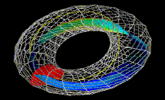
Magnetic Confinement
Efforts to control fusion first relied on the principle of magnetic confinement, in which apowerful magnetic field traps a hot deuterium-tritium plasma long enough for fusion to begin.
In November 1997, researchers exploiting the magnetic confinement approach created a fusion reaction that produced 65 percent as much energy as was fed into it to initiate the reaction.

Slide 35
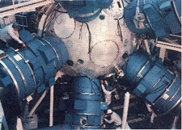
Inertial Confinement
Inertial confinement makes use of intense laser or electron beams to implode a fuel pellet. The pellet of deuterium/tritium fuel - a peppercorn-size fuel pellet - must be bombarded by two million joules, delivered in 4 nanoseconds.

Slide 36
Inertial Confinement
Here's how it's supposed to work?
Many pulsed laser beams hit the fuel pellet simultaneously, causing the surface of the pellet to become a very hot plasma.
This plasma expands inward, compressing the remaining deuterium and tritium so much that its temperature rises to the required 100,000,000 degrees. For about one tenth of a billionth of a second.

Slide 37
Inertial Confinement

Slide 38
Why Will Fusion Power Be Important?
By the middle of the next century, the world's population will double, and energy demand will tripled.
This will be due in large part to the industrialization and economic growth of developing nations.
Continued use of fossil fuels (coal, oil and natural gas) will rapidly deplete these limited and localized natural resources.

Slide 39
Why Will Fusion Power Be Important?
There is, perhaps, another 50-100 years supply of oil and natural gas, and enough coal for several hundred years. Burning these fossil fuels threatens to irreparably harm our environment.
On the other hand, the deuterium in the earth's oceans is sufficient to fuel advanced fusion reactors for millions of years. The waste product from a deuterium-tritium fusion reactor isordinary harmless helium.

Slide 40
At The End
Nuclear fusion indeed looks like it may be the power source of the future!

Slide 41
The Fusion Process
2
H
1
3
H
1

Slide 42
The Fusion Process
2
H
1
3
H
1

Slide 43
The Fusion Process
2
H
1
3
H
1

Slide 44
The Fusion Process
2
H
1
3
H
1

Slide 45
The Fusion Process

Slide 46
The Fusion Process

Slide 47
The Fusion Process

Slide 48
The Fusion Process

Slide 49
The Fusion Process
1
n
0
4
He
2
ENERGY

Slide 50
The Fusion Process
1
n
0
4
He
2
ENERGY

Slide 51
The Fusion Process
1
n
0
4
He
2
ENERGY

Slide 52
The Fusion Process
1
n
0
4
He
2
ENERGY

Slide 53
Nuclear Energy Applications
Electricity Generation
Medical diagnosis and treatment
Hydrogen production
Food
Industrial & manufacturing
Desalination of seawater

Slide 54
Nuclear Drivers
Population growth in developing countries
Economic growth
Technology change
Climate change
Carbon issues
Challenge of energy gap
Energy security
Clean air

Slide 55
Why Don’t We All Use It?
Mainly, people are afraid of the possibility of a nuclear meltdown. However, there is a slim to none chance that a meltdown will occur in America.
Next, is the problem of nuclear waste. This problem however, can be solved with enough research.
Lastly, nuclear plants are costly to produce. The government has been largely ineffective in operating these and private corporations are the only entities able to maintain these facilities, as will they always be.

Slide 57
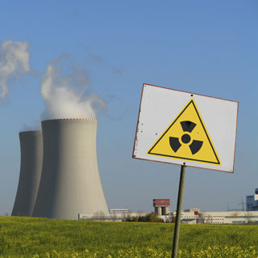
Nuclear energy - good and bad
Good:
Cheap energy.
It doesn’t let out any harmful things to the environment.
One reactor produces much electricity.
Bad:
There’s a risk that an accident can happen, for example a meltdown.
The plant is expensive.
The waste can be much radioactive and it takes long time before it gets risk-free, up to more than 100 000 years.

Slide 58
Chernobyl
Chernobyl had the RBMK design. In an experiment, technicians let the power of reactor 4 fall, and on April 26,1986 the result was rapid power levels rising inside the core— melting fuel and causing a reactor containment breach—in addition to an internal hydrogen explosion. The top of the reactor blew off and spewed radioactive material into the atmosphere for 10 days.

Slide 59
Uranium
Uranium is usually mined similarly to other heavy metals—under ground or in open pits—but other methods can also be used. After the uranium is mined it is milled near the excavation site using leaching processes. The mining process explained here is a combination of two of major mines in Australia. Then we will look at the Navajo uranium miners who were some of the first uranium miners. Next I will explain some of the other community and environmental impacts associated with the mining processes.

Slide 60
Mining
Uranium ore is usually located aerially; core samples are then drilled and analyzed by geologists. The uranium ore is extracted by means of drilling and blasting. Mines can be in either open pits or underground. Uranium concentrations are a small percentage of the rock that is mined, so tons of tailings waste are generated by the mining process.

Slide 61
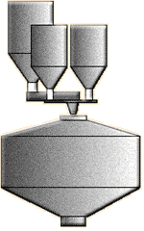
Milling & Leaching:
The ore is first crushed into smaller bits, then it is sent through a ball mill where it is crushed into a fine powder. The fine ore is mixed with water, thickened, and then put into leaching tanks where 90% of the uranium ore is leached out with sulfuric acid. Next the uranium ore is separated from the depleted ore in a multistage washing system. The depleted ore is then neutralized with lime and put into a tailings repository.

Slide 62
Transportation
In the final processes the yellow cake is heated to 800˚Celcius which makes a dark green powder which is 98% U3O8. The dark green powder is put into 200 liter drums and loaded into shipping containers and are shipped overseas to fuel nuclear power plants.

Slide 63
Electricity Consumption
1-3) power is generated or imported. 4) high voltage power lines make up the “grid” that connects power generators and neighborhood substations. 5) substation steps down the power and connects to the distribution system. 6) the distribution systems link to most customers.

Slide 64
Community Impacts
116,000 people were evacuated from 1990 to 1995 and 210,000 were resettled. Major infrastructure had to be rebuilt. There was also a shortage of electricity. Agricultural activities had to be reduced, which lead to a reduction in income.

Slide 65
Environmental Impacts
Radioactive fall out spread throughout the Ukraine and Europe, and eventually the whole northern hemisphere. In the local ecosystem (10 km radius) coniferous tress and small mammals died. The natural environment is recovering but there may be long-term genetic effects.

Slide 66
Impacts
Radioactive waste is highly dangerous to humans and the environment. Because the waste will remain radioactive for so long, it will remain to be a threat for thousands of years.

