Slide 1
An-Najah National University
Faculty of Medicine
Department of Physiology
Anatomy and Physiology 1
7102101
Instructor: Heba Salah
Chapter 2:
Cells and Tissues
Part 2: Anatomy of the Generalized Cell: The Cytoplasm

Slide 2
The Cytoplasm
Material outside the nucleus and inside the plasma membrane
The elements of cytoplasm:
1. Cytosol
Fluid that suspends other elements
2. Organelles
Metabolic machinery of the cell
3. Inclusions
Non-functioning units

Slide 3
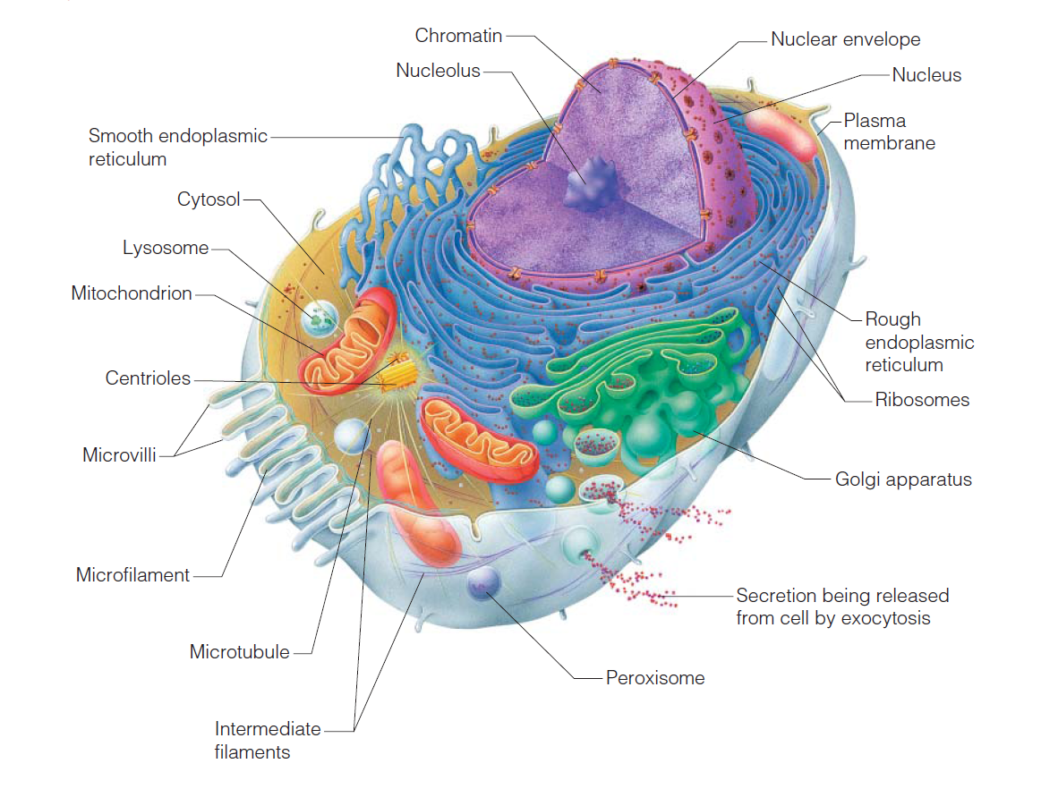
Cytoplasm Organelles

Slide 4
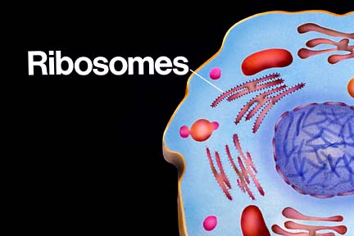
Cytoplasm Organelles
Ribosomes:
Made of protein and RNA
Sites of protein synthesis
Found at two locations
Free in the cytoplasm
Attached to rough endoplasmic reticulum

Slide 5
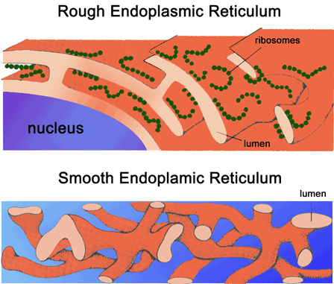
Cytoplasm Organelles
Endoplasmic reticulum (ER):
Fluid-filled tubules for carrying substances
Two types of ER:
1. Rough Endoplasmic Reticulum
2. Smooth Endoplasmic Reticulum

Slide 6
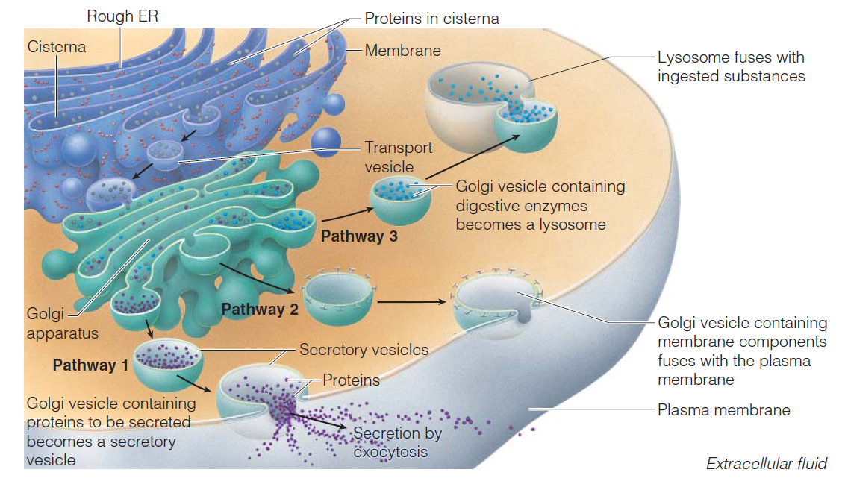
Cytoplasm Organelles
Golgi apparatus
Modifies and packages proteins

Slide 7
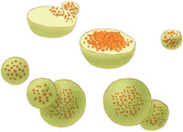
Cytoplasm Organelles
Lysosomes:
Contain enzymes that digest nonusable materials within the cell
Peroxisomes
Membranous sacs of oxidase enzymes
Replicate by pinching in half

Slide 8
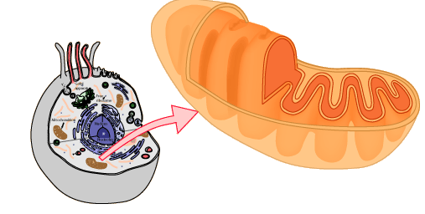
Cytoplasm Organelles
Mitochondria:
“Powerhouses” of the cell
Change shape continuously
Carry out reactions where oxygen is used to break down food
Provides ATP for cellular energy

Slide 9
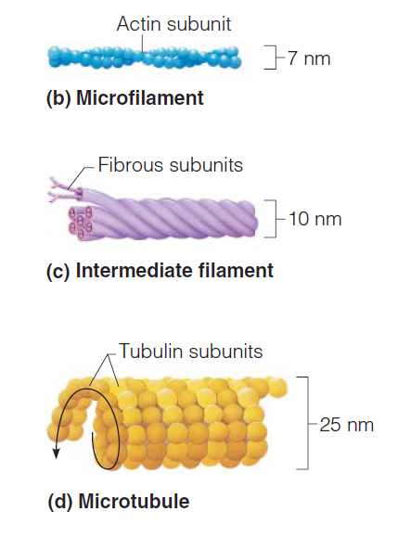
Cytoplasm Organelles
Cytoskeleton:
Three different types
1. Microfilaments
2. Intermediate filaments
3. Microtubules

Slide 10
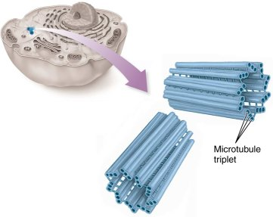
Cytoplasm Organelles
Centrioles:
Rod-shaped bodies made of microtubules
Direct formation of mitotic spindle during cell division

Slide 11
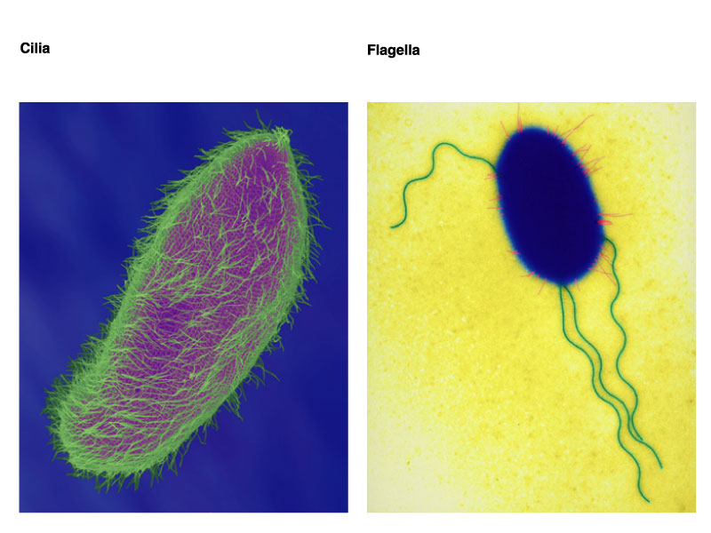
Cellular Projections
Not found in all cells
Used for movement
Cilia moves materials across the cell surface
Flagellum propels the cell

