Slide 1
Financial Accounting
IFRS 4th Edition
Weygandt ● Kimmel ● Kieso
Chapter 5
Accounting for Merchandise Operations

Slide 2
Chapter Outline
Learning Objectives
LO 1 Describe merchandising operations and inventory systems.
LO 2 Record purchases under a perpetual inventory system.
LO 3 Record sales under a perpetual inventory system.
LO 4 Apply the steps in the accounting cycle to a merchandising company.
LO 5 Prepare financial statements for a merchandising company.

Slide 3
Learning Objective 1 Describe Merchandising Operations and Inventory Systems

Slide 4
Merchandising Operations and Inventory Systems
Merchandising Companies
Buy and Sell Goods
Retailer
Wholesaler
Consumer
The primary source of revenues is referred to as sales revenue or sales.

Slide 5
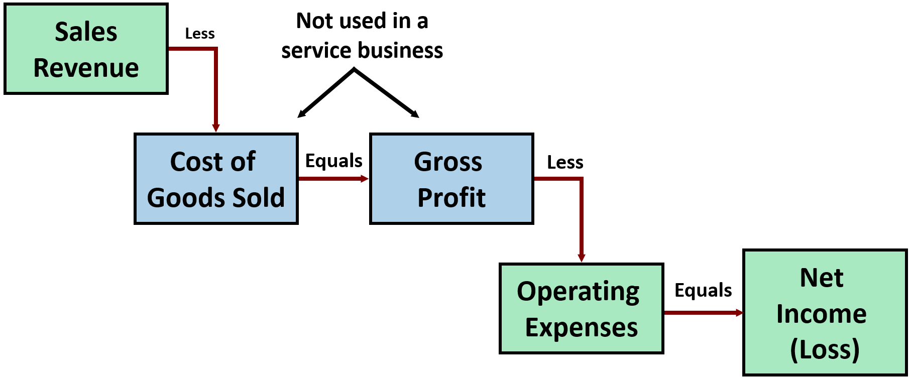
Merchandising Company
Income Measurement
Cost of goods sold is the total cost of merchandise sold during the period.

Slide 6
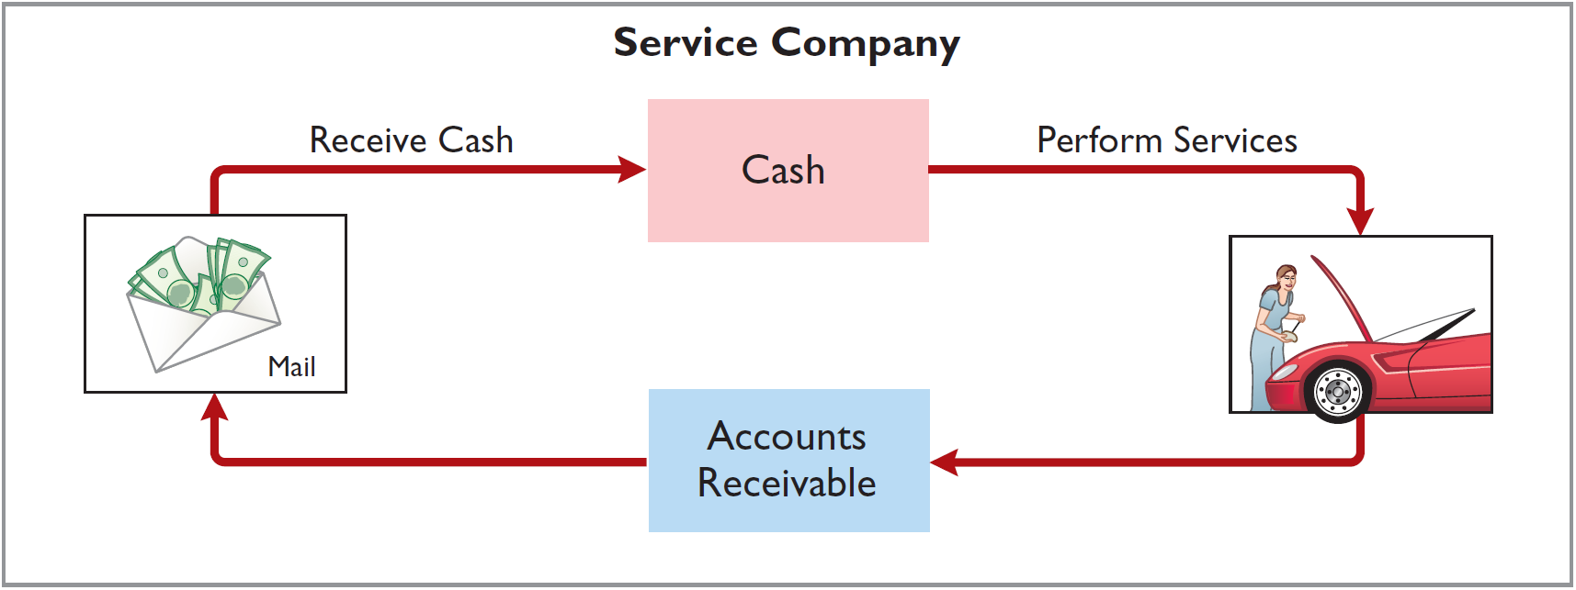
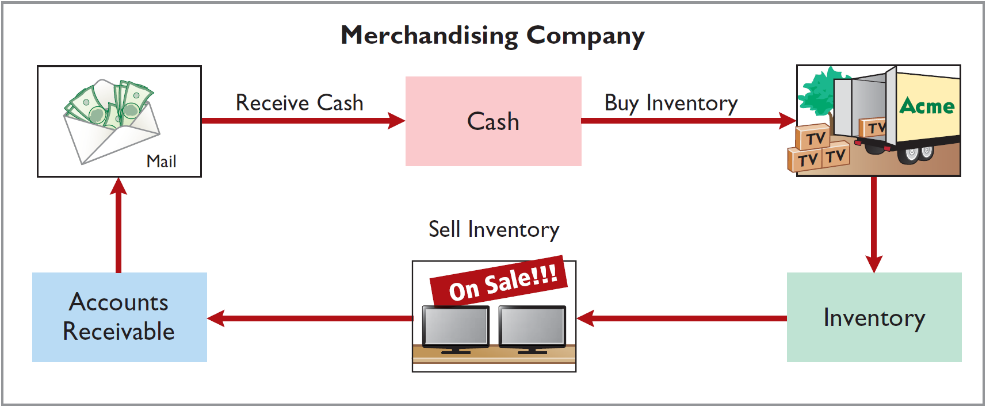
Operating Cycles

Slide 7
Flow of Costs (1 of 4)
Companies use either a perpetual inventory system or a periodic inventory system to account for inventory.

Slide 8
Flow of Costs (2 of 4)
Perpetual System
Maintain detailed records of the cost of each inventory purchase and sale
Records continuously show inventory that should be on hand for every item
Company determines cost of goods sold each time a sale occurs

Slide 9
Flow of Costs (3 of 4)
Periodic System
Does not keep detailed records of goods on hand
Cost of goods sold determined by count
Calculation of Cost of Goods Sold:
Beginning inventory | €100,000
Add: Purchases, net | 800,000
Goods available for sale | 900,000
Less: Ending inventory | 125,000
Cost of goods sold | €775,000

Slide 10
Flow of Costs (4 of 4)
Advantages of the Perpetual System
Traditionally used for merchandise with high unit values
Shows quantity and cost of inventory that should be on hand at any time
Provides better control over inventories than a periodic system

Slide 11
Do It! 1: Merchandising Operations and Inventory Systems
Indicate whether the following statements are true or false. If false, indicate how to correct the statement.
The primary source of revenue for a merchandising company results from performing services for customers.
False
(service company)
The operating cycle of a service company is usually shorter than that of a merchandising company.
True
Sales revenue less cost of goods sold equals gross profit.
True
Ending inventory plus the cost of goods purchased equals cost of goods available for sale.
False
(Beg. Inventory + COGS)

Slide 12
Learning Objective 2 Record Purchases Under a Perpetual System

Slide 13
Recording Purchases Under a Perpetual Inventory System
Made using cash or credit (on account)
Normally record when goods are received from the seller
Purchase invoice should support each credit purchase

Slide 14
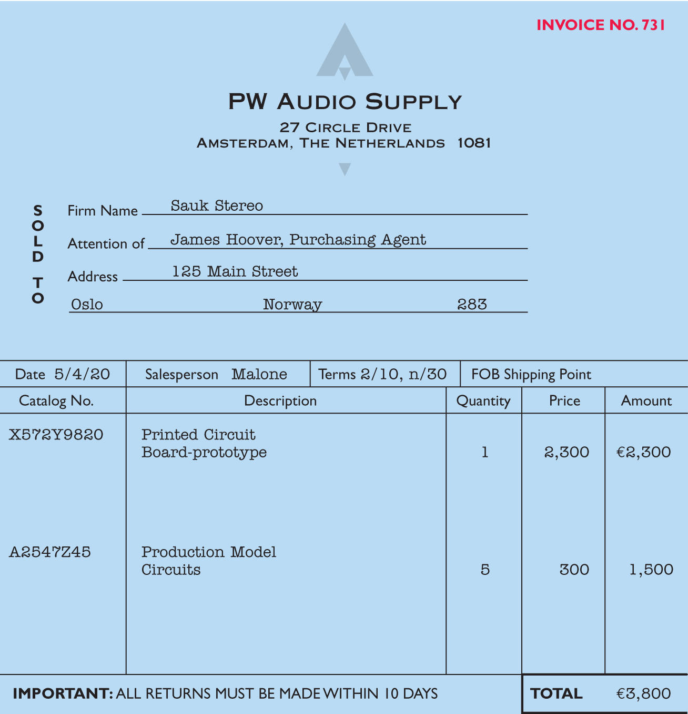
Recording Purchases
Purchase invoice should support each credit purchase

Slide 15
Record Purchase of Merchandise
Illustration: Sauk Stereo (the buyer) uses as a purchase invoice the sales invoice prepared by PW Audio Supply, Inc. (the seller). Prepare the journal entry for Sauk Stereo for the invoice from PW Audio Supply.
May 4
Inventory
3,800
Accounts Payable
3,800

Slide 16
Freight Costs (1 of 2)
Ownership of the goods passes to the buyer when the public carrier accepts the goods from the seller.
Ownership of the goods remains with the seller until the goods reach the buyer.
Freight costs incurred by the seller are an operating expense.

Slide 17
Freight Costs (2 of 2)
Illustration: Assume upon delivery of the goods on May 6, Sauk Stereo pays Public Freight Company €150 for freight charges, the entry on Sauk Stereo’s books is:
May 6
Inventory
150
Cash
150
Assume the freight terms on the invoice on slide number 13 had required PW Audio Supply to pay the freight charges, the entry by PW Audio Supply would be:
May 4
Freight-Out (or Delivery Expense)
150
Cash
150

Slide 18
Purchase Returns and Allowances (1 of 4)
Purchaser may be dissatisfied because goods are damaged or defective, of inferior quality, or do not meet specifications.
Purchase Return
Return goods for credit if the sale was made on credit, or for a cash refund if the purchase was for cash.
Purchase Allowance
May choose to keep the merchandise if the seller will grant a reduction of the purchase price.

Slide 19
Purchase Returns and Allowances (2 of 4)
Illustration: Assume Sauk Stereo returned goods costing €300 to PW Audio Supply on May 8.
May 8
Accounts Payable
300
Inventory
300

Slide 20
Purchase Returns and Allowances (3 of 4)
Review Question
In a perpetual inventory system, a return of defective merchandise by a purchaser is recorded by crediting:
a. Purchases
b. Purchase Returns
c. Purchase Allowance
d. Inventory

Slide 21
Purchase Returns and Allowances (4 of 4)
Review Question
In a perpetual inventory system, a return of defective merchandise by a purchaser is recorded by crediting:
a. Purchases
b. Purchase Returns
c. Purchase Allowance
d. Inventory

Slide 22
Purchase Discounts (1 of 5)
Credit terms may permit buyer to claim a cash discount for prompt payment.
Advantages:
Purchaser saves money
Seller shortens the operating cycle by converting the accounts receivable into cash earlier
Example: Credit terms may read 2/10, n/30.

Slide 23
Purchase Discounts (2 of 5)
2/10, n/30
2% discount if paid within 10 days, otherwise net amount due within 30 days.
1/10 EOM
1% discount if paid within first 10 days of next month.
n/10 EOM
Net amount due within the first 10 days of the next month.

Slide 24
Purchase Discounts (3 of 5)
Illustration: Assume Sauk Stereo pays the balance due of €3,500 (gross invoice price of €3,800 less purchase returns and allowances of €300) on May 14, the last day of the discount period. Prepare the journal entry Sauk Stereo makes on May 14 to record the payment.
May 14
Accounts Payable
3,500
Inventory
70
Cash
3,430
(Discount = €3,500 × 2% = €70)

Slide 25
Purchase Discounts (4 of 5)
Illustration: If Sauk Stereo failed to take the discount, and instead made full payment of €3,500 on June 3, the journal entry would be:
June 3
Accounts Payable
3,500
Cash
3,500

Slide 26
Purchase Discounts (5 of 5)
Should discounts be taken when offered?
Discount of 2% on €3,500 | €70.00*
€3,500 invested at 10% for 20 days | 19.18
Savings by taking the discount | €50.82
Example:
2% for 20 days = Annual rate of 36.5% (2% × 365/20)
*(€3,500 × 36.5% × 20) ÷ 365 = €70

Slide 27
Summary of Purchasing Transactions
 |  | Inventory
Purchase | May 4 | 3,800 | May 8 | 300 | Purchase return
Freight-in | 6 | 150 | 14 | 70 | Purchase discount
Balance |  | 3,580

Slide 28
Do It! 2: Purchase Transactions
On September 5, Zhū Company buys merchandise on account from Gāo Company. The purchase price of the goods paid by Zhū is ¥15,000, and the cost to Gāo Company was ¥8,000. On September 8, Zhū returns defective goods with a selling price of ¥2,000. Record the transactions on the books of Zhū Company.
Sept. 5
Inventory
15,000
Accounts Payable
15,000
Sept. 8
Accounts Payable
2,000
Inventory
2,000

Slide 29
Learning Objective 3 Record Sales Under a Perpetual System

Slide 30
Recording Sales Under a Perpetual Inventory System
Sales may be made on credit or for cash
Sales revenue, like service revenue, is recorded when the performance obligation is satisfied
Performance obligation is satisfied when goods are transferred from seller to buyer
Sales invoice should support each credit sale

Slide 31
Sales invoice should support each credit sale

Slide 32
Recording Sales (1 of 2)
Journal Entries to Record a Sale
#1
Accounts Receivable XXX
Selling Price
Sales Revenue XXX
#2
Cost of Goods Sold XXX
Cost
Inventory XXX

Slide 33
Recording Sales (2 of 2)
Illustration: PW Audio Supply records the sale of €3,800 on May 4 to Sauk Stereo on account as follows (assume the merchandise cost PW Audio Supply €2,400).
May 4
Accounts Receivable
3,800
Sales Revenue
3,800
May 4
Cost of Goods Sold
2,400
Inventory
2,400

Slide 34
Sales Returns and Allowances (1 of 5)
“Flip side” of purchase returns and allowances
Contra revenue account to Sales Revenue (debit)
Sales not reduced (debited) because:
Would obscure importance of sales returns and allowances as a percentage of sales
Could distort comparisons

Slide 35
Sales Returns and Allowances (2 of 5)
Illustration: Prepare the entry PW Audio Supply would make to record the credit for returned goods that had a €300 selling price (assume a €140 cost). Assume the goods were not defective.
May 8
Sales Returns and Allowance
300
Accounts Receivable
300
May 8
Inventory
140
Cost of Goods Sold
140

Slide 36
Sales Returns and Allowances (3 of 5)
Illustration: Assume the returned goods were defective and had a scrap value of €50, PW Audio would make the following entries:
May 8
Sales Returns and Allowance
300
Accounts Receivable
300
May 8
Inventory
50
Cost of Goods Sold
50

Slide 37
Sales Returns and Allowances (4 of 5)
Review Question
The cost of goods sold is determined and recorded each time a sale occurs in:
a. periodic inventory system only.
b. a perpetual inventory system only.
c. both a periodic and perpetual inventory system.
d. neither a periodic nor perpetual inventory system.

Slide 38
Sales Returns and Allowances (5 of 5)
Review Question
The cost of goods sold is determined and recorded each time a sale occurs in:
a. periodic inventory system only.
b. a perpetual inventory system only.
c. both a periodic and perpetual inventory system.
d. neither a periodic nor perpetual inventory system.

Slide 39
Sales Discounts
Offered to customers to promote prompt payment of balance due
Contra-revenue account (debit) to Sales Revenue
Sales Revenue |  |  | Sales Returns and Allowances |  |  | Sales Discounts
 | 3,800 |  | 300 |  |  | 70
 |  |  | Net Sales €3,430

Slide 40
Sales Discounts (2 of 2)
Illustration: Assume Sauk Stereo pays the balance due of €3,500 (gross invoice price of €3,800 less purchase returns and allowances of €300) on May 14, the last day of the discount period. Prepare the journal entry PW Audio Supply makes to record the receipt on May 14.
May 14
Cash
3,430
Sales Discounts
70*
Accounts Receivable
3,500
*[(€3,800 − €300) × 2%]

Slide 41
Do It! 3: Sales Transactions (1 of 2)
On September 5, Zhū Company buys merchandise on account from Gāo Company. The selling price of the goods is ¥15,000, and the cost to Gāo Company was ¥8,000. On September 8, Zhū returns defective goods with a selling price of ¥2,000 and a fair value of ¥300. Record the transactions on the books of Gāo Company.
Sept. 5
Accounts Receivable
15,000
Sales Revenue
15,000
Sept. 5
Cost of Goods Sold
8,000
Inventory
8,000

Slide 42
Do It! 3: Sales Transactions (2 of 2)
On September 5, Zhū Company buys merchandise on account from Gāo Company. The selling price of the goods is ¥15,000, and the cost to Gāo Company was ¥8,000. On September 8, Zhū returns defective goods with a selling price of ¥2,000 and a fair value of ¥300. Record the transactions on the books of Gāo Company.
Sept. 8
Sales Returns and Allowances
2,000
Accounts Receivable
2,000
Sept. 8
Inventory
300
Cost of Goods Sold
300

Slide 43
Learning Objective 4 Apply the Steps in the Accounting Cycle to a Merchandising Company

Slide 44
The Accounting Cycle for a Merchandising Company
Adjusting Entries
Generally same as a service company
One additional adjustment to make records agree with actual inventory on hand
Involves adjusting Inventory and Cost of Goods Sold

Slide 45
Adjusting Entries
Illustration: Suppose that PW Audio Supply has an unadjusted balance of €40,500 in Inventory. Through a physical count, PW Audio Supply determines that its actual merchandise inventory at December 31 is €40,000. The company would make an adjusting entry as follows.
Dec. 31
Cost of Goods Sold
500
Inventory (€40,500 − €40,000)
500

Slide 46
Closing Entries
Dec. 31 | Service Revenue | 480,000
 | Income Summary |  | 480,000
 | (Close credit balance accounts)
31 | Income Summary | 450,000
 | Cost of Goods Sold |  | 316,000
 | Salaries and Wages Expense |  | 64,000
 | Utilities Expense |  | 17,000
 | Advertising Expense |  | 16,000
 | Sales Returns and Allowances |  | 12,000
 | Sales Discounts |  | 8,000
 | Depreciation Expense |  | 8,000
 | Freight-Out |  | 7,000
 | Insurance Expense |  | 2,000
 | (Close debit balance accounts)

Slide 47
Closing Entries
Dec. 31 | Income Summary | 30,000
 | Retained Earnings |  | 30,000
 | (To close net income to retained earnings)
31 | Retained Earnings | 15,000
 | Dividends |  | 15,000
 | (To close dividends to retained earnings)

Slide 48
DO IT! 4: Closing Entries (1 of 2)
The trial balance of Celine’s Sports Wear Shop at December 31 shows Inventory €25,000, Sales Revenue €162,400, Sales Returns and Allowances €4,800, Sales Discounts €3,600, Cost of Goods Sold €110,000, Rent Revenue €6,000, Freight-Out €1,800, Rent Expense €8,800, and Salaries and Wages Expense €22,000. Prepare the closing entries for the above accounts.
Dec. 31
Sales Revenue
162,400
Rent Revenue
6,000
Income Summary
168,400

Slide 49
DO IT! 4: Closing Entries (2 of 2)
Prepare the closing entries for the above accounts.
Dec. 31
Income Summary
151,000
Cost of Goods Sold
110,000
Sales Returns and Allowances
4,800
Sales Discounts
3,600
Freight-Out
1,800
Rent Expense
8,800
Salaries and Wages Expense
22,000

Slide 50
Learning Objective 5 Prepare Financial Statements for a Merchandising Company

Slide 51
Income Statement (1 of 7)
Primary source of information for evaluating a company’s performance
Format is designed to differentiate between various sources of income and expense

Slide 52
Income Statement (2 of 7)
Income Statement Presentation of Sales
PW Audio Supply Income Statement (partial) For the Year Ended December 31, 2020
Sales
Sale revenue |  | €480,000
Less: Sales returns and allowances | €12,000
Sales discounts | 8,000 | 20,000
Net sales |  | €460,000

Slide 53
Income Statement (3 of 7)
Gross Profit
On the basis of the sales data for PW Audio Supply (net sales of €460,000) and cost of goods sold under the perpetual inventory system (assume €316,000), PW Audio Supply’s gross profit is €144,000, computed as shown.
Net Sales | €460,000
Cost of goods sold | 316,000
Gross profit | €144,000

Slide 54
Income Statement (4 of 7)
Gross Profit
We also can express a company’s gross profit as a percentage, called the gross profit rate.
Gross Profit | ÷ | Net Sales | = | Gross Profit Rate
€144,000 | ÷ | €460,000 | = | 31.3%
Analysts generally consider the gross profit rate to be more useful than the gross profit amount.

Slide 55
Income Statement (5 of 7)
Operating Expenses
Incurred in the process of earning sales revenue. Operating expense for PW Audio Supply include the following.
Operating expenses
Salaries and wages expense | € 64,000
Utilities expense | 17,000
Advertising expense | 16,000
Depreciation expense | 8,000
Freight-out | 7,000
Insurance expense | 2,000
Total operating expenses | €114,000

Slide 56
Income Statement (6 of 7)
Other Income and Expense
Various revenues and gains and expenses and losses that are unrelated to the company’s main line of operations.
Other Income
Interest revenue from notes receivable and marketable securities
Dividend revenue from investments in capital stock
Rent revenue from subleasing a portion of the store
Gain from the sale of property, plant, and equipment

Slide 57
Operating Income and Expense
Other Expense
Casualty losses from such causes as vandalism and accidents
Loss from sale or abandonment of property, plant, and equipment
Loss from strikes by employees and suppliers
Interest expense, if material, must be disclosed on the face of the income statement.

Slide 58
Income Statement (7 of 7)
PW Audio Supply Income Statement For the Year Ended December 31, 2020
Sales
Service revenue |  |  | €480,000
Less: Sales returns and allowances | €12,000
Sales discounts | 8,000 |  | 20,000
Net sales |  |  | 460,000
Cost of goods sold |  |  | 316,000
Gross profit |  |  | 144,000
Operating expenses
Salaries and wages expense | 64,000
Utilities expense | 17,000
Advertising expense | 16,000
Depreciation expense | 8,000
Freight-out | 7,000
Insurance expense | 2,000
Total operating expenses |  |  | 114,000
Income from operations |  |  | 30,000
Other income and expense
Interest revenue | 3,000
Gain on disposal of plant assets | 600
Casualty loss from vandalism | 200 |  | 3,400
Interest expense |  |  | 1,800
Net income |  |  | € 31,600
Key Items:
Sales
Gross Profit
Operating Expenses
Other Income and Expense
Net Income

Slide 59
Comprehensive Income Statement
Presents items not included in the determination of net income.
Items included in comprehensive income are either reported in a combined statement of net income and comprehensive income, or in a separate comprehensive income statement.
PW Audio Supply Comprehensive Income Statement For the Year Ended December 31, 2020
Net income
Other comprehensive income | €31,600
Unrealized holding gain on investment securities | 2,300
Comprehensive income | €33,900

Slide 60
Classified Statement of Financial Position
PW Audio Supply Statement of Financial Position (Partial) December 31, 2020
Assets
Property, plant, and equipment
Equipment | €80,000
Less: Accumulated depreciation | 24,000 |  | € 56,000
Current assets
Prepaid insurance | 1,800
Inventory | 40,000
Accounts receivable | 16,100
Cash | 9,500 |  | 67,400
Total assets |  |  | €123,400

Slide 61
DO IT! 5: Financial Statement Classification (2 of 3)
Indicate in which financial statement and under what classification each of the following would be reported.
Financial Statement
Account
Classification
Accounts payable
SFP
Current liabilities
Accounts receivable
SFP
Current assets
Accumulated Depreciation-Buildings
SFP
Property, plant, and equipment
Accumulated Depreciation-Equipment
SFP
Property, plant, and equipment
Advertising Expense
IS
Operating expenses
Buildings
SFP
Property, plant, and equipment
Cash
SFP
Current assets
Depreciation Expense
IS
Operating expenses
Dividends
RES
Deduction section

Slide 62
DO IT! 5: Financial Statement Classification (2 of 3)
Indicate in which financial statement and under what classification each of the following would be reported.
Financial Statement
Account
Classification
Equipment
SFP
Property, plant, and equipment
Freight-Out
IS
Operating expenses
Gain on Disposal of Plant Assets
IS
Other income and expense
Insurance Expense
IS
Operating expenses
Interest Expense
IS
Interest expense
Interest Payable
SFP
Current liabilities
Inventory
SFP
Current assets
Land
SFP
Property, plant, and equipment
Notes Payable (due in 3 years)
SFP
Non-current liabilities

Slide 63
DO IT! 5: Financial Statement Classification (3 of 3)
Indicate in which financial statement and under what classification each of the following would be reported.
Financial Statement
Account
Classification
Property Taxes Payable
SFP
Current liabilities
Salaries and Wages Expense
IS
Operating expenses
Salaries and Wages Payable
SFP
Current liabilities
Sales Returns and Allowances
IS
Sales
Sales Revenue
IS
Sales
Share Capital—Ordinary
SFP
Equity
Utilities Expense
IS
Operating expenses

Slide 64
Learning Objective 6 Prepare a Worksheet for a Merchandising Company

Slide 65
Appendix 5A Worksheet for a Merchandising Company
As indicated in Chapter 4, a worksheet enables companies to prepare financial statements before they journalize and post adjusting entries. The steps in preparing a worksheet for a merchandising company are the same as for a service company. The following Illustration shows the worksheet for PW Audio Supply (excluding non-operating items). The unique accounts for a merchandiser using a perpetual inventory system are in red.

Slide 66
PW Audio Supply Worksheet For the Year Ended December 31, 2020
 | Trial Balance |  | Adjustments |  | Adjusted Trial Balance |  | Income Statement |  | Statement of Financial Position
Account Titles | Dr. | Cr. | Dr. | Cr. | Dr. | Cr. | Dr. | Cr. | Dr. | Cr.
Cash | 9,500 |  |  |  | 9,500 |  |  |  | 9,500
Accounts Receivable | 16,000 |  |  |  | 1,6100 |  |  |  | 1,6100
Inventory | 40,500 |  |  | 500 | 40,000 |  |  |  | 40,000
Prepaid Insurance | 3,800 |  |  | (b) 2,000 | 1,800 |  |  |  | 1,800
Equipment | 80,000 |  |  |  | 80,000 |  |  |  | 80,000
Accumulated Depreciation |  | 16,000 |  | (c) 8,000 |  | 24,000 |  |  |  | 24,000
Accounts Payable |  | 20,400 |  |  |  | 20,400 |  |  |  | 20,400
Share Capital-Ordinary |  | 50,000 |  |  |  | 50,000 |  |  |  | 50,000
Retained Earnings |  | 33,000 |  |  |  | 33,000 |  |  |  | 33,000
Dividends | 15,000 |  |  |  | 15,000 |  |  |  | 15,000
Service Revenue |  | 480,000 |  |  |  | 480,000 |  | 480,000
Sales Returns and Allow. | 12,000 |  |  |  | 12,000 |  | 12,000
Sales Discounts | 8,000 |  |  |  | 8,000 |  | 8,000
Cost of Goods Sold | 315,500 |  | 500 |  | 316,000 |  | 316,000
Freight-Out | 7,000 |  |  |  | 7,000 |  | 7,000
Advertising Expense | 16,000 |  |  |  | 16,000 |  | 16,000
Salaries and Wages Expense | 59,000 |  | (d) 5,000 |  | 64,000 |  | 64,000
Utilities Expense | 17,000 |  |  |  | 17,000 |  | 17,000
Totals | 599,400 | 599,400
Insurance Expense |  |  | (b) 2,000 |  | 2,000 |  | 2,000
Depreciation Expense |  |  | (c) 8,000 |  | 8,000 |  | 8,000
Salaries and Wages Payable |  |  |  | (d) 5,000 |  | 5,000 |  |  |  | 5,000
Totals |  |  | 15,500 | 15,500 | 612,400 | 612,400 | 450,000 | 450,000 | 162,400 | 132,400
Net Income |  |  |  |  |  |  | 30,000 |  |  | 30,000
Totals |  |  |  |  |  |  | 480,000 | 480,000 | 162,400 | 162,400

Slide 67
Learning Objective 7 Record Purchases and Sales of Inventory Under a Periodic Inventory System

Slide 68
Appendix 5B Periodic Inventory System
Determining Cost of Goods Sold Under a Periodic Inventory System
No running account of changes in inventory
Ending inventory determined by physical count
Cost of goods sold not determined until the end of the period

Slide 69
Periodic Inventory System
PW Audio Supply Cost of Goods Sold For the Year Ended December 31, 2020
Cost of goods sold
Inventory, January 1 |  |  | € 36,000
Purchases |  | €325,000
Less: Purchase returns and allowances | €10,400
Purchase discounts | 6,800 | 17,200
Net purchases |  | 307,800
Add: Freight-in |  | 12,200
Cost of goods purchased |  |  | 320,000
Cost of goods available for sale |  |  | 356,000
Inventory, December 31 |  |  | 40,000
Cost of goods sold |  |  | €316,000

Slide 70
Recording Merchandise Transactions
Record revenues when sales are made
Do not record cost of merchandise sold on date of sale.
Physical inventory count determines:
Cost of merchandise on hand and
Cost of merchandise sold during the period
Record purchases in Purchases account
Purchase returns and allowances, Purchase discounts, and Freight costs are recorded in separate accounts

Slide 71
Recording Purchase of Merchandise
Illustration: On the basis of the sales invoice (slide 31) and receipt of the merchandise ordered from PW Audio Supply, Sauk Stereo records the €3,800 purchase as follows.
May 4
Purchases
3,800
Accounts Payable
3,800

Slide 72
Freight Costs
Illustration: If Sauk pays Public Freight Company €150 for freight charges on its purchase from PW Audio Supply on May 6, the entry on Sauk’s books is:
May 6
Freight-In (Transportation-In)
150
Cash
150

Slide 73
Purchase Returns and Allowances
Illustration: Sauk Stereo returns €300 of goods to PW Audio Supply and prepares the following entry to recognize the return.
May 8
Accounts Payable
300
Purchase Returns and Allowances
300

Slide 74
Purchase Discounts
Illustration: On May 14 Sauk Stereo pays the balance due on account to PW Audio Supply, taking the 2% cash discount allowed by PW Audio for payment within 10 days. Sauk Stereo records the payment and discount as follows.
May 14
Accounts Payable (€3,800 – €300)
3,500
Purchase Discounts (€3,500 × .02)
70
Cash
3,430

Slide 75
Recording Sales of Merchandise
Illustration: PW Audio Supply, records the sale of €3,800 of merchandise to Sauk Stereo on May 4 (sales invoice No. 731, slide 31) as follows.
May 4
Accounts Receivable
3,800
Sales Revenue
3,800
No entry is recorded for cost of goods sold at the time of the sale under a periodic system.

Slide 76
Sales Returns and Allowances
Illustration: To record the returned goods received from Sauk Stereo on May 8, PW Audio Supply records the €300 sales return as follows.
May 8
Sales Returns and Allowances
300
Accounts Receivable
300

Slide 77
Sales Discounts
Illustration: On May 14, PW Audio Supply receives payment of €3,430 on account from Sauk Stereo. PW Audio honors the 2% cash discount and records the payment of Sauk’s account receivable in full as follows.
May 14
Cash
3,430
Sales Discounts (€3,500 × .02)
70
Accounts Receivable (€3,800 – €300)
3,500

Slide 78
Comparison of Entries—Perpetual vs. Periodic (1 of 2)

Slide 79
Comparison of Entries—Perpetual vs. Periodic (2 of 2)

Slide 80
Closing Entries
All accounts that affect the determination of net income are closed to Income Summary
In journalizing, all debit column amounts are credited, and all credit columns amounts are debited
Beginning inventory balance is debited to Income Summary and credited to Inventory
Ending inventory balance is debited to Inventory and credited to Income Summary

Slide 81
PW Audio Supply Worksheet For the Year Ended December 31, 2020
 | Trial Balance |  | Adjustments |  | Adjusted Trial Balance |  | Income Statement |  | Statement of Financial Position
Account Titles | Dr. | Cr. | Dr. | Cr. | Dr. | Cr. | Dr. | Cr. | Dr. | Cr.
Cash | 9,500 |  |  |  | 9,500 |  |  |  | 9,500
Accounts Receivable | 16,000 |  |  |  | 1,6100 |  |  |  | 1,6100
Inventory | 36,000 |  |  |  | 36,000 |  | 36,000 | 40,000 | 40,000
Prepaid Insurance | 3,800 |  |  | (a) 2,000 | 1,800 |  |  |  | 1,800
Equipment | 80,000 |  |  |  | 80,000 |  |  |  | 80,000
Accumulated Depreciation |  | 16,000 |  | (b) 8,000 |  | 24,000 |  |  |  | 24,000
Accounts Payable |  | 20,400 |  |  |  | 20,400 |  |  |  | 20,400
Share Capital-Ordinary |  | 50,000 |  |  |  | 50,000 |  |  |  | 50,000
Retained Earnings |  | 33,000 |  |  |  | 33,000 |  |  |  | 33,000
Dividends | 15,000 |  |  |  | 15,000 |  |  |  | 15,000
Service Revenue |  | 480,000 |  |  |  | 480,000 |  | 480,000
Sales Returns and Allow. | 12,000 |  |  |  | 12,000 |  | 12,000
Sales Discounts | 8,000 |  |  |  | 8,000 |  | 8,000
Purchases | 325,000 |  |  |  | 325,000 |  | 325,000
Purchase Returns and Allow |  | 10,400 |  |  |  | 10,400 |  | 10,400
Purchase Discounts |  | 6,800 |  |  |  | 6,800 |  | 6,800
Freight-In | 12,200 |  |  |  | 12,200 |  | 12,200
Freight-Out | 7,000 |  |  |  | 7,000 |  | 7,000
Advertising Expense | 16,000 |  |  |  | 16,000 |  | 16,000
Salaries and Wages Expense | 59,000 |  | (c) 5,000 |  | 64,000 |  | 64,000
Utilities Expense | 17,000 |  |  |  | 17,000 |  | 17,000
Totals | 616,600 | 616,600
Insurance Expense |  |  | (a) 2,000 |  | 2,000 |  | 2,000
Depreciation Expense |  |  | (b) 8,000 |  | 8,000 |  | 8,000
Salaries and Wages Payable |  |  |  | (d) 5,000 |  | 5,000 |  |  |  | 5,000
Totals |  |  | 15,500 | 15,500 | 629,600 | 629,600 | 507,200 | 537,200 | 162,400 | 132,400
Net Income |  |  |  |  |  |  | 30,000 |  |  | 30,000
Totals |  |  |  |  |  |  | 537,200 | 537,200 | 162,400 | 162,400

Slide 82
Learning Objective 8 Compare the Accounting for Merchandising Under G A A P and I F R S.

Slide 83
A Look at U.S. GAAP
Key Points
Similarities
Under both GAAP and IFRS, a company can choose to use either a perpetual or periodic inventory systems.
Inventories are defined by IFRS as held-for-sale in the ordinary course of business, in the process of production for such sale, or in the form of materials or supplies to be consumed in the production process or in the performing of services. The definition under GAAP is essentially the same.
Similar to GAAP, comprehensive income under IFRS includes unrealized gains and losses (such as those on non-trading securities) that are not included in the calculation of net income.

Slide 84
A Look at U.S. GAAP
Key Points
Differences
Under GAAP companies generally classify income statement items by function. Classification by function leads to descriptions like administration, distribution (selling), and manufacturing. Under IFRS, companies must classify expenses either by nature or by function. Classification by nature leads to descriptions such as the following: salaries, depreciation expense, and utilities expense. If a company uses the functional-expense method on the income statement, disclosure by nature is required in the notes to the financial statements.

Slide 85
A Look at U.S. GAAP
Key Points
Differences
Presentation of the income statement under GAAP follows either a single-step or multiple-step format. IFRS does not mention a single-step or multiple-step approach.
Under IFRS revaluation of land, buildings, and intangible assets is permitted. The initial gains and losses resulting from this revaluation are reported as adjustments to equity, often referred to as other comprehensive income. The effect of this difference is that the use of IFRS results in more transactions affecting equity (other comprehensive income) but not net income.
IFRS requires that two years of income statement information be presented, whereas GAAP requires three years.

Slide 86
A Look at U.S. GAAP
Looking to the Future
The IASB and FASB are working on a project that would rework the structure of financial statements. Specifically, this project will address the issue of how to classify various items in the income statement. A main goal is to provide information that better represents how businesses are run. In addition, this approach draws attention away from just one number—net income. It will adopt major groupings similar to those currently used by the statement of cash flows (operating, investing, and financing), so that numbers can be more readily traced across statements. For example, the amount of income that is generated by operations would be traceable to the assets and liabilities used to generate the income. This approach would also provide detail, beyond that currently seen in most statements (either GAAP or IFRS), by requiring that line items be presented both by function and by nature. The new financial statement format was heavily influenced by suggestions from financial statement analysts.

Slide 87
Copyright
Copyright © 2019 John Wiley & Sons, Inc.
All rights reserved. Reproduction or translation of this work beyond that permitted in Section 117 of the 1976 United States Act without the express written permission of the copyright owner is unlawful. Request for further information should be addressed to the Permissions Department, John Wiley & Sons, Inc. The purchaser may make back-up copies for his/her own use only and not for distribution or resale. The Publisher assumes no responsibility for errors, omissions, or damages, caused by the use of these programs or from the use of the information contained herein.

