Slide 1
An-Najah National University
Faculty of Medicine
Department of Physiology
Anatomy and Physiology 1
7102101
Instructor: Heba Salah
Chapter 2:
Cells and Tissues
Part 3: Cell Diversity and Membrane Transport

Slide 2
Cell Diversity

Slide 3
Cell Diversity

Slide 4
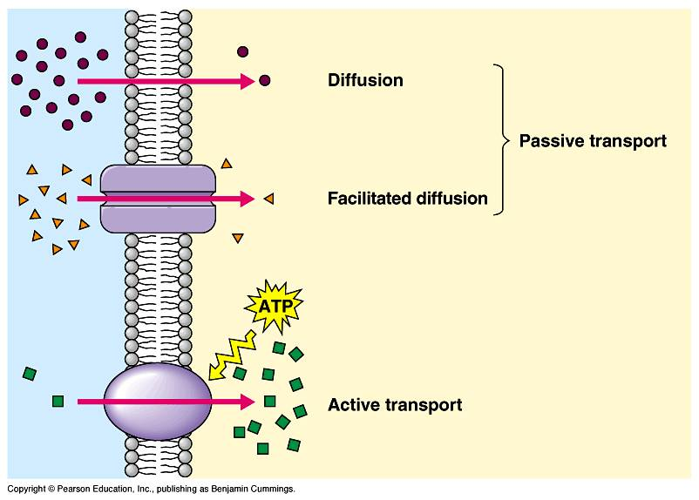
Cellular Physiology:
Membrane Transport
Membrane Transport – movement of substance into and out of the cell, selective permeability
Transport is by two
basic methods:
1. Passive transport
2. Active transport

Slide 5
Solutions and Transport
Solution: homogeneous mixture of two or more components
Solvent – dissolving medium
Solutes – components in smaller quantities within a solution
Intracellular fluid: nucleoplasm and cytosol
Interstitial fluid: fluid on the exterior of the cell

Slide 6
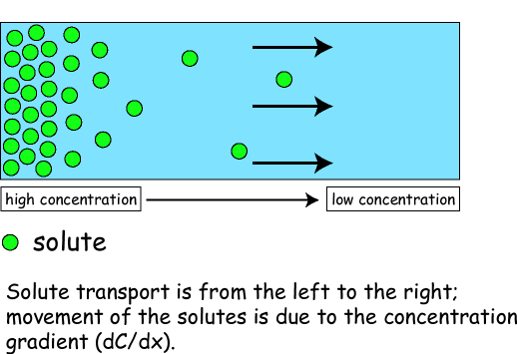
Passive Transport Processes: Diffusion

Slide 7
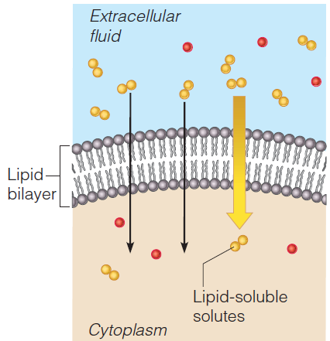
Types of Diffusion: Simple Diffusion

Slide 8
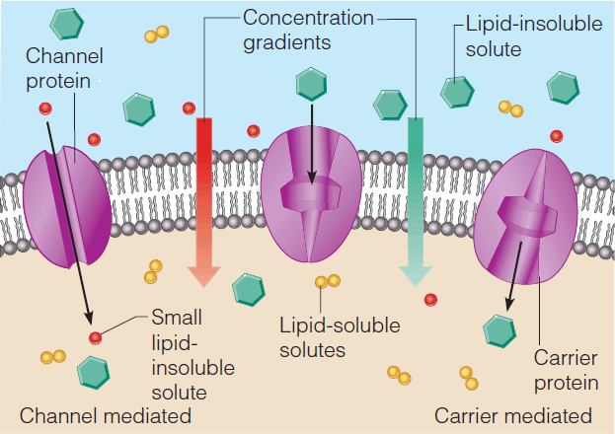
Types of Diffusion: Facilitated Diffusion

Slide 9
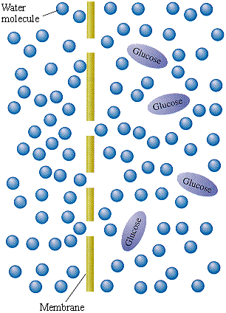
Types of Diffusion: Osmosis

Slide 10
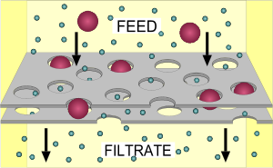
Types of Diffusion: Filtration

Slide 11
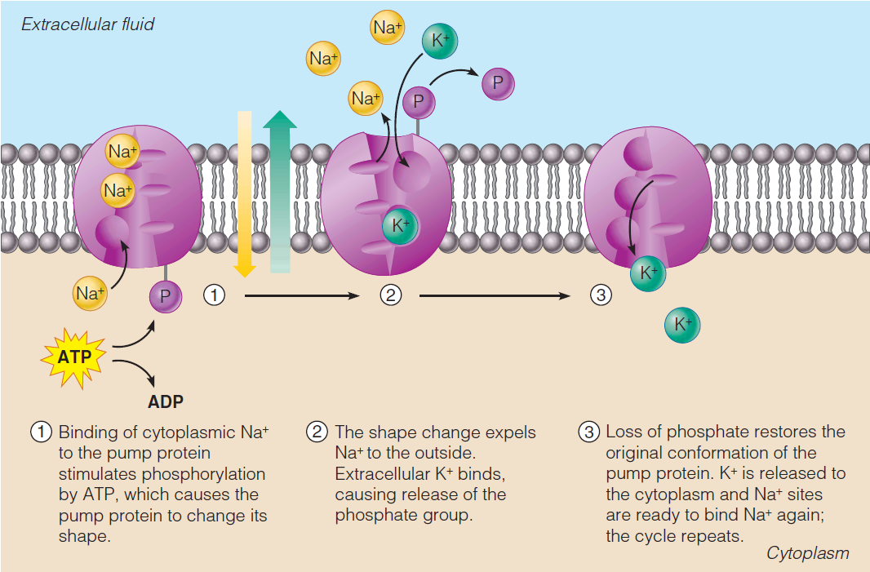
Active Transport Processes: Solute Pumping
Operation of sodium potassium pump

Slide 12
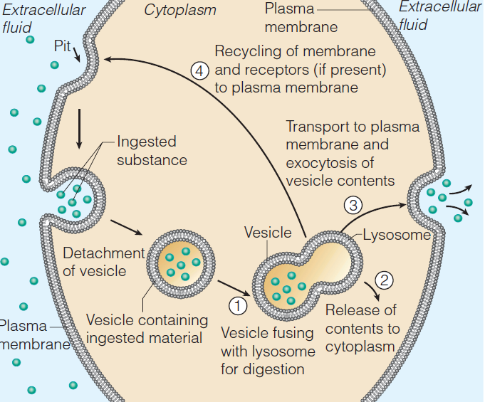
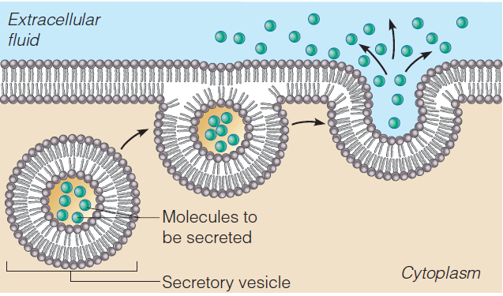
Active Transport Processes: Bulk Transport
Exocytosis
Endocytosis

