Slide 1
Dairy cattle production (95314)
Dr Jihad Abdallah
Topic10:Dairy cattle housing

Slide 2
Sources of lecture
1) Small Scale Dairy Calf and Cattle Housing.
http://extension.umass.edu/cdle/fact-sheets/small-scale-dairy-calf-and-cattle-housing
2) Dairy Cow Housing. Report prepared for Arla, Morrisons and DairyCo. The Dairy Group, New Agriculture House. August 2012.

Slide 3
Calf Housing
Hutches - Calves can be raised in individual hutches that afford them the opportunity to move around, be fed individually, and allow for good ventilation and ease of cleaning.
Hutches should be placed about 2 feet apart (to avoid spread of diseases) on well-draining material, such as a layer of sand, gravel, or stone for proper drainage.
The hutches should be well bedded (straw and/or shavings).
Fencing can be placed around the hutch to give the calf the opportunity to exercise

Slide 4
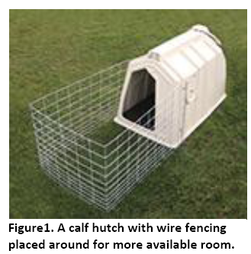
Source: (1)

Slide 5
Calf Housing
Another more cost effective option, is to have the calves in individual pens under a greenhouse structure.
If housed in groups, calves should have 30 square feet per animal.
Avoid housing systems that place calves on cold concrete, rubber mats or slatted floors.

Slide 6
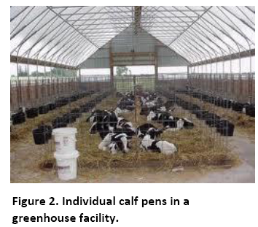
Source: (1)

Slide 7
Housing from weaning to 6 months
Transitional housing for weaned calves up to 6 months of age can be a shed with pasture, or group housing in a hoop shelter or shed.
Heifers in group housing need at least 35 square feet per animal.

Slide 8
Housing from 6 months to breeding
Most producers use loose housing to minimize work.
It is best to separate the large heifers from the small.
If you are able, leave liberal amounts of feeding space so that smaller animals will not be crowded out.
Heifers 6 to 24 months old should each have 35-40 square feet.
Hoop barns – One of the least expensive structures for housing cattle. Disadvantages are heat and ventilation problems during the summer months

Slide 9
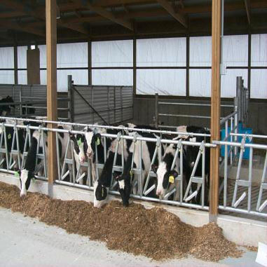
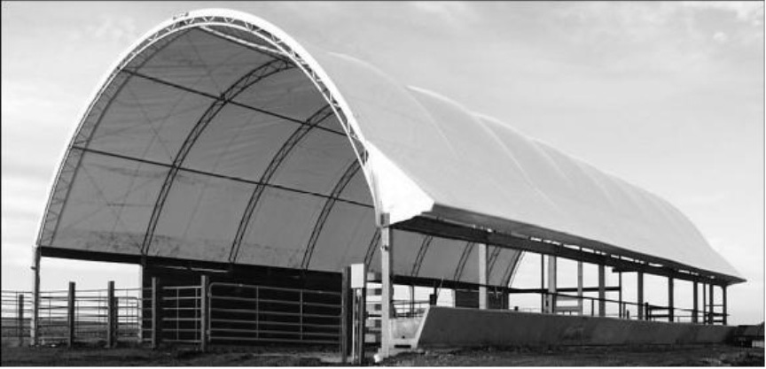
Figure 3. Group housing with headlocks.
Source: (1)
Figure 4. A hoop barn is one of the least expensive structures for housing.

Slide 10
Housing from 6 months to breeding
Open sided, single slope roof shed:
This type of housing is the most typical kind of structure used and is suitable for all cattle on the farm.
They are the least expensive of new structures and very easy to build.
Open sheds should face winter sun and block the prevailing winds.
Pole barns of this design can be partitioned for groups of animals without complicated interior construction.

Slide 11
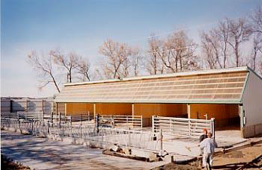
Figure 5. Open sided, single slope roof shed is one of the most common housing structures
Source: (1)

Slide 12
Housing the Milking Herd
Milking cattle may be housed in tie stalls, freestalls, or bedded-pack barns.
Cows typically rest 9 to 14 hours per day in intervals of five or more hours.
Cows should be turned outside, for a minimum of one hour, at least once per day, for exercise during the non-grazing season or when appropriate conditions for grazing do not exist. This is especially important for cows in tie stall barns

Slide 13
Housing the Milking Herd
1. Tie stall housing:
Allows the farmer greater interaction with the herd.
This type of system is good for small herds with fewer than 100 cattle.
Good ventilation is critical in this type of housing.
The stall should be large enough to allow the largest cow in the herd to freely enter the stall, lie down, rest comfortably and easily get to her feet and exit the stall.

Slide 14
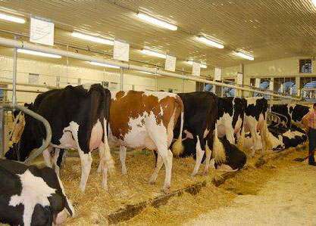
Figure 6. Tie stall housing allows for individual cow monitoring especially for animal health.
Source: (1)

Slide 15
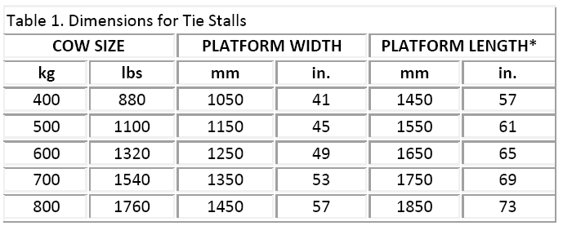
*Length is with use of cow trainers. If no trainers are used decrease stall length by 100 mm (4 in.). Ontario Department of Agriculture.
Source: (1)

Slide 16
Housing the Milking Herd
2. Freestalls:
well designed freestalls can reduce excessive standing, and minimize injuries.
Many freestall barns start out as bedded-pack barns until enough capital is saved to add freestalls and freestall alleys.
Freestall barns evolved from bedded-pack barns to reduce bedding costs and the amount of labor spent on bedding management.

Slide 17
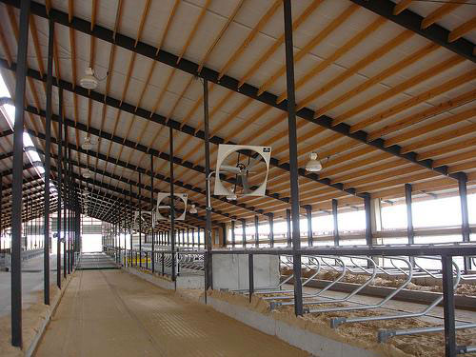
Figure 7. A freestall barn with proper ventilation and fans for air movement
Source: (1)

Slide 18
Housing the Milking Herd
Bedded-pack barns:
Are a low cost alternative to freestall barns.
However, the lower initial investment for bedded-pack barns may be offset by higher annual costs. Bedded-pack barns require careful and consistent daily management to create a healthy and comfortable cow environment.
Poorly managed bedded packs can quickly turn into a sloppy, wet manure mess if not cleaned daily.

Slide 19
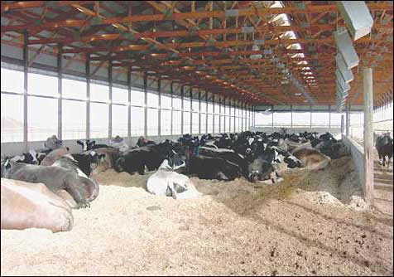
Figure 8. Bedded-pack barns provide a comfortable resting place; however, consistent daily management is needed
Source: (1)

Slide 20
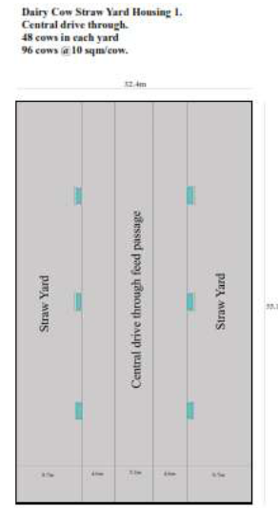
Straw Yard and central feed passage
Source: (2)

Slide 21
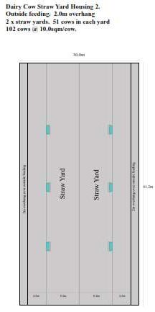
Example straw yard with perimeter feeding
Source: (2)

Slide 22
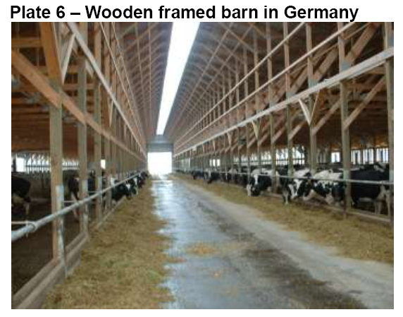
Source: (2)

Slide 23
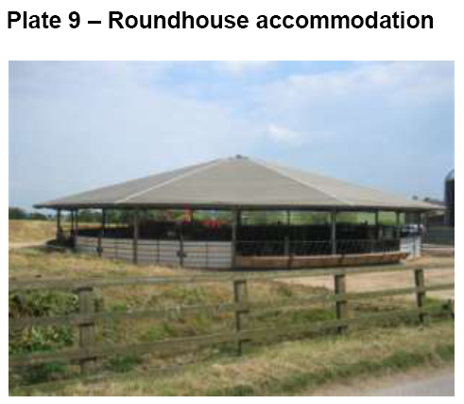
Source: (2)

Slide 24
Cubicles
Cubicles must provide a clean comfortable lying space.
The cow must be able to enter and leave the cubicle easily and lie down and rise without interference or injury.
Poorly designed and managed cubicles can lead to poor occupancy, wet and soiled cubicle beds, increased risks of udder disease and lameness and physical damage to the cows.
The cubicle must be long enough to allow the cow to rest comfortably on the floor without injury, yet short enough to ensure that urine and fecal material fall into the scraping passage and not onto the cubicle be.
The cubicle must be wide enough for the cow to lie comfortably, but narrow enough to prevent her turning around

Slide 25
Cubicles
Number of cubicles: a cubicle housing system should have a minimum of one cubicle per cow. It is recommended to have 5% more cubicles than cows
Location of cubicles: towards the center of the building close to feed passage
Number of rows of cubicles: when considering a cubicle housing system with a central feed passage, the system is likely to be either a two-row system (two rows of cubicles accessing one section of feed stance) or a three-row system (three rows of cubicles accessing one section of feed stance). The three-row design has been favored by many farmers and designers as the space requirement per cow and therefore cost per cow is less (i.e. cows are housed at a higher stocking rate).

Slide 26
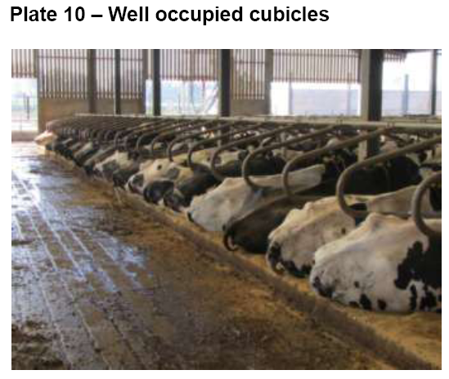
Source: (2)

Slide 27
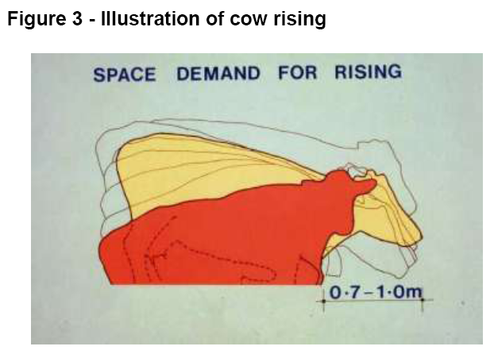
Source: (2)

Slide 28
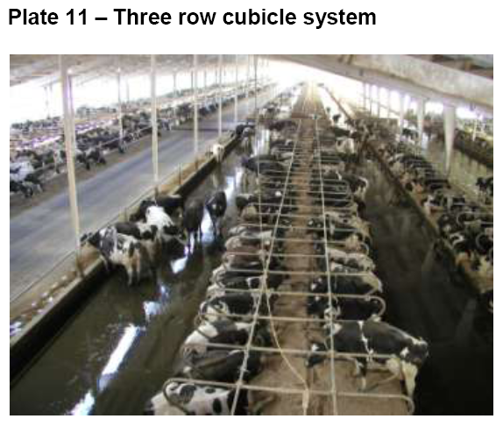
Source: (2)

Slide 29
Cubicles
Passage width:
The width of the scrape passage between rows of cubicles should be a minimum of 3.0m, although 3.6m would appear more appropriate
Where a three-row system is built, with one row of cows backing out of cubicles onto the feed stance, the passage width should be at least 5.2m.
When a two-row system is built, the feed stance width can be reduced to 4.6m.

Slide 30
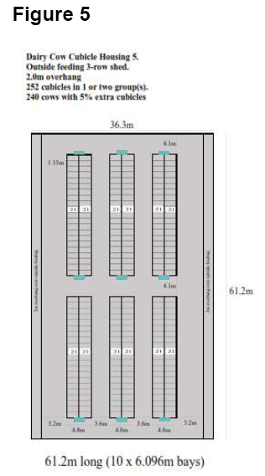
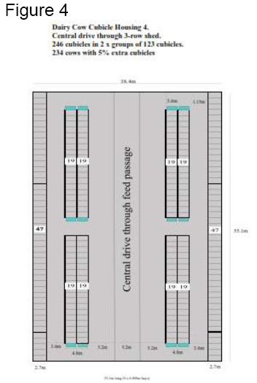
Three-row system utlizing central
feed passage
Three row cubicle system utilises
perimeter feeding.
Source: (2)

Slide 31
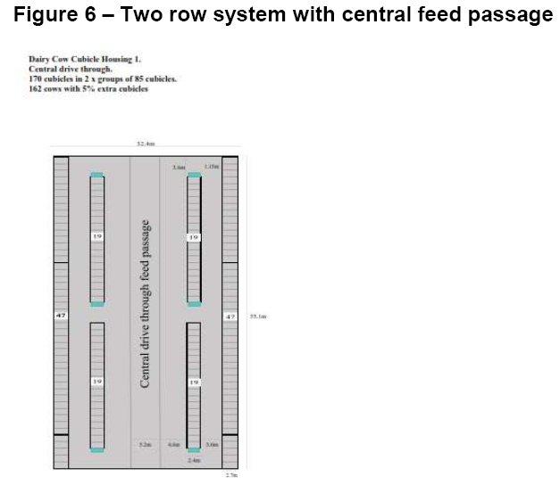
Source: (2)

Slide 32
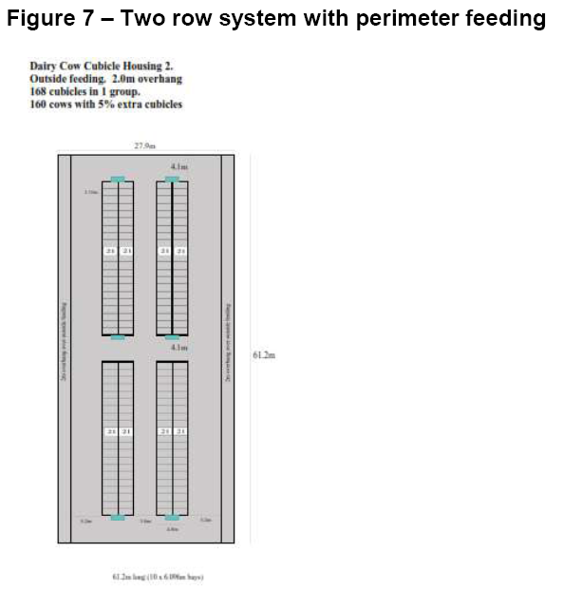
Source: (2)

Slide 33
Cubicle width should be at least 1.8 times cow hip width, (measured across the hook bones)
The width of the cubicle will be determined in part by the choice of cubicle partition. If the partition fitted has a rear support leg, the partition should be installed with a clear distance between partitions of 1.2m
Source: (2)

Slide 34
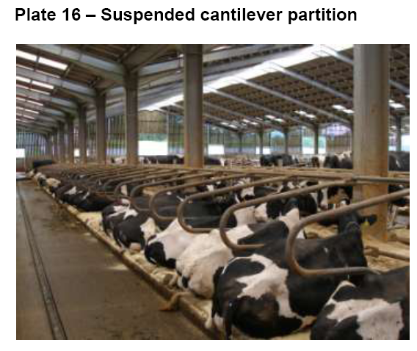
Suspended partitions with very little restrictions to interfere with the cow at rest continue to be very popular.
Source: (2)

Slide 35
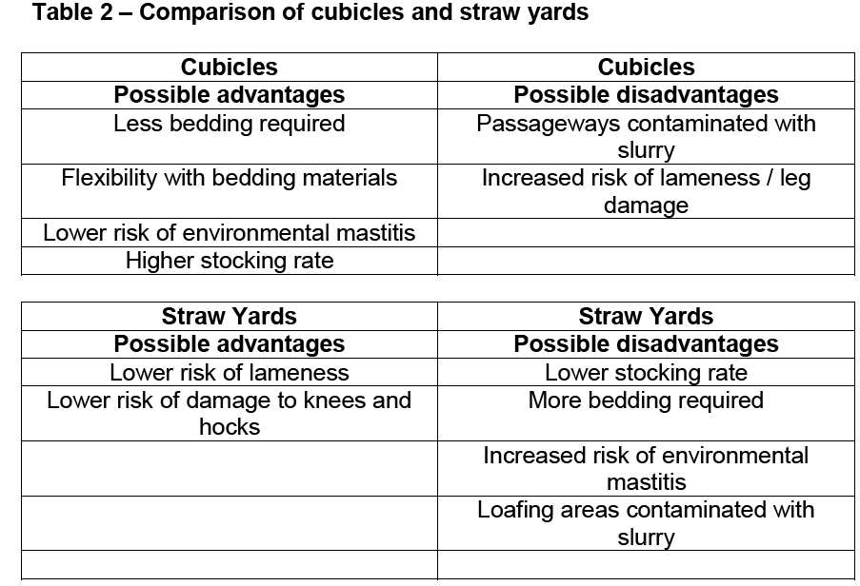
Source: (2)

Slide 36
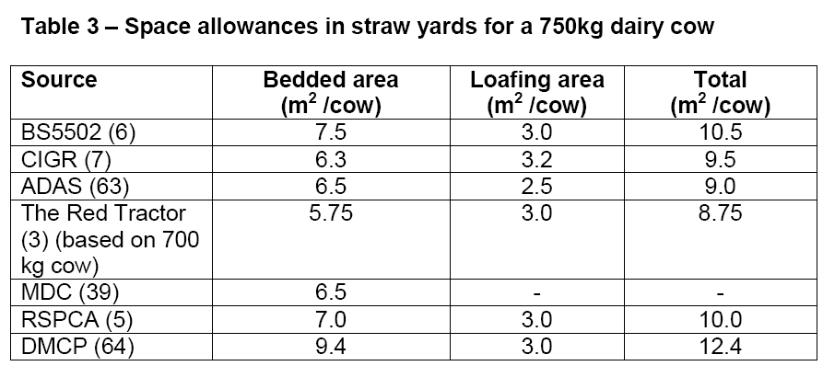
Source: (2)

Slide 37
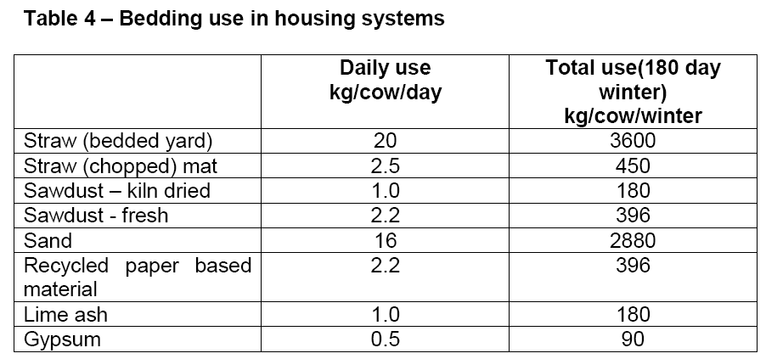
Source: (2)

