Slide 1
An-Najah National University
Faculty of Medicine
Department of Physiology
Anatomy and Physiology 1
7102101
Instructor: Heba Salah
Chapter 5:
The Nervous System
Part 3: Neurons Physiology

Slide 2
How Neurons Function (Physiology)
Irritability – ability to respond to stimuli
Conductivity – ability to transmit an impulse
The plasma membrane at rest is polarized
Fewer positive ions are inside the cell than outside the cell

Slide 3
The Nerve Impulse

Slide 4
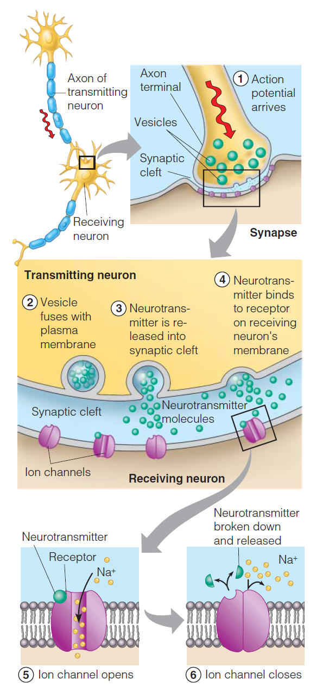
Continuation of the Nerve Impulse between Neurons

Slide 5
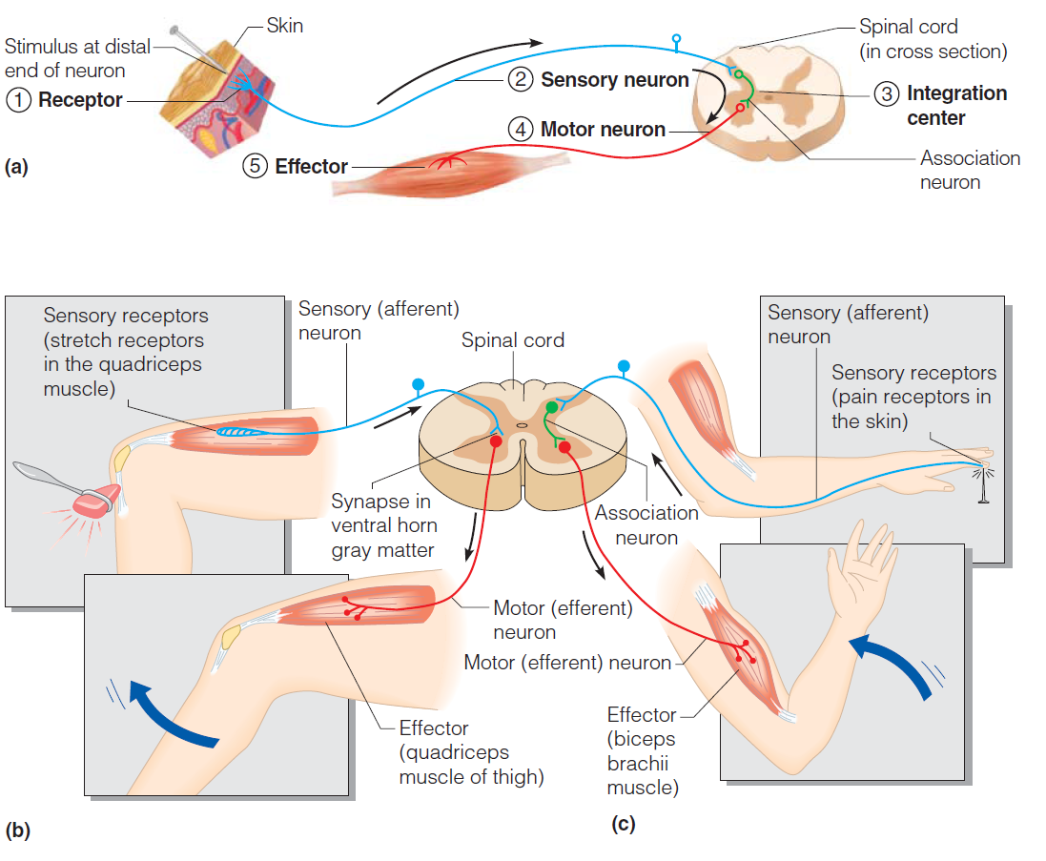
Simple Reflex Arc

Slide 6
Types of Reflexes and Regulation
1. Autonomic reflexes
Smooth muscle regulation
Heart and blood pressure regulation
Regulation of glands
Digestive system regulation
2. Somatic reflexes
Activation of skeletal muscles

