Slide 1
An-Najah National University
Faculty of Medicine
Department of Physiology
Anatomy and Physiology 1
7102101
Instructor: Heba Salah
Chapter 7:
The Urinary System
Part 3: Ureters, Urinary Bladder, and Urethra

Slide 2
Ureters
Slender tubes attaching the kidney to the bladder
Continuous with the renal pelvis
Enter the posterior aspect of the bladder
Runs behind the peritoneum
Peristalsis aids gravity in urine transport

Slide 3
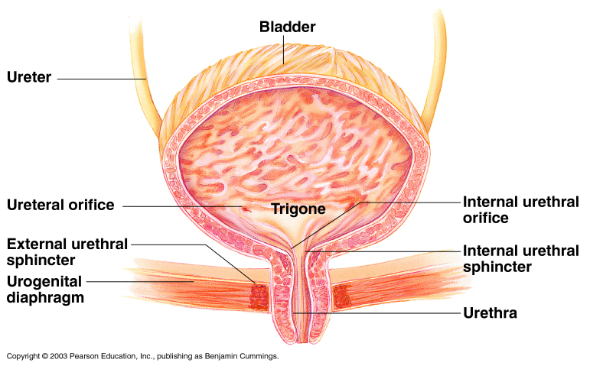
Urinary Bladder
Smooth, collapsible, muscular sac
Temporarily stores urine

Slide 4
Urethra
Thin-walled tube that carries urine from the bladder to the outside of the body by peristalsis
Release of urine is controlled by two sphincters
Internal urethral sphincter (involuntary)
External urethral sphincter (voluntary)

Slide 5
Urethra Gender Differences
Length
Location
Function

Slide 6
Micturition (Voiding)
Both sphincter muscles must open to allow voiding
The internal urethral sphincter is relaxed after stretching of the bladder
Activation is from an impulse sent to the spinal cord and then back via the pelvic splanchnic nerves
The external urethral sphincter must be voluntarily relaxed

