Slide 1
Materials & Products Design/ 10661440
E-Learning Lecture # 7
March 29, 2020
Students Presentations on:
Visual thinking in Materials Science & Engineering

Slide 2
Products and Operations Design
Supervised by:
Dr. Hamdallah Bearat
Made by :
Mariana Mari
Aya Omary

Slide 3
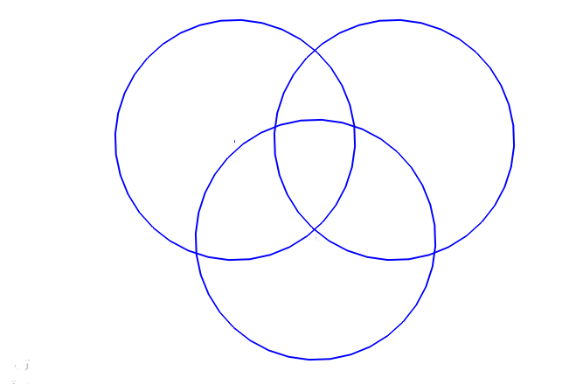
Venn diagram illustration of relationships and procedures:
FA21
FA23
SiO2
SiO2
Cr2O3
TiO2
TiO2
NiO
K2O
K2O
FeO
CuO
P2O5
MgO
MnO
CaO
FeO
Al2O3
ZnO
CoO
MgO
P2O5
MnO
CaO
ZnO
FeO
Cr2O3
ZnO
NiO
SiO2
K2O
P2O5
CuO
TiO2
CaO
FeO
FA26

Slide 4
Scheme:

Slide 7
Thanks

Slide 8
Material science engineering
Product Design and Operations
Comparison between materials by
Venn shapes and charts
Ismael Hamawi
Mohammad Kalbonah

Slide 9
Concentration of elements is each sample

Slide 10
Table of sample of clay
Oxide formela | SiO2 | TiO2 | Al2O3 | FeO | MgO | CaO | K2O | P2O5 | MnO | NiO | Cr2O3 | CuO | CoO | ZnO
FA24 | 58.67 | 1.75 | 20.1 | 9.58 | 3.79 | 4.12 | 1.39 | 0.35 | 0.15 | 0 | 0.07 | 0.02 | 0 | 0.01
FA25 | 64.93 | 0.69 | 18 | 4.29 | 2.5 | 7.87 | 1.36 | 0.26 | 0.03 | 0 | 0.03 | 0.02 | 0.01 | 0
FA26 | 60.67 | 1.29 | 14.44 | 7.05 | 3.73 | 10.11 | 2.13 | 0.28 | 0.12 | 0 | 0.11 | 0.02 | 0 | 0.07

Slide 11
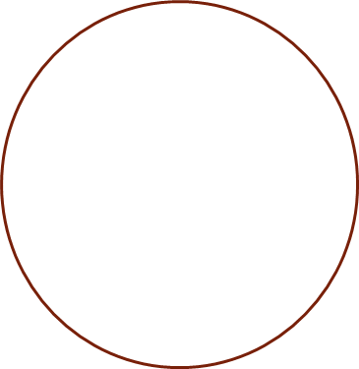
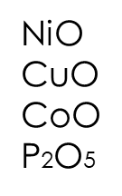
Venn diagram
FA25
Cr2O3
SiO2
ZnO
Al2O3
CaO
TiO2
MgO
MnO
FeO
K2O
P2O5
Cr2O3
SiO2
SiO2
FA 24
TiO2
TiO2
FA 26
Al2O3
MgO
Al2O3
MnO
FeO
ZnO
FeO
CaO
CaO
P2O5
Cr2O3
K2O

Slide 12
CoO vs CuO for all samples

Slide 13
NiO vs MnO for all samples

Slide 14
Thanks

Slide 15
Material Engineering Department
An-Najah National University
Visual thinking in material sience
Prepared by:
Anagheem Batta
Aseel Bouziyah
Submitted to:
Dr. Hamdallah Bearat

Slide 16
SiO₂
FeO
FA25
Al₂O₃
CaO
MnO
CuO
CoO
k₂O
TiO₂
Cr₂O₃
MgO
FA27
FA22
SiO₂
P₂O₅
SiO₂
TiO₂
FeO
NiO
CaO
Al₂O₃
MgO
Cr₂O₃
CuO
k₂O
MnO
CaO
Al₂O₃
CoO
FeO
k₂O
P₂O₅
MnO

Slide 17
Function between FA

Slide 21
Form relationships by Venn diagram and charts
Operation and Product Design
Visual thinking
By: Diana Mustafa and Farah Seddah
Supervisor: Ph.D.Hamdallah Bearat

Slide 22
Chart describe the relationship between CaO and MnO

Slide 23
Chart describe the distributions of SiO2 and Al2O3

Slide 24
Venn Diagram
FA26
SiO2
CaO
K2O
SiO2
Al2O3
MgO
FeO
CaO
CaO
SiO2
AL2O3
FeO
MgO
TiO2,NiO P2O5 ZnO
MnO
CuO, CoO
K2O
FA21
FA25

Slide 25
Comparison between materials by Venn shapes and charts.
Sara Hamza & Razan Omour
Hamdallah Bearat

Slide 26
TiO2 FeO
CaO MnO
NiO Cr2O3
CuO ZnO
SiO2
K2O
P2O5
Al2O3 CaO
MnO Cr2O3
CuO
FA26
SiO2 CaO
K2O P2O5
MnO NiO
Cr2O3 CuO
ZnO
FA27
MgO
TiO2
FeO
Al2O3
FA23

Slide 27
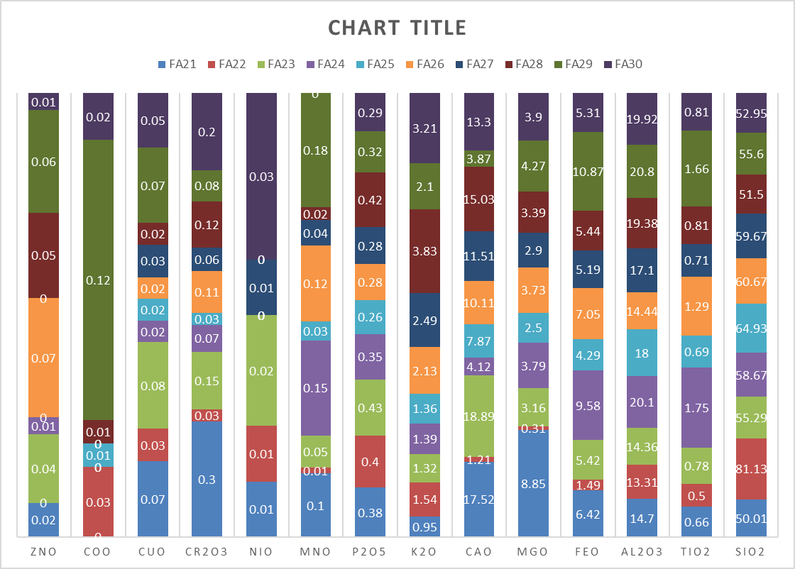

Slide 28
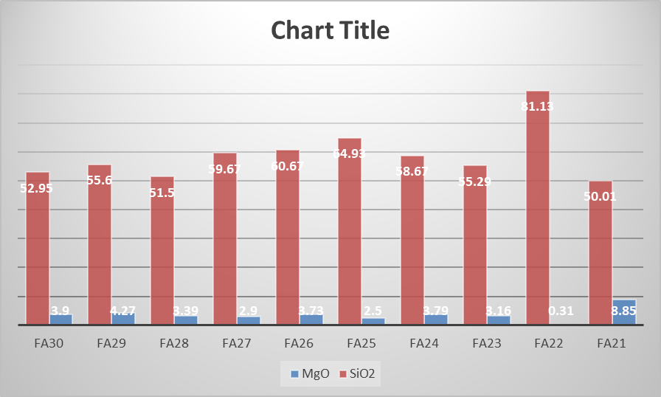

Slide 29
Thank you ☺

Slide 30
Design and Designing
SSSsupervised by:
Dr. Hamdallah Bearat
Pprepared by:
Saja Hussein
Hanan Walwil
Shahd Yasin

Slide 31
Venn diagram illustration of relationships and procedures
Mgo
Feo
Sio2
Al2o3
Cao
Sio2
Feo
Mgo
Cao
Zno
FA21
FA22
K2o ,P2o5 ,Mno ,Nio ,Cr2o3 , Cuo , , Tio2
CoO
Al2o3
Mgo
Feo
Sio2
Cao
Zno
FA23

Slide 32
FA23
FA22
SiO2
CaO
CoO
FeO
TiO2 Nio
SiO2
MgO
Al2O3
CaO
MnO
Al2O3
FeO
Cr2O3
Nio
P2O5
K2o
Cuo
Cr2O3
MgO ZnO
TiO2
FeO
CaO
FA24
Al2O3
MnO
Zno
SiO2

Slide 33
: Scheme

Slide 36
Thanks

Slide 37
Comparison between materials by Venn shapes and charts.
Aamer Abojalboush
Submetted to
Dr. Hamdalleh Bearat

Slide 38
Venn shape

Slide 42
Comparison between materials by shapes and charts. Noora Khanfa Supervised by: Hamdallah Bearat

Slide 43
F A22
K2O
F A21
Cr2O3
Cr2O3
Sio2
CoO
MgO
MnO
TiO2
FeO
CuO
MnO
P2O5
Al2O3
MgO
NiO
CaO
K2O
SiO2
ZnO
FeO
MnO
Cr2O3
MgO
F A23

Slide 46
Thanks

