Slide 1
An- Najah National University
Faculty of Medicine and Health Science
Department of Nursing and Midwifery
BUDGET PLANNING AND IMPLEMENTATION
Prepared by:
ساهر محمد عبدالله حيدريه 12027686
حمزه جمال غالب الدايه 12028790
أشرف أمجد هلال النوري 12010452
محمد عمار عبدالقادر قنازع 11923516
DR.Samah Ishtieh
2023– 2024

Slide 2
Introduction
A budget is a financial plan that outlines your income and expenses over a specific period, typically a month or a year. It is a crucial tool for managing your finances and achieving your financial goals. Budgeting helps you allocate your money wisely, prioritize your spending, and save for future needs or desires.

Slide 3
Key components of a budget include:
Income: This includes your regular earnings from sources such as salary, business profits, investments, and any other sources of money coming in.
Expenses: These are the costs associated with your daily living, such as rent or mortgage, utilities, groceries, transportation, insurance, and entertainment.
Savings: Allocating a portion of your income for savings is a fundamental aspect of budgeting. This can include emergency savings, retirement savings, or specific savings goals like a vacation or a down payment on a house.
Debt Repayment: If you have outstanding debts, such as loans or credit card balances, budgeting helps you plan for and manage debt repayment.
Budget Categories: Organizing your expenses into categories makes it easier to track and manage your spending. Common categories include housing, food, transportation, utilities, and entertainment.

Slide 4
Importance of Budgeting
Financial Control: Budgeting provides a clear picture of your financial situation, helping you understand how much money you have coming in and where it is going. This control enables you to make informed decisions about your spending and saving habits.
Expense Management: By categorizing your expenses, budgeting allows you to identify areas where you can cut costs or reallocate funds. This helps prevent unnecessary spending and ensures that you allocate money to essential needs.
Savings and Investments: A well-structured budget includes provisions for savings and investments. This ensures that you set aside money for future goals, emergencies, and long-term financial security. Regular saving and investing can lead to wealth accumulation

Slide 5
Debt Management: Budgeting helps you allocate funds for debt repayment. Whether it's student loans, credit card debt, or other obligations, having a budget allows you to prioritize debt repayment and work towards becoming debt-free.
Financial Goals: Budgeting allows you to set and achieve financial goals. Whether it's saving for a vacation, buying a home, or funding your education, a budget provides a roadmap for reaching these objectives by allocating funds appropriately.
Emergency Preparedness: Unexpected expenses can arise at any time. A budget helps you build an emergency fund, providing a financial cushion for unforeseen events like medical emergencies, car repairs, or job loss.

Slide 6
Steps in Budget Implementation
There are several steps in the budgeting process before the final budget is implemented;
Common steps include;
Communicating within executive management
Establishing targets and objectives
Developing a detailed budget, compilation, and revision of the budget model
Reviewing and approval by the budget committee

Slide 7
Monitoring and Adjusting of budget
Monitoring and adjusting your budget is a critical aspect of successful financial management. Regularly reviewing your budget allows you to track your spending, assess your progress toward financial goals, and make necessary adjustments. Here are steps to effectively monitor and adjust your budget:

Slide 8
Set Regular Review Periods:
Establish a schedule for reviewing your budget. This could be weekly, bi-weekly, or monthly, depending on your preference and the complexity of your financial situation.
Compare Actual vs. Planned Spending:
Compare your actual spending against the budgeted amounts for each category. This helps identify areas where you may be overspending or where adjustments might be needed.
Identify Variances:
Analyze any significant variances between your planned budget and actual expenses. Look for patterns or trends in your spending behavior.

Slide 9
Examine Changes in Income:
If there have been changes in your income, whether positive or negative, consider adjusting your budget accordingly. This could involve reallocating funds to different categories or revising your financial goals.
Review Financial Goals:
Assess your progress toward achieving financial goals. If you're falling behind, evaluate whether the goals are realistic or if adjustments are needed. Consider reprioritizing goals based on changing circumstances.
Emergency Fund Check:
Ensure your emergency fund is adequately funded. If you've had to dip into it for unexpected expenses, make a plan to replenish it as soon as possible

Slide 10
Address Overspending:
If you find that you consistently overspend in certain categories, evaluate the reasons behind it. Adjust the budget for those categories or implement strategies to curb overspending.
Look for Cost-Cutting Opportunities:
Identify areas where you can cut costs without sacrificing essential needs. This could involve renegotiating bills, finding more cost-effective alternatives, or eliminating non-essential expenses.
Automate Savings and Payments:
Consider automating savings and bill payments to ensure that you consistently allocate funds to your savings goals and meet financial obligations.

Slide 11
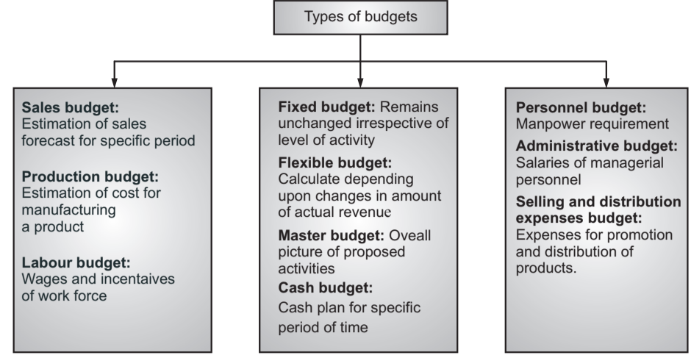
• Classification/Types of Budget There are different types of budgets and these are classified as per the activities of an organization

Slide 12
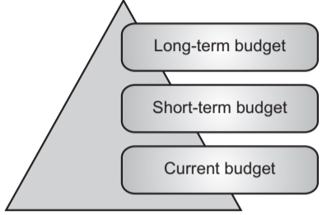
Budget Preparation Budgets are prepared as per the requirements or types of organization. Based on the requirement, the budget may be prepared considering the length of the period of its implementation. Requirements

Slide 13
Long-term Budget: These budgets are prepared for the long term. They are prepared for a period of 5 to 10 years. This type of budget is prepared to depend upon the size of the organization.
• Short-term Budget: This type of budget is prepared for a duration of 2 to 5 years. These budgets are prepared under controlled conditions.
• Current Budget: This type of budget is prepared for a shorter duration. The duration is usually 1 to 3 months

Slide 14
Budgeting Control:
.Effective control of a system or any plan is a very important aspect of the business.
.To bring efficiency in the working of any business budgetary control is a useful method. .Budgeting is closely connected with control.
"The process of control in the organization with the help of budgets is known as budgetary control." Budgetary control involves three steps:
• Preparation of budgets.
• Comparisons of actual results with planned ones.
• Revision of plans or budgets in the light of changed circumstances

Slide 15
Essentials of Effective Budgeting
Sound Organizational Structure: Authority and responsibility for all phases of operations are clearly defined.
Based on Research and Analysis: Realistic goals that will contribute to the growth and profitability of the company
Top Management: Directly related acceptance by all levels of management

Slide 16
Implementation of a Budget
For the Implementation of a budget, there is a requirement of different parameters:
Actual Fund Position:
Successful implementation of the budget will depend on the financial position of a firm.
2) The master budget will give insight into the plan.
3) A cash budget will help to know the cash plan for a specific period.
4) Overall, all types of budgets are studied at the micro level to implement the planned budget.

Slide 17
Utility of Particular Item:
1) This depends upon materials used and expressed in quantities whereas the materials purchases budget is expressed in both ways is quantitative and financial.
2) This helps in scheduling the purchase of materials to produce a given volume of output during a particular period.
Cost of Products:
1) Study of the cost required to manufacture/purchase a particular product is very important in budget planning.
2) Cost includes direct costs and indirect costs. It is the production and non-production costs required to manufacture a particular product
Quantity of products:
• Effective inventory management is needed for the successful implementation of a budget plan.
• To avoid stock out and over-stock, effective inventory control is needed, as a huge amount of capital is invested in inventory

