Slide 1
An-Najah National University
Faculty of Medicine
Department of Physiology
Anatomy and Physiology 1
7102101
Instructor: Heba Salah
Chapter 6:
The DigestiveSystem
Part 1: Organs of the Alimentary Canal: the Mouth, Pharynx, and Esophagus

Slide 2
The Digestive System and Body Metabolism
1. Digestion
Breakdown of ingested food
Absorption of nutrients into the blood
2. Metabolism
Production of cellular energy (ATP)
Constructive and degradative cellular activities

Slide 3
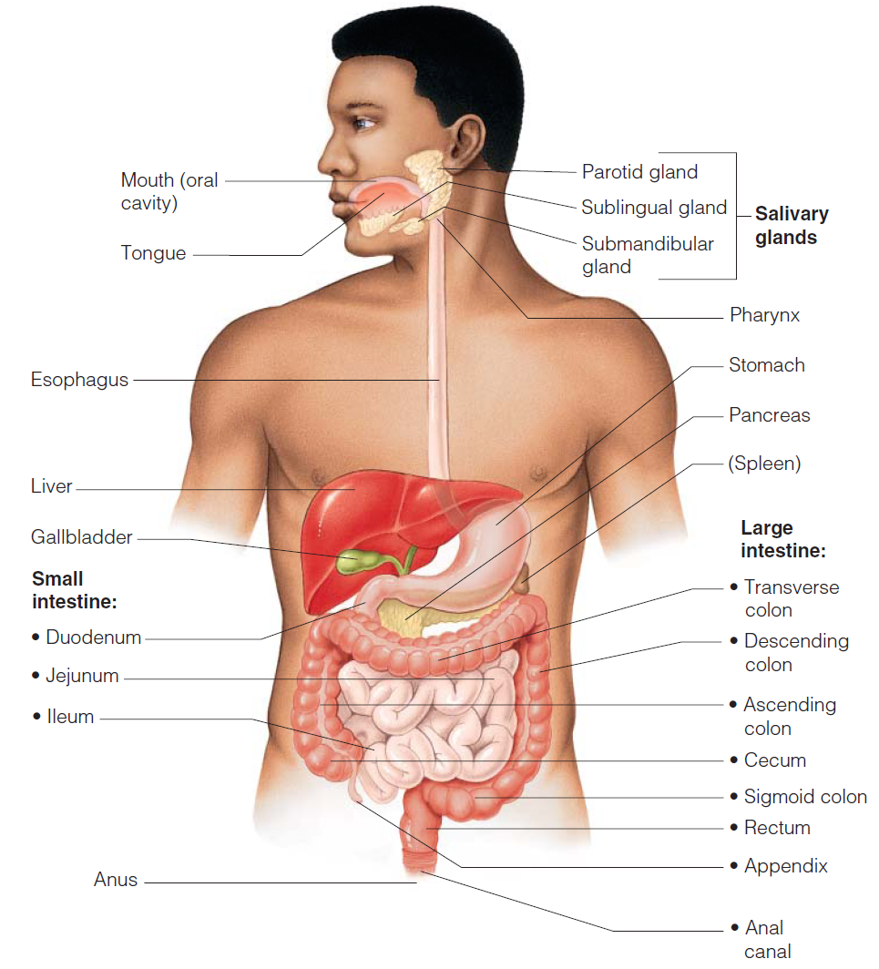
Organs of the Digestive System

Slide 4
Mouth (Oral Cavity) Anatomy
Lips (labia) – protect the anterior opening
Cheeks – form the lateral walls
Hard palate – forms the anterior roof
Soft palate – forms the posterior roof
Uvula – fleshy projection of the soft palate

Slide 5
Mouth (Oral Cavity) Anatomy
Vestibule – space between lips externally and teeth and gums internally
Oral cavity – area contained by the teeth
Tongue – attached at hyoid and styloid processes of the skull, and by the lingual frenulum
Tonsils:
Palatine tonsils
Lingual tonsil

Slide 6
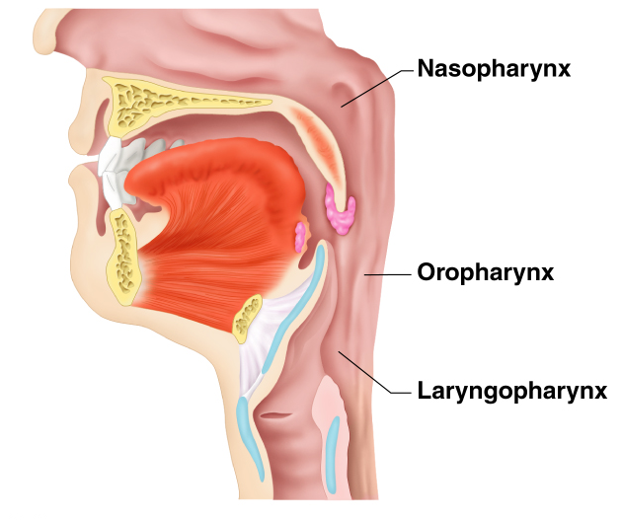
Pharynx Anatomy
Nasopharynx – not part of the digestive system
Oropharynx – posterior to oral cavity
Laryngopharynx – below the oropharynx and connected to the esophagus

Slide 7
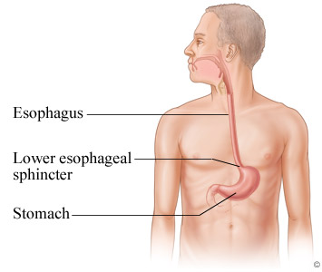
Esophagus
Runs from pharynx to stomach through the diaphragm
Conducts food by peristalsis (slow rhythmic squeezing)
Passageway for food only (respiratory system branches off after the pharynx)

Slide 8
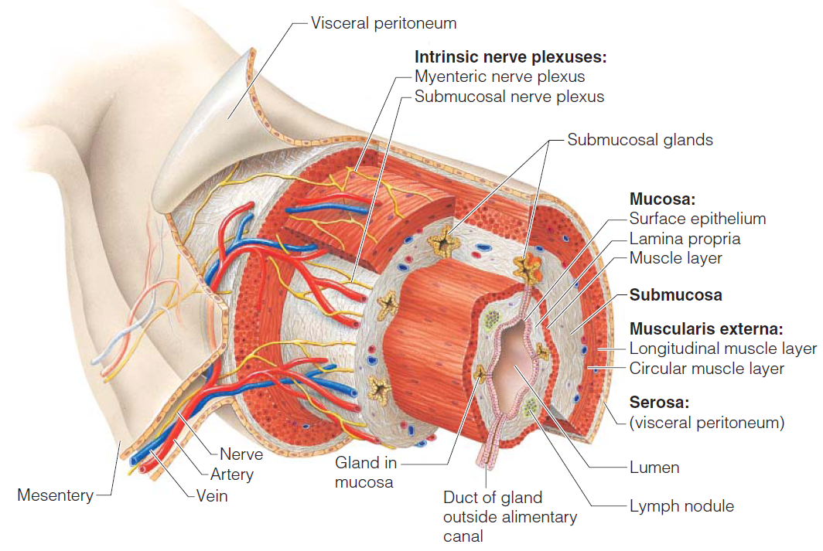
Layers of Alimentary Canal Organs

Slide 9
Alimentary Canal Nerve Plexuses
All are part of the autonomic nervous system
Three separate networks of nerve fibers:
1. Submucosal nerve plexus
2. Myenteric nerve plexus
3. Subserous plexus

