Slide 1
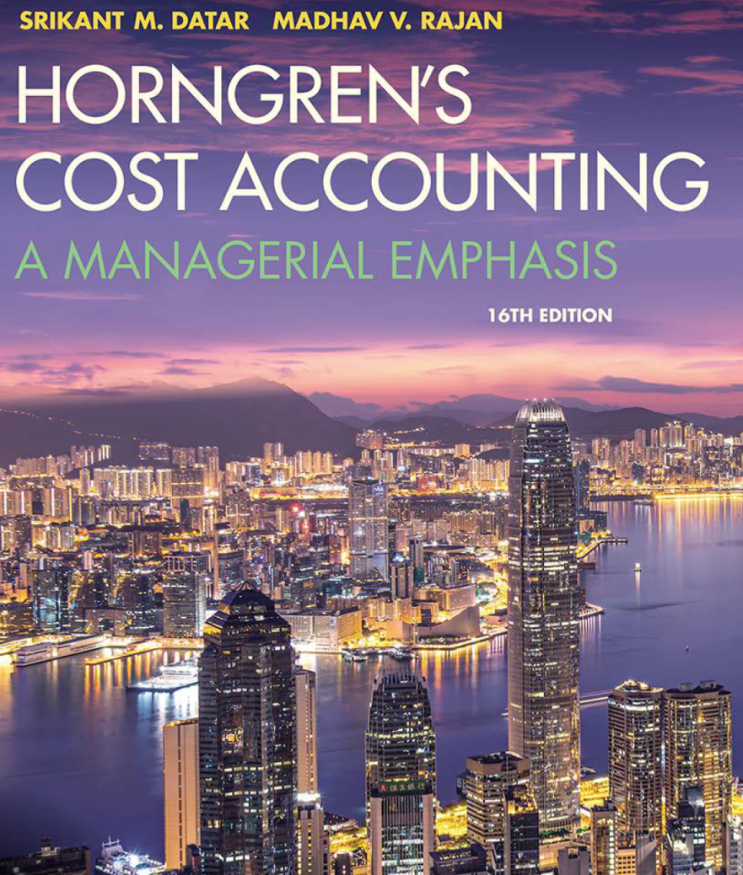
Cost Accounting
Sixteenth Edition
Chapter 1
The Manager and Management Accounting
Copyright © 2018, 2016, 2015 Pearson Education, Inc. All Rights Reserved.

Slide 2
Learning Objectives (1 of 2)
1.1 Distinguish financial accounting from management accounting
1.2 Understand how management accountants help firms make strategic decisions
1.4 Explain the five-step decision-making process and its role in management accounting
1.5 Describe three guidelines management accountants follow in supporting managers
Notes:
Managers at companies large and small must understand how revenues and costs behave or they risk losing control of the performance of their firms.
In this slide we see the first 4 of 7 Learning Objectives for Chapter 1:
1.1 Distinguish financial accounting from management accounting
1.2 Understand how management accountants help firms make strategic decisions
1.3 Describe the set of business functions in the value chain and identify the dimensions of performance that customers are expecting of companies
1.4 Explain the five-step decision-making process and its role in management accounting

Slide 3
Accounting Discipline Overview (1 of 3)
Management accounting measures, analyzes, and reports financial and nonfinancial information that helps managers make decisions to fulfill organizational goals. Management accounting need not be GAAP compliant.
Managers use management accounting information to:
Develop, communicate and implement strategies
Coordinate product design, production, and marketing decisions and evaluate a company’s performance
Notes:
Accounting systems are used to record economic events and transactions such as sales and the purchases of materials and then process the data into a format that is helpful for managers and others.
Management accounting is the process of measuring, analyzing and reporting financial and nonfinancial information that helps managers make decisions.

Slide 4
Accounting Discipline Overview (2 of 3)
Financial accounting focuses on reporting financial information to external parties such as investors, governmental agencies, banks, and suppliers, based on GAAP.
Cost Accounting measures, analyzes and reports financial and nonfinancial information related to the costs of acquiring or using resources in an organization.
Notes:
Accounting systems are used to record economic events and transactions such as sales and the purchases of materials and then process the data into a format that is helpful for managers and others.
Financial accounting has a focus on the financial information that is disseminated to external parties such as investors, governmental agencies, banks, and suppliers.
Cost accounting provides information for both management and financial accounting professionals. The focus is on the costs of acquiring or using resources in the organization.

Slide 5
Accounting Discipline Overview ( 3 of 3)
Today, most accounting professionals take the perspective that cost information is part of the information collected to make management decisions; therefore the distinction between the two is not clear-cut and in your book and these PowerPoint presentations, we often use the terms interchangeably.

Slide 6
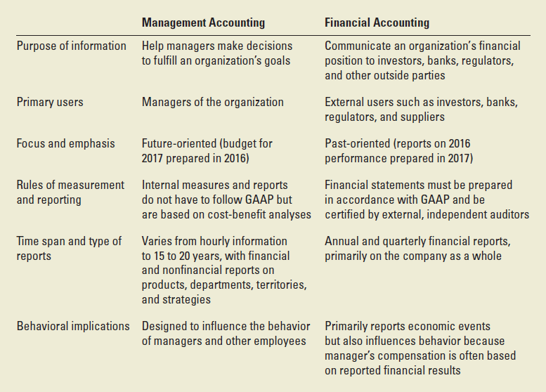
Major Differences Between Management and Financial Accounting
EXHIBIT 1.1 Major Difference Between Management and Financial Accounting
Notes:
In this slide, a graphical representation highlighting the major differences between management and financial accounting is presented. The categories compared are the:
Purpose of the information, primary users, focus and emphasis, rules of measurement and reporting, time span and type of reports, and behavioral implications.
This is Exhibit 1-1 from page 3.

Slide 7
Strategic Decisions and the Management Accountant- (1 of 2)
Strategy specifies how an organization matches its own capabilities with the opportunities in the marketplace
There are two broad strategies: cost leadership and product differentiation
Strategic cost management describes cost management that specifically focuses on strategic issues.
Notes:
Deciding between the two broad strategies of cost leadership or product differentiation is a critical part of what managers do. Management accountants work closely with managers in various departments to formulate strategies by providing information about the source of competitive advantage, such as (1) the company’s cost, productivity or efficiency advantage relative to competitors or (2) the premium prices a company can charge over its cost for distinctive product or service features.

Slide 8
Strategic Decisions and the Management Accountant- (2 of 2)
Management accounting information helps managers formulate strategy by answering questions such as the following:
Who are our most important customers and what critical capability do we have to be competitive and deliver value to our customers?
What is the bargaining power of our customers?
What is the bargaining power of our suppliers?
What substitute products exist in the marketplace and how do they differ from our product in terms of features, price, cost and quality?
Will adequate cash be available to fund the strategy, or will additional funds need to be raised?
Notes:
Management accounting information helps managers formulate strategy by answering questions such as the following:
Who are our most important customers and what critical capability do we have to be competitive and deliver value to our customers?
What is the bargaining power of our customers?
What is the bargaining power of our suppliers?
What substitute products exist in the marketplace and how do they differ from our product in terms of features, price, cost and quality?
Will adequate cash be available to fund the strategy, or will additional funds need to be raised?

Slide 9
Decision-making, Planning and Control: The Five-step Decision-making Process
Identify the problem/uncertainties
Obtain information
Make predictions about the future
Make decisions by choosing among alternatives
Implement the decision, evaluate performance and learn.
Notes:
Here are the five steps in the decision making process in planning and control. The first four of these steps fall under Planning and step five falls under Control.

Slide 10
Planning and Control Systems (1 of 2)
Planning consists of
selecting an organization’s goals and strategies
predicting results under various alternative ways of achieving those goals
deciding how to attain the desired goals, and
communicating the goals and how to achieve them to the entire organization.
Management accountants serve as business partners in these planning activities because they understand the key success factors and what creates value.
Notes:
On this slide, we see some details of the 4 steps that comprise the planning part of the system.
As we can see, in these 4 steps, we decide on the organization’s goals, including actions that are required for success and estimated outcomes as well as communication to the organization.
The budget (see next slide) is the most important tool for planning.

Slide 11
Planning and Control Systems (2 of 2)
Control comprises
taking actions that implement the planning decisions
evaluating past performance, and
providing feedback and learning to help future decision making.
The most important planning tool when implementing strategy is a budget. A budget is the quantitative expression of a proposed plan of action by management and is an aid to coordinating what needs to be done to execute that plan.
Notes:
Control implements the plan, evaluates performance and provides feedback
A budget is the qualitative expression of a proposed plan.

Slide 12
Management Accounting Guidelines
Three guidelines help management accountants provide the most value to the strategic and operational decision-making of their companies:
The Cost-benefit approach compares the benefits of an action/purchase to the costs. Generally, of course, the benefits should exceed the costs.
Behavioral and technical considerations recognize, among other things, that management is primarily a human activity that should focus on encouraging individuals to do their jobs better.
Managers use alternative ways to compare costs in different decision-making situations because there are different costs for different purposes.
Notes:
The three guidelines shown here for Management Accountants help management accountants provide the information that is most needed for decision-making.

