Slide 2
Table of Contents
(5.1) Pressure
(5.2) The gas laws of Boyle, Charles, and Avogadro
(5.3) The ideal gas law
(5.4) Gas stoichiometry
(5.5) Dalton’s law of partial pressures
(5.6) The kinetic molecular theory of gases

Slide 3
Table of Contents (Continued)
(5.7) Effusion and diffusion
(5.8) Real gases
(5.9) Characteristics of several real gases

Slide 4
Properties of Gases
Uniformly fill any container
Easily compressible
Completely mix with other gases
Exert pressure on their surroundings

Slide 5
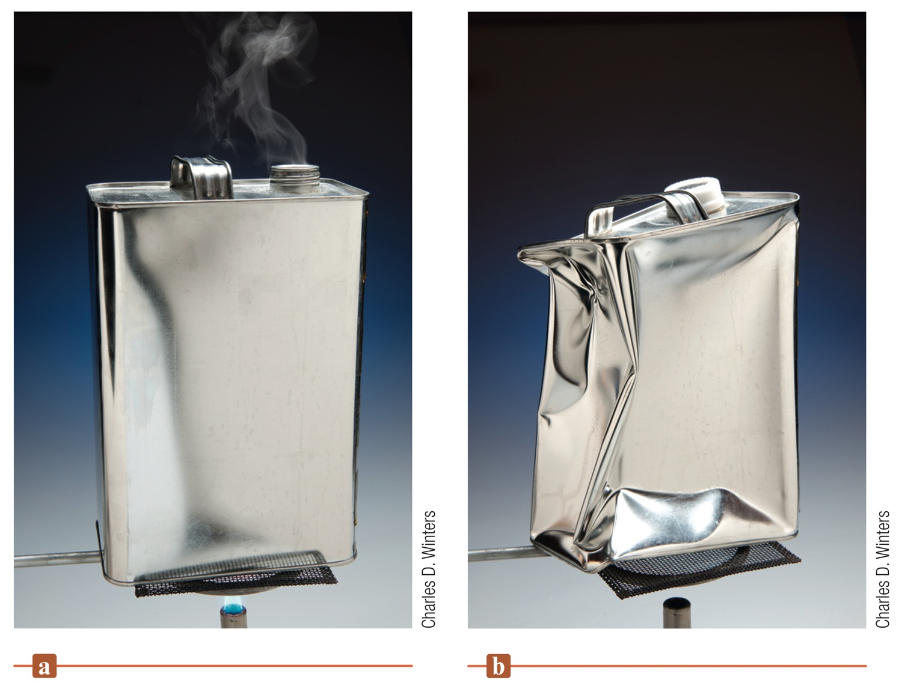
Figure 5.1 - The Collapsing Can Experiment

Slide 6
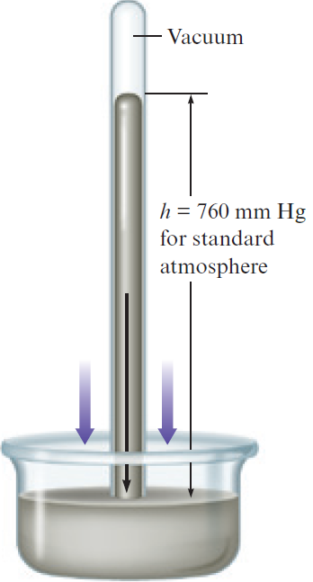
Barometer
Device used to measure atmospheric pressure
Atmospheric pressure results from the weight of the air
Variations are attributed to change in weather conditions and altitudes
Contains a glass tube filled with liquid mercury that is inverted in a dish containing mercury

Slide 7
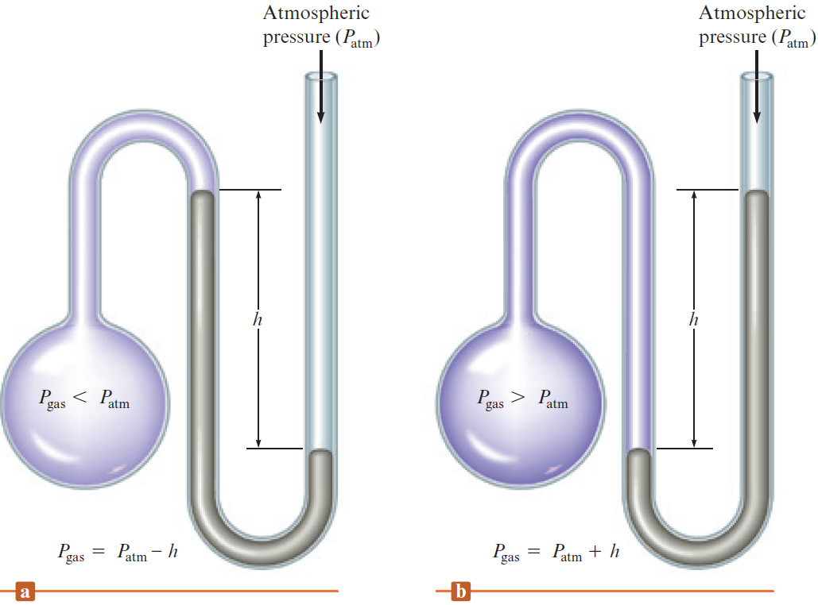
Manometer
Device used for measuring the pressure of a gas in a container

Slide 8
Units of Pressure
Based on the height of the mercury column that a gas can support
mm Hg (millimeter of mercury)
Torr and mm Hg are used interchangeably
Standard atmosphere (atm)

Slide 9
Units of Pressure (Continued)
Defined as force per unit area
SI system
Newton/m² = 1 pascal (Pa)
1 standard atmosphere = 101,325 Pa
1 atmosphere ≈ 10⁵ Pa

Slide 10
Interactive Example 5.1 - Pressure Conversions
The pressure of a gas is measured as 49 torr
Represent this pressure in both atmospheres and pascals

Slide 11
Interactive Example 5.1 - Solution

Slide 12
Boyle’s Law
Robert Boyle studied the relationship between the pressure of trapped gas and its volume
k - Constant for a given sample of air at a specific temperature
Deduced that pressure and volume are inversely related
Ideal gas: Gas that strictly obeys Boyle’s law

Slide 13
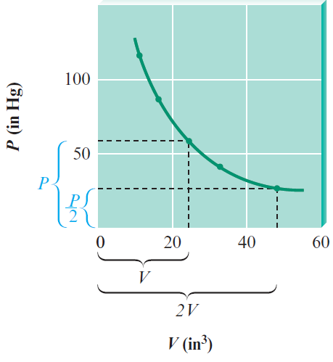
Plot of Boyle’s Law
A plot of P versus V shows that the volume doubles as the pressure is halved
Resulting curve is a hyperbola

Slide 14
Plot of Boyle’s Law (Continued)
Boyle’s law can be rearranged to mirror the straight line equation
y = V
x = 1/P
m = k
b = 0

Slide 15
Figure 5.5 - Linear Plot of Boyle’s Law

Slide 16
Figure 5.6 - A Plot of PV versus P for Several Gases at Pressures below 1 atm

Slide 17
Interactive Example 5.2 - Boyle’s Law I
Sulfur dioxide (SO₂), a gas that plays a central role in the formation of acid rain, is found in the exhaust of automobiles and power plants
Consider a 1.53-L sample of gaseous SO₂ at a pressure of 5.6×10³ Pa
If the pressure is changed to 1.5×10⁴ Pa at a constant temperature, what will be the new volume of the gas?

Slide 18
Interactive Example 5.2 - Solution
Where are we going?
To calculate the new volume of gas
What do we know?
P₁ = 5.6×10³ Pa P₂ = 1.5×10⁴ Pa
V₁ = 1.53 L V₂ = ?
What information do we need?
Boyle’s law

Slide 19
Interactive Example 5.2 - Solution (Continued 1)
How do we get there?
What is Boyle’s law (in a form useful with our knowns)?
What is V₂?
The new volume will be 0.57 L

Slide 20
Interactive Example 5.2 - Solution (Continued 2)
Reality check
The new volume (0.57 L) is smaller than the original volume
As pressure increases, the volume should decrease, so our answer is reasonable

Slide 21
Exercise
A particular balloon is designed by its manufacturer to be inflated to a volume of no more than 2.5 L
If the balloon is filled with 2.0 L helium at sea level, is released, and rises to an altitude at which the atmospheric pressure is only 500 mm Hg, will the balloon burst? (Assume temperature is constant)
The balloon will burst

Slide 22
Example 5.3 - Boyle’s Law II
In a study to see how closely gaseous ammonia obeys Boyle’s law, several volume measurements were made at various pressures, using 1.0 mole of NH₃ gas at a temperature of 0°C
Using the results listed below, calculate the Boyle’s law constant for NH₃ at the various pressures

Slide 23
Example 5.3 - Boyle’s Law II (Continued)

Slide 24
Example 5.3 - Solution
To determine how closely NH₃ gas follows Boyle’s law under these conditions, we calculate the value of k (in L · atm) for each set of values

Slide 25
Example 5.3 - Solution (Continued 1)
Although the deviations from true Boyle’s law behavior are quite small at these low pressures, note that the value of k changes regularly in one direction as the pressure is increased
To calculate the ideal value of k for NH₃, we can plot PV versus P, and extrapolate back to zero pressure, where, for reasons we will discuss later, a gas behaves most ideally

Slide 26
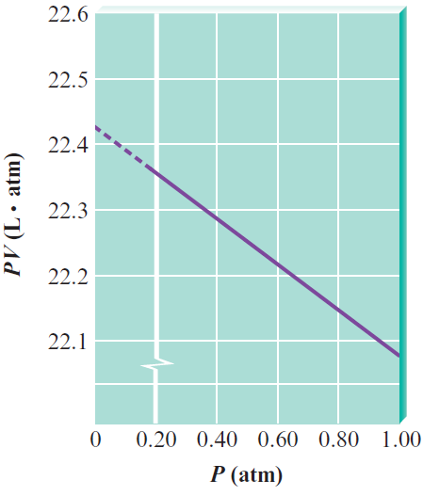
Example 5.3 - Solution (Continued 2)
The value of k obtained by this extrapolation is 22.41 L· atm
Notice that this is the same value obtained from similar plots for the gases CO₂, O₂, and Ne at 0°C

Slide 27
Jacques Charles
French physicist who made the first solo balloon flight
Determined that the volume of a gas at constant pressure increases linearly with the temperature of the gas
Plot of volume of gas (at constant pressure) versus temperature (in °C) gives a straight line

Slide 28
Figure 5.8 - Plots of V versus T (°C) for Several Gases

Slide 29
Charles’s Law
Volume of each gas is directly proportional to the temperature
Volume extrapolates to zero when the temperature is equal to 0 K (absolute zero)
T - Temperature in kelvins
b - Proportionality constant

Slide 30
Critical Thinking
According to Charles’s law, the volume of a gas is directly related to its temperature in kelvins at constant pressure and number of moles
What if the volume of a gas was directly related to its temperature in degrees Celsius at constant pressure and number of moles?
What differences would you notice?

Slide 31
Interactive Example 5.4 - Charles’s Law
A sample of gas at 15°C and 1 atm has a volume of 2.58 L
What volume will this gas occupy at 38°C and 1 atm?

Slide 32
Interactive Example 5.4 - Solution
Where are we going?
To calculate the new volume of gas
What do we know?
T₁ = 15°C + 273 = 288 K
T₂ = 38°C + 273 = 311 K
V₁ = 2.58 L
V₂ = ?

Slide 33
Interactive Example 5.4 - Solution (Continued 1)
What information do we need?
Charles’s law
How do we get there?
What is Charles’s law (in a form useful with our knowns)?

Slide 34
Interactive Example 5.4 - Solution (Continued 2)
What is V₂?
Reality check
The new volume is greater than the original volume, which makes physical sense because the gas will expand as it is heated

Slide 35
Avogadro’s Law
For a gas at constant pressure and temperature, the volume is directly proportional to the number of moles of gas
V - Volume of gas
n - Number of moles of gas particles
a - Proportionality constant

Slide 36
Figure 5.10 - Representation of Avogadro’s Law
These balloons each hold 1.0 L gas at 25°C and 1 atm, and each balloon contains 0.041 mole of gas, or 2.5×10²² molecules

Slide 37
Interactive Example 5.5 - Avogadro’s Law
Suppose we have a 12.2-L sample containing 0.50 mole of oxygen gas (O₂) at a pressure of 1 atm and a temperature of 25°C
If all this O₂ were converted to ozone (O₃) at the same temperature and pressure, what would be the volume of the ozone?

Slide 38
Interactive Example 5.5 - Solution
Where are we going?
To calculate the volume of the ozone produced by 0.50 mole of oxygen
What do we know?
n₁ = 0.50 mol O₂
n₂ = ? mol O₃
V₁ = 12.2 L O₂
V₂ = ? L O₃

Slide 39
Interactive Example 5.5 - Solution (Continued 1)
What information do we need?
Balanced equation
Moles of O₃
Avogadro’s law:
How do we get there?
How many moles of O₃ are produced by 0.50 mole of O₂?

Slide 40
Interactive Example 5.5 - Solution (Continued 2)
What is the balanced equation?
What is the mole ratio between O₃ and O₂?
Now we can calculate the moles of O₃ formed

Slide 41
Interactive Example 5.5 - Solution (Continued 3)
What is the volume of O₃ produced?
Avogadro’s law states that V = an, which can be rearranged to give
Since a is a constant, an alternative representation is
V₁ is the volume of n₁ moles of O₂ gas and V₂ is the volume of n₂ moles of O₃ gas

Slide 42
Interactive Example 5.5 - Solution (Continued 4)
In this case we have
n₁ = 0.50 mol n₂ = 0.33 mol
V₁ = 12.2 L V₂ = ?
Solving for V₂ gives
Reality check - Note that the volume decreases, as it should, since fewer moles of gas molecules will be present after O₂ is converted to O₃

Slide 43
Exercise
An 11.2-L sample of gas is determined to contain 0.50 mole of N₂
At the same temperature and pressure, how many moles of gas would there be in a 20-L sample?
0.89 mol

Slide 44
Ideal Gas Law
The gas laws of Boyle, Charles, and Avogadro can be combined to give the ideal gas law
Universal gas constant: Combined proportionality constant (R)
R = 0.08206 L · atm/K · mol when pressure is expressed in atmospheres and the volume in liters

Slide 45
Ideal Gas Law (Continued)
Can be rearranged to:
Equation of state for a gas, where the state of the gas is its condition at a given time
Based on experimental measurements of the properties of gases
Any gas that obeys this law is said to be behaving ideally
An ideal gas is a hypothetical substance

Slide 46
Gas Law Problems
Types
Boyle’s law problems
Charles’s law problems
Avogadro’s law problems
Ideal gas law can be applied to any problem
Place the variables that change on one side of the equal sign and the constants on the other side

Slide 47
Interactive Example 5.7 - Ideal Gas Law II
Suppose we have a sample of ammonia gas with a volume of 7.0 mL at a pressure of 1.68 atm
The gas is compressed to a volume of 2.7 mL at a constant temperature
Use the ideal gas law to calculate the final pressure

Slide 48
Interactive Example 5.7 - Solution
Where are we going?
To use the ideal gas equation to determine the final pressure
What do we know?
P₁ = 1.68 atm
P₂ = ?
V₁ = 7.0 mL
V₂ = 2.7 mL

Slide 49
Interactive Example 5.7 - Solution (Continued 1)
What information do we need?
Ideal gas law
R = 0.08206 L · atm/K · mol
How do we get there?
What are the variables that change?
P, V

Slide 50
Interactive Example 5.7 - Solution (Continued 2)
What are the variables that remain constant?
n, R, T
Write the ideal gas law, collecting the change variables on one side of the equal sign and the variables that do not change on the other
Change
Remain
constant

Slide 51
Interactive Example 5.7 - Solution (Continued 3)
Since n and T remain the same in this case, we can write P₁V₁ = nRT and P₂V₂ = nRT, and combining these gives
P₁ = 1.68 atm V₁ = 7.0 mL V₂ = 2.7 mL
Solving for P₂ gives

Slide 52
Interactive Example 5.7 - Solution (Continued 4)
Reality check - The volume decreased (at constant temperature), so the pressure should increase
Note that the calculated final pressure is 4.4 atm
Most gases do not behave ideally above 1 atm
If the pressure of this gas sample was measured, the observed pressure would differ slightly from 4.4 atm

Slide 53
Interactive Example 5.9 - Ideal Gas Law IV
A sample of diborane gas (B₂H₆), a substance that bursts into flame when exposed to air, has a pressure of 345 torr at a temperature of –15°C and a volume of 3.48 L
If conditions are changed so that the temperature is 36°C and the pressure is 468 torr, what will be the volume of the sample?

Slide 54
Interactive Example 5.9 - Solution
Where are we going?
To use the ideal gas equation to determine the final volume
What do we know?
T₁ = 15°C + 273 = 258 K T₂ = 36°C + 273 = 309 K
V₁ = 3.48 L V₂ = ?
P₁ = 345 torr P₂ = 468 torr

Slide 55
Interactive Example 5.9 - Solution (Continued 1)
What information do we need?
Ideal gas law
R = 0.08206 L · atm/K · mol
How do we get there?
What are the variables that change?
P, V, T

Slide 56
Interactive Example 5.9 - Solution (Continued 2)
What are the variables that remain constant?
n, R
Write the ideal gas law, collecting the change variables on one side of the equal sign and the variables that do not change on the other

Slide 57
Interactive Example 5.9 - Solution (Continued 3)
Solving for V₂

Slide 58
Interactive Example 5.10 - Ideal Gas Law V
A sample containing 0.35 mole of argon gas at a temperature of 13°C and a pressure of 568 torr is heated to 56°C and a pressure of 897 torr
Calculate the change in volume that occurs

Slide 59
Interactive Example 5.10 - Solution
Where are we going?
To use the ideal gas equation to determine the final volume
What do we know?

Slide 60
Interactive Example 5.10 - Solution (Continued 1)
What information do we need?
Ideal gas law
R = 0.08206 L · atm/K · mol
V₁ and V₂

Slide 61
Interactive Example 5.10 - Solution (Continued 2)
How do we get there?
What is V₁?

Slide 62
Interactive Example 5.10 - Solution (Continued 3)
What is V₂?

Slide 63
Interactive Example 5.10 - Solution (Continued 4)
What is the change in volume ΔV?
Conclusion
The change in volume is negative because the volume decreases

Slide 64
Molar Volume of an Ideal Gas
Molar volume: For 1 mole of an ideal gas at 0°C and 1 atm, the volume of the gas is 22.42 L
Standard temperature and pressure (STP): Conditions 0°C and 1 atm

Slide 65
Critical Thinking
What if STP was defined as normal room temperature (22°C) and 1 atm?
How would this affect the molar volume of an ideal gas?
Include an explanation and a number

Slide 66
Interactive Example 5.12 - Gas Stoichiometry II
Quicklime (CaO) is produced by the thermal decomposition of calcium carbonate (CaCO₃)
Calculate the volume of CO₂ at STP produced from the decomposition of 152 g CaCO₃ by the reaction

Slide 67
Interactive Example 5.12 - Solution
Where are we going?
To use stoichiometry to determine the volume of CO₂ produced
What do we know?
What information do we need?
Molar volume of a gas at STP is 22.42 L

Slide 68
Interactive Example 5.12 - Solution (Continued 1)
How do we get there?
What is the balanced equation?
What are the moles of CaCO₃ (100.09 g/mol)?

Slide 69
Interactive Example 5.12 - Solution (Continued 2)
What is the mole ratio between CO₂ and CaCO₃ in the balanced equation?
What are the moles of CO₂?
1.52 moles of CO₂, which is the same as the moles of CaCO₃ because the mole ratio is 1

Slide 70
Interactive Example 5.12 - Solution (Continued 3)
What is the volume of CO₂ produced?
We can compute this by using the molar volume since the sample is at STP:
Thus, the decomposition of 152 g CaCO₃ produces 34.1 L CO₂ at STP

Slide 71
Interactive Example 5.13 - Gas Stoichiometry III
A sample of methane gas having a volume of 2.80 L at 25°C and 1.65 atm was mixed with a sample of oxygen gas having a volume of 35.0 L at 31°C and 1.25 atm, and the mixture was then ignited to form carbon dioxide and water
Calculate the volume of CO₂ formed at a pressure of 2.50 atm and a temperature of 125°C

Slide 72
Interactive Example 5.13 - Solution
Where are we going?
To determine the volume of CO₂ produced
What do we know?

Slide 73
Interactive Example 5.13 - Solution (Continued 1)
What information do we need?
Balanced chemical equation for the reaction
Ideal gas law
R = 0.08206 L · atm/K · mol

Slide 74
Interactive Example 5.13 - Solution (Continued 2)
How do we get there?
What is the balanced equation?
From the description of the reaction, the unbalanced equation is
This can be balanced to give

Slide 75
Interactive Example 5.13 - Solution (Continued 3)
What is the limiting reactant?
We can determine this by using the ideal gas law to determine the moles for each reactant

Slide 76
Interactive Example 5.13 - Solution (Continued 4)
In the balanced equation for the combustion reaction, 1 mole of CH₄ requires 2 moles of O₂
The moles of O₂ required by 0.189 mole of CH₄ can be calculated as follows:
The limiting reactant is CH₄

Slide 77
Interactive Example 5.13 - Solution (Continued 5)
What are the moles of CO₂?
Since CH₄ is limiting, we use the moles of CH₄ to determine the moles of CO₂ produced
What is the volume of CO₂ produced?
Since the conditions stated are not STP, we must use the ideal gas law to calculate the volume

Slide 78
Interactive Example 5.13 - Solution (Continued 6)
In this case, n = 0.189 mol, T = 125°C + 273 = 398 K, P = 2.50 atm, and R = 0.08206 L · atm/K · mol
This represents the volume of CO₂ produced under these conditions

Slide 79
Molar Mass of a Gas
Ideal gas law is essential for the calculation of molar mass of a gas from its measured density
Substituting into the ideal gas equation gives:

Slide 80
Molar Mass of a Gas (Continued)
Density, d, is equal to m/V
Or

Slide 81
Interactive Example 5.14 - Gas Density/Molar Mass
The density of a gas was measured at 1.50 atm and 27°C and found to be 1.95 g/L
Calculate the molar mass of the gas

Slide 82
Interactive Example 5.14 - Solution
Where are we going?
To determine the molar mass of the gas
What do we know?
P = 1.50 atm
T = 27°C + 273 = 300 K
d = 1.95 g/L

Slide 83
Interactive Example 5.14 - Solution (Continued)
What information do we need?
R = 0.08206 L · atm/K · mol
How do we get there?
Reality check - These are the units expected for molar mass

Slide 84
Law of Partial Pressures - John Dalton
For a mixture of gases in a container, the total pressure exerted is the sum of the partial pressures
Partial pressure: Pressure that a gas would exert if it were alone in a container
Represented by symbols P₁, P₂, and P₃

Slide 85
Law of Partial Pressures - John Dalton (Continued 1)
Assume that all gases behave ideally
Their partial pressures can be calculated from the ideal gas law
Total pressure of the mixture P_{TOTAL}

Slide 86
Law of Partial Pressures - John Dalton (Continued 2)
n_{TOTAL} - Sum of the number of moles of the various gases

Slide 87
Figure 5.12 - Schematic Diagram of Dalton's Law of Partial Pressures

Slide 88
Characteristics of an Ideal Gas
Since the pressure exerted by an ideal gas is unaffected by its identity:
The volume of individual gas particles must not be important
The forces among the particles must not be important

Slide 89
Interactive Example 5.15 - Dalton’s Law I
Mixtures of helium and oxygen can be used in scuba diving tanks to help prevent “the bends”
For a particular dive, 46 L He at 25°C and 1.0 atm and 12 L O₂ at 25°C and 1.0 atm were pumped into a tank with a volume of 5.0 L
Calculate the partial pressure of each gas and the total pressure in the tank at 25°C

Slide 90
Interactive Example 5.15 - Solution
Where are we going?
To determine the partial pressure of each gas
To determine the total pressure in the tank at 25°C
What do we know?

Slide 91
Interactive Example 5.15 - Solution (Continued 1)
What information do we need?
Ideal gas law
R = 0.08206 L · atm/K · mol
How do we get there?
How many moles are present for each gas?

Slide 92
Interactive Example 5.15 - Solution (Continued 2)

Slide 93
Interactive Example 5.15 - Solution (Continued 3)
What is the partial pressure for each gas in the tank?
The tank containing the mixture has a volume of 5.0 L, and the temperature is 25°C
We can use these data and the ideal gas law to calculate the partial pressure of each gas

Slide 94
Interactive Example 5.15 - Solution (Continued 4)
What is the total pressure of the mixture of gases in the tank?
The total pressure is the sum of the partial pressures

Slide 95
Mole Fraction (χ)
Ratio of number of moles of a given component in a mixture to the total number of moles in the mixture
Example
For a given component in a mixture, χ₁ is calculated as follows:

Slide 96
Mole Fraction (χ) in Terms of Pressure
Number of moles of a gas is directly proportional to the pressure of the gas, since
Representation of mole fraction in terms of pressure

Slide 97
Mole Fraction (χ) in Terms of Pressure (Continued)
Mole fraction of each component in a mixture of ideal gases is directly related to its partial pressure

Slide 98
Interactive Example 5.16 - Dalton’s Law II
The partial pressure of oxygen was observed to be 156 torr in air with a total atmospheric pressure of 743 torr
Calculate the mole fraction of O₂ present

Slide 99
Interactive Example 5.16 - Solution
Where are we going?
To determine the mole fraction of O₂
What do we know?
P_{O2} = 156 torr
P_{TOTAL} = 743 torr

Slide 100
Interactive Example 5.16 - Solution (Continued)
How do we get there?
The mole fraction of O₂ can be calculated from the equation
Note that the mole fraction has no units

Slide 101
Rearranging the Expression of Mole Fraction
This can be rearranged to give
P₁ = χ₁ + P_{TOTAL}
The partial pressure of a particular component of a gaseous mixture is the mole fraction of that component times the total pressure

Slide 102
Vapor Pressure of Water
When the rate of escape of a gas in a container equals the rate of return:
Number of water molecules in the vapor state remain constant
Pressure of water vapor remains constant

Slide 103
Figure 5.13 - The Production of Oxygen by Thermal Decomposition of Potassium Chlorate

Slide 104
Interactive Example 5.18 - Gas Collection over Water
A sample of solid potassium chlorate (KClO₃) was heated in a test tube and decomposed by the following reaction:
The oxygen produced was collected by displacement of water at 22°C at a total pressure of 754 torr
The volume of the gas collected was 0.650 L, and the vapor pressure of water at 22°C is 21 torr

Slide 105
Interactive Example 5.18 - Gas Collection over Water (Continued)
Calculate the partial pressure of O₂ in the gas collected and the mass of KClO₃ in the sample that was decomposed

Slide 106
Interactive Example 5.18 - Solution
Where are we going?
To determine the partial pressure of O₂ in the gas collected
Calculate the mass of KClO₃ in the original sample
What do we know?

Slide 107
Interactive Example 5.18 - Solution (Continued 1)
How do we get there?
What is the partial pressure of O₂?
What is the number of moles of O₂?
Now we use the ideal gas law to find the number of moles of O₂

Slide 108
Interactive Example 5.18 - Solution (Continued 2)
In this case, the partial pressure of the O₂ is
To find the moles of O₂ produced, we use
V = 0.650 L
T = 22°C + 273 = 295 K
R = 0.08206 L · atm/K · mol

Slide 109
Interactive Example 5.18 - Solution (Continued 3)
How many moles of KClO₃ are required to produce this amount of O₂?
What is the balanced equation?
What is the mole ratio between KClO₃ and O₂ in the balanced equation?

Slide 110
Interactive Example 5.18 - Solution (Continued 4)
What are the moles of KClO₃?
What is the mass of KClO₃ (molar mass 122.6 g/mol) in the original sample?

Slide 111
The Kinetic Molecular Theory (KMT)
Attempts to explain the properties of an ideal gas
Real gases do not conform to the postulates of the KMT
Based on speculations about the behavior of individual gas particles

Slide 112
Postulates of the Kinetic Molecular Theory
Particles are so small compared with the distances between them that the volume of the individual particles can be assumed to be negligible (zero)

Slide 113
Postulates of the Kinetic Molecular Theory (Continued 1)
Particles are in constant motion
Collisions of the particles with the walls of the container are the cause of the pressure exerted by the gas
Particles are assumed to exert no forces on each other
Particles are assumed neither to attract nor to repel each other

Slide 114
Postulates of the Kinetic Molecular Theory (Continued 2)
Average kinetic energy of a collection of gas particles is assumed to be directly proportional to the Kelvin temperature of the gas

Slide 115
Pressure and Volume (Boyle’s Law)
For a given sample of a gas at any given temperature, if the volume decreases, the pressure increases
According to KMT, decrease in volume implies that the gas particles would hit the wall more often
Increases pressure
Constant

Slide 116
Figure 5.16 - Effects of Decreasing the Volume of a Sample of Gas at Constant Temperature

Slide 117
Pressure and Temperature
According to the ideal gas law, for a given sample of an ideal gas at constant volume, the pressure is directly proportional to the temperature
According to KMT, as the temperature increases, the speed of the gas particles increases, and they hit the wall with greater force resulting in increased pressure
Constant

Slide 118
Figure 5.16 - Effects of Increasing the Temperature of a Sample of Gas at Constant Volume

Slide 119
Critical Thinking
You have learned the postulates of the KMT
What if we could not assume the third postulate to be true?
How would this affect the measured pressure of a gas?

Slide 120
Volume and Temperature (Charles’s Law)
According to the ideal gas law, for a sample of a gas at constant pressure, the volume of the gas is directly proportional to the temperature in Kelvins
According to the KMT, at higher temperature, the speed of gas molecules increases
Hit the walls with more force
Constant

Slide 121
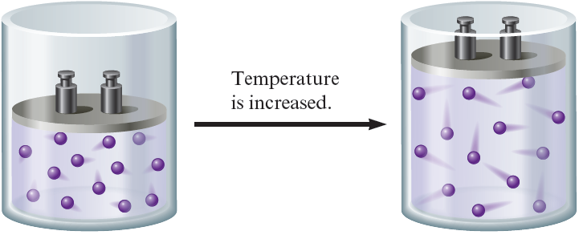
Volume and Temperature (Charles’s Law) (Continued)
Pressure can be kept constant only by increasing the volume of the container

Slide 122
Volume and Number of Moles (Avogadro’s Law)
According to the ideal gas law, the volume of a gas at constant temperature and pressure directly depends on the number of gas particles present
According to the KMT, increase in number of gas particles at the same temperature would cause the pressure to increase if the volume were held constant
Constant

Slide 123
Volume and Number of Moles (Avogadro’s Law) (Continued)
Pressure can return to its original value if volume is increased

Slide 124
Mixture of Gases (Dalton’s Law)
Total pressure exerted by a mixture of gases is the sum of the pressures of the individual gases
The KMT assumes that:
All gas particles are independent of one another
Volume of individual particles are not important

Slide 125
Deriving the Ideal Gas Law
Pressure can be expressed differently by applying the definitions of velocity, momentum, force, and pressure to the collection of particles in an ideal gas

Slide 126
Deriving the Ideal Gas Law (Continued 1)
Here,
P - Pressure of the gas
n - Number of moles of gas
N_{A} - Avogadro’s number
m - Mass of each particle
- Average of the square of the velocities of the particles
V - Volume of the container
- Average kinetic energy of a gas particle

Slide 127
Deriving the Ideal Gas Law (Continued 2)
Average kinetic energy for a mole of gas particles can be ascertained by multiplying the average kinetic energy of an individual particle by N_{A}
The expression for pressure can be rewritten as:

Slide 128
Deriving the Ideal Gas Law (Continued 3)
Since (KE)_{avg} ∝ T:
The agreement between the ideal gas law and the postulates of the KMT prove the validity of the KMT model

Slide 129
The Meaning of Temperature
According to the KMT, the Kelvin temperature indicates the average kinetic energy of gas particles
This relationship between temperature and average kinetic energy can be obtained when the following equations are combined:

Slide 130
The Meaning of Temperature (Continued)
This shows that the Kelvin temperature is an index of the random motions of particles of a gas
As temperature increases, the motion of the particles becomes greater

Slide 131
Root Mean Square Velocity
Refers to the square root of
Symbolized by u_{rms}
The expression for u_{rms} can also be attained from the following equations:

Slide 132
Root Mean Square Velocity (Continued 1)
Combination of the equations gives
Taking square root on both sides, we get:
m - Mass (kg) of a single gas particle
N_{A} - Number of particles in a mole

Slide 133
Root Mean Square Velocity (Continued 2)
Substituting M for N_{A}m in the equation for u_{rms}, we obtain:
M - Mass of a mole of gas particles (kg)
R = 8.3145 J/K·mol
J = joule = kg . m²/s²

Slide 134
Interactive Example 5.19 - Root Mean Square Velocity
Calculate the root mean square velocity for the atoms in a sample of helium gas at 25°C

Slide 135
Interactive Example 5.19 - Solution
Where are we going?
To determine the root mean square velocity for the atoms of He
What do we know?
T = 25°C + 273 = 298 K
R = 8.3145 J/K · mol
What information do we need?
Root mean square velocity is

Slide 136
Interactive Example 5.19 - Solution (Continued 1)
How do we get there?
What is the mass of a mole of He in kilograms?
What is the root mean square velocity for the atoms of He?

Slide 137
Interactive Example 5.19 - Solution (Continued 2)
Since the units of J are kg · m²/s², this expression gives:
Reality check - The resulting units are appropriate for velocity

Slide 138
Range of Velocities in Gas Particles
Real gases have large number of collisions between particles
Path of a gas particle is erratic
Mean free path
Average distance travelled by a particle between collisions in a gas sample
1×10^{–7} m for O₂ at STP

Slide 139
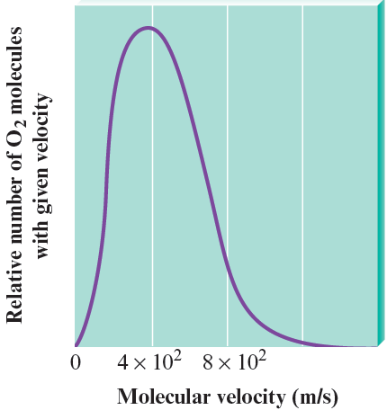
Effect of Collisions among Gas Particles
When particles collide and exchange kinetic energy, a large range of velocities is produced
This plot depicts the relative number of O₂ molecules that have a given velocity at STP

Slide 140
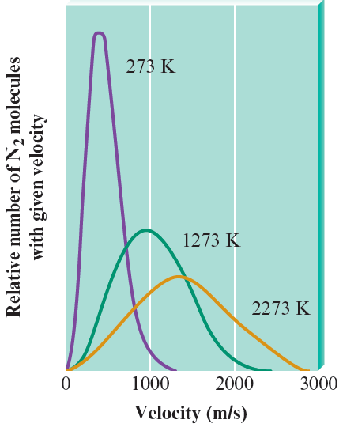
Effect of Temperature on Velocity Distribution
As the temperature increases, the range of velocities becomes larger
Peak of the curve reflects the most probable velocity

Slide 141
Effusion and Diffusion - An Introduction
Diffusion: Describes the mixing of gases
Rate of diffusion is the rate of mixing of gases
Effusion: Describes the passage of a gas through a tiny orifice into an evacuated chamber
Rate of effusion measures the speed at which the gas is transferred into the chamber
Inversely proportional to the square root of the mass of the gas particles

Slide 142
Figure 5.22 - The Effusion of a Gas into an Evacuated Chamber

Slide 143
Graham’s Law of Effusion
Relative rates of effusion of two gases at the same T and P are given by the inverse ratio of the square roots of the masses of the gas particles
M₁ and M₂ - Molar masses of the gases

Slide 144
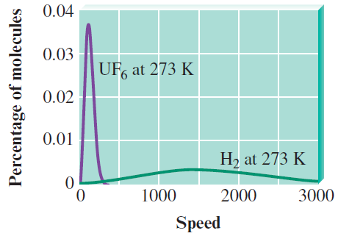
Interactive Example 5.20 - Effusion Rates
Calculate the ratio of the effusion rates of hydrogen gas (H₂) and uranium hexafluoride (UF₆), a gas used in the enrichment process to produce fuel for nuclear reactors
Relative molecular speed distribution of H₂ and UF₆

Slide 145
Interactive Example 5.20 - Solution
First we need to compute the molar masses
Molar mass of H₂ = 2.016 g/mol, and molar mass of UF₆ = 352.02 g/mol
Using Graham’s law, we have:
The effusion rate of the very light H₂ molecules is about 13 times that of the massive UF₆ molecules

Slide 146
Prediction of the Relative Effusion Rates of Gases by the KMT
The kinetic molecular model fits the experimental results for the effusion of gases
Prediction for two gases at the same pressure and temperature

Slide 147
Figure 5.24 - Demonstration of the Relative Diffusion Rates of NH₃ and HCl Molecules

Slide 148
Ideal Gas Behavior
Exhibited by real gases under certain conditions of:
Low pressure
High temperature

Slide 149
Figure 5.25 - Plots of PV/nRT versus P for Several Gases (200 K)

Slide 150
Figure 5.26 - Plots of PV/nRT versus P for Nitrogen Gas at Three Temperatures

Slide 151
van der Waals Equation
Actual volume available to a given gas molecule can be calculated as follows:
V - Volume of the container
nb - Correction factor for the volume of the molecules
n - Number of moles of gas
b - Empirical constant

Slide 152
van der Waals Equation (Continued 1)
The ideal gas equation can be modified as follows:
When gas particles come close together, attractive forces occur
Cause the particles to hit the walls very slightly and less often

Slide 153
van der Waals Equation (Continued 2)
Size of the correction factor depends on the concentration of gas molecules
Higher the concentration, the more likely that the particles will attract each other
a - Proportionality constant whose value can be determined by observing the actual behavior of the gas

Slide 154
van der Waals Equation (Continued 3)
Values of a are b vary until the best fit for the observed pressure is obtained
Corrected volume
V_{ideal}

Slide 155
Table 5.3 - Values of the van der Waals Constants for some Common Gases

Slide 156
Critical Thinking
You have learned that no gases behave perfectly ideally, but under conditions of high temperature and low pressure (high volume), gases behave more ideally
What if all gases always behaved perfectly ideally?
How would the world be different?

Slide 157
Behavior of Real Gases - Conclusions
For a real gas, the actual observed pressure is lower than the pressure expected for an ideal gas
Caused due to intermolecular attractions that occur in real gases, which increase in the following order:
H₂ < N₂ < CH₄ < CO₂

