Slide 1
Fossil Fuels

Slide 2
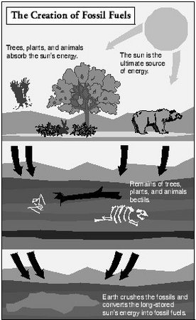
What is fossil fuels?
Fossil fuel is an energy resource that is formed from the remains of plant and animals that lived a long time ago.
Fossil fuels consist largely of hydrocarbons, which are complex chains of hydrogen and carbon atoms. They are extracted from the earth’s crust .

Slide 3
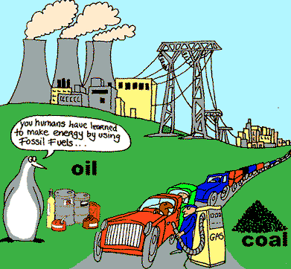
What are different types of fossil fuels?

Slide 4
What is Oil ?
Oil is a liquid fossil fuel composed of decayed organic matter that occurs naturally in underground reservoirs.
It is extracted from subsurface reservoirs as crude oil and is sent
to a refinery for separation into its various component fuels such as Kerosene, Diesel Fuel,
and Aviation Fuel.

Slide 5
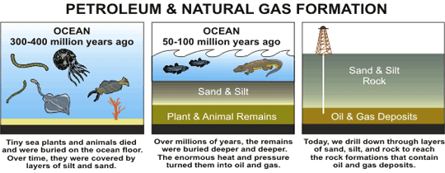
How is Oil Formed ?

Slide 6
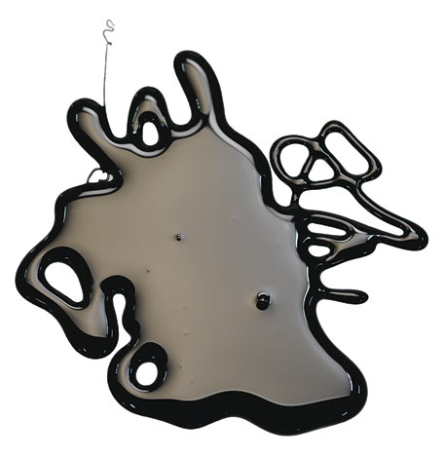
How is Oil Formed ?
The remains of animals and plants that lived millions of years ago in water environment were covered by layers of sand and silt.
Heat and pressure from these layers helped the remains turn into what we today call crude oil.

Slide 7
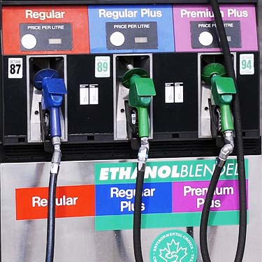
Oil Uses
When petroleum is refined, its various chemical parts are separated and some become gasoline, some lubricants, some asphalt, and others the raw materials for plastics and rubber and many more things.

Slide 8
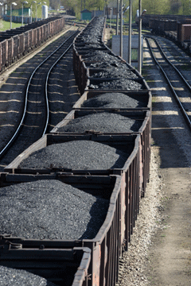
What is coal ?
Coal is a readily combustible rock consisting of more than 50 % by weight and more than 70 % by volume of carbonaceous materials.

Slide 9
Coal uses
Coal is very commonly used today to produce electricity.
Coal is also used in iron and steel production, cement manufacturing, in the production of coal tar, home heating, and any number of industrial applications that require heat.

Slide 10
What is Natural Gas ?
Natural gas is a mixture of hydrocarbons, primarily methane.
Other gases present typically include ethane, propane, nitrogen, water vapor, & carbon dioxide.

Slide 11
How is natural gas formed?
Theory states natural gas is composed of the remnants of decayed plant and animal matter that has been subjected to immense pressure under the earth’s crust over millions of years.
A further way in which natural gas can be produced is by microorganisms breaking down organic matter and producing methane.
Natural gas is made up of a combination of gases, which consists largely of methane (CH4) with lesser amounts of Ethane, Propane And Butane as well as Nitrogen, Carbon Dioxide & traces of some other gases.

Slide 12
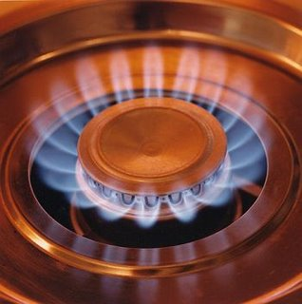
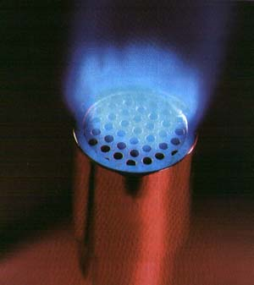
Natural gas uses
Natural gas is used to produce steel, glass, paper, clothing, brick, electricity and as an essential raw material for many common products.
Some products that use natural gas as a raw material are:
paints, fertilizer, plastics, antifreeze, dyes, photographic film, medicines, & explosives.

Slide 13
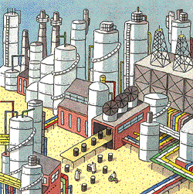
Refineries
A refinery is a factory.
A refinery takes a raw material (crude oil) and transforms it into petrol and hundreds of other useful products. A typical large refinery costs billions of pounds to build and millions more to run and upgrade.
It runs around the clock 365 days a year, employs hundreds of people and occupies as much land as several hundred football pitches.

Slide 14
How are Refineries worked ?
All refineries perform three basic steps:
Separation (fractional distillation)
Conversion (cracking and rearranging the molecules)
Treatment ( the finishing touch)

Slide 15
Step.1 : Separation
Modern separation involves piping crude oil through hot furnaces.
The resulting liquids and vapors are passed into distillation towers.

Slide 16
Step.1 : Separation
It is important to realize that the column is hot at the bottom and cool at the top.
The crude oil separates into fractions according to weight and boiling point.
The lightest fractions, including petrol & liquid petroleum gas (LPG), vaporize and rise to the top of the tower.
Kerosene (aviation fuel) & diesel oil, stay in the middle of the tower
Heavier liquids separate lower down.
The heaviest fractions with the highest boiling points settle at the very bottom.

Slide 17
Step.2: Conversion
The most widely used conversion method is called cracking because it uses heat and pressure to "crack" heavy hydrocarbon molecules into lighter ones.
A cracking unit consists of one or more tall, thick-walled, reactors and a network of furnaces, heat exchangers & other vessels.
Catalytic cracking, or "cat cracking," is the basic petrol-making process. Using intense heat (about 600°C), low pressure and a powdered catalyst (a substance that speeds up a chemical reaction), the cat. cracker can convert most of the heavy fractions into smaller more useful molecules.

Slide 18
Step.3: Treatment
Today, a major portion of refining involves blending, purifying, fine-tuning and improving products to meet specific requirements.
To make petrol, refinery workers carefully blend together a variety of hydrocarbons. Technicians also add performance additives and dyes that distinguish the various grades of fuel.
By the time the petrol is pumped into a car it contains more than 200 hydrocarbons and additives.

Slide 19
Pollution From Fossil Fuels
Problem:
The burning of fossil fuels is dangerous to the Earth, and all of the earth’s living species.
Solution:
We need to find an alternate power source, such as wind power, solar power, and water currents, and only use a little of the fossil fuels.

Slide 20
Prices of Fossil Fuels
The costs of continuing on our current energy path are steep. American consumers and businesses already spend roughly $700 billion to $1 trillion each year on coal, oil and natural gas, and suffer the incalculable costs of pollution from fossil fuels through damage to our health and environment.
If America continues along a business-as-usual energy path, U.S. fossil fuel spending is likely to grow, totaling an estimated $23 trillion between 2010 and 2030.

Slide 21
Global warming
Global warming: Carbon monoxide is the result of burning fossil fuels. The temperature of the earth has increased by approximately 1° centigrade since the 1800s. This has led to glacier melting in the Polar Regions, thus increasing the water content in the seas. This has further led to inundation of river deltas, wetlands, and coastal areas. Extreme weather is reported throughout the world.

Slide 22
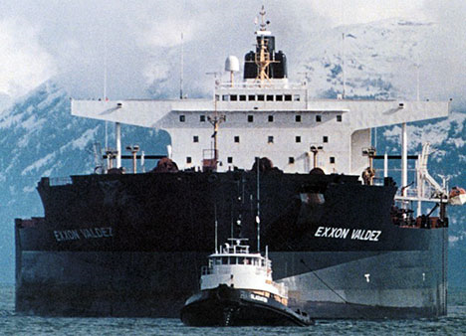
Exxon Valdez oil spill
The Exxon Valdez oil spill occurred in Prince William Sound, Alaska, on March 24, 1989, when the Exxon Valdez, an oil tanker bound for Long Beach, California, hit Prince William Sound's Bligh Reef and spilled an estimated minimum 10.8 million US gallons of crude oil.
It is considered to be one of the most devastating human-caused environmental disasters ever to occur in history.

