Slide 1
Metabolism
Dr. Manal Haj Hamad
References :
1- advanced human nutrition and metabolism
2-Contemporary nutrition , functional approach

Slide 2
Introduction

Slide 3
Metabolism
The totality of an organism’s chemical processes.
Concerned with managing the material and energy resources of the cell.
Metabolism is an emergent property of life that arises from interactions between molecules within the cell

Slide 4
Metabolism
A metabolic pathway begins with a specific molecule and ends with a product
Each step is catalyzed by a specific enzyme
A → B → C→ D→ ( out put, catalyst)

Slide 5
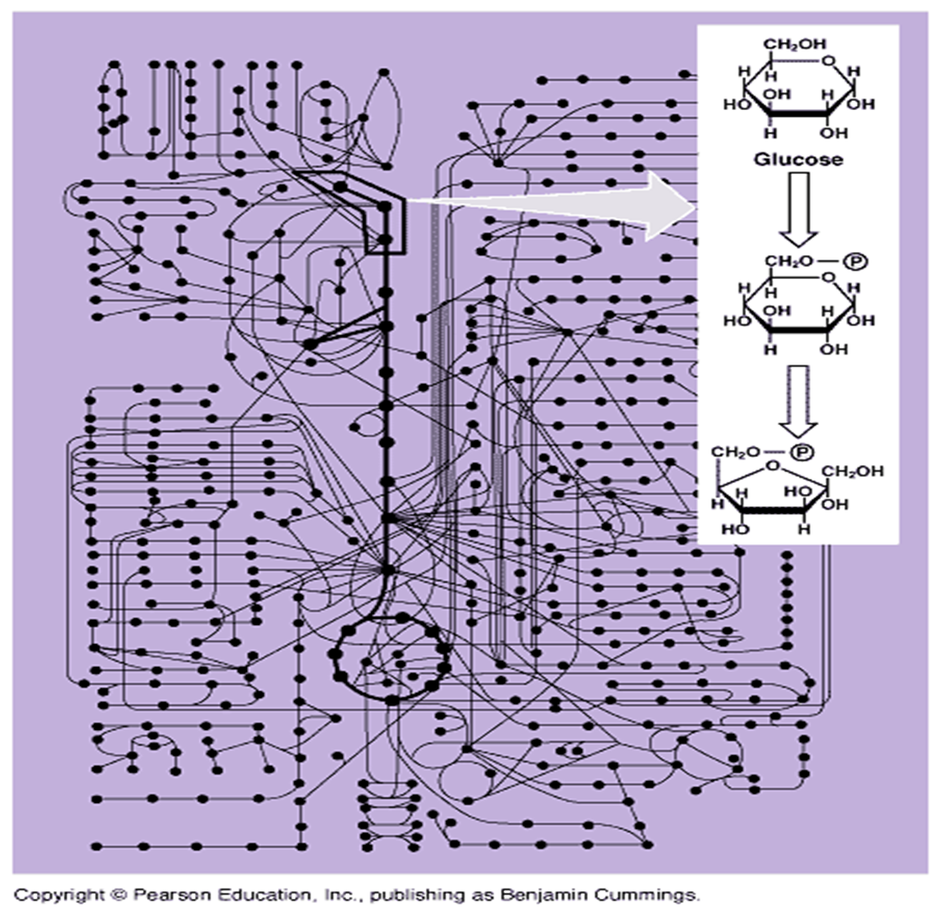

Slide 6
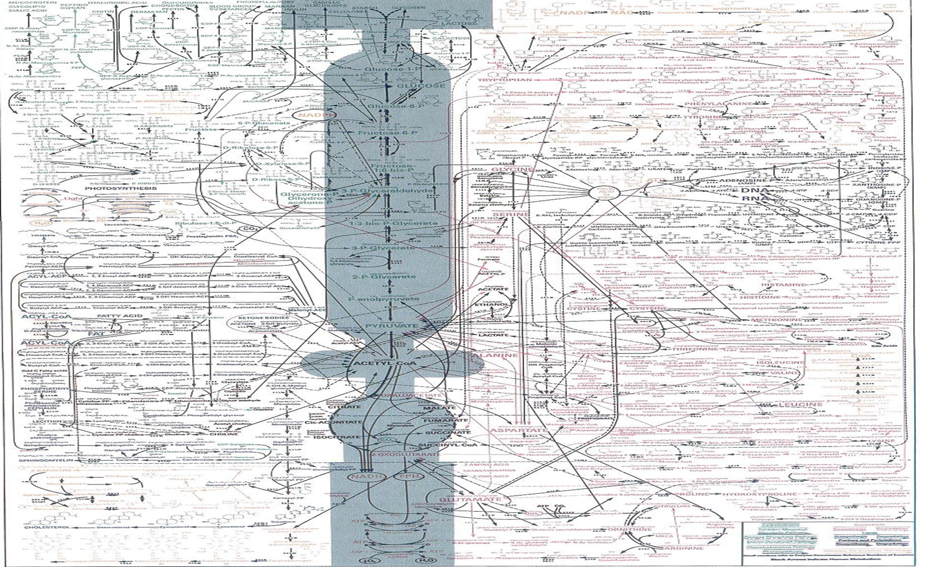

Slide 7
Metabolic pathways
Metabolic: ---------- Anabolic
---------- Catabolic

Slide 8
Catabolic pathways
Catabolic pathways release energy by breaking down complex molecules into simpler compounds
Cellular respiration, the breakdown of glucose in the presence of oxygen, is an example of a pathway of catabolism

Slide 9
Anabolic pathways
Anabolic pathways consume energy to build complex molecules from simpler ones
The synthesis of protein from amino acids is an example of anabolism

Slide 10
Anabolism
Catabolism
large complex organic molecules are constructed from small molecules
Decomposition of large complex molecules into small molecules
Biosynthetic
Degradative
Reductive
Oxidative
Energy Required
Energy Liberated

Slide 11
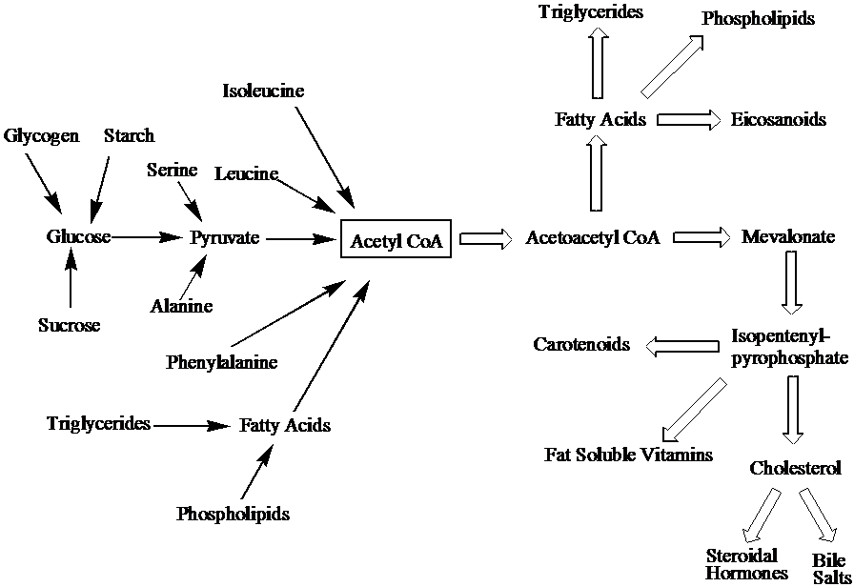
Catabolism
Anabolism
(converging)
(diverging)
Few
Many
Many
Few

Slide 12
Catabolism and anabolism are always related
Nutrients
Carbohydrates
Fats
Proteins
Macromolecules
Proteins
Polysaccharides
Lipids
Nucleic acids
GTP
ATP
Catabolism (oxidative, exergonic)
NADPH
Anabolism (reductive, endergonic)
NADPH
Chemical energy
NADPH
NADH
ATP
ATP
Precursor Molecules
Amino acids
Sugars
Fatty acids
Nitrogenous bases
End products
H₂O, CO_{2,} NH₃
Notes:
To

Slide 13
Chemical energy
ATP - energy currency. It serves as the driving force for nearly all biochemical processes
NADH,NADPH - reducing power.
NADH for oxidation and energy yielding.
NADPH for biosynthetic processes

Slide 14
Metabolic Pathways
Sequential steps catalyzed by enzymes
intermediates
A
B
C
D
A is a precursor for B, C and D
metabolites of A
B is a precursor for C and D
C is a precursor for D

Slide 15
Characteristics of Metabolic Pathways
Metabolic pathways are irreversible
Metabolic pathways have committed step
Early step unique to a pathway
Irreversible step
Requires energy
Often results in a phosphorylated compound
Metabolic pathways are regulated
Metabolic pathways are compartmentalized.

Slide 16
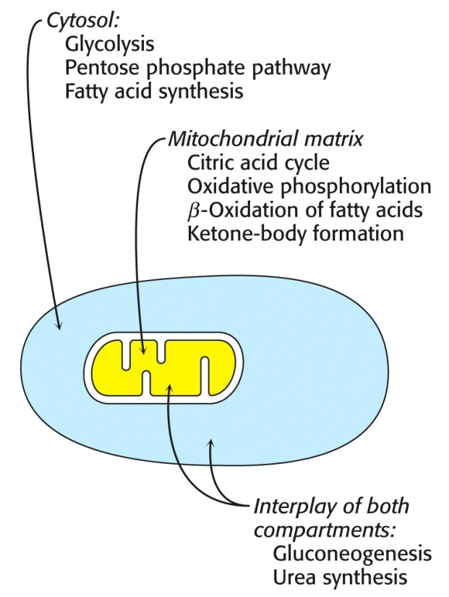
Cellular level Compartmentation
Mitochondria (TCA cycle, fatty acid oxidation, amino acid breakdown)
Cytosol (glycolysis, fatty acid biosynthesis, pentose phosphate pathway)

Slide 17
Control of metabolic pathways
Molecular level:
Control of enzyme levels
gene expression
Control of enzyme activity

Slide 18
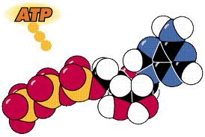
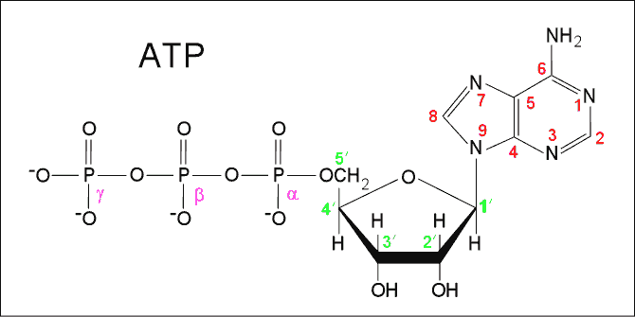
ATP
Nucleotide with three phosphate groups attached to the ribose sugar
Most important phosphate compound in metabolism
One of the common links between catabolism and anabolism is ATP
ATP is used to shuttle chemical energy from catabolism to anabolism

Slide 19
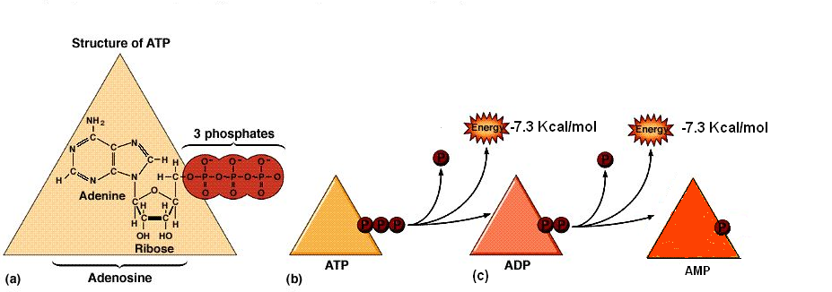
A large amount of energy is liberated when
1.
ATP → ADP + Pi (orthophosphate)
2.
ATP → AMP + PPi (pyrophospahte)

Slide 20
ATP is continuously formed and consumed
Resting person consumes ~ 40kg of ATP/ 24 hr.
ADP
ATP
Photosynthesis or oxidation of fuel molecules
Basic model of energy exchange in biological systems

Slide 21
Carbohydrate metabolism

Slide 22
Structural features
Source: advanced nutrition and human metabolism (P:64)

Slide 23
Source: Contemporary nutrition, functional approach

Slide 24
Classification of carbohydrates
CLASS (DP) | SUBGROUP | EXAMPLES
Sugars (1 – 2) | Monosaccharides Disaccharides Polyols (sugar alcohols) | Glucose, fructose, galactose Sucrose, lactose, maltose, Sorbitol, mannitol, lactitol, xylitol
Oligosaccharides (3 – 9) | a-glucans (malto-oligosaccharides) Non a-glucan oligosaccharides | Maltodextrins Raffinose, fructo- and galacto-oligosaccharides, polydextrose, inulin
Polysaccharides (>9) | Starch (a-glucans) Non-starch polysaccharides | Amylose, amylopectin, modified starches Cellulose, hemicellulose, pectin, arabinoxylans, plant gums.
amylose A digestible straight-chain type of starch composed of glucose units.
amylopectin A digestible branched-chain type of starch composed of glucose units.

Slide 25
Fiber
Source: Contemporary nutrition, functional approach

Slide 26
CHO in human body- Digestion

Slide 27
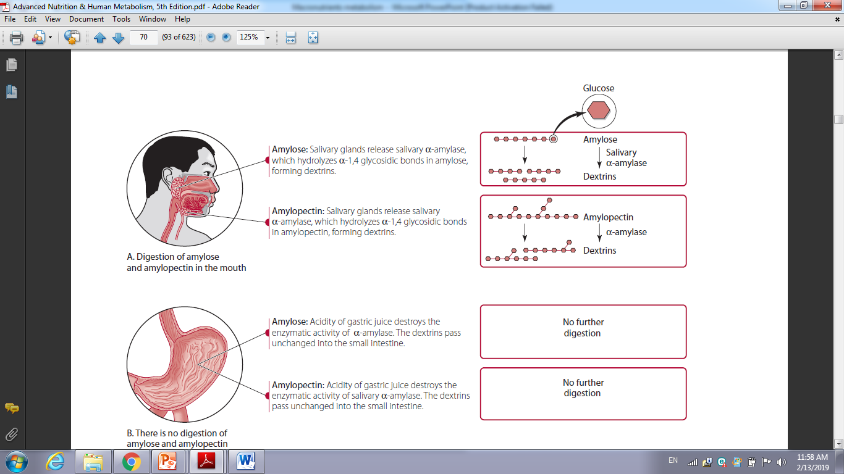

Slide 28
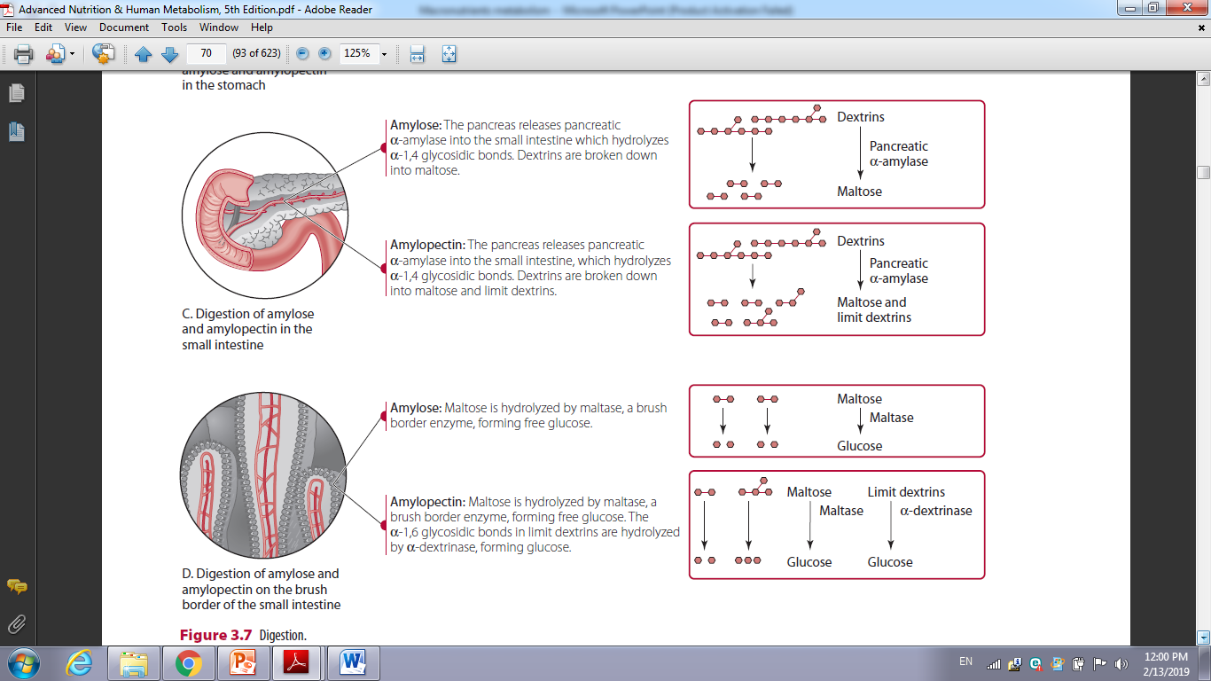

Slide 29
CHO in human body- Absorption
Glucose and galactose are absorbed into the mucosal cells by active transport, a process that requires energy and the involvement of a specific receptor.
Fructose is transported into the mucosal cell by a specific facilitative transporter

Slide 30
CHO – transportation
Glucose is effectively used by a wide variety of cell types under normal conditions, and its concentration in the blood must be precisely controlled.
The cellular uptake of glucose requires that it cross the plasma membrane of the cell.
The highly polar glucose molecule cannot move across the cellular membrane by simple diffusion, because the highly polar molecule cannot pass through the nonpolar matrix of the lipid bilayer.
For glucose to be used by cells, an efficient transport system for moving the molecule into and out of cells is essential.

Slide 31
Glucose is passively admitted to nearly all cells in the body by a carrier-mediated transport mechanism that does not require energy.
The family of protein carriers involved in this process are called glucose transporters, abbreviated GLUT ( twelve individual transport proteins have been identified along with the genes that code for them).

Slide 33
Glucose cellular absorption
Insulin is a very powerful anabolic hormone and is involved in glucose, lipid, and amino acid/ protein synthesis and storage.

Slide 34
When blood glucose levels are elevated, insulin is released by the β-cells of the pancreas. Insulin stimulates the uptake of glucose by muscle and adipose and also inhibits the synthesis of glucose gluconeogenesis) by the liver.
Insulin binds to a specific receptor located on the cell membrane
of muscle and adipose tissue and stimulates the tubulovesicle-enclosed GLUT4 transports to be translocated to the plasma membrane.
Glucose regulation: glycemic response, glycemic load and glycemic index ???

Slide 35
Metabolism
The metabolic fate of the monosaccharides depends to a great extent on the body’s energy needs at the time.
The major regulatory mechanisms are hormonal (involving the action of hormones such as insulin, glucagon, epinephrine, and the corticosteroid
hormones)
allosteric enzyme activation or suppression

Slide 37
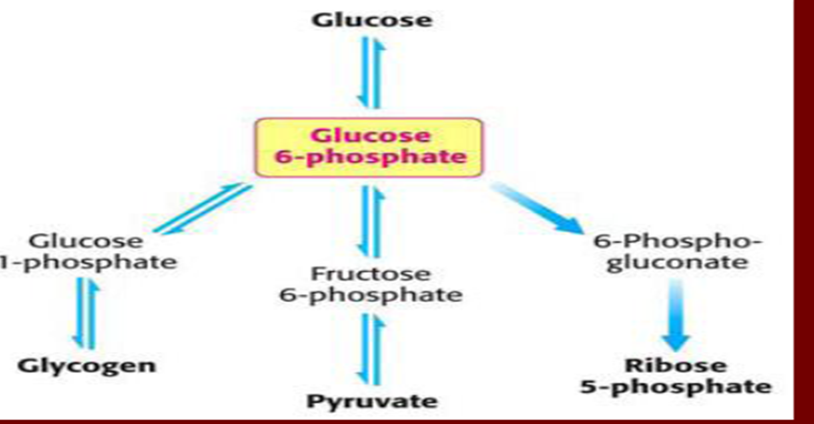
Metabolic fate of glucose

Slide 38
Pathways of CHO metabolism
FIRST:
Glycolysis
process of breaking glucose to two molecules of pyrovate + 2 ATP+ 2 NADPH + H+
This process occur at cytosol
Second
Glycogenesis: the conversion of glucose to the glycogen in liver
n glucose -→ glycogen

Slide 39
Third
Glycogenolysis
The conversion of glycogen to glucose
Fourth
Gluconeogenesis
The synthesis of glucose from the materials other than CHO
Such as amino acid, lactate and glycerol

Slide 40
I. Glycolysis
Definition:
1. Glycolysis means oxidation of glucose to give pyruvate (in the
presence of oxygen) or lactate (in the absence of oxygen).
Site:
cytoplasm of all tissue cells, but it is of physiological importance in:
1. Tissues with no mitochondria: mature RBCs, cornea and lens.
2. Tissues with few mitochondria: Testis, leucocytes, medulla of the
kidney, retina, skin and gastrointestinal tract.
3. Tissues undergo frequent oxygen lack: skeletal muscles especially
during exercise.

Slide 41
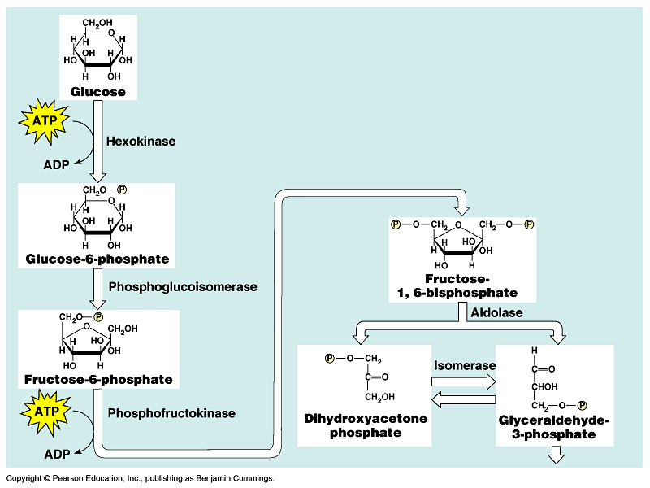
Energy Investment Phase (steps 1-5)

Slide 42
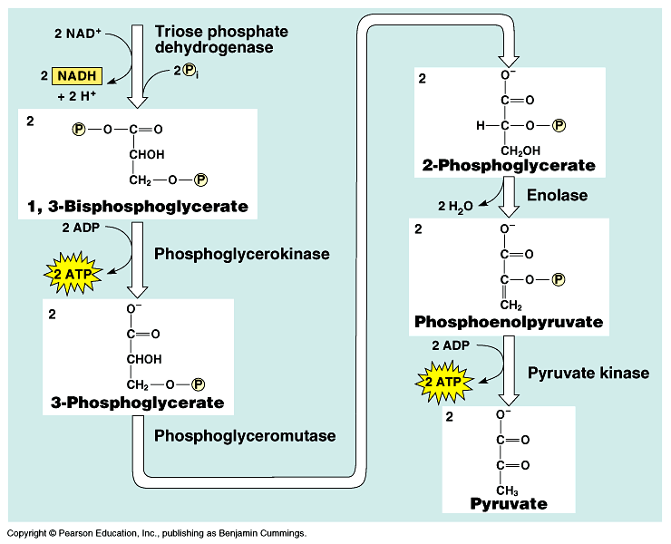
Energy-Payoff Phase (Steps 6-10)

Slide 43
Special features of glycolysis in RBCs
1. Mature RBCs contain no mitochondria, thus:
a) They depend only upon glycolysis for energy production (=2 ATP).
b) Lactate is always the end product.
2. Glucose uptake by RBCs is independent on insulin hormone. ( differ from the other cells)
3. Glycolysis produces NADH+H+, which used for reduction of met-hemoglobin in red cells.
*met hemoglobin: ????/

Slide 44
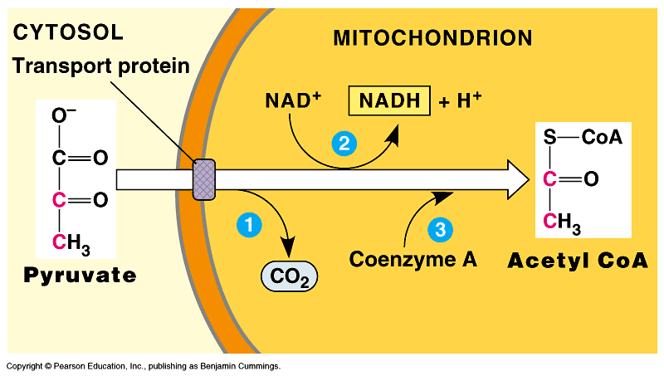
As pyruvate enters the mitochondrion, a multienzyme complex modifies pyruvate to acetyl CoA which enters the Krebs cycle in the matrix.
A carboxyl group is removed as CO₂.
A pair of electrons is transferred from the remaining two-carbon fragment to NAD⁺ to form NADH.
The oxidized fragment, acetate, combines with coenzyme A to form acetyl CoA.

Slide 45
Pyruvate ACETYL CO-A
3 C 2 C
Co₂
NADH
Enzyme used is Pyruvate dehydrogenase complex
Four vitamins important for the activity of the complex:
Thiamin B₁
Riboflavin B₂
Niacin B₃
- Pantothenic Acid B₅ (part of the CO-A structure)

Slide 46
Galactose
Galactose will convert to glucose -1- phosphate ( enzyme)
then continue the steps like glucose
Fructose
Fructose converted to fructose -1- phospaphate → change to glyceraldehyde then continue the steps

Slide 47
GLYCOGEN synthesis
Glycogen is the storage form of glucose. The synthesis and degradation of glycogen are carefully regulated so that sufficient glucose is available for the body’s
energy needs. Both glycogenesis and glycogenolysis are controlled primarily by three hormones: insulin, glucagon, and epinephrine.
Glycogen synthesis occurs after a meal, when blood glucose levels are high. It has long been recognized that the consumption of a carbohydrate meal is followed promptly by liver glycogenesis.

Slide 48
Reactions in glycogenesis
1. Synthesis of glucose-1-phosphate. Glucose-6-phosphate is reversibly converted to glucose-1-phosphate by phosphoglucomutase,

Slide 49
2- Synthesis of UDP-glucose.
UDP : uridine diphosphate

Slide 50
3. Synthesis of glycogen from UDP-glucose.
The formation of glycogen from UDP-glucose requires two enzymes: (a) glycogen synthase ( activate the end of the UDP – glucose
(b) amylo- alpha ( link the branches)

Slide 52
Glycogenolysis
Glycogen degradation requires the following two reactions.
Removal of glucose from the nonreducing ends of glycogen.
Using the enzyme : Glycogen phosphorylase.
2. Hydrolysis of the a(1,6) glycosidic bonds at branch points of glycogen.
Amylo-(1,6)-glucosidase, also called debranching enzyme, begins the
removal of (1,6) branch points

Slide 54
Gluconeogenesis
Gluconeogenesis, the formation of new glucose molecules from noncarbohydrate precursors, occurs primarily in the liver. Precursor molecules include lactate, pyruvate , glycerol, and certain -keto acids (molecules derived from amino acids).
Between meals adequate blood glucose levels are maintained by the hydrolysis of liver glycogen. When liver glycogen is depleted (e.g., owing to prolonged fasting or vigorous exercise), the gluconeogenesis
pathway provides the body with adequate glucose. Brain and red blood
cells rely exclusively on glucose as their energy source.

Slide 55
Gluconeogenesis reaction-pyruvate
1. Synthesis of PEP (phosphoenolpyruvate (PEP))
PEP synthesis from pyruvate requires two enzymes: pyruvate carboxylase and PEP carboxykinase. Pyruvate carboxylase, found within mitochondria, converts pyruvate to oxaloacetate (OAA).
OAA is then decarboxylated and phosphorylated by PEP
carboxykinase ( found in the mitochondria / cytoplasm ) changed to Malate , Malate changes to Fructose-1,6-bisphosphate

Slide 56
2. Conversion of fructose-1,6-bisphosphate to fructose-6-phosphate.
Using PFK-1– enzyme catalyzed
3. Formation of glucose from glucose-6-phosphate. Glucose-6-phosphatase, found only in liver and kidney, catalyzes the irreversible hydrolysis of glucose- 6-phosphate to form glucose and Pi. Glucose is subsequently released into the blood.

Slide 57
Gluconeogenesis from lactate
Lactate is released by red blood cells and other cells that lack mitochondria or have low oxygen concentrations. Also lactate is released from skeletal muscle from during exercise.

Slide 58
Cori cycle
The (also known as the Lactic acid cycle), named after its discoverers, Carl Ferdinand Cori and Gerty Cori, refers to the metabolic pathway in which lactate produced by anaerobic glycolysis in the muscles and other cells moves to the liver and is converted to glucose, which then returns to the muscles and is metabolized back to lactate

Slide 59
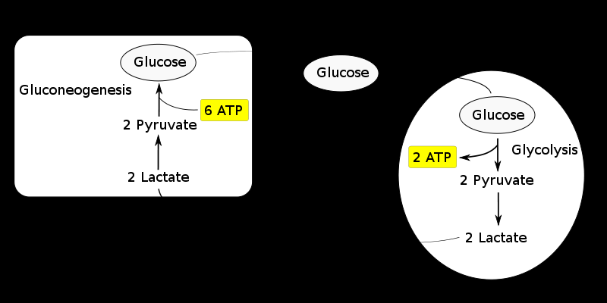

Slide 60
Facts – principles
The cycle's importance is based on the prevention of lactic acidosis in the muscle under anaerobic conditions. However, normally before this happens the lactic acid is moved out of the muscles and into the liver
The cycle is also important in producing ATP, an energy source, during muscle activity.
The Cori cycle functions more efficiently when muscle activity has ceased. This allows the oxygen debt to be repaid such that the Krebs cycle and electron transport chain can produce energy at peak efficiency.

Slide 61
The contribution of Cori cycle lactate to overall glucose production increases with fasting duration
Specifically, after 12, 20, and 40 hours of fasting by human volunteers, the contribution of Cori cycle lactate to gluconeogenesis is 41%, 71%, and 92%, respectively
Discuss ???

Slide 62
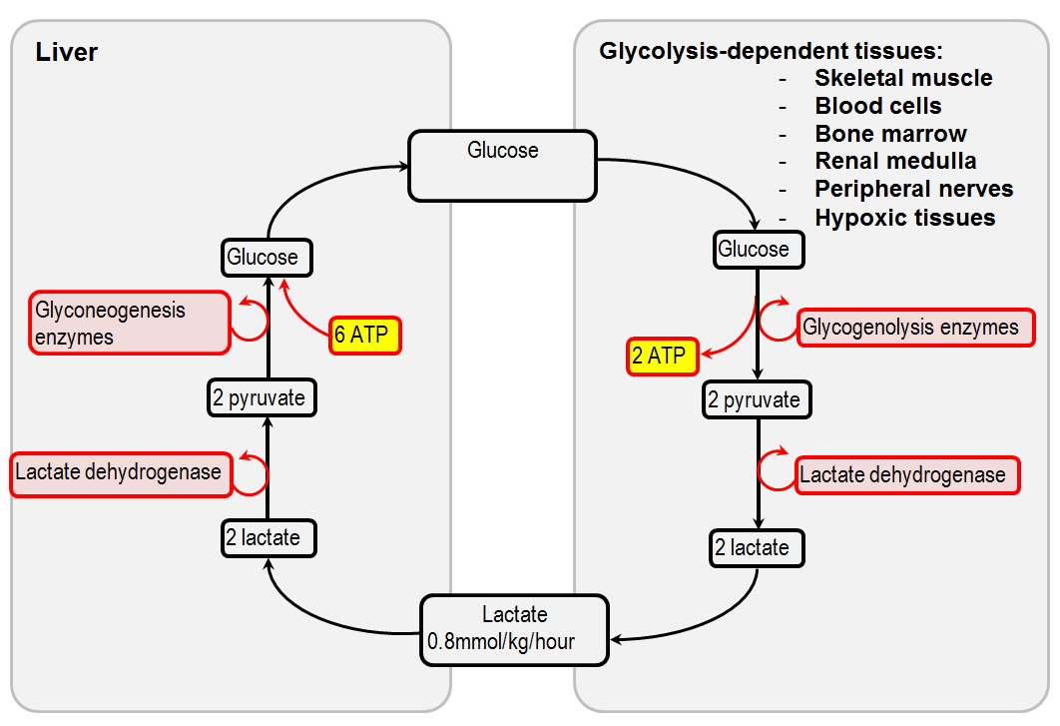

Slide 63
Energy cost of the Cori cycle The Cori cycle results in a net consumption of 4 ATP

Slide 64
Gluconeogenesis from amino acids and fatty acids ,,, will be discussed next chapters ( Protein and fat metabolism)

Slide 65
TCA CYCLE

Slide 66
overview
Also called citric acid cycle or the Krebs cycle, tricarboxylic acid (TCA) cycle
(after its discoverer, Hans Krebs).
Function of TCA cycle:
a series of reactions catalyzed by different enzymes in which acetyl CoA is oxidized into CO₂, H₂O & energy.
Also used for synthesis of NADH
It occurs in the mitochondrial matrix aerobically.

Slide 67
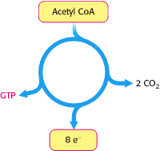
The TCA cycle is the final common catabolic pathway for the oxidation of fuel molecules:
amino acids,
fatty acids
carbohydrates.
90% of energy released from food is a result of TCA cycle.

Slide 68
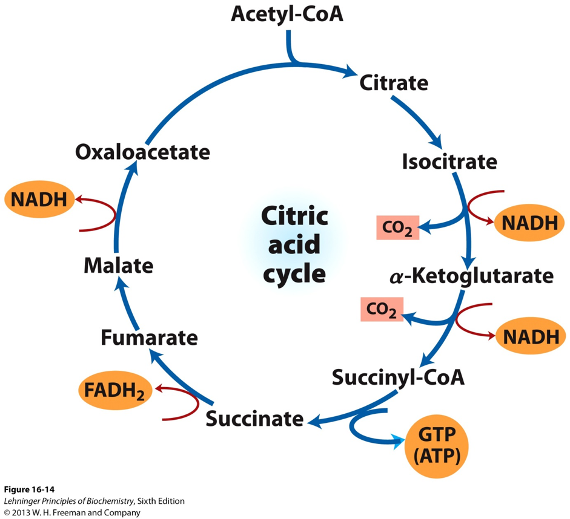

Slide 69
Source: advance nutrition and human metabolism page: 87

Slide 70
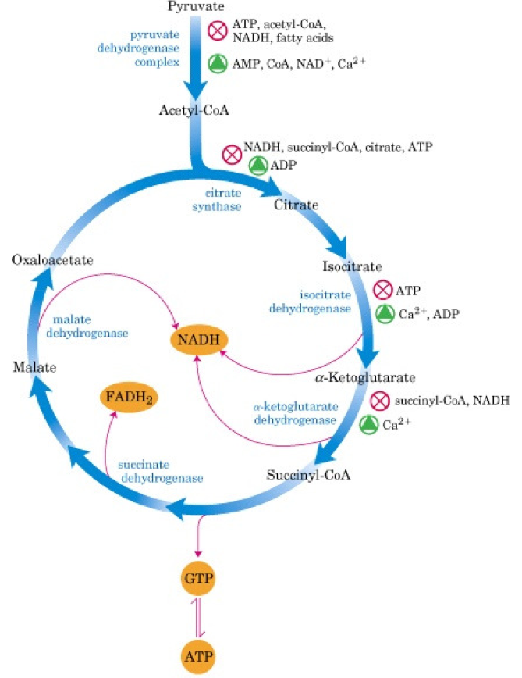
Enzyme Control of the TCA Cycle

Slide 71
Inhibitors of TCA Cycle
Arsenate and Mercury :
-Inhibit Pyruvate dehydrogenase and α-ketoglutarate dehydrogenase complexes.
Certain free radical hydrogen peroxide (H2O2)

Slide 72
Products of Kreb’s Cycle
2 CO₂
3 NADH
1 ATP Per 1 Acetyl CoA (double for 1 glucose)
1 FADH₂
ATP Yield:
Each NADH yields 3 ATP
Each FADH₂ yields 2 ATP

Slide 73
Summary of total energy yield of complete oxidation of 1 glucose molecule
Step | Coenzyme Yield | ATP Yield | Source of ATP
Glycolysis –Stage 1 |  | - 2 | Phosphorylation of glucose and fructose uses 2 ATP
Glycolysis –Stage 2 |  | 4 | Substrate level phosphorylation
 | 2 NADH | 2 * 3 = 6 | Oxidative phosphorylation
Pyruvate metabolism | 2 NADH | 2 * 3 = 6 | Oxidative phosphorylation
TCA cycle |  | 2 | Substrate level phosphorylation
 | 6 NADH | 6 * 3 = 18 | Oxidative phosphorylation
 | 2 FADH₂ | 2 * 2 = 4 | Oxidative phosphorylation
Total Yield |  | 38 ATP

Slide 74
Lipids

Slide 75
Types of lipids
1. Simple lipids
a. Fatty acids
b. Triacylglycerols, diacylglycerols, and monoacylglycerols
c. Waxes (esters of fatty acids with higher alcohols)
(1) Sterol esters (cholesterol–fatty acid esters)
(2) Nonsterol esters

Slide 76
Compound lipids
a. Phospholipids
(1) Phosphatidic acids (i.e., lecithin, cephalins)
(2) Plasmalogens
(3) Sphingomyelins
b. Glycolipids (carbohydrate containing)
c. Lipoproteins (lipids in association with proteins)

Slide 77
3- Derived lipids (derivatives such as sterols and straight-chain alcohols obtained by hydrolysis of those lipids in groups 1 and 2 that still possess general properties of lipids)
4. Ethyl alcohol (though it is not a lipid, it does supply dietary energy, and its metabolism resembles lipid metabolism)

Slide 78
Lipid
Compound
phospholipid
Lipoprotein
Simple
Fatty acids
Triacylglycerols,
Waxes
Glycoprotein

Slide 79
Fatty acids
As a class, the fatty acids are the simplest of the lipids.
They are composed of a straight hydrocarbon chain terminating with a carboxylic acid group.
They are of vital importance as an energy
nutrient, furnishing most of the calories from dietary fat.
The length of the carbon chains of fatty acids found in foods and body tissues varies from 4 to about 24 carbon atoms.
May be saturated SFA, MUFA or PUFA

Slide 81
Delta: number of chain and location of the unsaturation)

Slide 82
Essential Fatty Acids
If fat is entirely excluded from the diet of humans, a condition develops that is characterized by retarded growth, dermatitis,
kidney lesions, and early death.
eating certain unsaturated fatty acids such as linoleic, α-linolenic, and arachidonic acids is effective in curing the conditions related to the lack of these fatty acids.

Slide 83
Some unsaturated fatty acids thus cannot be synthesized in animal cells but must be acquired in the diet.
The two essential fatty acids are linoleic acid (18:2 n-6) and α-linolenic acid (18:3 n-3).

Slide 84
linoleic acid (18:2 n-6)

Slide 85
Omega 3
Nutritional interest in the n-3 fatty acids has escalated enormously in recent years because of their reported hypolipidemic and antithrombotic effects.
An n-3 fatty acid of particular interest is eicosapentaenoic acid (20:5 n-3),

Slide 88
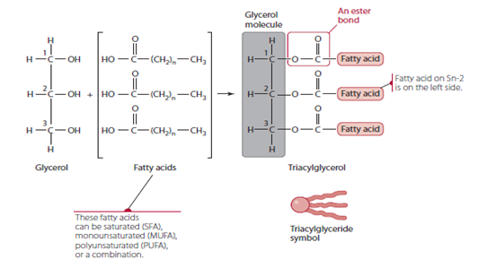
TRIACYLGLYCEROLS (TRIGLYCERIDES)
Most stored body fat is in the form of triacylglycerols (TAG), which represent a highly concentrated form of energy.
Structurally, they are composed of a trihydroxy alcohol, glycerol, to which three fatty acids are attached by ester bonds,
Triacylglycerols exist as fats (solid) or oils (liquid) at room temperature, depending on the nature of the component fatty acids.

Slide 89
STEROLS AND STEROIDS
This class of lipid is characterized by a four-ring core structure called the cyclopentanoperhydrophenanthrene, or steroid, nucleus.
Sterols are monohydroxy alcohols of steroidal structure, with cholesterol being the most common example.

Slide 91
In the body, this sterol is an essential component of cell membranes, particularly the membranes of nerve tissue.
Despite the bad press that cholesterol has implication in cardiovascular disease, it serves as the precursor for many other important steroids in the body, including the bile acids; steroid sex hormones such as estrogens, androgens, and progesterone;
the adrenocortical hormones; and the vitamin D of animal tissues (cholecalciferol

Slide 92
Phospholipids
As the name implies, lipids belonging to phospholipids contain phosphate.
Phospholipids are categorized into one of
two groups called:
glycerophosphatides an sphingophosphatides,
depending on whether their core structure
is glycerol (glycerophosphatides) or the amino alcohol sphingosine (sphingolipids

Slide 93
Glycolipid
Glycolipids can be sub classified into cerebrosides and gangliosides.
They are so named because they have a carbohydrate component within their structure.
Their physiological role is principally structural, contributing little as an energy source(Cerebrosides and gangliosides occur in the medullary sheaths of nerves and in brain tissue, particularly the white matter

Slide 94
Digestion and absorption

Slide 95
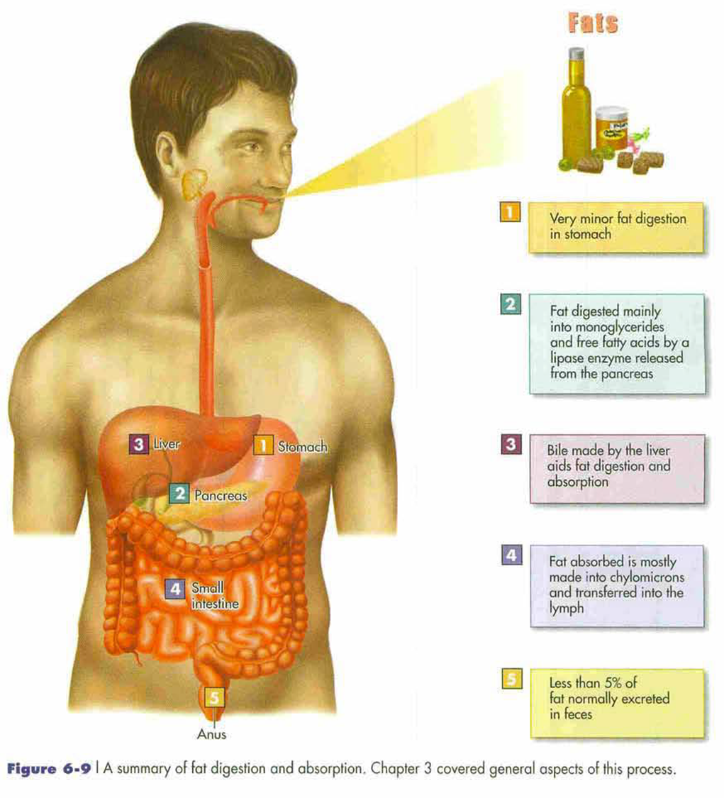

Slide 96
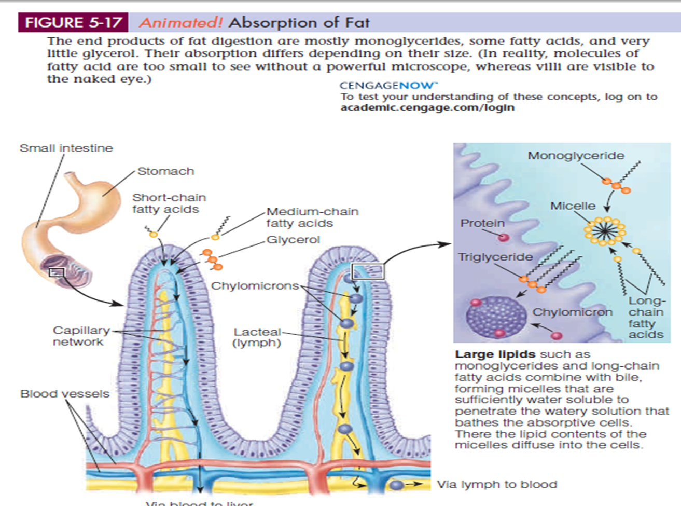

Slide 97
Chylomicrons
are the primary form of lipoprotein formed from exogenous (dietary) lipids. The role of the chylomicron is to deliver dietary lipid mostly to tissues other than the liver, such as muscle and adipose tissue (80%).
Chylomicrons are transported by the blood throughout all tissues in the body, while undergoing intravascular hydrolysis at certain tissue sites. (enzymes)
chylomicron remnant—a smaller particle, relatively
less rich in triacylglycerol, but richer in cholesterol and
cholesteryl esters. These remnants are removed from the bloodstream by liver cell

Slide 98
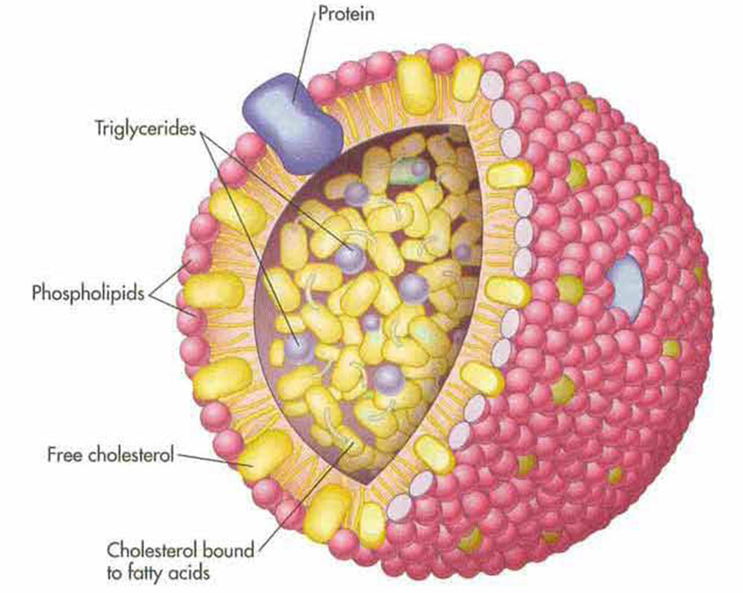

Slide 100
Apolipoproteins, the protein components of lipoproteins, tend to stabilize the lipoproteins as they circulate in the aqueous environment of the blood
Apolipoprotein: allow the lipoprotein to be recognized by specific receptors on cell surfaces.

Slide 101
Role of liver in lipid metabolism

Slide 102
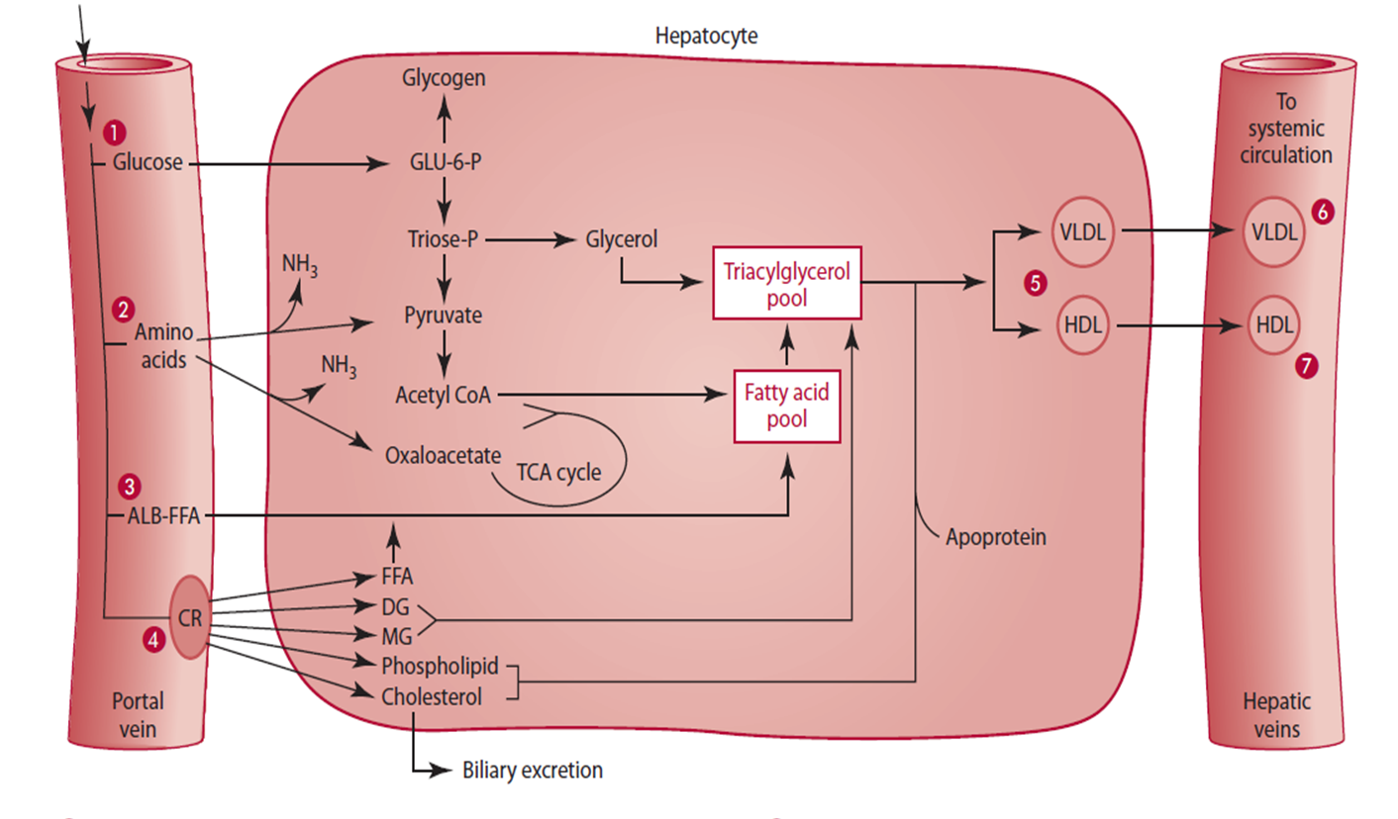

Slide 103
1- hepatic synthesis of the bile salts, indispensable for digesting and absorbing dietary lipids,
2- it is the site of synthesis of lipoproteins formed from endogenous lipids and apoproteins.
3- The liver is capable of synthesizing new lipids
from nonlipid precursors, such as glucose and amino acids.
4- It can also take up and catabolize exogenous lipids delivered to it in the form of chylomicron remnants, repackaging their lipids into HDL and VLDL forms.

Slide 104
The role of adipose tissue

Slide 105
Lipid metabolism
Triglyceride:(triacylglycerol, triacyleglyceride)
The complete hydrolysis of triacylglycerols yields glycerol and three fatty acids.
The glycerol portion can be used for energy by the liver and by other tissues
Glycerol can enter the glycolytic pathway: energy oxidation or gluconeogenesis

Slide 106
Glycerol → Pyruvat: Glycerol (3C) is easily converted into other 3C molecules, intermediate for glucose or pyruvat production, and further to Acetyl CoA & CO2.
Fatty acid → Acety lCoA: If energy is needed fatty acid will be oxidized in Beta oxidation (- 2 C and condensation with CoA to produce Acetyl CoA). If energy is not needed, AcetylCoA can be used for free fatty acid synthesis/ adipose tissue.

Slide 107
Fatty acids are a very rich source of energy,
The oxidation of fatty acids occurs within the mitochondrion.
Short-chain fatty acids can pass directly into the mitochondrial matrix, long chain fatty acids need carrier (L-carnitine amino acid)

Slide 108
Beta oxidation
The oxidation of the activated fatty acid in the mitochondrion occurs through a cyclic degradative pathway by which two-carbon units in the form of acetyl CoA are cleaved one by one from the carboxyl end.

Slide 109
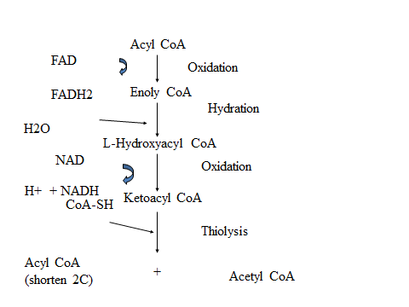

Slide 110
FORMATION OF KETONE BODIES
In addition to its direct oxidation through the TCA cycle
acetyl CoA may follow other catabolic routes in the liver, one of which is the pathway by which the so-called ketone bodies (acetoacetate, β-hydroxybutyrate, and
acetone)

Slide 111
acetoacetate, β-hydroxybutyrate : are not oxidized further in the liver but instead are transported by the blood to peripheral tissues,
Water soluble
Transported across the inner mitochondrial membrane as well as across the blood-brain barrier and cell membranes.
Source of fuel for brain, heart and some muscles
Major energy source(75%) for brain during starvation

Slide 112
When excess ketone bodies accumulate, this abnormal (but not necessarily harmful) state is called ketosis.
When even larger amounts of ketone bodies accumulate such that the body's pH is lowered to dangerously acidic levels, this state is called ketoacidosis

Slide 113
Ketone bodies are produced when glucose is not available as fuel source.
Transport of fatty acids through the mitochondrial membrane is an important regulatory point.

Slide 115
CATABOLISM OF CHOLESTEROL
Unlike the triacylglycerols and fatty acids, cholesterol is not an energy-producing nutrient.
Its four-ring core structure remains intact in the course of its catabolism and is eliminated
as such through the biliary system,

Slide 116
Fatty acid synthesis
linoleic acid and α-linolenic acid, which are essential and must be acquired from the diet, the body is capable of synthesizing fatty acids from simple precursors.
The basic process involve assembly of a “starter” molecule of acetyl CoA with units of malonyl CoA ( by product of acetyle coA)
This reaction occurs in the cytoplasm.
It is catalyzed by acetyl CoA carboxylase

Slide 117
Nearly all the acetyl CoA formed in metabolism occurs in the mitochondria.
It is formed there from pyruvate oxidation, from the oxidation of fatty acids, and from the
degradation of the carbon skeletons of some amino acids
Followed by steps to elongate the fatty acid chain ( reverse the beta oxidation)

Slide 118
Impact of Diet on Fatty Acid Synthesis
The rate of fatty acid synthesis can be influenced by diet.
Diets high in simple carbohydrates and low in fats induce
a set of lipogenic enzymes in the liver.
Other studies have confirmed that a very low fat–
high sugar diet causes an increase in fatty acid synthesis
Furthermore, the effect may be reduced if starch
is substituted for the sugar, possibly owing to the slower
absorption of starch glucose and a lower postprandial
insulin response

Slide 119
SYNTHESIS OF TRIACYLGLYCEROLS TRIGLYCERIDES
The precursors are CoA-activated fatty acids and glycerol 3-phosphate, the latter of which is produced either from the reduction of dihydroxyacetone phosphate or from the phosphorylation of glycerol

Slide 120
SYNTHESIS OF CHOLESTEROL
Nearly all tissues in the body are capable of synthesizing cholesterol from acetyl CoA.
The liver accounts for about 20% of endogenous cholesterol.
Among the extrahepatic tissues, which are responsible for the remaining 80% of synthesized cholesterol, the intestine is probably the most active.

Slide 121
The cholesterol production rate, which includes both absorbed cholesterol and endogenously synthesized cholesterol (1gm/day)
Recommended diet intake 300mg/day
Endogenous synthesis therefore
accounts for more than two-thirds of the daily total.

Slide 122
Steps of cholesterol synthesis
At least 26 steps are known to be involved in the formation of cholesterol from acetyl CoA.
the synthesis of cholesterol can be thought of as occurring in three stages:
1- a cytoplasmic sequence by which 3-hydroxy-3-methylglutaryl CoA (HMG CoA) is formed from 3 molecules of acetyl CoA
2. the conversion of HMG CoA to squalene, including the important rate-limiting step of cholesterol synthesis, in which HMG CoA is reduced to mevalonic acid by HMG CoA reductase
3. the formation of cholesterol from squalene

Slide 123
As total body cholesterol increases, the rate of synthesis tends to decrease. (negative feedback mechanism)
This is known to be caused by a negative feedback regulation of the HMG CoA reductase reaction.
The suppression is not sufficient to
prevent an increase in the total body pool of cholesterol when dietary intake is high.

Slide 124
Regulation of Lipid Metabolism
The regulation of fatty acid oxidation is closely linked to carbohydrate status.
Fatty acids formed in the cytoplast of liver cells can either be converted into triacylglycerols and phospholipids or be transported via carnitine into the mitochondrion for oxidation.
The enzyme carnitine acyl transferase I, which catalyzes the transfer of fatty acyl groups to carnitine (, is specifically inhibited by malonyl CoA.
Recall that malonyl CoA is the first intermediate in the synthesis of fatty acids

Slide 125
Therefore, it is logical that an increase in the concentration of malonyl CoA would promote fatty acid synthesis while inhibiting fatty acid oxidation.
Malonyl CoA concentration increases whenever a person is well supplied with carbohydrate

Slide 126
Blood glucose levels can affect lipolysis and fatty acid oxidation by other mechanisms.
Hyperglycemia triggers the release of insulin, which promotes glucose transport into the adipose cell and therefore promotes lipogenesis.
Hypoglycemia, results in a reduced intracellular supply of glucose, thereby suppressing lipogenesis.
the low level of insulin accompanying the hypoglycemic state would favor lipolysis, with a flow of free fatty acids into the bloodstream

Slide 127
Low glucose levels also stimulate the rate of fatty acid oxidation and lead to formation of ketone bodies.

Slide 128
Lipolysis is stimulated by hormones such as epinephrine and norepinephrine, adrenocorticotropic hormone (ACTH), thyroid-stimulating hormone (TSH), glucagon, growth hormone, thyroxin,
The key enzyme for the mobilization of fat is hormone- sensitive triacylglycerol lipase, found in adipose tissue cells. Then acetyle coA carboxylase

Slide 129
Brown Fat Thermogenesis
Brown adipose tissue obtains its name from its high degree of vascularity and the abundant mitochondria present in it as compared to white fat.
the mitochondria also are structurally
different, to promote thermogenesis (heat production) at the expense of producing ATP.

Slide 130
Two types of external stimuli trigger thermogenesis:
(1) ingestion of food and
(2) prolonged exposure to cold temperature.
Both of these events stimulate the tissue via sympathetic innervation via the hormone norepinephrine.
Theoretically, then, weight reduction should accompany a higher activity of brown fat,

Slide 131
It was once thought that, in humans, only babies had brown fat. But in 2009, researchers found small amounts of brown fat in adults
What's more, they found that people with lower body mass indexes (BMIs) tended to have more brown fat.

Slide 132
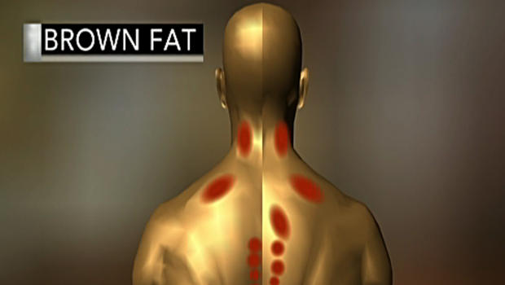

Slide 133
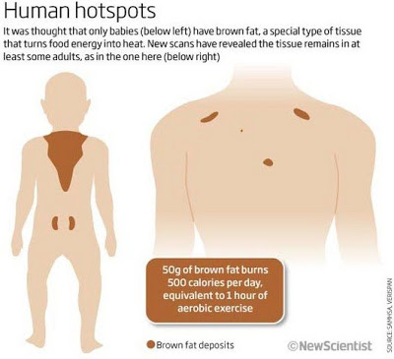

Slide 134
21/3: seminar + metabolism
28/3: metabolism + energy balance
4/4 : vitamins water soluble
11/4 fat soluble
18/ 4 minerals + water
24/4 oxidative stress
2/5 appetite control

Slide 135
Protein metabolism

Slide 136
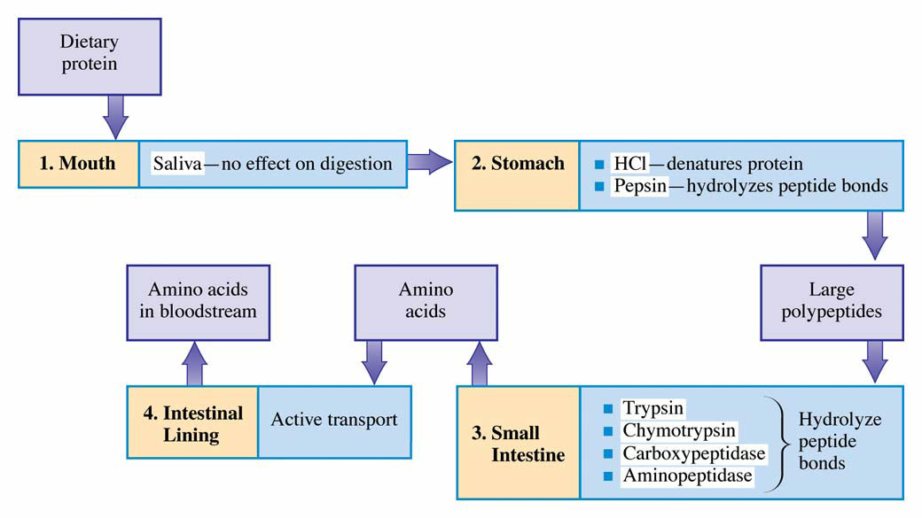
Summary of protein digestion in the human body. Possible fates for amino acid degradation products.

Slide 137
Function of protein
1- Catalysts
Enzymes are protein molecules (generally designated by the suffix -ase) that act as catalysts: they change the rate of reactions occurring in the body.
2-Messengers
Some proteins are hormones. Hormones act as chemical messengers. They are synthesized and secreted by endocrine tissue (glands) and transported in the blood to target tissues or organs, where they bind to protein receptors.

Slide 138
3- Structural elements
contractile proteins ( actin and myosin)
fibrous proteins ( collagen, keratin , bone, teeth, skin, tendons, nails, hair)
globular proteins (myoglobin, calmodulin, and many enzymes.
4- IMMUNOPROTECTORS
Immunoprotection is provided to the body in part by a
group of proteins called immunoproteins, also called
immunoglobulins (Ig) or antibodies (Ab). These immunoproteins,
of which there are five major classes (IgG,
IgA, IgM, IgE, and IgD),

Slide 139
5- TRANSPORTERS ( albumin, transferrin )
Transport proteins are a diverse group of proteins that
combine with other substances (especially vitamins and minerals, but also other nutrients) to provide a means of carrying those substances in the blood, or into cells, or out of cells, or within cells.
6- BUFFERS
Proteins, because of their constituent amino acids, can serve as a buffer in the body and thus help to regulate acidbase balance.

Slide 140
FLUID BALANCERS
In addition to acid-base balance, proteins (along with
other factors) influence fluid balance. The presence of protein in the blood and in cells helps maintain fluid balance, or stated differently, helps attract water and contribute to osmotic pressure.

Slide 141
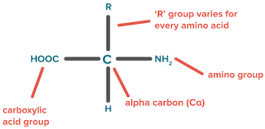
Structural classification
all amino acids have a central carbon (C), at least one amino group (—NH2), at least one carboxy (acid) group (—COOH), and a side chain (R group) that makes each amino acid unique.

Slide 142
The tendency of an amino acid to interact with water at physiological pH—that is, its polarity—represents another means of classifying amino acids.
Polarity depends on the side chain or R group of the amino acid.

Slide 144
Essentiality of AA
categorized the amino acids found in proteins as
nutritionally essential (indispensable) or nutritionally
nonessential (dispensable).
Previously only eight amino acids—leucine, isoleucine, valine, lysine, tryptophan, threonine, methionine, and phenylalanine—were considered essential for adult humans.
Histidine was later added as an essential amino acid.

Slide 145
Essentiality of AA

Slide 146
Newer categories added to the essential/indispensable and nonessential/ dispensable categories include
conditionally or acquired indispensable amino acids.
A dispensable amino acid may become indispensable if an organ fails to function properly,
(premature , disease-associated organ malfunction)

Slide 148
Amino acid metabolism
The liver is the primary site for the uptake of most amino acids (about 50%–65%) following ingestion of a meal.
The liver is thought to monitor the absorbed amino acids and to adjust the rate of their metabolism (including catabolism, or breakdown of amino acids, and anabolism, or use of amino acids for synthesis) according to the needs of the body.

Slide 149
Typically, of the amino acids entering the liver
after a meal, about 20% are used to synthesize proteins and nitrogen-containing compounds;
the rest is released into the plasma.

Slide 150
Plasma protein
Albumin, the most abundant of the plasma proteins,
is synthesized by the liver and released into the blood.
A healthy person makes about 9 to 12 g albumin per day , half life 14-18 day
Albumin in the plasma maintains oncotic pressure
and transports nutrients such as vitamin B6; minerals
including zinc, calcium, and small amounts of copper;
nutrients such as fatty acids; and the amino acid tryptophan.
Some drugs and hormones are also transported by albumin.
Albumin is used with a few other proteins in the blood to assess an individual’s protein status, specifically visceral (internal organ) protein status.

Slide 151
Two other proteins synthesized by the liver and released into plasma are transthyretin (also called prealbumin) and retinol-binding protein (which is complexed together and involved with retinol, or vitamin A, and thyroid hormone transport).
Transthyretin and retinol-binding protein, like
albumin, are used as biochemical indicators of visceral protein status.
Half life 2 days- 2 and a half day

Slide 152
Some of the other proteins made by the liver and
released into the blood are those needed for blood clotting, for immunoprotection
α 1-globulins: glycoproteins, high-density lipoproteins
(for lipid transport)
α 2-globulins: glycoproteins, haptoglobin (for free hemoglobin transport), ceruloplasmin (for copper transport and oxidase activity), prothrombin (for blood coagulation), and very low density lipoproteins (for lipid transport)
β-globulins: transferrin (for iron and other mineral transport)
and low-density lipoproteins (for lipid transport)
γ-globulins: immunoglobulins or antibodies (for immunoprotection)

Slide 153
Other group o protein released during inflammation
is called acute phase proteins or positive acute phase reactant proteins. Some examples of these acute phase proteins are C-reactive protein, fibronectin, orosomucoid (also called α 1 acid glycoprotein), α 1 antitrypsin, haptoglobin, α 2 macroglobulin, ceruloplasmin, metallothionein,
and serum amyloid A

Slide 154
The body also generates another group of proteins,
called stress or (heat) shock proteins (abbreviated hsp).
These proteins are synthesized in response to stress, including heat stress and oxidative stress.

Slide 155
Nitrogen-Containing Nonprotein Compounds
Nitrogen-containing nonprotein compounds or molecules, of which several exist, are also synthesized in the liver (and often in other sites) from amino acids and perform a number of functions in the body.
Glutathione Glutathione is a tripeptide synthesized from three amino acids: glycine, cysteine, and glutamate.
Glutathione is synthesized and found in the cytosol of most cells of the body,
It is a major antioxidant with the ability to scavenge free radicals

Slide 156
Creatine a key component of the energy compound creatine phosphate, also called phosphocreatine, can be obtained from foods (primarily meat and fish) or synthesized in the body.

Slide 157
Purine and Pyrimidine Bases
Another group of compounds derived in part from amino acids consists of purine and pyrimidine bases.
Purine and pyrimidine bases are main constituents of two nucleic acids—deoxyribonucleic acid (DNA) and ribonucleic acid (RNA).
The synthesis of the nitrogen-containing bases used to make nucleic acids and nucleotides occurs for the most part de novo in the liver.
De novo synthesis refers to the synthesis of complex molecules from simple molecules

Slide 159
Use of amino acids for anabolism occurs throughout the day, but especially following meal ingestion (foods containing carbohydrate, fat, and protein).
Although protein synthesis typically predominates over protein degradation after eating, the opposite becomes true when food is not eaten. During prolonged periods in which food is not eaten, such as during the overnight hours or a fast, protein synthesis still occurs but at a much lower rate, and protein degradation increases.
Protien synthesis Affect and affected by many processes (page 207-210 FYI )

Slide 160
Amino acids catabolism
Liver cells have a high capacity for the uptake and catabolism of amino acids. Catabolism of amino acids occurs to varying degrees in different tissues both during fasting periods and after eating.
Different a.a. have different way and rate of catabolism ( BCAA catabolized much slower than other a.a

Slide 162
Steps of amino acid metabolism
1- Transamination and/or Deamination
of Amino Acids
the first step in the metabolism of amino acids not
used for the synthesis of proteins or nitrogen- containing compounds is the removal of the amino group from the amino acid.
Deamination reactions involve only the removal of an amino group, with no direct transfer to another compound.
Transamination reactions involve the transfer of an amino group from one amino acid to an amino acid carbon skeleton

Slide 163
2- Disposal of Ammonia—The Urea Cycle
The urea cycle, functions in the liver and is important for the removal of ammonia from the body.
Too much ammonia in the body (as can occur with
liver failure) is toxic and can lead to brain malfunction and coma.
Ammonia in human body may come ( food, intestinal bac these two sources enter the portal blood sources ( changed directly to urea in the liver )

Slide 164
Urea cycle
 Urea is the major end product in Nitrogen
metabolism in humans and mammals.
 NH3, the product of oxidative deamination
reaction, is toxic in even small amount and
must be removed from the body.
 Urea cycle is the conversion reactions of NH3 into urea.

Slide 165
Urea cycle
This reaction occur in liver (certain occur in
cytosol and mitochondria)
 The urea is transported to the kidney where it is excreted.
 The overall urea formation reaction is :-
2 NH3 + CO2 + 3ATP ---> urea + H2O + 3 ADP

Slide 166
Urea cycle
Steps of urea cycle
1- Synthesis of carbamoyl phosphate ( need 2 ATP, enzymes, irreversible)
(condensation of NH4 + ions with CO2)
2- Formation of citrulline: intermediate in urea cycle
3- Synthesis of arginosuccinate ( need ATP)
4. Cleavage of arginosuccinate :
cleaves to give arginine ( precursor of urea and fumarate.
5. Formation of urea

Slide 167
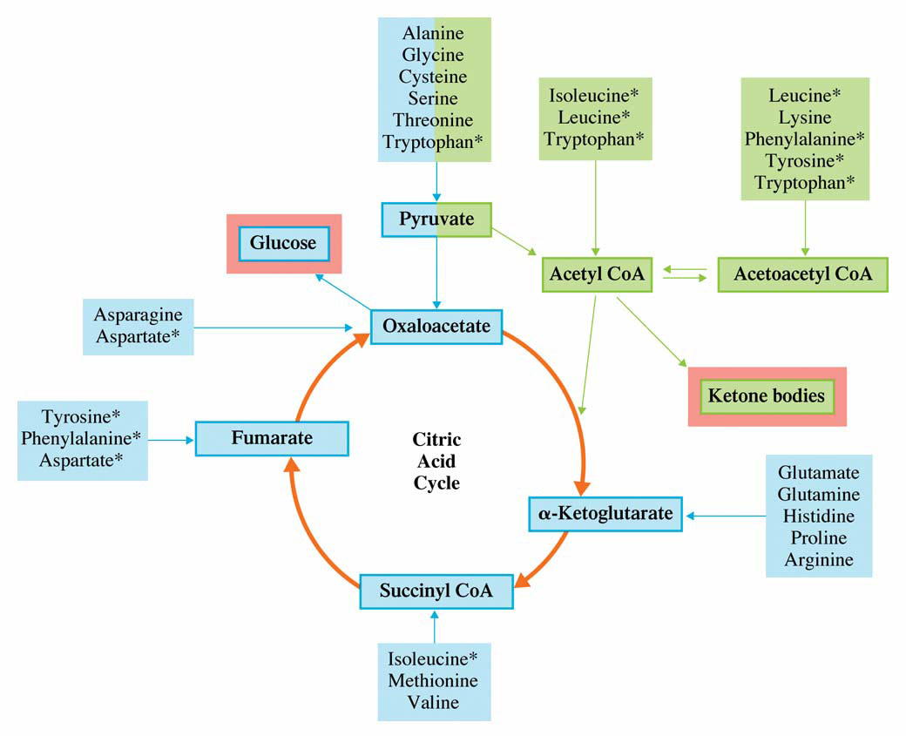
Fates of C skeletons of 20 amino acids.

Slide 168
Carbon skeletons of amino acids can be further
metabolized with the potential for multiple uses in the cell.
An amino acid’s carbon skeleton, for example, can be used to produce:
Energy
Glucose
Ketone Bodies
Cholesterol
Fatty Acids

Slide 169
all amino acids can be completely oxidized to
generate energy, not all amino acids can be used for synthesis of glucose.
Furthermore, the fate of the amino acid’s
carbon skeleton depends on the physiological nutritional state of the body.

Slide 170
Energy metabolism
Energy Generation The complete oxidation of amino acids generates energy, CO2/HCO3 , and ammonia/ammonium.
Amino acids are used for energy in the body when diets are inadequate in energy

Slide 171
Glucose and Ketone Body Production
Gluconeogenesis occurs primarily in the liver but also in the kidney.
The carbon skeletons of several amino acids can be used to synthesize glucose.
the carbon skeleton of asparagine can be converted into oxaloacetate
the carbon skeletons of glycine, serine,
cysteine, tryptophan, and threonine can be converted into pyruvate for glucose production in the liver.

Slide 172
Some amino acids, such as phenylalanine and tyrosine, can be degraded to form fumarate (an intermediate of the TCA cycle), which can be used to form glucose, OR it can also converted to acetoacetate, which can be used to synthesize ketone bodies.
Thus, these two amino acids are both glucogenic and ketogenic.
AA considered a glucogenic amino acid, catabolism of the amino acid must yield selected intermediates of the TCA cycle.

Slide 173
Regulations
The conversion of amino acids to glucose
is accelerated by
1- High glucagon: insulin ratios
2- glucocorticoids such as cortisol ) hormones are elevated when people are not receiving sufficient energy or carbohydrate in the diet, in times of illness such as occurs with infection or trauma,
3- In certain disease states such as untreated
diabetes mellitus and liver disease,

Slide 174
Cholesterol Production
Leucine is the only amino acid whose catabolism generates β-hydroxy β- methylglutaryl (HMG) CoA, an intermediate in the synthesis of cholesterol.
Fatty Acid Production
In times of excess energy and protein intakes coupled with adequate carbohydrate intake, the carbon skeleton of amino acids may be used to synthesize fatty acids.

Slide 175
Nitrogen balance

Slide 176
The amino acid pool
Protein Intake
Other metabolites
Small intestine
Synthesis
Amino acid pool
Total body protein
Absorption
Degradation
Oxidation
Colon
Urea pool
Energy
Low carbs
Excretion
Amino acid pool: amino acid circulation in the body: which are available for body use
Faeces
Urine
Ureagensis

Slide 177
The Amino Acid Pool
SUPPLY
DEMAND
Dietary Intake
Amino acid pool
Oxidation ( deamination)
De novo synthesis
Other pathways
Protein degradation
Protein synthesis

Slide 178
Demands for amino acids
Protein synthesis
Supply of proteins for a variety of functions
Oxidation (deamination)
Produces energy as an alternative metabolic fuel source
Breakdown and excretion of excess amino acids
Other pathways
Amino acids are precursors for other important nitrogen-containing compounds

Slide 179
Protein synthesis
All proteins are synthesised from amino acids in the body
Processes of transcription and translation
Protein synthesis relies on all the amino acids required being available
If an amino acid is in short supply, this will limit protein synthesis
‘Limiting amino acid’

Slide 180
A dynamic equilibrium
The proteins of the body are continually broken down & replaced
Adults:
Nitrogen balance (synthesis = degradation)
Childhood, pregnancy, recovery from protein loss:
Positive nitrogen balance (synthesis > degradation)
Insufficient protein intake, in response to trauma:
Negative nitrogen balance (synthesis < degradation)
Synthesis
Amino acid pool
Total body protein
Degradation

Slide 181
Nitrogen homeostasis is a highly regulated function. Nitrogen balance is commonly referred to as the net difference between the intake (and/or the effective absorption) of nitrogen contained in the diet and its excretion.
Nitrogen excretion and/or loss can occur through different routes. The principal component is in the urine as urea, ammonia and creatinine
Nitrogen balance can be used to derive estimates of human nitrogen (i.e. protein) requirements
http://eknygos.lsmuni.lt/springer/556/Section%203/73-79.pdf

Slide 182
Steps to Calculate Nitrogen Balance
Nitrogen balance .= Nitrogen intake - Nitrogen out put + 4
Determine nitrogen lost in urine by a 24 hour urinary urea nitrogen test.
Add 4* to the UUN to account for non-urinary losses of nitrogen.
Determine nitrogen intake by dividing the daily protein intake by 6.25.

Slide 183
Calculate NB
Protein intake 91g / day
24 hours urine nitrogen (10- 12, 20)
91 and 10
NB: 91/6.25 – (UUN +4)
= 0.56
91 and 12 (-1.4)
91 and 20 (-9.4)

Slide 184
Assume we have two critically ill patients: one not receiving nutrition support with a NB of –20 g/d and another receiving nutrition support at –5 g/d.
Compare the risk and clinical outcome
when a patient loses about 30% to 40% of their body
cell mass, the patient can die from protein malnutrition or starvation.
.

Slide 185
NPC : N ratio
Desireable NPC:N Ratios
80:1 the most severely stressed patients
100:1 severely stressed patients
150:1 unstressed patient

Slide 186
Integration of metabolism

Slide 187
Adipose Tissue
Main energy source (geometry structure (3D), anhydros.
Whole body (subcutaneous).
Geometry structure at tissue with a lot of capillaries.
Synthesized from VLDL (liver) & chylomicron (small intestine).

Slide 188
Liver
Control center for CHO, lipid & amino acid metabolism.
Liver & renal: gluconeogenesis (production of glucose from glycerol, lactate & alpha ketoacids from amino acid (especially Alanin).
After meal, liver can take ↑ glucose & store as glycogen.
During fasting, liver → glucose (glycogenolysis & gluconeogenesis).

Slide 189
Liver
After meal, synthesis of fatty acid occurs→ plasma (VLDL).
During fasting, liver degrade FFA → keton bodies.
Controller of pathway: malonyl CoA level.
Energy source for liver: amino acid Carbon skeleton from diet/ tissue.
Glycolysis occur in liver

Slide 190
Muscle
↑ glycogen storage after meal.
Exercise: glycogen is converted directly to glucose 6-phosfat (enter glycolysis pathway).
Vigorous exercise: anaerobic glycolysis → main E source, not from fatty acid or protein.

Slide 191
Muscle
During resting, Energy obtained from oxidation of fatty acid.
Heart muscle, energy from ketone bodies.
Muscle protein: main energy source, especially during starvation/ malnutrition, muscle mass → AA (gluconeogenesis at liver).

Slide 192
Renal
Renal medulla is hypoxic. Energy from anaerobic glycolysis, lactate is produced → glucose (liver) (cori cycle).
Renal cortex, gluconeogenesis as liver but most of the energy obtained from oxidation of FFA/ ketone bodies.

Slide 193
Brain
Energy from glucose in plasma (from glycolysis & TCA).
Use 2/3 of total glucose (400 – 600 kal).
Prolonged starvation: adaptation of the brain, 2/3 of energy requirement from ketone bodies.
Prolonged starvation, irreversible effect.

Slide 194
Red Blood Cell
No mitochondria, Energy from glycolysis.

Slide 195
HORMONS REGULATING METABOLISME
Insulin
Glucagon
Adrenalin (epinephrine)
Cortisol
Growth Hormon

Slide 196
Insulin
Main hormone after meals.
Promote energy storage as glycogen & protein synthesis. ( anabolic)
Excreted during increase glucose in plasma/ increase amino acid in plasma.
Oral glucose > significant from IV.
Rapidly degraded in the liver. T1/2 5 min.
Justify : TPN has metabolic disturbances

Slide 197
Glucagon
Prevent hypoglycaemia during fasting.
Source: islets of pancreas alpha cells.
Action: (catabolic)
Main - glycogenolysis in the liver.
Gluconeogenesis, increase catabolism amino acid & decrease synthesis FFA.
Excreted together with insulin after meal containing protein.
Therefore, excretion of insulin due to increase of amino acid in plasma will not result in hypoglycaemia.

Slide 198
Adrenalin (epinephrine)
Excreted by medulla of adrenal during hypoglycemia/ stress.
Metabolic action: (muscle) increase glycogenolysis, (adipose tissue) ↑ lipolysis.

Slide 199
Cortisol
Excreted from cortex of adrenal, slow action during hypoglycaemia, stress/ injury.
Decrease synthesis protein & increase release of amino acid in muscle for gluconeogenesis.
Catabolic

Slide 200
Growth Hormone
Main action: Promote tissue growth (bone & muscle), increase glucose in plasma (↑ release of glucose from liver & ↓ glucose uptake to muscle).

Slide 201
Actions of glucagon, adrenalin, cortisol & GH in the liver
 | Glucagon | Adrenalin | Cortisol | GH
Glycogen synthesis | ↓ | ↓ | ↑ | ↑
Glycogen degradation | ↑ | ↑
Gluconeogenesis | ↑ | ↑
Release of glucose | ↑ | ↑ | ↑ | ↑
Produce ketone bodies | ↑ | ↑
Catabolisma AA | ↑ |  | ↑
FA synthesis | ↓ | ↓

Slide 202
Actions of glucagon, adrenalin, cortisol & GH in the muscle
& adipose tissue
Muscle: | Glucagon | Adrenalin | Cortisol | GH
Utilisation of FA |  | ↑ |  | ↑
Degradation of glycogen |  | ↑
Glucose uptake |  | ↓ | ↓ | ↓
Protein synthesis |  |  | ↓ | ↑
Adipose tissue:
Release of FA |  | ↑ | ↑ | ↑
Tg synthesis |  |  |  | ↓

Slide 203
The effect of meal and fasting on metabolism
Liver glycogen: control glucose level in plasma during of fasting.
Ingestion and absorption of CHO: ↑ glucose in plasma (↑insulin, ↓ glucagon).
Glucose uptake by liver, glycogen synthesis.
Glucose uptake by muscle tissue & adipos tissue (E & Tg synthesis). (Synthesis of Tg after glycogen storage is saturated).
AA uptake by liver, glycogen synthesis. The remaining of AA including BCAA is transported to muscle → muscle protein. Protein +++, glucogenic/ ketogenic.

Slide 204
The effect of meal and fasting on metabolisme
TG from diet → Chylomicron: Adiose tissue, E for muscle & other tissue & transported to liver (VLDL). ↑ insulin: promote lipoprotein lipase & uptake of lipoprotein by adipose tissue.
Eating+++, store as fat either from CHO, protein & fat. Body can easily store energy if the excess of food is fat.

Slide 205
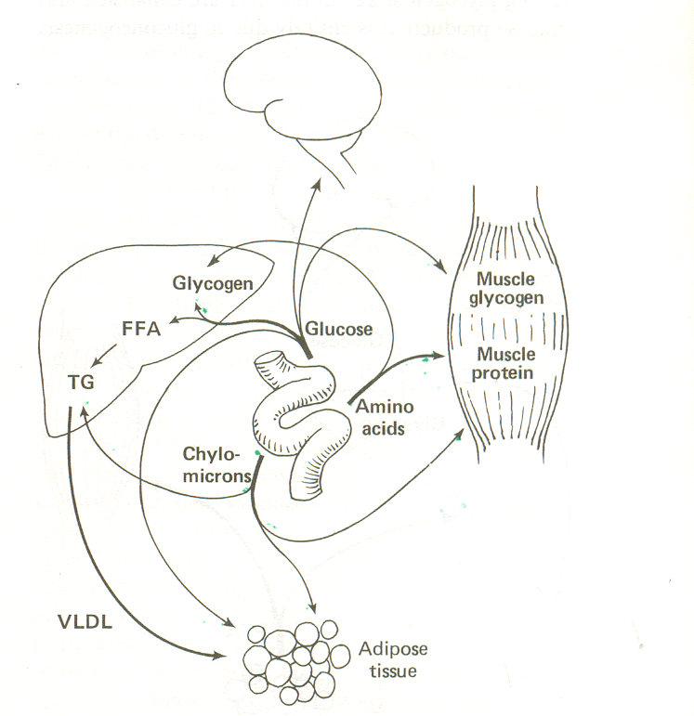
The movements of fuel molecules during the digestion of a meal

Slide 206
In between meals
insulin↓, glucagon↑.
Energy source for brain (& RBC): glycogen from hepatic store.
Energy source for muscle & other tissue including liver: FFA.

Slide 207
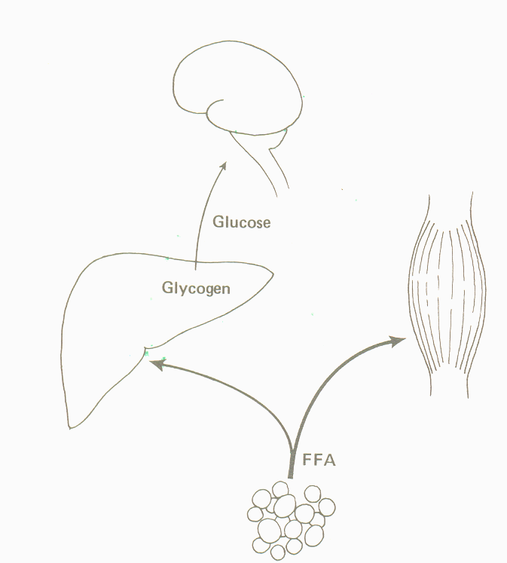
Fuel metabolism between meals

Slide 208
After an overnight fasting:
Most of the liver glycogen has been used, there is a little glycogen stored in the muscle.
Degradation of muscle protein begin → AA → pyruvat (gluconeogenesis). Gluconeogenesis also occurs at renal cortex.
AA ketogenic: E for other body cells.
FFA is continuously being released from adipose tissue to provide E for tissues other than brain & RBC.
Ketone bodies (liver): Energy for muscle.

Slide 209
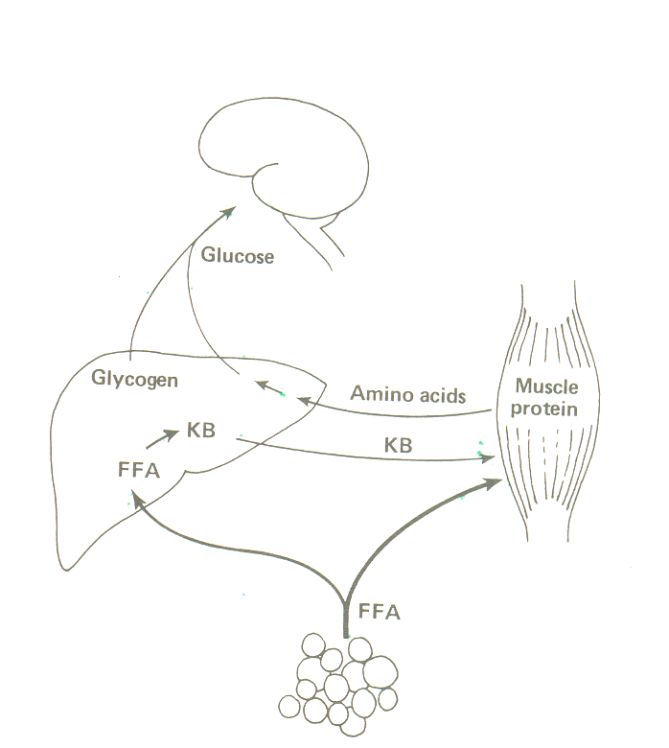
Fuel metabolism after an overnight fast. The renal cortex also
Plays a major part in gluconeogenesis from amino acids. Some
Glycogen is still available in muscle

Slide 210
After prolonged fasting
≅ 2 days fasting, no glycogen storage in the liver.
glucose production from gluconeogenesis of AA, glycerol & lactate.
Catabolisme of protein for gluconeogenesis is a very expensive way to obtain glucose.
Within a few days of fasting: 90% of glucose requirement fulfilled by gluconeogenesis; glycerol provide10% of the needs. If protein gluconeogenesis continuously occur at this rate, death will occur within 3 weeks.

Slide 211
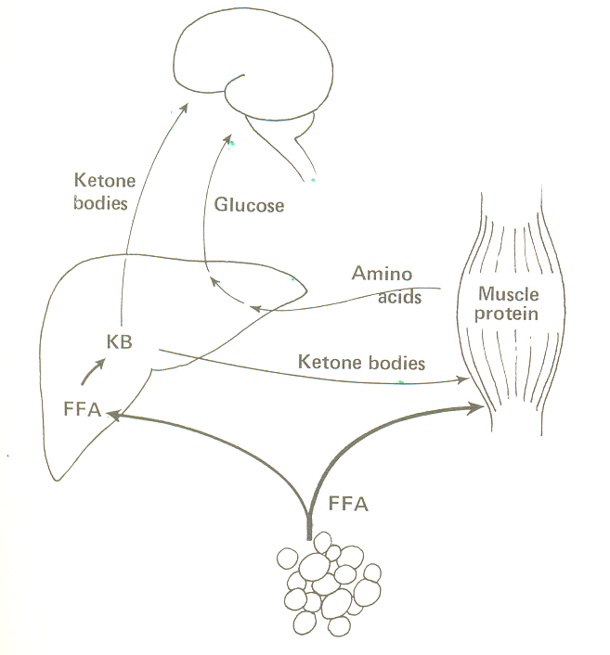
Fuel metabolism after a prolonged fast. The brain derives an
Increasing proportion of its energy from ketone bodies

Slide 212
After Prolonged Fasting
Therefore, lipolysis continuously occurs: FFA (E cell) & glycerol (glucose).
Some of FFA → ketone bodies (liver). Brain adaptation, condensation of Acetil CoA → Ketone bodies: E for selected brain cells.
Body protein continue being degraded → glucose for other brain cells. Until ≅10 d, KB main energy source for brain as compared to glucose. ↓ degradation of muscle protein. Emotional changes due to the usage of KB by brain.

Slide 213
After Prolonged Fasting
Starvation symptom: Muscle wasting, decrease of BMR, ↓ body temperature, immunity against diseases.
Starving children & adult, individual who are on hunger strike, anorexia nervosa and malnourished patient.

Slide 214
After Prolonged Fasting
Reduced appetite: Ketosis (↓ pH in blood & ketone bodies in urine & acetone breath) → LOA (coping mechanisme for starving individual). Regain appetite if food is available.
Ketogenic diet? ? ?

Slide 215
After Prolonged Fasting
↓ Metabolisme Rate: If body use Ketone Bodies → ↓ E expenditure (body try to maintain adipose tissue and muscle fat). Losses of muscle tissue: ↓ BMR & energy expenditure ↓. Losses of muscle tissue: ↓work capacity/ physical activity → ↓E requirement. ↓ metabolisme rate → losses of fat is less as compared to the losses in individuals on low calories diet.

Slide 216
Metabolism AFTER INJURY
After injury/ surgery (3/4 d):
↑catecolamine (sympathetic nervous system & medulla of adrenal): ↓insulin, ↑glucagon; ↑ACTH, ↑cortisol ⇒ rapid degradation of glycogen & muscle protein; ↑ mobilisation of FFA from adipose tissue; ketone bodies in the liver.

Slide 217
Insulinomas
Tumor produces insulin in the pancreas.
Rare.
Sx: dizziness after meal.
Tx: Increase the fq of high carbohydrate snacks.
Complication: Obesity

Slide 218
Excessive Glucagon
Tumor produces glucagon in the pancreas.
Sx: Dermatological problems (skin lession), probably due to the severe reduction in AA level/ pool.
Glucose in plasma is normal due to increase in insulin production.

