Slide 1
Chapter 12
The Endomembrane System

Slide 2
The Endomembrane System
An appreciation of eukaryotic cells depends on understanding the role of intercellular membranes and the compartmentalization of function within organelles
Movement of lipids and proteins between organelles (called trafficking) must be tightly regulated
Notes:
2

Slide 3
Components of the Endomembrane System
The endoplasmic reticulum and the Golgi complex are sites for protein synthesis, processing, and sorting
Endosomes carry and sort material brought into the cell
Lysosomes digest ingested material and unneeded cellular components
These form the endomembrane system
Notes:
3

Slide 4
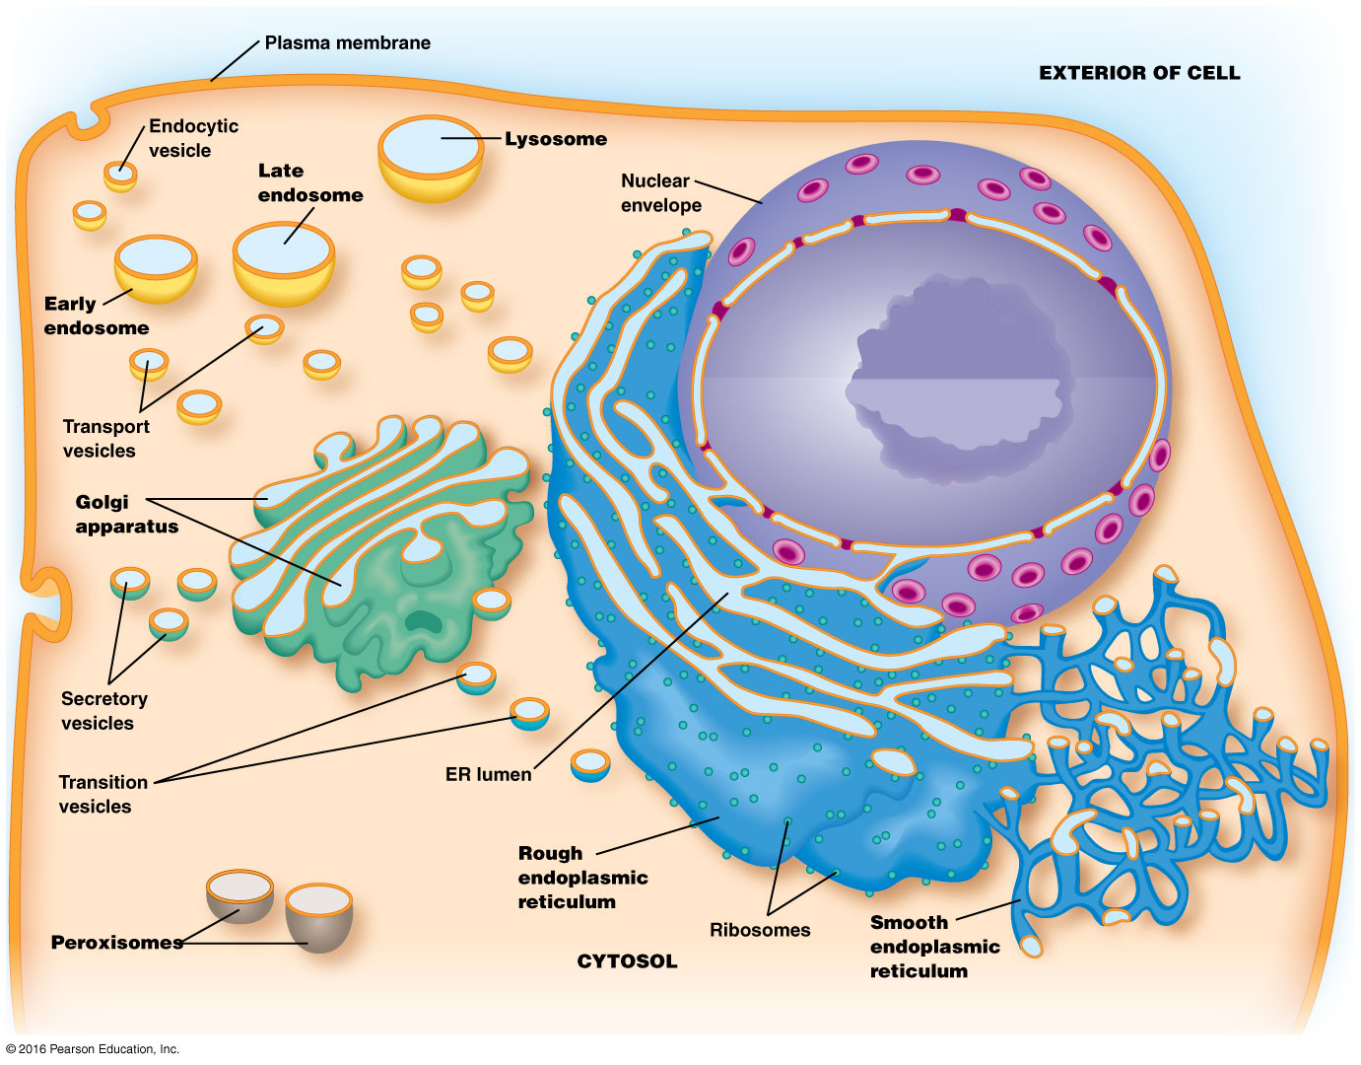

Slide 5
Peroxisomes
Peroxisomes house hydrogen peroxide–generating reactions
They also perform diverse metabolic functions
Notes:
5

Slide 6
12.1 The Endoplasmic Reticulum
The endoplasmic reticulum (ER) is a continuous network of flattened sacs, tubules, and vesicles through the cytoplasm of a eukaryotic cell
The membrane-bound sacs are called ER cisternae, and the space inside them is the ER lumen
Notes:
6

Slide 7
Functions of the ER
The enzymes associated with the ER are involved in synthesis of proteins for
Incorporation into the plasma membrane
Organelles of the endomembrane system
Export from the cell
The ER is also involved in lipid synthesis
Notes:
7

Slide 8
The Two Basic Kinds of Endoplasmic Reticulum Differ in Structure and Function
Rough endoplasmic reticulum (rough ER) is characterized by ribosomes on the cytosolic side of the membrane
A subdomain of rough ER, the transitional elements (TEs) plays a role in the formation of transition vesicles that shuttle lipids and proteins from the ER to the Golgi complex
Smooth ER lacks ribosomes and has other roles in the cell
Notes:
8

Slide 9
Rough and Smooth ER Are Easily Distinguished
Rough ER membranes form large flattened sheets
Smooth ER membranes form tubular structures
Transitional elements of the rough ER are an exception; they resemble the smooth ER
The lumenal spaces of rough and smooth ER are continuous
Notes:
9

Slide 10
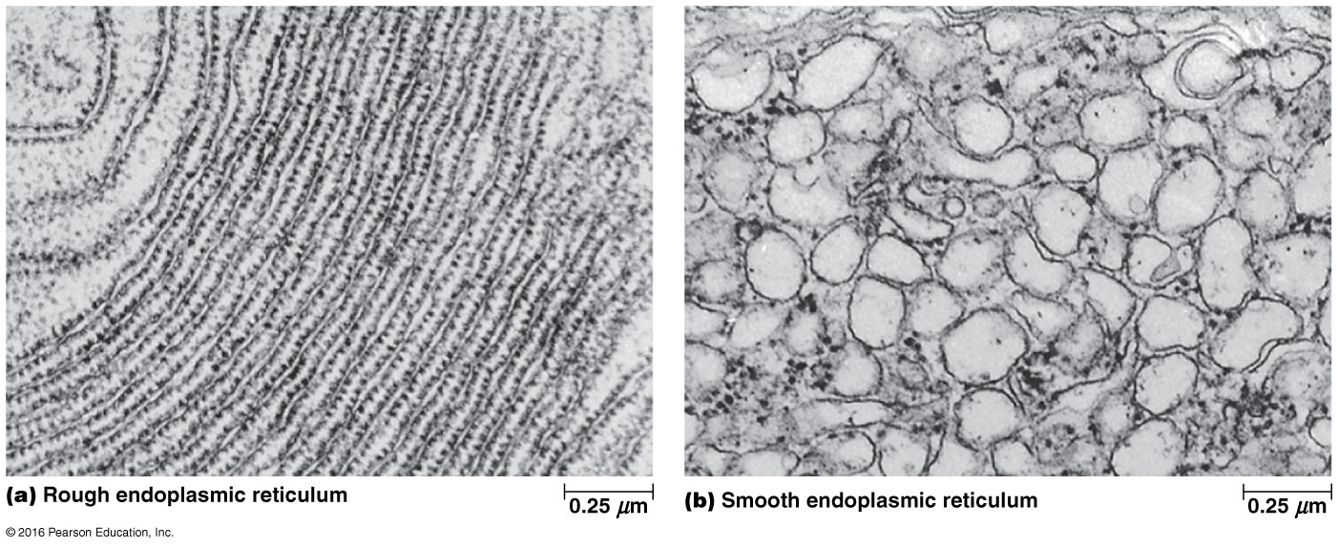

Slide 11
Variation in Amounts of Rough and Smooth ER
Both types of ER are present in most eukaryotic cells, but there is variation in the relative amounts
Cells involved in synthesis of secretory proteins have prominent rough ER networks
Cells producing steroid hormones tend to have extensive networks of smooth ER

Slide 12
Rough ER Is Involved in the Biosynthesis and Processing of Proteins
Ribosomes on the cytosolic side of the rough ER membrane synthesize both membrane-bound and soluble proteins for the endomembrane system
Newly synthesized proteins are inserted into the endomembrane system through a pore complex as they are synthesized (cotranslationally)

Slide 13
Rough ER—Other Functions
Rough ER is the site for
The initial steps of addition of carbohydrates to glycoproteins
The folding of polypeptides
Recognition and removal of misfolded proteins
Assembly of multimeric proteins

Slide 14
Rough ER Has a Role in Quality Control
In ER-associated degradation (ERAD), proteins that are incorrectly folded, modified, or assembled are exported for degradation
Degradation occurs in cytosolic proteasomes

Slide 15
Smooth ER Is Involved in Drug Detoxification, Carbohydrate Metabolism, Calcium Storage, and Steroid Biosynthesis
The functions of smooth ER differ from that of rough ER
Smooth ER is primarily involved in processing or storing nonprotein molecules within cells

Slide 16
Drug Detoxification
Drug detoxification often involves hydroxylation
Adding hydroxyl groups to hydrophobic drugs increases their solubility, making them easier to excrete from the body
Hydroxylation is catalyzed by a member of the cytochrome P-450 family of proteins, also called monooxygenases

Slide 17
Hydroxylation Occurs via Electron Transport
Electrons from NADPH or NADH are transferred to a heme group in cytochrome P-450
An electron is donated to O₂, where one oxygen atom forms H₂O and the other is added to the substrate as a hydroxyl group

Slide 18
Drug Tolerance
Injection of phenobarbital into rats causes rapid increases in the barbiturate-detoxifying enzymes and a proliferation of smooth ER
This means that higher doses of the drug are needed to achieve the same effect, a phenomenon known as tolerance
The enzymes involved can decrease the effectiveness of other drugs as well

Slide 19
Drug Synergy
Synergy is an effect in which the combined effect of two substances is stronger than expected from just the sum of their individual effects
Synergistic effects could lead to potential toxicity or lethality

Slide 20
Drug Detoxification in the Smooth ER
Another cytochrome P-450 is part of a complex called aryl hydrocarbon hydroxylase, which metabolizes polycyclic hydrocarbons
The products can be more toxic than the original compounds; some are associated with spontaneous cancers in mice
Cigarette smoke is a potent inducer of aryl hydrocarbon carboxylase

Slide 21
Pharmacogenetics
Differences in activities and side effects of certain medications can result from differences in presence or activity of particular cytochrome P-450 genes in different patients
A new field of study, called pharmacogenetics, investigates how inherited differences in genes can lead to differential responses to drugs and medications

Slide 22
Carbohydrate Metabolism
Smooth ER in liver cells is involved in breakdown of stored glycogen; it contains glucose-6-phosphatase, an enzyme unique to smooth ER
Glucose-6-phosphatase hydrolyzes the phosphate from glucose-6-phosphate to form free glucose

Slide 23
Regulation of Glucose
The liver stores glucose as glycogen in granules associated with smooth ER
When glucose is needed by the body, glycogen is broken down by phosphorolysis, producing glucose-6-phosphate
This must be converted to free glucose in order to leave the cell and enter the bloodstream

Slide 24
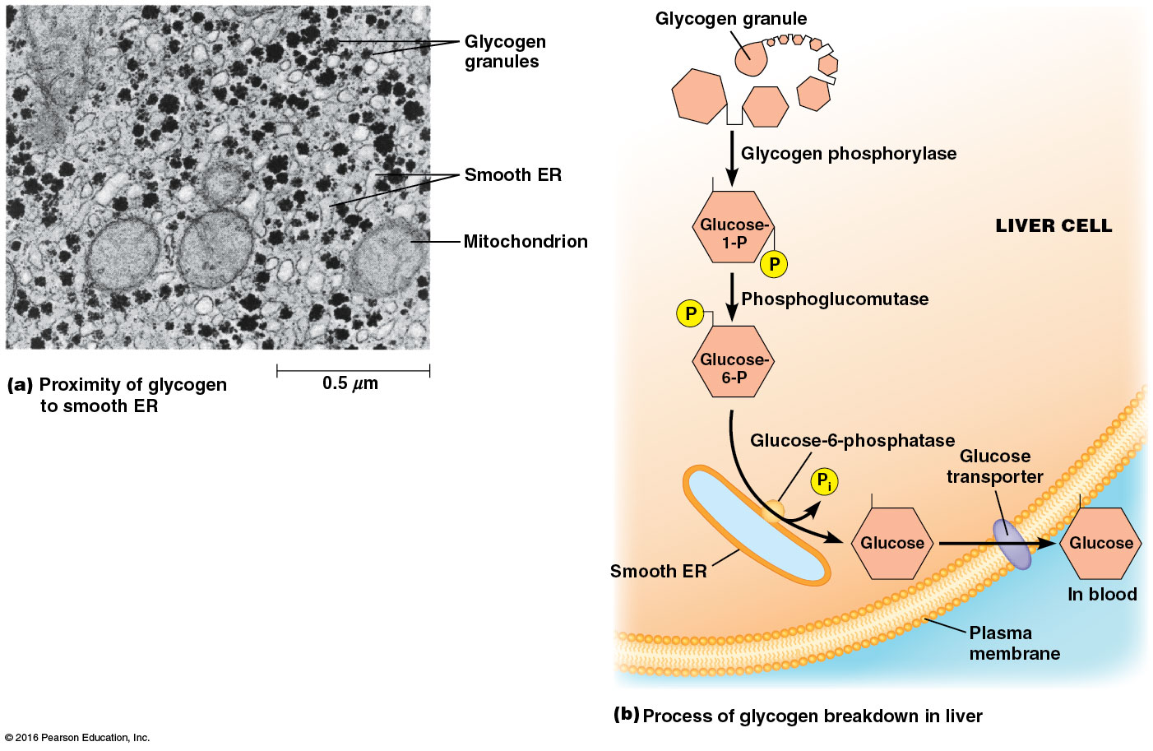

Slide 25
Calcium Storage
The sarcoplasmic reticulum of muscle cells is an example of smooth ER that specializes in calcium storage
The ER lumen contains high concentrations of calcium-binding proteins
Calcium ions are pumped into the ER by ATP-dependent calcium ATPases and are released when needed for muscle contraction

Slide 26
Steroid Biosynthesis
Smooth ER in some cells is the site of cholesterol and steroid hormone synthesis
Large amounts of smooth ER are found in cells that synthesize these
Smooth ER has also been found associated with plastids in some plants and may be involved in phytohormone synthesis

Slide 27
Cholesterol
Cholesterol, cortisol, and steroid hormones share a four-ring structure but differ in the number and arrangement of carbon side chains and hydroxyl groups
Hydroxymethylglutaryl-CoA reductase (HMG-CoA reductase) is the committed step in cholesterol biosynthesis
It is found in smooth ER of liver cells and is targeted by cholesterol-lowering drugs called statins

Slide 28
The ER Plays a Central Role in the Biosynthesis of Membranes
In eukaryotic cells, the ER is the primary source of membrane lipids, with a few exceptions
Mitochondria synthesize phosphatidylethanolamine
Peroxisomes synthesize cholesterol
Chloroplasts contain enzymes for chloroplast-specific lipids

Slide 29
Membrane Biosynthesis
Fatty acids for membrane phospholipids are synthesized in the cytoplasm and incorporated into the ER membrane on the cytosolic side
They are transferred to the lumenal side of the bilayer by enzymes called phospholipid translocators (flippases)
The type of phospholipid molecules transferred across the membrane depends on the particular translocator present, leading to membrane asymmetry

Slide 30
Membrane Biosynthesis (continued)
The distinct composition of cytosolic and lumenal monolayers established in the ER is transferred to other cellular membranes
Movement of phospholipids from ER to mitochondria, chloroplasts, or peroxisomes is problematic
Phospholipid exchange proteins (phospholipid transfer proteins) convey specific phospholipids to these organelles

Slide 31
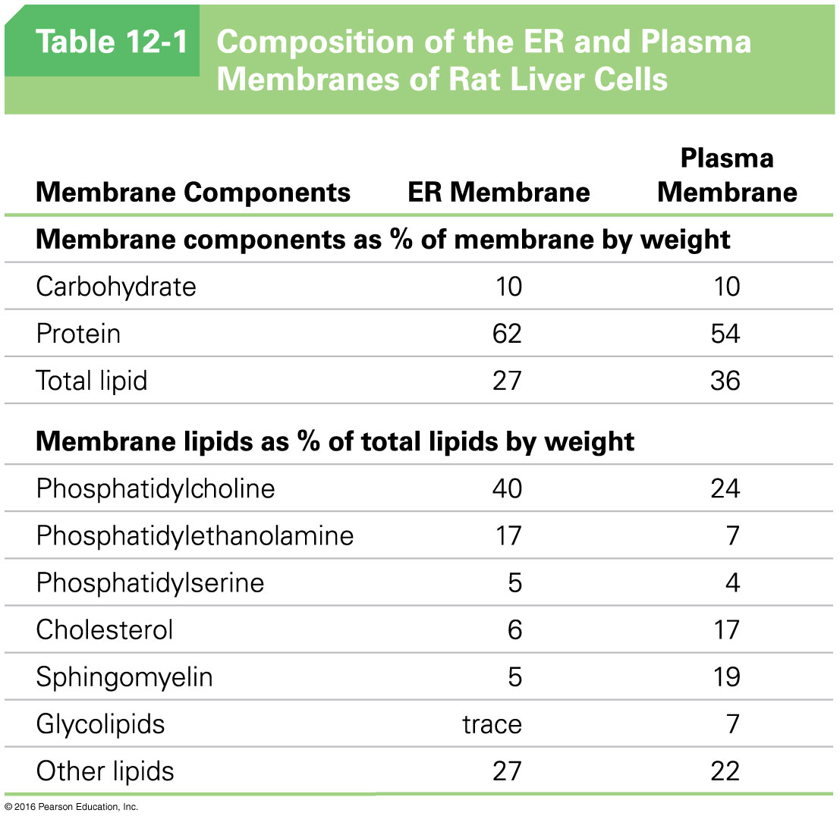

Slide 32
12.2 The Golgi Complex
The Golgi complex is functionally and physically linked to the ER
Here, glycoproteins and membrane lipids from the ER undergo further processing and are sorted and packaged for transport
Thus the Golgi complex plays a central role in membrane and protein trafficking in eukaryotic cells

Slide 33
The Golgi Complex Consists of a Series of Membrane-Bounded Cisternae
The Golgi complex is a series of flattened membrane-bounded cisternae
A series of cisternae, usually three to eight, is called a Golgi stack
Some cells have one large stack, and others, especially secretory cells, have hundreds or thousands of stacks

Slide 34
Transport Vesicles
Both ER and the Golgi complex are surrounded by numerous vesicles that carry lipids and proteins from the ER to the Golgi complex and then to various destinations in the cell
The Golgi complex lumen (intracisternal space) is part of the endomembrane system

Slide 35
The Two Faces of the Golgi Stack
Each Golgi stack has two distinct sides, or faces
The cis face is oriented toward the ER, and the Golgi compartment on this side is called the cis-Golgi network (CGN)
The opposite side is called the trans face, and the compartment on this side is called the trans-Golgi network (TGN)

Slide 36
The Golgi Network
Proteins and lipids leave the Golgi in transport vesicles that continuously bud from the tips of the TGN
Between the TGN and CGN are medial cisternae, where much of the processing of proteins occurs
Each compartment shows biochemical polarity, containing specific proteins unique to each portion of the network

Slide 37
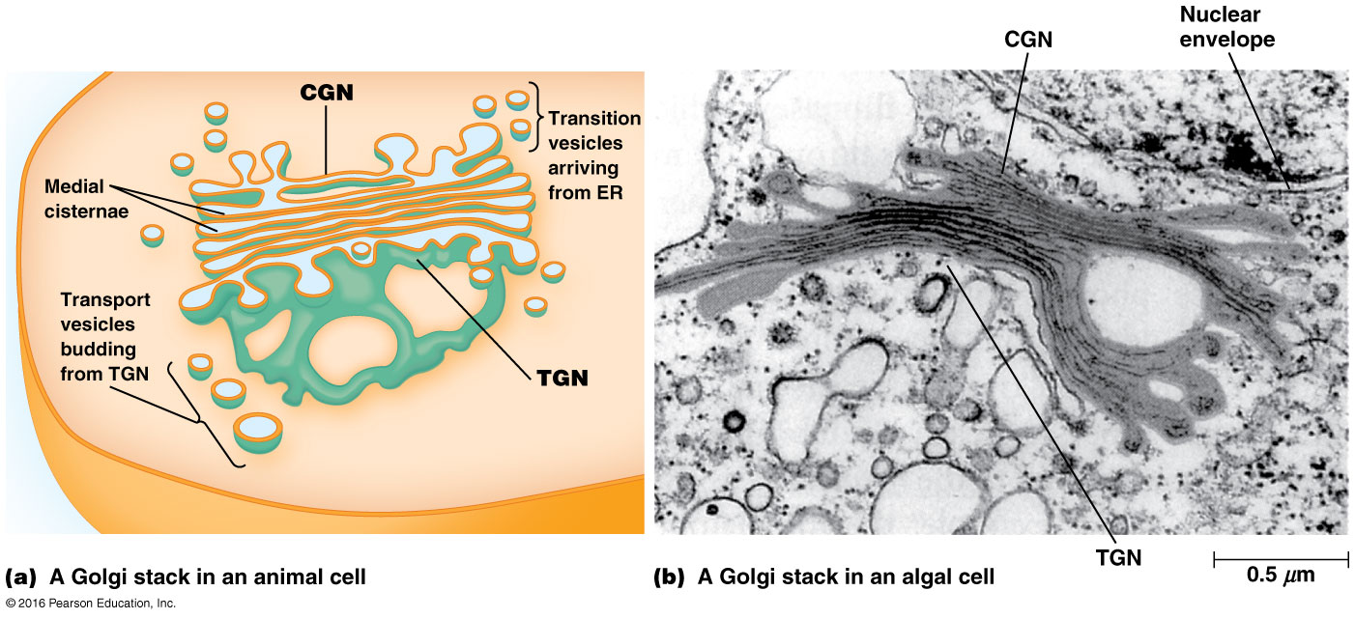

Slide 38
Two Models Depict the Flow of Lipids and Proteins Through the Golgi Complex
Two models have been proposed to explain the movement of lipids and proteins from the Golgi
These are
The stationary cisternae model
The cisternal maturation model

Slide 39
The Stationary Cisternae Model
In this model, each cisterna in the Golgi stack is a stable structure
Transport of materials from one cisterna to another is mediated by shuttle vesicles
These bud off from one cisterna and fuse with the next cisterna in a cis-to-trans sequence

Slide 40
The Cisternal Maturation Model
In this model, the Golgi cisternae are transient compartments
These gradually change from CGN through medial cisternae to TGN
Enzymes not needed in later compartments are returned to earlier compartments in vesicles

Slide 41
The Models Are Not Mutually Exclusive
Both models involve the formation of transport vesicles containing sorted cargo targeted for various destinations
Experimental evidence suggests that these models are not mutually exclusive
Experiments involve tracking the movement of substances between the compartments and time-lapse fluorescence microscopy

Slide 42
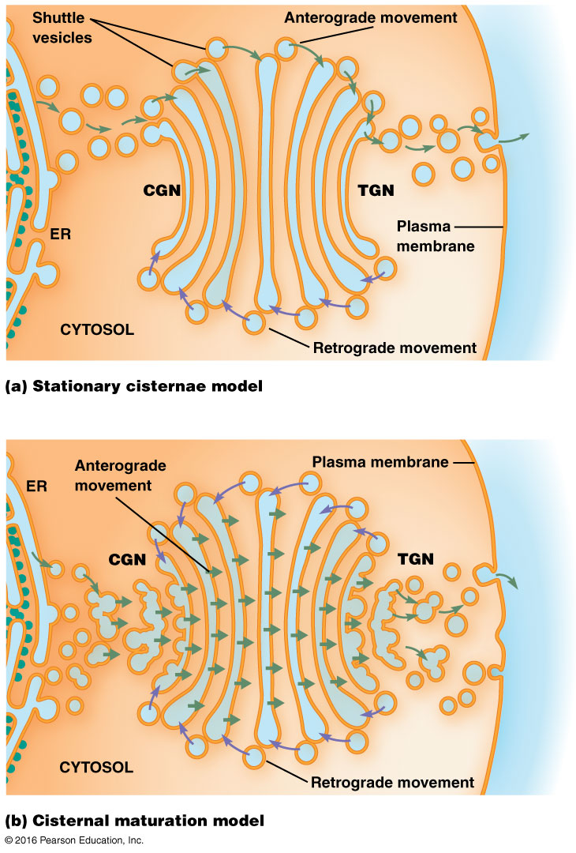

Slide 43
Anterograde and Retrograde Transport
Movement of material toward the plasma membrane is called anterograde transport
As a secretory granule fuses with the plasma membrane and discharges its contents (exocytosis), a bit of membrane from the ER becomes part of the plasma membrane
This flow of lipids toward the plasma membrane must be balanced

Slide 44
Retrograde Transport
Retrograde transport is the flow of vesicles from Golgi cisternae back to the ER
This allows the cell to balance the flow of lipids toward the plasma membrane
It also ensures a supply of materials for forming new vesicles

Slide 45
12.3 Roles of the ER and Golgi in Protein Glycosylation
Much of the protein processing carried out in the ER and Golgi involves glycosylation, the addition of carbohydrate side chains to proteins
Enzyme-catalyzed reactions involving the resulting glycoproteins then modify the oligosaccharide side chain

Slide 46
Two General Kinds of Glycosylation
N-linked glycosylation (N-glycosylation) involves the addition of an oligosaccharide to the nitrogen atom of certain asparagine residues
O-linked glycosylation involves addition of the oligosaccharide to the oxygen atom on the hydroxyl group of certain serine or threonine residues

Slide 47
Initial Glycosylation Occurs in the ER
The initial steps of N-glycosylation take place on the cytosolic surface of the ER membrane
Later steps take place in the ER lumen
All carbohydrate side chains initially have a common core oligosaccharide consisting of two units of N-acetylglucosamine, nine mannose units, and three glucose units

Slide 48
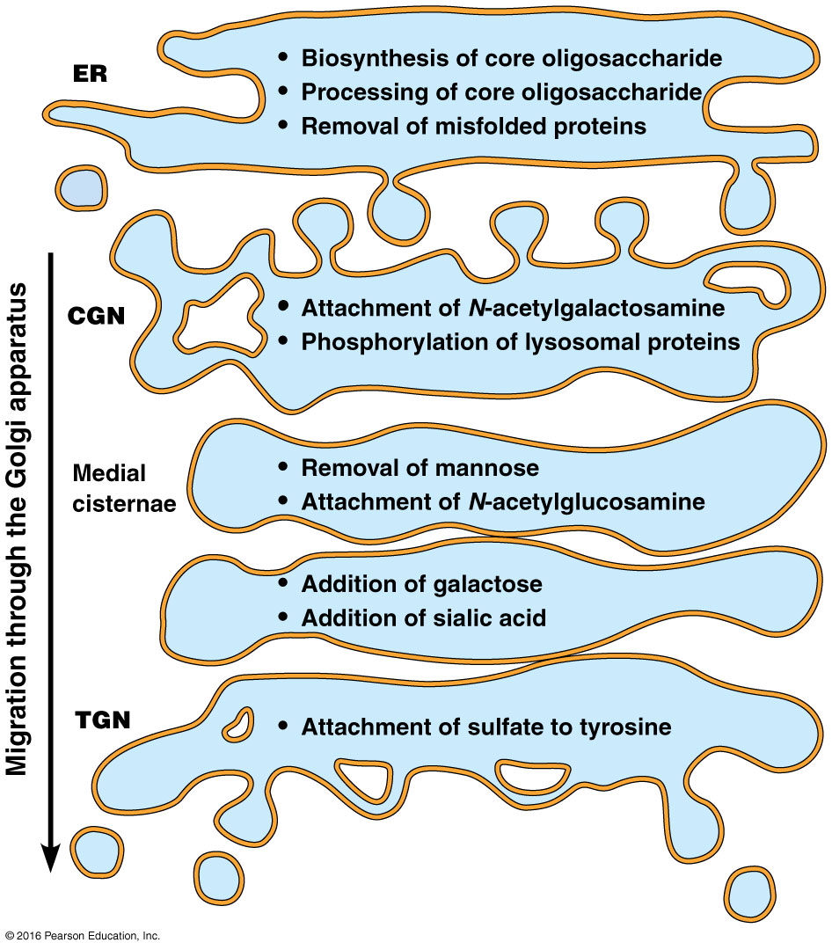

Slide 49
Initial Glycosylation Occurs in the ER (continued)
Glycosylation begins as dolichol phosphate, an oligosaccharide carrier, is inserted into the ER membrane (1)
GlcNAc and mannose groups are then added to the phosphate group (2)
The growing core oligosaccharide is translocated to the ER lumen by a flippase (3)

Slide 50
Initial Glycosylation Occurs in the ER (continued)
Once inside the lumen, more mannose and glucose are added (4)
The completed core oligosaccharide is transferred from dolichol to the asparagine residue of the recipient protein (5) by oligosaccharyl transferase
The core oligosaccharide attached to the protein is trimmed and modified (6)

Slide 51
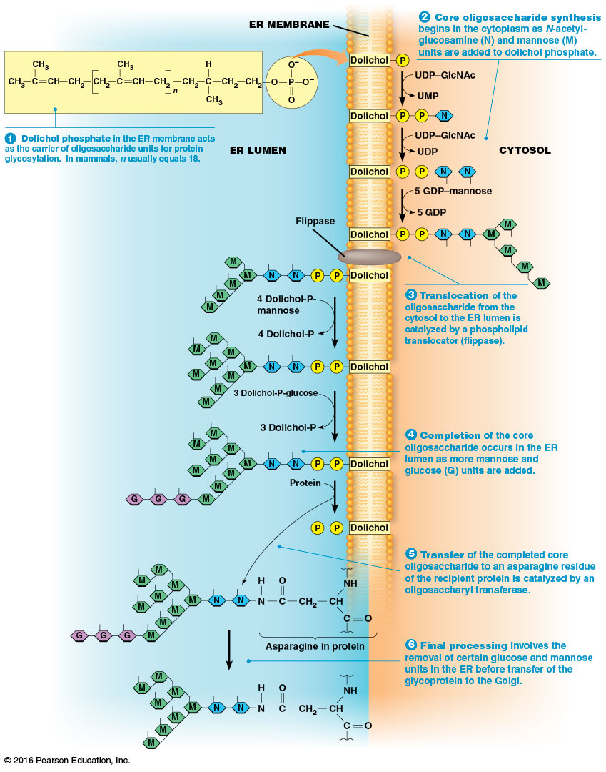

Slide 52
Cotranslational Glycosylation
Usually the oligosaccharide is added to the recipient protein as the polypeptide is being synthesized
This is called cotranslational glycosylation
It helps to promote proper protein folding

Slide 53
Two Proteins Assist with Proper Folding
Two ER proteins, calnexin (CNX) and calreticulin (CRT), bind to monoglucosylated glycoproteins and promote disulfide bond formation
This occurs via a complex that includes a thiol reductase known as ERp57
The complex dissociates and the final glucose is removed by glucosidase II

Slide 54
Proper Folding in the ER
A glucosyl transferase, UGGT, (UDP-glucose:glycoprotein glucotransferase), binds to improperly folded proteins
It adds back a single glucose unit, making the protein a substrate for CNX/CRT binding
Once proper conformation is achieved, UGGT no longer binds the new glycoprotein, which moves on to the Golgi

Slide 55
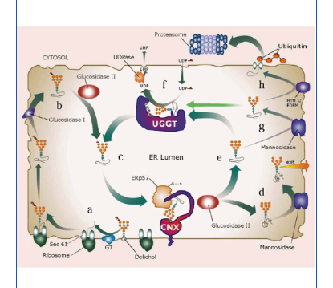

Slide 56
Further Glycosylation Occurs in the Golgi Complex
Further processing of N-glycosylated proteins occurs in the Golgi complex as the glycoproteins move from the cis face through to the trans face
These terminal glycosylations are variable and create great diversity
Terminal glycosylation involves the removal of a few units of the core oligosaccharide and sometimes nothing more

Slide 57
Terminal Glycosylation
In some cases, more complex oligosaccharides are generated by adding GlcNAc or other monosaccharides
Sometimes galactose units are added by galactosyl transferases
The ER and Golgi contain hundreds of different glycosyl transferases

Slide 58
12.4 Roles of the ER and Golgi Complex in Protein Trafficking
Proteins synthesized in the rough ER must be directed to a variety of locations
Once a protein reaches its destination, it must be prevented from leaving
Each protein contains a specific “tag” targeting it to a transport vesicle that will take it to the correct location

Slide 59
Protein Tags
A tag may be an amino acid sequence, a hydrophobic domain, oligosaccharide side chain, or some other feature
Tags can also exclude material from certain vesicles

Slide 60
Lipid Tags
Membrane lipids may also be tagged to help vesicles reach their destinations
Lipid tags can be one or more phosphate groups attached to positions 3, 4, and/or 5 of a membrane phosphatidyl inositol

Slide 61
Overview of Trafficking
Sorting of proteins begins in the ER and early compartments of the Golgi
There are mechanisms to retrieve or retain compartment-specific proteins
The final sorting of material that will leave the Golgi complex occurs in the TGN

Slide 62
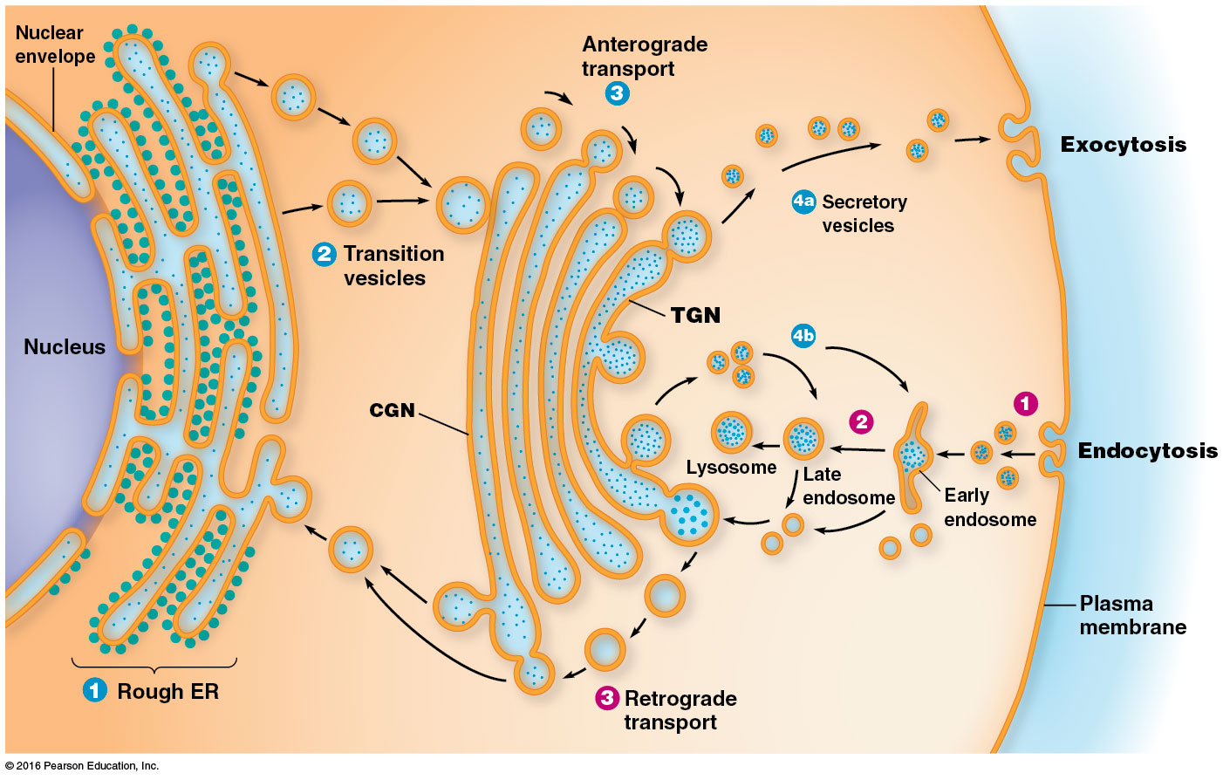
Notes:
62

Slide 63
ER-Specific Proteins Contain Retention and Retrieval Tags
Protein composition in the ER is maintained by preventing some proteins from escaping the ER and by retrieving others from the Golgi
Some proteins localized to the ER contain the sequence RXR (Arg-X-Arg; X is any amino acid)
This is a retention tag and is also found in some proteins that are destined for the plasma membrane

Slide 64
The RXR Tag
The N-methyl-D-aspartate (NMDA) receptor, important in mammalian neurotransmission, has the RXR tag
It is thought that the tripeptide causes subunits of NMDA to be retained in the ER until the complex is completely assembled
The RXR tag must be masked to allow the assembled complex to leave the ER

Slide 65
Retrieval Tags
Some proteins returned from the Golgi to the ER contain retrieval tags
The tags are short C-terminal sequences such as KDEL (Lys-Asp-Glu-Leu) or KKXX in mammals and HDEL (His-Asp-Glu-Leu) in yeast
When a protein with this tag binds a receptor, the receptor-ligand complex is packaged into a transport vesicle for return to the ER

Slide 66
Evidence Regarding Retrieval Tags
Evidence about the importance of retrieval tags comes from experiments involving chimeric proteins (fusion proteins)
These are made by joining the DNA sequences for two polypeptide segments to allow production of a hybrid protein
Proteins normally secreted from the cell that are altered to contain the retrieval tag end up in the ER

Slide 67
Golgi Complex Proteins May Be Sorted According to the Lengths of Their Membrane-Spanning Domains
Some proteins resident to the Golgi complex also contain retention or retrieval tags
Large complexes that are excluded from transport vesicles may play a role in maintaining the protein composition of the Golgi complex
A third mechanism involves hydrophobic regions of Golgi proteins

Slide 68
Golgi-Specific Proteins
All Golgi-specific proteins are integral membrane proteins with one or more membrane-spanning domains
The length of the hydrophobic domains may determine into which cisternae each protein is incorporated
The thickness of cellular membranes increases progressively from the ER (5 nm) to the plasma membrane (8 nm)

Slide 69
Length of Hydrophobic Domains Is Correlated with Location in the Golgi Complex
The thickness of membranes in the Golgi increases from the CGN to the TGN
Proteins move from compartment to compartment until the membrane thickness exceeds the length of the transmembrane domains
This blocks further migration

Slide 70
Targeting of Soluble Lysosomal Proteins to Endosomes and Lysosomes Is a Model for Protein Sorting in the TGN
Soluble lysosomal enzymes in the ER and early Golgi compartments undergo N-glycosylation followed by removal of glucose and mannose units
The mannose residues on the side chains are phosphorylated within the Golgi complex, forming an oligosaccharide containing mannose-6-phosphate
This tag ensures delivery of lysosomal proteins to the lysosomes

Slide 71
The Mannose-6-Phosphate Tag
Phosphorylation of mannnose is catalyzed by two Golgi-specific enzymes
The first is a phosphotransferase that adds GlcNAc-1-phosphate to carbon 6 of mannose in an early Golgi compartment
The second, in a mid-Golgi compartment, removes GlcNAc, leaving behind the mannose-6-phosphate residue
Notes:
71

Slide 72
Destination of Lysosomal Proteins
Tagged lysosomal proteins bind to mannose-6-phosphate receptors (MPRs)
The receptor-ligand complexes are packaged into transport vesicles and conveyed to an endosome
In animal cells, lysosomal enzymes are transported from the TGN to organelles known as late endosomes
Notes:
72

Slide 73
Multivesicular Endosomes
Degradation and recycling of unneeded or damaged components are carried out by specialized late endosomes called multivesicular endosomes (MVEs)
They are sometimes called multivesicular bodies (MVBs)
These serve as an intermediate between early endosomes and lysosomes and sequester materials destined for degradation or recycling
Notes:
73

Slide 74
Destination of Lysosomal Proteins (continued)
Dissociation of the lysosomal enzymes prevents the retrograde movement of the enzymes back to the Golgi with the receptors
The late endosome matures to form a new lysosome or delivers its contents to an active lysosome
In the human genetic disorder I-cell disease, ( Inclusion-cell disease; autosomal recessive disorder;due to the lack of phosphotransferase) lysosomal enzymes are misdirected
Notes:
74

Slide 75
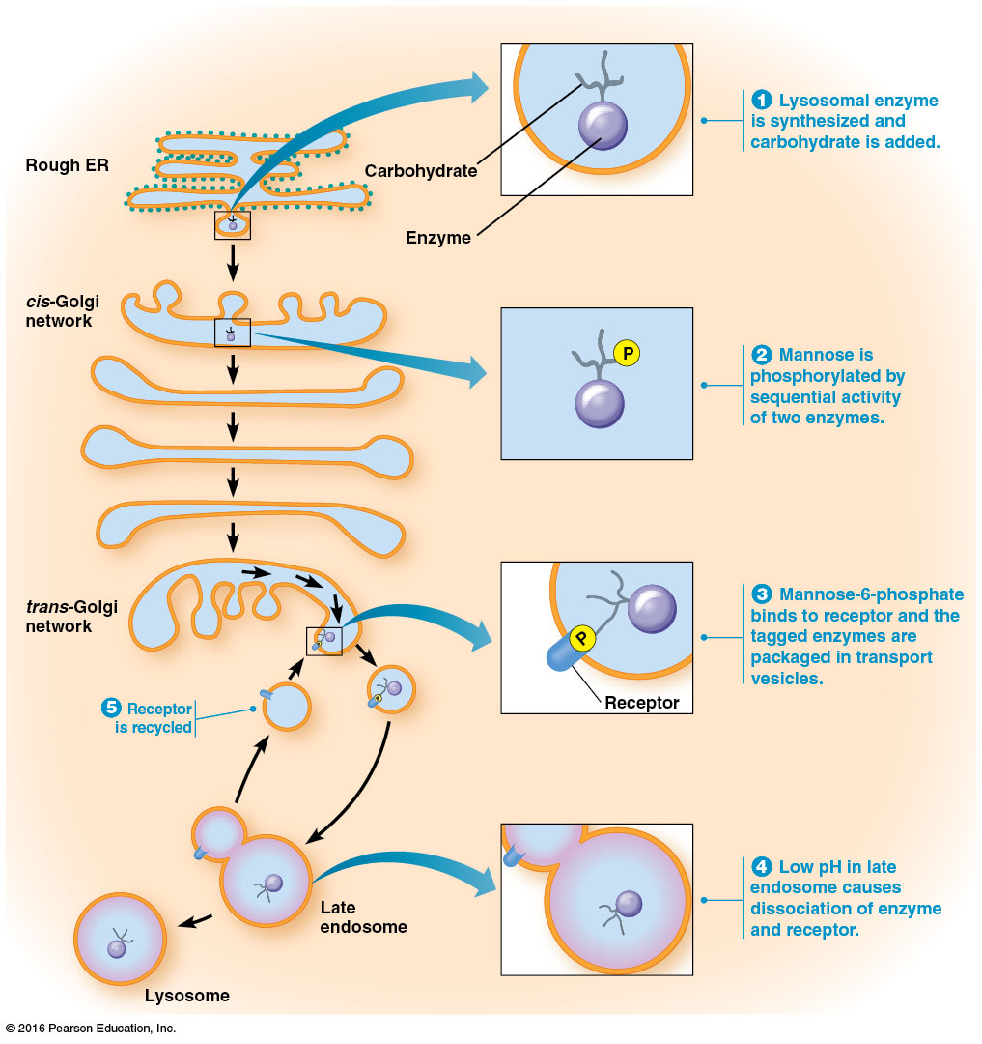

Slide 76
12.5 Exocytosis and Endocytosis: Transporting Material Across the Plasma Membrane
Two methods (unique to eukaryotes) for transporting materials across the plasma membrane are
Exocytosis, the process by which secretory vesicles release their contents outside the cell
Endocytosis, the process by which cells internalize external materials

Slide 77
Secretory Pathways Transport Molecules to the Exterior of the Cell
Secretory pathways move proteins from the ER through the Golgi complex to secretory vesicles and secretory granules
The secretory granules then discharge their contents to the exterior of the cell
Experiments using electron microscopy and autoradiography show the movement of proteins through secretory pathways
Notes:
77

Slide 78
Results of the Experiment
Proteins were radioactively labeled briefly
After three minutes, the proteins could be seen primarily in the rough ER
A few minutes later, the proteins began to appear in the Golgi complex
Notes:
78

Slide 79
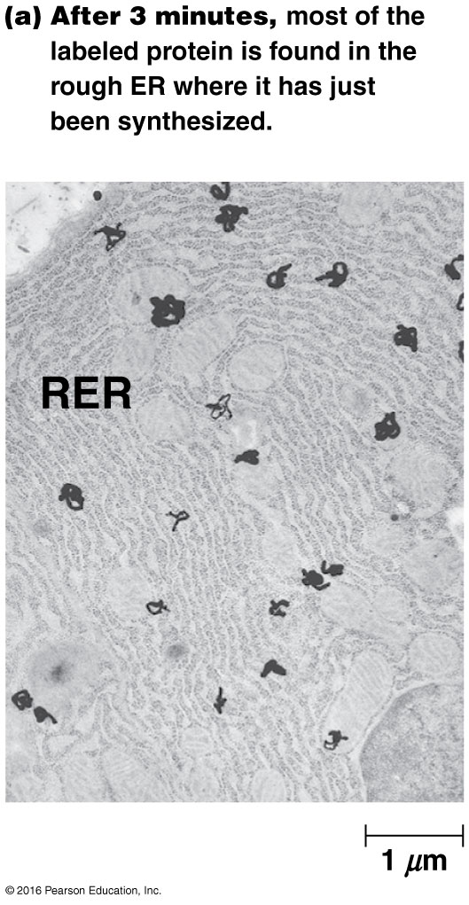
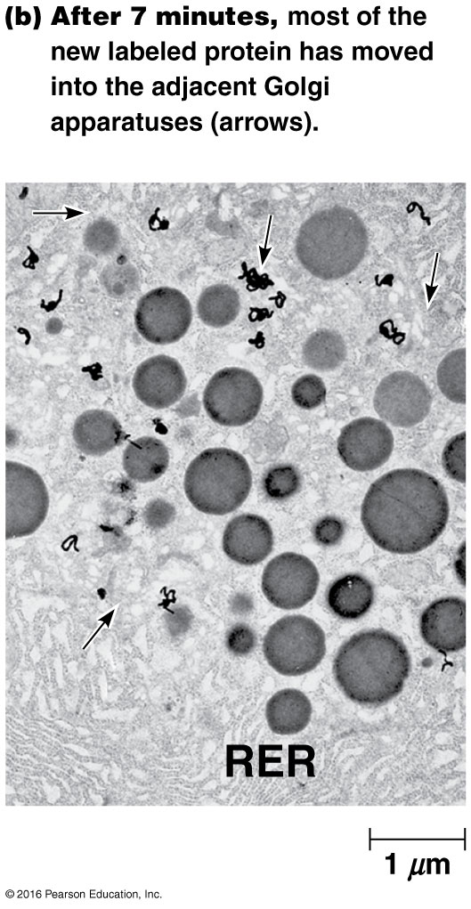

Slide 80
Results of the Experiment (continued)
After 37 minutes, the protein was detected in vesicles budding from the Golgi (named condensing vacuoles by the researchers)
After 117 minutes, the protein began to accumulate in dense zymogen granules, vesicles that discharge their contents out of the cell
Notes:
80

Slide 81
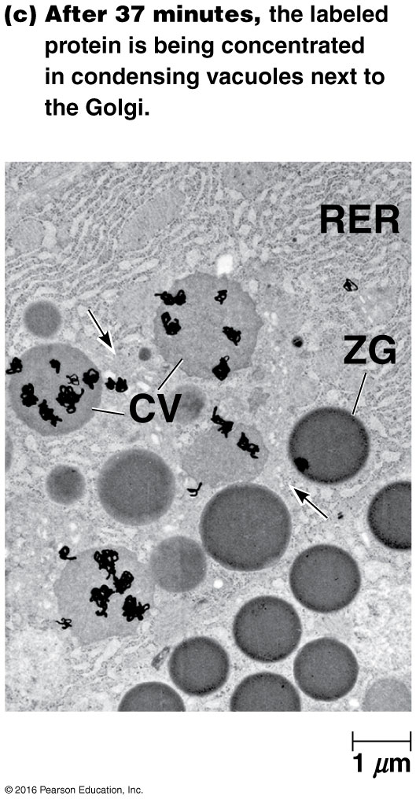

Slide 82
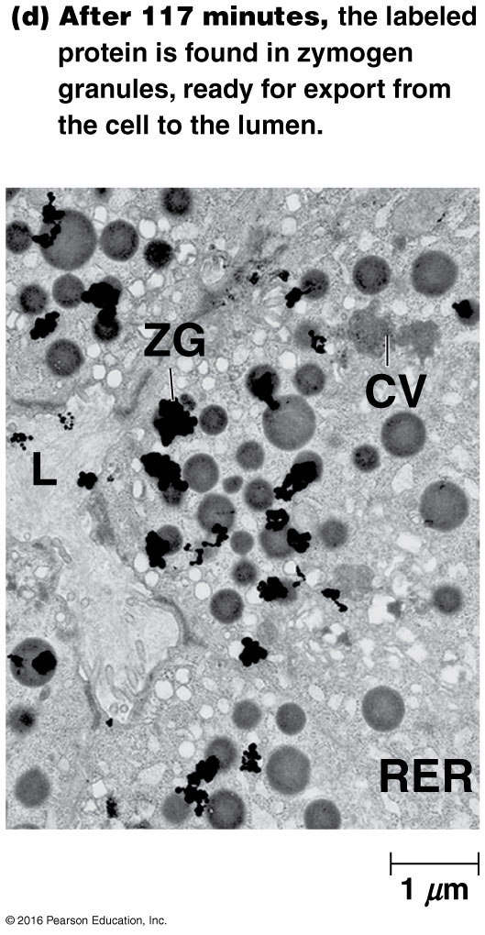

Slide 83
Constitutive Secretion
After budding from the TGN, some vesicles move directly to the cell surface and immediately fuse with the plasma membrane
This unregulated process is continuous and independent of external signals
It is called constitutive secretion; one example is mucus secretion by the intestinal lining

Slide 84
Constitutive Secretion by Default?
Constitutive secretion was once thought to be a default pathway for proteins synthesized by rough ER
It was thought that proteins destined to stay in the endomembrane system must have a tag to avoid constitutive secretion
Current evidence suggests that some tags may be required for constitutive secretion

Slide 85
Regulated Secretion
Secretory vesicles involved in regulated secretion accumulate in the cell and fuse with the plasma membrane only in response to specific signals
An important example is neurotransmitter release
Regulated secretory vesicles form by budding from the TGN as immature secretory vesicles

Slide 86
Regulated Secretion (continued)
Maturation of secretory proteins involves their concentration, called condensation, and sometimes proteolytic processing
The mature secretory vesicles move close to the site of secretion and remain there until receiving a signal
The signal triggers vesicles to release their contents by fusion with the plasma membrane

Slide 87
Excluding Nonsecretory Proteins from Vesicles
Evidence suggests that high concentrations of secretory proteins lead to formation of protein aggregates
These aggregates, formed in the TGN, act to exclude nonsecretory proteins from the forming secretory vesicles
Proteins that do not form aggregates or enter secretory vesicles would be transported elsewhere

Slide 88
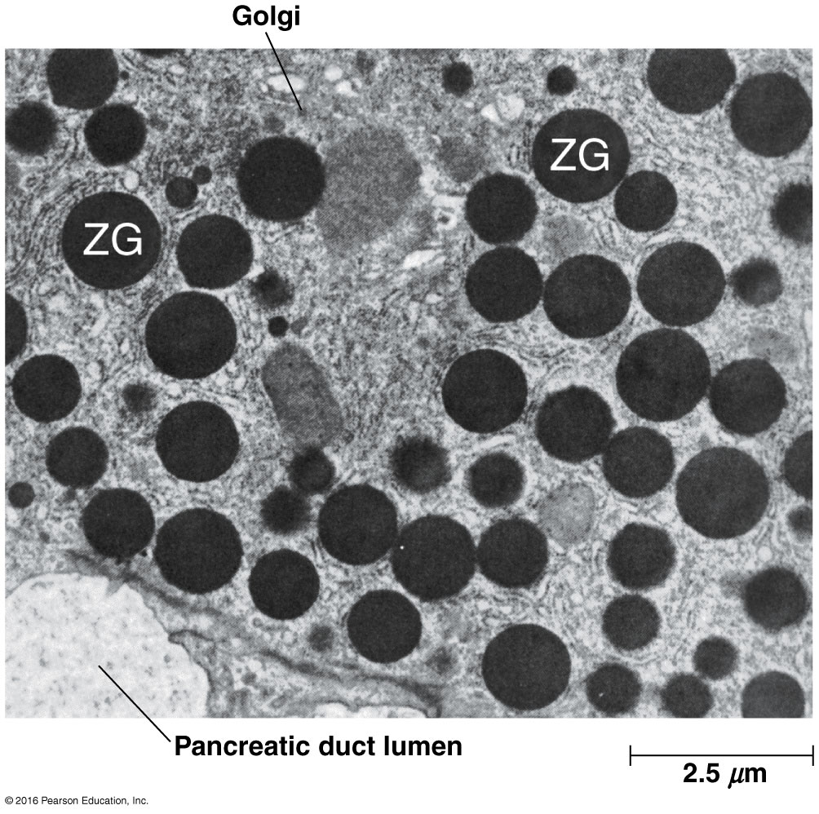

Slide 89
Polarized Secretion
In many cases, exocytosis of specific proteins is limited to a specific surface of the cell
For example, intestinal cells secrete digestive enzymes only on the side of the cell that faces into the intestine
This is called polarized secretion

Slide 90
Exocytosis Releases Intracellular Molecules Outside the Cell
In exocytosis, proteins in a vesicle are released to the exterior of the cell as the vesicle fuses with the plasma membrane
Animal cells secrete hormones, mucus, milk proteins, and digestive enzymes this way
Plant and fungal cells secrete enzyme and structural proteins for the cell wall

Slide 91
The Process of Exocytosis
Vesicles containing products for secretion move to the cell surface (1)
The membrane of the vesicle fuses with the plasma membrane (2)
Fusion with the plasma membrane discharges the contents of the vesicle (3)
The membrane of the vesicle becomes part of the cell membrane (4)

Slide 92
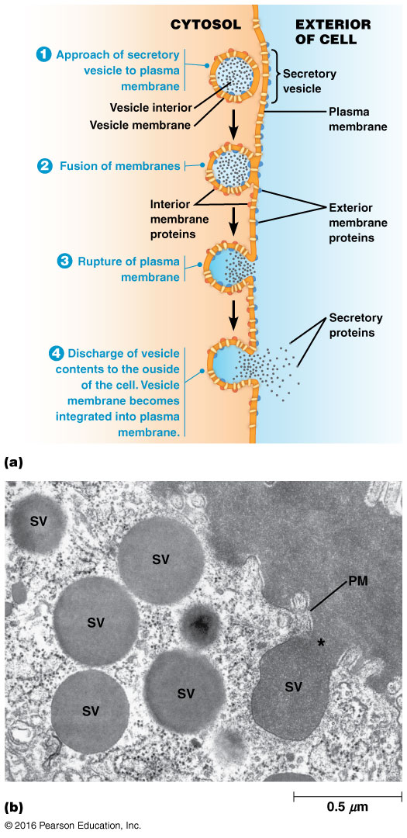

Slide 93
Orientation of Membrane
When the vesicle fuses with the plasma membrane
The lumenal (inner) membrane of the vesicle becomes part of the outer surface of the plasma membrane
So, glycolipids and glycoproteins that were formed in the ER and Golgi lumens will face the extracellular space

Slide 94
Mechanism of Exocytosis
The mechanism of the movement of exocytotic vesicles to the cell surface is not clear
Evidence points to the involvement of microtubules in vesicle movement
Vesicle movement stops when cells are treated with colchicine, a microtubule assembly inhibitor

Slide 95
The Role of Calcium in Triggering Exocytosis
Fusion of regulated secretory vesicles with the plasma membrane is generally triggered by an extracellular signal
In most cases, a hormone or neurotransmitter binds receptors on the cell surface and triggers a second messenger inside the cell
A transient elevation in Ca²⁺ appears to be an essential step in the signaling cascade

Slide 96
Endocytosis Imports Extracellular Molecules by Forming Vesicles from the Plasma Membrane
Most eukaryotic cells carry out one or more forms of endocytosis for uptake of extracellular material
A small segment of the plasma membrane folds inward (1)
Then it pinches off to form an endocytic vesicle containing ingested substances or particles (2–4)

Slide 97
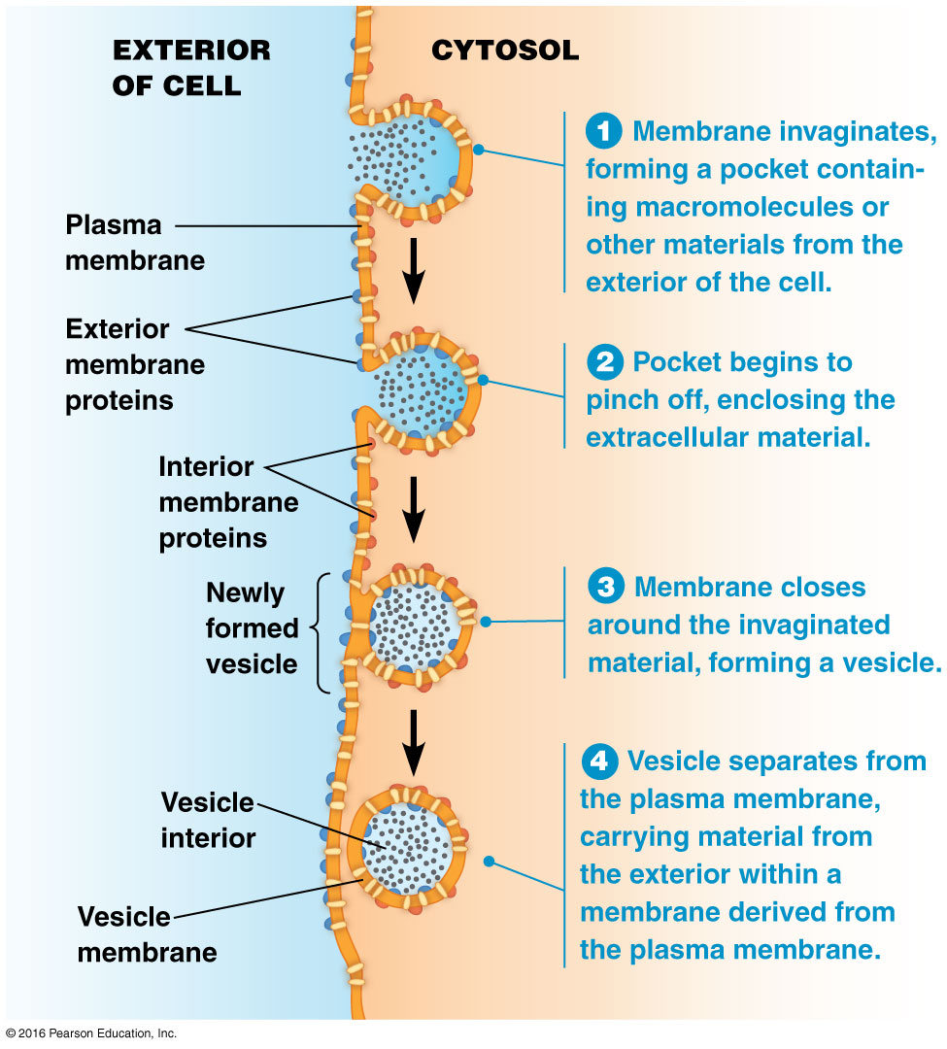

Slide 98
Membrane Flow
Endocytosis and exocytosis have opposite effects in terms of membrane flow
Exocytosis adds lipids and proteins to the plasma membrane, whereas endocytosis removes them
The steady-state composition of the plasma membrane results from a balance between the two processes

Slide 99
Endocytic Vesicles
Endocytic vesicles develop into early endosomes, which fuse with vesicles from the TGN
They acquire digestive enzymes and form new lysosomes
In phagocytosis, solid particles are ingested
In pinocytosis, liquids are taken up

Slide 100
Phagocytosis
The ingestion of large particles up to and including whole cells or microorganisms is called phagocytosis
For many unicellular organisms, it is a means of acquiring food
For more complex organisms, it is usually restricted to specialized cells called phagocytes
Notes:
100

Slide 101
Phagocytes in Immune Function
In humans, two types of white blood cells use phagocytosis as a means of defense
Neutrophils and macrophages engulf and digest foreign materials or invasive microorganisms found in the bloodstream or injured tissues
Macrophages are also scavengers, ingesting cellular debris and damaged cells
Notes:
101

Slide 102
Phagocytes in the Amoeba
Phagocytosis is most extensively studied in amoebae, which use it for nutrition
Contact with food or other particles triggers the formation of pseudopods, folds of membrane
These surround the object and engulf it, forming an intracellular phagocytic vacuole (phagosome)
Notes:
102

Slide 103
Phagocytes in the Amoeba (continued)
The phagosome fuses with a late endosome or matures directly into a lysosome
In the lysosome, the engulfed material is digested
In the human immune system, phagocytes generate toxic amounts of oxidants in the phagosome to kill microorganisms
Notes:
103

Slide 104
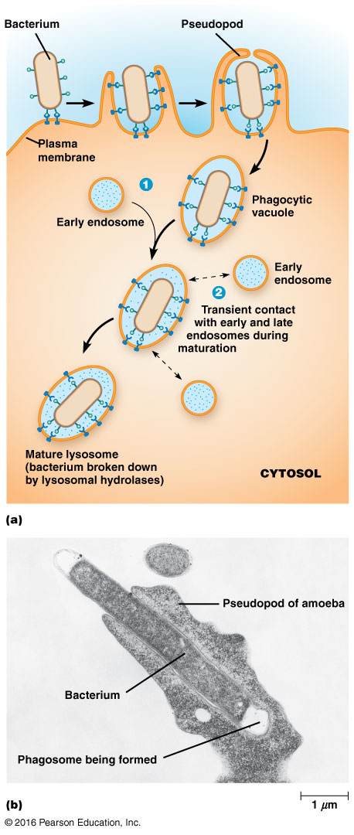

Slide 105
Video: Phagocytosis in Action

Slide 106
Receptor-Mediated Endocytosis
Cells acquire some substances by receptor-mediated endocytosis (or clathrin-dependent endocytosis)
Cells use receptors on the outer cell surface to internalize many macromolecules
Mammalian cells can ingest hormones, growth factors, serum proteins, enzymes, cholesterol, antibodies, iron, viruses, bacterial toxins
Notes:
106

Slide 107
Low-Density Lipoproteins
Low-density lipoproteins (LDLs) are internalized by receptor-mediated endocytosis
The internalization of LDL carries cholesterol into cells
The study of hypercholesterolemia and connection to heart disease led to the discovery of receptor-mediated endocytosis and a Nobel Prize for Michael Brown and Joseph Goldstein

Slide 108
Process of Receptor-Mediated Endocytosis
Specific molecules (ligands) bind to their receptors on the outer surface of the cell (1)
Receptor-ligand complexes diffuse laterally and encounter specialized regions called coated pits, sites for collection and internalization of these complexes (2)
In a typical mammalian cell, coated pits occupy about 20% of the total surface area

Slide 109
Process of Receptor-Mediated Endocytosis (continued)
Accumulation of complexes in the pits triggers the accumulation of additional proteins on the cytosolic surface of the membrane
These proteins—adaptor protein, clathrin, dynamin—induce curvature and invagination of the pit (3)
Eventually, the pit pinches off (4), forming a coated vesicle

Slide 110
Process of Receptor-Mediated Endocytosis (continued)
The clathrin coat is released, leaving an uncoated vesicle (5)
Coat proteins and dynamin are recycled to the plasma membrane, and the uncoated vesicle fuses with an early endosome (6)
The process is very rapid, and coated pits can be very numerous in cells

Slide 111
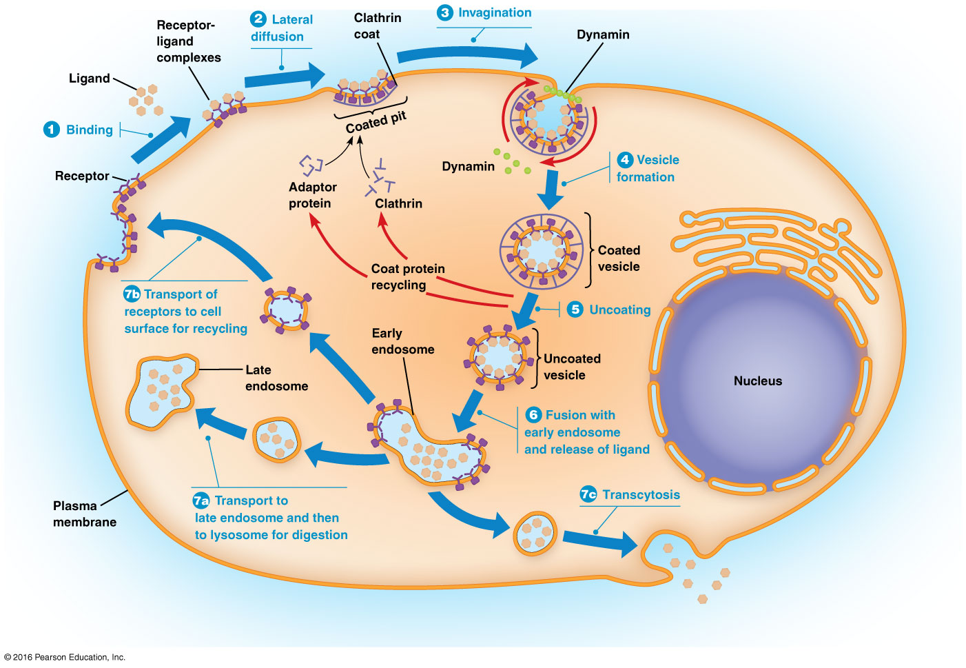

Slide 112
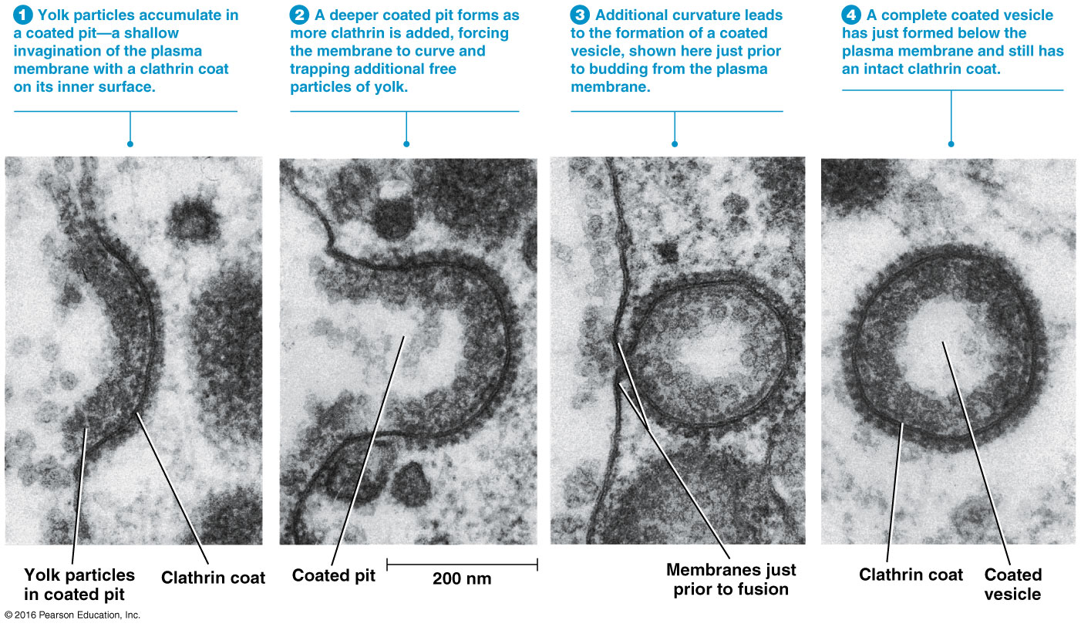

Slide 113
Variations of Receptor-Mediated Endocytosis
Epidermal growth factor undergoes endocytosis and is a signal that stimulates cell division
As EGF receptors are internalized, the cell becomes less responsive to EGF, a process known as desensitization
Defective desensitization through failure to endocytose the receptor can lead to excess cell proliferation and possible tumor formation

Slide 114
Variations of Receptor-Mediated Endocytosis (continued)
Receptors may be concentrated in coated pits independent of ligand binding
In this case, ligand binding triggers internalization
In another variation (for example, LDL receptors), receptors are constitutively concentrated and constitutively internalized independent of ligand binding

Slide 115
After Internalization
Uncoated vesicles fuse with vesicles budding from the TGN to form early endosomes
Early endosomes are sites for sorting and recycling of materials brought into the cell
Early endosomes continue to acquire lysosomal proteins from the TGN and mature to form late endosomes, which then develop into lysosomes

Slide 116
Recycling Plasma Membrane Receptors
Receptors from the plasma membrane are recycled as a result of acidification of the early endosome
The pH gradually declines as the endosome matures, facilitated by an ATP-dependent proton pump
The lower pH dissociates ligand and receptors, allowing receptors to be returned to the membrane

Slide 117
Alternative Fates for Ligand-Receptor Complexes
Some complexes are carried to a lysosome for degradation
Some complexes are carried to the TGN, where they enter a variety of pathways
Complexes can also travel by transport vesicles to a different region of the plasma membrane, where they are secreted (transcytosis)

Slide 118
Clathrin-Independent Endocytosis
Fluid-phase endocytosis is a type of pinocytosis for nonspecific internalization of extracellular fluid
This process does not concentrate the ingested material, and contents are routed to early endosomes
It proceeds at a fairly constant rate and compensates for membrane segments added by exocytosis

Slide 119
12.6 Coated Vesicles in Cellular Transport Processes
Most vesicles in protein and lipid transport are called coated vesicles because of the layers of proteins covering their cytosolic surfaces
Coated vesicles are involved in vesicular traffic throughout the endomembrane system, as well as in exocytosis and endocytosis
There are several types of coat proteins
Notes:
119

Slide 120
Coat Proteins
The most studied coat proteins are clathrin, COPI, and COPII
The type of coat protein on a vesicle helps to determine the destination of the vesicle
They also induce curvature needed for the formation of the vesicles and prevent nonspecific fusion of the vesicle with another membrane

Slide 121
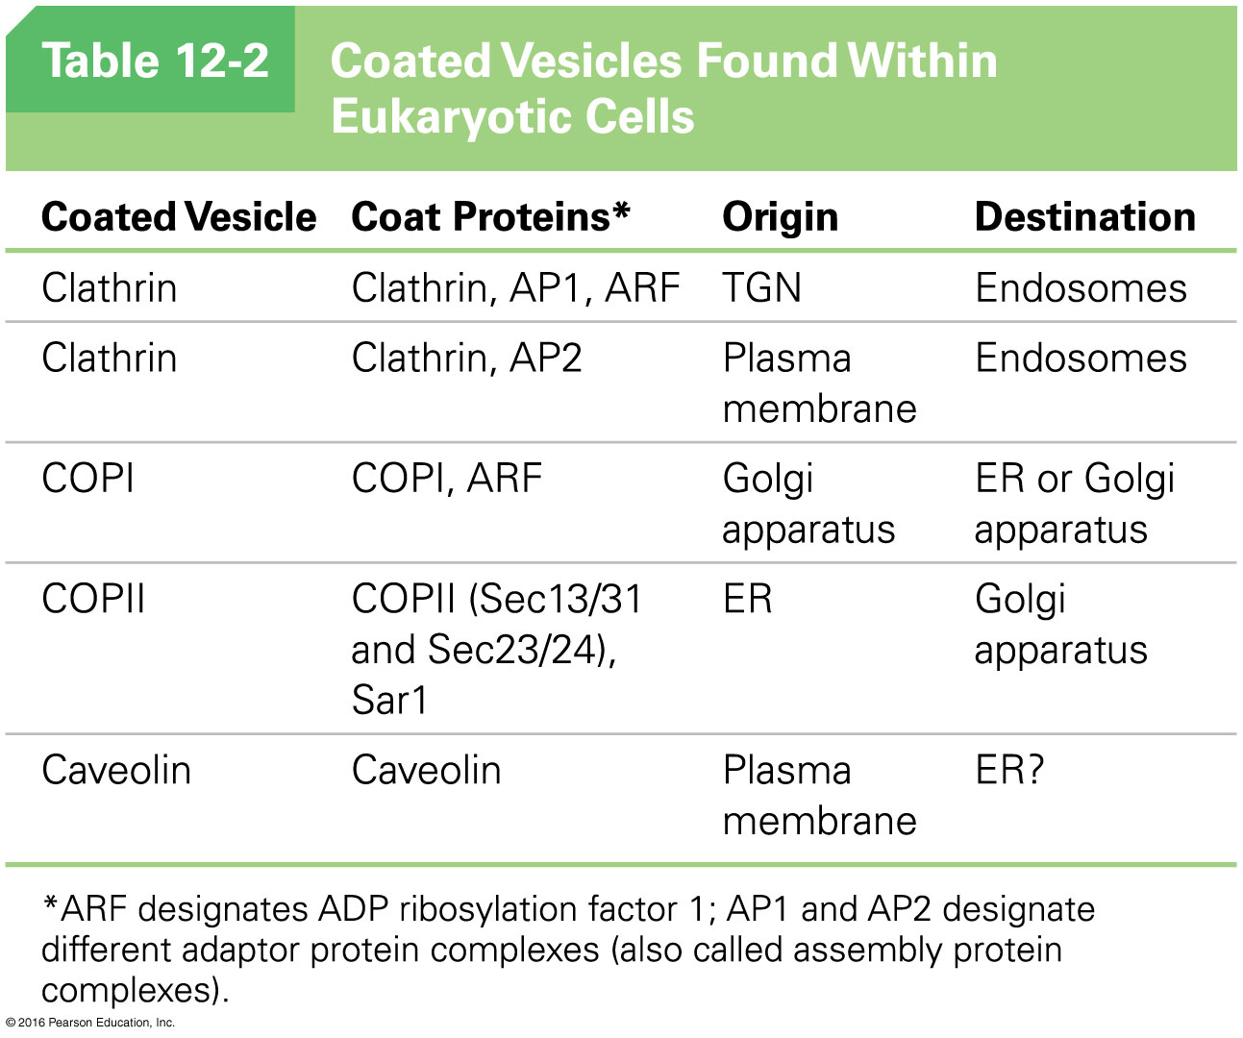

Slide 122
Caveolae
A recently discovered coat protein is caveolin
Caveolin-coated vesicles are caveolae
They are a type of lipid raft rich in cholesterol and sphingolipids and may be involved in cholesterol uptake by cells

Slide 123
Clathrin-Coated Vesicles Are Surrounded by Lattices Composed of Clathrin and Adaptor Protein
Clathrin-coated vesicles are surrounded by coats made of two multimeric proteins, clathrin and adaptor protein (AP)
The shape of clathrin proteins and the way they assemble provides the driving force to induce a flat membrane to form a spherical vesicle
The basic unit of clathrin lattices is a triskelion
Notes:
123

Slide 124
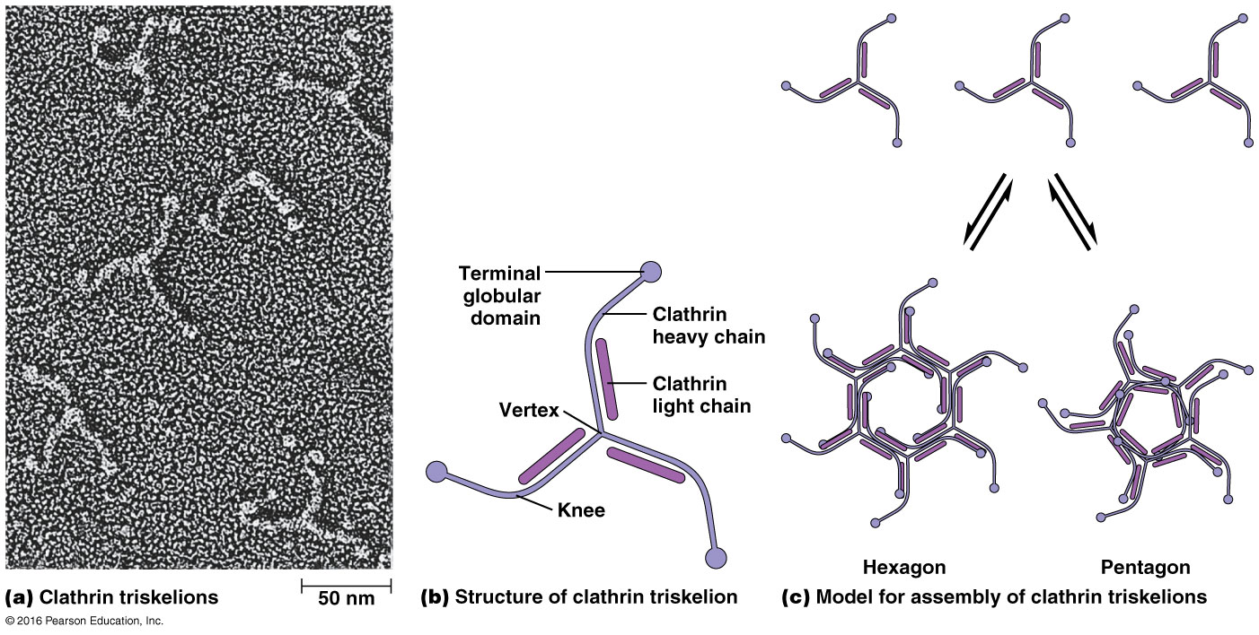

Slide 125
Structure of a Triskelion
Each is a multimeric protein composed of three heavy chains and three light chains
These radiate from a central vertex, with the light chains associated with the inner half of each “leg”
Triskelions assemble into the hexagons and pentagons of the lattice around clathrin-coated pits and vesicles

Slide 126
Adaptor Protein Complexes
The components of adaptor protein (AP) complexes were identified by their ability to promote assembly of clathrin coats around vesicles
There are four types of AP complexes, each composed of four polypeptides: two of adaptin, one medium chain, and one small chain
Each polypeptide binds to a different receptor

Slide 127
The Assembly of Clathrin Coats Drives the Formation of Vesicles from the Plasma Membrane and TGN
Binding of AP complexes to the plasma membrane and concentration of receptors or receptor-ligand complexes require ATP and GTP
The assembly of the clathrin coat appears to provide some of the driving force for vesicle formation

Slide 128
Clathrin Coat Assembly
Initially all clathrin units are hexagonal and form a planar structure
As more triskelions are incorporated into the growing lattice, some pentagons are formed
The mixture of pentagons and hexagons allows the new coat to curve around the budding vesicle

Slide 129
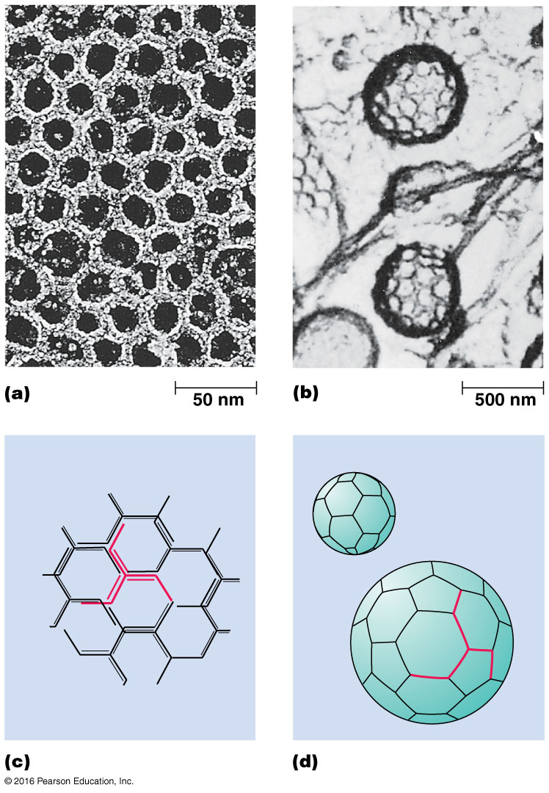

Slide 130
Video: Clathrin-Coated Vesicle Formation

Slide 131
Dynamin
As clathrin accumulates around the budding vesicle, dynamin is required for constricting and closing the vesicle
Dynamin is a cytosolic GTPase; as GTP is hydrolyzed, dynamin rings tighten and separate the vesicle from the plasma membrane

Slide 132
Uncoating the Vesicle
A mechanism is required to remove the clathrin coat (uncoat) from the newly formed vesicle
Clathrin dissociates rapidly once the vesicle is formed
Uncoating requires energy, provided by an uncoating ATPase

Slide 133
Clathrin Cages
In acidic conditions, with calcium present, clathrin can spontaneously form empty shells called clathrin cages
Assembly and disassembly occur very quickly

Slide 134
COPI- and COPII-Coated Vesicles Travel Between the ER and Golgi Complex Cisternae
COPI-coated vesicles are found in all eukaryotic cells examined and are involved in retrograde transport from the Golgi back to the ER
The vesicles are coated with COPI and an ADP ribosylation factor (ARF), a small GTP-binding protein
Assembly of the coat is mediated by ARF

Slide 135
Role of ARF
In the cytosol, ARF exists as part of an ARF-GDP complex
Upon meeting a guanine nucleotide exchange factor associated with the membrane, the GDP is exchanged for GTP
The resulting conformational change in ARF attaches it to the lipid bilayer

Slide 136
Role of ARF (continued)
Once firmly anchored, ARF binds COPI multimers
Assembly of the coat drives vesicle formation
Once the vesicle is formed, a protein in the donor membrane triggers hydrolysis of GTP to GDP, a conformational change in ARF, and release of the coat

Slide 137
COPII-Coated Vesicles
COPII-coated vesicles have a role in transport from the ER to the Golgi
In yeast, the COPII coat is assembled from two protein complexes (Sec 13/31 and Sec 23/24) and a small GTP-binding protein called Sar1
Sar1 is similar to ARF, (GTP-Binding proteins),and the process of coat formation is similar to COPI-coated vesicles

Slide 138
SNARE Proteins Mediate Fusion Between Vesicles and Target Membranes
Once vesicles form, additional proteins ensure delivery to the correct destination
The SNARE hypothesis explains this specificity
Proteins necessary for secretion include N-ethylmaleimide-sensitive factor (NSF) and soluble NSF attachment proteins (SNAPs)

Slide 139
SNARE Proteins
Proper sorting and targeting of vesicles involves two families of SNARE (SNAP receptor) proteins
v-SNAREs (vesicle-SNAP receptors) are found on vesicles
t-SNAREs (target-SNAP receptors) are found on target membranes
v- and t-SNAREs are complementary molecules that allow recognition between vesicles and their targets

Slide 140
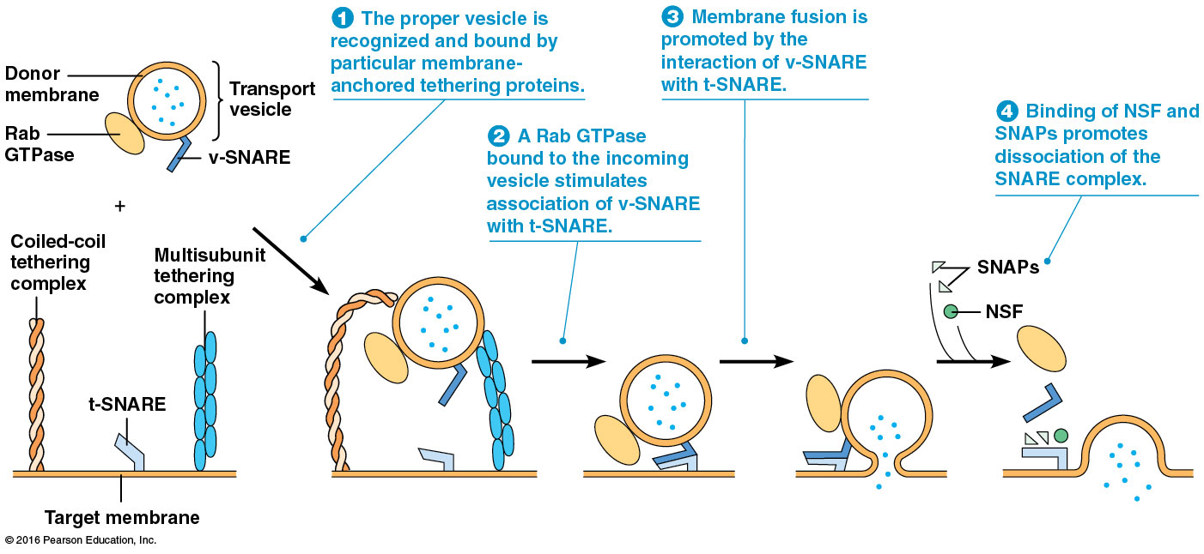

Slide 141
Rab GTPases
When a vesicle reaches its destination, Rab GTPases (specific for different destinations) lock the complementary SNARE proteins together
This facilitates membrane fusion

Slide 142
Release of SNAREs
Following vesicle fusion, NSF and a group of SNAPs mediate release of the SNAREs of the donor and target membranes
ATP hydrolysis may be needed, though its role is unclear
NSF and SNAPs are nonspecific

Slide 143
SNAREs May Not Be the Whole Story
Recent research suggests that SNAREs are not solely responsible for targeting specificity
Tethering proteins act over longer distances and attach vesicles to their targets before the SNAREs interact
Chemical blocking of SNARE complex formation does not abolish vesicle-target interaction

Slide 144
Tethering Proteins
Two main groups of tethering proteins are coiled-coil proteins and multisubunit complexes
Coiled-coil proteins such as golgins are important in recognition and binding of COPI or COPII vesicles to the Golgi
Multisubunit protein complexes such as the exocyst complex are important for protein secretion

Slide 145
12.7 Lysosomes and Cellular Digestion
The lysosome is an organelle of the endomembrane system that contains digestive enzymes
It is capable of degrading all the major classes of biological macromolecules

Slide 146
Lysosomes Isolate Digestive Enzymes from the Rest of the Cell
Lysosomes contain acid phosphatase and several other hydrolytic enzymes
They vary in size and shape but are usually about 0.5 µm in diameter, bounded by a single membrane
The lumenal side of the membrane is coated with glycoproteins to protect the membrane from degradation

Slide 147
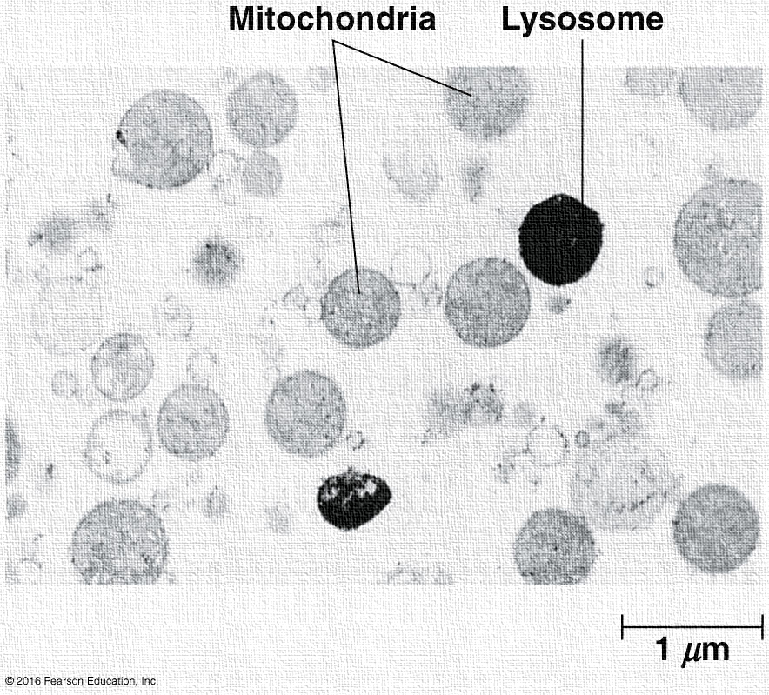

Slide 148
Lysosomes Are Highly Acidic Inside
Lysosomes maintain an acidic environment (pH 4.0–5.0) inside
ATP-dependent proton pumps in the membrane are responsible for this
There are numerous enzymes inside lysosomes; all are acid hydrolases

Slide 149
Lysosomes Develop from Endosomes
Lysosomal enzymes are synthesized by ribosomes on rough ER and translocated inside
Lysosomal enzymes are delivered from the TGN to endosomes in transport vesicles
Over time, endosomes mature into late endosomes, with all the enzymes, but not engaged in digestion

Slide 150
Endosome Development
The pH of the early endosome lumen drops from about 6.0 to 5.5
The endosome loses its ability to fuse with endocytic vesicles
The late endosome is packaged with material to be digested and newly synthesized digestive enzymes
This protects the cell from hydrolytic enzymes

Slide 151
Final Step of Lysosome Development
The last step in development of a lysosome is activation of the acid hydrolases
This occurs as the internal environment becomes more acidic (pH 4.0–5.0)
This occurs through the pumping of protons or through fusion with an existing lysosome

Slide 152
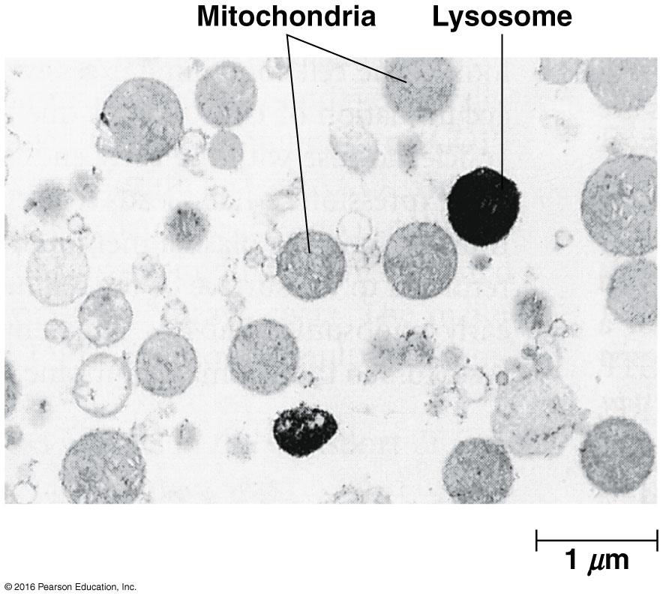

Slide 153
Lysosomal Enzymes Are Important for Several Different Digestive Properties
Lysosomes containing substances that originated outside the cell are called heterophagic lysosomes
Those with materials that originated inside the cell are called autophagic lysosomes

Slide 154
Phagocytosis and Receptor-Mediated Endocytosis: Lysosomes in Defense and Nutrition
The degradation of external materials brought into the cell occurs by phagocytosis and receptor-mediated endocytosis
Phagocytic vacuoles become lysosomes by fusion with endosomes
Vesicles formed by receptor-mediated endocytosis fuse with vesicles of the TGN containing acid hydrolases

Slide 155
After Digestion Is Complete
Eventually, indigestible material is all that remains in a lysosome
The lysosome becomes a residual body when digestion ceases
Some cells release the contents by exocytosis; in others, accumulation of debris may contribute to cellular aging

Slide 156
Autophagy: A Biological Recycling System
Cellular structures that are damaged or unneeded must be broken down via autophagy
Macrophagy: an organelle is wrapped in a double membrane derived from the ER, forming an autophagic vacuole (autophagosome)
Microphagy: a much smaller vacuole is formed, surrounded by a single-membrane bilayer

Slide 157
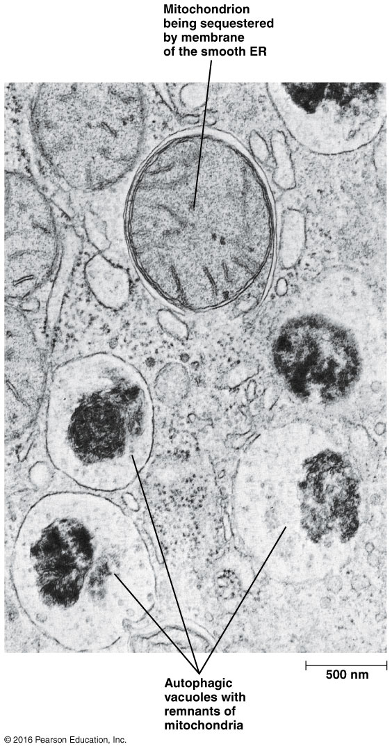

Slide 158
Autophagy and Cancer
Recent works suggests a direct link between autophagy and cancer
In mice, knockout of a gene required for autophagy in yeast causes decrease in autophagy and an increase in breast and lung tumors

Slide 159
Extracellular Digestion
Most lysosomal digestion occurs inside the cell
In some cases, lysosomes discharge their contents outside the cell, resulting in extracellular digestion
For example, the head of a sperm releases digestive enzymes to degrade barriers protecting an egg

Slide 160
Lysosomal Storage Diseases Are Usually Characterized by the Accumulation of Indigestible Material
Over 40 lysosomal storage diseases are known, in which certain lysosomal proteins are absent
The diseases are characterized by the accumulation of substances that cannot be broken down as needed
Most are not treatable yet

Slide 161
Examples of Lysosomal Storage diseases
Type II glycogenosis—accumulation of excessive glycogen
Hurler syndrome, Hunter syndrome—accumulation of glycosaminoglycans
Tay-Sachs disease—accumulation of a ganglioside in the nervous system

Slide 162
Treatment of Lysosomal Storage Diseases
Lysosomal storage diseases can be diagnosed prenatally
It is hoped that treatments that replace the missing enzyme will be developed
This is known as enzyme replacement therapy
Or, altering the DNA of patients (gene therapy) is another possible approach

Slide 163
12.8 The Plant Vacuole: A Multifunctional Organelle
Plant cells have acidic vacuoles that perform the function of lysosomes
However, these have additional roles as well
Vacuole development is similar to that of lysosomes, with coated vesicles conveying materials for the vacuole to a provacuole, similar to an endosome

Slide 164
Additional Functions of Vacuoles
Vacuoles mature to form a structure that can fill up to 90% of the cell’s total volume
Vacuoles maintain turgor pressure, the osmotic pressure preventing plant cells from collapsing
They regulate cytosolic pH, using ATP-dependent proton pumps

Slide 165
Additional Functions of Vacuoles (continued)
Vacuoles serve as a storage compartment for such substances as
Seed storage proteins
Malate (in CAM plants)
Anthocyanins
Soluble and insoluble waste

Slide 166
12.9 Peroxisomes
Peroxisomes are bounded by single membranes but are not derived from ER
Thus they are not part of the endomembrane system
The defining characteristic of peroxisomes is the presence of catalase for degrading H₂O₂
Notes:
166

Slide 167
Peroxisome Structure
Animal peroxisomes contain a crystalline core, consisting of crystalline urate oxidase
Plant peroxisomes contain crystalline catalase
Peroxisomes without the crystalline cores may be difficult to identify microscopically
Notes:
167

Slide 168
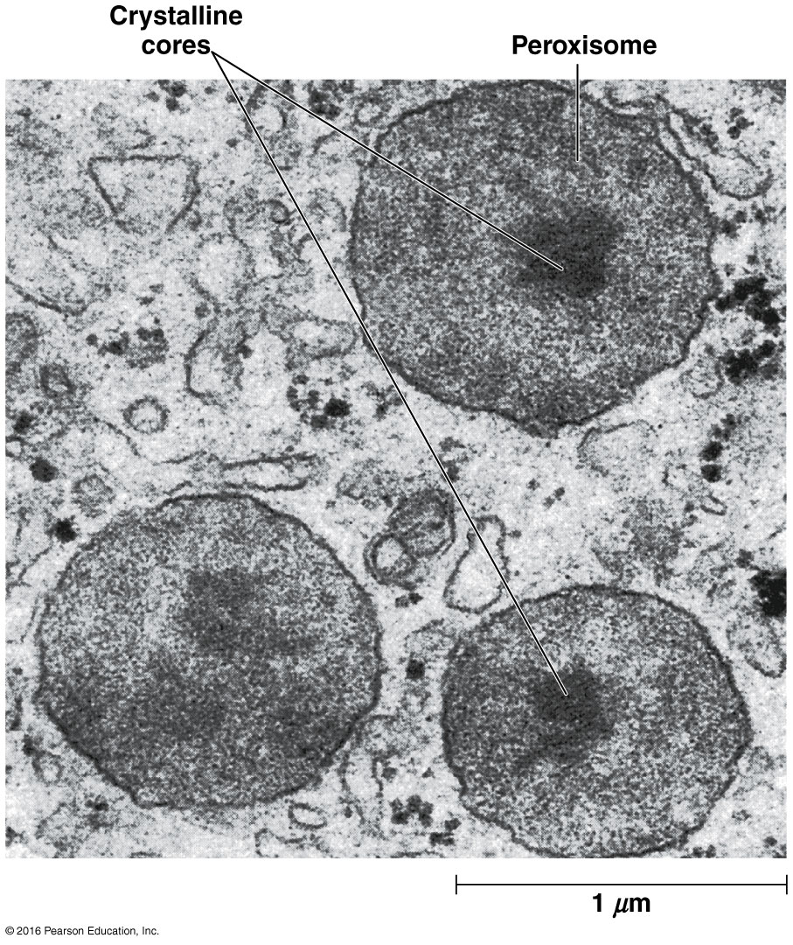

Slide 169
Chemical Identification of Peroxisomes in Plant Cells
Catalase oxidizes diaminobenzidine (DAB) to a form that causes deposition of osmium ions
These electron-dense deposits can be seen via electron microscopy

Slide 170
Most Peroxisomal Functions Are Linked to Hydrogen Peroxide Metabolism
The essential roles of peroxisomes include
Hydrogen peroxide metabolism
Detoxification of harmful compounds
Oxidation of fatty acids
Metabolism of nitrogen-containing compounds
Catabolism of unusual substances

Slide 171
Hydrogen Peroxide Metabolism
Oxidases generate H₂O₂ in peroxisomes
The hydrogen peroxide is detoxified by catalase

Slide 172
Hydrogen Peroxide Can Be Detoxified Another Way
Alternatively, catalase can function as a peroxidase
The result is the same in either case—hydrogen peroxide is degraded while still inside the peroxisome

Slide 173
Detoxification of Harmful Compounds
Peroxisomes detoxify reactive oxygen species (H₂O₂, O₂–)
If these accumulate, they can cause oxidative stress
Peroxisomal enzymes such as superoxide dismutase and others detoxify reactive oxygen species

Slide 174
Oxidation of Fatty Acids
Peroxisomes contain enzymes for β oxidation of fatty acids
In animals, the primary product of β oxidation, acetyl-CoA, is exported to the cytosol and enters biosynthetic pathways or the citric acid cycle
In plants and yeast, fatty acids are completely oxidized in peroxisomes

Slide 175
Metabolism of Nitrogen-Containing Compounds
Most animals (not primates) require urate oxidase to oxidize urate, formed during catabolism of nucleic acids and some proteins
.

Slide 176
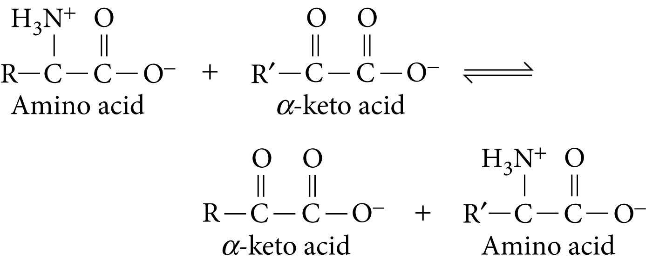
Aminotransferases
Aminotransferases catalyze the transfer of amino groups from amino acids to α-keto acids in the degradation and synthesis of amino acids
.

Slide 177
Catabolism of Unusual Substances
d-amino acids are rare substances for which the cell has no degradative pathways, except in the peroxisome
In some cells, peroxisomes also contain enzymes that break down xenobiotics, compounds foreign to living organisms
This includes short-chain hydrocarbons such as alkanes

Slide 178
Peroxisomal Disorders
A large number of disorders arise from defects in peroxisomal proteins
The most common is X-linked adrenoleukodystrophy
The defective protein in this case may be responsible for transporting long-chain fatty acids into the peroxisome for degradation

Slide 179
Plant Cells Contain Types of Peroxisomes Not Found in Animal Cells
In plants and algae, peroxisomes are involved in several aspects of cell energy metabolism
Notes:
179

Slide 180
Leaf Peroxisomes
Cells of photosynthetic tissues contain leaf peroxisomes in close contact with mitochondria and chloroplasts
They are involved in the glycolate pathway, also called the photorespiratory pathway
Notes:
180

Slide 181
Glyoxysomes
Glyoxysomes occur transiently in seedlings
They contain enzymes needed to convert stored triacylglycerols to sucrose, β oxidation of fatty acids, and the glyoxylate cycle
They are found only in tissues where fat is stored, and when no longer needed they are converted to peroxisomes
Notes:
181

Slide 182
Peroxisome Biogenesis Occurs by Division of Preexisting Peroxisomes or by Vesicle Fusion
Peroxisomes increase in number as cells grow and divide; this proliferation is biogenesis
Proteins required for this process are peroxins
Peroxisomes are also formed by fusion of vesicles budding from the Golgi apparatus

Slide 183
Peroxisome Biogenesis
Membrane components, matrix enzymes, and cofactors from the cytosol are incorporated into peroxisomes (1–3)
Then, new peroxisomes are formed by division of a preexisting one (4)
Some peroxisomes may obtain materials or form de novo from vesicles derived from the ER (5)

Slide 184
