Slide 1
An-Najah National University
Faculty of Medicine
Department of Physiology
Anatomy and Physiology 1
7102101
Instructor: Heba Salah
Chapter 4:
The Muscular System
Part 5: Naming Skeletal Muscle, and Gross anatomy of Head and Neck Muscles

Slide 2
Naming of Skeletal Muscles
1. Direction of muscle fibers
Example: rectus (straight)
2. Relative size of the muscle
Example: maximus (largest)
3. Location of the muscle
Example: many muscles are named for bones (e.g., temporalis)
4. Number of origins
Example: triceps (three heads)

Slide 3
Naming of Skeletal Muscles
5. Location of the muscles origin and insertion
Example: sterno (on the sternum)
6. Shape of the muscle
Example: deltoid (triangular)
7. Action of the muscle
Example: flexor and extensor (flexes or extends a bone)

Slide 4
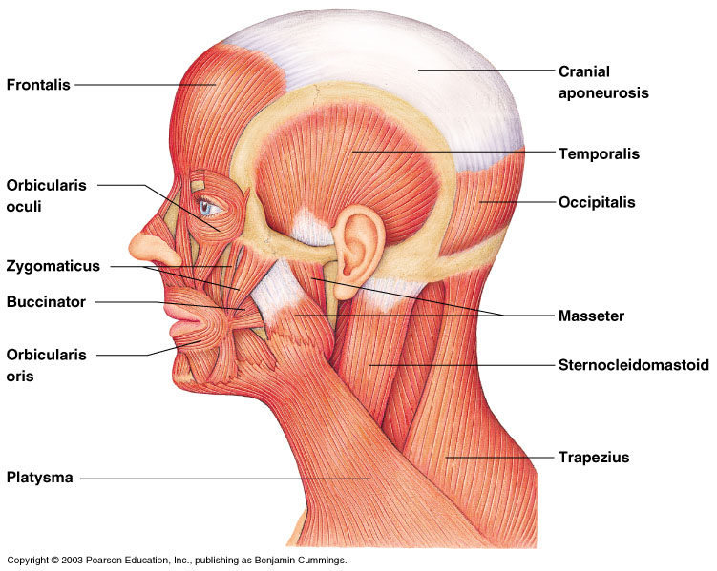
Head and Neck Muscles

