Slide 1
Inheritance
in C++

Slide 2
Types of relationships in C++

Slide 3
Inheritance is considered (Is a relationship)

Slide 7
How to implement inheritance
class derived-class: access-specifier base-class
{
Members of the derived class
};
Where access-specifier is one of public, protected, or private, and base-class is the name of a previously defined class. If the access-specifier is not used, then it is private by default.

Slide 8
Access Control and Inheritance
Access Level | Public | Protected | Private
Members of the same class | Yes | Yes | Yes
Members of derived classes | Yes | Yes | No
Non-members | Yes | No | no
A derived class can access all the non-private members of its base class. Thus base-class members that should not be accessible to the member functions of derived classes should be declared private in the base class.

Slide 9
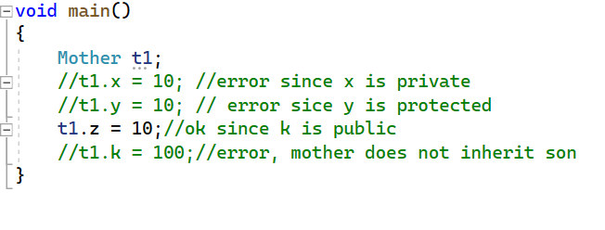
Access Control and Inheritance

Slide 10
Access Control and Inheritance

Slide 11
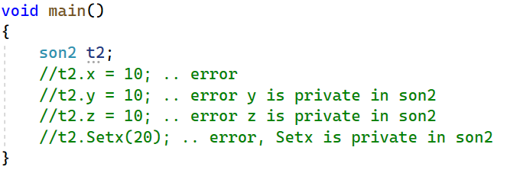
Access Control and Inheritance

Slide 12
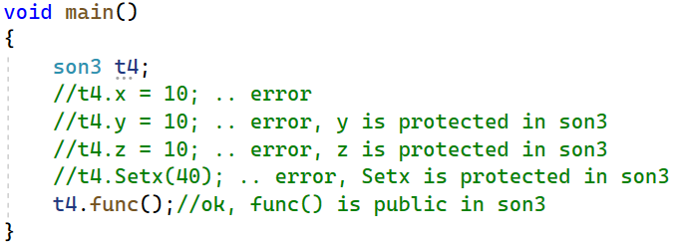
Access Control and Inheritance

Slide 13
Order of constructor call in C++ Inheritance
Whether derived class default constructor is called or parameterized constructor is called, base class default constructor is always called inside them first.
To call base class parametrized constructor inside derived class parameterized constructor, we must mention it explicitly when we declare parameterized constructor of derived class.

Slide 14
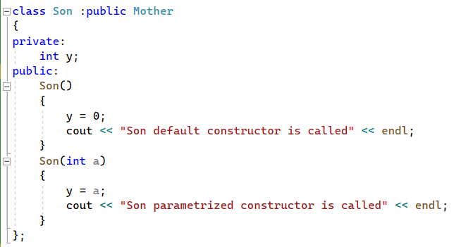
Example

Slide 15
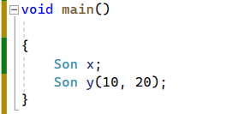
Example

Slide 16
Inheritance Function Overriding
It is the redefinition of a base class function in the derived class with same signature.
Function signature includes: function name, types of parameters, number of parameters and order of parameters.
Note:
Function overriding cannot be done within same class

Slide 17
Function overriding (example)

Slide 18
Overloading and Overriding
Function overloading happens within same class only
Function overloading does not happen in inheritance.
Function overriding happens in inheritance.

Slide 19
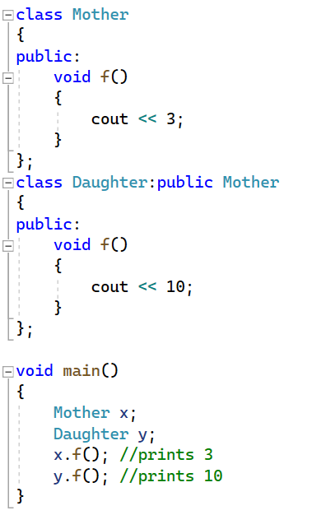
Example (function overriding in Inheritance)

Slide 20
Example (function overloading)

Slide 21
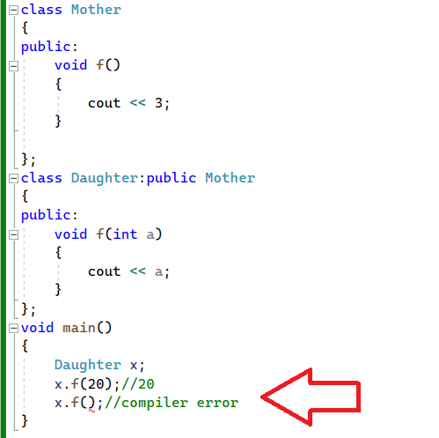
There is no function overloading between base class and derived class.

Slide 22
Polymorphism
A Greek word that means many forms
Polymorphism is the ability of an object to take on many forms.
The most common use of polymorphism in OOP occurs when a parent class reference is used to refer to a child class object.
Any C++ object that can pass more than one IS-A test is considered to be polymorphic.

Slide 23
Binding types
Types of Polymorphism:
Compile time polymorphism (static binding polymorphism):
Function overloading, operator overloading
2. Run-time polymorphism (late binding polymorphism):
Virtual functions

Slide 24
A pointer or reference of the base class can point to an object of the derived class (whether the object is statically or dynamically allocated).
A pointer or reference of the derived class cannot point to an object of the base class (whether the object is statically or dynamically allocated).

Slide 25
Virtual function in polymorphism simply means: delay the decision of which function to call until run-time.

Slide 26
Multilevel Inheritance

Slide 27
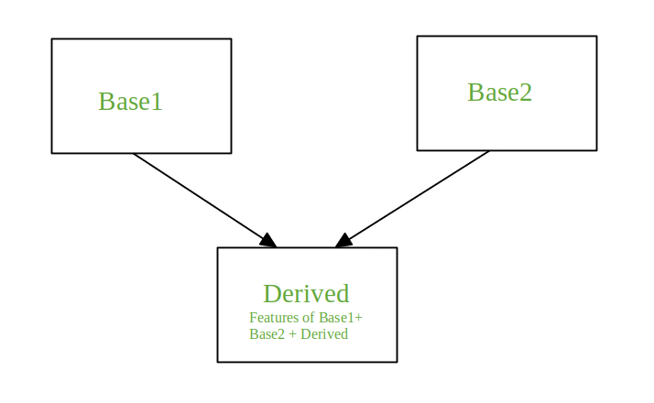
Multiple Inheritance
A class can inherit from more than one base class. This is called multiple inheritance.
C++ allows multiple inheritance.
Java does not allow multiple inheritance.

Slide 28
Multiple Inheritance Syntax

Slide 29
Recall: The (?) operator
Using if
Using ? operator

