Slide 1
Financial Accounting
IFRS 4th Edition
Weygandt ● Kimmel ● Kieso
Chapter 8
Accounting for Receivables

Slide 2
Chapter Outline:
Learning Objectives
LO 1 Explain how companies recognize accounts receivable.
LO 2 Describe how companies value accounts receivable and record their disposition.
LO 3 Explain how companies recognize, value, and dispose of notes receivable.
LO 4 Describe the statement presentation and analysis of receivables.

Slide 3
Learning Objective 1 Explain How Companies Recognize Accounts Receivable

Slide 4
Recognition of Accounts Receivables
The term receivables refers to amounts due from individuals and companies.
Receivables are claims that are expected to be collected in cash.
Management of receivables is a very important activity for any company that sells goods or services on credit.
Receivables are important because they represent one of a company’s most liquid assets

Slide 5
Types of Receivables (1 of 2)
Amounts due from individuals and companies that are expected to be collected in cash.
Amounts customers owe on account that result from the sale of goods and services. (30-60 days)
Written promise (formal instrument) for amount to be received. Normally requires the collection of interest. (60-90 days)
Nontrade receivables such as interest, loans to officers, advances to employees, and income taxes refundable.
Accounts Receivable
Other Receivables
Notes Receivable

Slide 6
Recognizing Accounts Receivable (1 of 5)
Service organization records a receivable when it performs service on account
Merchandiser records accounts receivable at point of sale of merchandise on account
Seller may offer a discount to encourage early payment ( 3/10 n 30)
Buyer might return goods found to be unacceptable
Sales returns reduce receivables

Slide 7
Recognizing Accounts Receivable (2 of 5)
Illustration: Assume that Zhang Ltd. on July 1, 2020, sells merchandise on account to Li Stores for ¥1,000, terms 2/10, n/30 (amounts in thousands).
On July 5, Li returns merchandise with a sales price of ¥100 to Zhang. Prepare the journal entries to record these transactions.
On July 11, Zhang receives payment from Li for the balance due. Prepare the journal entry to record this transaction.

Slide 8
Recognizing Accounts Receivable (4 of 5)
Illustration: Some retailers issue their own credit cards. When you use a retailer’s credit card (IKEA, for example), the retailer charges interest on the balance due if not paid within a specified period (usually 25–30 days).
Illustration: Assume you use your IKEA credit card to purchase clothing with a sales price of €300 on June 1, 2020. The entry is recorded as follows.
Illustration: Assuming that you owe €300 at the end of the month and IKEA charges 1.5% per month on the balance due, the adjusting entry that IKEA makes

Slide 9
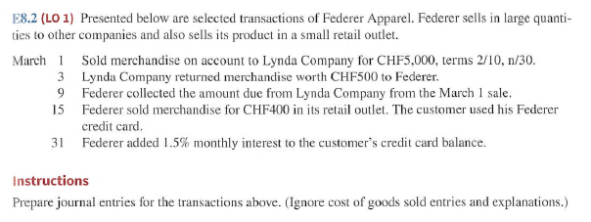
Recognising accounts receivable

Slide 10
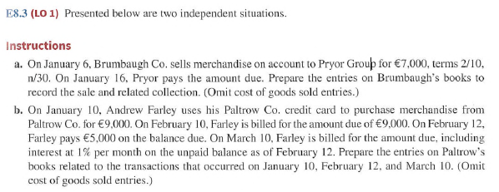
Recognising accounts receivable

Slide 11
Do It! 1: Recognizing Accounts Receivable (1 of 3)
On May 1, Wilton sold merchandise on account to Bates for £50,000, terms 3/15, net 45. On May 4, Bates returns merchandise with a sales price of £2,000. On May 16, Wilton receives payment from Bates for the balance due. Prepare journal entries to record the May transactions on Wilton’s books. (Ignore cost of goods sold entries.)
May 1
Accounts Receivable
50,000
Sales Revenue
50,000

Slide 12
Do It! 1: Recognizing Accounts Receivable (2 of 3)
On May 1, Wilton sold merchandise on account to Bates for £50,000, terms 3/15, net 45. On May 4, Bates returns merchandise with a sales price of £2,000. On May 16, Wilton receives payment from Bates for the balance due. Prepare journal entries to record the May transactions on Wilton’s books. (Ignore cost of goods sold entries.)
May 4
Sales Returns and Allowances
2,000
Accounts Receivable
2,000

Slide 13
Do It! 1: Recognizing Accounts Receivable (3 of 3)
On May 1, Wilton sold merchandise on account to Bates for £50,000, terms 3/15, net 45. On May 4, Bates returns merchandise with a sales price of £2,000. On May 16, Wilton receives payment from Bates for the balance due. Prepare journal entries to record the May transactions on Wilton’s books. (Ignore cost of goods sold entries.)
May 16
Cash (£48,000 − £1,440)
46,560
Sales Discounts (£48,000 × .03)
1,440
Accounts Receivable
48,000

Slide 14
Learning Objective 2 Describe How Companies Value Accounts Receivable and Record Their Disposition

Slide 15
Valuation of Accounts Receivable
Valuing Accounts Receivable
Current asset
Valuation (net realizable value) مقدار الذمم المدينة المتوقع ان يتم جمعها
Uncollectible Accounts Receivable
Sales on account raise possibility of accounts not being collected
Seller records losses that result from extending credit as Bad Debt Expense ( uncollectable account expense)

Slide 16
Valuing Accounts Receivable
Methods of Accounting for Uncollectible Accounts
Direct Write-Off
Theoretically undesirable:
No matching.
Receivable not stated at amount expect to be received.
Not acceptable for financial reporting.
Allowance Method
Losses are estimated:
Better matching.
Receivable stated at cash (net) realizable value.
Required by IFRS.
LO 3

Slide 17
Direct Write-Off Method for Uncollectible Accounts
Illustration: Assume that Warden Co. writes off M. E. Doran’s NT$1600 balance as uncollectible on December 12. Warden’s entry is as follows. ) use Direct write off method )
Unless bad debt losses are insignificant, the direct write-off method is not acceptable for financial reporting purposes.

Slide 18
Allowance Method for Uncollectible Accounts
Companies estimate uncollectible accounts receivable.
Debit Bad Debt Expense and credit Allowance for Doubtful Accounts (a contra-asset account).
Companies debit Allowance for Doubtful Accounts and credit Accounts Receivable at the time the specific account is written off as uncollectible.

Slide 19
Allowance Method for Uncollectibles (1 of 5)
Recording Estimated Uncollectibles
Illustration: Hampson Furniture has credit sales of €1,200,000 in 2020, of which €200,000 remains uncollected at December 31. The credit manager estimates that €12,000 of these sales will be uncollectible.

Slide 20
Allowance Method for Uncollectibles (2 of 5)
Hampson Furniture Statement of Financial Position (partial)
Current Assets | Blank | Blank
Supplies | Blank | € 25,000
Inventory | Blank | 310,000
Accounts receivable | €200,000 | 188,000
Allowance for doubtful accounts | 12,000 | Blank
Cash | Blank | 14,800
Total current assets | Blank | €537,800

Slide 21
Allowance Method for Uncollectibles (3 of 5)
Illustration: The financial vice president of Hampson Furniture authorizes a write-off of the €500 balance owed by R. A. Ware on March 1, 2021. The entry to record the write-off is as follows.
Accounts Receivable |  |  |  |  |  |  | Allowance for Doubtful Accounts
Jan. 1 | Bal. | 200,000 | Mar. 1 |  | 500 |  | Mar. 1 |  | 500 | Jan. 1 | Bal. | 12,000
Mar. 1 | Bal. | 199,500 |  |  |  |  |  |  |  | Mar. 1 | Bal. | 11,500

Slide 22
Allowance Method for Uncollectibles (4 of 5)
Recovery of an Uncollectible Account
Illustration: On July 1, R. A. Ware pays the €500 amount that Hampson had written off on March 1. Hampson makes the following entries.

Slide 23
Valuing Accounts Receivable
How are these accounts presented on the Balance Sheet?
Accounts Receivable |  |  |  |  | Allowance for Doubtful Accounts
Bal. | 200,000 |  |  |  |  |  | 12,000 | Bal.
Bal. |  |  |  |  |  |  |  | Bal.

Slide 24
Valuing Accounts Receivable
Hampson Furniture Statement of Financial Position (partial)
Current Assets
Supplies |  |  | € 25,000
Inventory |  |  | 310,000
Accounts receivable | €200,000
Less: Allowance for doubtful accounts | 12,000 |  | 188,000
Cash |  |  | 14,800
Total current assets |  |  | €537,800
LO 2

Slide 25
Valuing Accounts Receivable
Alternate Presentation
Hampson Furniture Statement of Financial Position (partial)
Current Assets
Supplies | € 25,000
Inventory | 310,000
Accounts receivable, net of €12,000 allowance | 188,000
Cash | 14,800
Total current assets | €537,800
LO 2

Slide 26
Valuing Accounts Receivable
Journal entry for credit sale of €100
Accounts Receivable
100
Sales Revenue
100
Accounts Receivable |  |  |  |  | Allowance for Doubtful Accounts
Bal. | 500 |  |  |  |  |  | 25 | Bal.
Sale | 100
Bal. | 600 |  |  |  |  |  | 25 | Bal.
LO 2

Slide 27
Valuing Accounts Receivable
Collect €333 on account?
Cash
333
Accounts Receivable
333
Accounts Receivable |  |  |  |  | Allowance for Doubtful Accounts
Bal. | 500 |  |  |  |  |  | 25 | Bal.
Sale | 100 | 333 | Coll.
Bal. | 267 |  |  |  |  |  | 25 | Bal.
LO 2

Slide 28
Valuing Accounts Receivable
Adjustment of €15 for estimated bad debts?
Bad Debt Expense
15
Allowance for Doubtful Accounts
15
Accounts Receivable |  |  |  |  | Allowance for Doubtful Accounts
Bal. | 500 |  |  |  |  |  | 25 | Bal.
Sale | 100 | 333 | Coll. |  |  |  | 15 | Exp.
Bal. | 267 |  |  |  |  |  | 40 | Bal.
LO 2

Slide 29
Valuing Accounts Receivable
Write-off of uncollectible accounts of €10?
Allowance for Doubtful Accounts
10
Accounts Receivable
10
Accounts Receivable |  |  |  |  | Allowance for Doubtful Accounts
Bal. | 500 |  |  |  |  |  | 25 | Bal.
Sale | 100 | 333 | Coll. |  |  |  | 15 | Exp.
 |  | 10 | w/o |  | w/o | 10
Bal. | 257 |  |  |  |  |  | 30 | Bal.
LO 2

Slide 30
Valuing Accounts Receivable
ABC Supplies Statement of Financial Position (partial)
Current Assets
Prepaid expense |  |  | € 40
Inventory |  |  | 812
Accounts receivable | €257
Less: Allowance for doubtful accounts | 30 |  | 227
Cash |  |  | 330
Total current assets |  |  | €1,409
LO 2

Slide 31
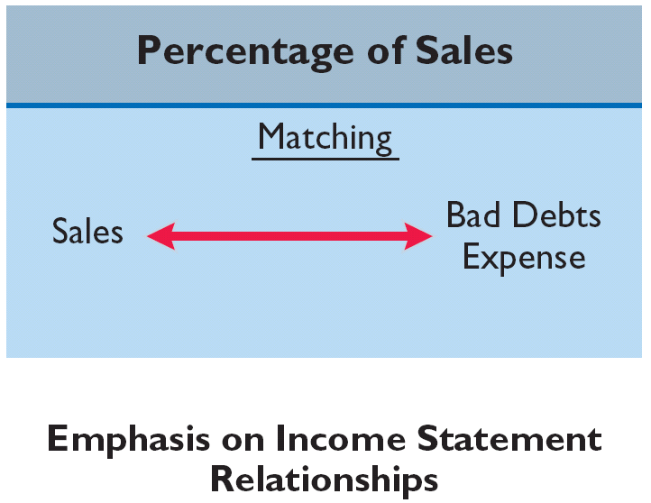
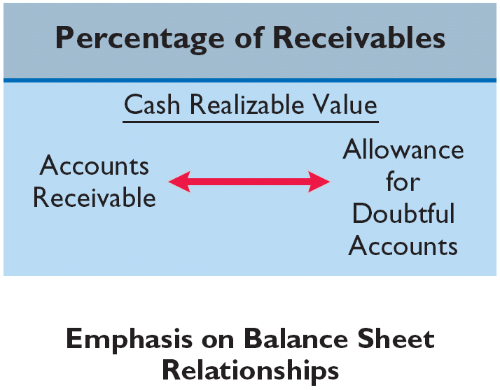
Allowance Method for Uncollectibles
ESTIMATING THE ALLOWANCE
Illustration 8-6
Comparison of bases for
estimating uncollectibles
Emphasis on Income Statement Relationships
Emphasis on Statement of Financial Position Relationships
LO 3

Slide 32
Allowance Method for Uncollectibles
ESTIMATING THE ALLOWANCE
Illustration 8-6
Management estimates what percentage of credit sales will be uncollectible. This percentage is based on past experience and anticipated credit policy.
Emphasis on Income Statement Relationships
LO 3

Slide 33
Allowance Method for Uncollectibles
Percentage-of-Sales
Illustration: Assume that Gonzalez SA elects to use the percentage-of-sales basis. It concludes that 1% of net credit sales will become uncollectible. If net credit sales for 2017 are €800,000, the adjusting entry is:
Dec. 31
Bad Debt Expense 8,000
*
Allowance for Doubtful Accounts 8,000
* €800,000 x 1%
LO 3

Slide 34
Allowance Method for Uncollectibles
Percentage-of-Sales
Emphasizes matching of expenses with revenues.
Adjusting entry to record bad debts disregards the existing balance in Allowance for Doubtful Accounts.
Illustration 8-7
Bad debt accounts after posting
LO 3

Slide 35
Allowance Method for Uncollectibles
ESTIMATING THE ALLOWANCE
Illustration 8-6
Management establishes a percentage relationship between the amount of receivables and expected losses from uncollectible accounts.
Emphasis on Statement of Financial Position Relationships
LO 3

Slide 36
Estimating the Allowance (1 of 4)
Frequently, companies estimate the allowance as a percentage of the outstanding receivables.
Percentage-of-Receivables Basis
Management establishes a percentage relationship between amount of receivables and expected losses from uncollectible accounts
Amount of bad debt expense that should be recorded is difference between required balance and existing credit balance in allowance account

Slide 37
Estimating the Allowance (2 of 4)
Accounts Receivable Aging Schedule
 |  |  | Number of Days Past Due
Customer | Total | Not yet Due | 1-30 | 31-60 | 61-90 | Over 90
T.E. Adert | ¥ 600 |  | ¥ 300 |  | ¥ 200 | ¥ 100
R.C. Bortz | 300 | ¥ 300
B.A. Carl | 450 |  | 200 | ¥ 250
O.L. Diker | 700 | 500 |  |  | 200
T.O. Ebbet | 600 |  |  | 300 |  | 300
Others | 36,950 | 26,200 | 5,200 | 2,450 | 1,600 | 1,500
 | ¥39,600 | ¥27,000 | ¥5,700 | ¥3,000 | ¥2,000 | ¥1,900
Estimated % uncollectible |  | 2% | 4% | 10% | 20% | 40%
Total estimated uncollectible | ¥2,228 | ¥540 | ¥228 | ¥300 | ¥400 | ¥760

Slide 38
Estimating the Allowance (3 of 4)
Illustration: The unadjusted trial balance shows Allowance for Doubtful Accounts with a credit balance of ¥528. Prepare the adjusting entry assuming ¥2,228 is the estimate of uncollectible receivables from the aging schedule.
Dec. 31
Bad Debt Expense
1,700
Allowance for Doubtful Accounts
1,700
Bad Debt Expense |  |  |  |  |  |  | Allowance for Doubtful Accounts
Dec. 31 | Adj. | 1,700 |  |  |  |  |  |  |  | Dec.31 | Bal. | 528
 |  |  |  |  |  |  |  |  |  | Dec. 31 | Adj. | 1,700
 |  |  |  |  |  |  |  |  |  | Dec. 31 | Bal. | 2,228

Slide 39
Estimating the Allowance (4 of 4)
Illustration: Assume the unadjusted trial balance shows Allowance for Doubtful Accounts with a debit balance of ¥500. Prepare the adjusting entry assuming ¥2,228 is the estimate of uncollectible receivables.
Dec. 31
Bad Debt Expense
2,728
Allowance for Doubtful Accounts
2,728
Bad Debt Expense |  |  |  |  |  |  | Allowance for Doubtful Accounts
Dec. 31 | Adj. | 2,728 |  |  |  |  | Dec. 31 | Bal. | 500
 |  |  |  |  |  |  |  |  |  | Dec. 31 | Adj. | 2,728
 |  |  |  |  |  |  |  |  |  | Dec. 31 | Bal. | 2,228

Slide 40
Valuing account receivable

Slide 41
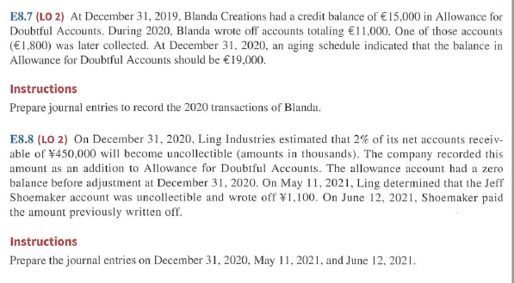
Valuing account receivable

Slide 42
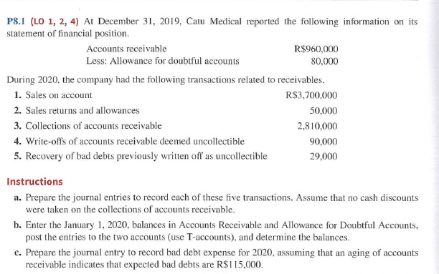
Valuing account receivable

Slide 43
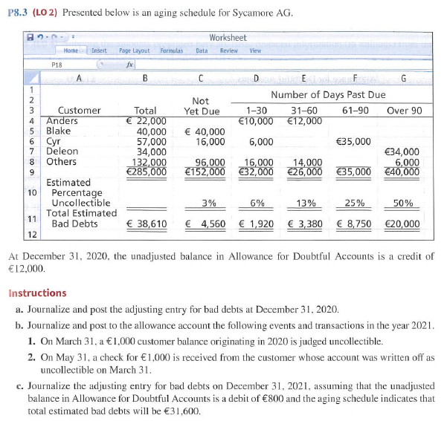
Valuing account receivable

Slide 44
Disposing of Accounts Receivables (1 of 2)
Companies sell receivables for two major reasons.
Receivables may be the only reasonable source of cash.
Billing and collection are often time-consuming and costly.
LO 2

Slide 45
Disposing of Accounts Receivables (2 of 3)
Sale of Receivables to a Factor
Finance company or bank
Buys receivables from businesses and then collects payments directly from customers
Typically charges a commission to company that is selling receivables
Fee ranges from 1% to 3% of receivables purchased

Slide 46
Sale of Receivables to a Factor
Illustration: Assume that Keelung Jewelry factors NT$600,000 of receivables to Federal Factors (amounts in thousands). Federal Factors assesses a service charge of 2% of the amount of receivables sold. The journal entry to record the sale by Keelung Jewelry is as follows.
Cash
588,000
Service Charge Expense
12,000
Accounts Receivable
600,000
(NT$600,000 × 2% = NT$12,000)

Slide 47
Disposing of Accounts Receivables (3 of 3)
National Credit Card Sales
Retailer pays card issuer a fee of 2 to 4% of invoice price
Recorded same as cash sales
Advantages to retailer:
Issuer does credit investigation of customer
Issuer maintains customer accounts
Issuer undertakes collection and absorbs losses
Receives cash more quickly

Slide 48
National Credit Card Sales
Illustration: Ling Lee purchases NT$6,000 of paper products for her restaurant from Wu Supplies using her Visa First Bank Card. First Bank charges a service fee of 3%. The entry to record this transaction by Wu Supplies on March 22, 2020, is as follows.
Cash
5,820
Service Charge Expense
180
Sales Revenue
6,000
(NT$6,000 × 3% = NT$180)

Slide 49
Do It! 2b: Factoring
Kell Wholesalers needs to raise €120,000 in cash to safely cover next Friday’s employee payroll. Kell has reached its debt ceiling. Kell’s present balance of outstanding receivables totals €750,000. Kell decides to factor €125,000 of its receivables on September 7, 2020, to alleviate this cash crunch. Record the entry that Kell would make when it raises the needed cash. (Assume a 1% service charge.)
Cash
123,750
Service Charge Expense
1,250
Accounts Receivable
125,000
(€125,000 × 1% = €1,250)

Slide 50
Disposing account receivable

Slide 51
Disposing account receivable

Slide 52
Learning Objective 3 Explain How Companies Recognize, Value, and Dispose of Notes Receivable

Slide 53
Notes Receivable (1 of 2)
Companies may grant credit in exchange for a promissory note. A promissory note is a written promise to pay a specified amount of money on demand or at a definite time. ( negotiable instrument)
Promissory notes may be used
when individuals and companies lend or borrow money,
when amount of transaction and credit period exceed normal limits, or
in settlement of accounts receivable.

Slide 54
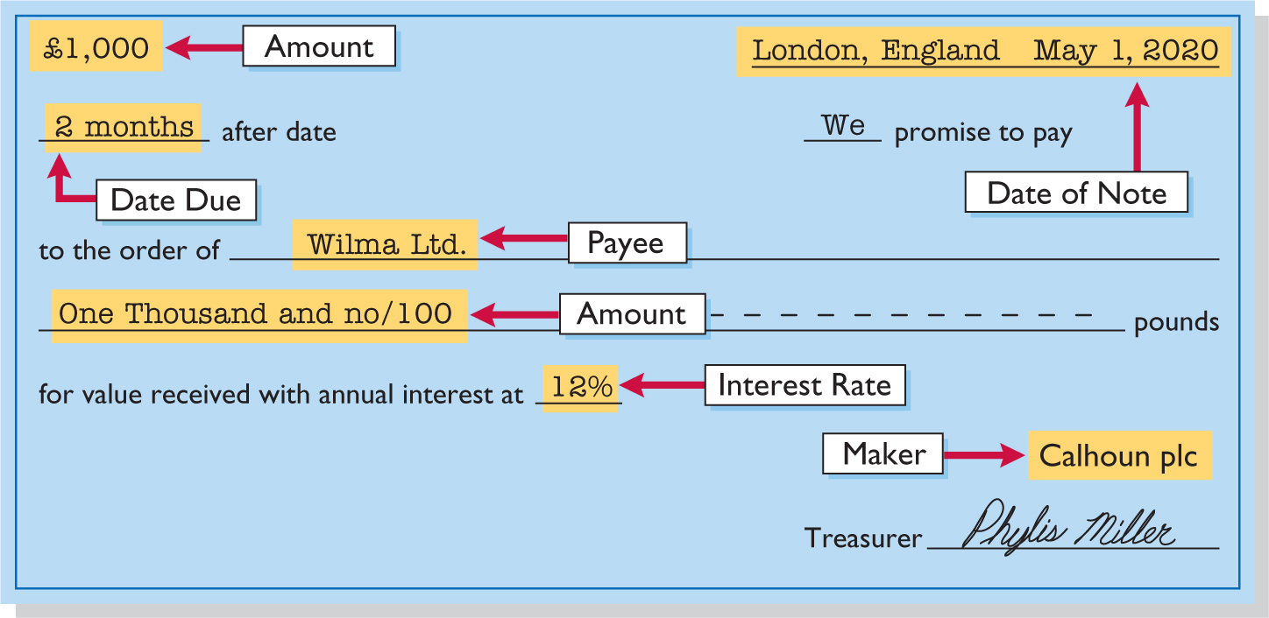
Notes Receivable (2 of 2)
To the payee, the promissory note is a note receivable.
To the maker, the promissory note is a note payable.

Slide 55
Determining the Maturity Date
Maturity date of a promissory note may be stated in one of three ways:
On demand.
On a stated date.
At the end of a stated period of time.
Note terms are expressed in:
Months
Days

Slide 56
Computing Interest
Face Value of Note × Annual Interest Rate × Time in Terms of One Year = Interest
When counting days, omit date note is issued, but include due date
Terms of Note |  |  |  | Interest Computation
 |  |  |  | Face | x | Rate | x | Time | = | Interest
₺ 730, | 12%, | 120 days |  | ₺ 730 | x | 12% | x | 120/360 | = | ₺ 29.20
₺1,000, | 9%, | 6 months |  | ₺1,000 | x | 9% | x | 6/12 | = | ₺ 45.00
₺2,000, | 6%, | 1 year |  | ₺2,000 | x | 6% | x | 1/1 | = | ₺120.00

Slide 57
Recognizing Notes Receivable
Illustration: Calhoun plc wrote a £1,000, two-month, 12% promissory note dated May 1, to settle an open account. Prepare an entry Wilma Ltd. would make for the receipt of the note.
May 1
Notes Receivable
1,000
Accounts Receivable
1,000

Slide 58
Valuing Notes Receivable
Report short-term notes receivable at their cash (net) realizable value
Estimation of cash realizable value and recording bad debt expense and related allowance are similar to accounts receivable

Slide 59
Disposing of Notes Receivable (1 of 2)
Notes may be held to their maturity date
Maker may default and payee must make an adjustment to the account
Holder speeds up conversion to cash by selling the note receivable

Slide 60
Disposing of Notes Receivable (2 of 2)
Honor of Notes Receivable
Maker pays it in full at its maturity date
Dishonor of Notes Receivable
Not paid in full at maturity
No longer negotiable

Slide 61
Honor of Notes Receivable
Illustration: Wolder Co. lends Higley Co. €10,000 on June 1, accepting a five-month, 9% interest note. To obtain payment, Wolder (the payee) must present the note either to Higley Co. (the maker) or to the maker’s agent, such as a bank. If Wolder presents the note to Higley Co. on November 1, the maturity date, Wolder’s entry to record the collection is as follows.
Nov. 1
Cash
10,375
Notes Receivable
10,000
Interest Revenue (€10,000 × 9% x 5/12)
375

Slide 62
Accrual of Interest Receivable (1 of 2)
Illustration: Suppose instead that Wolder Co. prepares financial statements as of September 30. The adjusting entry by Wolder is for four months ending Sept. 30.
Sept. 30
Interest Receivable (€10,000 × 9% x 4/12)
300
Interest Revenue
300

Slide 63
Accrual of Interest Receivable (2 of 2)
Illustration: Prepare the entry Wolder’s would make to record the honoring of the Higley note on November 1.
Nov. 1
Cash
10,375
Notes Receivable
10,000
Interest Receivable
300
Interest Revenue (€10,000 × 9% x 1/12)
75

Slide 64
Dishonor of Notes Receivable (1 of 2)
Illustration: Assume that Higley Co. on November 1 indicates that it cannot pay at the present time. If it does expect eventual collection, Wolder Co. would make the following entry at the time the note is dishonored (assuming no previous accrual of interest).
Nov. 1
Accounts Receivable
10,375
Notes Receivable
10,000
Interest Revenue
375

Slide 65
Dishonor of Notes Receivable (2 of 2)
Illustration: If instead on November 1 there is no hope of collection, the note holder would write off the face value of the note by making the following entry at the time the note is dishonored (assuming no previous accrual of interest).
Nov. 1
Allowance for Doubtful Accounts
10,000
Notes Receivable
10,000

Slide 66
DO IT! 3: Recognizing Notes Receivable (1 of 3)
Gambit Stores accepts from Leonard Co. a $3,400, 90-day, 6% note dated May 10 in settlement of Leonard’s overdue account. (a) What is the maturity date of the note? (b) What is the interest payable at the maturity date? (c) What entry does Gambit make at the maturity date, assuming Leonard pays the note and interest in full at that time?
a. The maturity date is August 8, computed as follows:
Term of note: |  |  | 90 | days
May (31-10) | 21
June | 30
July | 31 |  | 82
Maturity date: August |  |  | 8

Slide 67
DO IT! 3: Recognizing Notes Receivable (2 of 3)
Gambit Stores accepts from Leonard Co. a $3,400, 90-day, 6% note dated May 10 in settlement of Leonard’s overdue account. (a) What is the maturity date of the note? (b) What is the interest payable at the maturity date? (c) What entry does Gambit make at the maturity date, assuming Leonard pays the note and interest in full at that time?
b. The interest payable at the maturity date is $51, computed as:
Face | x | Rate | x | Time | = | Interest
$3,400 | x | 6% | x | 90/360 | = | $51.00

Slide 68
DO IT! 3: Recognizing Notes Receivable (3 of 3)
Gambit Stores accepts from Leonard Co. a $3,400, 90-day, 6% note dated May 10 in settlement of Leonard’s overdue account. (a) What is the maturity date of the note? (b) What is the interest payable at the maturity date? (c) What entry does Gambit make at the maturity date, assuming Leonard pays the note and interest in full at that time?
Gambit Stores records this entry at the maturity date:
Cash
3,451
Notes Receivable
3,400
Interest Revenue
51

Slide 69
Learning Objective 4 Describe the Statement Presentation and Analysis of Receivables

Slide 70
Presentation and Analysis
Presentation
Statement of Financial Position
Identify on statement or in the notes each major type of receivable
Report short-term receivables as current assets
Report both gross amount of receivables and allowance for doubtful account

Slide 71
Presentation and Analysis
Presentation
Income Statement
Report bad debt expense and service charge expense in operating expenses section
Report interest revenue under “Other income and expense” in non-operating section

Slide 72
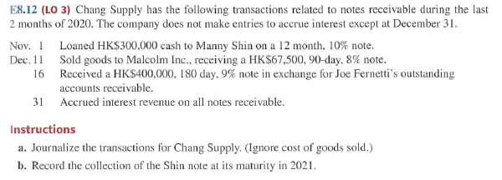

Slide 73
