Slide 1
Leading: Culture and Ethics
Healthcare Service Management
Wafaa Menawi
Ph.D. Health Care Management
Head of Quality Assurance Unit
An-Najah BioSciences Unit (NBU)
Mobile: +972 568279063
E. mail: w.menawi@najah.edu

Slide 2
Learning Outcomes
• Explain the power of culture in the strategy execution process.
• Describe the characteristics of low‐ and high‐performance cultures.
• Differentiate between the four cultural value types.
• Describe Hofstede’s value dimensions of national culture.
• Explain the primary reasons for embracing diversity.
• Identify and briefly describe the obstacles that make it hard to achieve diversity objectives.
• Describe the key indicators of a culture that supports diversity.

Slide 3
Culture
Is the aggregate of beliefs, norms, attitudes, values, assumptions and ways of doing things that is shared by members of an organization and taught to new members.
Gives meaning to each individual’s membership in the workplace and, in so doing, defines organization’s essential purpose.
Is recognized as a source of competitive advantage.
Is the operating system that brings to life the underlying core values of an organization.
Determines the way that an organization responds to problems of survival in its external and internal environments.
Emerges from the history and experiences of individuals and groups in that particular organization’s context.

Slide 4
• A deeply rooted culture that is well matched to strategy and external environmental trends is a strong recipe for successful strategy execution.
• A weak or “shallow‐root” culture can become an obstacle to successful strategy execution.
• Culture serves two important functions in organizations:
– It creates internal unity
– It helps the organization adapt to the external environment.
1. Internal unity
Organizational culture defines a normative order that serves as a source of consistent behavior within the organization
Provides organizational members with a way of making sense of their daily lives
Establishes guidelines and rules for how to behave
Provides a value system in which to operate
Promotes strong employee identification with the organization’s vision, mission, goals, and strategy
Provides a shared understanding about the identity of an organization

Slide 5
2. External adaptation- Culture serves two important functions in organizations (con.):
Culture determines how the organization responds to changes in its external environment
The appropriate culture type can ensure that an organization responds quickly to rapidly changing customer needs or the offensive actions of a competitor.
Low‐ and High‐Performance Cultures
• The strength of any culture depends on the degree to which a set of norms and values are widely shared and strongly held throughout the organization.
A weak culture symbolizes a lack of agreement on key values and norms
A strong culture symbolizes widespread consensus

Slide 6
Low‐Performance Cultures – Characteristics
Insular thinking
A tendency to avoid looking outside the organization for superior practices and approaches. This often prevents the organization from making the necessary cultural adaptation as external conditions change, thus leading to a decline in company performance.
b) Resistance to change
Avoiding risks and not making mistakes becomes more important to a person’s career advancement than entrepreneurial successes and innovate accomplishments.
Politicized internal environment
An environmental that allows influential managers to operate their units autonomously like personal kingdoms is more likely to resist needed change. What is best for the organization is secondary to the self‐interests of individual players
d) Unhealthy promotion practices
Promotions are often based on personal considerations (friendship, family ties, favoritism, and so forth) rather than professional considerations.

Slide 7
High‐Performance Cultures- – Characteristics
Culture reinforcement tools
Leaders celebrate high‐performing employees, and help create an emotional bond among all employees.
Leaders tell stories to new employees to illustrate the company’s primary values and provide a shared understanding among workers.
Leaders use symbols and specialized language (such as slogans) to convey meaning and values
b) Intensely people oriented
Treat employees with dignity and respect
Grant employees enough autonomy to excel and contribute
Cultivate a relationship with employees based on mutual respect and interdependency
Initiate unique one‐to‐one relationships with top performers
Give increased responsibility to the best employees
Implement major programs
Hold managers at every level responsible for the growth and development of the people who report to them
Use the full range of rewards and punishment to enforce high performance standards
Encourage employees to use their own initiative and creativity in performing their jobs
Set reasonable and clear performance standards for all employees

Slide 8
High‐Performance Cultures – Characteristics (cont.)
c) Results oriented
Quantitative measures of success are used
Emphasis is placed on individual goal setting, whereby employees draft performance goals and have them approved by their managers
d) Emphasis on achievement and excellence
per‐unit cost reductions, zero defect, improved product quality, and extraordinary customer service

Slide 9
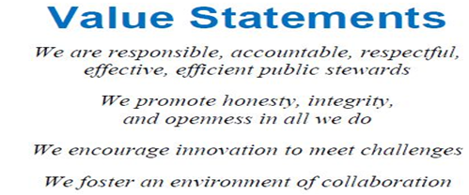
Role of Leadership in Culture Creation and Sustainability
Making sure an organization’s culture is aligned with its strategies.
A clearly defined vision, mission, and culture statements that define the way things are done.
Changing the culture of an organization to adapt to changes in the environment
To create strong, high‐performing cultures.
Leaders serving as role models , employees learn what is valued most in an organization by watching what attitudes and behaviors leaders pay attention to and reward and whether the leaders’ own behaviors match the espoused values
Reinforce specific values and create emotional bonds by allowing employees to share in important meetings.
Interacting face‐to‐face with rank‐and‐file
Matching organizational structure to culture
Matching HR practices to culture , leaders can influence culture by establishing new criteria for recruiting, selecting, promoting, and firing employees
Matching operating policies and practices to culture
Creating a strategy–culture fit
Aligning reward/incentive system with culture
Matching work environment design to culture
Developing a written values statement , value statements serve as a building block in the task of culture creation and maintenance.

Slide 10
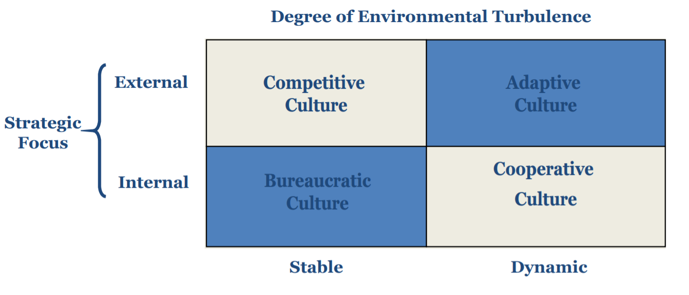
Types of Organizational Cultures

Slide 11
Cultural Value Types
Cooperative culture
Represents a leadership belief in strong, mutually reinforcing exchanges and linkages between employees and departments
Operating policies, procedures, standards, and tasks are all designed to encourage cooperation, teamwork, power sharing, and camaraderie among employees
Management thinking is predicated on the belief that organizational success is influenced more by employee relationships inside the organization than by external relationships
Employees are trained to think like owners rather than hired hands
Adaptive culture
Represents a leadership belief in active monitoring of the external environment for emerging opportunities and threats
Made up of policies, procedures, and practices that support employees’ ability to respond quickly to changing environmental conditions
Members are encouraged to take risks, experiment, and innovate
Management thinking is based on the belief that organizational success is influenced more by events outside the organization than by internal factors
Employees are empowered to make decisions and act quickly to take advantage of emerging opportunities or avoid threats.

Slide 12
Cultural Value Types
3. Competitive culture
Represents a leadership that encourages and values a highly competitive work environment
Organizational policies, procedures, work practices, rules, and tasks are all designed to foster both internal competition and external competition
Leaders focus on the achievement of specific targets such as market share, revenue, growth, or profitability
Values competitiveness, personal initiative, aggressiveness, achievement, and the willingness to work long and hard for yourself or for the team
4. Bureaucratic culture
Represents a leadership that values order, stability, status, and efficiency
Leaders perceive their environments as basically stable with an internal strategic focus
Emphasizes strict adherence to set rules, policies, and procedures
Are highly structured and efficiency driven
How to Sustain an Organization’s Culture
• Define a strategic plan for implementing the company culture
• Use well‐trained and experienced employees to train new hires
• Make sure that employees at all levels know what the culture is and accept it

Slide 13
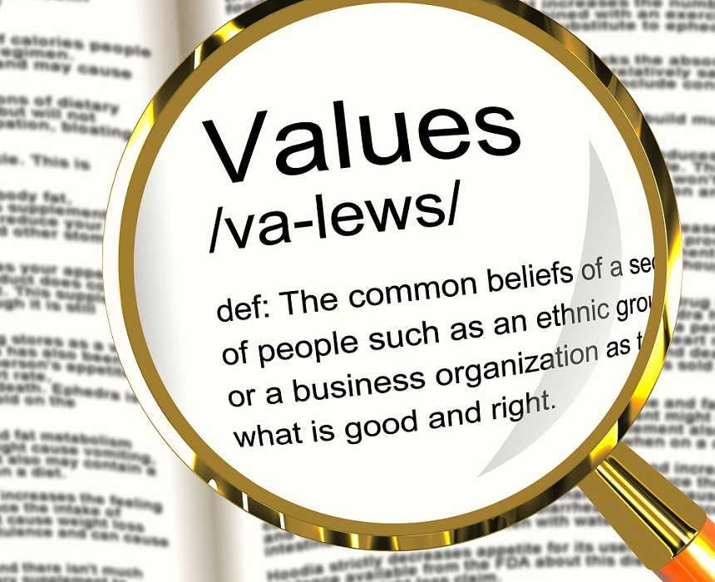
Values‐Based Leadership
• Values are generalized beliefs and behaviors that are considered by an individual or group to be important
• A leader’s decisions and actions reflect his or her personal values and beliefs
• Integrity and strong values are vital traits of good leaders
• How leaders’ ethical values influence follower behavior or and performance is the subject of values‐based leadership
• Followers take their cue from the leader

Slide 14
The Leader’s Role in Advocating Ethical Standards
• Some of the tools available for leaders to use in enforcing ethical behavior include:
Codes of ethics
Ethics committees
Training programs
Disclosure mechanisms
Code of ethics
Written statements have the advantage of explicitly stating the company’s position on ethical or moral issues
They serve as benchmarks for judging both company policies and actions and individual conduct
Some organizations include ethics as part of their mission
Developing a code of ethics program should incorporate some key components: – Leaders model expected behaviors
– Ethics is a core element of the corporate culture
– Everyone participates in creating the guidelines
– Ethics is discussed openly
– Rules are applied consistently

Slide 15
The Leader’s Role in Advocating Ethical Standards (cont.)
3. Ethics committees
– Charged with overseeing ethical issues
– Ethics ombudsperson Is a single person entrusted with the responsibility of acting as the organization’s conscience
Training programs
– Teach employees how to incorporate ethics into daily behavior
– Help align member behaviors with the organization’s values
5. Disclosure mechanisms
Whistle blowing Is employee disclosure of illegal or unethical practices on the part of the organization
Can be risky for those who choose to do it
Ostracization by coworkers – Demotion – Transfer – Termination

Slide 16
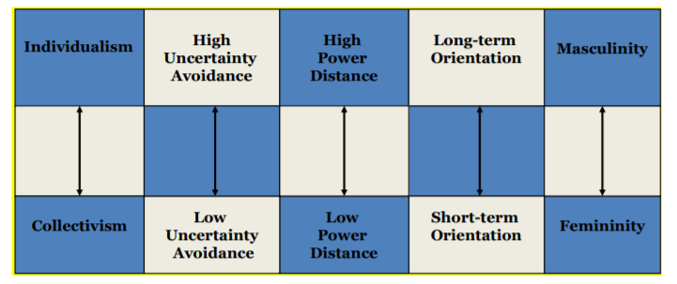
National Culture Identities
Hofstede’s Value Dimensions
• A nation’s values and norms determine what kinds of attitudes and behaviors are acceptable or appropriate
• The people of a particular culture are socialized into national values as they grow up • Norms and social guidelines prescribe how members of a nation should behave toward each other
• Significant differences between national cultures exist and make a difference in how leaders and employees behave in organizations
A Framework of Value Dimensions for Understanding Cultural Differences

Slide 17
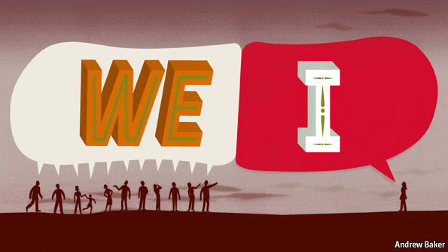
Individualistic to Collectivist Cultures
• Individualism is a psychological state in which people see themselves first as individuals and believe their own interest and values are primary
– Examples:
– United States – Great Britain – Canada
• Collectivism is the state of mind wherein the values and goals of the group whether extended family, ethnic group, or company are primary
– Examples: – Greece – Japan – Mexico

Slide 18
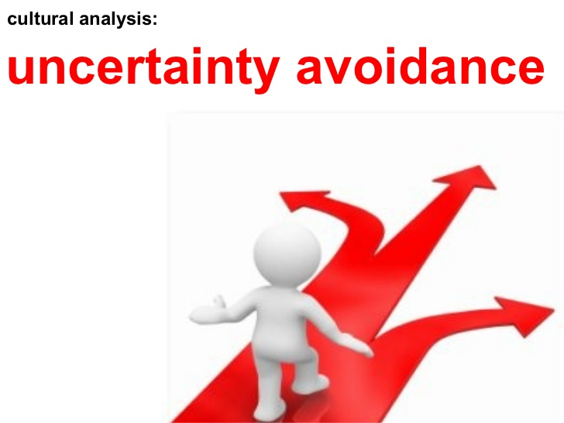
High to Low Uncertainty Avoidance Cultures
• A society with high uncertainty avoidance contains a majority of people who do not tolerate risk, avoid the unknown, and are comfortable when the future is relatively predictable and certain
– Examples: – United States – Australia – Canada
• A society where the majority of the people have low uncertainty avoidance has people who are comfortable with and accepting the unknown, and tolerate risk and unpredictability
– Examples: – Italy – Japan – Israel

Slide 19
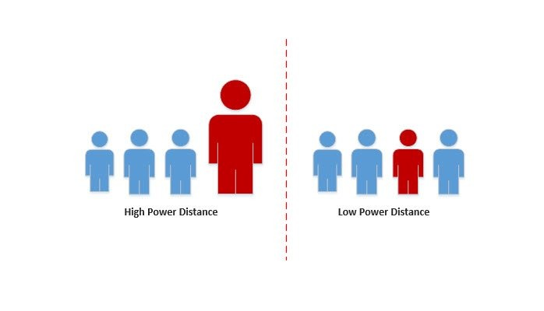
High to Low Power‐Distance Cultures
In a high power‐distance culture, leaders and followers rarely interact as equals
Examples: – Mexico – Spain – Japan – France
• In a low power‐distance culture, leaders and their members interact on several levels as equals
– Examples: – Germany – United States – Ireland

Slide 20
Long‐Term to Short‐Term Oriented Cultures
• People from a culture with a long‐term orientation have a future‐oriented view of life and thus are persistent in achieving goals
– Examples: – Most Asian countries
• A short‐term orientation derives from values that express a concern for maintaining personal happiness and living for the present
– Examples: – Most European countries – United States

Slide 21
Masculinity–Femininity
• Masculinity describes a culture that emphasizes assertiveness and a competitive drive for money and material objects
– Examples: – Japan – Italy
• Femininity describes a culture that emphasizes developing and nurturing personal relationships and a high quality of life
– Examples: – Sweden – Denmark

Slide 22
Implications for Leadership Practice
The growing diversity of the workforce and the increasing globalization of the marketplace create the need for leaders with multicultural backgrounds and experiences
Multicultural leaders possess competencies that enable them to relate effectively to and motivate people across race, gender, age, social strata, and nationality
Cross‐cultural and international joint venture (IJV) studies often identify cultural differences as the cause of many interpersonal difficulties, including conflict and poor performance
• Demographic diversity Is any characteristic that serves as a basis for social categorization and self‐identification Includes:
– Race – Gender – Age – Ethnicity – Religion – Sexual orientation
• Diversity – Is the inclusion of all groups at all levels in an organization
Generational diversity in the workplace
– Traditionalists (1900–1945)
– Baby Boomers (1946–1964)
– Generation Xers (1965–1980)
– Millennials (1981–2000)

Slide 23
The most significant increase in workforce diversity is due to:
– National demographic changes
– Greater minority representation in the workforce
A greater likelihood exists that individuals will find themselves leading or under the leadership of someone demographically different from them
In the new work environment, workers must often share work duties and space with coworkers of diverse races, social backgrounds, and cultures
In the last 25 years, attitudes toward diversity have and continue to change
Companies that can effectively manage diversity will be able to recruit from a larger pool, train and retrain superior performers, and maximize the benefits of this diverse workforce
More organizations are highlighting diversity in their advertising, because they are competing for talent in a tight labor market
They recognize that demographic shifts are going to dramatically change their marketplace over the next 20 years

Slide 24
The Impact of Globalization on Diversity
Globally interconnected economies mean changes in one economy quickly impact others
A global labor market is emerging, dominated by India and China
Collaboration among competitors, suppliers, and financial institutions has become a common way to compete globally
Global strategic alliances between independent firms are becoming more prevalent for the purpose of:
– Achieving common goals
– Overcoming domestic country bias
Understanding cultural differences and learning to deal effectively with partners from different cultures will be critical
The increased need for leaders with global mindsets and cross‐cultural leadership abilities has led to a shortage of qualified people
Organizational leaders need to recognize that:
– Each person can bring values and strengths to the workplace based on his or her own unique backgrounds
– Cultural values and norms can shape employee receptivity to leadership styles

Slide 25
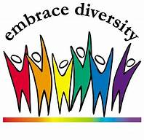
Reasons for Embracing Diversity
• Can offer a company a marketing advantage
• Can help a company to develop and retain talented people
• Can be cost effective
• May provide a broader and deeper base of creative problem solving and decision making
Despite its benefits, negative outcomes can result if diversıty is not effectively managed
Left unmanaged, workforce diversity is more likely to: – Damage morale – Increase turnover – Cause communication problems – Ultimately cause conflict

Slide 26
Obstacles to Achieving Diversity
Stereotypes and prejudice – Prejudice is the tendency to form an adverse opinion without just cause about people who are different from the mainstream in terms of their gender, race, ethnicity, or any other definable characteristic – It is an assumption, without evidence, that people who are not part of the mainstream culture (women, African Americans, and other minorities) are:
– Inherently inferior
– Less competent at their jobs
– Less suitable for leadership positions
Ethnocentrism – Is the belife that one’s own group or subculture is naturally superior to other groups and cultures – Produces a homogeneous culture
Policies and practices
The glass ceiling – Is an invisible barrier that separates women and minorities from top leadership positions – Remains a pervasive problem in corporate America
Unfriendly work environment – Sexual harassment, intimidation, bullying, and social rejection are all examples of actions that make the workplace unfriendly – Making the workplace friendly for everyone will go a long way toward alleviating the problem of hi hg turnover and preserve diversity initiatives

Slide 27
Creating a Culture That Supports Diversity
For organizations to embrace and value diversity, the concept itself must be embedded in the organizations’ business model – A company’s business model defines its vision, mission, strategic objectives, and strategies for achieving those objectives
When diversity leadership becomes part of the organization’s mission, all employees are given equal opportunities to contribute their talents, skills, and expertise toward achieving organizational objectives
A successful diversity program requires a team approach – A strong commitment to attract, retain, and promote employees of minority backgrounds – The creation of a culture that fully supports and rewards diversity initiatives throughout the organization
Leaders have a responsibility to create a work culture that accommodates the needs of a diverse workforce

Slide 28
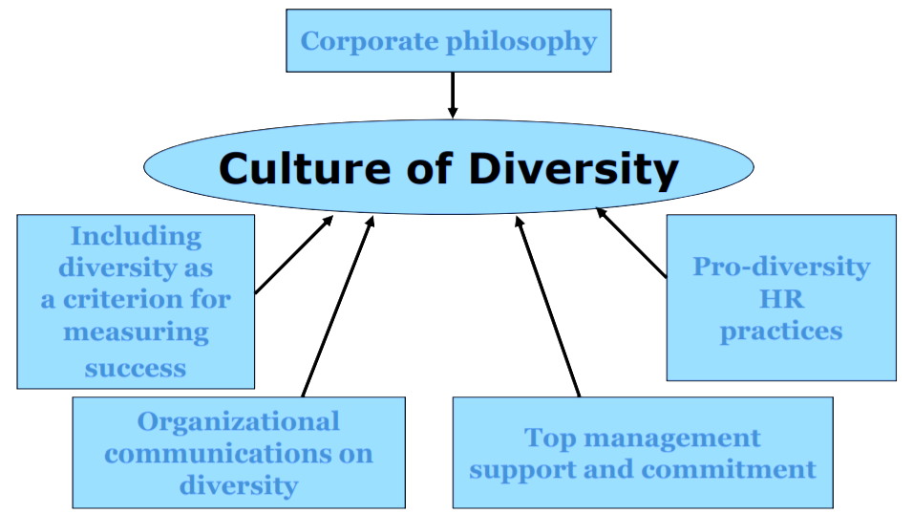
Factors Related to Diversity Success

Slide 29
Diversity Awareness Training and Leadership Education
The ultimate objective of diversity training and education on is to create a diversıty sensitive orientation (DSO) within the entire workforce
Diversity training
– Training sessions are aimed at increasing people’s awareness of and empathy for people from different cultures and backgrounds
– Diversity training can include:
– Role‐playing
– Self‐awareness activities
– Awareness activities
– Training programs can last hours or days
– They can be conducted by outside experts on diversity, or by existing members of the organization with expertise in diversity
– Not all diversity‐training programs are successful. Diversity training is most likely to be successfull when it is not a one‐time event, b t u an ongoing or repeated activity along with follow‐up activities to see whether training objectives were accomplished

Slide 30
Diversity Awareness Training and Leadership Education (cont.)
Education – Additional education is sometimes needed for leaders beyond diversity training – Leaders develop personal characteristics to make them better able to communicate and work with diverse employees – Leaders are taught to view diversity in the larger context of the organization’s long‐term vision – They should be educated on the strategic significance of linking diversity to the organization’s competitiveness
• Education (cont.)
– Through education, leaders learn how to:
– Communicate effectively
– Encourage feedback from all employees regardless of background
– Accept criticism
– Adjust their behavior when appropriate
– Mentor and empower employees of diverse cultures

