Slide 1
An-Najah National University
Faculty of Medicine
Department of Physiology
Anatomy and Physiology 1
7102101
Instructor: Heba Salah
Chapter 1:
The human Body: An Orientation
Part 5: The Language of Anatomy

Slide 2
The Language of Anatomy
Special terminology is used to prevent misunderstanding
Exact terms are used for:
Position
Direction
Regions
Structures

Slide 3
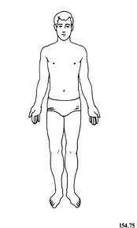
Anatomical Position
Assumed to be in an erect position, with the feet parallel and the arms hanging at the sides, with the palms facing forward

Slide 4
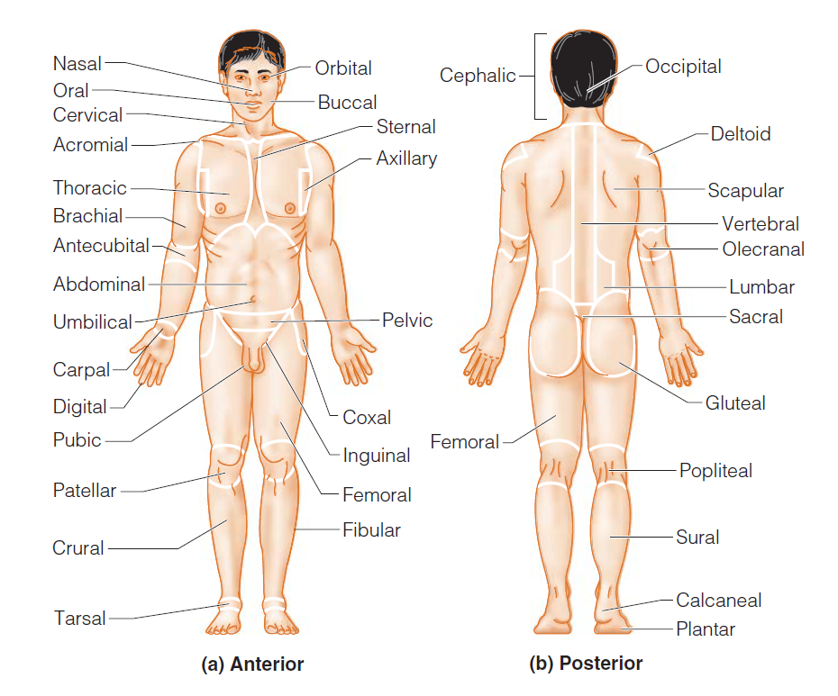
Surface Anatomy: Regional Terms

Slide 5
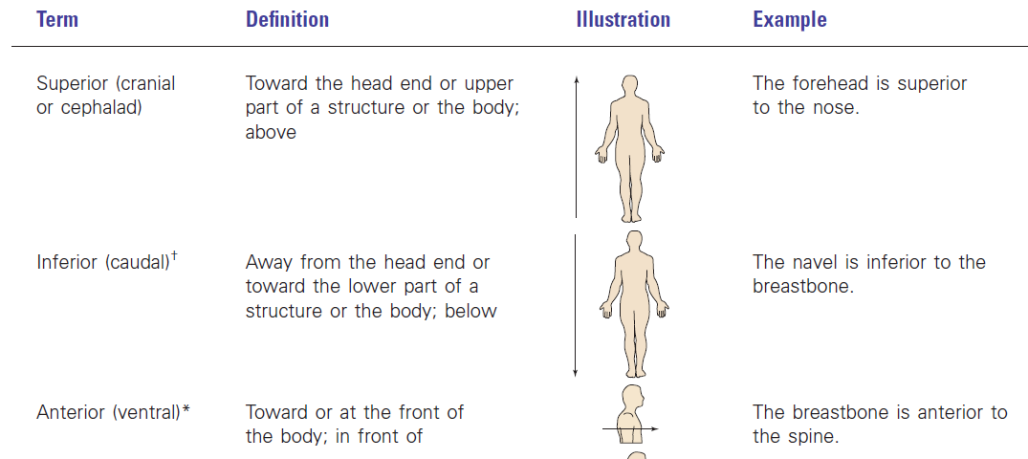
Orientation and Directional Terms

Slide 6
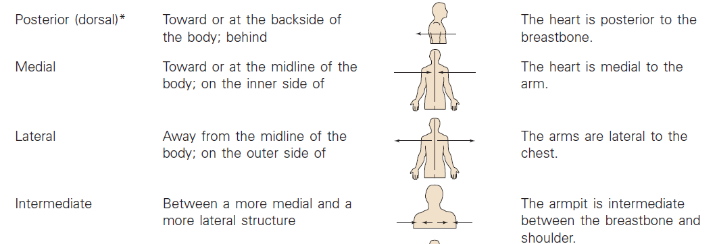
Orientation and Directional Terms

Slide 7
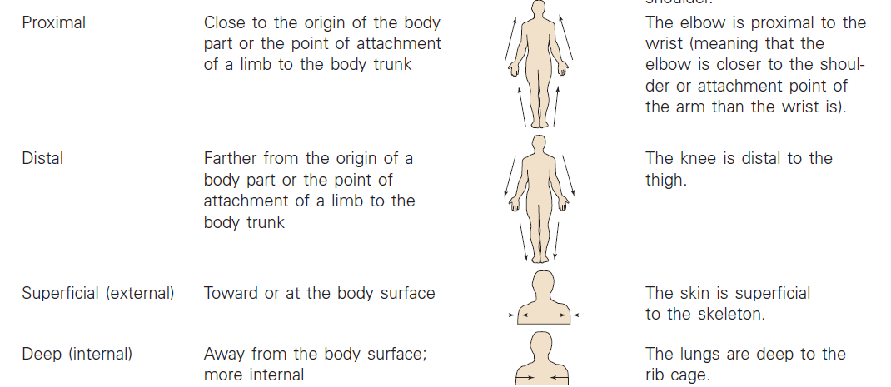
Orientation and Directional Terms

