Slide 1
Latex

Slide 2
Simple title page
\documentclass{article}
\begin{document}
\title{Global Warming}
\author{Mai Kanaan}
\date{Feb,16,2018}
\date{\today}
\maketitle
\end{document}

Slide 3
New page
\documentclass{article}
\begin{document}
\title{Global Warming}
\author{Mai Kanaan}
\date{Feb,16,2018}
\maketitle
\newpage
Hello World
\end{document}

Slide 4
New lines and alignment
To print a line you can use \\ or double (enter)
to make the new line after 5cm, 10mm, 10 cm, use \\ and [5 cm]
Note that the [5cm] must come immediately after \\
\begin{center} … \end{center}
\begin{flushright}… \end{flushright}

Slide 5
Huge, bold
{\huge only some text is huge} and the rest is normal.
In this sentence, \huge{too much text is huge}, including this.
\textbf{\huge My name is Mai}
Bold:
\bfseries{Global Warming}
{\bfseries Global Warming}
huge and bold:
{\huge\bfseries Global Warming} abc
Or
\huge{\bfseries Global Warming} abc
What is the difference?
Note: Huge is bigger than large

Slide 6
Large & textsc
\textsc{Mai Kanaan}
Produces small capitals
Ex:
\textsc{Hello World}\\
\textsc{\LARGE Hello World}\\
\textsc{\Large Hello World}\\
\textsc{\large Hello World}\\
{\LARGE Hello World}\\
Hello World

Slide 7
Exercise
Try the following examples and notice the results
\newpage
\textsc{Hello World}\\
[2cm]
Hello World\\
[2cm]
{\large Hello World}\\
{\Large Hello World}\\
{\LARGE Hello World}\\
{\huge Hello World}\\
{\Huge Hello World}\\
{\HUGE Hello World}\\ ………wrong, undefined

Slide 8
Lines
\line(1,0){200}
(1,0) is the slope and 200 is the line length
\line(1,0){100}
Hello World
Output:
_____________________ Hello world
\line(1,0){100}
% there is a new line here
Hello World
Output:
____________________
Hello World

Slide 9
Note
To print a number starting with #
\# 118235677
To make a comment in Latex use %

Slide 10
Making a customized title page
\begin{titlepage} …… \end{titlepage}
Title page has no number

Slide 11
Making a customized title page
\documentclass{article}
\begin{document}
\begin{titlepage}
\begin{center}
\huge{\bfseries Moodle Tutorial}\\
\line(1,0){300} \\
[5mm]
\today\\
\textsc{Mai Kanaan}\\
[15cm]
\end{center}
\begin{flushright}
Mai Kanaan
\end{flushright}
\end{titlepage}
This is a trial
\end{document}

Slide 12
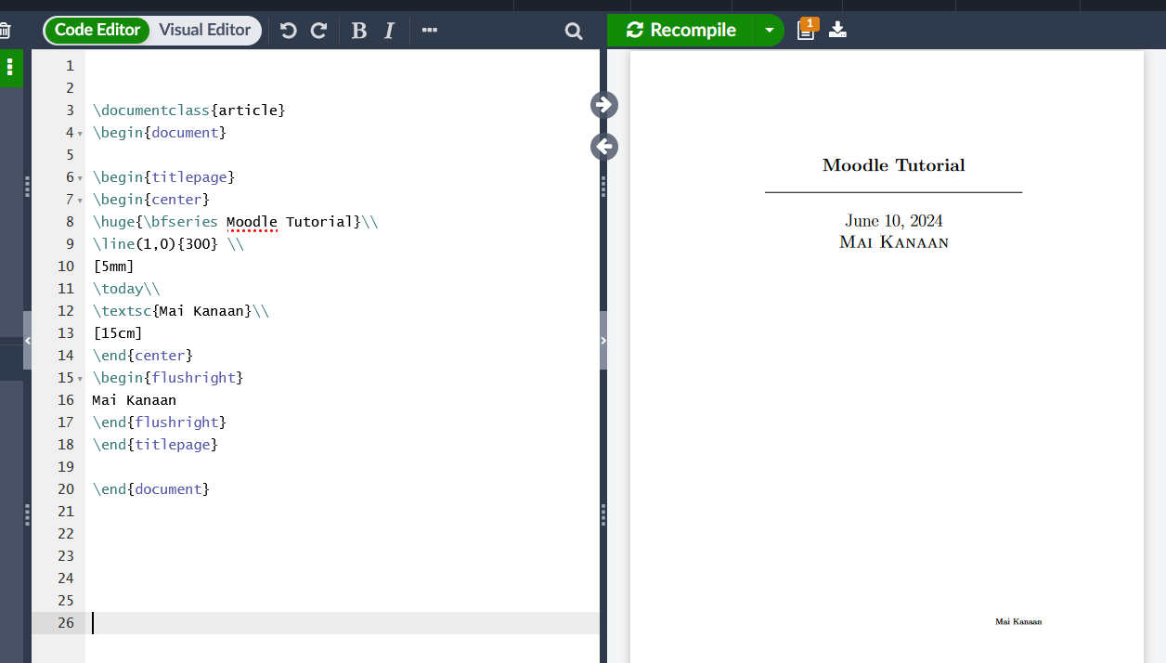

Slide 13
Section
Example:
\documentclass{article}
\begin{document}
\begin{titlepage}… \end{titlepage}
\section{Introduction} \label{sec:intro}
This is a Moodle tutorial. This tutorial shows how to perform the main tasks that the students need in Moodle environment. \\ %or double enter
Also, it discusses the main tasks the students need to perform on Zajel. The text will wrap around properly
\end{document}
Note: Using \\ does not yield the indentation of a new paragraph. Double enter does.

Slide 14
Adding random text
Use lipsum package to get a random text in order to check how the formatting and the indentation look before you continue working on your document.
Ex:
documentclass{article}
\usepackage{lipsum}
\begin{document}
\section{Introduction}\label{sec:intro}
This is a Moodle tutorial. This tutorial shows how to perform the main tasks that the students need in Moodle environment. \\ %or double enter
Also, it discusses the main tasks the students need to perform in Zajel. The text will wrap around properly
\lipsum[1]
\end{document}

Slide 15
Margins (the geometry package)
\documentclass{article}
\usepackage{lipsum}
\usepackage[margin=1in,left=1.5in]{geometry}
.
.
.
\lipsum[1]
\end{document}
Note:
\usepackage[left=1.5in,margin=1in,includefoot]{geometry}
In this case the margin will undo the effect of the left margin, therefore you must set the margins first, then the left margin

Slide 16
Margins (the geometry package)
Ex1:
\usepackage{geometry}
\geometry{margin=1in,left=1.5in}
Ex2:
Suppose that you have to create a document in an A4 paper and the text shouldn't exceed 6 in width and 8 in height. Include this in the preamble:
\usepackage{geometry}
\geometry{a4paper,total={6in,8in}}
Ex3:
\usepackage{geometry}
\geometry{a4paper,landscape,margin=2in}
Or
\geometry{a4paper,portrait,margin=1in}

Slide 17
Page numbers, headers and footers fancyhdr package
%header and footer code
\usepackage{fancyhdr}
\pagestyle{fancy}
\fancyhead{} %used to clear the current header given by the package
\fancyfoot{} %used to clear the current footer (page number)
\fancyhead[L]{Moodle Tutorial} %used to add a header to the left
\fancyfoot[R]{\thepage} %used to add a footer to the right, in this case the footer is the page number
Note:
Try
\fancyhead {Moodle Tutorial}
without the [L]
What is the result?

Slide 18
More on (fancyhdr)
Removing and adding lines using fancyhdr
\renewcommand{\headrulewidth}{0pt}
\renewcommand{\footrulewidth}{1pt}

Slide 19
Creating sections and subsections
\section{Introduction to Moodle}
This is a moodle tutorial\\
\lipsum[1]
\section{Open course on Moodle}
\lipsum[1]
\subsection{Open Moodle assignment}
\subsubsection{Submit Moodle assignment}

Slide 20
Using labels
\section{Introduction to Moodle}
This is a moodle tutorial\\
\lipsum[1]
\section{Open course on Moodle}\label{s1}
\lipsum[1]
\newpage
\subsection{Submit Moodle assignment}
Open Moodle course, see page \pageref{s1}
\subsubsection{Re-submit Moodle assignment}

Slide 21
Creating a table of contents
\end{titlepage}
\tableofcontents
\thispagestyle{empty}
\newpage
\setcounter{page}{1}
\section{Introduction to Moodle}This is a moodle tutorial\\
\lipsum[1]
\section{Open course on Moodle}\label{s1}
\lipsum[1]
\newpage
\subsection{Submit Moodle assignment} Open Moodle course, see page \pageref{s1}
\subsubsection {Re-submit Moodle assignment}

Slide 22
References and Citation
Citation:
Create a new file (ex: Refences.bib)
Copy the bibtex code from ResearchGate or Google Scholar or any research platform.
Paste the bibtex code on you references file.
To cite the reference in your text, Use \cite{put reference label here}
Example: as mentioned in \cite{9762787}
References:
\bibliographystyle{plain}
\bibliography{references}

