Slide 1
Analog to digital Conversion (fast review) 1
Dig. Comm.

Slide 2
Transmitter
Source
Encoder
Channel
Encoder
Baseband
Signaling
Source Encoder translates the out put of the source in an
efficient manner for communication (e.g., compression).
Channel Encoder transforms the coded source to enable
error detection and correction at the receiver (e.g., add
redundancy).
Baseband signaling encodes digital information in a
sequence of analog pulses (before modulation).

Slide 3
Modulation Types
Transition from Analog to Digital Communications
Sampling Process
Analog Pulse Modulation
Pulse-Amplitude Modulation
Pulse-Position Modulation
Pulse-Duration Modulation
Completing the Transition from Analog to Digital
Quantization Process
Pulse-Code Modulation
--------------------------------------------------------------
Digital Pulse Modulation
Other forms of pulse modulation: DM, SDM, DPCM, ADPCM, LP, …
Line Codes

Slide 4
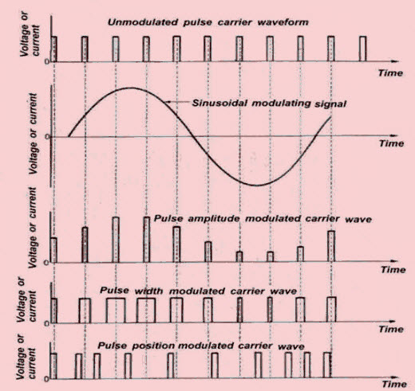

Slide 5
Bandwidth-Noise Trade-Off
PPM & FM related to the square of BW
Can we produce a trade off better than the square law?
YES but using Digital Pulse Modulation➔ exponential law
What are the advantages offered by digital pulse modulation ??

Slide 6
Analog to Digital Conversion (A/D)
- Sampling
- Quantization
- Encoding
Digital to Analog Conversion (D/A) ??

Slide 7
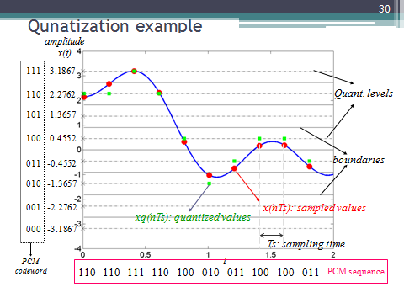
Quantization & Coding illustration

Slide 8
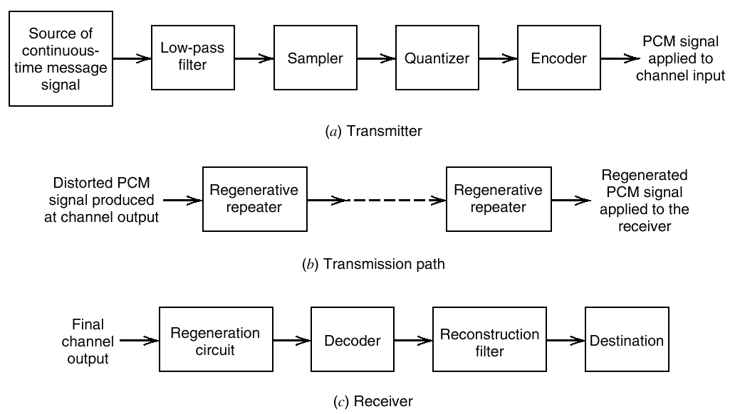
Pulse Code Modulation - PCM

Slide 9
Bandwidth of PCM
Assume m(t) is bandlimited to B hertz.
Minimum sampling rate = 2B samples / second
A/D output = n bits per sample (quantization level M=2^{n})
Assume a simple PCM without redundancy.
Minimum channel bandwidth = bit rate /2
Bandwidth of PCM signals:
B_{PCM} ≥ nB (with sinc functions as orthogonal basis)
B_{PCM} ≥ 2nB (with rectangular pulses as orthogonal basis)
For any reasonable quantization level M, PCM requires
much higher bandwidth than the original m(t).
Bandwidth depends on: bit rate and pulse shape used to represent the data
Dimensionality theorem gives the bounds:

Slide 10
Noise Considerations in PCM Systems
Two major sources:
channel noise – always present
quantization noise – signal dependent
Define: Bit Error Rate (BER )
BER is the probability that the reconstructed bit at the receiver output differs from the transmitted bit on average.
Usually channel noise is assumed Additive, White & Gaussian (AWGN)
Quantization noise is under the designer's control.

Slide 11
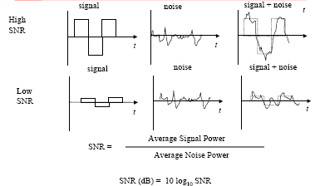
Signal-to-Noise Ratio-(metric to quantify quality of digital signal)

Slide 12
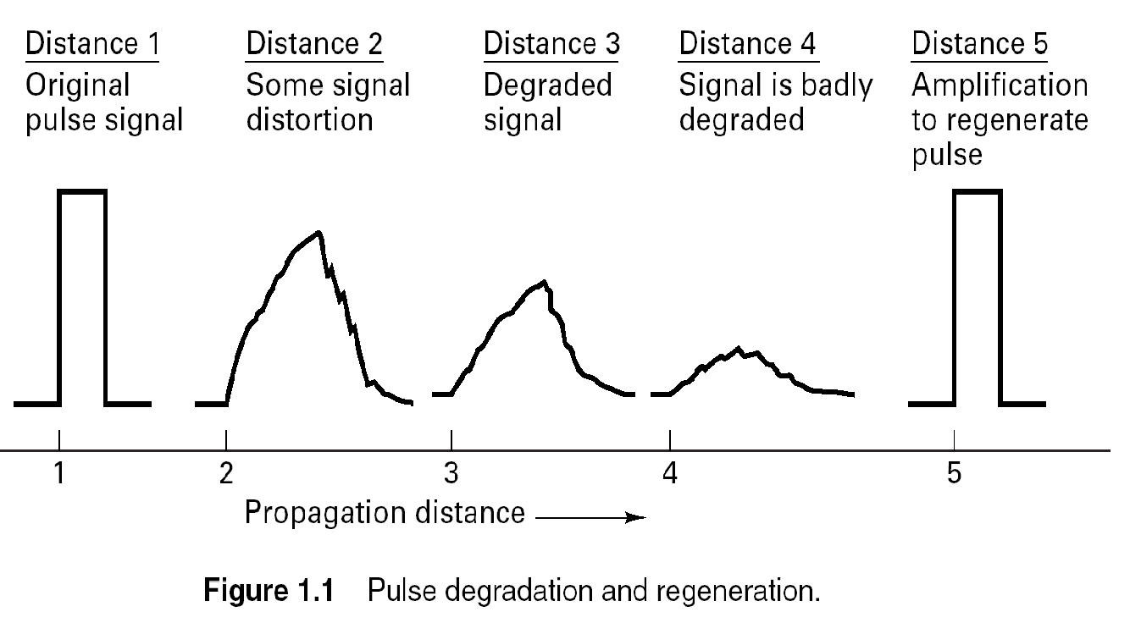

Slide 13
Error threshold :
BER depends on Eb/No, where Eb/No is the ratio of the transmitted signal energy per bit (Eb), to the noise spectral density (No).
Table: Influence of Eb/No on the probability of error :
For a bit rate of 10^5 b/s, one error every | probability of error (Pe) | Eb/No (dB)
10-3 second | 10^-2 | 4.3
10-1 second | 10^-4 | 8.4
10 second | 10^-6 | 10.6
………………… | ………… | →11.0
20 minutes | 10^-8 | 12.0
1 day | 10^-10 | 13.0
3 months | 10^-12 | 14.0

Slide 14
The threshold is about Eb/No = 11.0 dB
If Eb/No > 11.0 dB then, channel noise has virtually no-effect on the receiver performance ( goal of PCM )
CASE: PCM vs. AM
11 dB error threshold in PCM (using NRZ signaling).
60-70 dB for AM used for high quality transmission speech.
→ PCM requires much less power (even though the average noise power in PCM system is increased by the R-fold increase in the bandwidth.
R: # of bits in a codeword
PCM is robust to channel noise & interference

Slide 15
Line coding and decoding

Slide 16
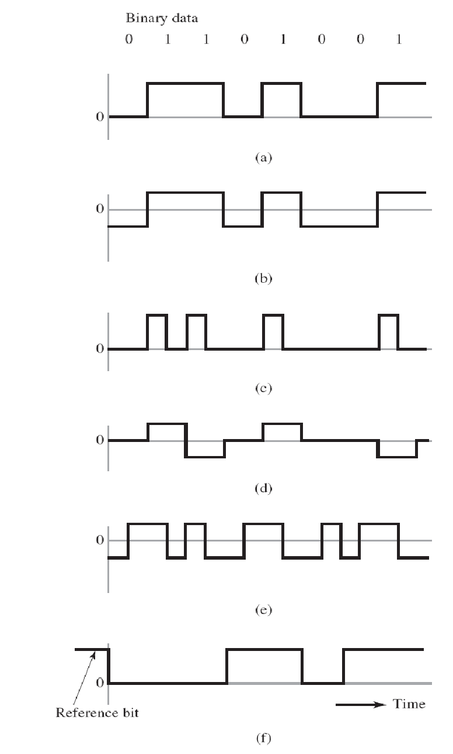
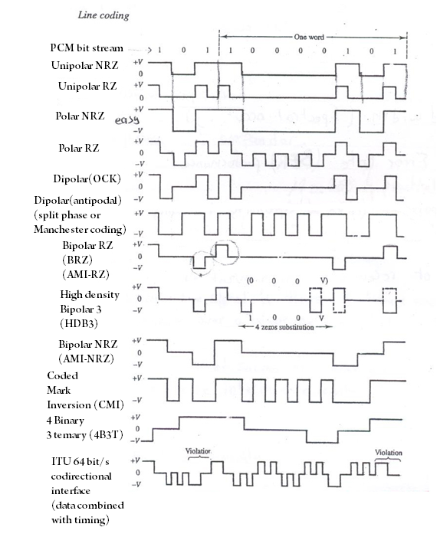
Check the reference, Iann

Slide 17
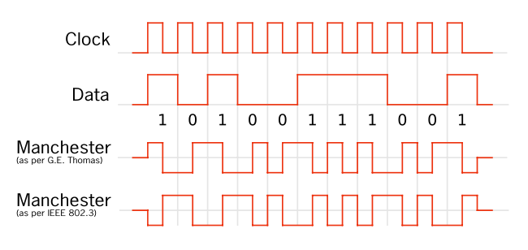

Slide 18
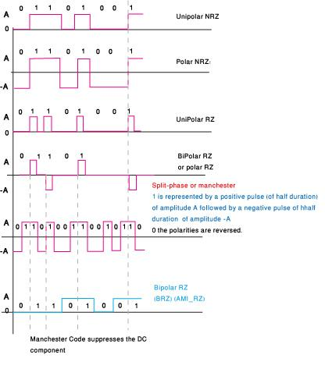
Example- check the reference

Slide 19
Differential Encoding
A transition is used to designate symbol 0 in the incoming steam of data & no transition is used to designate symbol 1 .
Whenever you encounter a zero in the incoming signal then you apply transition in the encoded signal .
The decoder compares the polarity of adjacent binary symbols to establish whether or not a transition has occurred (a reference bit is required )
(a) Original binary data. (b) Differentially encoded data, assuming reference bit 1. (c) Waveform of differentially encoded data using unipolar NRZ signaling.

Slide 20
Main purpose of Differential Encoding is to protect against polarity reversals of input bit sequences.
Hence Differentially Encoded data sequences have a slightly superior error performance
It makes the transmitted data to depend not only on the current signal state, but also on the previous one.

Slide 21
Disadvantages:
Increases complexity - VLSI technology
Increased bandwidth – satellites and fiber optic cables; data compression techniques;
Hence we need to find other ways to represent our signal….
END OF Review

