Slide 1
An-Najah National University
Faculty of Medicine
Department of Physiology
Anatomy and Physiology 1
7102101
Instructor: Heba Salah
Chapter 6:
The DigestiveSystem
Part 6: Digestive Activities in the Small and Large Intestine

Slide 2
Digestion in the Small Intestine
Enzymes from the brush border
Break double sugars into simple sugars
Complete some protein digestion
Pancreatic enzymes play the major digestive function
Help complete digestion of starch (pancreatic amylase)
Carry out about half of all protein digestion (trypsin, etc.)

Slide 3
Digestion in the Small Intestine
Pancreatic enzymes play the major digestive function (continued):
Responsible for fat digestion (lipase)
Digest nucleic acids (nucleases)
Alkaline content neutralizes acidic chyme

Slide 4
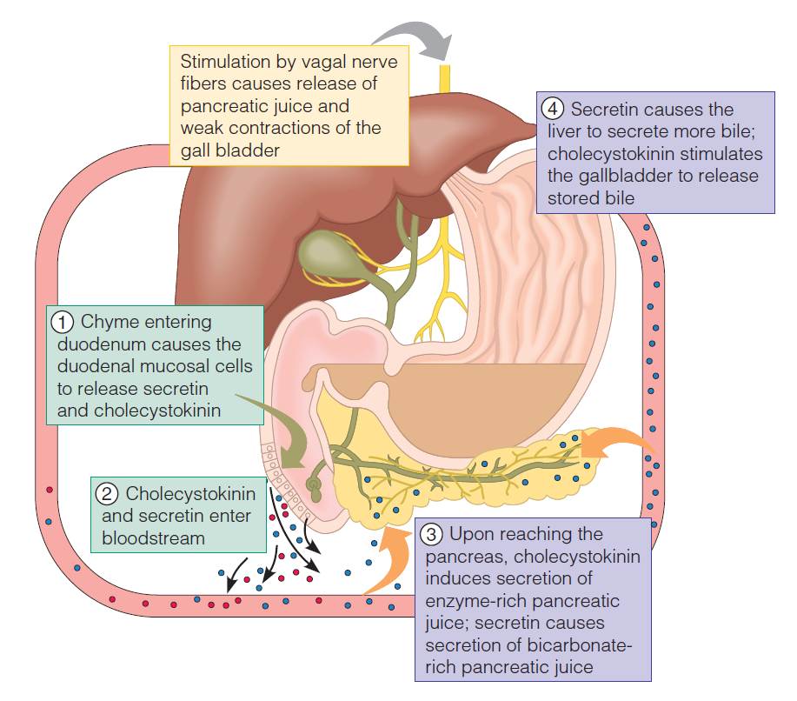
Stimulation of the Release of Pancreatic Juice

Slide 5
Absorption in the Small Intestine
Water is absorbed along the length of the small intestine
End products of digestion
Most substances are absorbed by active transport through cell membranes
Lipids are absorbed by diffusion
Substances are transported to the liver by the hepatic portal vein or lymph

Slide 6
Propulsion in the Small Intestine
Peristalsis is the major means of moving food
Segmental movements
Mix chyme with digestive juices
Aid in propelling food

Slide 7
Food Breakdown and Absorption in the Large Intestine
No digestive enzymes are produced
Resident bacteria digest remaining nutrients
Produce some vitamin K and B
Release gases
Water and vitamins K and B are absorbed
Remaining materials are eliminated via feces

Slide 8
Propulsion in the Large Intestine
Sluggish peristalsis
Mass movements
Slow, powerful movements
Occur three to four times per day
Presence of feces in the rectum causes a defecation reflex
Internal anal sphincter is relaxed
Defecation occurs with relaxation of the voluntary (external) anal sphincter

