Slide 1
An-Najah National University
Faculty of Medicine
Department of Physiology
Anatomy and Physiology 1
7102101
Instructor: Heba Salah
Chapter 3:
The Skeletal System
Part 2: Bones Markings, Formation, Growth, and Remodeling

Slide 2
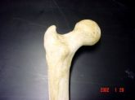
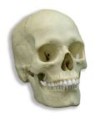
Bone Markings
Two types of bone markings:
1. Projections : ( processes) that grow out from the bone
2. Depressions: (cavities) that indent the bone

Slide 3
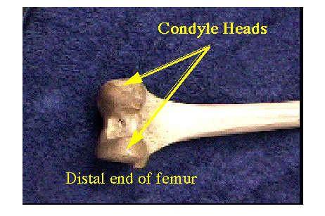
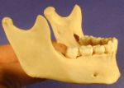
Joint Projections
1. Condyle: Rounded articular projection
Condyle

Slide 4
Joint Projections
2) Head: bony expansion on a narrow neck
3) Facet: smooth, nearly flat articular surface

Slide 5
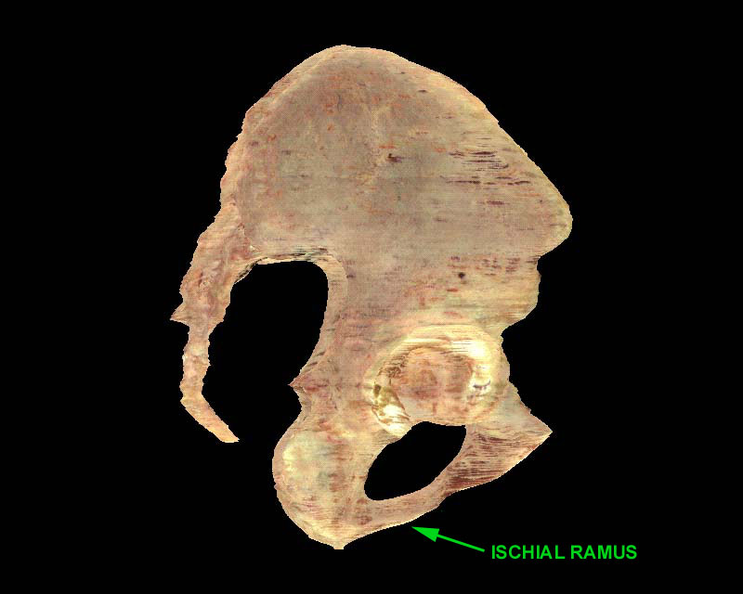
Joint Projections
4) Ramus: Armlike bar of bone

Slide 6
Ligament/Tendon Projections
1) Crest: Narrow ridge of bone (Line: smaller than a crest)
2) Epicondyle: Raised area on or above a condyle

Slide 7
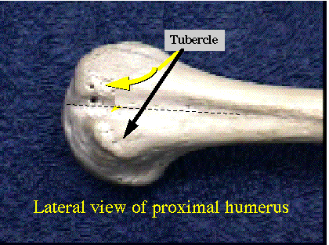
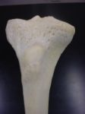
Ligament/Tendon Projections
3) Tubercle: Small rounded projection
4) Tuberosity: large rounded or roughened projection
5) Trochanter: very large, blunt projection
(only on femur)

Slide 8
Ligament/Tendon Projections
6) Spine: Sharp, pointed projection
Thoracic Vertebrae

Slide 9
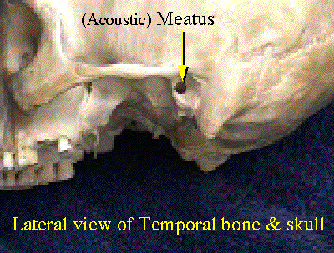
DEPRESSIONS
Allow blood vessels or nerves to pass through.
1) Meatus: Canal or tube

Slide 10
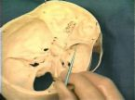
Depressions
2) Fossa: shallow basin
3) Fissure: narrow, slit-like opening

Slide 11
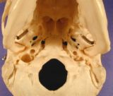
Depressions
4) Sinus: Cavity within a bone; filled with air and lined with mucous membranes
5) Foramen: Round or oval opening
Foramen Magnum

Slide 12
Depressions
6) Sulcus, Groove or Furrow: a shallow depression

Slide 13
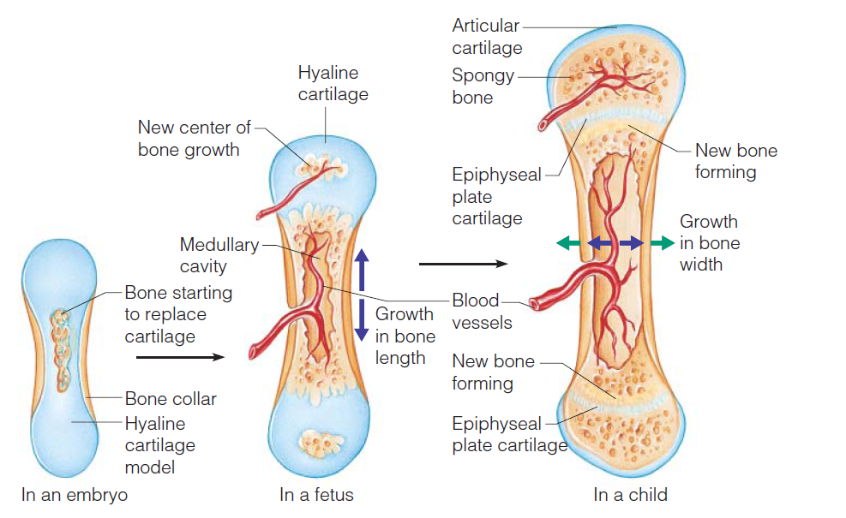
Long Bone Formation and Growth

Slide 14
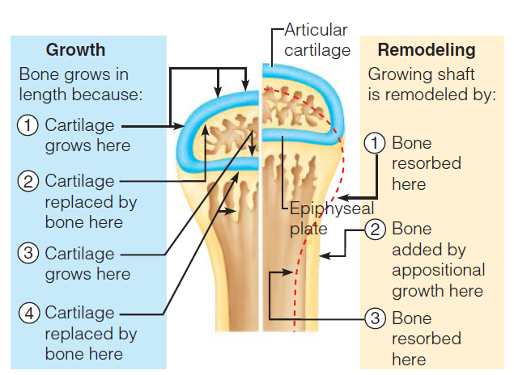
Long Bone Formation and Growth

