Slide 1
An-Najah National University
Faculty of Medicine
Department of Physiology
Anatomy and Physiology 1
7102101
Instructor: Heba Salah
Chapter 4:
The Muscular System
Part 1: Overview of Muscle Tissue.

Slide 2
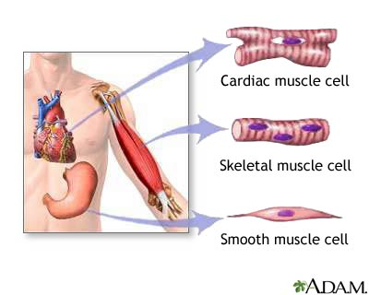
The Muscular System
Muscles are responsible for all types of body movement – they contract or shorten and are the machine of the body
Three basic muscle types are found in the body
Skeletal muscle
Cardiac muscle
Smooth muscle

Slide 3
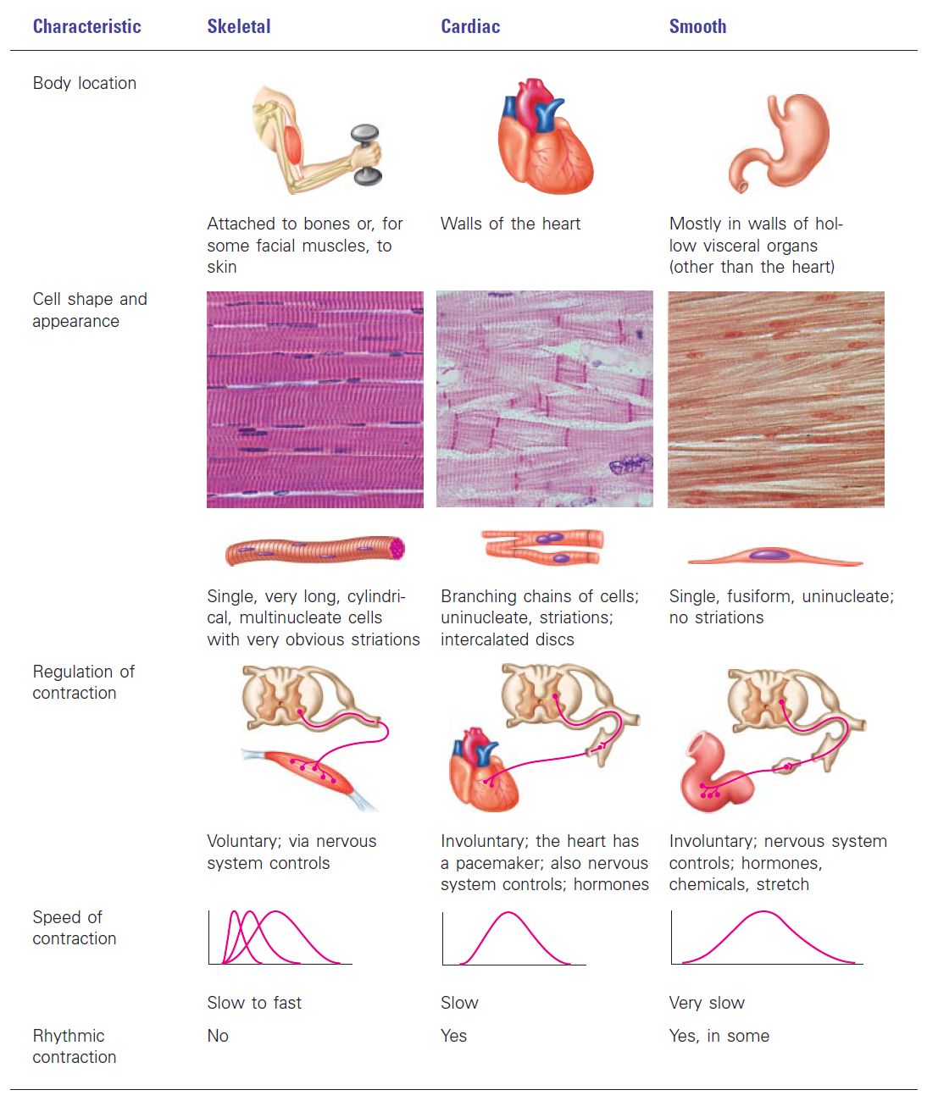
Comparison of Skeletal, Cardiac, and Smooth Muscle

Slide 4
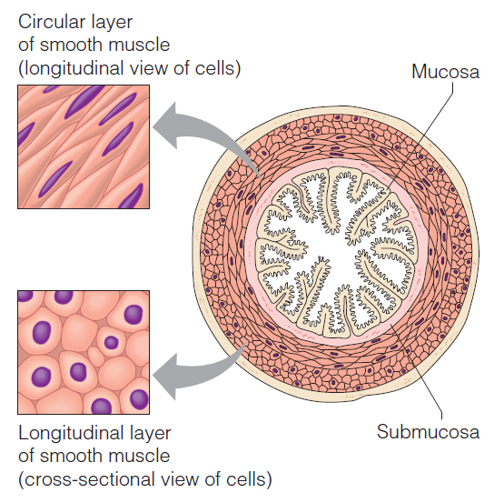
Smooth Muscles Arrangement

Slide 5
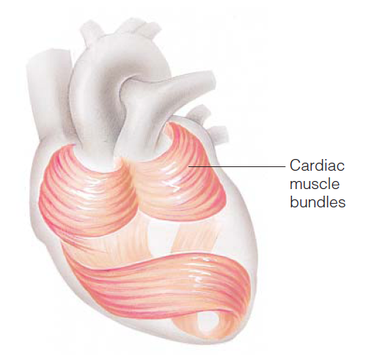
Cardiac Muscles Arrangement

Slide 6
Function of Muscles
Produce movement
Maintain posture
Stabilize joints
Generate heat

