Slide 1
What is technical writing?
No universally accepted definition
We can recognize technical writing from its characteristics
What are the two main differences between technical and non-technical writing? Explain and give examples
Is it ok to evoke emotional responses in technical documents?
Is it ok to use persuasion in technical writing?
Encyclopedias, directories and handbooks.. What do they share with technical writing?
Is it necessary to have equations in technical writing?
Who writes technical documents?

Slide 2
What are the two main differences between technical and non-technical writing? With examples
Precision and intent
Precision: “Syntax is destiny”
Examples of precision: device, chemical formula in a nuclear plant, Nasa Mariner1 Venus satellite story.
Precision is important in other types of writing but it is more important here, why? consequences.

Slide 3
intent: Deliver correct technical information precisely.
No intent to evoke emotional response
Examples of writing that evokes emotional response: poetry, prose, news reporting, advertisement and lawsuits.
technical writing may include persuasion of opinions, for example, convincing readers that a commonly held view about a topic is incorrect.
Technical writing may include equations (scientific papers) or may not.

Slide 4
Who writes technical documents?
Engineers
Scientists
Architects
Physicians
Lab technicians
Lawyers
Any profession or trade that has technical component
Experts who write technical documents use jargons مصطلحات)) of their discipline
technical professional: a large and flexible collection of any profession or trade where technical writing can occur.

Slide 5
Technical writer / technical professional
Technical writers write technical and software manuals, handbooks, technical guides, online help,….. Etc.
The united states department of labor recognizes technical writing as a distinct job category.
According to the US department of labor: technical writers produce instruction manuals and other supporting documents to communicate complex and technical information easily
Technical writer can be called: technical communicator, documentation specialist, information developer, …. .

Slide 6
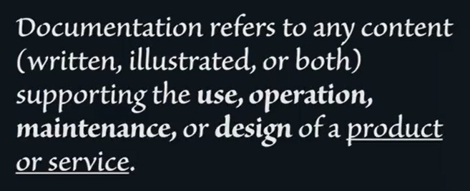
Technical Writer
Technical writers create or gather technical information and then organize it and present it in such a way that is understandable and useful to the defined audience.
Technical writers produce documentation توثيق( printed book, web page, helping software, video, blog, wiki…).

Slide 7
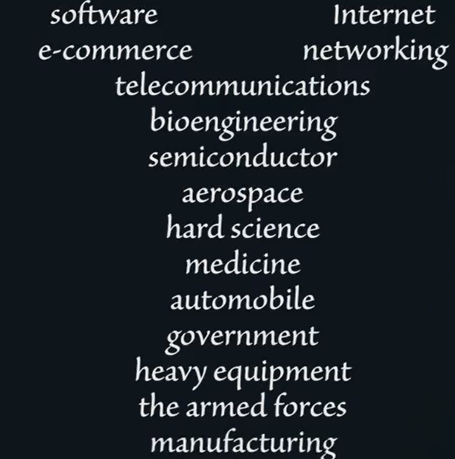
Technical Writers
Technical writers write in a wide range of industries:

Slide 8
Skills needed for a technical writer
Writing skills ( clear and concise manner)
Knowledge in the subject, product or service that needs to be documented (ex: Hardware, software, pharmaceutical, medical documentation)
Ex: Documenting a developer’s guide needs programming knowledge
Knowledge in computer systems and tools needed for documentation (depends on the organization): MS word, adobe frame maker, MadCap flare, Robohelp, PageMaker, Quark
Continuous learning
How to ask questions (interviewing and listening skills)
Find and approach the appropriate SME (subject matter expert)
Design skills: graphics, formatting
Usability and testing of the product: to test if the product works as documented

Slide 9
Taxonomy of technical writing
See figure 1.1 & 1.2 in book
What is meant by pedagogically oriented technical writing? Examples.
What is meant by theoretically oriented technical writing? Examples.
(Ex: Religious studies or English literature research)
writing—professional orientation—serves the needs of various professionals in any discipline.

Slide 10
Technical Reports
What is meant by technical reports?
Give examples.
Common purpose of different types of reports: To convey information in an archival way ( the document is stored and referenced for many years in many cases).

Slide 11
Business Communication
Business communications include a wide range of correspondence that must be written in the course of business activities
Examples
Transmittal letters: A type of cover letter that accompanies a document, such as a financial report

Slide 12
Scientific Writing
Scientific writing includes experimental research and associated documentation and scholarly publications that emerge from that work ( in science or medicine)
Where is it published?
newsletter: a bulletin issued periodically to the members of a society, business, or organization.
Which of these scientific writings need less time to be published? What do you expect?
Authority refers to the reliability of the scientific content (higher if the content is peer reviewed)
Peer review takes many months, thus research papers must have archival quality.
Rapidly changing technical matters must be published in magazines that need less publication time. ( research papers focus on the theory behind the technology rather than the technology, theory tends to change slower than the technology).
consider the trade-off of time to publication versus authority

Slide 13
Books
Books are a way for scientists and engineers to get very wide and archival distribution for their ideas
Textbooks versus books focusing on the professional reader (time-wise)

Slide 14
Journals
venue for publication of important scientific ideas and technical breakthroughs
Widely cited and read journals are preferred
focus more on theory and less on applications because they are intended to be relevant for a long period of time.
Refereeing: reviewing the work by experts to determine if the work is worthy of publication
Who is a referee/reviewer?
open-access journals: faster publication time and lower cost to readers but less authority

Slide 15
Impact Factor (IF)
is a measure reflecting the yearly average number of citations to recent articles published in that journal. Journals with higher impact factors are often deemed to be more important than those with lower ones. The impact factor was devised by Eugene Garfield, the founder of the Institute for Scientific Information. Impact factors are calculated yearly starting from 1975 for journals listed in the Journal Citation Reports.
Source: Wikipedia

Slide 16
Magazines
scientific and technical
What is a community of interest?
Examples
Are magazines’ articles always refereed?
Time of publication compared to journals?
What are readers of magazines usually looking for?

Slide 17
Conferences
Conferences are meetings where researchers present scientific findings, often in preliminary form.
Abstract
Vetting committee
Conference proceedings: presentations at a conference are based on papers that are intended to be published in a transcript of the conference called “conference proceedings”.
conferences are often peer reviewed

Slide 18
Newsletters
Newsletters are informal publications produced by some community of interest
Fast turnaround
Are they usually peer reviewed?

Slide 19
Websites and blogs
Dedicated websites
Instantaneous publication
Are they peer reviewed?
Are they accurate?

