Slide 1
An-Najah National University
Faculty of Medicine
Department of Physiology
Anatomy and Physiology 1
7102101
Instructor: Heba Salah
Chapter 7:
The Urinary System
Part 1: Kidney Location and Structure, and Nephron

Slide 2
Functions of the Urinary System
1. Elimination of waste products
2. Regulate aspects of homeostasis
Water balance
Electrolytes
Acid-base balance in the blood
Blood pressure
Red blood cell production
Activation of vitamin D

Slide 3
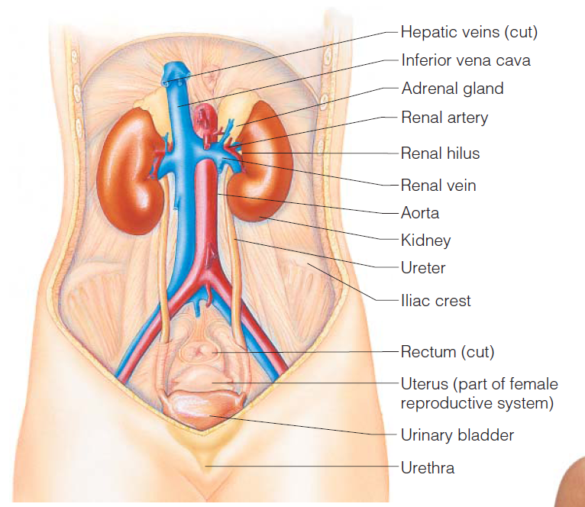
Organs of the Urinary system
Kidneys
Ureters
Urinary bladder
Urethra

Slide 4
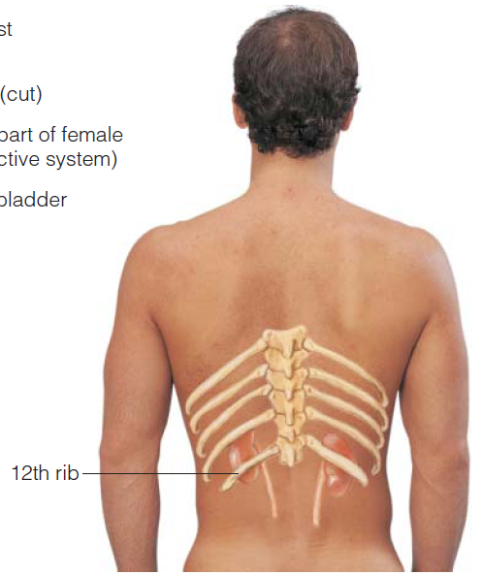
The Kidneys
Against the dorsal body wall
At the level of T₁₂ to L₃
The right kidney is slightly lower than the left
Attached to ureters, renal blood vessels, and nerves at renal hilus
Atop each kidney is an adrenal gland

Slide 5
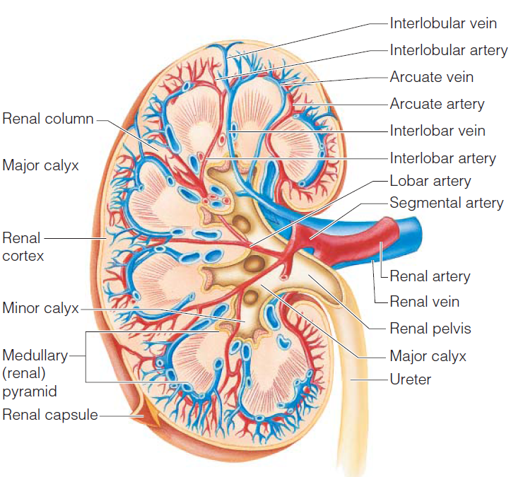
Regions of the Kidney
Renal cortex – outer region
Renal medulla – inside the cortex
Renal pelvis – inner collecting tube

Slide 6
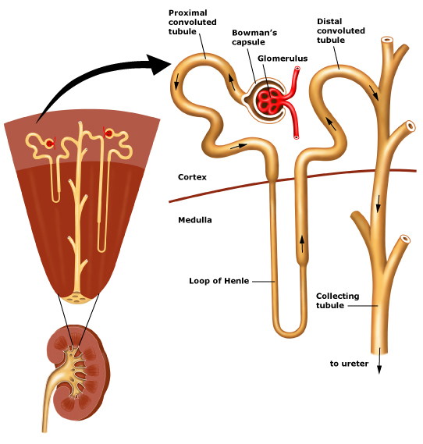
Nephrons
The structural and functional units of the kidneys
Responsible for forming urine
Main structures of the nephrons
Glomerulus
Renal tubule

Slide 7
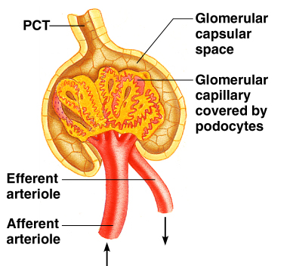
Glomerulus
A specialized capillary bed
Attached to arterioles on both sides (maintains high pressure)
Large afferent arteriole
Narrow efferent arteriole

Slide 8
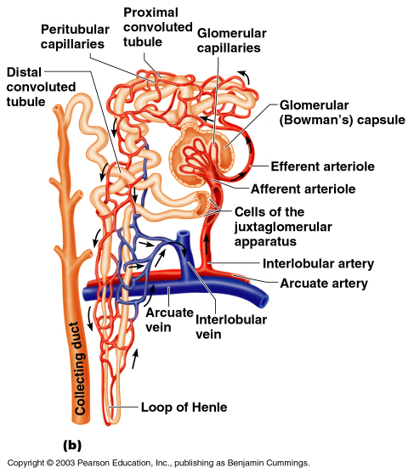
Renal Tubule
Glomerular (Bowman’s) capsule
Proximal convoluted tubule
Loop of Henle
Distal convoluted tubule

Slide 9
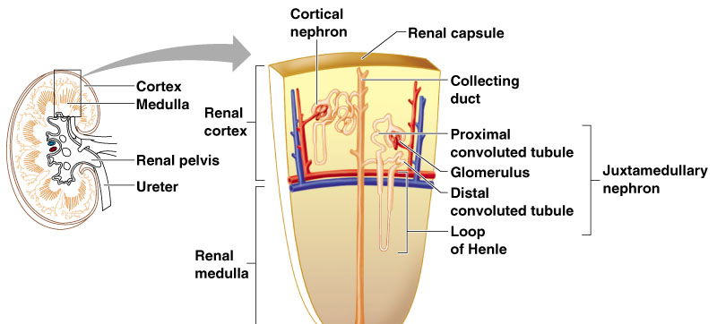
Types of Nephrons
Cortical nephrons
Juxtamedullary nephrons

Slide 10
Peritubular Capillaries
Arise from efferent arteriole of the glomerulus
Normal, low pressure capillaries
Reabsorb (reclaim) some substances from collecting tubes

