Slide 1
ADME
Dr Basma Damiri
Toxicology
105447

Slide 3
In general, a toxicant should be absorbed in order to have an effect. True or false? Why?
False
Some toxicants are locally toxic or irritating such as acids can cause serious dangerous to the skin even though it is not absorbed through the skin

Slide 4
Significance of Target Tissue
Where does lead bioaccomulate?
skeleton
What are its target tissues?
Kidney, central and peripheral nervous system, hematopoietic system
As cause hemalotic anemia → blood is the target

Slide 5
What is the target tissue or organ?
It is not necessarily the tissue in which toxicant is most highly concentrated.
Examples:
Cd
Pb
Halogenated hydrocarbon

Slide 6
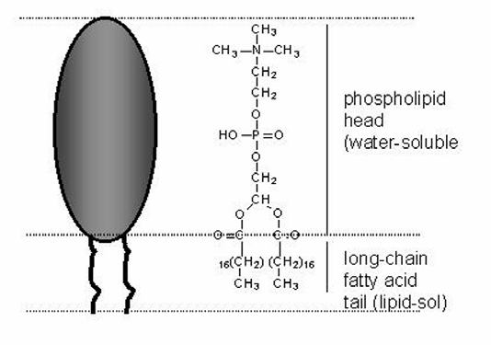
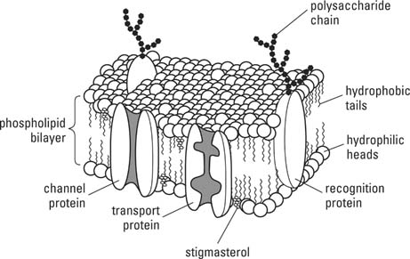
Transfer across membrane barriers
Membrane structure

Slide 7
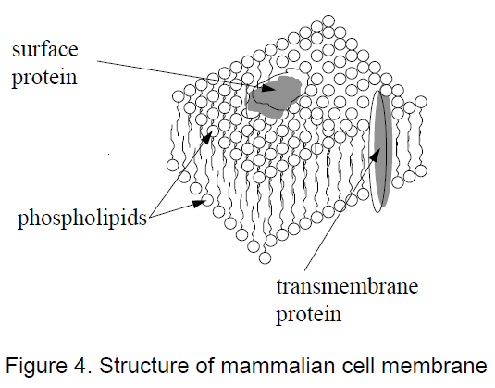
Some of these proteins completely traverse the membrane, providing aqueous channels through the lipid membrane

Slide 8
Small water-soluble molecules and ions can diffuse through these channels,
Lipid-soluble molecules diffuse freely through the phospholipid component of the cell membrane.
Large water soluble molecules cannot readily cross these membranes except by special transport mechanisms.

Slide 9
Proteins can cross, both in absorption and secretion, by a special process called pinocytosis.
Because the majority of the surface area of the cell membrane is phospholipid, lipid-soluble compounds cross the cell membrane much faster (i.e., at greater rates) than do water-soluble compounds which are restricted to crossing the membrane only where protein channels occur.

Slide 10
In general
lipid-soluble compounds are absorbed from the ody's surfaces at faster rates (usually much faster) than water-soluble compounds, unless the water-soluble compound crosses the cell membrane by a specialized transport mechanism.

Slide 11
Molecules can traverse membranes by three principal mechanisms:
Passive diffusion
Most toxicants pass by passive diffusion.
Does not require ATP
Factors regulate determine the rate of it:
Depends on concentration gradient
The ease at which a molecule can pass or move through a lipophilic interior of the membrane and this depends on:
The lipophilicity or lipid solubility, partition coefficient
Molecular size: ↑ M size→ ↓ rate of movements across membrane
Degree of ionization

Slide 12
Lipid solubility is expressed as
Partition coefficient Kow:
The concentration of a chemical in the organic phase / concentration of the chemical in water phase
In general, as the lipophilicity increases , the Kow increases as so does ease the movements through the membrane
Extremely lipid soluble compounds do not dissolve in GI fluid and therefore, their absorption is low.

Slide 14
Degree of ionization
Weak organic acids and bases can be ionized in solutions.
Dissociation constant pK:
The pH at which a week organic acid or base is 50% is ionized .
The pKa is the negative logarithm of the acid dissociation constant. If, for example, the acid dissociation constant Ka is 10–3, then the pKa is 3.

Slide 15
Many toxicants are weak acids or weak bases and exist in solution as a mixture of ionized (protonated) and nonionized forms.
The less polar,nonionized forms are usually more lipid-soluble and are the forms that will diffuse rapidly across a lipoid membrane.
The proportion of a toxicant that exists in the nonionized form depends on the dissociation constant of the compound and on the pH of the solution in which it is dissolved.

Slide 16
The relationship is given by the Henderson-Hasselbach equation:
for a weak acid: pKa - pH = log [nonionized]/ [ionized]
for a weak base: pKa - pH = log [ionized] / [nonionized]
Make sure that you know how to use these equations.

Slide 17
Answer these questions:
What happens when the pH is
equal to the pKa? 50% of the toxicant is ionized and 50% is not ionized.
less than the pKa? Acids are less completely ionized
Greater than the pKa? Bases are less completely ionized

Slide 18
2- Facilitated diffusion
Does as passive diffusion but faster and requires carriers
For most essential nutrients
Does not require ATP but Requires a carrier protein
Limited by the # of carriers → has maximum rate
Question??
How can we inhibit the transverse of carrier x that cross membrane by facilitated diffusion?
By agent that can compete binding to a carrier,
By agent that can affect the carrier in some way.

Slide 19
Only very small ionized molecules can pass through membrane pores.
Large non-ionized molecules are able to pass the membrane
Large ionized forms are too large to pass through the water pores and are insufficient lipophilic to be transferred by passive diffusion.

Slide 20
Active transport
Requires ATP.
Transvers nutrients and excretion of toxic chemicals and their metabolites.
At least, two active transport processed in the kidney for secretion into the urine: one for organic acids and one for organic bases.
At least, 4 active transport processes in the liver: one for acids, one for bases, one for neutral compounds, and one for metals).

Slide 21
Important
Active transport is critical to conservation and regulation of body's’ supply of essential nutrients and the excretion of toxic chemicals and their metabolites

Slide 22
Specialized active transport:
In the placenta, kidney, and the intestine. Why?
Think about essential nutrients (EN)! Reabsorption of EN
Phagocytosis→ Particularly in respiratory system in the alveoli of lungs, reticuloednothelial cells in the liver and the spleen
Pinocytosis.

Slide 23
The distribution and excretion of toxicants depends on:
1. water compartments in the tissues of the body
2. lipid compartments in the tissues of the body
3. macromolecular binding
4. passage through placenta
5. passage in brain and cerebrospinal fluid
6. rate of pulmonary excretion
7. rate of renal excretion
8. rate of biliary excretion
9. rate of metabolism
10. lactation, perspiration, salivation, lachrymation; reproductive tract secretions

