Slide 1
An-Najah National University
Faculty of Medicine
Department of Physiology
Anatomy and Physiology 1
7102101
Instructor: Heba Salah
Chapter 1:
The Human Body: An Orientation
Part 1: An overview of anatomy and physiology, Levels of structural organization

Slide 2
Anatomy Vss. Physiology
Anatomy: the study of the structure and shape of the body and body parts and their relationships to one another.
Physiology: is the study of how the body and its parts work or function.

Slide 3
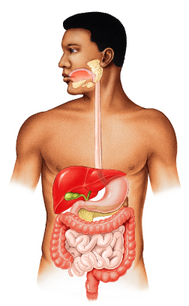
Anatomy: Levels of Study
:1. Gross Anatomy
Large structures
Easily observable

Slide 4
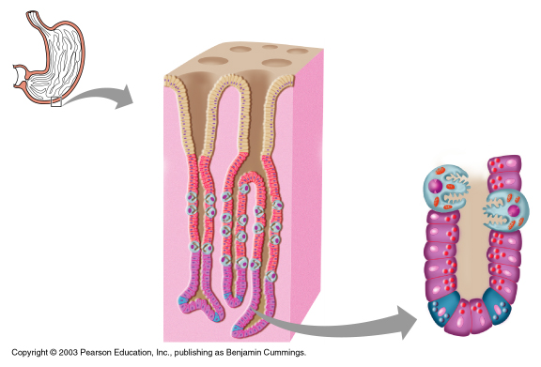
Anatomy: Levels of Study
2. Microscopic Anatomy:
Very small structures
Can only be viewed with a microscope

Slide 5
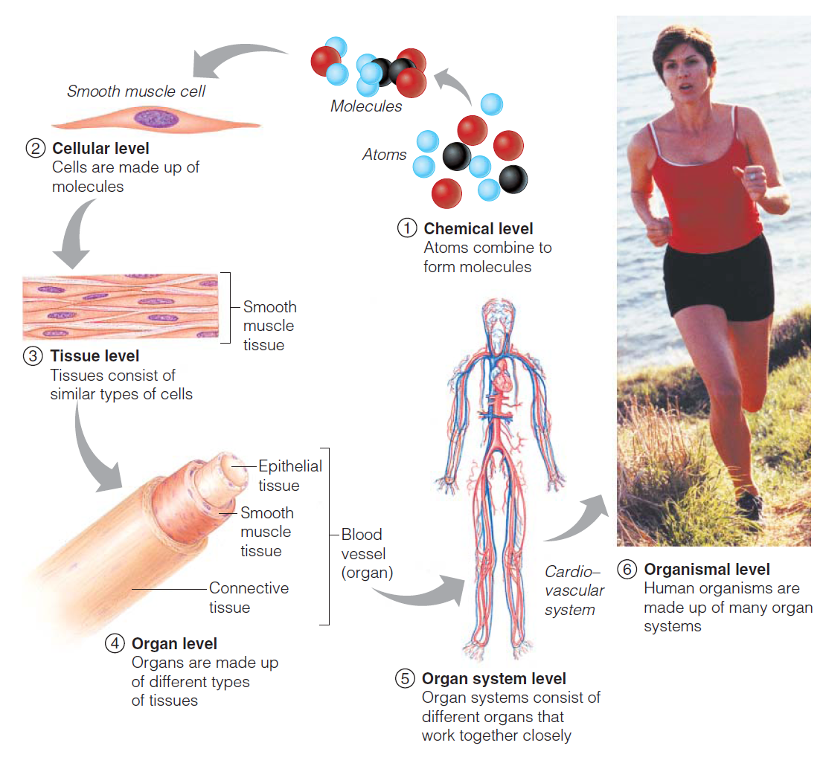
Levels of Structural Organization

