Slide 1
An-Najah National University
Faculty of Medicine
Department of Physiology
Anatomy and Physiology 1
7102101
Instructor: Heba Salah
Chapter 3:
The Skeletal System
Part 1: Bones, An Overview

Slide 2
The Skeletal System
Parts of the skeletal system:
Bones (skeleton)
Joints
Cartilages
Ligaments
Divided into two divisions
Axial skeleton
Appendicular skeleton

Slide 3
Functions of Bones
Support of the body
Protection of soft organs
Movement due to attached skeletal muscles
Storage of minerals and fats
Blood cell formation

Slide 4
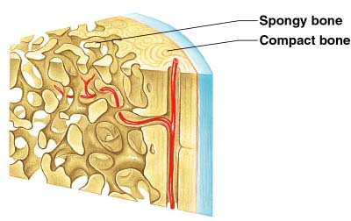
Bones of the Human Body
The skeleton has 206 bones
Two basic types of bone tissue
1. Compact bone
2. Spongy bone

Slide 5
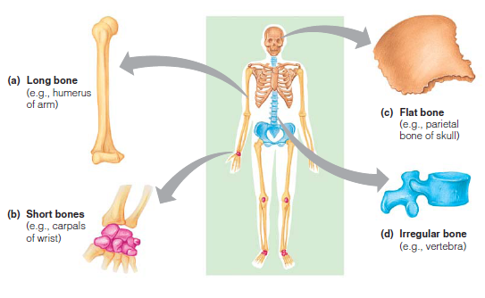
Classification of Bones

Slide 6
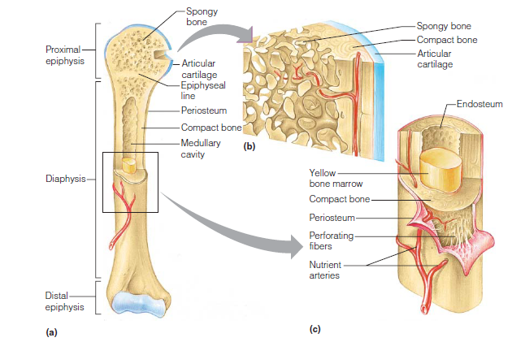
Structure of Long Bones

Slide 7
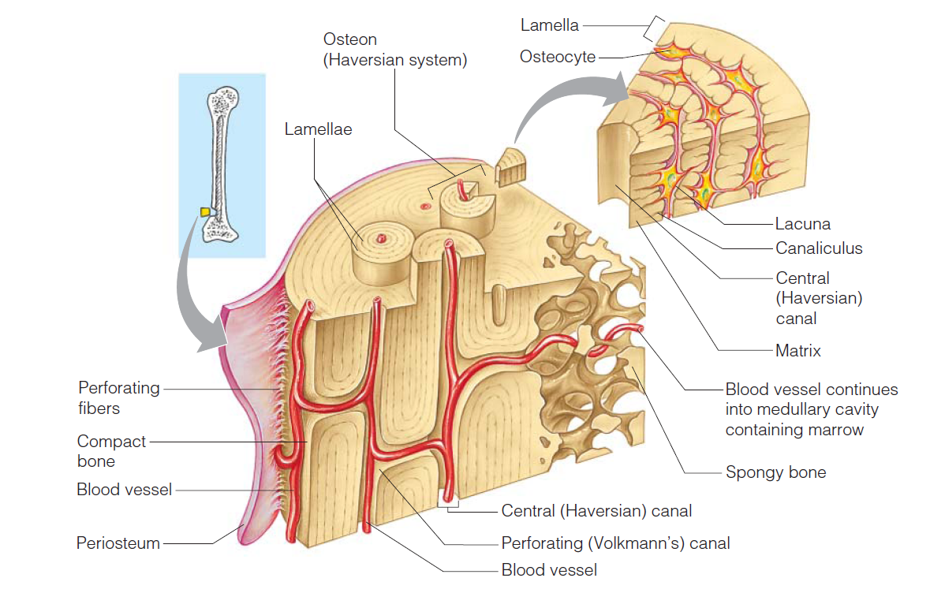
Microscopic Anatomy of Compact Bone

