Slide 1
An-Najah National University
Faculty of Medicine
Department of Physiology
Anatomy and Physiology 1
7102101
Instructor: Heba Salah
Chapter 2:
Cells and Tissues
Part 1: Anatomy of the Generalized Cell: Nucleus, and Plasma Membrane

Slide 2
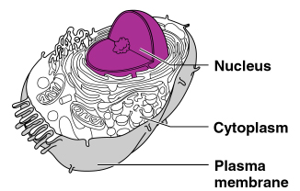
Anatomy of the Cell
Cells are not all the same
All cells share general structures
Cells are organized into three main regions:
Nucleus
Cytoplasm
Plasma membrane

Slide 3
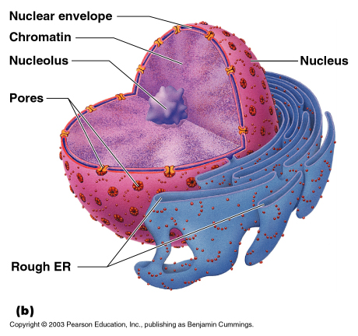
The Nucleus
Control center of the cell
Contains genetic material (DNA)
Three regions
Nuclear membrane
Nucleolus
Chromatin

Slide 4
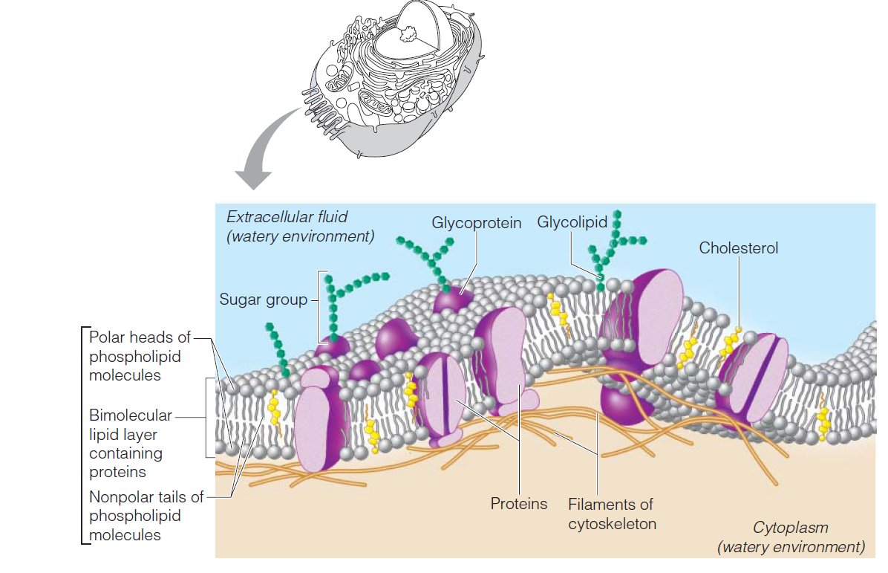
Structure of Plasma Membrane

Slide 5
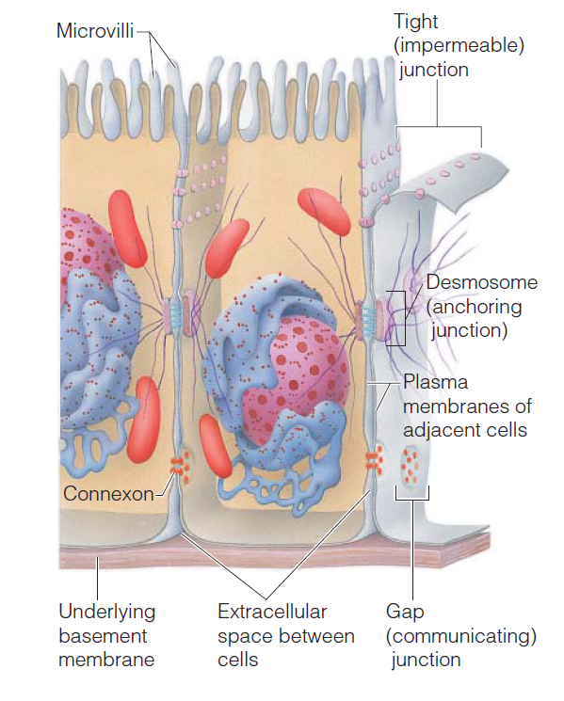
Specialization of the Plasma Membrane
Microvilli:
Finger-like projections that increase surface area for absorption
Membrane junctions:
Tight junctions
Desmosomes
Gap junctions

