Slide 1
An-Najah National University
Faculty of Medicine
Department of Physiology
Anatomy and Physiology 1
7102101
Instructor: Heba Salah
Chapter 2:
Cells and Tissues
Part 6: Body Tissues: Muscle and Nervous Tissue, and Tissue Repair

Slide 2
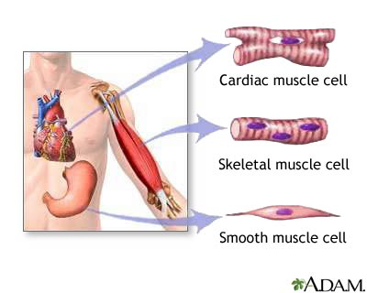
Muscle Tissue
Function is to produce movement
Three types:
Skeletal muscle
Cardiac muscle
Smooth muscle

Slide 3
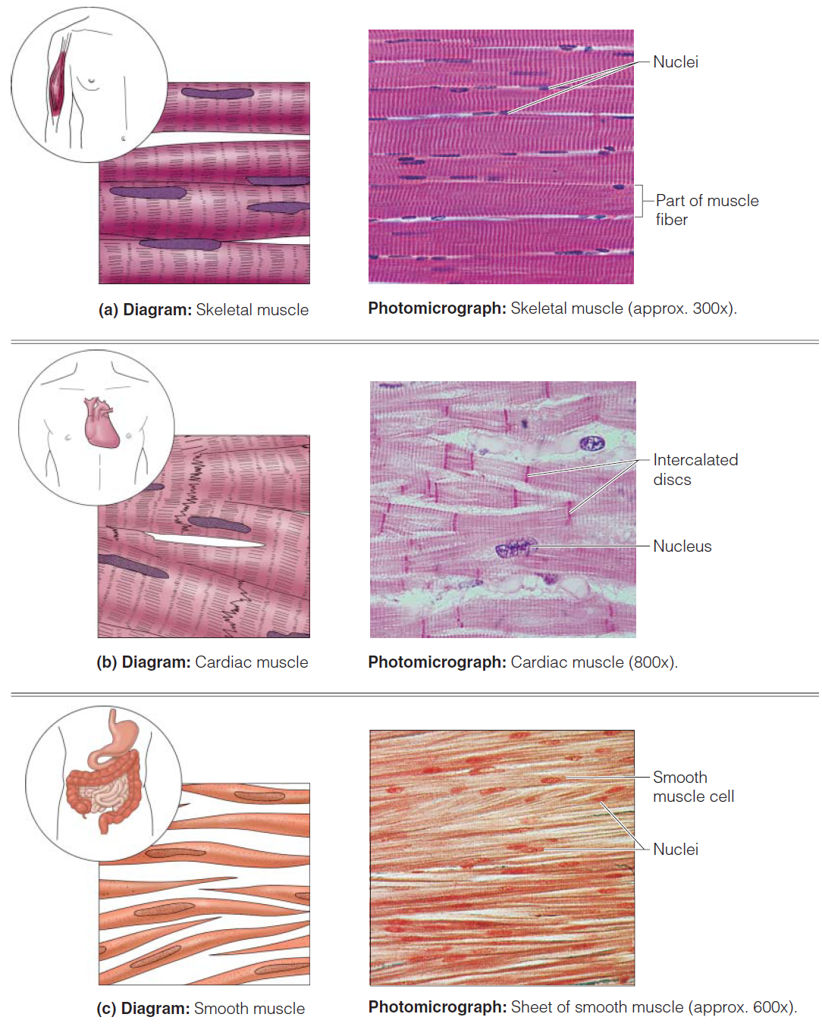
Muscle Tissue Types

Slide 4
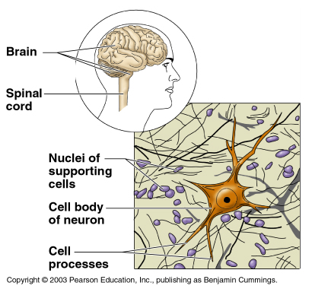
Nervous Tissue
Neurons and nerve support cells
Function is to send impulses to other areas of the body
Irritability
Conductivity

Slide 5
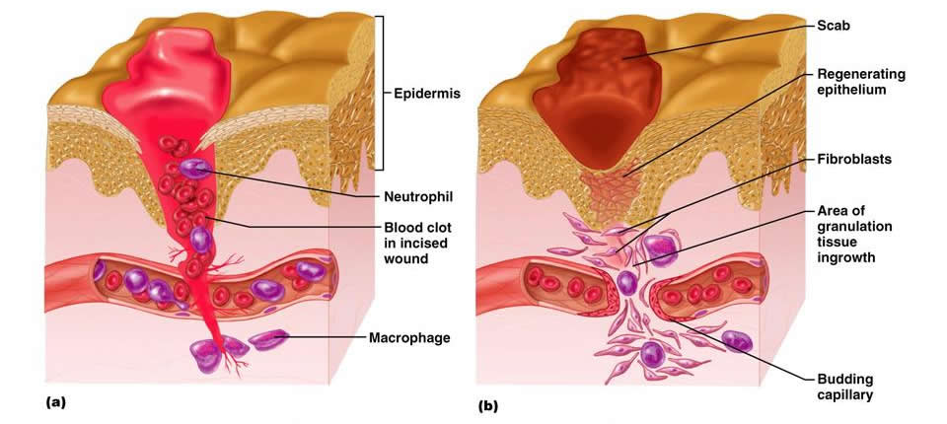
Tissue Repair
Types of tissue repair:
1. Regeneration: Replacement of destroyed tissue by the same kind of cells
2. Fibrosis: Repair by dense fibrous connective tissue (scar tissue)

Slide 6
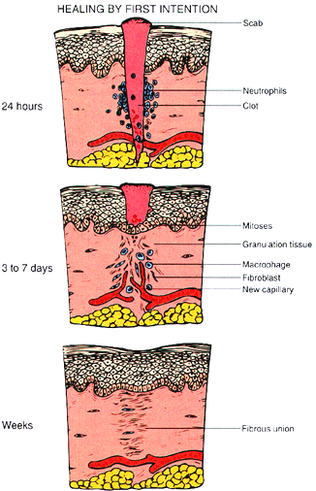
Events in Tissue Repair
1. Capillaries become very permeable
2. Formation of granulation tissue
3. Regeneration of surface epithelium

