Slide 1
An-Najah National University
Faculty of Medicine
Department of Physiology
Anatomy and Physiology 1
7102101
Instructor: Heba Salah
Chapter 7:
The Urinary System
Part 2: Urine Formation

Slide 2
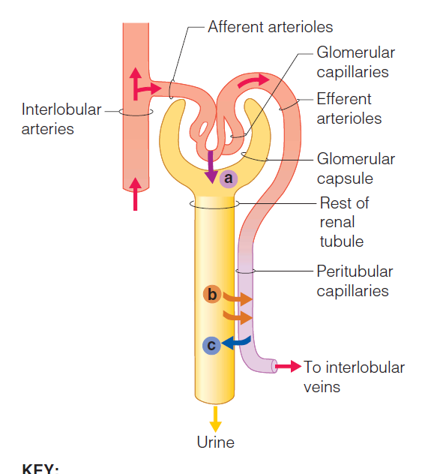
Urine Formation Processes
Filtration
Reabsorption
Secretion

Slide 3
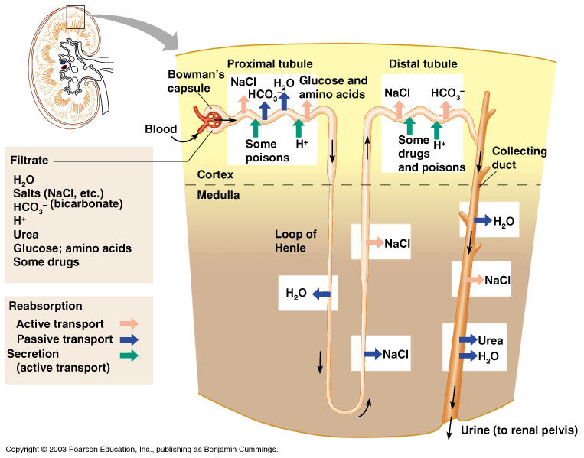
Formation of Urine

Slide 4
Characteristics of Urine Used for Medical Diagnosis
Colored somewhat yellow due to the pigment urochrome (from the destruction of hemoglobin) and solutes
Sterile
Slightly aromatic
Normal pH of around 6 (varies 4.5-8)
Specific gravity of 1.001 to 1.035

