Slide 1
Anthropometric measurements
Instructor: Alma Irshaid, MSc, ANutr

Slide 2
Learning outcomes
Demonstrate ability to accuretly measure anthropometric parameters.
Differentiate between the different uses of each measure.
Demonstrate the ability to calculte indecies.
Evaluate the factors that need to be considered for each measure.

Slide 3
Anthropometry
Anthropos “human” Metron “measurement”
Anthropometry is a quantitative measurement of the size, weight, and proportions of the human body and it is one of the most important means of nutritional assessment.
Note: 1.These measurements are used to assess both under and over-nutrition.
2. Measured Values reflect only current nutritional status and does not differentiate between acute and chronic changes.

Slide 4
Use of anthropometry
Individual level
Screening “One-time Assessment”
To immediately decrease case fatality “Emergency situation”
Non-Emergency situations.
Research
Growth Monitoring.

Slide 5
Use of anthropometry
Population Level
One-Time Assessment
Under circumstances of food crisis
For long term planning
- Nutritional Surveillance “Trend Assessment”
1. Long term planning 2. Timely warning 3. Program management.

Slide 6
Technique of measuring people
Measure
Index
Reference
Indicator
Classification

Slide 7
Techniques
1. Measurements: Using anthropometric tools to obtain raw values.
2. Reference values: Compare with National & International standards.
3. Index : Derived from two measurements or a measurement and a reference (e.g.: BMI, Height-for- age). Computed or tables , Age and gender dependent/Independent.
4. Indicator: an index combined with a cut-off point (e.g. Height for age < -2 z score)
5. Classification: Grading of Nutritional Status.

Slide 8
Advantages
Methods are precise and accurate, provided standardized techniques are used.
Procedures use simple, safe and non-invasive techniques.
Equipment required is inexpensive, portable and durable, and can be made or purchased locally.
Relatively unskilled personnel can perform measurement procedures.
Can be used to quantify the degree of under-nutrition (or over-nutrition)
Suitable for large sample sizes such as representative population samples.
Can be used to monitor and evaluate changes in nutritional status over time, seasons, generations, etc.
Adapted to develop screening tests to identify those at high risk.

Slide 9
Disadvantages
The relative insensitivity to detect changes in nutritional status following inadequacy of food over short periods of time.
The inability to distinguish the effect of specific nutrient deficiencies (e.g. zinc deficiency) that affect growth in children from that due to inadequacy of food in general.

Slide 10
Characteristics we need:
Easy
Cheap
Acceptable
Reproducible

Slide 11
Measurements : Weight/Body Mass
Sensitive to changes (acute)
Changes in two directions up and down
Usually easy to collect
Standardisation of scales needed “calibration”
Small changes are difficult to measure: food intake of the child, urine, dehydration, temp, etc: not very specific.
Usually measured to nearest 100 gr.
Tool used : Scale/Balance

Slide 12
Should be measured to the nearest 10 g (0.01 kg)

Slide 14
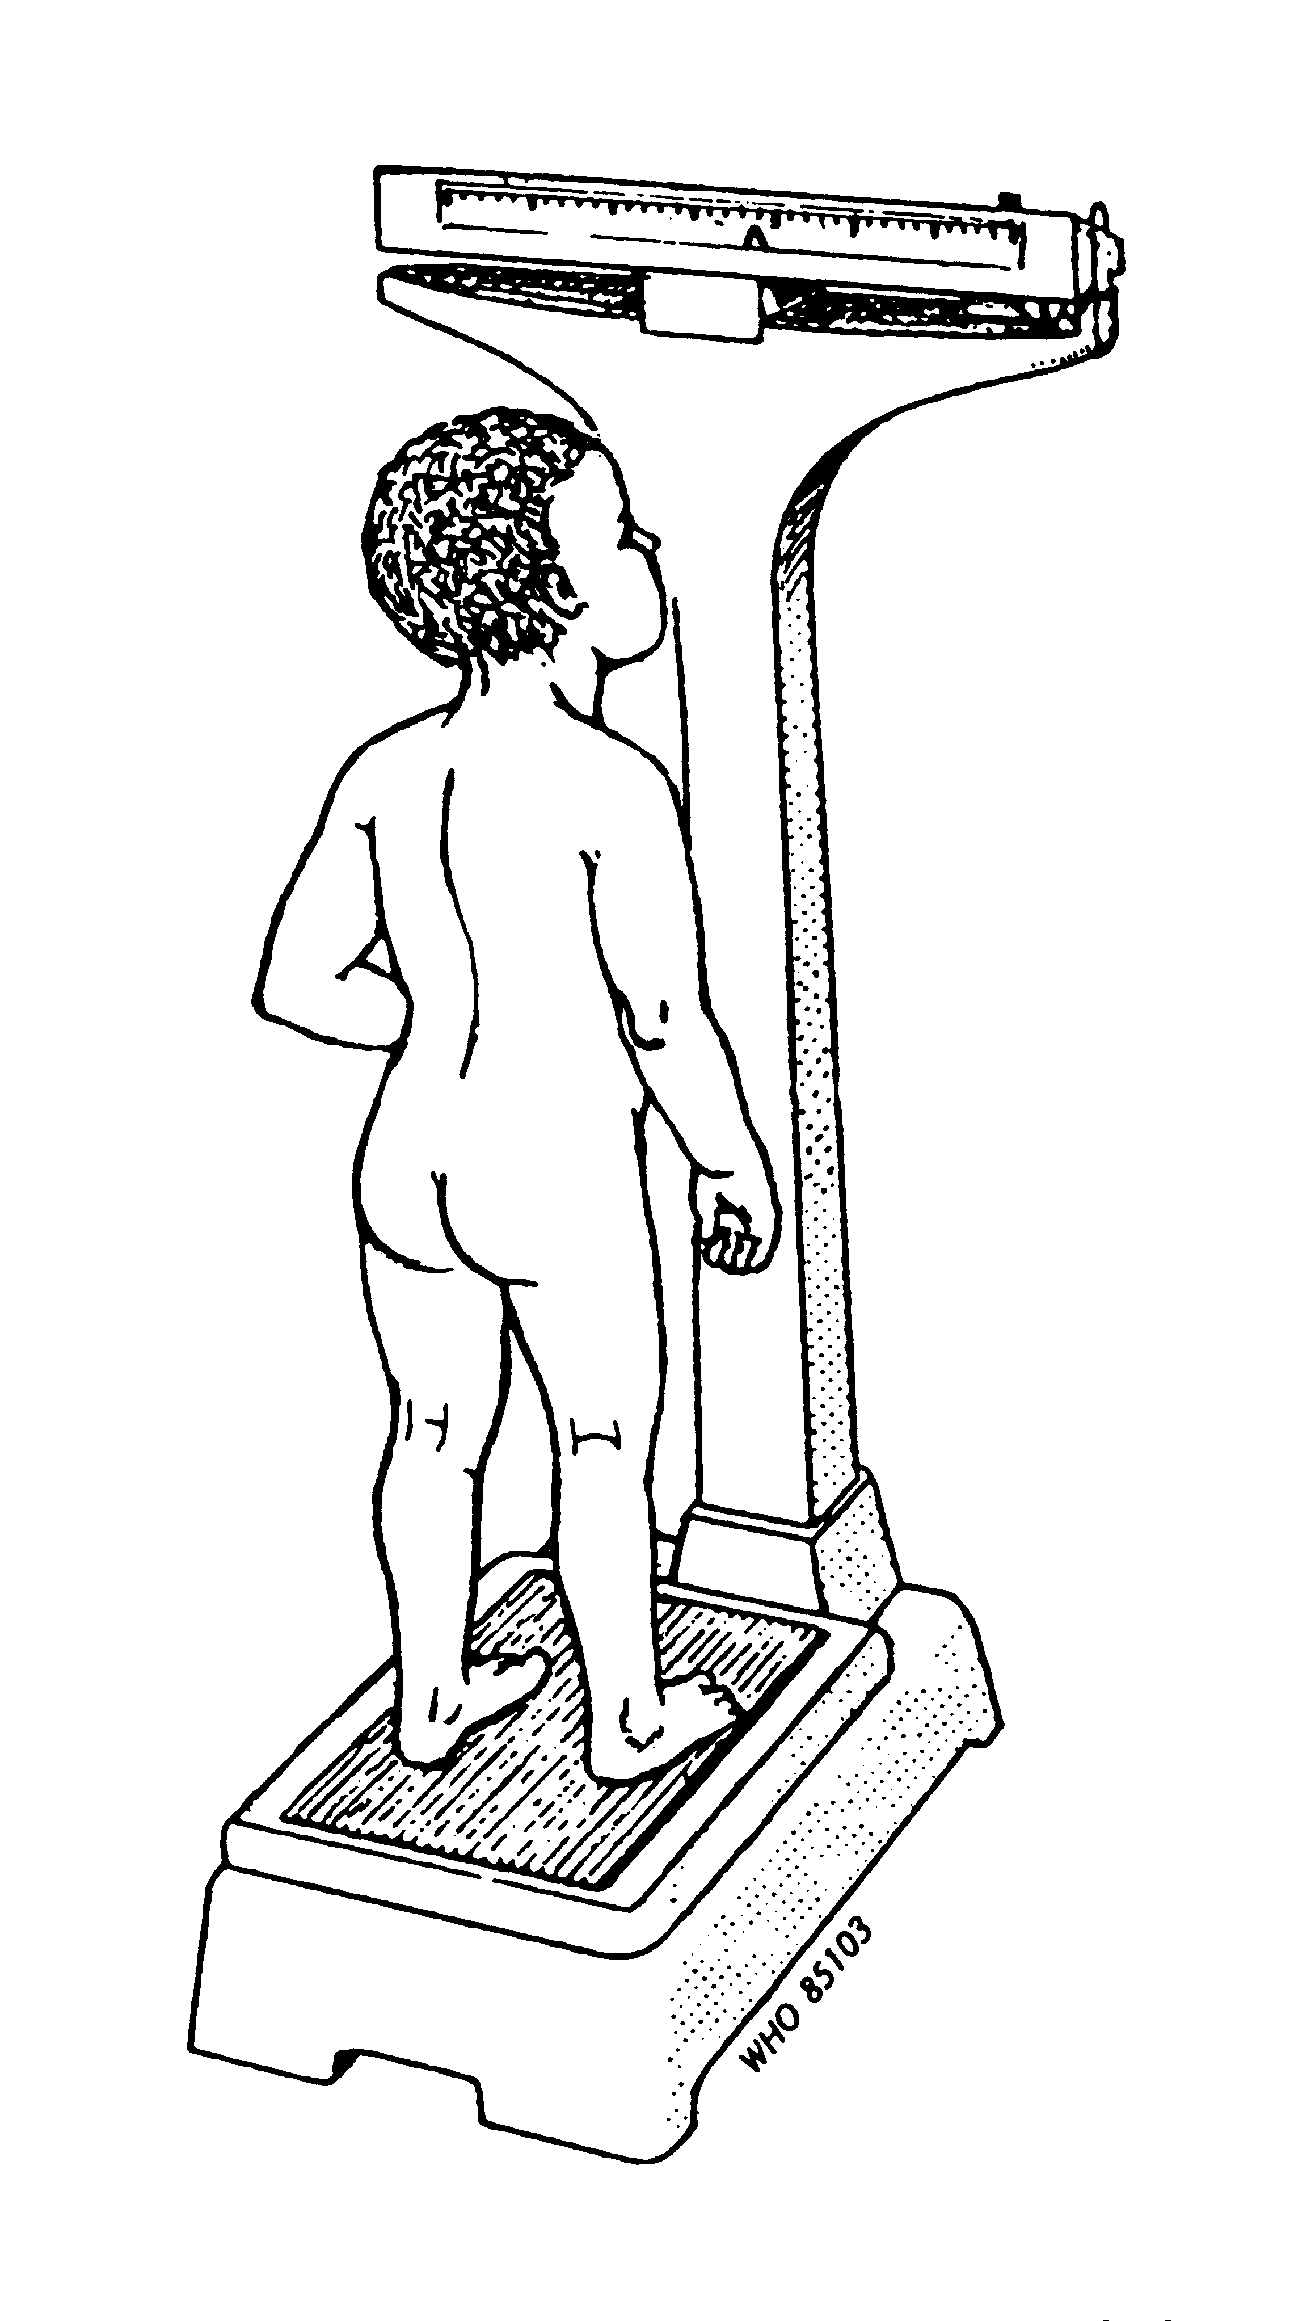

Slide 15
Weight
Actual body weight (ABW): Weight measurement at time of examination. Highly affected by fluid status. Usual body weight (UBW): Baseline weight. Ideal body weight (IBW):
“a weight that is believed to be maximally healthful for a person, based chiefly on height but modified by factors such as gender, age, build, and degree of muscular development.

Slide 16
Ideal Body Weight
As a role of thump, these equations can be used for rough estimation of IBW:
Women IBW = 100 Ib for the first 5 ft. of height + 5 Ib for every inch over 5 ft.
Men IBW= 106 Ib for the first 5 ft. of height + 6 Ib for every inch over 5 ft.

Slide 17
Relative weight(RW)
Significant weight loss:
• 2% lossin1week.
• 5% loss in 1 month.
• 7.5% loss in 3 months.
• 10% loss in 6 months.
Severe weight loss:
o > 2% in 1 week.
o > 5% in1 month. o > 7.5% in 3 months.
o > 10% in 6 months.
Patients with weight within 85% to 90% of UBW:
Mild malnutrition
Patients with 75% to 84% of UBW:
Moderate malnutrition
Patients with weight less than 74% of UBW:
Severe malnutrition

Slide 18
Non-ambulatory persons
Persons who cannot stand unassisted on a scale can be weighed in a bed scale or wheelchair scale.
The subject to be weighed in the bed scale is comfortably positioned in the weighing sling, which then is gently raised until the subject is suspended off the bed.
In a chair scale, the subject sits upright in the center of the chair while leaning against the backrest.
Using either method, once the subject is still, weight can be read and recorded to the nearest 100 g (0.1 kg)

Slide 19
Measurement: Height
Genetically determined.
Reflects chronic malnutrition ‘Stunting”
Easy, retrospective, cheap and widely used.
Tool used: Stadiometer, measuring rod for direct method.

Slide 22
Height/Indirect method
Arm span : “physical measurement of the length from one end of an individual's arms (measured at the fingertips) to the other when raised parallel to the ground at shoulder height at a 90º angle.
Recumbent length: “length while lying down” generally used for children.
knee height : estimation of height using knee and ankle measurments.
Used to measure individuals’ height/stature who can’t stand up straight like those who have “Paralysis, cerebral palsy , bedridden, kyphosis (curvature of the spine).

Slide 23
Think!
Look up height to weight tables , what are the limkitations?

Slide 24
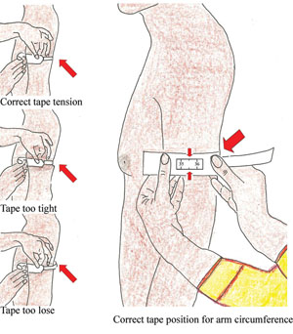
Circumference/Mid-Upper Arm (MUAC):
Defined as mid point between the shoulder and elbow of the left bare arm bent at right angle.
- Reflects muscle/fat.
- Easy to use for quick screening.
- Helps to estimate body composition.
Tool used: measuring tape

Slide 25
MUAC Adults cut-off points

Slide 26
MUAC children cut-off points

Slide 27
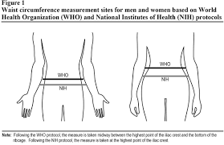
Circumference/Waist
This is obtained by measuring the distance around the smallest area below the rib cage and above the umbilicus with the use of a non stretch tape.
This method asses abdominal fat content.

Slide 28
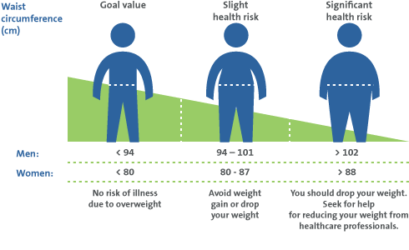

Slide 29
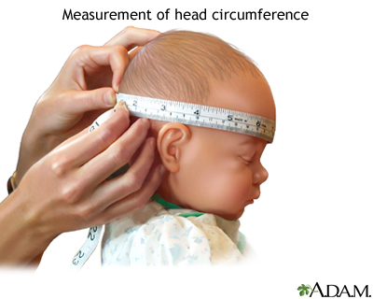
Circumference/Head circumference
This measurement is useful for
children under the age of 3 years.
Usually indicates non-nutritional abnormalities, Under nutrition must be severe to affect head circumference.

Slide 30
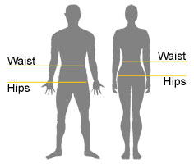
Circumference/ Hip circumference
This measurement is taken at the widest area of the buttock muscle, it is used to obtain the waist-to-hip ratio.

Slide 31
Skin fold thickness

Slide 32
Skin Fold thickness
Measurement of folds of skin and fat taken from several specific locations on the body to estimate total body fat on the assumption that 50% of body fat is subcutaneous. Accuracy decreases with increasing obesity.
This method is performed by grabbing skin with thumb and forefinger about 0.5 inch away of determined measurement site and then caliper is applied and reading is done after 4 seconds.

Slide 37
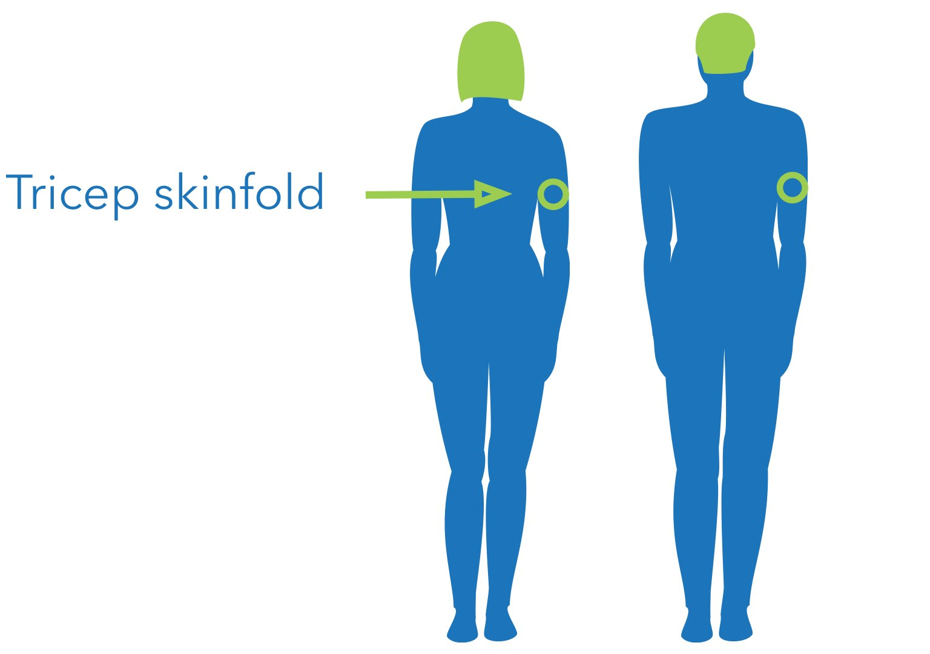
Skin Fold Thickness
Tool: Special skin fold caliper and recorded by (mm).
1. Triceps skinfold
Along the midline on the back of the triceps of the right arm, determine the midpoint located between the top of the acromial process (top of the shoulder) to the bottom of the olecranon process of the ulna (elbow).
Pinching the skin should be vertically.

Slide 38
Skin fold thickness
2. Biceps skinfold
- Located on the anterior midline of the right upper arm 1 cm higher than the level used to mark the triceps site.

Slide 39
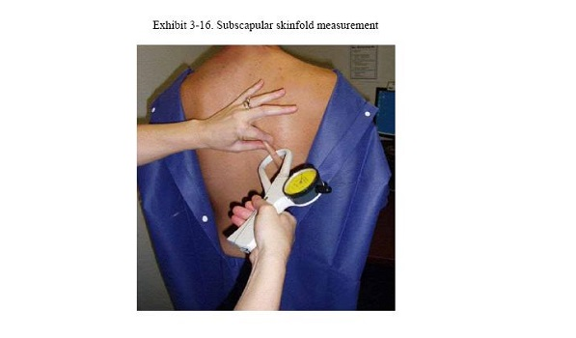
Skinfold thickness
3.Subscapular skinfold
This is measured at the inferior angle of right scapula

Slide 40
Skinfold thickness
4.Suprailiac Skinfold
- Diagonal fold
- Located 1 cm above the anterior superior iliac crest (top of the hip bone)
- Locating this landmark may require you to ‘poke’ firmly through thick subcutaneous layers of fat to find the bone underneath.

Slide 41
Skinfold thickness
Four skin fold thickness measurements (biceps, triceps, subscapula and suprailiac) are summed and then entered into special equations or compared with reference tables to estimate percent body fat.

Slide 42
Skin fold
5. Chest/ opectoral skinfold site
Measured using a skinfold with its long axis running from the top of the anterior axillary fold to the nipple.
The skinfold is grasped as high as possible on the anterior axillary fold, and the thickness of the fat fold is measured 1 cm.
below the fingers along the axis
The skinfold site is the same for males and females.
Other than to help determine the long axis of the skin- fold, the nipple is not used as a landmark for either males or females.

Slide 43
Skin fold thickness
6. Mid-axillary line
This site is at the right midaxillary line (a vertical line extending from the middle of the axilla)
It is measured with the subject standing erectly and with the right arm slightly abducted (moved away from center of the body) and flexed (bent posteriorly)

Slide 44
Skin fold thickness
7. Abdomen
The subject stands erectly with the body weight evenly distributed on both feet, abdominal muscles relaxed, and breathing quietly.
A horizontal skinfold 3 cm to the right of and 1 cm below the midpoint of the umbilicus is measured

Slide 45
Skin Fold thickness
8. Thigh
This site is a vertical skinfold along the midline of the anterior aspect of the thigh
Flexing the subject’s hip helps locate the inguinal crease.
The subject shifts the weight to the left foot and relaxes the leg being measured by slightly flexing the knee with the foot flat on the floor.

Slide 46
Skin fold thickness
9. Mid-calf
With the subject sitting, the right leg is flexed about 90 degrees at the knee with the sole of the foot flat on the floor.
The measurement also may be taken with the subject standing with the foot resting on a platform, so that the knee and hip are flexed about 90 degrees.
The point of maximum calf circumference is marked at the medial (inner) aspect of the calf. A vertical skinfold is grasped about 1 cm proximal to the marked site and measured.

Slide 47
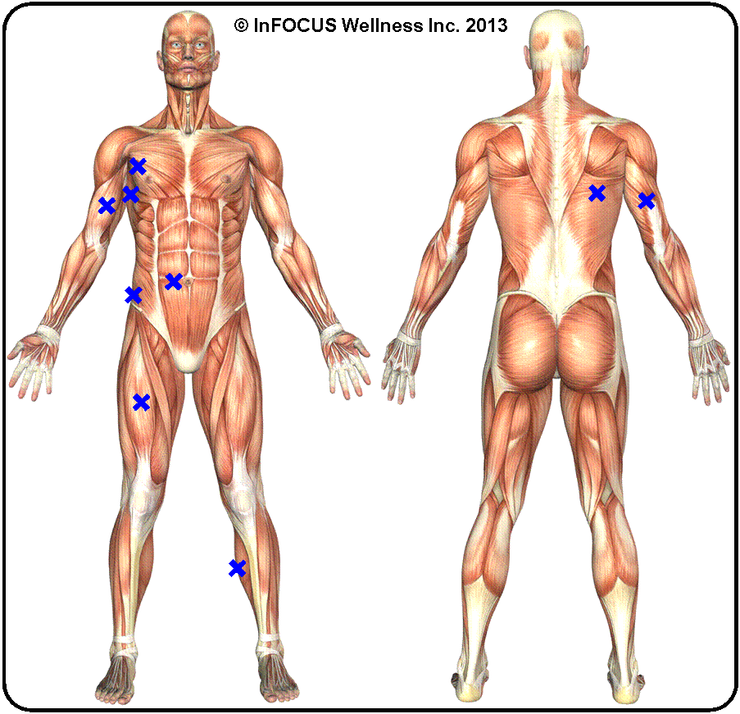
Nine sites of measuring skinfold thickness

Slide 48
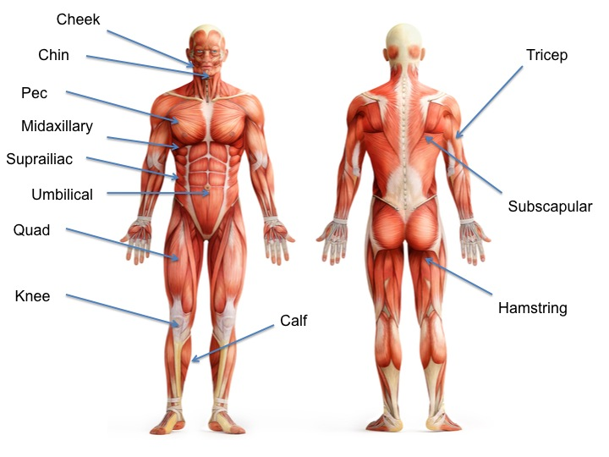

Slide 49
BMI
Index of a person’s weight in relation to height; determined by dividing the weight in (kg) by the square of the height in (m)
BMI = weight (kg)
height (m)²
BMI = weight (lb) x 703
height (in)²

Slide 50
Classification of Overweight and obesity by BMI, waist circumference and associated risk in adults
Disease risk relative to normal weight and Waist circumference
 | BMI (kg/m2) | Obesity Class | Men < 102 cm Women < 88 cm | Men > 102 cm Women > 88 cm
Underweight | < 18.5 |  | - | -
Normal | 18.5 - 24.9 |  | - | -
Overweight | 25-29.9 |  | Increased | High
Obesity | 30-34.9 35-39.9 | Type 1 Type 2 | High Very High | Very high Very high
Extreme Obesity | > 40 | Type 3 | Extremely High | Extremely high

Slide 51
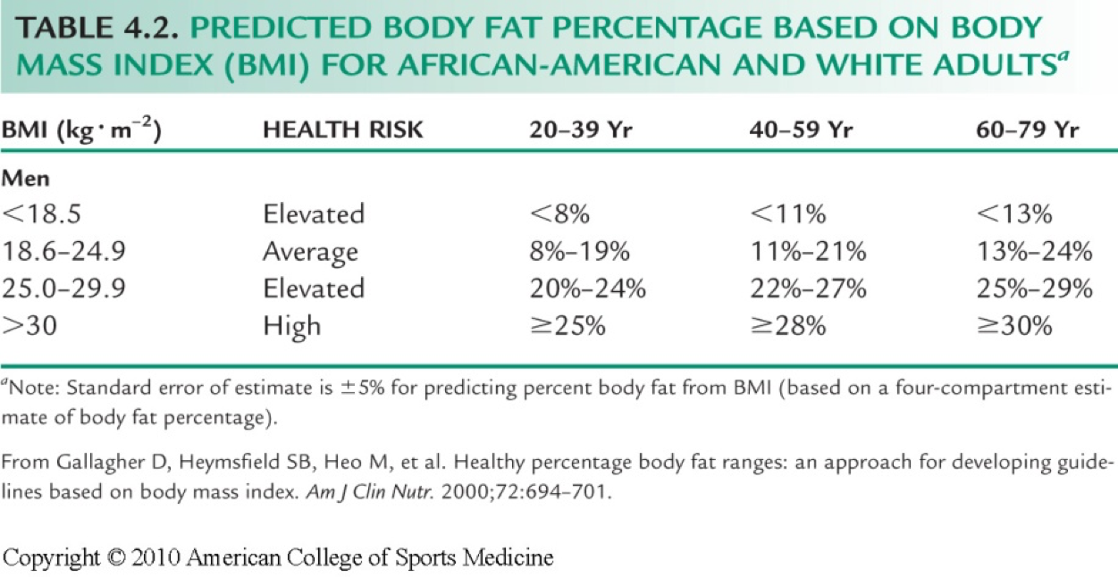

Slide 52
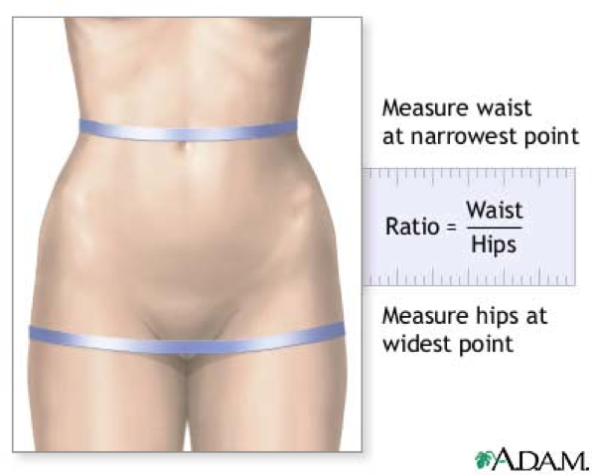
Waist-hip ratio
There is evidence to suggest that excessive fat stored in the intra-abdominal cavity may increase risk of disease. This intra-abdominal fat mass can be reasonably inferred by waist measurement. A high waist: hip ratio= waist circumference (cm) / hip circumference (cm) implies a high degree of central obesity and is a risk factor for ischaemic heart disease.

Slide 53
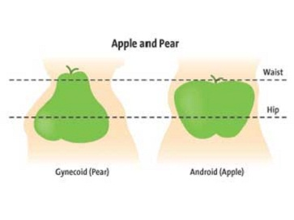
W/H ratio
The pattern of body fat distribution is recognized as an important predictor of the health risks of obesity.
Android obesity, which is characterized by more fat on the trunk (abdominal fat), provides an increased risk of metabolic syndrome compared with individuals who demonstrate gynecoid obesity (fat distributed in the hip and thigh).

Slide 54
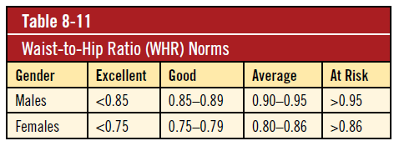
W/H ratio reference

Slide 55
Frame size
Determining the frame size increases accuracy in estimating appropriate weight to height.
The two most common measurements to estimate body frame size are :
Elbow Breadth. (Tables)
Wrist circumference. (Formula)

Slide 56
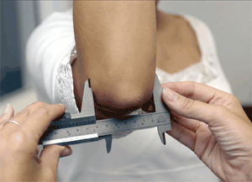
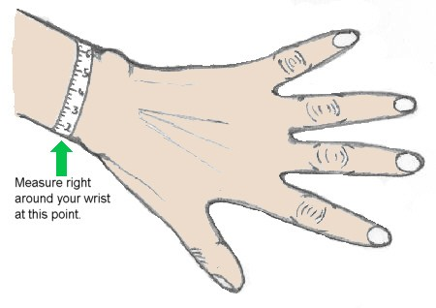
Elbow breadth
Wrist Circumference

Slide 57
Wrist circumference
The following formula is used:
r = H
C
r = ratio of body height to wrist circumference
H = height in (cm)
C = circumference of the right wrist in (cm)

Slide 58
Wrist circumference
Frame Size | r Value
 | Women | Men
Small | > 10.9 | > 10.4
Medium | 10.9 – 9.9 | 10.4 – 9.6
Large | < 9.9 | < 9.6

Slide 60
Other Indices
Other special indices are used in anthropometry to monitor growth patterns like:
Height for age (Stunting)
Weight for age (General status)
Weight for height (Wasting)
Head circumference for age
Chest for head circumference

