Slide 1
Measuring Diet
Chapter 3
Alma Irshaid, MSc

Slide 2
Techniques in Measuring Diet
Measurement of dietary intake usually is conducted for one of three purposes:
Compare average nutrient intakes of different groups.
Rank individuals within a group.
Estimate an individual’s usual intake.
Dietary measurement techniques can be categorized as:
Daily food consumption methods (food record and 24-hour recall)
Recalled “usual” or average food consumption methods (diet history and food frequency questionnaire

Slide 3
24-Hour Recall (Retrospective)
A trained interviewer asks the respondent to recall in detail all the food and drink consumed . The interviewer then records this information for later coding and analysis.
the interviewer helps the respondent remember all that was consumed during the period in question and assists the respondent in estimating portion sizes of foods consumed or activities done.
Foods are coded allowing it to be identified easily for computer analysis.
Occasionally, it can be done for the previous 48 hours, the past 7 days.

Slide 4
Pros and Cons?
Respondents may withhold or alter information about what they ate because of poor memory or embarrassment or to please or impress the interviewer .
Underreport binge eating, alcohol and consumption of foods perceived as unhealthful.
Overreport consumption of name-brand foods, expensive cuts of meat, and foods considered healthful
Foods eaten but not reported are known as missing foods, while foods not eaten but reported are known as phantom foods.
Several researchers report that, when respondents’ actual food consumption is low, they have a tendency to overestimate, and, when their actual consumption is high, they underestimate the amount recalled “flat-slope syndrome.
Energy intake often is underestimated if drinks, sauces, and dressings are not reported.
Inexpensive
Quick (< 20 mins)
Can provide detailed information on specific foods if brand names can be recalled
Requires only short-term memory. It is well accepted by respondents
Does not alter the usual diet
How to increase accuracy?

Slide 6
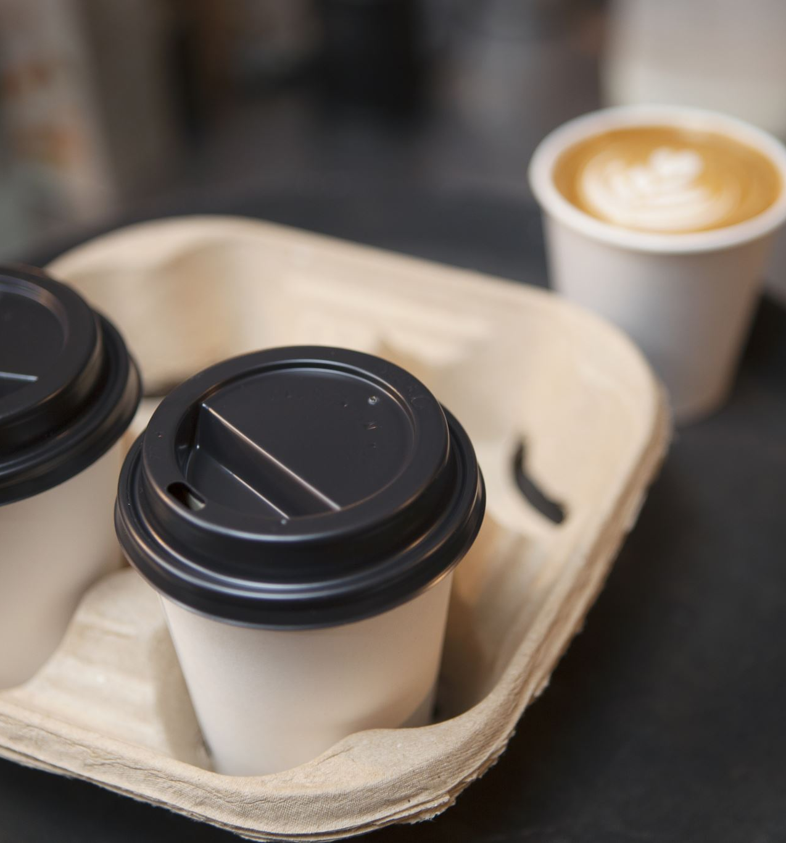
Food Record, or Diary (Prospective)
The respondent records, at the time of consumption, the identity and amounts of all foods and beverages consumed for a period of time, usually ranging from 1 to 7 days. (average 3 days , 2 weekdays and 1 weekend)
Can be quantified by estimating portion sizes, using household measures, or weighing the food or beverage on scales.
Certain items, such as eggs, apples, or 12-oz cans of soft drinks, may be thought of as units and simply counted.
This method is sometimes referred to as the estimated food record/weighed food record because portion sizes are estimated.

Slide 8
Food Frequency Questionnaires (Retrospective)
FFQ assess energy and/ or nutrient intake by determining how frequently a person consumes a limited number of foods that are major sources of nutrients or of a particular dietary component in question.
The questionnaires consist of a list of ~150 or fewer individual foods or food groups that are important contributors to the population’s intake of energy and nutrients. Respondents indicate how many times a day, week, month, or year that they usually consume the foods.

Slide 9
Standard
None-quantative
Semi-quantative
quantative

Slide 11
A questionnaire developed to quickly estimate how frequently foods high in total fat, saturated fatty acids, and cholesterol are eaten is shown in Appendix E. It is called the MEDFICTS Dietary Assessment Questionnaire (Meats, Eggs, Dairy, Fried foods, In baked goods, Convenience foods, Table fats, Snacks) and is recommended by the National Cholesterol Education Program as a simple approach to assess a person’s intake of total fat, saturated fat, and dietary cholesterol

