Slide 1
Using Graphical Elements

Slide 2
Graphical Elements
Graphical elements are anything that is not just text, including tables, figures, equations and photographs.
Graphics are used to break monotony in the text.
Monotony: رتابة، ملل

Slide 3
Modeling ideas with graphics
Words, tables, figures, equations, and so on can be used to model any idea.
Graphical elements enliven the presentation, hold reader’s attention, enrich ideas and alleviate the boredom of plain text
The challenge is to find the right elements and techniques to explain the idea
This chapter addresses appropriate uses of these graphical elements in technical writing.
Both too many graphical elements or too few of them can distract reader

Slide 4
Example
Consider the following example:
In 1998 there were more than 1,170,000 reported traffic fatalities worldwide. The number of traffic fatalities in poor nations was 8.7% higher than in wealthy nations. China and Africa had the misfortune of leading the way with more than 178,000 and 170,000 deaths, respectively. Of the wealthy nations, those in Eastern Europe fared the best, with only 923 deaths.
Instead:
The following graph conveys more information in an easily digested way .. But it has a problem, what is it?

Slide 5
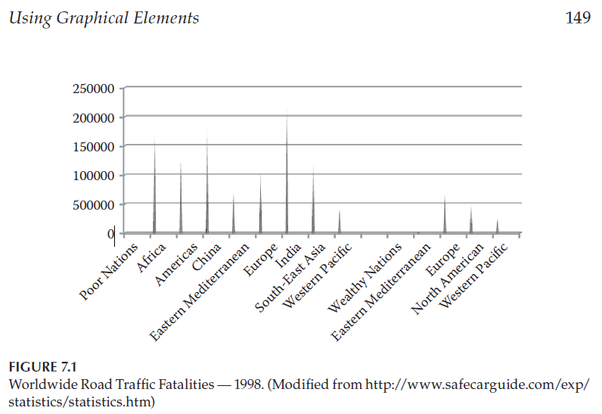
Example cont.

Slide 6
What is the problem with the graph?
Be aware that graphical representation can be used to misrepresent information to advance a hidden agenda.
In the case of Figure 7.1, the whole story is not obvious because the chart gives only gross (اجمالي) fatalities, not fatalities as a percentage of population.
India’s population in 1998 was estimated at 984,003,683, while China’s population was 1,236,914,658 during the same period (1998 CIA World Factbook).
Computing the number of traffic fatalities per 1,000 people in China and India, we get 0.01% versus 0.02%.
India had twice the traffic fatality rate of China in that year.
Of course, there are deep underlying factors for this difference—differences in mass transportation systems, roadways, population density, and so on.
Sometimes words are better than pictures, although usually both together make the most powerful exposition.

Slide 7
a. Using graphical elements to model behavior
When attempting to describe complex behavior, it is usually better to use an appropriate graphical technique. Unlike natural languages (e.g., English), a well-drawn diagram is unambiguous.
See book example (Answering machine graph) page 166
A graphical description may not always serve as an appropriate substitute for text, particularly when the reader has little or no prior domain knowledge.
See book example page (167)

Slide 8
b. Using graphical elements to model the evolution of an idea
Graphics are a powerful means to show the evolution of an idea from conception to completion.
See book example page (152 - 153)

Slide 9
Selecting the Best Model for a Schedule
Example: Gantt Chart
Can be done using various tools including Excel, Microsoft Project ...etc.
You can make a simple Gantt chart or a detailed one
The level of refinement that you choose for a model—in this case, a project schedule—depends on several factors, including the number of persons involved in the project, the tools available, and the need for simplicity and convenience versus the need for a more detailed project plan.
Gantt chart: It's a tool for visually representing the steps, assignments, and duration in any project. For example, with a Microsoft Project Gantt chart, you can display the critical path or change the color or shape of the bars, it also lets you link tasks with dependencies.

Slide 10
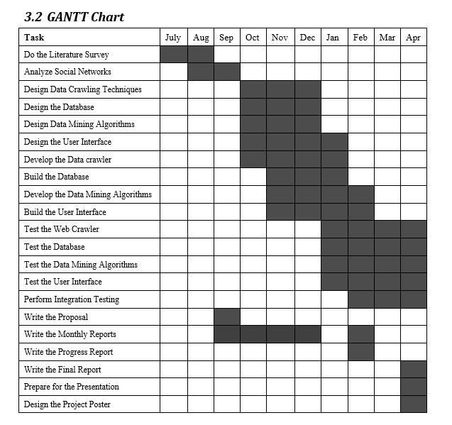
Simple Gantt Chart

Slide 11
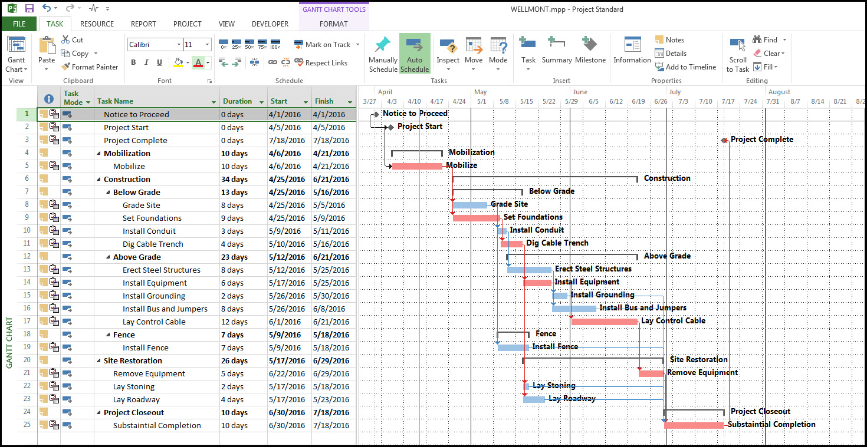
Detailed Gantt Chart using Microsoft Project
Source: https://thedigitalprojectmanager.com/microsoft-project-alternatives/

Slide 12
Dealing with figures

Slide 13
a. Callouts, Captioning, and Placement of figures
There are some basic conventions in using figures in technical writing:
Every figure must have a caption, and the caption must have a unique number to reference the figure later
Callout is the reference of the figure in the text
Every figure must be called out in the text. Even if the purpose of the figure seems obvious to you, call out that figure in the text.
Make sure that the figure appears after its first callout and not before.
Don’t end a section or chapter with a figure caption. Instead, finish the chapter or section with a discussion pertaining to the figure after the figure caption
Read details in book and see example page 173

Slide 14
b. Permissions for Figures
Copyright: حقوق النشر
If you create a figure, you own its copyrights and you can use it however you want
If you reuse a figure from another source, you must either cite the source and/or obtain proper permissions. How?
If you want to use a copyrighted figure without change, then you must obtain permission to use the figure and you must cite the original as well
If you want to redraw the figure and it is substantially different from original, you don’t need permission, but cite the original.
If you publish a book or work through a publisher, then the copyrights of the figures in the book are transferred to the publisher: You can use these figures in books published by the same publisher, but you need permission to use them in a book or work published by another publisher (although you created the figures)

Slide 15
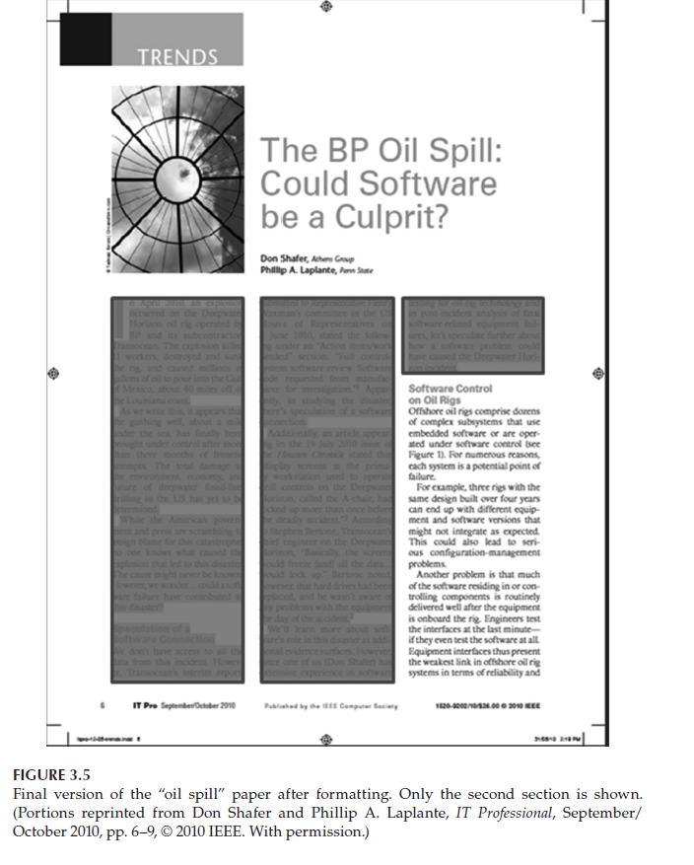
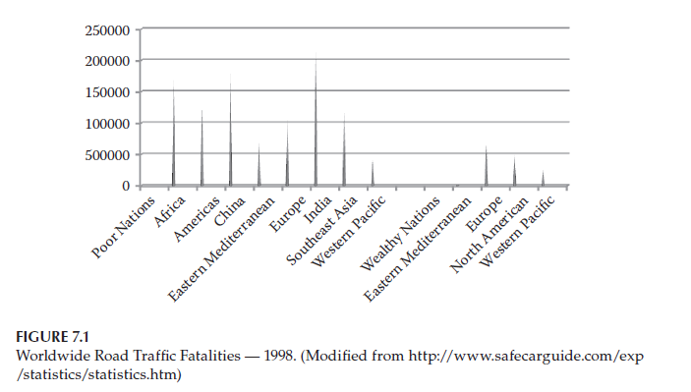
Examples of Figure Citation

Slide 16
Dealing with Tables
You can use tables in conventional or creative ways (see example page 175)
keep tables as simple as possible. For example, multiple nested columns can be confusing. If a table becomes complicated, you can break it up into 2 tables (or more if necessary)
Example: Table 7.3 on page 176 (see Explanation in book)
Conventions for captioning, numbering, calling out and permissions for tables are the same as for other figures

Slide 17
Dealing with Equations
Example: E = mc² (explains the relation between energy and matter in the universe)
Equations do not need to be cited unless they are new or not well known.
The conventions for captioning, numbering, and calling out equations are the same as for figures with one exception: Not every equation must be numbered.
You number equations that are called out later in the text.
In a series of calculations such as derivations, you can number only the final equation or only the ones you will call out later.
If you are going to use equations and symbolic values, they must be defined prior to first usage.
See examples in book page 178

Slide 18
Typesetting Equations
There are special tools
Examples:
Microsoft Equation Editor: Be aware of the compatibility issues
MathType:
More powerful and platform independent version of Equation Editor
compatible with a wide range of non-Microsoft document types and operating systems.
Latex:
can handle very complex mathematical equations and tables
not graphical in nature, it uses plaintext input and a rather cryptic markup language to achieve its result.
Used to typeset Master theses, doctoral dissertations, reports and other types of documents
Some publishers, for example for conferences, will only accept papers typeset using LaTeX.

Slide 19
Dynamic Content
For example, You can use equations to make tables with dynamic content using Microsoft word (if you change a value, the result of the equation changes as well)
Sometimes the most effective way of conveying information is by using moving pictures or graphics (videos, multimedia)
If the document is stored in some electronic media, such as on a disk or a website, then dynamic content could be embedded within the document.

Slide 20
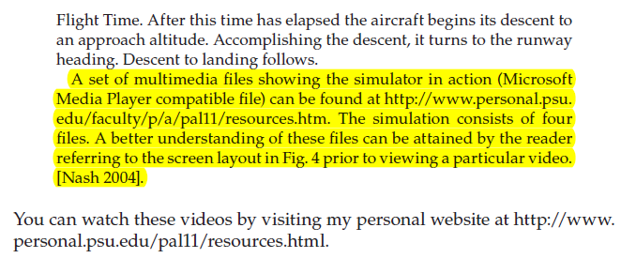
Dynamic Content
If the document is printed, or you cannot embed dynamic content, you can provide a link to a website hosting the dynamic content and reference that site in your document.
Example: book page 160

