Slide 1
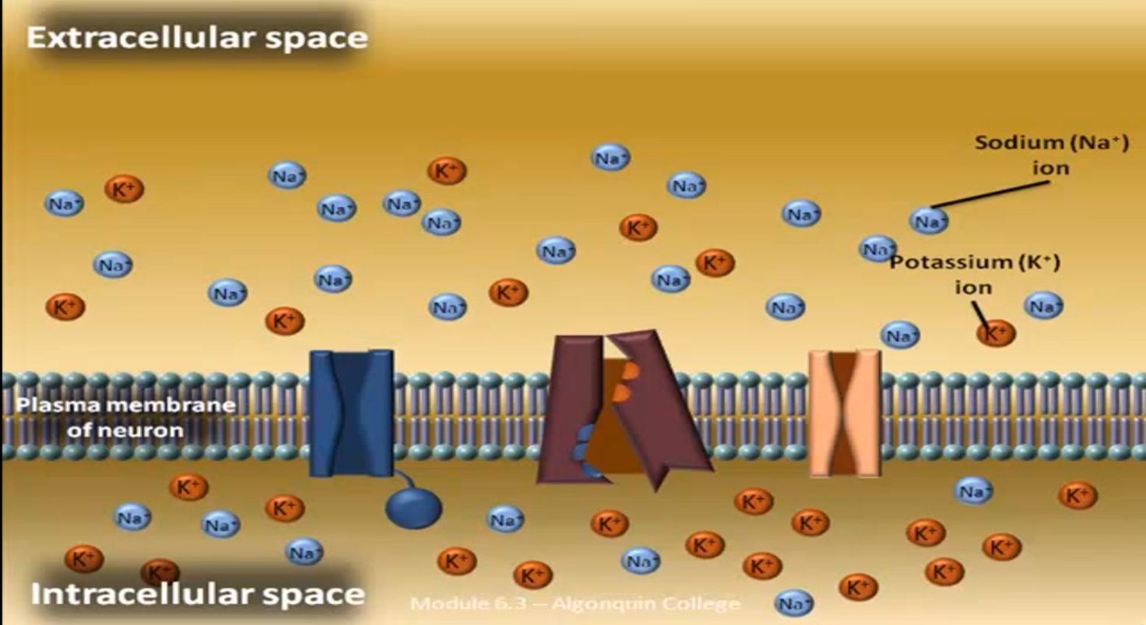
In the normal condition: Na is predominant in the ECF, and K in the ICF

Slide 2
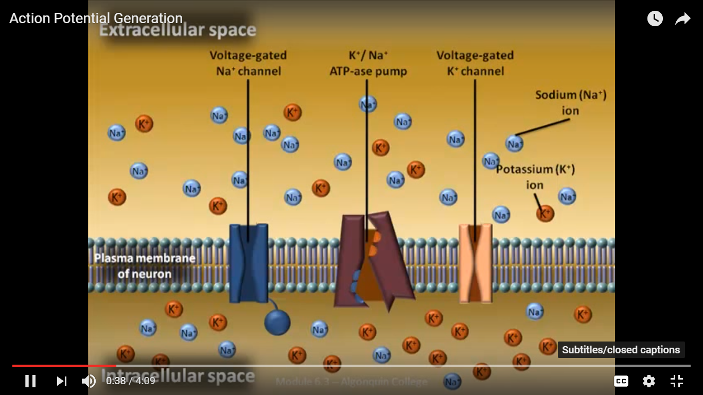
Three types of gates involve in the action potential

