Slide 1
An-Najah National University
Faculty of Medicine
Department of Physiology
Anatomy and Physiology 1
7102101
Instructor: Heba Salah
Chapter 3:
The Skeletal System
Part 7: Appendicular Skeleton: Pelvic Girdle, and Lower Limb

Slide 2
Bones of the Pelvic Girdle

Slide 3
Gender Differences of the Pelvis
Male
Female

Slide 4
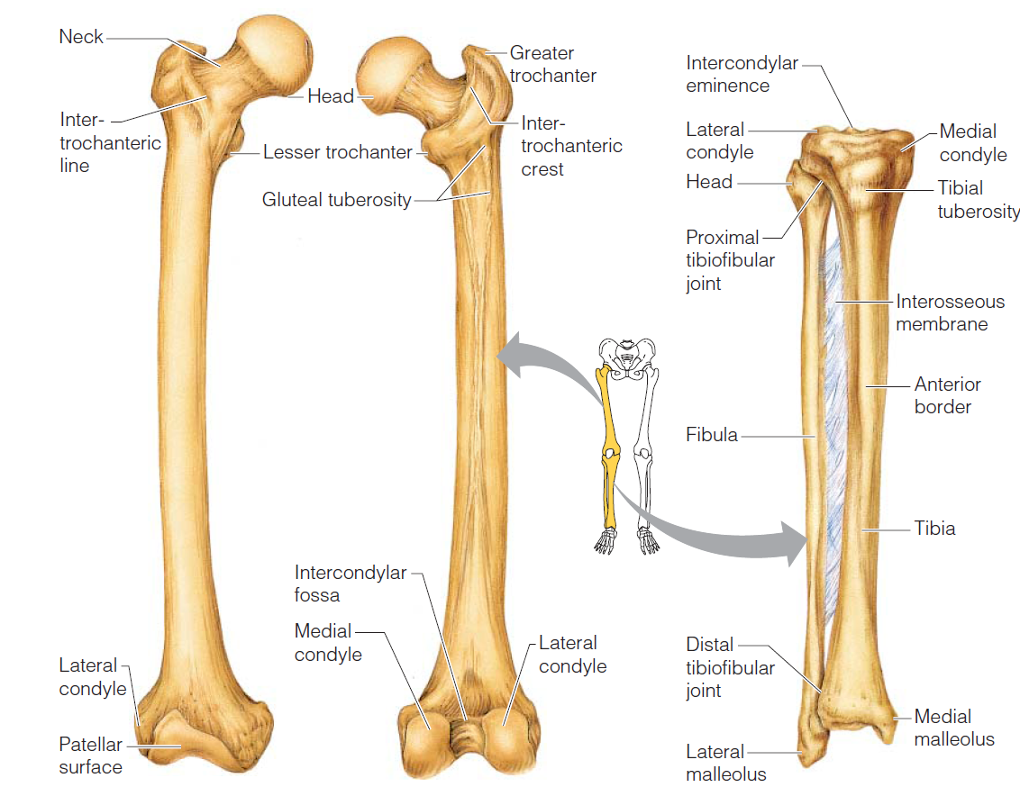
Bones of the Lower Limbs
The thigh has one bone: femur – thigh bone

Slide 5
Bones of the Lower Limbs
The leg has two bones:
Tibia
Fibula

Slide 6
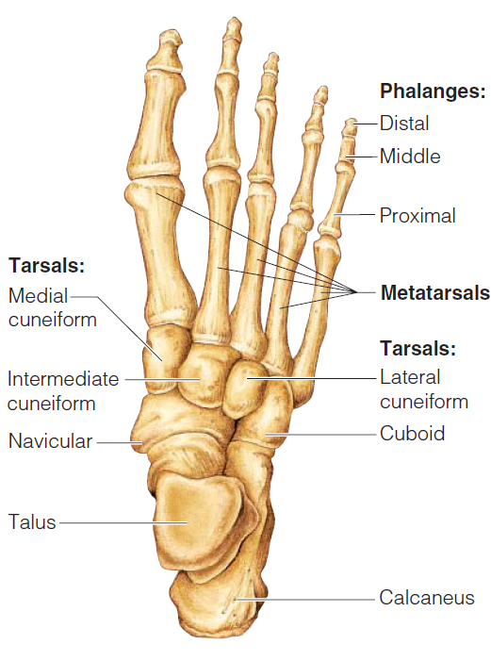
Bones of the Lower Limbs
The foot:
Tarsus – ankle
Metatarsals – sole
Phalanges – toes

Slide 7
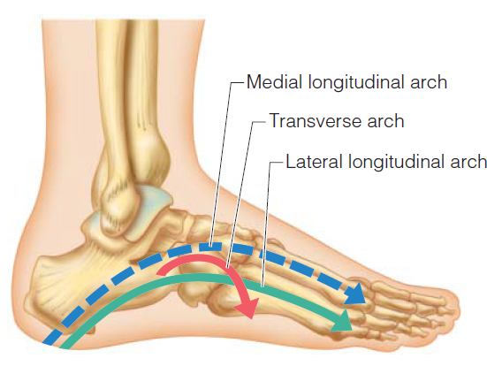
Arches of the Foot

