Slide 1
Digital Communications
Introduction to Telecommunications
0.0

Slide 2
Definition
Communication
Telecommunication
Data & information
Data communication
Voice communication
Video communication
Multimedia communication

Slide 3
Components
Source (Transmitter)
Medium (Communication Line)
Sink (Receiver)
Communication Networks
Communication Rules (protocol)

Slide 4
Introt.
Digital communications offer several advantages over analog communication, including higher fidelity, better noise immunity, improved signal quality, greater flexibility, and the ability to incorporate advanced signal processing techniques for error detection and correction.

Slide 5
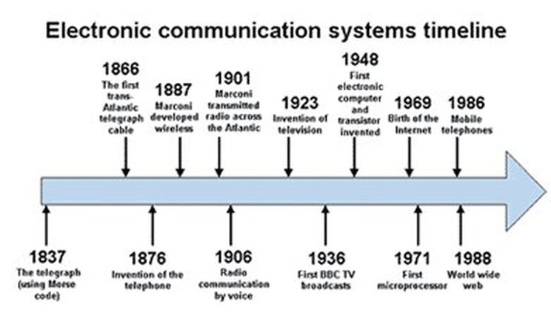
Evolution of Communication Systems:

Slide 6
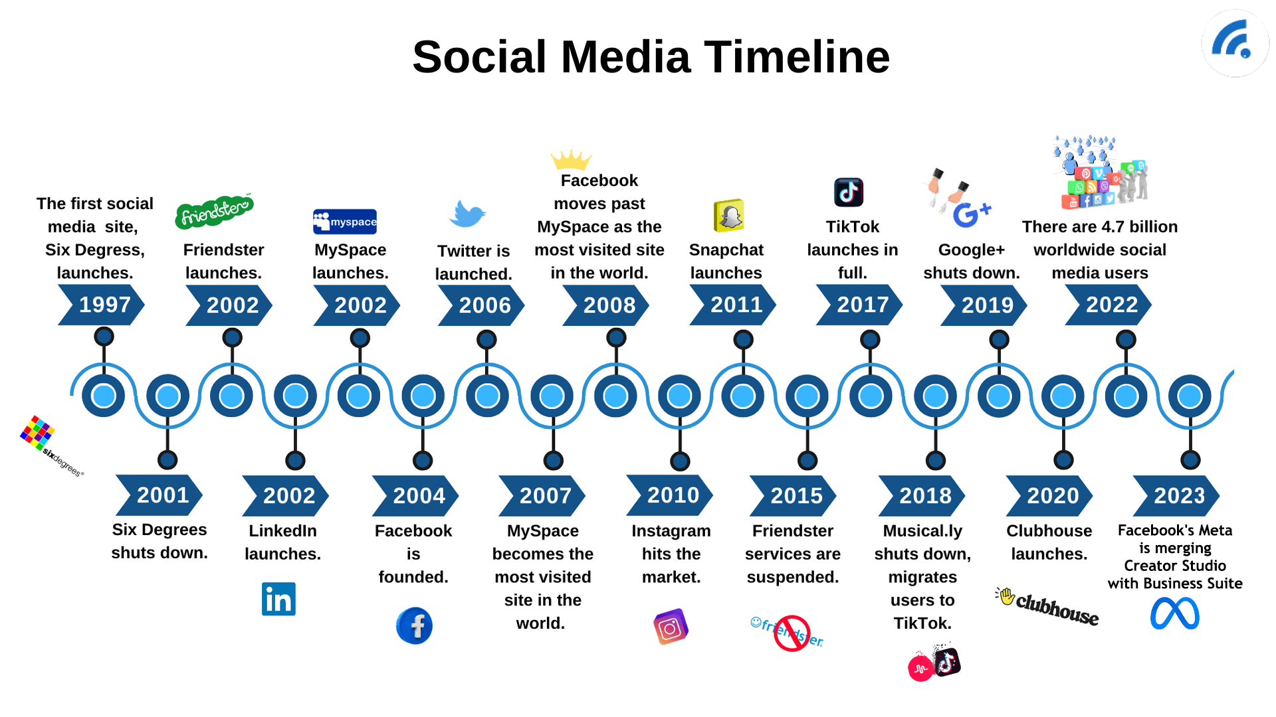

Slide 7
Analog vs. Digital Signals:
Representation:
Analog Signals: are continuous waveforms that vary smoothly over time. They can take on any value within a continuous range and are typically represented by sine waves.
Digital Signals: are discrete signals that have a finite number of possible values. They are represented by sequences of binary digits (bits), where each bit can take on one of two possible states (0 or 1).
Properties:
Analog Signals: are susceptible to noise and distortion, which can degrade signal quality. They also suffer from signal attenuation over long distances.
Digital Signals: are less susceptible to noise and distortion compared to analog signals. They can be transmitted over long distances with minimal degradation, and errors can be detected and corrected using error control coding techniques.

Slide 8
Analog vs. Digital Signals:
Advantages of Digital Signals:
Noise Immunity: Digital signals are more resistant to noise and interference compared to analog signals, making them more reliable in noisy environments.
Error Detection and Correction: Digital signals can be encoded with error detection and correction codes, allowing for accurate transmission and reception of data even in the presence of errors.
Compression: Digital signals can be compressed more efficiently than analog signals, leading to reduced bandwidth requirements and more efficient use of communication channels.
Flexibility: Digital signals can carry different types of information (e.g., voice, data, video) using the same transmission medium, allowing for greater flexibility in communication systems.

Slide 9
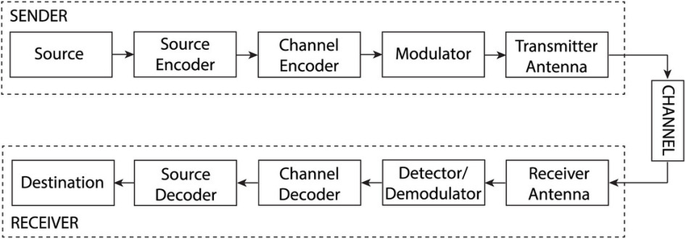
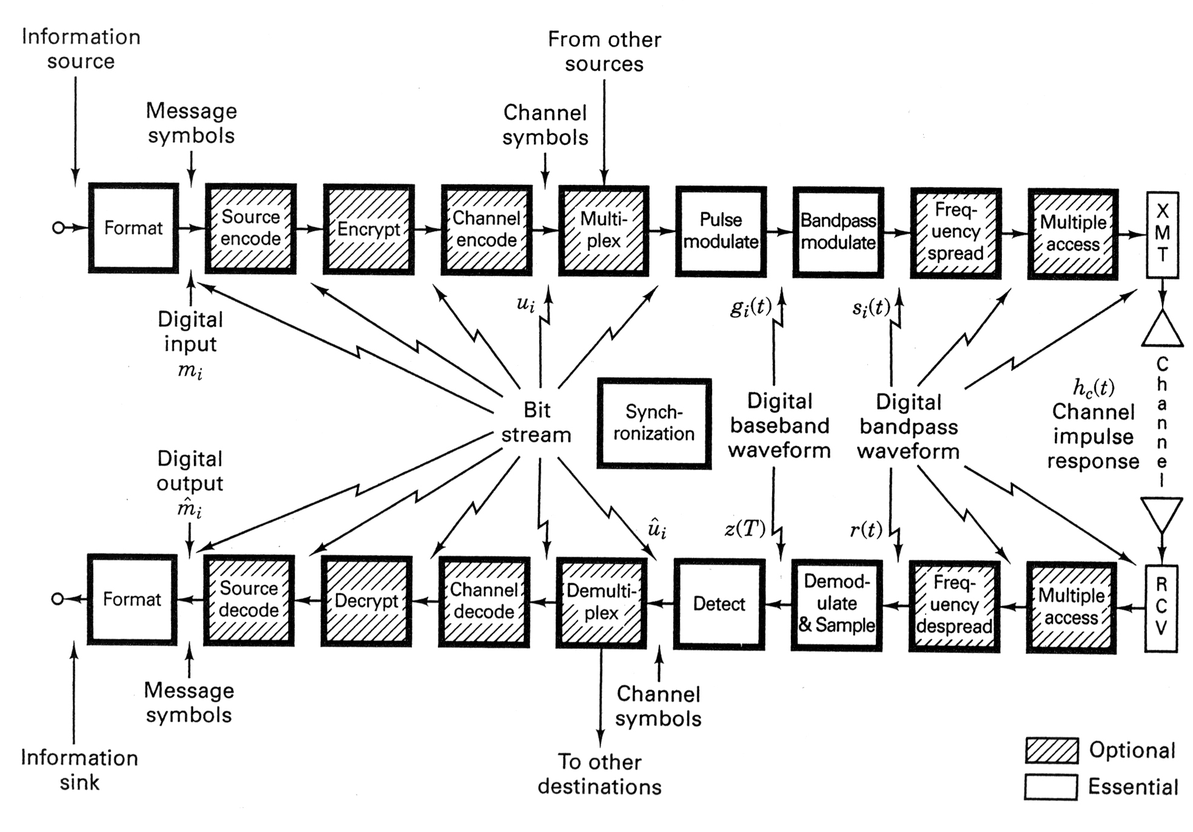
Components of Digital Communication Systems

Slide 10
1. Transmitter:
The transmitter in a digital communication system is responsible for converting information into a form suitable for transmission over a communication channel. It typically consists of the following components and functions:
Source Encoding: Source encoding involves converting the input data (e.g., voice, video, text) into a digital format suitable for transmission. This may include compression techniques to reduce the data rate and improve efficiency.
Channel Encoding: Channel encoding adds redundancy to the digital data to enable error detection and correction at the receiver. Techniques such as forward error correction (FEC) coding and convolutional coding are used for this purpose.
Modulation: Modulation involves modifying a carrier signal's characteristics (e.g., amplitude, frequency, phase) to encode the digital data. Various modulation techniques, such as amplitude shift keying (ASK), frequency shift keying (FSK), and phase shift keying (PSK), are used depending on the application and channel characteristics.
Signal Processing: Signal processing techniques may be applied to the modulated signal before transmission to improve its quality and efficiency. This may include filtering, equalization, and amplification.

Slide 11
2. Channel:
The channel in a digital communication system represents the medium through which the modulated signal is transmitted from the transmitter to the receiver. It can be wired or wireless and exhibits certain characteristics that affect signal transmission. Some key characteristics of communication channels include:
Noise: Noise refers to any unwanted signals or disturbances that interfere with the transmitted signal. Noise can degrade signal quality and affect communication performance.
Interference: Interference occurs when signals from other sources disrupt the transmitted signal. Interference may be caused by external sources such as electromagnetic radiation or by other users sharing the same channel.
Bandwidth: Bandwidth refers to the range of frequencies available for signal transmission over the channel. The bandwidth of a channel determines its data transmission capacity.
Propagation Effects: Propagation effects, such as attenuation, dispersion, and multipath fading, occur as the signal propagates through the channel. These effects can distort the transmitted signal and affect its quality.

Slide 12
3. Receiver:
The receiver in a digital communication system is responsible for recovering the transmitted signal, decoding the digital data, and delivering it to the intended recipient. It typically consists of the following components and functions:
Demodulation: Demodulation involves extracting the modulated digital data from the received signal by reversing the modulation process. Demodulation techniques are chosen based on the modulation scheme used at the transmitter.
Decoding: Decoding involves reversing the channel encoding process to recover the original digital data from the received signal. Error detection and correction techniques, such as FEC decoding and convolutional decoding, are applied to mitigate errors introduced during transmission.
Error Detection and Correction: Error detection and correction techniques are used to identify and correct errors in the received data. This ensures the accuracy and reliability of the transmitted information.
Signal Processing: Signal processing techniques may be applied to the received signal to enhance its quality and improve the performance of the receiver. This may include filtering, equalization, and noise reduction.

Slide 13
Requirements for Communications Systems
Availability
Reliability
Response time
User friendly
Universal service
Fast
Security
Inexpensive
ecosystem
Flexibility and growth
Others

Slide 14
Some examples of communications systems and how they meet various requirements:
Cellular Network (e.g., 4G LTE, 5G, 6G):
Reliability: Cellular networks use techniques like error correction coding and handover mechanisms to ensure reliable communication, even in the presence of noise and interference.
Speed: 4G LTE, 5G, and 6G networks support high data rates, allowing for fast data transmission, suitable for applications like video streaming and online gaming.
Security: These networks employ encryption and authentication mechanisms to secure user data and prevent unauthorized access.
Coverage: Cellular networks provide coverage over large geographic areas through a network of base stations, ensuring widespread connectivity.
Latency: 5G networks aim to reduce latency significantly, enabling low-latency applications like autonomous vehicles and real-time remote surgeries.

Slide 15
Satellite Communication System:
Reliability: Satellite communication systems use redundancy and error correction techniques to ensure reliable communication over long distances and in harsh environments.
Coverage: Satellite systems can provide coverage to remote areas where terrestrial infrastructure is unavailable, making them ideal for global communication.
Security: Encryption and authentication protocols are used to secure data transmitted over satellite links, protecting against unauthorized access.
Latency: While satellite communication can introduce higher latency compared to terrestrial networks due to signal travel time, advances in technology aim to minimize this latency.

Slide 16
Wireless Local Area Network (Wi-Fi):
Speed: Wi-Fi networks support high data rates suitable for applications like internet browsing, file transfer, and video streaming within a localized area.
Compatibility: Wi-Fi is compatible with a wide range of devices, allowing for easy communication between smartphones, laptops, smart home devices, and more.
Security: Wi-Fi networks implement encryption protocols like WPA2/WPA3 and password authentication to secure wireless communication and prevent unauthorized access.
Scalability: Wi-Fi networks can be scaled by adding additional access points to increase coverage and support more users within a specific area.
Manageability: Wi-Fi networks can be managed centrally through network management software, allowing for configuration, monitoring, and troubleshooting of network devices.
These examples demonstrate how different communications systems address various requirements such as reliability, speed, security, coverage, scalability, and manageability, depending on their specific use cases and deployment scenarios.

Slide 17
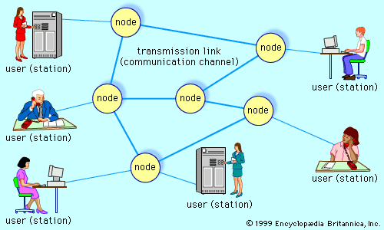
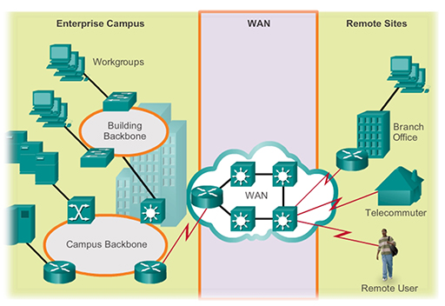
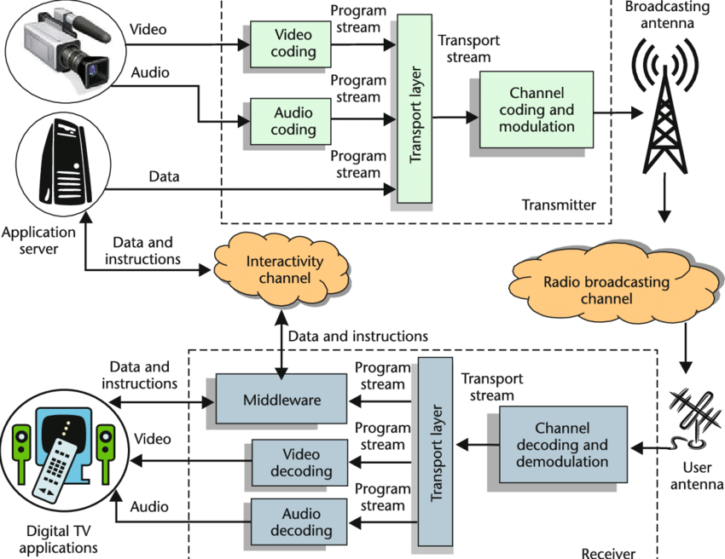
Applications of Digital Communications:
Telecommunication: applications of digital communications in telephony, mobile communication, and internet communication.
Data Transmission: how digital communications are used for data transmission in computer networks, including local area networks (LANs) and wide area networks (WANs).
Broadcasting: the role of digital communications in broadcasting, including digital television (DTV) and digital radio.

Slide 18
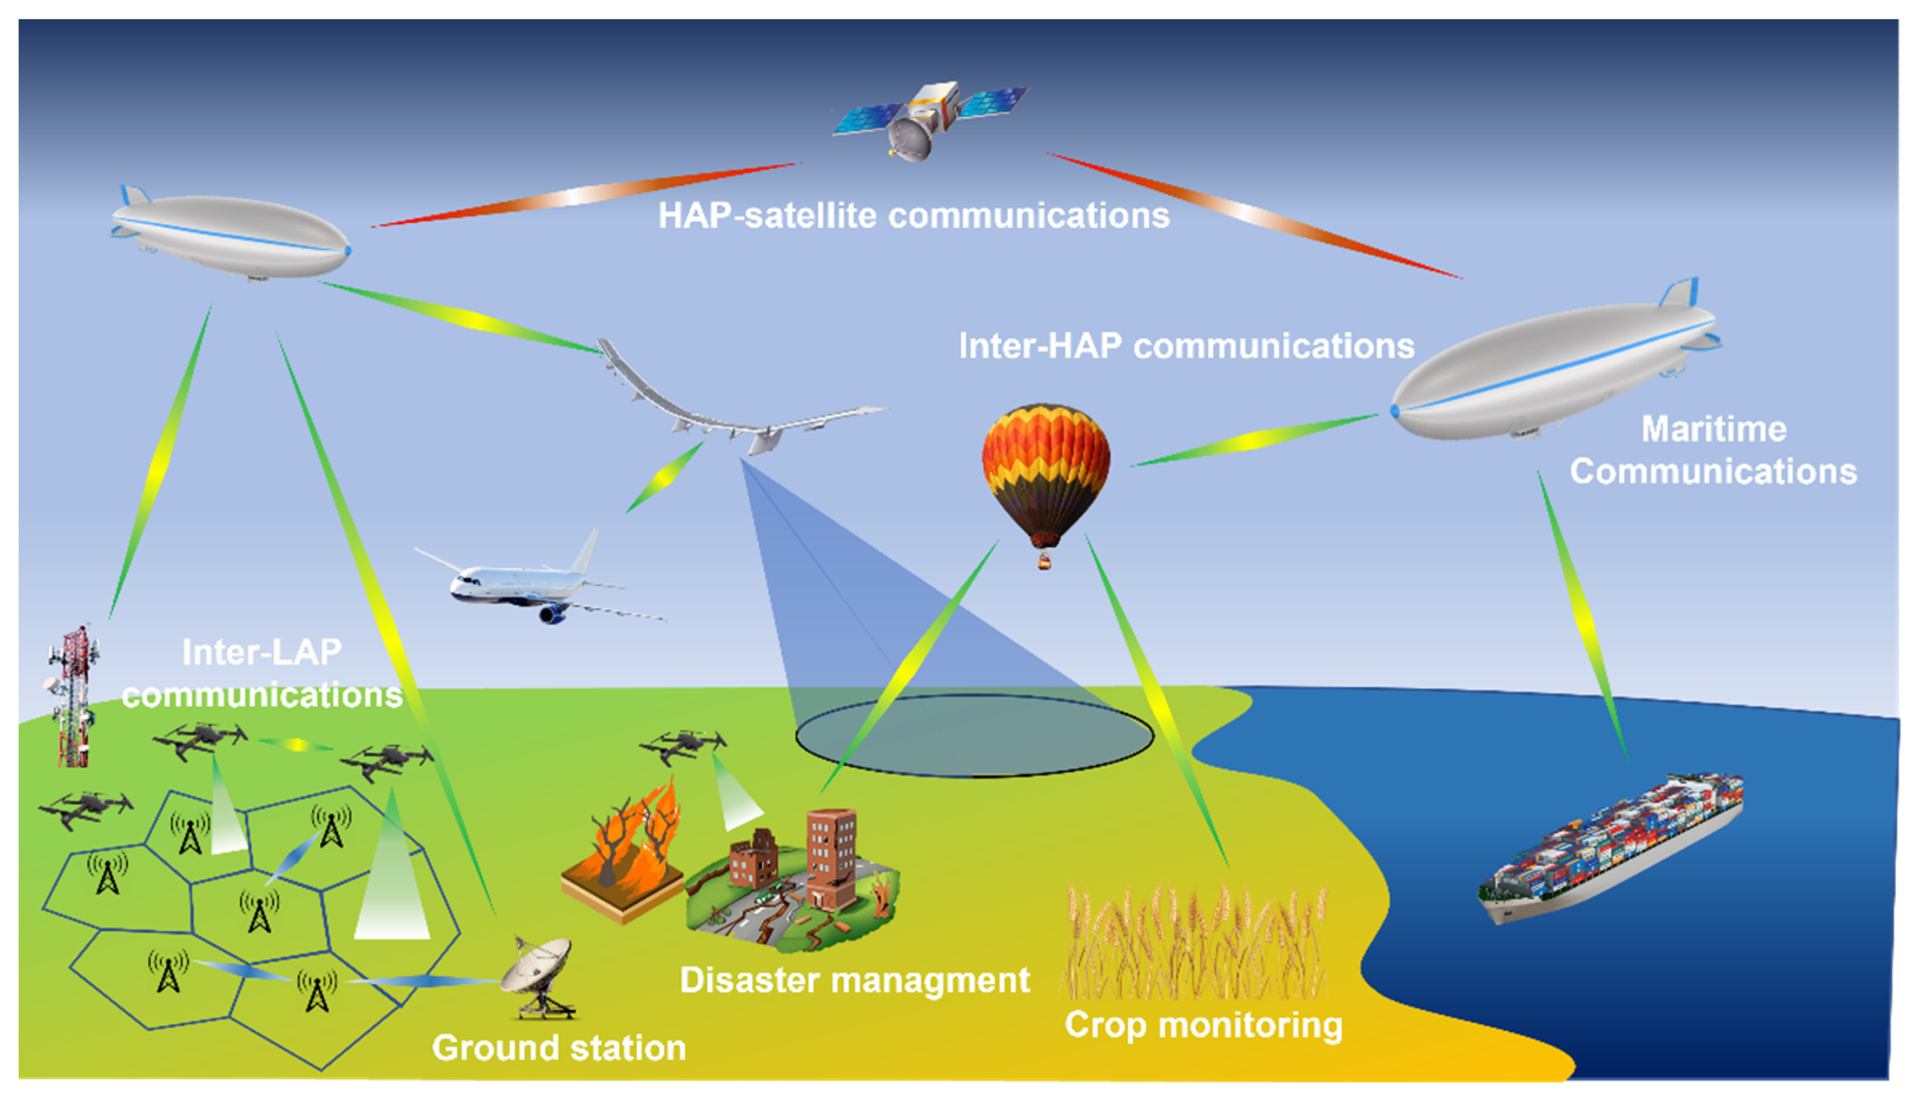
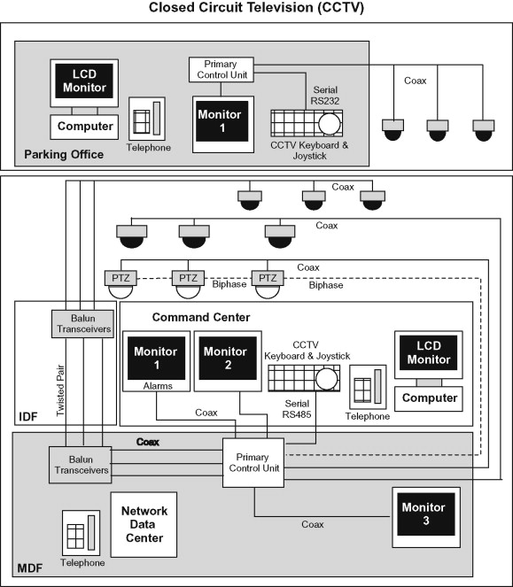
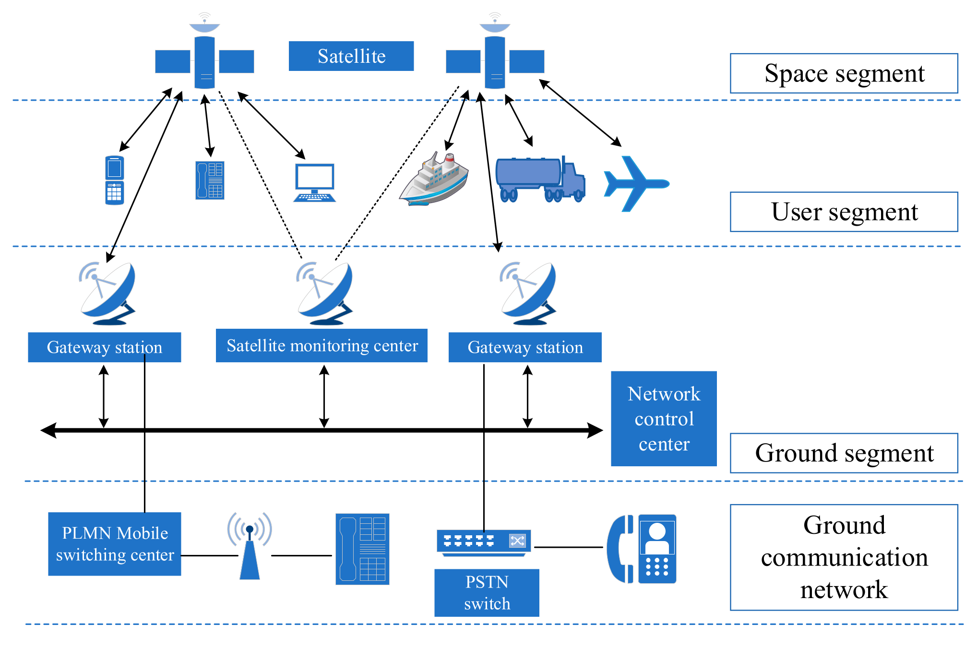
Applications of Digital Communications:
Remote Sensing and Control: Digital communications are used in remote sensing and control systems for monitoring and controlling remote devices and systems. Examples include remote environmental monitoring, remote control of industrial equipment, and telemetry systems used in aerospace and satellite communication.
Surveillance and Security: Digital communications support surveillance and security applications, including closed-circuit television (CCTV), video surveillance systems, and security alarms. They enable the transmission of video, audio, and data signals for monitoring and protecting physical and digital assets.
Emergency Communication: Digital communications are critical for emergency communication systems, including public safety networks, emergency alert systems, and disaster response communication. They enable rapid and reliable communication during emergencies and natural disasters to coordinate response efforts and disseminate critical information.

Slide 19
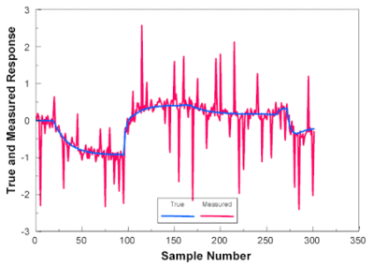
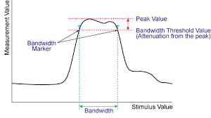
Challenges Faced by Digital Communication Systems:
Bandwidth Limitations: The increasing demand for data-intensive applications, such as video streaming and cloud computing, poses challenges related to limited available bandwidth. This can lead to congestion and slower data transmission rates, particularly in wireless communication systems.
Noise and Interference: Digital communication systems are susceptible to noise and interference from various sources, including electromagnetic radiation, radio frequency interference, and signal distortion. Noise and interference degrade signal quality, leading to errors and reduced data reliability.

Slide 20
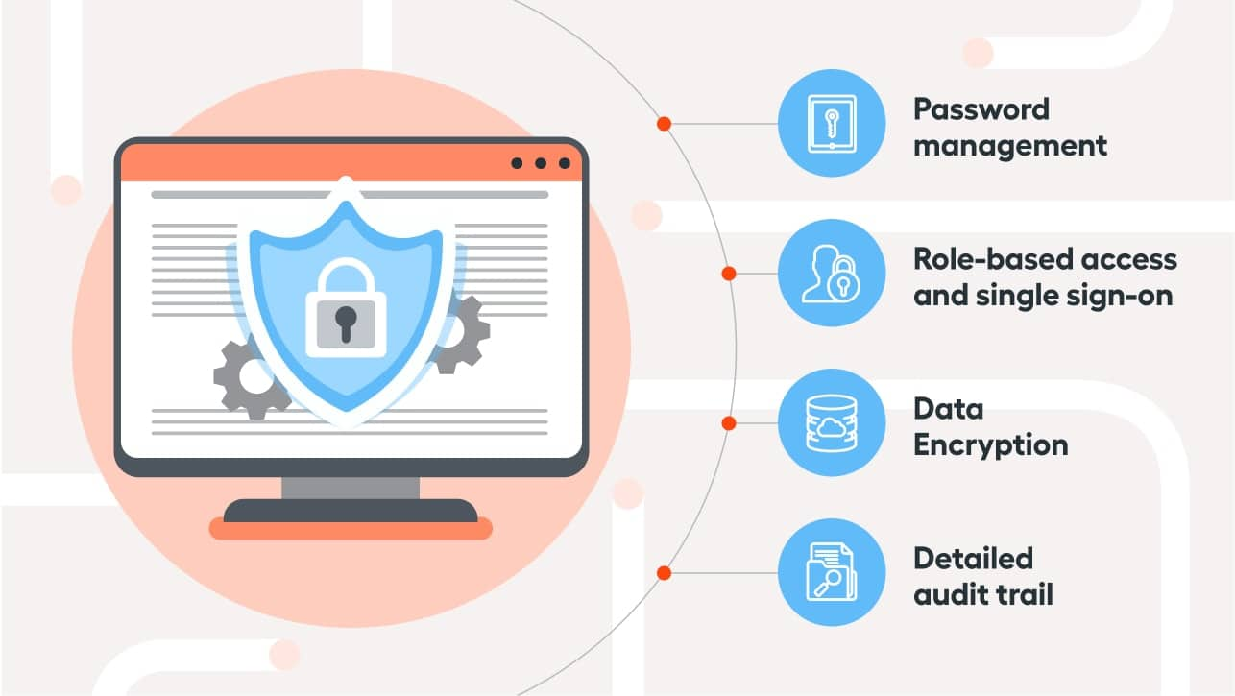
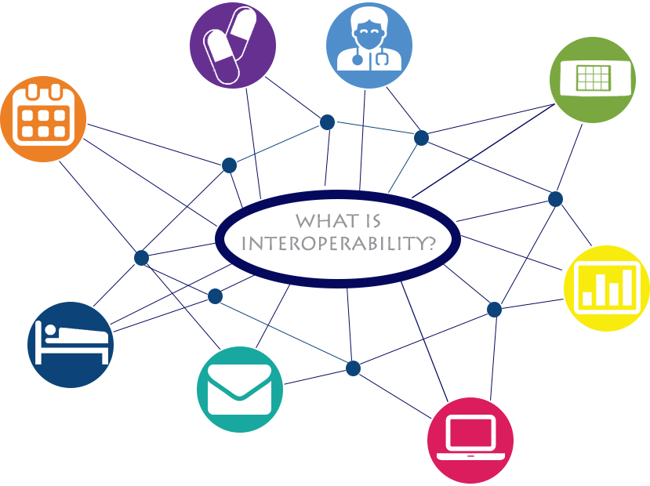
Challenges Faced by Digital Communication Systems:
Security Concerns: Ensuring the security and privacy of transmitted data is a significant challenge in digital communication systems. Threats such as eavesdropping, hacking, and data breaches pose risks to sensitive information, requiring robust encryption, authentication, and access control measures to mitigate security vulnerabilities.
Interoperability Issues: Interoperability refers to the ability of different communication systems, devices, and protocols to work together easily. Achieving interoperability can be challenging due to the availability of diverse technologies and standards, leading to compatibility issues and communication barriers between different systems.

Slide 21
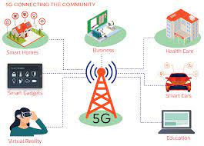
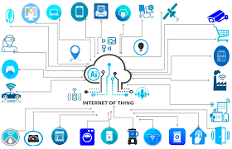
Future Trends and Emerging Technologies in Digital Communications:
5G & 6G Networks: 5G networks represent the next generation of wireless communication technology, offering higher data rates, lower latency, and increased network capacity compared to previous generations. 5G enables new applications such as autonomous vehicles, augmented reality, and massive IoT deployments.
Internet of Things (IoT): The IoT involves connecting everyday objects and devices to the Internet, enabling them to collect, exchange, and analyze data. IoT applications span various sectors, including smart homes, healthcare, agriculture, and industrial automation. Future trends in IoT include edge computing, AI-driven analytics, and secure IoT ecosystems.

Slide 22
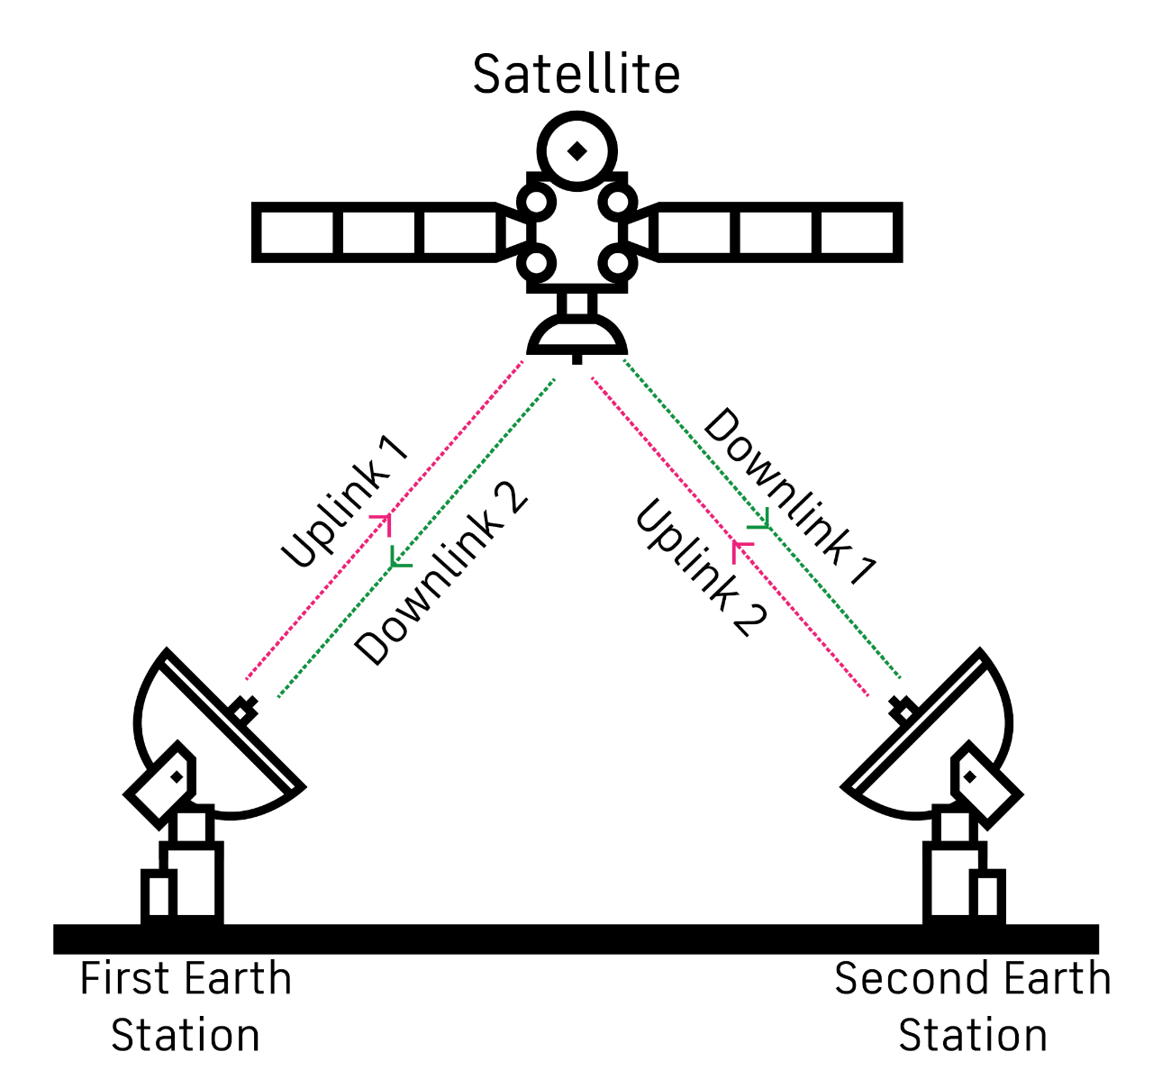
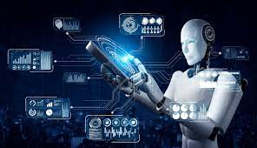
Future Trends and Emerging Technologies in Digital Communications:
Satellite Communication: Satellite communication continues to evolve with advancements in satellite technology, including high-throughput satellites (HTS), small satellites (SmallSats), and low Earth orbit (LEO) satellite constellations. These advancements enable improved global connectivity, broadband internet access in remote areas, and new satellite-based services.
Artificial Intelligence (AI) and Machine Learning: AI and machine learning technologies are increasingly being integrated into digital communication systems to enhance performance, optimize network management, and improve user experience. AI-driven applications include network optimization, predictive maintenance, and intelligent traffic routing in communication networks.

Slide 23
Future Trends and Emerging Technologies in Digital Communications:
Software-Defined Networking (SDN) and Network Function Virtualization (NFV): SDN and NFV technologies enable the virtualization and programmability of network infrastructure, allowing for more agile, scalable, and efficient communication networks. These technologies facilitate network automation, dynamic resource allocation, and flexible service delivery.
Quantum Communication: Quantum communication leverages the principles of quantum mechanics to achieve secure and ultra-fast communication. Quantum key distribution (QKD) enables secure transmission of encryption keys using quantum properties, offering unparalleled security for sensitive data transmission.
Green Communication: With increasing environmental concerns, there is a growing focus on developing sustainable and energy-efficient communication technologies. Green communication initiatives include energy-efficient network designs, renewable energy-powered communication infrastructure, and eco-friendly communication devices.

Slide 24
More on Challenges
Challenges while dealing with digital communications systems
Changing technology: Several technology trends that will drive Telcom innovation, including; 5G, WiFi 6, SMART CITIES, EDGE COMPUTING. ELECTRONIC SIGNATURE, …
Legislative & regulation
Changing business environment: The economy fluctuates up or down daily, frequently causing businesses to alter the way they operate. New competitors enter the marketplace while others leave.

Slide 25
Who could solve the Telecom Challenges
Some potential contributors to solving telecommunications challenges could include:
Telecommunications Companies: Established telecom companies like AT&T, Verizon, Vodafone, and others often lead the way in implementing new technologies and infrastructure to address challenges in the industry.
Technology Firms: Companies like Huawei, Ericsson, Nokia, Cisco, and others are major players in providing equipment, software, and solutions for telecommunications networks. They continually innovate to improve network performance, security, and efficiency.
Startups and Innovators: Small startups and innovative companies may introduce disruptive technologies and solutions that address specific challenges in the telecommunications sector, such as improving bandwidth efficiency, enhancing network security, or optimizing infrastructure deployment.
Research Institutions: Universities, research labs, and institutions focused on telecommunications research contribute significantly to advancing the field through fundamental research, developing new technologies, and testing innovative solutions.
Regulatory Bodies: Government agencies and regulatory bodies play a crucial role in shaping the telecommunications industry through policies, regulations, and standards that aim to ensure fair competition, protect consumers, and promote technological innovation.
International Organizations: Bodies like the International Telecommunication Union (ITU) and regional telecommunications organizations work towards global cooperation, standardization, and addressing challenges that require coordination across borders.
Collaborative Efforts: Collaborative initiatives involving multiple stakeholders from industry, academia, government, and non-profit sectors can drive innovation and address complex telecommunications challenges more effectively through shared resources, expertise, and perspectives.

Slide 26
ITU regions and the dividing lines between them.
The ITU, in its International Radio Regulations, divides the world into three ITU regions for the purposes of managing the global radio spectrum.
Each region has its own set of frequency allocations
Region 2
Region 1
Region 3

Slide 27
LATEST TRENDS IN TELECOM SECTOR

Slide 28
The four stages of the Industrial Revolution
It is expected that 5G will provide the means to move into exactly this fourth stage of the Industrial Revolution, as it allows the currently human-dominated wireless communications to be extended to an all connected world of humans and objects.
Notes:
the power loom and the steam engine
mass production and the production line
electronics and IT particularly PLC
wireless communications enables pervasive connectivity between machines and objects

Slide 29
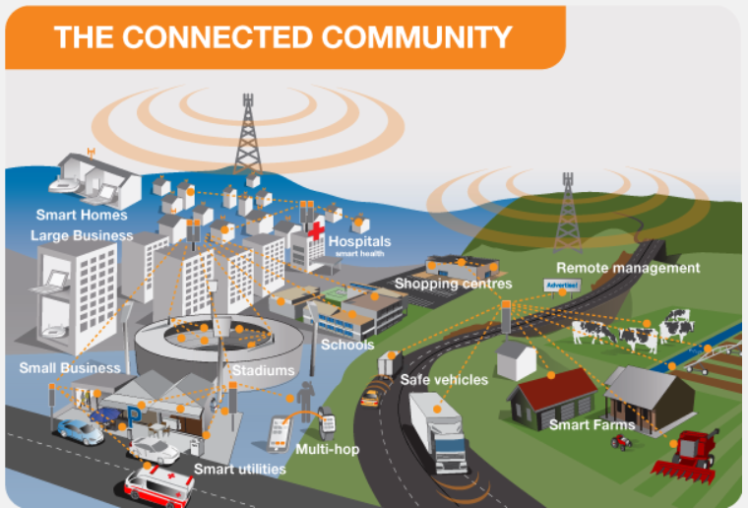
Notes:
In addition to delivering faster connections and greater capacity, a very important advantage of 5G is the fast response time referred to as latency. Latency is the time taken for devices to respond to each other over the wireless network. 3G networks had a typical response time of 100 milliseconds, 4G is around 30 milliseconds and 5G will be as low as 1 millisecond. This is virtually instantaneous opening up a new world of connected applications.

Slide 30
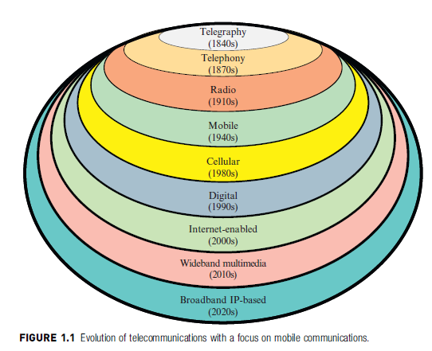

Slide 31
The End

