Slide 1
Financial Accounting
IFRS 4th Edition
Weygandt ● Kimmel ● Kieso
Chapter 9
Plant Assets, Natural Resources, and Intangible Assets

Slide 2
Chapter Outline
Learning Objectives
LO 1 Explain the accounting for plant asset expenditures.
LO 2 Apply depreciation methods to plant assets.
LO 3 Explain how to account for the disposal of plant assets.
LO 4 Describe how to account for natural resources and intangible assets.
LO 5 Discuss how plant assets, natural resources, and intangible assets are reported and analyzed.

Slide 3
Learning Objective 1 Explain the Accounting for Plant Asset Expenditures

Slide 4
Plant Asset Expenditures (1 of 2)
Plant assets are resources that have
physical substance (a definite size and shape),
are used in the operations of a business,
are not intended for sale to customers,
are expected to provide service to the company for a number of years, except for land.
Referred to as property, plant, and equipment; plant and equipment; and fixed assets.

Slide 5
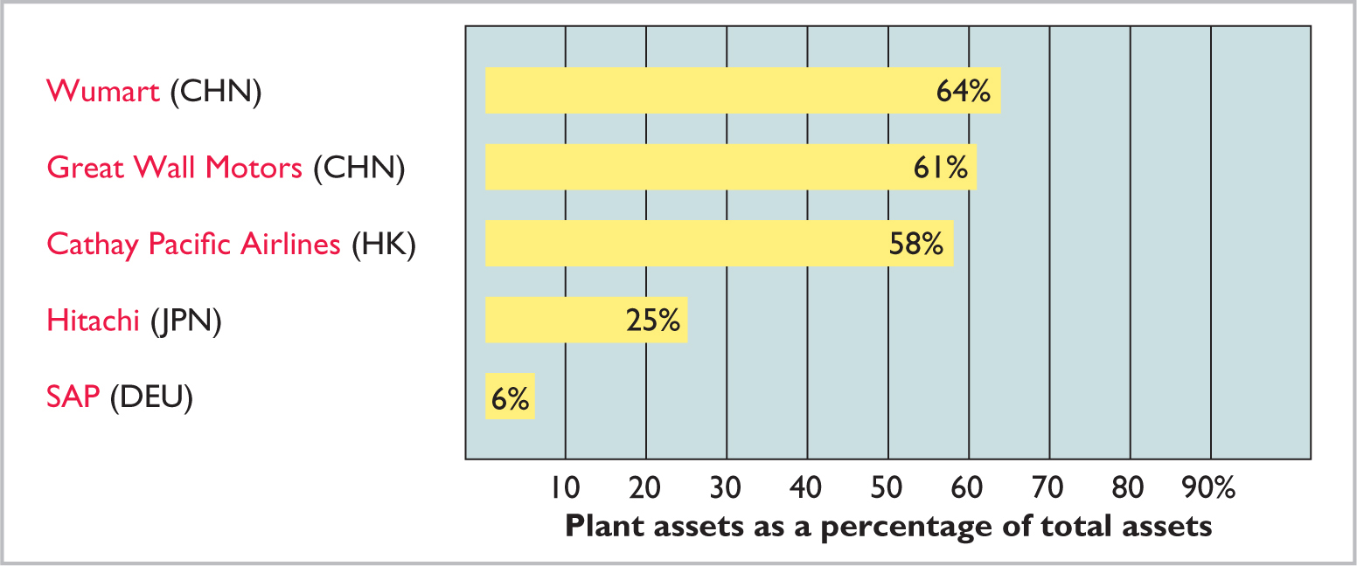
Plant Asset Expenditures (2 of 2)
Plant assets play a key role in ongoing operations.

Slide 6
The Cost of Plant Assets (1 of 10)
Historical Cost Principle
Requires that companies record plant assets at cost
Cost consists of all expenditures necessary to acquire an asset and make it ready for its intended use

Slide 7
The Cost of Plant Assets (2 of 10)
Land
All necessary costs incurred in making land ready for its intended use increase (debit) the Land account.
Costs typically include:
cash purchase price
closing costs such as title and attorney’s fees
real estate brokers’ commissions
accrued property taxes and other liens on land assumed by purchaser

Slide 8
The Cost of Plant Assets (3 of 10)
Illustration: Lew Ltd. acquires real estate at a cash cost of HK$2,000,000. The property contains an old warehouse that is razed at a net cost of HK$60,000 (HK$75,000 in costs less HK$15,000 proceeds from salvaged materials). Additional expenditures are the attorney’s fee, HK$10,000, and the real estate broker’s commission, HK$80,000. Determine the amount to be reported as the cost of the land.

Slide 9
The Cost of Plant Assets (4 of 10)
Required: Determine amount to be reported as the cost of the land.
 | Land
Cash price of property (HK$2,000,000) | HK$2,000,000
Net removal cost of warehouse (HK$60,000) | 60,000
Attorney's fees (HK$10,000) | 10,000
Real estate broker’s commission (HK$80,000) | 80,000
Cost of Land | HK$2,150,000
Lew makes the following entry:
Land
2,150,000
Cash
2,150,000

Slide 10
The Cost of Plant Assets (5 of 10)
Land Improvements
Structural additions with limited lives that are made to land. Cost includes all expenditures necessary to make the improvements ready for their intended use.
Examples: driveways, parking lots, fences, landscaping, and underground sprinklers
Limited useful lives
Expense (depreciate) cost of land improvements over their useful lives

Slide 11
The Cost of Plant Assets (6 of 10)
Buildings
Includes all costs related directly to purchase or construction.
Purchase costs:
Purchase price, closing costs (attorney’s fees, title insurance, etc.) and real estate broker’s commission
Remodeling and replacing or repairing the roof, floors, electrical wiring, and plumbing

Slide 12
The Cost of Plant Assets (7 of 10)
Buildings
Includes all costs related directly to purchase or construction.
Construction costs:
Contract price
Payments for architects’ fees
Building permits
Excavation costs

Slide 13
The Cost of Plant Assets (8 of 10)
Equipment
Include all costs incurred in acquiring the equipment and preparing it for use.
Costs typically include:
Cash purchase price
Sales taxes
Freight charges
Insurance during transit paid by purchaser
Assembling, installing, and testing

Slide 14
The Cost of Plant Assets (9 of 10)
Illustration: Lenard Huang Group purchases a delivery truck at a cash price of HK$420,000. Related expenditures consist of sales taxes HK$13,200, painting and lettering HK$5,000, motor vehicle license HK$800, and a three-year accident insurance policy HK$16,000. Compute the cost of the delivery truck.
Blank | Truck
Cash price | HK$420,000
Sales taxes | 13,200
Painting and lettering | 5,000
Blank | Blank
Cost of Delivery Truck | HK$438,200

Slide 15
The Cost of Plant Assets (10 of 10)
Illustration: Lenard Huang Group purchases a delivery truck at a cash price of HK$420,000. Related expenditures consist of sales taxes HK$13,200, painting and lettering HK$5,000, motor vehicle license HK$800, and a three-year accident insurance policy HK$16,000. Prepare the journal entry to record these costs.
Equipment
438,200
License Expense
800
Prepaid Insurance
16,000
Cash
455,000

Slide 16
Expenditures During Useful Life
Ordinary Repairs are expenditures to maintain the operating efficiency and productive life of the unit.
Debit to Maintenance and Repairs Expense
Referred to as revenue expenditures
Additions and Improvements are costs incurred to increase the operating efficiency, productive capacity, or useful life of a plant asset.
Debit plant asset affected
Referred to as capital expenditures

Slide 17
DO IT! 1: Cost of Plant Assets
Assume that Jing Feng Heating and Cooling purchases a delivery truck for ¥150,000 cash, plus sales taxes of ¥9,000 and delivery costs of ¥5,000. The buyer also pays ¥2,000 for painting and lettering, ¥6,000 for an annual insurance policy, and ¥800 for a motor vehicle license. Explain how each of these costs would be accounted for.
Solution
The first four payments (¥150,000, ¥9,000, ¥5,000, and ¥2,000) are included in the cost of the truck (¥166,000)
The payments for insurance and the license are operating costs and therefore are expensed

Slide 18
Learning Objective 2 Apply Depreciation Methods to Plant Assets

Slide 19
Depreciation Methods
Depreciation
Process of allocating to expense the cost of a plant asset over its useful life in a rational and systematic manner.
Process of cost allocation, not asset valuation
Applies to land improvements, buildings, and equipment, not land
Depreciable, because the revenue-producing ability of asset will decline over the asset’s useful life

Slide 20
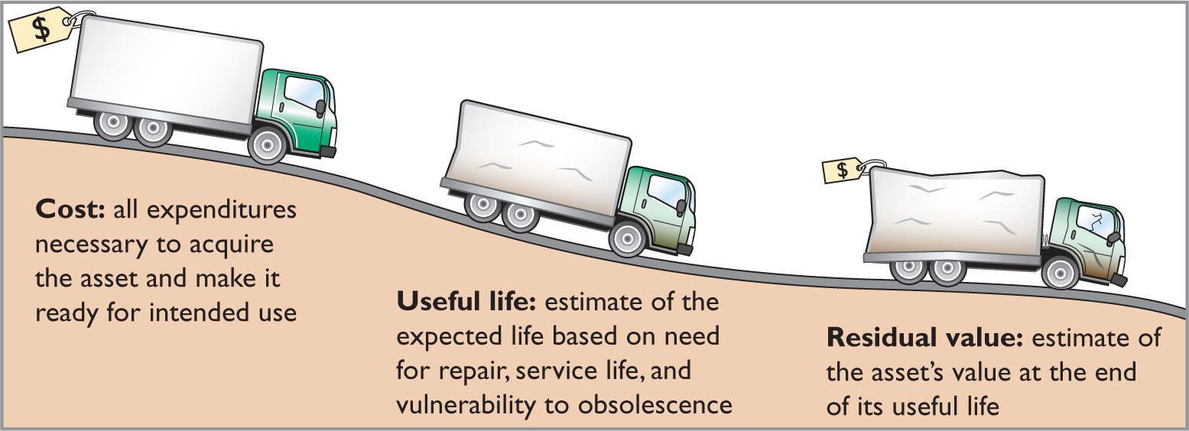
Factors in Computing Depreciation
Depreciation expense is reported on the income statement. Accumulated depreciation is reported on the balance sheet as a deduction from plant assets.

Slide 21
Depreciation Methods (1 of 2)
Management selects the method it believes best measures an asset’s contribution to revenue over its useful life.
Examples include:
Straight-line method.
Units-of-activity method.
Declining-balance method.

Slide 22
Depreciation Methods (2 of 2)
Illustration: Barb’s Florists purchased a small delivery truck on January 1, 2020.
Cost €13,000
Expected salvage value € 1,000
Estimated useful life in years 5
Estimated useful life in miles 100,000
Required: Compute depreciation using the following.
(a) Straight-Line (b) Units-of-Activity (c) Declining Balance

Slide 23
Straight-Line Method (1 of 3)
Expense is same amount for each year
Depreciable cost = Cost less residual value
Cost | - | Residual Value | = | Depreciable Cost
€13,000 | - | €1,000 | = | €12,000
Depreciable Cost | ÷ | Useful Life (in years) | = | Annual Depreciation Expense
€12,000 | ÷ | 5 | = | €2,400

Slide 24
Straight-Line Method (2 of 3)
 | Computations |  |  | End of Year
Year | Depreciable Cost | x | Rate | = | Annual Expense | Accumulated Depreciation | Book Value
2020 | $12,000 | x | 20% | = | € 2,400 | € 2,400 | €10,600*
2021 | 12,000 | x | 20 | = | 2,400 | 4,800 | 8,200
2022 | 12,000 | x | 20 | = | 2,400 | 7,200 | 5,800
2023 | 12,000 | x | 20 | = | 2,400 | 9,600 | 3,400
2024 | 12,000 | x | 20 | = | 2,400 | 12,000 | 1,000
 |  |  |  |  | €12,000
Journal Entry
Dec.31.2020
Depreciation Expense
2,400
Accumulated Depreciation
2,400
*€13,000 − €2,400

Slide 25
Straight-Line Method (3 of 3)
Assume the delivery truck was purchased on April 1, 2020.
 | Computations |  |  | End of Year
Year | Depreciable Cost | x | Rate | = | Annual Expense | x | Partial Year | = | Depreciation Expense | Accum. Deprec.
1.Ap –Dec.31 2020 | €12,000 | x | 20% | = | € 2,400 | x | 9/12 | = | € 1,800 | €1,800
Dec.31.2021 | 12,000 | x | 20 | = | 2,400 | x |  | = | 2,400 | 4,200
2022 | 12,000 | x | 20 | = | 2,400 | x |  | = | 2,400 | 6,600
2023 | 12,000 | x | 20 | = | 2,400 | x |  | = | 2,400 | 9,000
2024 | 12,000 | x | 20 | = | 2,400 | x |  | = | 2,400 | 11,400
2025 | 12,000 | x | 20 | = | 2,400 | x | 3/12 | = | 600 | 12,000
 |  |  |  |  |  |  |  |  | €12,000

Slide 26
Do It! 2a: Straight-Line Depreciation
On January 1, 2020, Iron Mountain Ski Corporation purchased a new snow-grooming machine for €50,000. The machine is estimated to have a 10-year life with a €2,000 residual value. What journal entry would Iron Mountain Ski Corporation make at December 31, 2020, if it uses the straight-line method of depreciation?
Year | Cost | - | Residual Value | ÷ | Rate | = | Annual Expense
2020 | €50,000 | - | €2,000 | ÷ | 10% | = | €4,800
Depreciation Expense
4,800
Accumulated Depreciation
4,800

Slide 27
Units-of-Activity Method (1 of 2)
Companies estimate total units of activity to calculate depreciation cost per unit
Expense varies based on units of activity.
Depreciable cost is cost less salvage value
Often referred to as units-of-production method
Depreciable Cost | ÷ | Total Units of Activity | = | Depreciable Cost per Unit
€12,000 | ÷ | 100,000 miles | = | €0.12

Slide 28
Units-of-Activity Method (2 of 2)
 | Computations |  |  | End of Year
Year | Units of Activity | x | Rate | = | Annual Expense | Accumulated Depreciation | Book Value
2020 | 15,000 | x | €.012 | = | € 1,800 | € 1,800 | €11,200*
2021 | 30,000 | x | .012 | = | 3,600 | 5,400 | 7,600
2022 | 20,000 | x | .012 | = | 2,400 | 7,800 | 5,200
2023 | 25,000 | x | .012 | = | 3,000 | 10,800 | 2,200
2024 | 10,000 | x | .012 | = | 1,200 | 12,000 | 1,000
Journal Entry
2020
Depreciation Expense
1,800
Accumulated Depreciation
1,800
*€13,000 − €1,800

Slide 29
Declining-Balance Method (1 of 3)
Accelerated method
Decreasing annual depreciation expense over asset’s useful life
Double declining-balance rate is double the straight-line rate
Rate applied to book value

Slide 30
Declining-Balance Method (2 of 3)
 | Computations |  |  | End of Year
Year | Beginning Book Value | x | Rate | = | Annual Expense | Accumulated Depreciation | Book Value
2020 | €13,000 | x | 40% | = | € 5,200 | € 5,200 | €7,800
2021 | 7,800 | x | 40 | = | 3,120 | 8,320 | 4,680
2022 | 4,680 | x | 40 | = | 1,872 | 10,192 | 2,808
2023 | 2,808 | x | 40 | = | 1,123 | 11,315 | 1,685
2024 | 1,685 | x | 40 | = | 685 | 12,000 | 1,000
(a)
(b)
(a) €13,000 − €5,200
(b) €1,685 x 40% = €674, expense adjusted to €685 to result in residual value of €1,000.

Slide 31
Declining-Balance Method (3 of 3)
Assume the delivery truck was purchased on April 1, 2020.
 | Computations |  |  | End of Year
Year | Beginning Book Value | x | Rate | = | Annual Expense | x | Partial Year | = | Depreciation Expense | Accum. Deprec.
2020 | €13,000 | x | 40% | = | € 5,200 | x | 9/12 | = | € 3,900 | €3,900
2021 | 9,100 | x | 40 | = | 3,640 | x |  | = | 3,640 | 7,540
2022 | 5,460 | x | 40 | = | 2,184 | x |  | = | 2,184 | 9,724
2023 | 3,276 | x | 40 | = | 1,310 | x |  | = | 1,310 | 11,034
2024 | 1,966 | x | 40 | = | 786 | x |  | = | 786 | 11,820
2025 | 1,180 | x | 40 | = | 472 | x |  | = | 180 | 12,000
(a)
(a) Expense adjusted to €180 to result in residual value of €1,000.

Slide 32
Comparison of Methods (1 of 2)
Year | Straight- Line | Declining- Balance | Units-of- Activity
2020 | € 2,400 | € 5,200 | € 1,800
2021 | 2,400 | 3,120 | 3,600
2022 | 2,400 | 1,872 | 2,400
2023 | 2,400 | 1,123 | 3,000
2024 | 2,400 | 685 | 1,200
 | €12,000 | €12,000 | €12,000
Annual depreciation expense varies, but total depreciation expense is the same (€12,000) for the five-year period.

Slide 33
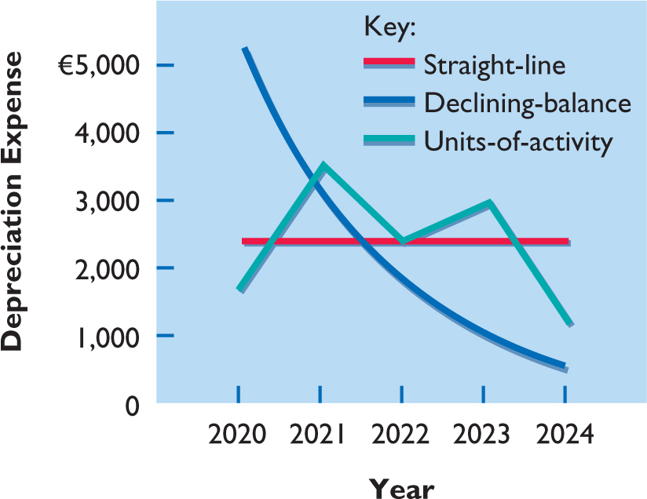
Comparison of Methods (2 of 2)

Slide 34
Component Depreciation (1 of 2)
IFRS requires component depreciation for plant assets
Any significant parts of a plant asset that have significantly different estimated useful lives should be separately depreciated

Slide 35
Component Depreciation (2 of 2)
Illustration: Lexure Construction builds an office building for HK$4,000,000, not including the cost of the land. If the HK$4,000,000 is allocated over the 40-year useful life of the building, Lexure reports HK$100,000 (HK$4,000,000 ÷ 40) of depreciation per year, assuming straight-line depreciation and no residual value. However, assume that HK$320,000 of the cost of the building relates to a heating, ventilation, and air conditioning (HVAC) system and HK$600,000 relates to flooring. Because the HVAC system has a depreciable life of five years and the flooring has a depreciable life of 10 years, Lexure must use component depreciation. It must reclassify HK$320,000 of the cost of the building to the HVAC system and HK$600,000 to the cost of flooring.

Slide 36
Component Depreciation (2 of 2)
Assuming that Lexure uses straight-line depreciation, the following shows the computation of component depreciation for the first year of the office building.
Building cost adjusted (HK$4,000,000 − HK$320,000 − HK$600,000) | HK$3,080,000
Building cost depreciation per year (HK$3,080,000 ÷ 40) | HK$ 77,000
Personal HVAC system depreciation (HK$320,000 ÷ 5) | 64,000
Flooring depreciation (HK$600,000 ÷ 10) | 60,000
Total component depreciation in first year | HK$ 201,000

Slide 37
Depreciation and Income Taxes
Tax laws do not require taxpayer to use the same depreciation method on the tax return that is used in preparing financial statements.
Many companies use straight-line in their financial statements to maximize net income.
They also use an accelerated depreciation method on their tax returns to minimize their income taxes.

Slide 38
Revaluation of Plant Assets (1 of 5)
IFRS allows companies to revalue plant assets to fair value at the reporting date
Must be applied to all assets in a class of assets
Assets that are experiencing rapid price changes must be revalued on an annual basis

Slide 39
Revaluation of Plant Assets (2 of 5)
Gain Situation
Illustration: Pernice Ltd. applies revaluation to equipment purchased on January 1, 2020, for HK$1,000,000. The equipment has a useful life of five years and no residual value. On December 31, 2020, Pernice makes the following journal entry to record depreciation expense, assuming straight-line depreciation.
Depreciation Expense
200,000
Accumulated Depreciation—Equipment
200,000

Slide 40
Revaluation of Plant Assets (3 of 5)
At the end of 2020, independent appraisers determine that the asset has a fair value of HK$850,000. To report the equipment at its fair value of HK$850,000 on December 31, 2020, Pernice eliminates the Accumulated Depreciation—Equipment account, reduces Equipment to its fair value of HK$850,000, and records Revaluation Surplus of HK$50,000. The entry to record the revaluation is as follows.
Accumulated Depreciation—Equipment
200,000
Equipment
150,000
Revaluation Surplus
50,000

Slide 41
Revaluation of Plant Assets (4 of 5)
Pernice reports
Depreciation expense of HK$200,000 in the income statement
HK$50,000 in other comprehensive income
HK$850,000 is the new basis of the asset
Assuming no change in the total useful life, depreciation in 2021 will be HK$212,500 (HK$850,000 ÷ 4).

Slide 42
Revaluation of Plant Assets (5 of 4)
Loss Situation
Illustration: Pernice’s equipment has a carrying amount of HK$800,000 (HK$1,000,000 − HK$200,000). However, at the end of 2020, independent appraisers determine that the asset has a fair value of HK$775,000, which results in an impairment loss of HK$25,000 (HK$800,000 − HK$775,000). The entry to record the equipment and report the impairment loss is as follows.
Accumulated Depreciation—Equipment
200,000
Impairment Loss
25,000
Equipment
225,000

Slide 43
Revising Periodic Depreciation (1 of 4)
Accounted for in period of change and future periods (Change in Estimate)
No change in depreciation reported for prior years
Not considered an error
Use a step-by-step approach:
determine new depreciable cost
divide by remaining useful life

Slide 44
Revising Periodic Depreciation (2 of 4)
Illustration: Barb’s Florists decides on January 1, 2023, to extend the useful life of the truck by one year (a total life of six years) and increase its residual value to €2,200. The company has used the straight-line method to depreciate the asset to date. Depreciation for the first 3 years is as follows.
Equipment cost | €13,000
Residual value | − 1,000
Depreciable base | 12,000
Useful life (original) | ÷ 5 years
Annual depreciation | € 2,400
× 3 years = €7,200

Slide 45
Revising Periodic Depreciation (3 of 4)
Net book value at date of change in estimate (after 3 years).
Plant Assets:
Equipment | €13,000
Accumulated depreciation | 7,200
Net book value | € 5,800

Slide 46
Revising Periodic Depreciation (4 of 4)
Calculation of depreciation expense for 2023, year 4.
Net book value after year 3 | €5,800
Residual value (revised) | − 2,200
Depreciable base | 3,600
Remaining life | ÷ 3 years
Revised Annual depreciation | €1,200
Journal entry for 2023 and future years.
Depreciation Expense
1,200
Accumulated Depreciation
1,200

Slide 47
Do It! 2b: Revised Depreciation (1 of 3)
Chambers Corporation purchased a piece of equipment for £36,000. It estimated a 6-year life and £6,000 salvage value. Thus, straight-line depreciation was £5,000 per year [(£36,000 − £6,000) ÷ 6]. At the end of year three (before the depreciation adjustment), it estimated the new total life to be 10 years and the new salvage value to be £2,000. Compute the revised depreciation.

Slide 48
Do It! 2b: Revised Depreciation (2 of 3)
Calculation of depreciation expense for first 2 years.
Equipment cost | £36,000
Salvage value | − 6,000
Depreciable base | 30,000
Useful life (original) | ÷ 6 years
Annual depreciation | £ 5,000
× 2 years = £10,000
Net book value at date of change in estimate (after 2 years).
Plant Assets:
Equipment | £36,000
Accumulated depreciation | 10,000
Net book value | £26,000

Slide 49
Do It! 2b: Revised Depreciation (3 of 3)
Calculation of revised depreciation expense for remaining years.
Net book value after year 2 | £26,000
Salvage value (revised) | − 2,000
Depreciable base | 24,000
Remaining life | ÷ 8 years
Annual depreciation | £ 3,000
Journal entry for remaining years.
Depreciation Expense
3,000
Accumulated Depreciation
3,000

Slide 50
Learning Objective 3 Explain How to Account for the Disposal of Plant Assets

Slide 51
Plant Asset Disposals
Companies dispose of plant assets in three ways —
Retirement: Equipment is scrapped or discarded
Sale: Equipment is sold to another party
Exchange: Equipment is traded for new equipment
Record depreciation up to the date of disposal.
Eliminate asset by (1) debiting Accumulated Depreciation, and (2) crediting the asset account.

Slide 52
Retirement of Plant Assets (1 of 3)
No cash is received
Decrease (debit) Accumulated Depreciation for full amount of depreciation taken over life of asset
Decrease (credit) asset account for original cost of asset

Slide 53
Retirement of Plant Assets (2 of 3)
Illustration: Hobart Publishing retires its computer printers, which cost €32,000. The accumulated depreciation on these printers is €32,000. Prepare the entry to record this retirement.
Accumulated Depreciation—Equipment
32,000
Equipment
32,000
Question: What happens if a fully depreciated plant asset is still useful to the company?

Slide 54
Retirement of Plant Assets (3 of 3)
Illustration: Sunset Company discards delivery equipment that cost €18,000 and has accumulated depreciation of €14,000. The journal entry is?
Accumulated Depreciation—Equipment
14,000
Loss on Disposal of Plant Assets
4,000
Equipment
18,000
Companies report a loss on disposal in the “Other income and expense” section of the income statement.

Slide 55
Sale of Plant Assets (1 of 4)
Compare the book value of the asset with the proceeds received from the sale.
If proceeds exceed the book value, a gain on disposal occurs
If proceeds are less than the book value, a loss on disposal occurs

Slide 56
Sale of Plant Assets (2 of 4)
Illustration: On July 1, 2020, Wright Interiors sells office furniture for €16,000 cash. The office furniture originally cost €60,000. As of January 1, 2020, it had accumulated depreciation of €41,000. Depreciation for the first six months of 2020 is €8,000. Prepare the journal entry to record depreciation expense up to the date of sale.
Depreciation Expense
8,000
Accumulated Depreciation—Equipment
8,000

Slide 57
Sale of Plant Assets (3 of 4)
Cost of office furniture | €60,000
Less: Accumulated depreciation (€41, 000 + €8,000) | 49,000
Book value at date of disposal | 11,000
Proceeds from sale | 16,000
Gain on disposal of plant asset | € 5,000
Wright records the sale as follows on July 1.
Cash
16,000
Accumulated Depreciation—Equipment
49,000
Equipment
60,000
Gain on Disposal of Plant Assets
5,000

Slide 58
Sale of Plant Assets (4 of 4)
Illustration: Assume that instead of selling the office furniture for €16,000, Wright sells it for €9,000.
Cost of office furniture | €60,000
Less: Accumulated depreciation (€41, 000 + €8,000) | 49,000
Book value at date of disposal | 11,000
Proceeds from sale | 9,000
Loss on disposal of plant asset | € 2,000
Cash
9,000
Accumulated Depreciation—Equipment
49,000
Loss on Disposal of Plant Assets
2,000
Equipment
60,000

Slide 59
Do It! 3: Plant Asset Disposal (1 of 2)
Overland Trucking has decided to sell an old truck that cost £30,000 and which has accumulated depreciation of £16,000. (a) What entry would Overland Trucking make to record the sale of the truck for £17,000 cash?
Cash
17,000
Accumulated Depreciation—Equipment
16,000
Equipment
30,000
Gain on Disposal of Plant Assets
3,000

Slide 60
Do It! 3: Plant Asset Disposal (2 of 2)
Overland Trucking has decided to sell an old truck that cost £30,000 and which has accumulated depreciation of £16,000. (b) What entry would Overland Trucking make to record the sale of the truck for £10,000 cash?
Cash
10,000
Accumulated Depreciation—Equipment
16,000
Loss on Disposal of Plant Assets
4,000
Equipment
30,000

Slide 61
Learning Objective 4 Describe How to Account for Natural Resources and Intangible Assets

Slide 62
Natural Resources and Intangible Assets
Natural resources consist of standing timber and underground deposits of oil, gas, and minerals.
Distinguishing characteristics:
Physically extracted in operations
Replaceable only by an act of nature
Cost is the price needed to acquire the resource and prepare it for its intended use.

Slide 63
Depletion (1 of 3)
The allocation of the cost to expense in a rational and systematic manner over the resource’s useful life.
Companies generally use units-of-activity method
Depletion generally is a function of the units extracted
Total Cost - Residual Value | = | Depletion Cost per Unit
Total Estimated Units Available

Slide 64
Depletion (2 of 3)
Illustration: Lane Coal Company invests HK$50 million in a mine estimated to have 10 million tons of coal and no residual value. Compute the depletion cost per unit.
Total Cost - Residual Value | = | Depletion Cost per Unit
Total Estimated Units Available
HK$50,000,000 | = | HK$5.00 per ton
10,000,000

Slide 65
Depletion (3 of 3)
Illustration: Lane Coal Company invests HK$50 million in a mine estimated to have 10 million tons of coal and no residual value. In the first year, Lane extracts and sells 250,000 tons of coal. Lane computes the depletion as follows:
HK$50,000,000 ÷ 10,000,000 = HK$5.00 depletion cost per ton
HK$5.00 x 250,000 = HK$1,250,000 annual depletion
Journal entry:
Inventory (coal)
1,250,000
Accumulated Depletion
1,250,000

Slide 66
Intangible Assets
Rights, privileges, and competitive advantages that result from ownership of long-lived assets that do not possess physical substance.
Limited life or an indefinite life.
Common types of intangibles:
Patents | Trademarks
Copyrights | Trade names
Franchises and Licenses | Goodwill

Slide 67
Accounting for Intangible Assets (1 of 8)
Limited-Life Intangibles:
Amortize to expense
Credit asset account or accumulated amortization
Indefinite-Life Intangibles:
No foreseeable limit on time asset is expected to provide cash flow
No amortization

Slide 68
Accounting for Intangible Assets (2 of 8)
Patents
Amortize to expense
Exclusive right to manufacture, sell, or otherwise control an invention for 20 years from date of grant
Capitalize costs of purchasing a patent and amortize over 20-year life or its useful life, whichever is shorter
Expense any R&D costs in developing a patent
Legal fees incurred successfully defending a patent are capitalized to Patents account

Slide 69
Accounting for Intangible Assets (4 of 8)
Illustration: National Labs purchases a patent at a cost of NT$720,000. National estimates the useful life to be eight years. Prepare the journal entry to record the annual amortization for the year ended December 31.
Cost | NT$720,000
Useful life | ÷ 8
Amortization | NT$ 90,000
Dec. 31
Amortization Expense
90,000
Patents
90,000

Slide 70
Accounting for Intangible Assets (5 of 8)
Copyrights
Gives owner exclusive right to reproduce and sell an artistic or published work
Granted for life of creator plus 70 years
Capitalize costs of acquiring and defending
Amortized to expense over useful life

Slide 71
Accounting for Intangible Assets (6 of 8)
Trademarks and Trade Names
Word, phrase, jingle, or symbol that distinguishes or identifies a particular enterprise or product
Big Mac, Coca-Cola, and Jetta
Legal protection for indefinite number of 20 year renewal periods
Capitalize acquisition costs
No amortization

Slide 72
Accounting for Intangible Assets (7 of 8)
Franchises
Contractual arrangement between a franchisor and a franchisee
CPC, Subway, and Europcar are franchises
Franchise (or license) with a limited life should be amortized to expense over its useful life
If life is indefinite, cost is not amortized

Slide 73
Accounting for Intangible Assets (8 of 8)
Goodwill
Includes exceptional management, desirable location, good customer relations, skilled employees, high-quality products, etc.
Only recorded when an entire business is purchased
Goodwill is recorded as excess of purchase price over fair value of net assets acquired
Not amortized

Slide 74
Research and Development Costs
Expenditures that may lead to
patents
copyrights
new processes
new products
All R & D costs are expensed when incurred
Not intangible assets

Slide 75
Do It! 4: Classification Concepts (1 of 3)
Match the term most directly associated with each statement.
Copyrights | Depletion
Intangible assets | Franchises
Research costs
The allocation of the cost of a natural resource in a rational and systematic manner.
Depletion
Rights, privileges, and competitive advantages that result from the ownership of long-lived assets that do not possess physical substance.
Intangible assets

Slide 76
Do It! 4: Classification Concepts (2 of 3)
Match the term most directly associated with each statement.
Copyrights | Depletion
Intangible assets | Franchises
Research costs
An exclusive right granted by the government to reproduce and sell an artistic or published work.
Copyrights
A right to sell certain products or services or to use certain trademarks or trade names within a designated geographic area.
Franchises

Slide 77
Do It! 4: Classification Concepts (3 of 3)
Match the term most directly associated with each statement.
Copyrights | Depletion
Intangible assets | Franchises
Research costs
Costs incurred by a company that often lead to patents or new products. These costs must be expensed as incurred.
Research costs

Slide 78
Learning Objective 5 Discuss How Plant Assets, Natural Resources, and Intangible Assets are Reported and Analyzed

Slide 79
Statement Presentation and Analysis
Presentation
Usually, companies combine plant assets and natural resources under “Property, plant, and equipment” in the statement of financial position.
Intangible assets are shown separately

Slide 80
Statement Presentation
Artex Enterprises Statement of Financial Position (partial) (in billions)
Property, plant, and equipment
Gold mine | ¥ 530
Less: Accumulated depletion | 210 |  | ¥ 320
Land |  |  | 600
Buildings | 7,600
Less: Accumulated depreciation—buildings | 500 |  | 7,100
Equipment | 3,870
Less: Accumulated depreciation—equipment | 620 |  | 3,250
Total property, plant, and equipment |  |  |  |  | ¥11,270
Intangible assets
Patents |  |  | 440
Trademarks |  |  | 180
Goodwill |  |  | 900 |  | 1,520
Total assets |  |  |  |  | ¥12,790

Slide 81
Analysis
Illustration: LG’s net sales for a recent year were ₩58,140 billion. Its total ending assets were ₩35,528 billion, and beginning assets were ₩34,766 billion.
Net Sales | ÷ | Average Total Assets | = | Asset Turnover
₩58,140 | ÷ | ₩35,528 + ₩34,766 | = | 1.65 Times
 |  | 2
Each dollar invested in assets produced ₩1.65 in sales. If a company is using its assets efficiently, each investment in assets will create a high amount of sales.

Slide 82
DO IT! 5: Asset Turnover
Paramour Company reported net income of $180,000, net sales of $420,000, and had total assets of $460,000 on January 1, 2020, and total assets on December 31, 2020, of $540,000 billion. Determine Paramour’s asset turnover for 2020.
Solution
Net Sales | ÷ | Average Total Assets | = | Asset Turnover
$420,000 | ÷ | $460,000 + $540,000 | = | .84 Times
 |  | 2

Slide 83
Learning Objective 6 Explain How to Account for the Exchange of Plant Assets

Slide 84
Appendix 9A Exchange of Plant Assets
Ordinarily, companies record a gain or loss on exchange of plant assets
Most exchanges have commercial substance
Commercial substance if future cash flows change as a result of exchange

Slide 85
Loss Treatment
Illustration: Roland NV exchanged old trucks (cost €64,000 less €22,000 accumulated depreciation) plus cash of €17,000 for a new semi-truck. The old trucks had a fair market value of €26,000.
Cost of used trucks | €64,000
Less: Accumulated depreciation | 22,000
Book value | 42,000
Fair market value of used trucks | 26,000
Loss on disposal of plant assets | €16,000
Fair market value of used trucks | €26,000
Cash paid | 17,000
Cost of new truck | €43,000

Slide 86
Loss Treatment
Illustration: Roland NV exchanged old trucks (cost €64,000 less €22,000 accumulated depreciation) plus cash of €17,000 for a new semi-truck. The old trucks had a fair market value of €26,000. Prepare the entry to record the exchange of assets by Roland.
Equipment (new)
43,000
Accumulated Depreciation—Equipment
22,000
Loss on Disposal of Plant Assets
16,000
Equipment (old)
64,000
Cash
17,000

Slide 87
Gain Treatment
Illustration: Mark Express trades its old delivery equipment (cost €40,000 less €28,000 accumulated depreciation) for new delivery equipment. The old equipment had a fair market value of €19,000. Mark also paid €3,000.
Cost of old equipment | €40,000
Less: Accumulated depreciation | 28,000
Book value | 12,000
Fair market value of old equipment | 19,000
Gain on disposal of plant assets | € 7,000
Fair market value of old equipment | €19,000
Cash paid | 3,000
Cost of new equipment | €22,000

Slide 88
Gain Treatment
Illustration: Mark Express trades its old delivery equipment (cost €40,000 less €28,000 accumulated depreciation) for new delivery equipment. The old equipment had a fair market value of €19,000. Mark also paid €3,000.
Equipment (new)
22,000
Accumulated Depreciation—Equipment
28,000
Equipment (old)
40,000
Gain on Disposal of Plant Assets
7,000
Cash
3,000

Slide 89
Learning Objective 7 Compare the Accounting For Long-lived Assets Under I F R S and U.S. G A A P

Slide 90
A Look at U.S. GAAP
Key Points
Similarities
The definition for plant assets for both IFRS and GAAP is essentially the same.
GAAP, like IFRS, capitalizes all direct costs in self-constructed assets such as raw materials and labor. IFRS does not address the capitalization of fixed overhead although in practice these costs are generally capitalized.
GAAP also views depreciation as an allocation of cost over an asset’s useful life. GAAP permits the same depreciation methods (e.g., straight-line, accelerated, and units-of activity) as IFRS.

Slide 91
A Look at U.S. GAAP
Key Points
Similarities
The accounting for subsequent expenditures (such as ordinary repairs and additions) are essentially the same under IFRS and GAAP.
Under both GAAP and IFRS, changes in the depreciation method used and changes in useful life are handled in current and future periods. Prior periods are not affected. GAAP recently conformed to IFRS in the accounting for changes in depreciation methods.
The accounting for plant asset disposals is essentially the same under IFRS and GAAP.
Initial costs to acquire natural resources are essentially the same under IFRS and GAAP.

Slide 92
A Look at U.S. GAAP
Key Points
Similarities
The definition of intangible assets is essentially the same under IFRS and GAAP.
The accounting for exchanges of non-monetary assets has converged between IFRS and GAAP. GAAP now requires that gains on exchanges of non-monetary assets be recognized if the exchange has commercial substance. This is the same framework used in IFRS.
Both IFRS and GAAP follow the historical cost principle when accounting for property, plant, and equipment at date of acquisition. Cost consists of all expenditures necessary to acquire the asset and make it ready for its intended use.

Slide 93
A Look at U.S. GAAP
Key Points
Similarities
Under both IFRS and GAAP, interest costs incurred during construction are capitalized. Recently, IFRS converged to GAAP requirements in this area.
Differences
Under GAAP, an item of property, plant, and equipment with multiple parts is generally depreciated over the useful life of the total asset. Thus, component depreciation is generally not used. However, GAAP permits companies to use component depreciation.
GAAP uses the term salvage value, rather than residual value, to refer to an owner’s estimate of an asset’s value at the end of its useful life for that owner.

Slide 94
A Look at U.S. GAAP
Key Points
Differences
IFRS allows companies to revalue plant assets to fair value at the reporting date.
As in IFRS, under GAAP the costs associated with research and development are segregated into the two components. Costs in the research phase are always expensed under both IFRS and GAAP. Under IFRS, however, costs in the development phase are capitalized as Development Costs once technological feasibility is achieved.
IFRS permits revaluation of intangible assets (except for goodwill). GAAP prohibits revaluation of intangible assets.

Slide 95
A Look at U.S. GAAP
Key Points
Differences
IFRS requires an impairment test at each reporting date for plant assets and intangibles and records an impairment if the asset’s carrying amount exceeds its recoverable amount. The recoverable amount is the higher of the asset’s fair value less costs to sell or its value-in-use. Value-in-use is the future cash flows to be derived from the particular asset, discounted to present value. Under GAAP, impairment loss is measured as the excess of the carrying amount over the asset’s fair value.

Slide 96
A Look at U.S. GAAP
Key Points
Differences
IFRS allows reversal of impairment losses when there has been a change in economic conditions or in the expected use of the asset. Under GAAP, impairment losses cannot be reversed for assets to be held and used; the impairment loss results in a new cost basis for the asset. IFRS and GAAP are similar in the accounting for impairments of assets held for disposal.

Slide 97
A Look at U.S. GAAP
Looking to the Future
With respect to revaluations, as part of the conceptual framework project, the Boards will examine the measurement bases used in accounting. It is too early to say whether a converged conceptual framework will recommend fair value measurement (and revaluation accounting) for plant assets and intangibles. However, this is likely to be one of the more contentious issues, given the long-standing use of historical cost as a measurement basis in GAAP. The IASB and FASB have identified a project that would consider expanded recognition of internally generated intangible assets. IFRS permits more recognition of intangibles compared to GAAP. Thus, it will be challenging to develop converged standards for intangible assets, given the long-standing prohibition on capitalizing internally generated intangible assets and research and development costs in GAAP.

Slide 98
Copyright
Copyright © 2019 John Wiley & Sons, Inc.
All rights reserved. Reproduction or translation of this work beyond that permitted in Section 117 of the 1976 United States Act without the express written permission of the copyright owner is unlawful. Request for further information should be addressed to the Permissions Department, John Wiley & Sons, Inc. The purchaser may make back-up copies for his/her own use only and not for distribution or resale. The Publisher assumes no responsibility for errors, omissions, or damages, caused by the use of these programs or from the use of the information contained herein.

