Slide 1
An-Najah National University
Faculty of Medicine
Department of Physiology
Anatomy and Physiology 1
7102101
Instructor: Heba Salah
Chapter 5:
The Nervous System
Part 1: Organization of the Nervous System, and Supporting Cells.

Slide 2
Functions of the Nervous System
1. Sensory input – gathering information
To monitor changes occurring inside and outside the body (changes = stimuli)
2. Integration –
To process and interpret sensory input and decide if action is needed.
3. Motor output
A response to integrated stimuli
The response activates muscles or glands

Slide 3
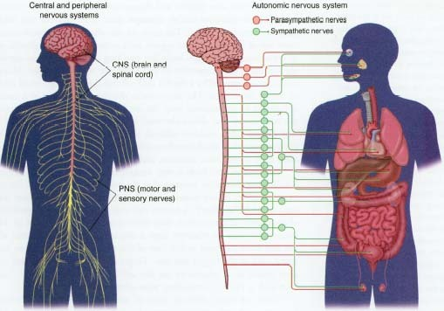
Structural Classification of the Nervous System
1. Central nervous system (CNS)
Brain
Spinal cord
2. Peripheral nervous system (PNS)
Nerve outside the brain and spinal cord

Slide 4
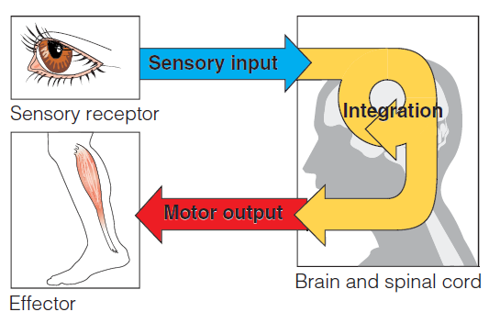
Functional Classification of the Peripheral Nervous System
1. Sensory (afferent) division
Nerve fibers that carry information to the central nervous system
2. Motor (efferent) division
Nerve fibers that carry impulses away from the central nervous system

Slide 5
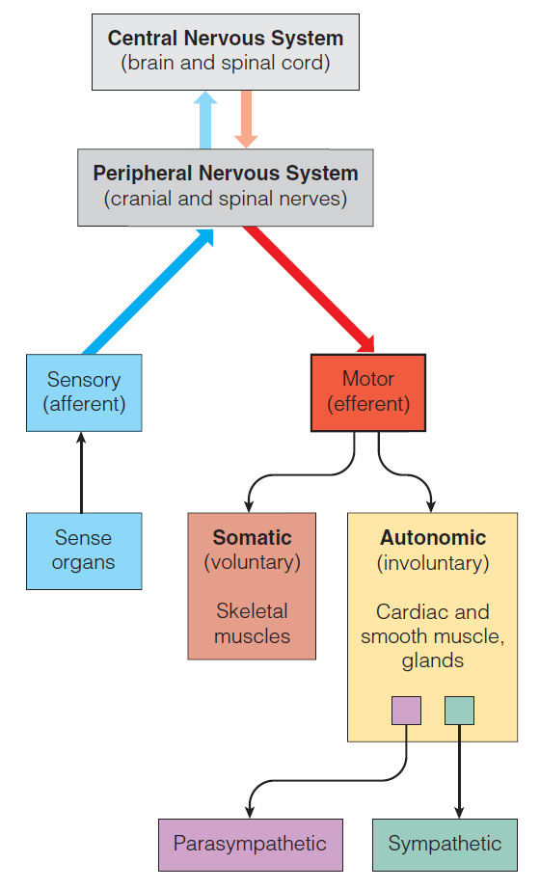
Organization of the Nervous System

Slide 6
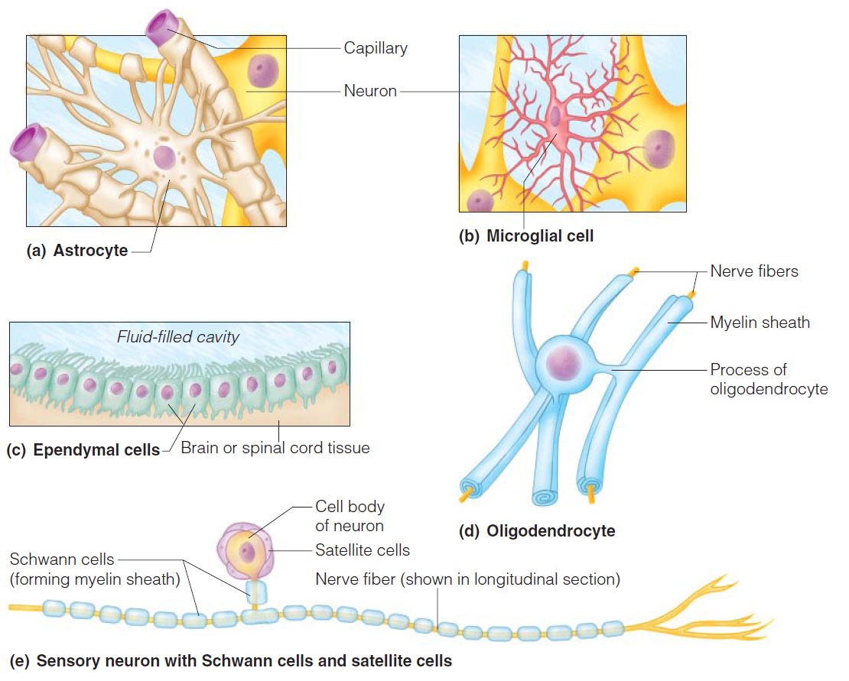
Nervous Tissue: Support Cells (Neuroglia or Glia)

