Slide 1
Proposals

Slide 2
A proposal is a document that is submitted to a funding agency, an oversight committee, management, or some other entity that can provide permission, funding, or substantive support for some planned activity.
Government agencies have elaborate requirements for their proposals.
Many private foundations and corporations have simple proposal formats (Some offer no specific format)

Slide 3
modified proposal template for a U.S. Government agency (from book)
Title
• Problem Statement
• Hypotheses/Objective
• Scope and Limitations
• Definition of Terms
• Abbreviations
• Background
• Uniqueness of the Research
• Potential Contribution
• Direct Application
• Potential for Technology Transfer
• Methods and Procedures
• Success Criteria
• Qualifications of the Research Team
• Organizational Center Initiative History
• Deliverables/Schedule
• Estimated Cost
• Other Funding Sources

Slide 4
See example in textbook pages (143-147)

Slide 5
Assignment
Title page (title of project, participants’ names, course name, university name).
Table of contents
Problem
Why is the project being undertaken? Describe an opportunity or problem that the project will address
Objective(s)/vision/Solution
[specific & measurable objective 1]
[specific & measurable objective 2]
[specific & measurable objective 3]
Definition of terms
Background/overview
Related work & uniqueness of research or project
Methods and procedures (Methodology)
Software & Hardware used
References
Ex: References or pages where you read about related work
Tasks and Gantt Chart
Stakeholders
Estimated Costs
Note: Choose 2 from the blue titles

Slide 6
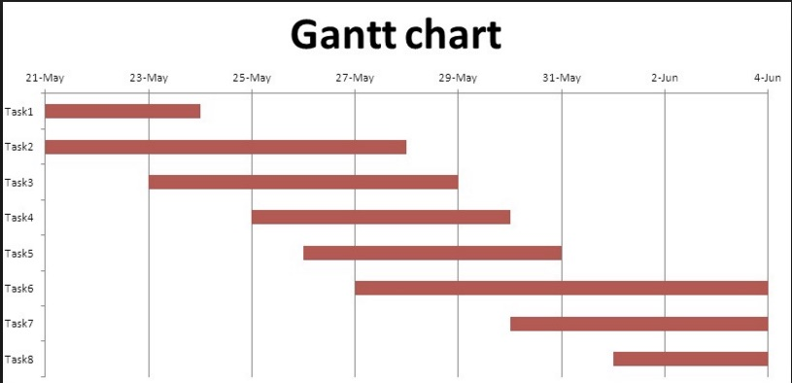
Time table of tasks and Gantt chart
 | Description of Work | Start and End Dates
Phase One / task 1 | … | …
Phase Two /task 2 | … | …
Phase Three/ task 3 | … | …

Slide 7
Estimated cost
 | Description of Work | Anticipated Costs
Phase One | … | …
Phase Two | … | …
Phase Three | … | …
 | Total | $ 0.00

Slide 8
Stakeholders:
 | Name
Supervisor
Student1
Student2
Company/organization

Slide 9
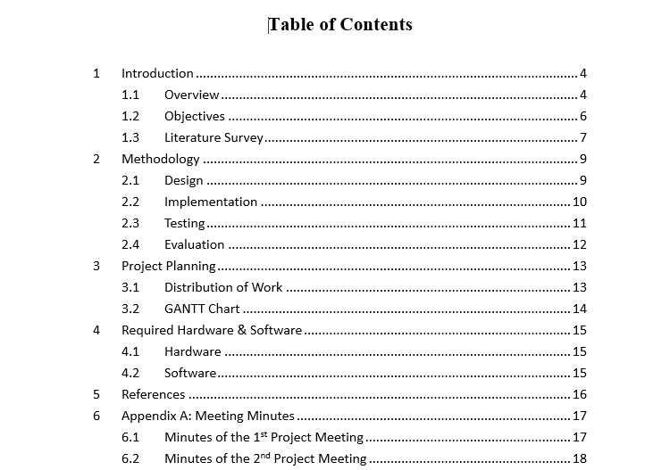
Table of contents example

Slide 10
Notes
All figures and tables must be captioned.
Be consistent in headings and numbering.

Slide 11
Types of proposals (extra information – not required)
There are six types of proposal:
Formally solicited
Informally solicited
Unsolicited
Continuation
Renewal
Supplemental
For explanation see: https://www.process.st/project-proposal/

