Slide 1
Angle modulation

Slide 2
Angle modulation- Outlines
In this chapter we will study the following topics
Frequency modulation (FM) and phase modulation (PM)
Narrowband and wide band modulation
Modulation and demodulation of FM signals
Commercial FM systems
Relationship between PM and FM waves

Slide 3
Introduction
In angle modulation the angle of the carrier is varied according to the message signal $m\left(t\right)$ while the amplitude of the carrier remains constant
The carrier typically is a sinusoidal signal which is expressed mathematically by
$$c\left(t\right)=A_{c}cos\left(ω_{c}t+θ_{c}\right)$$
The angle modulation is a nonlinear process while the amplitude modulation is a linear process
The nonlinearity of the angle modulation means that
In analytic terms, the spectral analysis of angle modulation is complicated
In practical terms, the implementation of angle modulation is harder than amplitude modulation
Amplitude
Angle

Slide 4
Bandwidth and noise effect on angle modulation
Theoretically the bandwidth of an angle-modulated extends to infinity compared to $2W$ for AM modulated signals wave may an infinite extent, at least in theory
Because the information signal is contained within the angle of the carrier, the angle modulation is less affected by noise compared with amplitude modulated signals
Angle modulation can provide better discrimination against noise and interference than amplitude modulation
Angle modulation has relatively large bandwidth for improved noise performance

Slide 5
Definition of FM and PM signals
Recall that the carrier of the signal is defined by
$$c\left(t\right)=A_{c}cos(ω_{c}t+θ_{c})$$
Frequency modulation (FM) can be obtained by varying the frequency of the carrier $ω_{c}$ according to the message signal $m\left(t\right)$
Phase modulation (PM) can be obtained by varying the phase of the carrier $θ\left(t\right)$ according to the message signal $m\left(t\right)$

Slide 6
Mathematical formulation of FM signals
When generating FM signals the frequency of the carrier is varied linearly with message signal $m\left(t\right)$
Mathematically we can write the instantaneous frequency of the carrier as
$$ω_{i}\left(t\right)=ω_{c}+k_{f}m\left(t\right)$$
Where $ω_{i}$ is the instantaneous frequency of the carrier, $ω_{c}$ is the carrier frequency, $k_{f}$ is the frequency modulation constant
The phase of the carrier is related to its instantaneous frequency by
$$θ\left(t\right)=\int_{0}^{t}{ω_{i}\left(τ\right)dτ}=\int_{0}^{t}{\left[ω_{c}+k_{f}m\left(τ\right)\right]dτ}=ω_{c}t+k_{f}\int_{0}^{t}{m\left(τ\right)dτ}$$
The mathematical expression for the FM modulated signal is given by
$$s_{FM}\left(t\right)=A_{c}\cos\left(ω_{c}t+k_{f}\int_{0}^{t}{m\left(τ\right)}dτ\right)$$
FM modulated signal

Slide 7
Mathematical formulation of PM signals
When generating PM signals the phase of the carrier is varied linearly with message signal $m\left(t\right)$
Mathematically we can write the instantaneous phase of the carrier as
$$θ_{i}\left(t\right)=ω_{c}t+k_{p}m\left(t\right)+θ_{0}$$
Where $θ\left(t\right)$ is the phase of the carrier, $k_{p}$ is the phase modulation constant, $θ_{0}$ is the initial phase of the carrier
The instantaneous frequency of the carrier is defined by
$$ω_{i}\left(t\right)=\frac{∂θ\left(t\right)}{∂t }=ω_{c}+k_{p}\frac{∂m\left(t\right)}{∂t}$$
The mathematical expression for the carrier is given by
$$s_{PM}\left(t\right)=A_{c}\cos\left(ω_{c}t+k_{p}m\left(t\right)+θ_{0}\right)$$
PM modulated signal

Slide 8
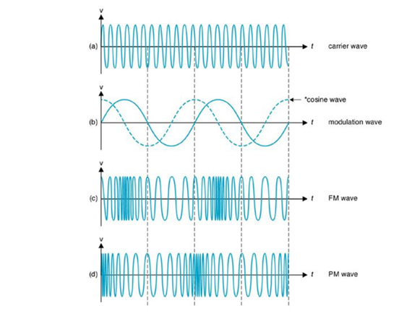
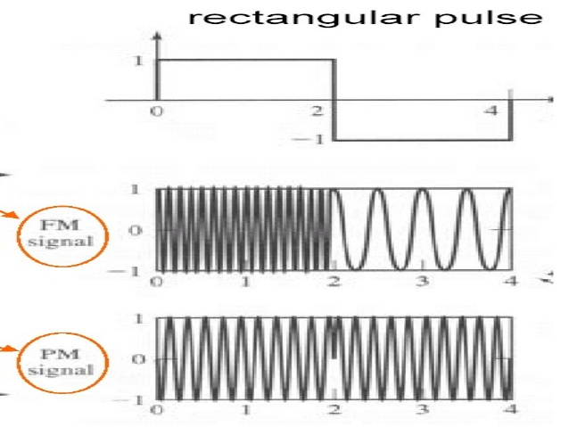
FM and PM waveforms
FM and PM modulated waveforms when $m\left(t\right)=A_{m}\cos\left(ω_{m}t\right)$
FM and PM modulated waveforms when $m\left(t\right)=square wave$

Slide 9
Narrowband FM
To formulate the narrow band FM modulation let $m\left(t\right)=A_{m}cos\left(ω_{m}t\right)$
The instantaneous frequency of the carrier is
$$ω_{i}\left(t\right)=ω_{c}+k_{f}m\left(t\right)$$
$$ω_{i}\left(t\right)=ω_{c}+A_{m}k_{f}\cos\left(ω_{m}t\right)$$
The peak frequency deviation from the carrier is obtained when $\cos\left(ω_{m}t\right)=+1$, therefore we can write
$$∆ω=ω_{i}−ω_{c}=A_{m}k_{f}$$
Now the instantaneous phase of the carrier is given by
$$θ_{i}\left(t\right)=\int_{0}^{t}{ω_{i}\left(τ\right)dτ}=\int_{0}^{t}{\left[ω_{c}+k_{f}m\left(τ\right)\right]dτ}$$
$$θ_{i}\left(t\right)=ω_{c}t+k_{f}\int_{0}^{t}{A_{m}\cos\left(ω_{m}τ\right)dτ}=ω_{c}t+\frac{A_{m}k_{f}}{ω_{m}}sin\left(ω_{m}\right)t$$
Peak frequency deviation

Slide 10
Narrowband FM
$$θ_{i}\left(t\right)=ω_{c}t+k_{f}\int_{0}^{t}{A_{m}\cos\left(ω_{m}τ\right)dτ}=ω_{c}t+\frac{A_{m}k_{f}}{ω_{m}}sin\left(ω_{m}\right)t$$
The term $\frac{A_{m}k_{f}}{ω_{m}}=\frac{∆ω_{m}}{ω_{m}}$ is known as the FM modulation constant
$$β=\frac{A_{m}k_{f}}{ω_{m}}=\frac{∆ω_{m}}{ω_{m}}$$
$β$ is also know as the peak phase deviation of the carrier, $β$ is measured in radians/second
For narrow band FM (NBFM) typically $β≤0.5$
For values of $β>0.5$ the modulation is known as wideband FM
The expression for NBFM signal when $m\left(t\right)=A_{m}\cos{(ω_{m}t})$ is
$$s_{NBFM}\left(t\right)=A_{c}\cos\left(ω_{c}t+β\sin\left(ω_{m}t\right)\right)$$
The general expression for the NBFM modulated signal is
$$s_{NBFM}\left(t\right)=A_{c}\cos\left(ω_{c}t+k_{f}\int_{0}^{t}{m\left(τ\right)}dτ\right) provided that β≤0.5$$
Peak phase deviation

Slide 11
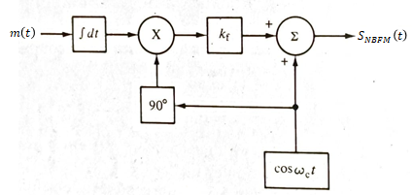
Bandwidth, and block diagram representation of NBFM
The bandwidth required for the NBFM signal is given by
$$BW=2W$$
Where $W$ is the bandwidth (largest frequency component in $m\left(t\right)$)
$$s_{NBFM}\left(t\right)=A_{c}\cos\left(ω_{c}t+k_{f}\int_{0}^{t}{m\left(τ\right)}dτ\right)$$
$$s_{NBFM}\left(t\right)=A_{c}\cos\left(ω_{c}t\right)cos({k_{f}}\int_{0}^{t}{m\left(τ\right)}dτ )−A_{c}\sin\left(ω_{c}t\right)sin⁡({k_{f}\int_{0}^{t}{m\left(τ\right)}dτ})$$
$$s_{NBFM}\left(t\right)=A_{c}\cos\left(ω_{c}t\right)−A_{c}\sin\left(ω_{c}t\right)k_{f}\int_{0}^{t}{m\left(τ\right)}dτ$$
$$k_{f}\int_{0}^{t}{m\left(τ\right)}dτ$$
1

Slide 12
Narrowband PM
To formulate the narrow band PM modulation let $m\left(t\right)=A_{m}cos\left(ω_{m}t\right)$
The instantaneous phase of the carrier is
$$θ_{i}\left(t\right)=ω_{c}t+k_{p}m\left(t\right)$$
The instantaneous frequency is given by
$$ω_{i}\left(t\right)=\frac{∂θ_{i}\left(t\right)}{∂t}=ω_{c}−A_{m}k_{p}ω_{m}\sin\left(ω_{m}t\right)$$
The peak frequency deviation from the carrier is obtained when $\sin\left(ω_{m}t\right)=−1$, therefore we can write
$$∆ω=ω_{i}−ω_{c}=A_{m}k_{p}ω_{m}$$
Peak frequency deviation

Slide 13
Narrowband PM
The term $\frac{A_{m}k_{p}ω_{m}}{ω_{m}}=A_{m}k_{p}$ is known as the PM modulation constant
$$β=\frac{A_{m}k_{f}ω_{m}}{ω_{m}}=A_{m}k_{p}$$
$β$ is also know as the peak phase deviation of the carrier, $β$ is measured in radians/second
For narrow band PM (NBPM) typically $β≤0.5$
For values of $β>0.5$ the modulation is known as wideband PM
The expression for NBPM signal when $m\left(t\right)=A_{m}\cos{(ω_{m}t})$ is
$$s_{NBFM}\left(t\right)=A_{c}\cos\left(ω_{c}t+A_{m}k_{p}\cos\left(ω_{m}t\right)\right)$$
The general expression for the NBPM modulated signal is
$$s_{NBPM}\left(t\right)=A_{c}\cos\left(ω_{c}t+k_{p}m\left(t\right)\right) provided that β≤0.5$$
Peak phase deviation

Slide 14
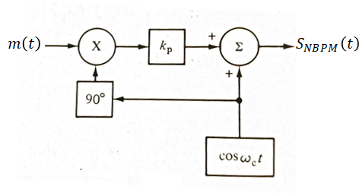
Bandwidth, and block diagram representation of NBPM
The bandwidth required for the NBPM signal is given by
$$BW=2W$$
Where $W$ is the bandwidth (largest frequency component in $m\left(t\right)$)
$$s_{NBPM}\left(t\right)=A_{c}\cos\left(ω_{c}t+k_{p}m\left(t\right)\right)$$
$$s_{NBFM}\left(t\right)=A_{c}\cos\left(ω_{c}t\right)\cos\left(k_{p}m\left(t\right)\right)−A_{c}\sin\left(ω_{c}t\right)\sin\left(k_{p}m\left(t\right)\right)$$
$$s_{NBFM}\left(t\right)=A_{c}\cos\left(ω_{c}t\right)−A_{c}\sin\left(ω_{c}t\right)k_{p}m\left(t\right)$$
$$k_{p}m\left(t\right)$$
$$1$$
$$s\left(t\right)$$
NBFM, NBPM generation block diagram

Slide 15
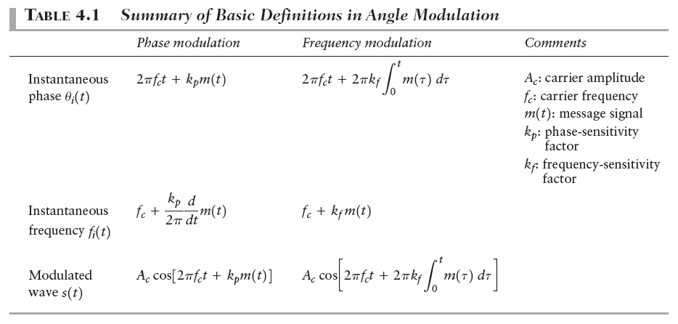
FM, PM comparison

Slide 16
Wideband FM modulation, transmission bandwidth
Wide band FM modulation is usually obtained when $β>0.5$
A major problem in wide band FM modulation is to compute its required transmission bandwidth
The bandwidth can be computed by computing the Fourier transform of the wideband FM signal which can be computed by the use of the Bessel function
The bandwidth can be computed by using one of the following ways
Using the harmonics generated by the Bessel function
Approximated by Carson’s rule

Slide 17
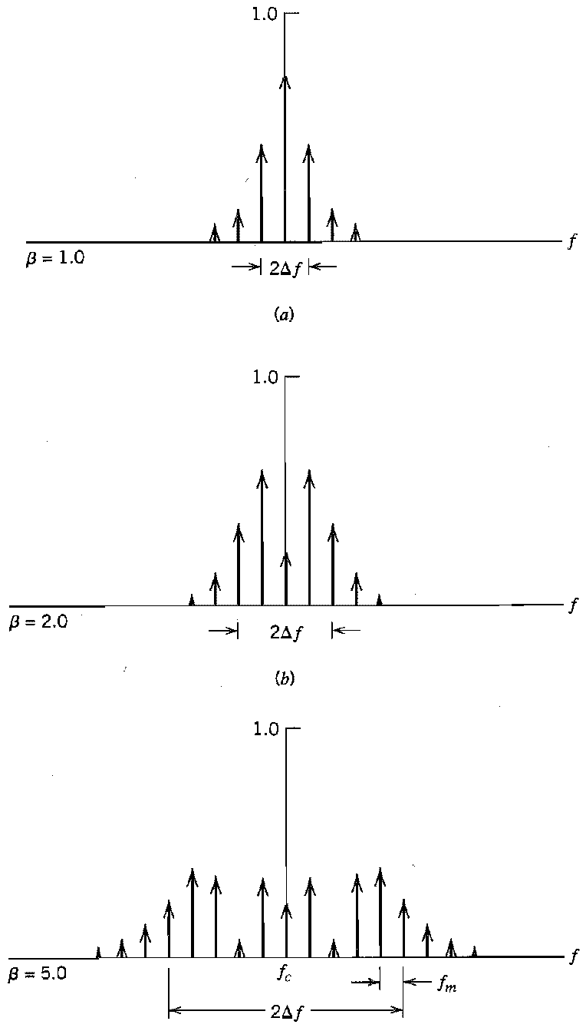
Wideband FM modulation, transmission bandwidth using Bessel function
The bandwidth using the Bessel function can be computed from
$$BW=2nf_{m}$$
Where $n$ is the number of the Bessel function component (spectrum harmonic) whose magnitude $\left|J_{n}\left(β\right)\right|≥0.01$, $f_{m}$ is the maximum frequency component contained within $m(t)$
Magnitude spectrum of the FM generated signal

Slide 18
Wideband FM modulation, transmission bandwidth using Carson’s rule
It was been noted that, for large values of $β≥10$, the value of Bessel harmonic $\left|J_{n}\left(β\right)\right|≥0.01$ occurs when $β=n$
Form the above observation it was been noticed that bandwidth for wide band FM signal, the bandwidth is
$$BW_{WBFM}=2nf_{m}=2βf_{m}=2∆f_{m}$$
Also for narrow band signals the bandwidth is given by
$$BW_{NBFM}=2W$$
where $W$ is the bandwidth (maximum frequency content of the message signal)
Carson’s suggest an approximate relation for the bandwidth which is the sum of the bandwidths of the wideband and narrow band cases

Slide 19
Wideband FM modulation, transmission bandwidth using Carson’s rule
Therefore, the bandwidth using Carson’s rule can be approximated by
$$BW=2f_{m}+2∆f$$
Or
$$BW=2f_{m}\left(1+\frac{∆f}{f_{m}}\right)=2f_{m}\left(1+β\right)$$

Slide 20
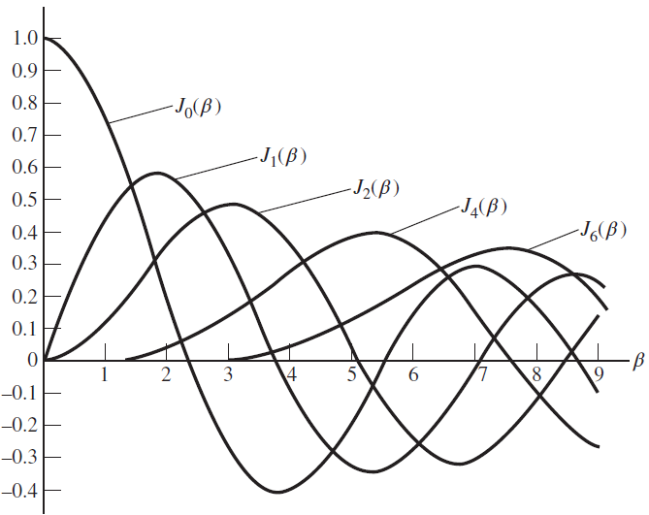
Properties of the Bessel function
The Bessel function that can be used to estimate the spectrum of the angle modulated signal would have the following properties
$J_{n}\left(β\right)$ are real valued
$J_{n}\left(β\right)=J_{n}\left(β\right), for n even$
$J_{n}\left(β\right)=−J_{−n}\left(β\right), for n odd$
$\sum_{n=−∞}^{∞}{J_{n}^{2}\left(β\right)}=1$
Plot of the Bessel function of the first kind for varying order

Slide 21
Bessel function table

Slide 22
Bandwidth example
Example A $10 MHz$ carrier is frequency-modulated by a sinusoidal signal such that the peak frequency deviation is $∆f=50 kHz$. Determine the bandwidth of the FM signal if the carrier frequency is
$f_{m}=500 kHz$
$f_{m}=500 Hz$
$f_{m}=10 kHz$
Solution
$BW=2f_{m}\left(1+β\right)$
$$β=\frac{∆f}{f_{m}}=\frac{50 kHz}{500 kHz}=0.1$$
$$BW=2×500 kHz\left(1+0.1\right)=1.1 MHz$$

Slide 23
Bandwidth example
$β=\frac{∆f}{f_{m}}=\frac{50 kHz}{500 Hz}=100$
$$BW=2×500\left(1+100\right)=101 kHz$$
$β=\frac{∆f}{f_{m}}=\frac{50 kHz}{10 kHz}=5$
$$BW=2×10 kHz\left(1+5\right)=120 kHz$$
In this case if we compute the bandwidth using the number of generated harmonics around the carrier, the number of the significant harmonics whose magnitude is $J_{n}\left(β\right)≥0.01$is 8, therefore the bandwidth is
$$BW=2nf_{m}=2×8×10 kHz=160 kHz$$

Slide 24
Average power in angle modulated waveforms
Recall that the general expression for the FM modulated signal can be written as
$s_{FM}\left(t\right)=A_{c}\cos\left(ω_{c}t+k_{f}\int_{0}^{t}{m(τ)dτ}\right)$
If the signal is applied a transmission system whose resistance is $R$, then the average power delivered by the FM signal is given by
$$P_{av}=\overline{s_{FM}{\left(t\right)}^{2}}=\frac{A_{c}^{2}}{2R}$$
This average power will be distributed over the sideband spectrum of the harmonics generated around the carrier

Slide 25
Average power in angle modulated waveforms
For example the fraction of the average power that is available on the carrier frequency is
$$J_{0}^{2}\left(β\right)\frac{A_{c}^{2}}{2R}$$
The fraction of the average power contained within the first side band is
$$J_{1}^{2}\left(β\right)\frac{A_{c}^{2}}{2R}+J_{−1}^{2}\left(β\right)\frac{A_{c}^{2}}{2R}=2J_{1}^{2}A_{c}^{2}$$
The fraction of the average power contained within the second side band is
$$J_{2}^{2}\left(β\right)\frac{A_{c}^{2}}{2R}+J_{−2}^{2}\left(β\right)\frac{A_{c}^{2}}{2R}=2J_{2}^{2}\frac{A_{c}^{2}}{2R}$$
The fraction of the average power contained within the third side band is
$$J_{3}^{2}\left(β\right)\frac{A_{c}^{2}}{2R}+J_{−3}^{2}\left(β\right)\frac{A_{c}^{2}}{2R}=2J_{3}^{2}\frac{A_{c}^{2}}{2R}$$

Slide 26
Average power example
A given FM transmitter is modulated with single sinusoid. The output average power with no modulation is 100 Watt across $50 Ω$ resistive load. The peak frequency deviation of the transmitter is increased carefully from zero until the first side band in the output spectrum is zero.
The fraction of the average power at the carrier
The average power in the remaining side bands
The average power in the second-order side band
Solution
The fraction of the average power at the carrier frequency is $J_{0}^{2}\left(β\right)\frac{A_{c}^{2}}{2R}$

Slide 27
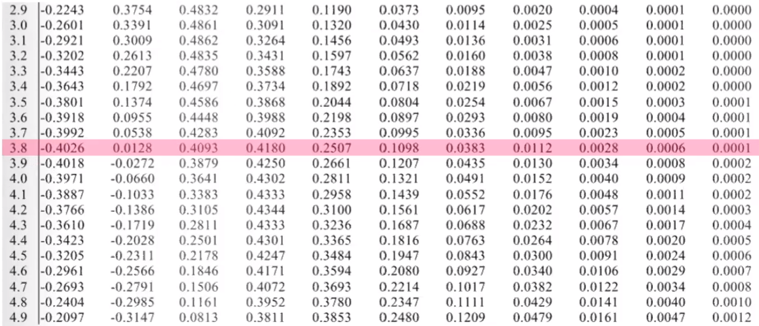
Average power example
Solution
$β$ can be determined from the Bessel function table. Note that the peak frequency deviation is increased from zero until the magnitude of the first side band became zero $J_{1}\left(β\right)=0$, therefore $β$ from the Bessel function table is determined where $J_{1}\left(β\right)$ is the smallest in magnitude. From the table $β=3.8$

Slide 28
Average power example
Solution
The fraction of the average power at the carrier frequency is
$J_{o}^{2}\left(β\right)\frac{A_{c}^{2}}{2R}={3.8}^{2}×100 Watt=16 Watt$
The average power in the remaining sidebands is $P_{1,2,3,4,…,8}=P_{av}−P_{carrier}=100−16=84 Watt$
The fraction of the average power in the second side band is
$P_{2}=2J_{2}^{2}\left(β\right)\frac{A_{c}^{2}}{2R}=2×{0.41}^{2}×100=≅32 Watt$

Slide 29
FM example
Example A given FM modulator is excited by a sinusoidal signal $m\left(t\right)=\cos\left(2000πt\right)$. The resulting modulated FM signal is applied across $50 Ω$ resistive load. If the resulting FM signal has the following expression determine
$$s_{FM}\left(t\right)=100\cos\left(2π×{10}^{7}t+4\sin\left(2000πt\right)\right)$$
The peak frequency deviation from the carrier $∆f$
The total average power developed by $s_{FM}\left(t\right)$
What percentage of the average power is present at $10 MHz$
What is the approximate bandwidth using Carson’s rule

Slide 30
FM example
Solution
The peak frequency deviation from the carrier
$$∆f=βf_{m}=4×1 kHz=4 kHz$$
The total average power developed by $s_{FM}\left(t\right)$ is
$$P_{av}=\frac{A_{c}^{2}}{2R}=\frac{{100}^{2}}{2×50}=100 Watt$$
The percentage of average power at $10 MHz$ is the power found at the carrier, therefore
$$P_{C}=J_{0}^{2}\left(β\right)\frac{A_{c}^{2}}{2R}=J_{0}^{2}\left(4\right)×100={3.97}^{2}×100≅16 Watt$$
The bandwidth is
$$BW=2f_{m}\left(1+β\right)=2×1 kHz×\left(1+4\right)=10 kHz$$

Slide 31
Commercial FM stations
FM stations are broadcasting from $88 MHz$ to $108 MHz$
The bandwidth used for commercial FM stations is $0.2 MHz$
The $0.2 MHz$ bandwidth is derived as follows
The maximum frequency content of the audio signal is
$$f_{m}=15 kHz$$
The peak frequency deviation is $∆f=75 kHz$
The bandwidth using Carson’s rule is
$$BW=2f_{m}+2∆f=2×15+2×75=180 kHz$$
Also we use $20 kHz$ as guard frequency to prevent interference between adjacent channels
The overall bandwidth of the commercial FM signal is
$$BW=180+20=200 kHz=0.2 MHz$$
The number of channels in commercial FM stations is
$$\frac{108−88}{0.2}=100 channels$$

Slide 32
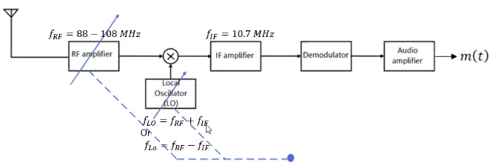
Commercial FM receiver
Commercial FM system uses the superheterodyne receiver with an RF frequencies ranging from 88-108 MHz
The intermediate frequency is $f_{IF}=10.7 MHz$ to avoid image problems

Slide 33
Generation (modulation) of WBFM
WBFM signals can be generated by two ways
Direct method by using voltage controlled oscillator (VCO)
Indirect method by Armstrong modulator

Slide 34
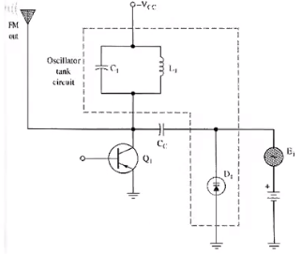
Generation of WBFM-direct method
In the direct method of generating FM signal we can use a VCO as illustrated by the following diagrams
Disadvantage:
A serious limitation of the direct method is the tendency for the carrier to drift, which is usually unacceptable for commercial radio applications
$$C_{1}$$
$$L_{1}$$
$$f_{c}=\frac{1}{2π\sqrt{L_{1}C_{eq}}}$$
$$C_{eq}=C_{1}∥C_{D}$$
$$m(t)$$
$$C_{D}$$

Slide 35
Generation of WBFM –direct method
To solve the frequency drift problem, frequency stabilization of the FM generator is required, Which is realized through the use of feedback around the oscillator
Although the oscillator itself be simple to build, the use of frequency stabilization adds system complexity to the design of the frequency modulator

Slide 36
Generation of WBFM-indirect method
In the indirect method, the modulator starts by generating a NBFM signal
The NBFM signal is fed through a frequency multiplier as shown
To understand the principle of operation of this modulator assume that the frequency multiplication factor $n=2$

Slide 37
Generation of WBFM-indirect method
The output of the frequency multiplier would be
$$s^{′}\left(t\right)=A_{c}^{2}\cos^{2}\left(ω_{c}t+β\sin\left(ω_{m}t\right)\right)=\frac{1}{2}A_{c}^{2}+\frac{1}{2}A_{c}^{2}\cos\left(2ω_{c}t+2β\sin\left(ω_{m}t\right)\right)$$
Observe that at the output of the multiplier both the carrier frequency and the magnitude of $β$ are doubled
If the frequency of the multiplier is set to $n$ value, then the resulting signal would contain $A_{c}^{n}\cos\left(nω_{c}t+nβ\sin\left(nω_{m}t\right)\right)$ plus other harmonics

Slide 38
Generation of WBFM-indirect method
By using a BPF whose center frequency is $f_{c}$ and its bandwidth $BW=2f_{m}(1+nβ)$ we can isolate the required WBFM signal
The major problem with the indirect method is sometimes the carrier frequency is increased to large levels greater than the commercial FM range $(88−108) MHz$
To solve this problem we can use a down frequency converter to convert the carrier frequency to an acceptable level as illustrated in the next slide

Slide 39
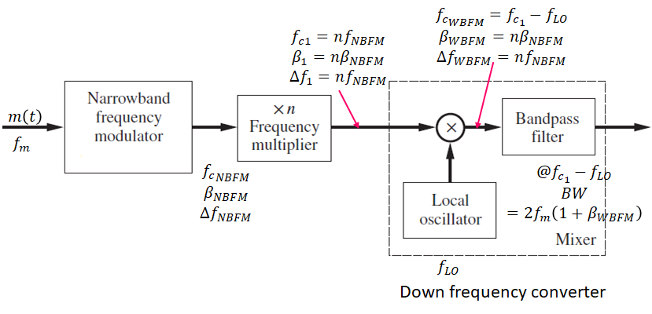
Generation of WBF-indirect method

Slide 40
Generation of WBFM-indirect method example
A WBFM signal is generated indirectly. If the carrier frequency of the narrowband FM modulator is ${f_{c}}_{NBFM}=100 kHz,$the peak frequency deviation of the narrow band FM modulator is $∆f_{NBFM}=50 Hz$, and the bandwidth of the message signal is $500 Hz.$ The wideband signal have a carrier frequency ${f_{c}}_{WBFM}=85 MHz$ and a deviation ratio $β_{WBFM}=5$. Determine
Frequency multiplication factor $n$
The possible values of the local oscillator frequency $f_{LO}$
The center frequency and bandwidth of the down frequency filter

Slide 41
Generation of WBFM-indirect method solution
Solution
The frequency multiplication factor $n$ can be determined from $n=\frac{β_{WBFM}}{β_{NBFM}}$
$$β_{NBFM}=\frac{∆f_{NBFM}}{f_{m}}=\frac{50}{500}=0.1$$
$$n=\frac{5}{0.1}=50$$
The possible values of the local oscillator frequency $f_{LO}$ would be
$$f_{LO}=f_{c_{1}}+f_{c_{WBFM}}$$
Or
$$f_{LO}=f_{c_{1}}−f_{c_{NBFM}}$$
$${f_{c}}_{1}=nf_{c_{NBFM}}=50×100 kHz=5 MHZ$$
$$f_{c_{WBFM}}=85 MHz$$
$$β_{WBFM}=nβ_{NBFM}=5$$
$$f_{m}=500 Hz$$
$$f_{c_{NBFM}}=100 kHz$$
$$∆f_{NBFM}=50 Hz$$
Solution
$$f_{LO}=5+85=90 MHz$$
$$f_{Lo}=85−5=80 MHz$$
The center frequency and bandwidth of the down frequency filter are
$$f_{c}=85 MHz$$
$$BW=2×500\left(1+5\right)=6 kHz$$

Slide 42
Demodulation of angle modulated signals
We can demodulate an angle modulated signal by two ways
Direct method by using a differentiator followed by an envelope detector
Indirect method using phase locked loop
By using zero crossing detector

Slide 43
Demodulation of angle modulated signals-Direct method
In the direct method we can pass the FM signal through a differentiator followed by an envelope detector as illustrated by
The differentiator is typically know as discriminator
To understand the theory of operation of this kind of modulator assume that then input to the modulator is an $s_{FM}\left(t\right)=A_{c}\cos\left(ω_{c}t+k_{f}\int_{0}^{τ}{m\left(t\right)dτ}\right)$
Taking the derivative $\frac{∂s_{FM}\left(t\right)}{∂t}=\frac{∂}{ ∂t}\left(A_{c}\cos\left(ω_{c}t+k_{f}\int_{0}^{τ}{m\left(t\right)dτ}\right)\right)=−\left[ω_{c}+k_{f}m\left(t\right)\right]A_{c}\sin\left(ω_{c}t+k_{f}\int_{0}^{τ}{m\left(τ\right)dτ}\right)$
Observe that output of the differentiator is an AM modulated signal that can be demodulated by an envelope detector
$$s_{AM}\left(t\right)$$

Slide 44
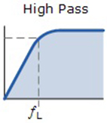
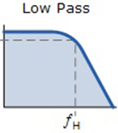
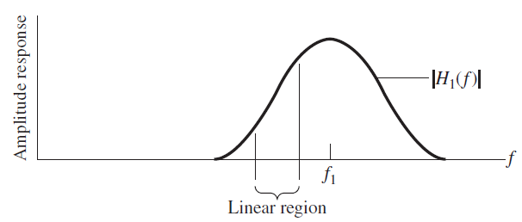
Demodulation of angle modulated signals-discriminator circuit
The discriminator (differentiator) can be implemented by any circuit whose transfer characteristics is linear with frequency (i.e. $H\left(jω\right)=kjω$)
Typical low pass, high pass and pass filters can be used as differentiators if the input signal is fed through their linear part of their frequency responses
Linear region
Linear region

Slide 45
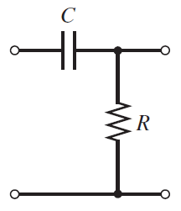
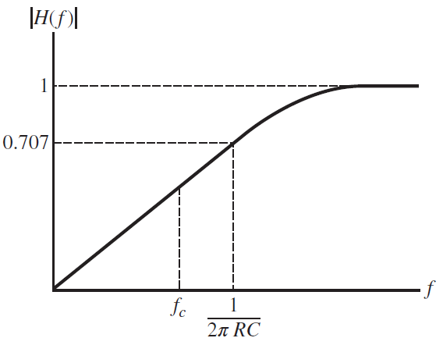
Differentiator example
Example For the simple RC filter shown below find
An expression for $H\left(jω\right)$
Under what conditions this filter behaves as a differentiator
Find and expression for $v_{out}\left(t\right)$
Solution
$H\left(jω\right)=\frac{V_{out}\left(jω\right)}{V_{in}\left(jω\right)}=\frac{R}{R+\frac{1}{jωC}}=\frac{jωRC}{1+jωRC }$
the filter behaves as a differentiator if it operates in its linear region of $H\left(jω\right)$. This can be achieved only if
$1≫jωRC$ under this conditions we have
$$H\left(jω\right)≅jωRC$$
$$+$$
$$+$$
$$v_{in}$$
$$v_{out}$$
$$−$$
$$−$$

Slide 46
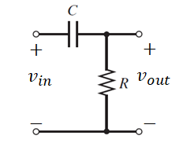
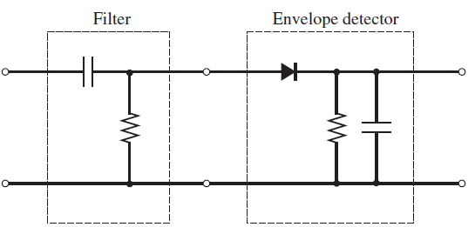
Differentiator example
Solution
$H\left(jω\right)=\frac{V_{out}\left(jω\right)}{V_{in}\left(jω\right)}⇒V_{out}\left(jω\right)=H\left(jω\right)V_{in}\left(jω\right)=jωRCV_{in}\left(jω\right)$
Taking the inverse Fourier transform we have $v_{out}\left(t\right)=\frac{∂}{∂t}RCv_{in}\left(t\right)$
Complete FM demodulator

Slide 47
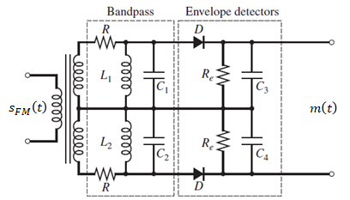
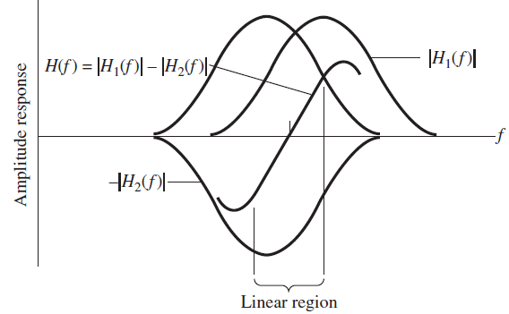
Differentiator limitation and balanced discriminator
The discriminator suffers from limited linear range, therefore it can not be used to demodulate wideband FM signals properly
To overcome this limitation, it is possible to extend the linear range of the discriminator by using two band pass filters as shown
If we take transfere characteristics of the balanced discrimenator to be
$$H\left(f\right)=H_{1}\left(f\right)−H_{2}\left(f\right)$$
Then an increased linear range can be obtained

Slide 48
Discriminator approximation
The discriminator circuit can be approximated by using a time delay as illustrated by the following block
Observe that
$$e\left(t\right)=s_{FM}\left(t\right)−s_{FM}\left(t−τ\right)$$
If the time delay is made too small, then it is possible to write
$$\lim_{τ→0}{\frac{e\left(t\right)}{τ}}$$
$$\lim_{τ→0}{\frac{s_{FM}\left(t\right)−s_{FM}\left(t−τ\right)}{τ}}=\frac{∂}{∂t}s_{FM}\left(t\right)$$
The use of an envelope detector can be used to recover the message signal from $m\left(t\right)$

Slide 49
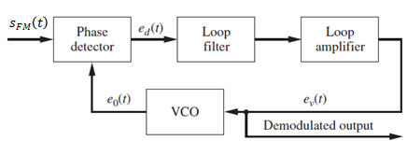
Demodulation of FM signals using PLL
It is possible to demodulate FM signals by using a PLL as illustrated by the following system
The principle of operation of this modulator can be understood from the following mathematical equations
$$s_{FM}\left(t\right)=A_{c}\cos\left(ω_{c}t+k_{f}\int_{0}^{t}{m\left(τ\right)dτ}\right)$$
$$e_{o}\left(t\right)=A_{v}\sin\left(ω_{c}t+θ\left(t\right)\right)$$
$$e_{d}\left(t\right)=\frac{1}{2}A_{c}A_{v}\sin\left(k_{f}\int_{0}^{t}{m\left(τ\right)dτ}−θ\left(t\right)\right)$$
However for good design, the phase difference $k_{f}\int_{0}^{t}{m\left(τ\right)dτ}−θ\left(t\right)$ is too small and approaches zero
Recall that $\sin\left(θ\right)≅θ$ when $θ≅0$, therefore
$$e_{d}\left(t\right)=K_{D}\left[k_{f}\int_{0}^{t}{m\left(τ\right)dτ}−θ\left(t\right)\right]=0$$
Or
$$θ\left(t\right)=K_{D}k_{f}\int_{0}^{t}{m\left(τ\right)dτ}$$
The loop filter is a LPF which eliminate the high frequency signal
We can recover $m\left(t\right)$ by deriving $e_{v}\left(t\right)$ as given by
$$e_{v}\left(t\right)=\frac{∂}{∂t}e_{d}\left(t\right)=km\left(t\right)$$

Slide 50
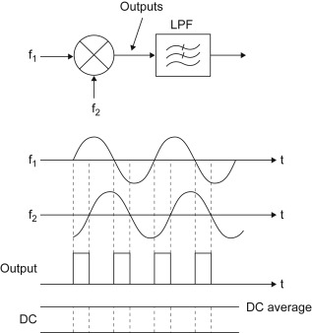
Demodulation of FM signals using PLL
The phase detector can be implemented by a multiplier followed by a LPF or by using simple XOR circuit
$$s_{FM}\left(t\right)=A_{c}\cos\left(ω_{c}t+k_{f}\int_{0}^{t}{m\left(τ\right)dτ}\right)$$
$$e_{o}\left(t\right)=A_{v}\sin\left(ω_{c}t+θ\left(t\right)\right)$$
$$e_{d}\left(t\right)=s_{FM}\left(t\right)e_{o}\left(t\right)=\frac{1}{2}A_{c}A_{v}\sin\left(k_{f}\int_{0}^{t}{m\left(τ\right)dτ}−θ\left(t\right)\right)+\frac{1}{2}A_{c}A_{v}\sin\left(2ω_{c}t+k_{f}\int_{0}^{t}{m\left(τ\right)dτ}+θ\left(t\right)\right)$$
$$\frac{1}{2}A_{c}A_{v}\sin\left(k_{f}\int_{0}^{τ}{m\left(τ\right)dτ}−θ\left(t\right)\right)$$
Removed by the LPF

Slide 51
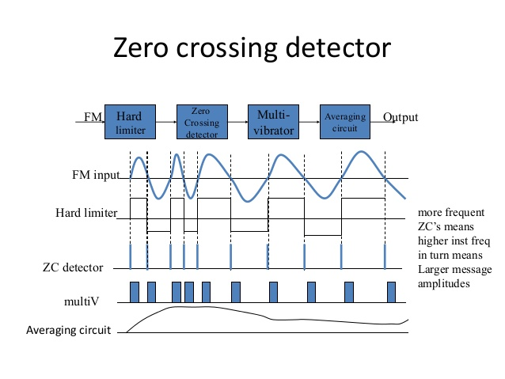
Demodulation of FM signals using zero crossing detector
The demodulation of FM signals by the use of zero crossing detector can be illustrated by the diagram shown
The averaging circuit is a simple LPF

Slide 52
Solved examples
Example For the FM system shown, find
The modulation index at the output of the modulator
The center frequency and bandwidth of the BPF
Solution
$β=\frac{∆f}{f_{m}}=\frac{200×2}{1 kHz}=0.4$
The center frequency of the filter would be
$$f_{c}=2×50 kHz=100 kHz$$
The bandwidth can be approximated by Carson’s rule by
$$BW=2f_{m}\left(1+β\right)$$
$$BW=2×1\left(1+0.4\right)=2.8 kHz$$

Slide 53
Solved examples
Example: A carrier is phase modulated such that the PM modulated signal is given by
$$s_{PM}\left(t\right)=100\cos\left(2π×{10}^{7}t+4\cos\left(2000πt\right)\right)$$
The resulting PM modulated signal is applied across a $50 Ω$ resistive load, find
The peak frequency deviation from the carrier $∆f$
The total average power developed by $s_{PM}\left(t\right)$
What percentage of the average power is present at $10 MHz$
What is the approximate bandwidth using Carson’s rule

Slide 54
Solved examples
$$θ_{i}\left(t\right)$$
$$s_{PM}\left(t\right)=100\cos\left(2π×{10}^{7}t+4\cos\left(2000πt\right)\right)$$
Solution:
The peak frequency deviation can be found from the phase of the carrier (i.e.)
$$ω_{i}\left(t\right)=\frac{∂θ_{i}(t)}{∂t}=\frac{∂}{∂t}\left(ω_{c}t+k_{p}m\left(t\right)\right)=ω_{c}+k_{p}\frac{∂m\left(t\right)}{∂t}$$
$$∆ω=ω_{i}−ω_{c}=−4×2000π\sin\left(2000πt\right)$$
The peak frequency deviation is the largest value of $∆ω$ which is given by
$$∆ω=8000π⇒∆f=\frac{∆ω}{2π}=\frac{8000π}{2π}=4 kHz$$
The total average power developed by $s_{FM}\left(t\right)$ is given by
$$P_{av}=\frac{A_{c}^{2}}{2R}=\frac{{100}^{2}}{2×50}=100 Watt$$
$$k_{p}m\left(t\right)$$

Slide 55
Solved examples
$$θ_{i}\left(t\right)$$
$$s_{PM}\left(t\right)=100\cos\left(2π×{10}^{7}t+4\cos\left(2000πt\right)\right)$$
Solution:
The percentage of the average power present at $10 MHz$ is
$$P_{c}=J_{0}^{2}\left(β\right)\frac{A_{c}^{2}}{2R}=J_{0}^{2}\left(4\right)×100={0.3971}^{2}×100=16 Watt$$
The approximate bandwidth is
$$BW=2f_{m}\left(1+β\right)=2×1 kHz\left(1+4\right)=10 kHz$$
$$k_{p}m\left(t\right)$$

Slide 56
Solved examples
Example: For the indirect FM modulator shown below specify the bandwidth and the center frequency of each BPF used
Solution
The bandwidth of each filter can be determined by Carson’s rule
For the firs filter the bandwidth is
$$BW1=2f_{m}+2∆f=2×1+2×0.200=2.4 kHz$$
The center frequency is $f_{c_{1}}=1 kHz$
For the second BPF filter , we have
$$BW2=2×1+2×0.4=2.8 kHz$$
The center frequency is $f_{c_{2}}=2 kHz$
$$f_{m}=1 kHz$$
$$∆f_{1}=200 Hz$$
$$∆f_{2}=400 Hz$$
$$∆f_{3}=800 Hz$$
$$∆f_{4}=1600 Hz$$
$$∆f_{5}=3200 Hz$$
$$f_{c_{1}}=1 kHz$$
$$f_{c_{2}}=2 kHz$$
$$f_{c_{3}}=4 kHz$$
$$f_{c_{4}}=8 kHz$$
$$f_{c_{5}}=16 kH$$

Slide 57
Solved examples
$$f_{m}=1 kHz$$
Solution
For the third BPF filter , we have
$$BW3=2×1+2×0.8=3.6 kHz$$
The center frequency is $f_{c_{3}}=2×2=4 kHz$
For the fourth BPF filter , we have
$$BW4=2×1+2×1.6=5.6 kHz$$
The center frequency is $f_{c_{4}}=2×4=8 kHz$
For the fifth BPF filter , we have
$$BW5=2×1+2×3.2=8.4 kHz$$
The center frequency is $f_{c_{5}}=2×8=16 kHz$
$$∆f_{1}=200 Hz$$
$$∆f_{2}=400 Hz$$
$$∆f_{3}=800 Hz$$
$$∆f_{4}=1600 Hz$$
$$∆f_{5}=3200 Hz$$
$$f_{c_{1}}=1 kHz$$
$$f_{c_{2}}=2 kHz$$
$$f_{c_{3}}=4 kHz$$
$$f_{c_{4}}=8 kHz$$
$$f_{c_{5}}=16 kH$$

Slide 58
Solved examples
Example
An angle modulated signal is $φ_{FM}\left(t\right)=100cos⁡(2π×{10}^{6}t+20sin1000πt+10sin2000πt)$ across a 50-ohm resistive load. Determine the peak frequency deviation from the carrier
Solution
The peak frequency deviation can be computed by
$$∆ω=ω_{i}−ω_{c}=\frac{∂}{∂t}\left(20sin1000πt+10sin2000πt\right)$$
$$∆ω=ω_{i}−ω_{c}=\max\left(20×{10}^{3}πcos1000πt+20×{10}^{3}πcos2000πt\right)$$
$$∆ω=40π×{10}^{3} rad/s$$
$$∆f=\frac{∆ω}{2π}=20 kHz$$

Slide 59
Solved examples

Slide 60
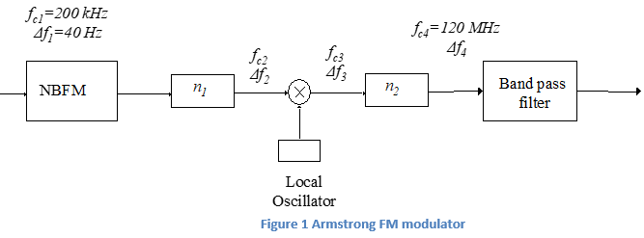
Solved examples
Solution
The solution could starts from
$$β=\frac{∆f_{4}}{f_{m}}=\frac{∆f_{4}}{10 kHz}=10⇒∆f_{4}=100 kHz$$
$$∆f_{3}=\frac{∆f_{4}}{n_{2}}=\frac{100 kHz}{50}=2 kHz$$
Also $f_{c_{3}}=\frac{f_{c_{4}}}{n_{2}}=\frac{120 MHz}{50}=2.4 MHz$
Since the multiplier circuit in the down frequency converter does not affect the peak frequency deviation we have
$$∆f_{2}=∆f_{3}=2 kHz$$
$$∆f_{2}=n_{1}∆f_{1}$$
$$2 kHz=n_{1}×40Hz⇒n_{1}=\frac{2000}{40}=50$$

Slide 61
Solved examples
Solution
Now from the first frequency multiplier we have
$$f_{c_{2}}=n_{1}f_{c_{1}}=50×200 kHz=10 MHz$$
Now the frequency of the local oscillator can be determined from the multiplier circuit to be
$$f_{LO}=f_{c_{2}}+f_{c_{3}}$$
$$f_{LO}=10+2.4=12. 4 MHz$$
Or
$$f_{LO}=f_{c_{2}}−f_{c_{3}}$$
$$f_{LO}=10−2.4=7.6 MHz$$

Slide 62
Solved examples
Example: A given FM modulator is excited by a sinusoidal signal whose frequency $f_{m}=1 kHz$. The amplitude of the message signal is increased from zero until the carrier component $J_{0}\left(β\right)=0$ when $A_{m}=2 V$. Determine
The frequency sensitivity $k_{f}$ of the modulator
What is the value of $A_{m}$ for which the carrier component is reduced to zero for the second time

Slide 63
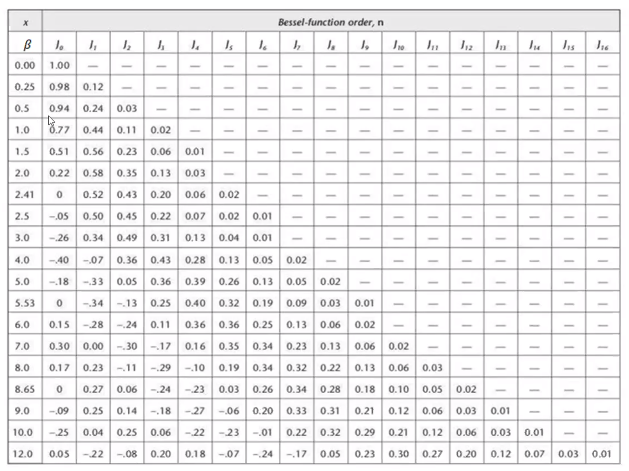
Solved examples
Solution
The frequency sensitivity $k_{f}$ can be determined from
$$β=\frac{∆f}{f_{m}}=\frac{A_{m}k_{f}}{f_{m}}$$
From the Bessel function table we can see $J_{0}\left(β\right)=0$ for the first time when $β=2.41$
$β=\frac{A_{m}k_{f}}{f_{m}}=\frac{2k_{f}}{1000}=2.41⇒k_{f}=1.205\frac{kHz}{V}$
If we keep increasing $A_{m}$ more than $2 Volts$, then $J_{0}\left(β\right)$ would be zero again when $β=5.53$, therefore we have
$$\frac{A_{m}k_{f}}{f_{m}}=5.53=A_{m}×\frac{1.205}{1000}$$
$$A_{m} =4.6 V$$

Slide 64
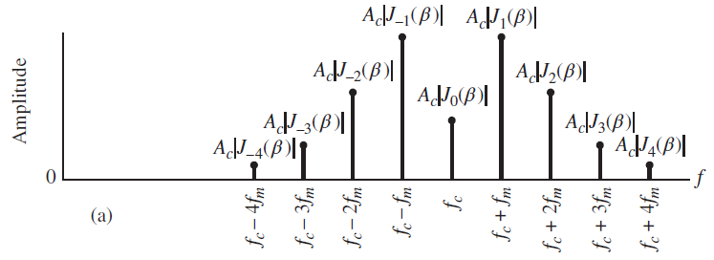
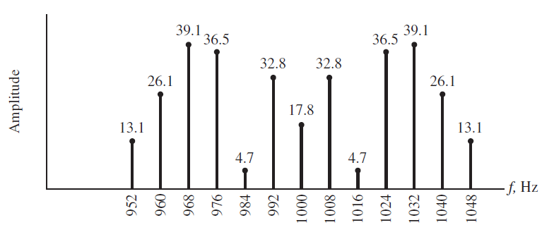
Solved examples
Example A FM modulator is excited by a sinusoidal signal $m\left(t\right)=A_{m}\cos\left(2π8t\right)$. If the modulator sensitivity factor $k_{f}=8 Hz/V$, the carrier frequency is $f_{m}=1 kHz$, and the carrier amplitude is $A_{c}=100 V$. Compute the values of $β$ and sketch the resulting magnitude (line spectrum) in the following cases
$A_{m}=5 V$
$A_{m}=0.5 V$
Solution
Recall that $β=\frac{∆f}{f_{m}}=\frac{A_{m}k_{f}}{f_{m}}=\frac{5×8}{8}=5$
If we plot the magnitude spectrum of the FM modulated signal we may obtain the following
The Wide band FM signal can be expressed mathematically by using Bessel function by
$$s_{FM}\left(t\right)=\sum_{n=−∞}^{∞}{A_{c}\left|J_{n}\left(β\right)\right|\cos\left(ω_{c}t+nω_{m}\right)}$$
Wideband FM spectrum

Slide 65
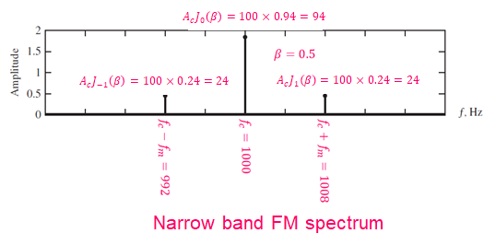
Solved examples
Solution
Recall that $β=\frac{∆f}{f_{m}}=\frac{A_{m}k_{f}}{f_{m}}=\frac{0.5×8}{8}=0.5$
If we plot the magnitude spectrum of the FM modulated signal we may obtain the following

Slide 66
$∆f$ and $β$ summery for FM and PM signals
We can summarize the peak frequency deviation $∆f$ and the peak phase deviation $β$ for both FM and PM modulated signals by the following table
 | FM | PM
Peak frequency deviation $∆f$ | $$k_{f}\left|m\left(t\right)\right|$$ | $$k_{p}\frac{∂}{∂t}m\left(t\right)$$
Peak phase deviation $β$ | $$\frac{∆f}{f_{m}}$$ | $$\frac{∆f}{f_{m}}$$

